Slide 1
Capturing Carbon
7 November 2025
Hyae Ryung Kim, Grace Frascati, Isabel Hoyos, Petr Jenicek, Sean Lee, Maitreyi Menon, Yosafat Partogi, Michelle Priscilla, Shaurir Ramanujan, Christian Sandjaja, Anda Wang, Xiaodan Zhu, and Gernot Wagner

Slide 2
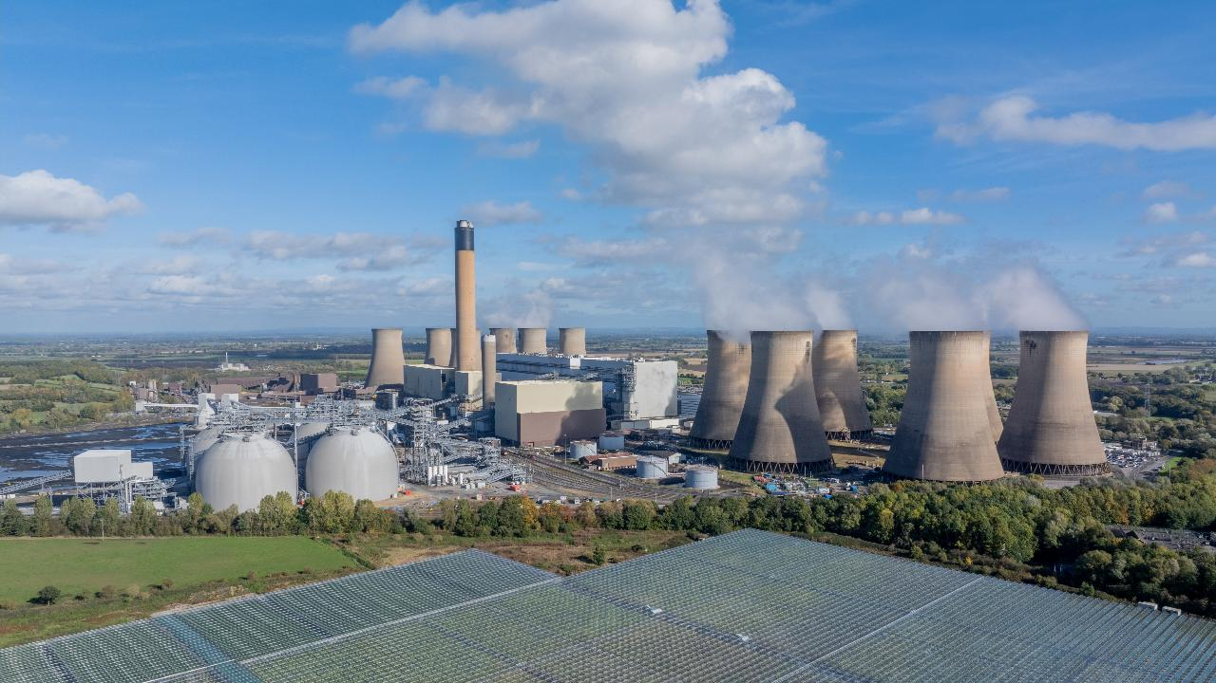
Capturing Carbon:
The Opportunity

Slide 3

CCUS overview: Carbon capture, utilization, and storage (CCUS) involves capturing CO₂ from industrial facilities or directly from the atmosphere, known as direct air capture (DAC), then utilizing or storing it.
Role in net-zero emissions (NZE): CCUS is essential for reaching NZE by 2050, with the potential to abate 6 Gt of CO₂ in select subsectors depending on the scenario.
Types of carbon capture:
Point-source capture (99%): Industrial facilities or bioenergy with carbon capture storage (BECCS)
Ambient carbon removal (<1%): DAC, field weathering, mineralization, ocean removal, and ocean alkalinity enhancement
Current CCUS adoption: As of 2024, CCUS captures 50 MtCO₂ per year (0.1% of global emissions), with growth projected to expand by 130x by 2050.
Global market trends: ~50 operational CCUS projects are expected to capture 440 Mt CO₂ by 2030 but remain 60% behind 2050 NZE goals. The top five facilities account for 56% of current capacity.
Challenges and regional growth: High costs are the main barrier to CCUS adoption. North America leads in capacity, while Europe and APAC are expected to see the highest growth, with over 15 Mt per year of new capture capacity currently under construction in China and the Middle East. Government funding is crucial to scaling global deployment.
Key messages
Capturing Carbon Opportunity
Source: GMI, Europe Carbon Capture and Storage Market, (2024).
Credit: Maitreyi Menon, Michelle Priscilla, Anda Wang, Yosafat Partogi, Hyae Ryung Kim, and Gernot Wagner. Share with attribution: Kim et al., “Capturing Carbon” (7 November 2025).

Slide 4
CCUS, a retroactive CO₂ abatement lever, used for hard-to-abate emissions not addressed by renewable power and alternative fuels
Focus of deck
Non-Exhaustive
1
Renewable power
2
Capturing carbon (CCUS)
3
Alternative fuels
Description
There has been a shift toward low-carbon and/or clean power sources such as renewables.
Wind and solar will double their share to 25% of global electricity by 2028.
Solar, wind, and hydro costs have
decreased, making renewables competitive.
CCUS is tech that captures CO₂, generally from large point sources like power generation and industrial facilities or directly from air.
CCUS can either store CO₂ in geologic formations or reuse it to create valuable products.
The remaining emissions that cannot be electrified will be replaced with cleaner fuels
Primary use case has been in transportation and industrials
Biofuels and hydrogen for road transport, SAF for airplanes, ammonia for shipping
Progress to date
Renewables surpassed coal as the largest electricity source in 2025.
Investment imbalances exist across regions; emerging and developing markets account for only 16%.
Today, CCUS facilities capture ~50 MtCO₂ annually.
Cost per CO₂ ton captured varies from $25 to $340 depending on sector and technology.
Biofuel for road is more price competitive as countries regulate biofuel usage in transportation
SAF and gaseous fuels remain costly due to low adoption
Impact (potential abatement)
Emissions reduction: Transitioning the U.S. power grid to 100% clean electricity by 2035 could cut economywide emissions by 62% compared with
2005 levels.
Retrofitting fossil plants: CCUS could reduce emissions from existing coal and gas plants by >90%, preventing lock-in of legacy infrastructure.
CCUS facilities can adjust operations in response to electricity supply and demand, helping balance the grid as intermittent renewables are integrated.
Biofuel and H₂: By 2031, biodiesel production supported by U.S. tax credits could reduce emissions by 31 MMT and 48 MMT for clean hydrogen annually
Notes: Hard-to-abate emissions are those that are difficult to eliminate due to inherent process emissions in sectors like cement (calcination), steel (coal-based reduction), and chemicals (process-related CO₂ release). Carbon capture is essential to address these emissions.
Sources: IAE, Renewables (2024); IAE, CCUS (2024); IAE, Levelized cost of CO₂ (2024); DoE, Pathways to Commercial Liftoff: Clean Hydrogen (2024).
Credit: Maitreyi Menon, Michelle Priscilla, Anda Wang, Yosafat Partogi, Hyae Ryung Kim, and Gernot Wagner. Share with attribution: Kim et al., “Capturing Carbon” (7 November 2025).

Slide 5
CCUS to play small role in energy sector abatement in net-zero scenarios (NZS) with widespread renewables adoption
NZS from IEA (in thousands of TWh)
NZS from BNEF (in thousands of TWh)
Observations
Under the IEA scenario, aim is to capture 1 Gt of CO₂ annually by 2030, compared with capture capacity in 2023 of ~50 Mt of CO₂.
Under the BNEF scenario, capturing and storing carbon removes 97 Gt of CO₂ by 2050.
Unabated fossil fuels will decline by 5.6% annually between 2022 and 2050; IEA projects that fossil fuels equipped with carbon capture will grow by 31% annually from 2022 to 2030.
80
90
Solar
Bioenergy with BECCS
Unabated coal
Nuclear
70
Wind
Coal with CCUS
80
Coal with CCS
Unabated oil
Other renewables
Gas with CCUS
Unabated gas
Other
60
Nuclear
Unabated gas
70
Gas with CCS
Solar
Bioenergy without BECCS
Unabated oil
Other renewables
Wind
Hydrogen and ammonia
Unabated coal
60
Hydrogen
50
50
40
40
30
30
20
20
10
10
0
0
2010
2022
2030
2040
2050
2000
2005
2010
2015
2020
2025
2030
2035
2040
2045
2050
Sources: IEA, Net Zero Roadmap: A Global Pathway to keep the 1.5°C Goal in Reach (2023); BNEF, New Energy Outlook (2024).
Credit: Michelle Priscilla, Anda Wang, Shaurir Ramanujan, Hyae Ryung Kim, and Gernot Wagner. Share with attribution: Kim et al., “Capturing Carbon” (7 November 2025).

Slide 6
Two key categories of carbon management — point source and ambient — differ based on the origin and dispersal of emissions
 | Point-source capture | Ambient carbon removal
Description | Separation and entrapment of CO₂ before it is released from large stationary sources (e.g., industrial plants) | Removal of CO₂ already in the atmosphere or from biomass energy by targeting diffuse CO₂ concentrations rather than capturing emissions at the source
Examples | Applications to iron & steel, cement, freight, blue hydrogen & ammonia | Direct air capture (DAC), field weathering, mineralization, direct ocean removal, ocean alkalinity enhancement
% share of total CO₂ captured using carbon capture technologies, by method
Current CO₂ absorption (per year) | ~50 MtCO₂ | <1 MtCO₂
Technological readiness level | High with immediate scalability | Low to medium with limited scalability; DAC is medium while others are relatively low
Cost of CCUS per ton of CO₂ | $21-$210 depending on industry | DAC: $135-$345 Enhanced weathering: $50-$200 Ocean methods: $50-$150
1
2
Cement
Others
29%
18%
15%
Iron & steel
Chemical
Vast majority of current capture is industrial point source.
<1%
Sources: IEA, CCUS (2025); IEA, BECCS (2023); IEA, DAC (2022); DoE, Pathways to Commercial Liftoff: Industrial Decarbonization, (2023).
Credit: Maitreyi Menon, Michelle Priscilla, Anda Wang, Yosafat Partogi, Hyae Ryung Kim, and Gernot Wagner. Share with attribution: Kim et al., “Capturing Carbon” (7 November 2025).

Slide 7
Carbon capture to play key role in abating the ~30% global GHG emissions from industrial sources through retrofitting
Global GHG emissions by sector (2023, %)
Observations
  CO₂ emissions originate from stationary point sources or are diffused in ambient air.
  The stationary nature of industrial facilities —
  such as cement, steel,
  and chemical and petrochemical plants — makes them well-suited for carbon capture retrofitting.
  Stationary power sources (e.g., coal and gas plants) could also be retrofitted; however, current projections indicate they will be phased out in parallel with the adoption of clean energy and carbon capture, limiting the long-term role of retrofitting in this segment.
100%
Stationary point sources
(low to high CO₂ concentration)
Power
90%
Industry
Buildings
80%
Fuel production
70%
Industrial processes
Transport
Diffused emission in ambient air (low CO₂ concentration)
60%
Agriculture
50%
LULUCF
Solid waste
40%
Liquid waste
Other (waste)
30%
20%
10%
0%
1%
2%
Sources: Rhodium Group, Climate Action and Competitiveness (2023); IPCC, Special Report on Carbon Dioxide Capture and Storage; UNEP, UN Emissions Gap Report (2024).
Credit: Michelle Priscilla, Anda Wang, Grace Frascati, Shaurir Ramanujan, Hyae Ryung Kim, and Gernot Wagner. Share with attribution: Kim et al., “Capturing Carbon” (7 November 2025).

Slide 8
Capturing carbon currently removes 0.1% of emissions per year;
NZE would require a 130x increase in total CO₂ capture by 2050
CO₂ capture potential is expected to grow by 19% year over year
Observations
As of 2024, CCUS technology captures ~50 Mt of CO₂ per year.
Over 98% of current CO₂ capture occurs from industrial processes and fuel transformation.
CCUS is expected to capture 1,024 MtCO₂ by 2030 and 6,040 MtCO₂ by 2050.
66% of total announced CO₂ capture capacity occurs in developing countries and emerging markets.
Operational captured capacity lags significantly behind announced capture capacity.
Completion of planned CCUS projects would increase capacity by 8x by 2030.
Total CO₂ captured by technology (MtCO₂ per year)
Industrial point source
BECCS
6,040
Direct air capture
+19%
1,024
45
185
1
44
80
2022
2030
2050
Source: IEA, Net Zero Roadmap: A Global Pathway to Keep the 1.5°C Goal in Reach (2023).
Credit: Michelle Priscilla, Anda Wang, Shaurir Ramanujan, Hyae Ryung Kim, and Gernot Wagner. Share with attribution: Kim et al., “Capturing Carbon” (7 November 2025).

Slide 9
51 operational CCUS projects projected to reach ~440 Mt of global CO₂ capacity by 2030 but still 60% behind 2050 net-zero emissions
Operational and planned capture capacity expected to increase ~6x from 2024-30e
Observations
>60% of the current 50.4 Mt of CCUS capacity is used for natural gas processing, and significant growth is expected for power (64% CAGR 2023-30), iron and steel (51%), and hydrogen (43%).
~436 Mt of captured CO₂ in 2030 is ~40% of the ~1 Gt CO₂ p.a. captured in the NZE by 2030 scenario.
While most current capacity uses point-source technology, DAC is on the rise, with ~61 Mt of 2030 capacity expected to be DAC ( ~16 Mt NZE gap).
Of the current and planned facilities, 34 (~5%) are DAC; the main technology in place remains industrial point-source capture (ready today with the potential to capture large volumes of CO₂ from hard-to-abate industries).
Operational and planned capture capacity (MtCO₂ per year)
450
436
Operational
400
Under construction
~8% of projects announced through 2024 are enhanced oil recovery, concentrated in the U.S. (~40% of the number of EOR projects); ~6% are offshore, concentrated in the EU and emerging especially in APAC.
350
Planned
300
296
250
~238 MtCO₂ per year marked planned/FID in 2024
200
168
150
100
67
50
0
9
7
2023
2024
2026e
2028e
2030e
Sources: IEA, CCUS Projects Explorer (2024); IEA, Direct Air Capture (2022); McKinsey, Global Energy Perspective: CCUS Outlook (2023) and Scaling CCUS (2022).
Credit: Michelle Priscilla, Anda Wang, Grace Frascati, Hyae Ryung Kim, and Gernot Wagner. Share with attribution: Kim et al., “Capturing Carbon” (7 November 2025).

Slide 10






Current projects are concentrated in North America with density of
26 MtCO₂ per year; growth is expected in Europe and APAC
While the highest capture capacity is in North America, APAC is expected to see the highest CAGR (38%)
Observations
~50% of the current capacity comes from North America; significant growth is expected in Europe (35% CAGR 2023-30), Asia Pacific (38%), and North America (34%).
Development in China, India, Latin America, the Middle East, and Africa is limited by a lack of firm policy and regulatory frameworks.
Geographic expansion is fueled by funding and cross-border initiatives:
  The Carbon Management Challenge introduced a
  joint call to action for governments to accelerate the deployment of tech.
  Denmark, Belgium, the Netherlands, and Sweden signed a CO₂ transport and storage agreement with Norway.
Operational and planned capture capacity, shaded by approximate density (in MtCO₂ per year), with 2023-30 CAGR
~34%
% CAGR
~1%
~24%
~22%
~38%
~35%
North America
Central & South America
Middle East
Australia & New Zealand
APAC
Europe
Sources: IEA, CCUS Projects Explorer (2024); IEA, CCUS (2024); Wood Mackenzie, CCUS: US$196bn Investment Opportunity (2024); ABI Research, The Future of Industrial Decarbonization (2024).
Credit: Grace Frascati, Anda Wang, Hyae Ryung Kim, and Gernot Wagner. Share with attribution: Kim et al., “Capturing Carbon” (7 November 2025).

Slide 11
Top 5 facilities today comprise 56% of the current capture capacity, indicating concentrated and slow-to-deploy projects
Major CCUS facilities are concentrated in developed countries
 | Description | Country | Established | Facility industry | Type of storage | Capture capacity | Current capture
Petrobras Santos Basin Pre-Salt Oil Field | First CCUS project in ultra-deep waters and among the fastest growing | Brazil | 2013 | Natural gas processing | Enhanced oil recovery | 14.2 Mtpa CO₂ | ~14.2 Mtpa CO₂
ExxonMobil Shute Creek Gas | Made controversial after report finding a venting of unsold CO₂ back into the atmosphere | U.S. | 1986 | Natural gas processing | Enhanced oil recovery | 7.0 Mtpa CO₂ | ~7.0 Mtpa CO₂
Chevron Gorgon | Largest single-resource development in Australia with 40+ years of production lifespan | Australia | 2019 | Natural gas processing | Dedicated geological storage | 4.0 Mtpa CO₂ | ~3.0 Mtpa CO₂
Great Plains Synfuels Plant | Converts coal into synthetic natural gas and has captured CO₂ for decades for EOR | U.S. | 2000 | Synfuels/ gasification | Enhanced oil recovery | 3.0 Mtpa CO₂ | ~3.0 Mtpa CO₂
Sleipner | First in the world to inject CO₂ into a dedicated geological storage formation | Norway | 1996 | Natural gas processing | Dedicated geological storage | 1.0 Mtpa CO₂ | ~1.0 Mtpa CO₂
Future projects are still anticipated to be megaprojects (>$1B), meaning they inherently face risks and thus
require robust planning, communication, stakeholder alignment, and committed project management teams.
Notes: Difference in Mt per year between this and prior slide is due to different figures/pathways (i.e., it is not additive) for CCUS vs. CCS.
Sources: BR Petrobas, Petrobas Santos Basin (2023); Catalyst Group, Lessons Learned (2024); Chevron, Evolution of the Gorgon Project; E&E News, The Kemper Project just collapsed. What it signifies for CCS (2021); ExxonMobil, ExxonMobile to expand carbon capture and storage at LaBarge, Wyoming, facility (2022); Geos, Processing plant details (2021); Global CCUS Institute, Global Status of CCUS (2024); IEEFA, Shute Creek (2022); Oil & Gas, Stuck at 1/3 Capacity (2023); S&P Global, CCUS in decarbonization (2021); Wolf Midstrream, Carbon (2024); Petrobras, News (2024); Equinor, Intro (2024).
Credit: Michelle Priscilla, Anda Wang, Grace Frascati, Hyae Ryung Kim, and Gernot Wagner. Share with attribution: Kim et al., “Capturing Carbon” (7 November 2025).

Slide 12
Government funding of CapEx required influences geographical dispersion of carbon capture facilities
About 70% of global CCUS investment stems from Europe and North America
Observations
Country progress stems mostly from government funding.
  In the U.S., $1.7B
  is allocated for demo projects and $1.2B for DAC hubs under the 2021 Infrastructure Investment and Jobs Act.
    The U.S. leads funding at 50% of the total, followed by the UK at 33% and Canada at 10%.
  Australia is investing AU$1.7B via ARENA to scale net-zero tech and AU$32.6M over four years to establish CCUS regulations.
Government funding for CCUS across key countries – including the U.S., Canada, the U.K., Denmark, and Australia – amounts to ~$80B.
CCUS: Government funding and 10-year investment outlook in key countries
100
100
1.0
Funding unique to CCUS (US$B)
Funding not unique to CCUS (US$B)
80
Investment
0.8
60
0.6
51
40
0.4
27
20
0.2
11
10
3
1
0
1
0.0
United States
Canada
United Kingdom
Denmark
Netherlands
Germany
Australia
Notes: “Funding unique to CCUS” refers to government funds that have been set aside or the amount of revenue foregone in the case of tax incentives for any part of the CCUS value chain — capture, transport, utilization, and storage. “Funding not unique to CCUS” also supports decarbonization technologies beyond CCUS.
Source: Wood Mackenzie, CCUS: US$196 billion investment opportunity (2024).
Credit: Michelle Priscilla, Anda Wang, Grace Frascati, Hyae Ryung Kim, and Gernot Wagner. Share with attribution: Kim et al., “Capturing Carbon” (7 November 2025).

Slide 13
Carbon capture favors fuel transformation for 90% abatement and competitive costs over constrained heavy industry applications
Levelized cost of CO₂ capture across sectors (in US$/ton)
Observations
Fuel transformation sectors (hydrogen, ethanol/methanol, ammonia) achieve ~90% abatement at low cost ($20-$60 per ton) with tight uncertainty bands. These process-constrained sectors benefit from pure CO2 streams in chemical processes, making abatement both high and predictable.
Power generation shows limited abatement potential (15%) despite low costs ($20-$60 per ton) due to competition with renewables; the physics ceiling determines the economic floor rather than technology constraints.
Heavy industry sectors (iron and steel, cement) face high costs with massive uncertainty. Iron and steel shows 25% abatement with moderate costs but wide uncertainty ranges, while cement achieves 61% abatement at the highest costs ($60-$200+ per ton) with the greatest uncertainty — retrofit complexity amplifies both cost and risk.
Baseline cost range
Higher cost range
Avg. current (2023) cost
Avg. future (2030) cost
CO₂ emissions (Mt)
~13,800
~920
~132
~450
~2,600
~2,400
220
61%
200
180
Including natural gas
Cost $/ton
160
140
15%
90%
25%
120
100
Ethanol/
Methanol
Ammonia
80
Hydrogen
60
40
20
0
Power gen.
Fuel transformation
Iron & steel
Cement
CCUS contribution to sector CO₂ emissions reductions, %
Sources: IEA, CCIS in Clean Energy Transitions (2020); IEA, Levelized Cost of CO2 Capture by Sector (2019); Harvard Kennedy School Belfer Center, Carbon Capture Utilization and Storage: Technologies and Costs US Context (2022); IEA, Biofuels (2023); IEA, Electricity (2025); IEA, Global Hydrogen Review (2024); IEA, Iron and Steel Technology Roadmap (2020); Farmdoc Daily, CO2 Production by the U.S. Ethanol Industry and the Potential Value of Sequestration (2024); CaptureMap, Ethanol – A Great Starting Point For Carbon Capture? (2023); IEA, Cement (2023); IEA, Ammonia Technology Roadmap (2021).
Credit: Maitreyi Menon, Michelle Priscilla, Hyae Ryung Kim, and Gernot Wagner. Share with attribution: Kim et al., “Capturing Carbon” (7 November 2025).

Slide 14
Industrial decarbonization costs vary 6x by sector; pure CO₂ streams enable low-cost capture
Additional CCUS cost index compared with baseline cost
Observations
No CCUS application is cost competitive today. Even best-case ethanol represents a 1.1x cost increase — a margin-destroying burden for commodity industries operating on 3-8% EBITDA margins.
Current economics require permanent subsidization: 45Q credits essentially function as production subsidies, not transition support.
Stream purity creates winner-takes-all economics: Ethanol's 99% pure streams require simple compression versus steel's 15% streams, which need energy-intensive separation.
Process integration determines viability: High-purity sectors benefit from integrated capture while dilute sectors require bolt-on solutions with 20-40% energy penalties.
Ethanol’s CCUS success relies on pure CO₂ streams, but its impact is small (~110 MtCO₂ per year, just 2% of what’s needed for industrial decarbonization).
Ethanol
1.1x
Baseline
Additional CCUS cost
Iron & steel
1.2x
CO₂ already pure from fermentation; cost = compression equipment + transport pipelines; no energy penalty on production process
Ammonia
1.3x
Natural gas
1.4x
Hydrogen
1.7x
Must install expensive equipment for both process emissions (limestone decomposition) and flue gas; unproven technology adds cost uncertainty
Cement
1.8x
Coal power plants
1.9x
Sources: IEA, CCIS in Clean Energy Transitions (2020); IEA, Levelized Cost of CO2 Capture by Sector and Initial CO2 Concentration (2019); Harvard Kennedy School Belfer Center, Carbon Capture Utilization and Storage: Technologies and Costs US Context (2022).
Credit: Maitreyi Menon, Michelle Priscilla, Hyae Ryung Kim, and Gernot Wagner. Share with attribution: Kim et al., “Capturing Carbon” (7 November 2025).

Slide 15
Cost premium of 10x separates temporary, nature-based solutions from permanent, engineered removal
CO₂ capture cost across carbon removal approaches and technologies (in US$/ton)
Observations
Nature-based removal is ready now (TRL 9). It's cheap at $5 to $50 per ton, but the carbon storage is temporary.
The 10x-plus cost premium for DAC buys permanent, millennium-scale storage. It's an earlier technology (TRL 7-8), but its potential to scale is massive.
Co-products and revenue streams complicate the cost analysis: BECCS generates dispatchable low-carbon power, biochar improves soil health and agricultural yields, and enhanced weathering can act as a fertilizer.
These co-products have distinct economic value, meaning the net cost of carbon removal is highly specific to each project's business model.
Shared infrastructure creates powerful synergies: While the front-end capture methods for technologies like BECCS and DAC are different, they ultimately depend on the exact same back-end infrastructure for CO₂ transport and geological storage.
1.8x
2.7x
2.9x
4.5x
8.7x
350
300
250
200
Cost $/ton
150
100
50
0
Afforestation/
Reforestation
Bioenergy
with CCS
Land Management
and Biochar Production
Ocean
Alkanization
Enhanced
Weathering
of Minerals
Direct Air Capture
and Storage
Carbon Removal Potential (Gt Co2)
*Multiples relative to afforestation/NBS
Sources: IEA, CCIS in Clean Energy Transitions (2020); IEA, Levelized Cost of CO2 Capture by Sector and Initial CO2 Concentration (2019); Harvard Kennedy School Belfer Center, Carbon Capture Utilization and Storage: Technologies and Costs US Context (2022).
Credit: Maitreyi Menon, Michelle Priscilla, Hyae Ryung Kim, and Gernot Wagner. Share with attribution: Kim et al., “Capturing Carbon” (7 November 2025).

Slide 16
CCUS commercialization is phased, viable now for high-purity sectors, entering a critical 2025-30 demonstration
Commercialization timelines for carbon capture techs (development stage, 2025-35+)
Observations
The cost chart highlights a clear economic divide: CCUS for chemicals and hydrogen is profitable now with a funding surplus, while DAC's $170/ton funding gap presents the largest economic challenge.
Chemicals and refining: Leads in maturity, entering scalable commercialization now (2025-27) with proven, replicable projects.
Hydrogen (blue): Major projects underway; the ~2030 scalable timeline reflects the long construction lead time for essential large-scale infrastructure.
Iron and steel: In an early demonstration phase, with foundational projects starting ~2026. A long proving period pushes scalable deployment to 2028-30+.
Cement: Entered its critical demonstration phase in mid-2025 with the Brevik plant. Scalable commercialization is not expected until after 2030.
Direct air capture (DAC): Enters a crucial demonstration phase with the Stratos plant commissioning in late 2025, which is key to proving reliability for post-2030 deployment.
BECCS WtE: Timeline mirrors DAC, with key demonstration projects starting in 2026 (Ørsted, Celsio) to prove the model for post-2030 commercialization.
Scalable industrial commercialization
Pilot project production
Activity
2025
2026
2027
2028
2029
2030
2031
2032
2033
2034
2035
Post
Cement
Iron & steel
Chemicals & refining
Hydrogen
DAC
BECCS WtE
2030
Comparative economic viability of decarbonization pathways ($/ton CO₂, 2025 estimates)
350
Primary incentive
120
65
130
90
Funding gap
35
85
-20
85
45
85
-25
Top sum # represents breakeven cost (= incentive + funding gap)
# represents expected cost/gap
Cement
DAC
Chemical & refining
Iron & steel
Hydrogen
Source: BCG, Cement’s Carbon Footprint Doesn’t Have to Be Set in Stone (2024); World Economic Forum, Net-Zero Industry Tracker (2024); Environmental Science & Technology Letters, Aqueous-Phase Single-Electron Transfer Calculations for Carbonate Radicals Using the Validated Marcus Theory (2023); Worley, Making CCUS viable for cement: The role of integration and partnership (2025) ; IDTechEx, Early Opportunities: Which Industries Will Embrace CCUS First? (2024); IEA, CCUS technology innovation (2024); UK Department for Energy Security & Net Zero, Hydrogen production and industrial carbon capture business models (2023).
Credit: Michelle Priscilla, Anda Wang, Hyae Ryung Kim, and Gernot Wagner. Share with attribution: Kim et al., “Capturing Carbon” (7 November 2025).

Slide 17



Closing gaps in investment, acceptance, and readiness is essential to scaling CCUS deployment globally
Financing gaps
Lack of shared infrastructure
Regulatory/market uncertainty
Investment has significantly increased, tripling to $6.4 billion by 2024. Also, the first project-financed CCUS initiative has occurred.
Investable revenue streams (e.g., ETS, carbon pricing) and de-risking mechanisms — including U.S. Department of Energy support through Bipartisan Infrastructure Law (BIL) funding — are critical to scaling carbon capture projects.
Without common-use CO₂ transport and storage, projects risk inefficiency and duplication.
DOE is supporting shared infrastructure development through BIL funding to help reduce costs.
Voluntary carbon markets are unpredictable, with uncertain long-term prices and volumes, making financing for carbon dioxide removal projects risky.
Greater transparency, regulatory backing, and demand-driven technology premiums are needed to stabilize funding.
China and the Middle East have strengthened their policy commitments. The problem persists, but there are now examples of progress.
Sources: DOE, Pathways to Commercial Liftoff: Carbon Management (April 2023); Energy Research & Social Science, Establishing Leadership in Bringing CCUS to Scale (2025).
Credit: Grace Frascati, Anda Wang, Hyae Ryung Kim, and Gernot Wagner. Share with attribution: Kim et al., “Capturing Carbon” (7 November 2025).

Slide 18
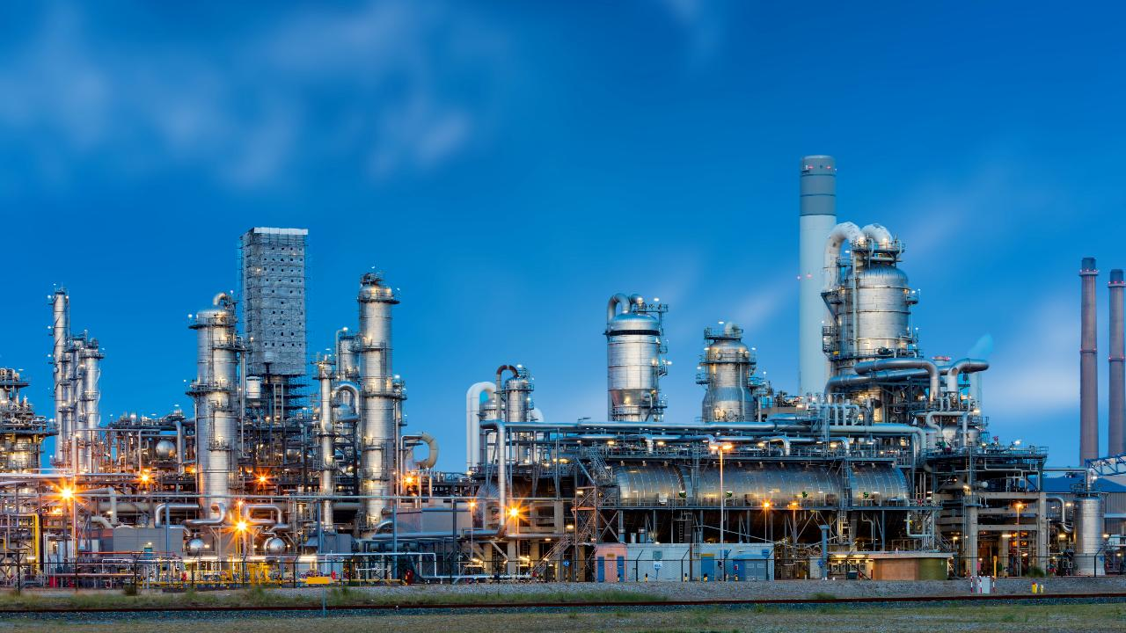
Carbon Capture Technology

Slide 19

Carbon capture: Involves capturing CO₂, methane, and nitrous oxide, focusing on hard-to-abate sectors like cement, iron, and steel. The capture technology constitutes ~70% of total project costs.
Cost breakdown: Key components are carbon capture (70%), transportation (10%), storage (15%), and utilization (5%). Research aims to reduce costs and enhance scalability.
Value chain development: Industrial CCUS technologies are moving from demonstration to commercialization, with integration challenges. Pipelines are the primary CO₂ transport method, with alternatives like truck, rail, and ship for specific regions.
Storage and utilization: Global storage capacity is sufficient to store the forecasted 220 Gt of CO₂ from 2020 to 2070. Currently, onshore geological storage accounts for two-thirds of the world's carbon capture capacity and will continue to play a critical role in storing captured carbon, while enhanced oil recovery (EOR) leads in utilization at ~75% globally within the oil and gas sector. Other uses, like carbon-based fuels and materials, face technological hurdles.
From an industry deep-dive point of view, cement and ammonia production may be the most promising industries for carbon capture using point-source technology, as their technological readiness has reached the commercialization level and is cost efficient provided that financial incentives remain available (i.e., Inflation Reduction Act).
Industries like iron and steel, freight transport, and blue hydrogen are still in niche stages, focused on R&D and pilot projects. High installation and operational costs make these solutions economically unviable, as the estimated LCOC per ton remains high, even with incentives.
Key messages
Carbon Capture Technology
Credit: Yosafat Partogi, Hyae Ryung Kim, and Gernot Wagner. Share with attribution: Kim et al., “Capturing Carbon” (7 November 2025).

Slide 20


















CO₂ capture value chain is comprised of CO₂ sources, capture, transport, and storage or usage
Level of adoption:
High
Moderate
Low
Need further research
CO2 Technology Value Chain
1
2
3
CO₂ sources
CO₂ capture
CO₂ transport
CO₂ storage
4A
Oil & gas
Chemicals
Onshore
Oxyfuel combustion
Pipeline
Ship
Offshore
Global CO₂ storage capacity is vast— estimated at 8,000–55,000 Gt — with a shift toward large-scale hubs serving multiple emitters, especially in the U.S. Gulf Coast, North Sea, and Southeast Asia.
Cement &
steel
Power
generation
(e.g., coal)
CO₂ usage
Pre-combustion
4B
Rail
Truck
Direct
from air
Other
(e.g., hydrogen production)
Enhanced oil recovery
New fuel
(e.g., biofuel, cement)
Post-combustion
The Northern Lights project, launched in 2024 in Norway, is the first commercial cross-border CO₂ transport and storage system, initially handling 1.5 Mtpa and expanding to over 5 Mtpa after 2028.
Modular plug-and-play systems are making carbon capture cheaper, faster, and more widely accessible, according to Carbon Clean.
Building materials and polymers (e.g., concrete)
Sources: Land & Climate Review, Capturing and storing problems (2022); MIT, How efficient is carbon capture and storage? (2021); CATF, Project track records (2024); CECO, Barriers to successfully implementing CCUS (2024); WRI, 7 Things to Know about CCUS (2023).
Credit: Christian Sandjaja, Sean Lee, Hyae Ryung Kim, and Gernot Wagner. Share with attribution: Kim et al., “Capturing Carbon” (7 November 2025).

Slide 21
Carbon capture technologies can be classified by capture type, system design, technology used, and separation process
1
Carbon Capture
Carbon capture technologies
Observations
Post-combustion is the most widely used capture system, representing the largest share of global CCS capacity.
Pre-combustion is the second most adopted system, indicating its significant role in current CCS deployment.
Absorption by chemical solvents is used in both major systems, showing its broad applicability across capture methods.
Carbon capture
Capture Type
Point-source capture
Direct air capture
Capture System
Process modifications
Oxyfuel combustion
Pre-combustion
Post-combustion
Capture Technology
Combustion in pure CO₂
Chemical looping
Absorption by chemical solvents
Absorption by physical solvents
Cryogenic separation
Membrane separation
Absorption by liquid solvents
Absorption by solid solvents
Process
modification
Oxyfuels
Global CCS capacity
by capture system
Pre-combustion
Post-combustion
0%
10%
20%
30%
40%
50%
60%
70%
80%
90%
100%
Sources: Energy Transition Committee, Carbon Capture, Utilisation, & Storage in the Energy Transition: Vital but Limited (2022); Concawe Review, Technology Scouting‒Carbon Capture: From Today’s to Novel Technologies (2021).
Credit: Michelle Priscilla, Hyae Ryung Kim, and Gernot Wagner. Share with attribution: Kim et al., “Capturing Carbon” (7 November 2025).

Slide 22
Capital and operating costs of capturing carbon varies by industry, technology, and energy costs
1
Carbon Capture
Cost breakdown for capturing carbon by industry, US$/ton
Observations
Technology readiness varies significantly across pathways, but all require substantial development.
Energy intensity of CO₂ conversion due to chemical inactivity creates a cost disadvantage —economics depend on "affordable, renewable energy" availability.
Commercial timeline spans two decades to develop and commercialize for most CO₂-use technologies.
Current costs exceed conventional alternatives: CO₂-derived products face a cost disadvantage and must compete with less-expensive non-CO₂-based routes.
Scale remains suboptimal: Existing commercial CO₂ use facilities operate at significantly smaller scale than traditional production plants, limiting cost competitiveness.
508
Carbon capture capital costs
444
Non-energy O&M cost
390
Energy cost
357
306
298
224
230
80
82
90
Ammonia
Ethanol
Natural Gas Processing (low)
Hydrogen
Cement
Steel & Iron
Natural Gas Processing (high)
Coal Power Plant
Natural Gas Power Plant
Refinery-FCC
Industrial Furnaces
Low-cost capture
High-cost capture
Very high costs/economically unviable
Source: DOE, Meeting the Dual Challenge (2019).
Credit:, Maitreyi Menon, Hyae Ryung Kim, and Gernot Wagner. Share with attribution: Kim et al., “Capturing Carbon” (7 November 2025).

Slide 23
Pipelines are most cost-efficient option for high-volume CO₂ transport, though alternatives offer essential flexibility
2
Transportation
Pipeline remains the most cost-efficient solution
Pipeline enables stable, high-volume transport
Cost range ($/tCO₂)
Volume capacity (tCO₂/day)
Pipelines are most cost efficient for large volumes over long distances ($1-$10/ton for 10 Mt/year), with low emissions and the potential to reuse existing infrastructure.
Rail is competitive for 100-500 km, especially at low volumes or when pipelines face opposition.
Trucks work for only short (<400 km), last-mile delivery.
Shipping suits long-distance or offshore routes but depends on port and regasification costs.
25,000
Pipelines are ideal for major CO₂ corridors (e.g., enhanced oil recovery zones), as they handle large-scale, continuous flows, supporting long-term carbon transport infrastructure.
A multimodal network is emerging to address regional disparities and smaller scale or early-stage projects, integrating alternatives alongside pipelines to balance volume, geography, cost, and deployment speed.
20,000
15,000
$100-$200
10,000
$60-$150
$0.25-$92
$8-$60
5,000
0
Pipeline
Shipping
Truck
Rail
Pipeline
Shipping
Truck
Rail
Sources: Energies, B3, Pipeline Infrastructure for CO2 Transport (2024); MIT, Cost of CO2 transport and storage (2021); Energies, Systematic Review of CCUS (2023); Wood Mackenzie, What’s shaping CCUS project costs? (2023); Nature Climate Change, A proposed global layout for CCUS (2021); Energy Procedia, Understanding the economic feasibility of ship transport (2014).
Credit: Shaurir Ramanujan, Grace Frascati, Christian Sandjaja, Hyae Ryung Kim, and Gernot Wagner. Share with attribution: Kim et al., “Capturing Carbon” (7 November 2025).

Slide 24
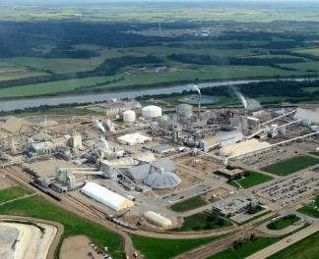
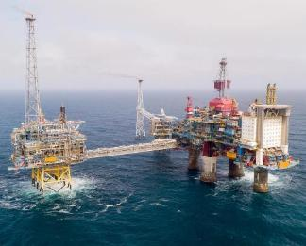
Coordinated expansion of onshore and offshore storage infrastructure required to meet rising CO₂ storage needs
3
Storage
Theoretical global CO₂ storage capacity
Observations
There is enough storage (8,000-55,000 Gt) around the world to store forecasted 220 Gt of CO₂ from 2020 to 2070.
80% of current operational storage is associated with EOR, while the remainder is dedicated to geological storage which is expanding rapidly and is expected to reach roughly half of global capacity.
Onshore storage is likely to dominate in the near term; but offshore storage is expected to expand rapidly over the medium to long term.
Large-scale CO₂ storage has demonstrated that risks of leakage are small and can be managed effectively, with careful storage site selection and appraisal.
~63%
~37%
About two-thirds of global storage capacity is onshore, driven by favorable cost effectiveness, proximity of lower cost of operation, and existing infrastructure.
Onshore storage
Sample: Alberta Carbon Trunk Line Project ‒
active CO₂ onshore storage site
Offshore storage
Sample: Northern Lights Project ‒
active CO₂ offshore storage site
Sources: IEA, Capacity and need to store CO2 (2021); IEA, CO2 Transport and Storage; University of Oxford, Onshore geological carbon storage has potential in the UK, but key knowledge and regulatory gaps remain (2024).
Credit: Michelle Priscilla, Christian Sandjaja, Sean Lee, Hyae Ryung Kim, and Gernot Wagner. Share with attribution: Kim et al., “Capturing Carbon” (7 November 2025).

Slide 25


Enhanced oil recovery is currently the only profitable application of captured CO₂, offers minimal net climate benefit (1/2)
4
Utilization
Captured CO₂ application | Definition and environmental impact | Cost (estimated $/ton)
EOR | Utilizes captured CO₂ to inject into mature oil fields, increasing oil extraction efficiency while simultaneously storing CO₂ underground. Environmental impact: Reduced carbon footprint: EOR oil produces 37% less CO₂ than conventional oil. Prolonged fossil fuel dependence: EOR extends the lifespan of oil fields and the fossil fuel industry. | Variable but can be profitable with oil prices and incentives; net $55/tCO2​ to provider (e.g., North Dakota EOR project)
Production of drop-in fuels | Converts captured CO₂ into liquid fuels that are chemically identical to conventional hydrocarbons, enabling direct use in existing engines and infrastructure without modification. Environmental impact: Reduced carbon footprint: Reduces 83% emission compared with conventional fuel. | Very high; e-kerosene $50-$80/GJ; synthetic gasoline needs electricity at <$0.03/kWh to compete
Building materials and polymers | Utilizes captured CO₂ as a feedstock to create sustainable concrete, carbon-based building materials, and polymers, reducing emissions and enhancing material performance. Environmental impact: Reduced carbon footprint: Reduces building products’ raw material greenhouse gas emissions by 30-50%. | Wide range: $77-$102/tCO2​ avoided (slag/wollastonite); some routes cheaper than CCS; aggregates $8-$11/t product
Sources: Environmental Technology & Innovation, A review of progress made on DAC (2022); Environmental International, Enhanced oil recovery: Environmental issues and state regulatory programs (2003); IEA, CO₂ Capture and Utilization; Iowa Capital Dispatch, Using Co2 to extract oil is ultimately worse for the environment (2024); WEF, What is CCUS? (2024); IEA, CO₂ Transport and storage; Clean Air Task Force, Carbon capture and storage in the United States power sector (2019); Pipeline Fighters Hub, CO₂ EOR issues (2024); Coryton, Sustainable Fuels Myths vs. Truths (2022); RMI, The Hidden Climate Impact of Residential Construction (2023).
Credit: Grace Frascati, Christian Sandjaja, Maitreyi Menon, Hyae Ryung Kim, and Gernot Wagner. Share with attribution: Kim et al., “Capturing Carbon” (7 November 2025).

Slide 26


Enhanced oil recovery is currently the only profitable application of captured CO₂, offers minimal net climate benefit (2/2)
4
Utilization
Captured CO₂ application | Advantages and concerns
EOR | Considered both a form of storage and utilization Currently most economically feasible use of CO₂, allowing companies to store CO₂ in geological formations (depleted oil fields) while pushing out additional oil that can be extracted to generate revenue and offset capture costs Raises several environmental concerns, such as pollution of land and surface water from chemical and oil leakages Early-on projects are carbon-negative, then go carbon-positive six to 18 years into operations as oil production declines
Production of drop-in fuels | Generates feedstock for methanol and synthetic fuels that are compatible with existing infrastructure (largely focusing on sustainable aviation fuel) Helps reduce reliance on fossil fuels and closes carbon loop Many technologies are in early development
Building materials and polymers | Converts CO₂ into carbonates used in cement and concrete production and can also be used to create plastics and other chemical and polymer materials Building materials derived from CO₂ products are the only use case that counts as permanent sequestration Only a handful of projects focus on this use due to lack of profitability
Sources: Environmental Technology & Innovation, A review of progress made in DAC of CO₂ (2022); Environment International, EOR environmental issues (2003); IEA, CO₂ Capture and Utilization; Iowa Capital Dispatch, Using CO2 to extract oil is ultimately worse for the environment (2024); WEF, What is CCUS? (2024); IEA, CO₂ Transport and Storage (2024); MDPI, Energies, Environmental and Operational Performance of CO2-EOR as a CCUS Technology (2019).
Credit: Grace Frascati, Christian Sandjaja, Hyae Ryung Kim, and Gernot Wagner. Share with attribution: Kim et al., “Capturing Carbon” (7 November 2025).

Slide 27
4
Utilization
North Dakota state subsidies for EOR incentivize oil extraction instead of CO₂ sequestration, undermining abatement potential
Cost model for single-well EOR project in North Dakota (November 2024)
Observations
State subsidies are misaligned with climate objectives, fueling increased oil production instead of incentivizing carbon sequestration.
At $80-per-barrel oil, producers earn nearly $50 net per barrel, making EOR with CO₂ highly attractive.
Full Bakken deployment could generate $3B-$9B in oil-linked state revenue over 10 years, reinforcing extraction over sequestration.
North Dakota’s policy stack (tax holidays, infrastructure relief) is the most aggressive in the U.S., significantly tilting economic viability toward EOR.
Costs
-50
Savings
1
-55
1
3
5
Transport
Project Costs
Royalty Payment (19%)
CO₂ Price
Less: Sales & Use Tax Exemption
Less: Cost-Share on Taxable CapEx
Less: Oil Extraction Tax Exemption
Total State Incentives
Net Cost per Barrel
Assumptions
Oil price fixed at $80/BBL; all calculations in $/BBL
CO₂ utilization = 3 barrels of oil per ton injected
Costs and incentives converted from $/tCO₂ to $/BBL
Tax benefits reflect statutory rates: 19% royalty, 5% extraction tax (86.5% exempt), 5% sales tax
State incentive values derived from Pelton (2025) model, applicable to typical Bakken CO₂-EOR project
Sources: Office of the North Dakota Tax Commissioner, North Dakota CO2-EOR Financial Analysis (2024).
Credit: Maitreyi Menon, Michelle Priscilla, Hyae Ryung Kim, and Gernot Wagner. Share with attribution: Kim et al., “Capturing Carbon” (7 November 2025).

Slide 28
Even when made with sequestered carbon, EOR delivers minimal net climate benefit and can promote increased oil production
4
Utilization
Lifecycle carbon emissions of CO₂-EOR (ton CO₂e/ton CO₂ injected)
Observations
Enhance oil recovery is often promoted as carbon-negative, but lifecycle analysis (CATF, IEA, NETL) shows it is still a source of emissions, typically 25-40% less per barrel than conventional oil, not zero.
The apparent benefit relies on perfect, permanent CO₂ storage and assumes the oil produced displaces other oil rather than adding to the total supply.
For every ton of CO₂ injected, roughly three barrels of oil are produced, releasing around 0.96 tons of CO₂e when extracted and burned. If these barrels are additional to global supply, total emissions increase and the process becomes a net climate harm.
At scale, even small per-barrel emission
gaps can add up to hundreds of millions of tons of CO₂, offsetting storage gains if demand stays high. Subsidizing EOR risks locking in fossil fuel infrastructure, prolonging oil use, and delivering minimal emissions cuts.
-1.00
+0.96
Underground CO₂ injection
(CO₂ stored)
Oil production
(CO₂ released)
Net emissions
For every ton of CO₂ injected into an oil reservoir for EOR production, operators can claim permanent storage.
That same ton of injected CO₂ enables production of ~3 barrels of oil, releasing 0.96 tons of CO₂e when burned.
Once both storage and combustion are counted, the net negative emissions are just 0.04 ton CO₂e. This doesn’t account for potential storage leaks.
Source: Office of the North Dakota Tax Commissioner, North Dakota CO2-EOR Financial Analysis (2024).
Credit: Maitreyi Menon, Michelle Priscilla, Hyae Ryung Kim, and Gernot Wagner. Share with attribution: Kim et al., “Capturing Carbon” (7 November 2025).

Slide 29
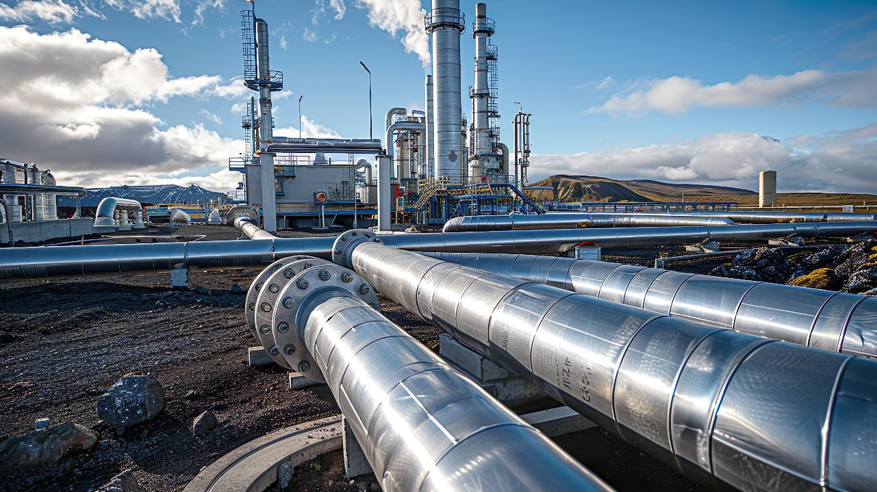
Technology Deep Dive

Slide 30
Two key categories of carbon management — point source and ambient — differ based on the origin and dispersal of emissions
 | Point-source capture | Ambient Carbon Removal
Description | Separation and entrapment of CO₂ before it is released from large stationary sources (e.g., industrial plants) | Removal of CO₂ already in the atmosphere or from biomass energy by targeting diffuse CO₂ concentrations rather than capturing emissions at the source
Examples | Applications to iron & steel, cement, freight, blue hydrogen & ammonia | DAC, Field Weathering, Mineralization, Direct Ocean Removal, Ocean Alkalinity Enhancement
% share of total CO₂ captured using carbon capture technologies, by method
Current CO₂ absorption (per year) | ~50 MtCO₂ | <1 MtCO₂
Technological readiness level | High with immediate scalability | Low to Medium with limited scalability; DAC is medium while the others are relatively low
Cost of CCUS per ton of CO₂ | $21-$210 depending on industry | DAC: $135-345 Enhanced Weathering: $50-200 Ocean Methods: $50-150
1
2
Others
Cement
29%
18%
15%
Steel & iron
Chemical
The majority of current capture is industrial point source.
<1%
Sources: IEA, CCUS (2025); IEA, BECCS (2023); IEA, DAC (2022); DOE, Pathways to Commercial Liftoff: Industrial Decarbonization (2023).
Credit: Maitreyi Menon, Michelle Priscilla, Anda Wang, Yosafat Partogi, Hyae Ryung Kim, and Gernot Wagner. Share with attribution: Kim et al., “Capturing Carbon” (7 November 2025).

Slide 31



Cement production may be the most promising industry for carbon capture application (1/2)
R&D/pilot scale
Ready for commercialization
Mature and commercialized
 | Iron & steel | Cement
Description | BF-BOF or DRI-EAF retrofitted with point capture equipment Captured CO₂ is then sequestered underground or reused | Captures CO₂ from limestone decomposition process and subsequently either: Sequesters it underground or Reuses it in the production of low-carbon cement
Technology readiness level
Estimated LCOC ($/ton) | $40-$100 | $60-$120
Challenges | Viability hotly contested due to absence of a single, harnessable carbon egress point and the scarcity of pure carbon | Variety of expensive technologies that are costly to retrofit and scale across plants
Future outlook | Continued technological advancements to make effective and cost efficient | Continued technological advancements to make effective and cost efficient
Real-time sector initiatives | ArcelorMittal Carbalyst® captures carbon from a blast furnace and reuses it as bioethanol; tech has moved beyond "not proven at scale" to being operational at an industrial demonstration scale | Brevik CCS (Heidelberg) Construction completed; project start operational May 2025
1
2
Sources: IEA, Iron and Steel Technology Roadmap (2020); IEA, Is carbon capture too expensive? (2021); Heidelberg, First CO₂ captured in Brevik as part of ramp-up phase (2025); ArcelorMittal, ArcelorMittal announces the first industrial production of ethanol (2023); IEA, Levelised cost of CO2 capture by sector and initial CO2 concentration, 2019 (2020).
Credit: Maitreyi Menon, Michelle Priscilla, Anda Wang, Grace Frascati, Shaurir Ramanujan, Sean Lee, Yosafat Partogi, Christian Sandjaja, Hyae Ryung Kim, and Gernot Wagner. Share with attribution: Kim et al., “Capturing Carbon” (7 November 2025).

Slide 32
Ammonia production considered another promising industry for carbon capture application (2/2)
R&D/pilot scale
Ready for commercialization
Mature and commercialized
 | Freight transport | Chemicals – blue ammonia and blue hydrogen
Description | Shipping: Onboard CCS with ~90% emission reductions; post-combustion system uses chemical adsorption and advanced cryogenic capture Trucking: Mobile system uses metal-organic frameworks with emissions reductions of ~50% | Fossil-based routes with CCS technology are in various stages: SMR with CCS (steam methane reforming) – ~60% CO₂ capture for ammonia (blue ammonia) ATR with CCS (autothermal reforming) – emerging for both ammonia and blue hydrogen Ammonia production seen as more mature; blue hydrogen still developing
Technology readiness level
Estimated levelized cost ($/ton) | N/A (marginal abatement cost but not reliable) | $25-$35 for ammonia, $50-$80 for blue hydrogen
Challenges | Costly installation and operating process, lack of storage and utilization infrastructure, energy intensive, discharge safety issues | High associated costs with electrolysis and CCS; reliance on natural gas for feedstock; lower CO₂ capture rates for some blue hydrogen processes
Future outlook | Continued technological and policy advancement to enhance energy, cost, and space efficiency | - Technological improvements in CCS to reduce costs - Ammonia: Commercially viable today - Blue hydrogen: Transitional solution until green hydrogen scales
Real-time sector initiatives | Shipping: Value Maritime Filtree System Trucking: Research and MOF design by Pezella and Sarathy | - Nutrien’s Redwater Nitrogen Facility in Alberta is producing blue ammonia (conventional ammonia with CCUS) - Moving more firmly into “ready for commercialization" for many large-scale industrial applications
3
4
For blue ammonia
For blue hydrogen
Sources: IEA, Iron and Steel Technology Roadmap (2020); Is carbon capture too expensive? (2021); Nutrien, Environmental Performance (2024); DOE, Pathways to Commercial Liftoff: Clean Hydrogen (2024); IEA, Levelised cost of CO2 capture by sector and initial CO2 concentration (2020).
Credit: Maitreyi Menon, Michelle Priscilla, Anda Wang, Grace Frascati, Shaurir Ramanujan, Sean Lee, Yosafat Partogi, Christian Sandjaja, Hyae Ryung Kim, and Gernot Wagner. Share with attribution: Kim et al., “Capturing Carbon” (7 November 2025).

Slide 33
Cost is an overarching challenge of CO₂ capture, with cost effectiveness the primary focus across industry sectors
Levelized cost of capture is highest for DAC, lowest for other industries
Observations
High cost is one of the most frequently cited reasons slowing CCUS adoption.
The graph reflects hypothetical capture costs; the cost of transport and storage also greatly varies depending mostly on CO₂ volumes, transport distances, and storage conditions.
In the real world, Climeworks has achieved a cost of $1,000/ton and aims to hit $250-$350/ton by 2030.
It can be more cost effective to retrofit existing facilities with CCUS than to build new low-carbon production capacity with alternative technologies.
CCUS is the cheapest emission reduction option for some chemicals (~20-40% more expensive than unabated, compared with ~50-115% for higher electrolytic H₂).
Levelized cost of CO₂ capture across sectors (in US$/ton)
Ambient: $85/ton
Iron & steel
$40-$133
Industrial carbon capture
Other carbon capture
Cement
$60-$205
Belfer estimated carbon capture
45Q credit
Freight transport
$750-$800
Chemicals & refining
(High-purity CO2)
$15-20
Chemicals & refining
(Refineries)
$88-$163
Chemicals & refining
(Ammonia)
$20-35
Hydrogen (SMR with CCS)
$50-$136
DAC: $180/ton
DAC
$100-$345
Other
$200-$300
Sources: Canary Media, CO₂ Removal (2024); Carbon180, DAC (2024); Eisneramper, 45Q Credit (2023); Lazard, LCOE (2023); IEA, Is carbon capture too expensive? (2021); IEA, Levelized Cost of CO2 (2020); DOE, Pathways to Commercial Liftoff (2024); IEA, Levelized Cost of CO2 Capture by Sector and Initial CO2 Concentration (2019); Harvard Kennedy School Belfer Center, Carbon Capture Utilization and Storage: Technologies and Costs in the U.S. Context (2022).
Credit: Grace Frascati, Anda Wang, Michelle Priscilla, Hyae Ryung Kim, and Gernot Wagner. Share with attribution: Kim et al., “Capturing Carbon” (7 November 2025).

Slide 34
Iron and steel emissions expected to rise without intervention; future reduction scenarios require drastic cuts
1
Iron and Steel
Only with intervention will CO₂ from iron and steel decline into 2050
Observations
If no action is taken, global emissions from the iron and steel sector are expected to peak at 2.7 gigatons per year in 2050.
  The increase in emissions is attributable to growing steel demand from emerging economies.
IEA has developed several possible pathways for the steel industry:
  In the 90% reduction by 2070 pathway, emissions would still need to drop by 50% by 2050.
  In the net-zero emissions by 2050 pathway, emissions would already need to drop by 25% by 2030 and drop to close to zero by 2050.
BF-BOF, the cheapest and most efficient steelmaking process, is also the most polluting.
Direct CO₂ emissions in the iron and steel sector per IEA scenario (in Gt Co₂ per year)
3.5
Baseline
90% reduction by 2070 (IEA)
Net-zero emissions by 2050 (IEA)
3.0
2.8
2.5
2.0
1.5
1.0
0.5
0.0
2023
2030
2050
Notes: The baseline scenario reflects the policies and implementing measures that have been adopted as of September 2022; NZE = net-zero emissions.
Sources: IEA, Direct CO2 emissions in the iron and steel sector by scenario, 2019-2050 (2020); IEA, Net Zero by 2050 (2021); IEA, Iron and Steel Technology Roadmap (2020); McKinsey, The resilience of steel: Navigating the crossroads (2023); World Economics Forum, Steel industry net-zero tracker (2024).
Credit: Grace Frascati, Anda Wang, Hyae Ryung Kim, and Gernot Wagner. Share with attribution: Kim et al., “Capturing Carbon” (7 November 2025).

Slide 35
Carbon capture with potential to reduce steelmaking emissions by ~90% if scaled, comparable to green H₂ and electrolysis
1
Iron and Steel
CCUS retroactively decreases emissions compared with other zero-carbon tech
Observations
The 90% CO₂ reduction for CCUS is a hypothetical best-case scenario, which at present has not been proven at scale.
Compared with other decarbonization technologies requiring new systems (e.g. DRI-EAF), carbon capture equipment can be retrofitted to existing equipment, increasing accessibility; at the same time, it continues reliance on fossil fuels (unlike, for example, electrolysis, which proactively decreases fossil fuel needs).
  Hypothetical best-case scenario
Crude steelmaking CO₂ emissions reduction potential of deep decarbonization technologies relative to conventional
BF-BOF and NG DRI-EAF routes (%)
100
97
96
80
60
40
20
0
Green H₂ DRI-EAF
(Zero-carbon elec.)
Electrolysis
(Zero-carbon elec.)
CCUS additions
CO₂ reduction potential (vs. conventional BF-BOF)
CO₂ reduction potential (vs. conventional NG DRI-EAF)
Sources: Columbia Center on Global Energy Policy, Low Carbon Production of Iron & Steel (2021); American Institute of Chemical Engineers, Catalyzing Commercialization: Producing Green Iron with a Zero-Carbon Electrochemical Process (2023); Electra; Boston Metal, Decarbonizing steelmaking for a net-zero future; Midrex, Impact of Hydrogen DRI on EAF Steelmaking (2021); International Journal of Greenhouse Gas Control, A techno-economic analysis and systematic review of carbon capture and storage (2017); Mission Possible Partnership, Net-Zero Steel Sector Transition Strategy (2021).
Credit: Michelle Priscilla, Grace Frascati, Hyae Ryung Kim, and Gernot Wagner. Share with attribution: Kim et al., “Capturing Carbon” (7 November 2025).

Slide 36
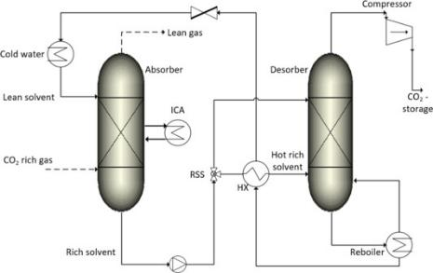
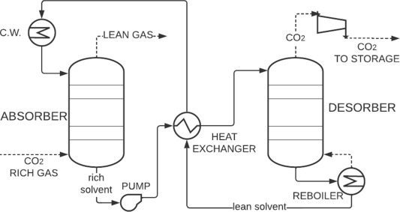
Iron and steel carbon capture possible both pre- and post-combustion
1
Iron and Steel
Pre-combustion capture
Post-combustion capture
Suitable for retrofitting existing BF-BOF plants
CO₂-rich gas is sent into absorber, where it interacts with a liquid amine solvent that absorbs CO₂.
The rich solvent is preheated by a heat exchanger before entering the desorber. Here, heat (provided by the reboiler) separates CO₂ from the solvent. Pure CO₂ is sent to storage or for further utilization.
CO₂-rich gas is sent to an absorber, where a liquid chemical solvent absorbs the CO₂ from the gas, while the remaining gas (low in CO₂) exits the absorber.
The CO₂-laden solvent is transported to a desorber for CO₂ separation; here, heat from the reboiler raises the temperature, causing the CO₂ to separate from the solvent.
CO₂ is collected as a concentrated gas and sent to storage/utilization.
Sources: Center on Global Energy Policy, Low-Carbon Production (2021); Fuel, Integration of Carbon Capture Tech (2023).
Credit: Grace Frascati, Hyae Ryung Kim, and Gernot Wagner. Share with attribution: Kim et al., “Capturing Carbon” (7 November 2025).

Slide 37
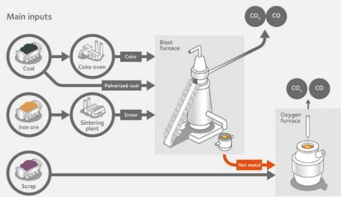
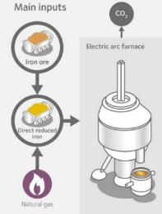
Iron and steel carbon capture can be implemented with BF-BOF or NG DRI-EAF
1
Iron and Steel
Blast furnace-basic oxygen furnace (BF-BOF)​
Natural gas-based direct reduced iron – electric arc furnace (NG DRI-EAF)​
BF-BOF requires metallurgical coal to be coked first, with coke oven gases either vented, burned in the BF-BOF, or used in cogeneration. The BF-BOF process uses coal and carbon monoxide as the heat source and reductant.
Exhaust gases from the process are approximately 20% but have an unpredictable mix of co-contaminants, complicating CCUS separation.
While IEA cites $40-$100/ton, a more feasible range may be $85-$157/ton once (or if) commercialized.
Methane-based DRI exposes iron ore to H₂ and CO syngas at a lower temperature of 900°C.
When using an autothermal process (e.g., Tenova) instead of steam methane reforming (standard Midrex), the resulting CO₂ is nearly pure.
This approach could potentially reduce CO₂ costs to $40-$80/ton once commercialized.
Sources: Midrex, Impact of Hydrogen DRI on EAF Steelmaking (2021); ArcelorMittal, Climate Action Report 2 (2021), World Steel Association (2021); Wiley, Physical and policy pathways to net-zero emissions industry (2019); IEEFA, Fact Sheet (2022); IEA, Iron and Steel Technology Roadmap (2020).​
Credit: Grace Frascati, Hyae Ryung Kim, and Gernot Wagner. Share with attribution: Kim et al., “Capturing Carbon” (7 November 2025).

Slide 38
Technological potential for iron and steel CCS exists but is not yet proven at scale
1
Iron and Steel
Capture facilities available today
Considerations
Estimated CCUS capture capacity
in 2025, in Mtpa CO₂
Pros
75
Offers potential for considerable emission reduction of this heavy-emitting, hard-to-abate sector.
  - If done successfully, could serve as a case study for other hard-to-abate sectors.
Can be used with existing equipment through retrofits.
Captured CO₂ can be used for enhanced oil recovery, increasing the efficiency of oil extraction and providing an additional revenue stream.
Cons
0.9
5.5
Technology is not yet proven at scale, making it difficult to secure conviction and funding.
Costs are significant with no guarantee of effectiveness, making for risky investments.
Does not remove reliance on fossil fuels in steel-making.
Operating
Under construction
Planned
CCUS facilities:
2
3
50+
Baotou Steel and Emirates Steel
ArcelorMittal and Tata Steel
Sources: AZO Cleantech, The Advantages and Disadvantages of Carbon Capture (2022); Center on Global Energy Policy, Low-Carbon Production of Iron and Steel (2021); IEA, Iron and Steel Technology Roadmap (2020); IEA, Is carbon capture too expensive? (2021); LETA, CCUS case studies (2025); Global CCS Institute, Facilities Database (2025).
Credit: Michelle Priscilla, Anda Wang, Grace Frascati, Hyae Ryung Kim, and Gernot Wagner. Share with attribution: Kim et al., “Capturing Carbon” (7 November 2025).

Slide 39
Capture costs in iron and steel indicate $40-$159/ton CO₂, though total CCUS cost is much higher and range from use of scrap
1
Iron and Steel
Iron and steel levelized cost is on the lower end of overall industry range
CCUS adds to cost consideration but is cheaper than hydrogen-based DRI
Levelized cost of CO₂ capture across sectors (in US$/ton)
Simplified levelized cost of competing low-carbon tech in steel
production
Iron & steel
$40-$133
Industrial carbon capture
Belfer estimated carbon capture
2,000
Conventional
Cement
$60-$205
CCUS-based
Non CCUS-based (low CO₂)
Supports BNEF’s $72/ton estimate
$750-
$800
Freight transport
1,500
Chemicals & refining
(High-purity CO2)
$15-$20
Chemicals & refining
(Refineries)
$88-$163
1,000
Chemicals & refining
(Ammonia)
$20-$35
Hydrogen (SMR with CCS)
$50-$136
500
DAC
$100-$345
Other
$200-$300
0
BF-BOF
ISR
Gas DRI
Gas DRI
H2 DRI
Note: Iron and steel recycling incorporates scrap steel. Sources: Arcelor Mittal, LanzaTech partnership (2021); Bloomberg, CCUS market (2023); IEA, CCUS Projects Explorer (2024); IEA, Iron and Steel Technology Roadmap (2020), IEA, Is carbon capture too expensive? (2021); Masdar, CCUS at Emirates Steel (2012); DOE, Pathways to Commercial Liftoff (2024)​; IEA, Levelized Cost of CO2 Capture by Sector and Initial CO2 Concentration (2019); Harvard Kennedy School Belfer Center, Carbon Capture Utilization and Storage: Technologies and Costs US Context (2022).
Credit: Grace Frascati, Michelle Priscilla, Hyae Ryung Kim, and Gernot Wagner. Share with attribution: Kim et al., “Capturing Carbon” (7 November 2025).

Slide 40
Carbon capture for iron and steel continues to face economic hurdles, even with current credits
1
Iron and Steel
Even with the 45Q credit, CCUS for iron and steel may not be economically feasible
Observations
ArcelorMittal’s Steelanol project has received funding from various sources, including from the European Union's Horizon 2020 program, the European Investment Bank, and the Belgian and Flemish governments (details not disclosed).
While specific funding details are not readily available, Emirates Steel’s CCUS project is supported by major organizations (Masdar and ADNOC).
  Funding has been fueled by a lack of other viable options for addressing this hard-to-abate sector (BF-BOF is a very efficient process, though carbon intensive).
Otherwise, capturing carbon in the iron and steel industry benefits from the same generic subsidies (e.g., 45Q tax credit).
Permanent storage + 45Q tax credit monetization, in $/ton CO₂
50
+$7
-$14
0
-$10
-$2
+$85
-$70
-50
Financial viability depends on the U.S. 45Q tax credit policy stability, but given the current climate policy, tax credits may not be guaranteed.
-100
LCOC
45Q credit
VCOM
Transport
Storage
Net value
Note: Uses $70, the average from prior slide, as LCOC. Uses $14 and $10 transport and storage costs, on the higher end of general (i.e., non-iron and steel specific) IEA estimates, for a more conservative approach; ~$7 VCOM is also a general figure.
Source: ArcelorMittal, LanzaTech partnership (2021); Bloomberg, CCUS market (2023); IEA, Iron and Steel Technology Roadmap (2020); IEA, Is carbon capture too expensive? (2021); Masdar, CCUS at Emirates Steel (2012).
Credit: Grace Frascati, Anda Wang, Hyae Ryung Kim, and Gernot Wagner. Share with attribution: Kim et al., “Capturing Carbon” (7 November 2025).

Slide 41
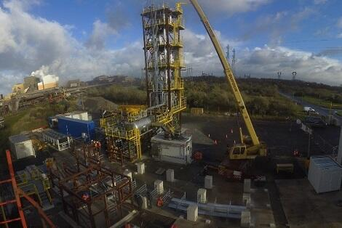
Case study: ArcelorMittal, one of only two operational projects in the industry, uses LanzaTech to capture carbon-rich waste gases
1
Iron and Steel
Plant overview
CCS expansion
Key statistics
Carbalyst®, also known as Steelanol, uses technology developed by LanzaTech to capture carbon-rich waste gases emitted from the blast furnace during the steelmaking process and convert them into recycled carbon chemicals.
The project is an industrial-scale demonstration plant at ArcelorMittal’s steelworks in Ghent, Belgium.
Proven effective reduction of hard-to-abate emissions: Cuts steel production emissions, advancing ArcelorMittal’s 2050 NZE goal.
Establishes company as a sustainability leader: By repurposing captured CO₂, ArcelorMittal promotes sustainability and leads CCUS adoption in steel.
Reduces CO₂ emissions by…
125,000 tons of CO₂ per year
Produces bioethanol at a rate of...
80M liters per year
Received funding to help finance the...
€180M project from the European Union's Horizon 2020 program, European Investment Bank, and Belgian and Flemish governments (details not disclosed)
LanzaTech received investment of…
$30M from ArcelorMittal’s XCarb Innovation Fund (most funding is private)
Sources: ArcelorMittal, Carbalyst, LanzaTech (2021); Georgeault, ArcelorMittal (2022).
Credit: Grace Frascati, Hyae Ryung Kim, and Gernot Wagner. Share with attribution: Kim et al., “Capturing Carbon” (7 November 2025).

Slide 42
Cement emissions expected to rise dramatically absent scaling carbon abatement technology, particularly in China
2
Cement
Only with intervention will CO₂e from cement decline into 2050
Observations
If no abatement measures are taken, global emissions from the cement sector are expected to peak at 3.8 gigatons per year in 2050.
  Increase in emissions attributable to growing construction from emerging economies with increased population and infrastructure needs
IEA has developed a net-zero pathway for the cement industry that assumes the following:
  A 30- to 40-year lifetime for cement kilns
  Hydrogen and CCUS playing an outsized role in achieving emissions reductions
  Bioenergy accounting for 30% of energy demand in cement production by 2050
Most projections assume a linear rise in alternative fuels and minimal changes in fundamental kiln structure.
Direct CO₂ emissions in the cement sector per IEA scenario (in Gt CO₂ per year)
4.0
Baseline
3.5
Net-zero emissions by 2050 (IEA)
3.0
2.5
2.4
2.0
1.9
1.5
1.0
0.5
0.0
2022
2030
2050
Sources: IEA, Net Zero by 2050 (2021); BCG, Cement’s Carbon Footprint Doesn’t Have to be Set in Stone (2024); Nature Communications, Projecting future carbon emissions from cement production in developing countries (2023).
Credit: Michelle Priscilla, Shaurir Ramanujan, Hyae Ryung Kim, and Gernot Wagner. Share with attribution: Kim et al., “Capturing Carbon” (7 November 2025).

Slide 43
Carbon capture, utilization, and storage projected to abate cement sector emissions not abated by other technologies
2
Cement
IEA targets for CO₂ captured, 2020-50
Gt CO₂
Abatement from CCUS by decarbonization roadmap, 2050
Percentage
Observations
~55% of the cumulative emissions reductions from CCUS will rely on technologies that are currently at the demonstration or prototype stage.
Heidelberg received Norwegian government funding in 2020 to build a full-scale carbon capture and storage facility at its factory in Brevik. Completed in 2024, the project anticipates reducing emissions by 400,000 tons of CO₂ annually. The project is in the final commissioning phase and is expected to be fully operational in the second half of 2025.
In 2018, China-based Anhui Conch invested $10 million in a carbon capture project to capture 50,000 tons of CO₂ annually; however, it is a “loss maker,” as there is a limited local market for the captured CO_{2.}
10
The DOE’s decarbonization roadmap projects ~60-70% of emissions abatement from CCUS, alternative production methods, and alternative binder chemistries.
Co₂ captured by CCUS per year
Other pathways
CO₂ captured by cement subsector
CCUS
8
120
6
100
100
100
4
2
1.7
0
2020
2030
2040
2050
GCCA
MPP
PCA
Cembureau
Sources: IEA, Net Zero by 2050 (2021); IEA, Cement (2023); Global Cement Magazine, CCUS (2024); International Cement Review, China starts CCUS focus (2024); Heidelberg, First global net-zero carbon capture and storage facility in the cement industry (2024); GCCA, Concrete Future (2021); Mission Possible Partnership (2023); PCA, Roadmap to Carbon Neutrality (2024); DOE, Low Carbon Cement (2023), Cembureau, From Ambition to Deployment (2024).
Credit: Michelle Priscilla, Anda Wang, Shaurir Ramanujan, Hyae Ryung Kim, and Gernot Wagner. Share with attribution: Kim et al., “Capturing Carbon” (7 November 2025).

Slide 44
Despite policy uncertainty, a broad range of instruments have been implemented to decarbonize cement manufacturing
2
Cement
Enabler | Policy type | Policy instrument | Key examples | Impact
Risk management | Risk-sharing | Financial certainty to innovators (through subsidies and incentives) | EU Carbon Contracts for Difference U.S. DOE Industrial Demonstration Program | Provides financial certainty to innovators by sharing investment risks in early-stage low-carbon technologies, incentivizing adoption and de-risking the transition to decarbonization solutions
Technology | Incentive- based | R&D direct funding | EU Innovation Fund | Grant funding provided for 20+ cement CCUS projects in eight countries
 |  | Supporting regulations | EU Net-Zero Industry Act | Strengthens regulations and creates targets and permitting environment to boost CCUS technology investments; entered into force in July 2024
 | Market- based | Carbon price | EU Emissions Trading System (ETS) California ETS China ETS (expand the ETS to include the cement sector) | Incentivizes cement producers to reduce emissions by trading credits
 |  | Border adjustment tariff | CBAM (full implementation in 2026) Prove It Act (under discussion) | Emission-intensive cement exporters to the EU face a cost escalation of up to 100%; needs to be complemented by transparent carbon accounting standards
Demand | Incentive- based | Green public procurement (GPP) | GPP concrete product policies in Germany, the Netherlands, the UK, and Sweden Federal Buy Clean Initiative in the U.S. | Creates a viable market for low-emission cement through GPP commitments
 | Mandate- based | Building/end-use product codes and standards | Embodied carbon limit policies in the Netherlands, Sweden, France, and Germany U.S. General Services Administration low embodied carbon concrete standards in the U.S. | Provides a clear market signal to low-emission cement production
Infrastructure | Incentive- based | CCUS infrastructure direct funding | Public funding of CCUS hubs in the EU CCUS hubs provision under Bipartisan Infrastructure Law | Over $15 billion committed to develop CCUS hubs in the U.S. and the EU
Capital | Incentive- based | Tax credits/subsidies | CCUS tax credits under Inflation Reduction Act | 20-30% reduction in costs to deploy CCUS in cement plants; extended 45Q credit results in a CCUS cost of $15-$65/ton in cement plants
Sources: WEF, Net-Zero Industry Tracker (2023); Climate Bond, Cementing the global net-zero transition (2023); EC, EU Innovation Fund (2024); Global Policy Watch, EU Net-Zero Industry Act (2024); EC, EU ETS (2024); ICAP, California ETS (2024); EC, EU CBAM (2024); UNIDO, GPP Pledge (2023); Office of the Federal Chief Sustainability Officer, Federal Buy Clean Initiative (2024); S&P Global IRA 45Q (2023); CATF, EU CCfDs (2024); DOE, DOE’s Industrial Demonstrations Program (2023); EC, EU Innovation Fund projects (2025).
Credit: Shaurir Ramanujan, Hoshi Ogawa, Sho Tatsuno, Jessica Cong, Shailesh Mishra, Hyae Ryung Kim, and Gernot Wagner. Share with attribution: Kim et al., “Capturing Carbon” (7 November 2025).

Slide 45
Significant reduction in LCOC and stronger financial incentives key to achieving economically feasible cement CCUS projects
2
Cement
Even with the 45Q credit, CCUS for cement is not currently economically feasible
Observations
Heidelberg has enjoyed generous funding from the Norwegian government for its Brevik plant.
In January 2025, the U.S. Department of Energy offered $101 million in funding for five projects to build new CCUS testing centers at cement plants.
  Another Cemex plant project in Germany, estimated to capture
  1.3 million MtCO₂ annually, received $164 million from the EU Innovation Fund in October 2024.
Otherwise, capturing carbon in the cement industry benefits from the generic subsidies (e.g., the 45Q tax credit).
Permanent storage + 45Q credit monetization, in $/ton CO₂
50
0
+$7
-$14
-$10
-$22
-50
-$90
+$85
-100
LCOC
45Q credit
VCOM
Transport
Storage
Net value
Notes: Uses $90, the industry average, as LCOC. Uses $14 and $10 transport and storage costs, on the higher end of general (i.e., non-iron and steel specific) IEA estimates, for a more conservative approach; ~$7 VCOM is also a general figure. Sources: DOE, Industrial Demonstrations Program (2024); Businesswire, EU backs pioneering CO₂ capture project at Cemex’s Rüdersdorf Cement Plant (2024); Agg-Net, Cemex cement plant chosen for US DOE-funded CCUS project (2025); ArcelorMittal, LanzaTech partnership (2021); Bloomberg, CCUS market (2023); IEA, Iron and Steel Technology Roadmap (2020); IEA, Is carbon capture too expensive? (2021).
Credit: Shaurir Ramanujan, Anda Wang, Hyae Ryung Kim, and Gernot Wagner. Share with attribution: Kim et al., “Capturing Carbon” (7 November 2025).

Slide 46
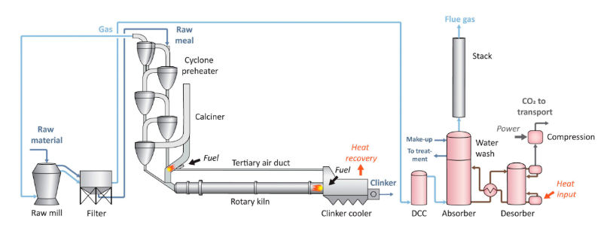
Capturing carbon in the hard-to-abate cement industry done by retrofitting post-combustion technology
2
Cement
Carbon capture process
Observations
Hot limestone is transformed into Portland cement clinker, providing cement with cohesive properties.
Two-thirds of emissions are from reactions in the chemical process of heating limestone, making CCS an attractive abatement solution.
  Process emissions associated with the decomposition of calcium carbonate are non-fossil fuel emissions that only CCS can resolve.
While there are many early-stage technologies to retrofit existing processes with CCS, the most common reference point is using monoethanloamine (MEA) a solvent that filters and absorbs CO₂ from flue gas.
Captured CO₂ is subsequently compressed and stored in a separate facility or underground.
Highly pure CO₂ solution is compressed and transported.
MEA absorbs CO₂ from outgoing flue gas.
MEA is recovered and regenerated.
Sources: MDPI, Energies, Comparison of Technologies for CO₂ Capture from Cement Production – Part 1: Technical Evaluation (2019); Scientific American, Solving Cement’s Massive Carbon Problem (2023).
Credit: Shaurir Ramanujan, Hyae Ryung Kim, and Gernot Wagner. Share with attribution: Kim et al., “Capturing Carbon” (7 November 2025).

Slide 47
Despite immense potential for GHG reduction in cement, CCUS remains untapped because results are largely unproven
2
Cement
Capture facility available today
Considerations
Estimated CCUS capture capacity
in 2025, in Mtpa CO₂
Pros
Provides feasible emissions abatement alternative for hard-to-abate industry with limited cost-efficient options.
A portfolio of technologies should be used for retrofitting existing plants, with a preference for post-combustion technology.
Some industry plants may inject captured CO₂ to be permanently stored in cement, a process known as carbon mineralization.
Very few of the facilities are fully operational in the status quo.
Cons
Many projects will not be operational until or beyond 2030, thereby making it an unreliable solution to implement at scale.
Most projects are announced in Europe, North America, and Australia, though 58% of cement is produced in China and India alone.
The effects of oceanic carbon storage on marine ecosystems remains unclear.
Operating
Planned (by 2032)
Sources: IEA, CCUS Projects Database (2024); BBC, The environmental cost of China’s addiction to cement (2024); IPCC, Ocean storage (2018); IEA, Is carbon capture too expensive? (2021); Global CCS Institute, Facilities Database (2025).
Credit: Michelle Priscilla, Anda Wang, Shaurir Ramanujan, Hyae Ryung Kim, and Gernot Wagner. Share with attribution: Kim et al., “Capturing Carbon” (7 November 2025).

Slide 48
The cost of capturing carbon in the cement industry ranges from $60-$134 US$/ton
2
Cement
Cement levelized cost is on the lower end of the overall industry range
CCUS-based cement technologies can double production cost vs. conventional methods
Levelized cost of CO₂ capture across sectors (in US$/ton)
Simplified levelized cost of competing low-carbon tech in cement
production
Iron & steel
$40-$133
Industrial carbon capture
Belfer estimated carbon capture
1,000
Conventional
Cement
$60-$205
CCUS-based
Freight transport
$750-
$800
Chemicals & refining
(High-purity CO2)
$15-$20
Chemicals & refining
(Refineries)
500
$88-$163
Chemicals & refining
(Ammonia)
$20-$35
Hydrogen (SMR with CCS)
$50-$136
DAC
$100-$345
0
Dry Process
Dry + Preheater / Precalciner
Oxyfuel Combustion
Calcium Looping (CaL)
CCS Retrofit (Amine Scrubbing)
Other
$200-$300
Sources: IEA, Is carbon capture too expensive? (2021); IEA, CCUS in Clean Energy Transitions (2020); Carbon Capture Coalition, Primer: 45Q Tax Credit for Carbon Capture Projects (2023); WRI, U.S. Investment in Abating Cement Emissions (2024); MDPI, Energies, Comparison of Technologies for CO2 Capture from Cement Production – Part 2: Cost Analysis (2019); DOE, Pathways to Commercial Liftoff (2024)​; IEA, Demand and Supply Measures for the Steel and Cement Transition (2024); IEA, Levelized Cost of CO2 Capture by Sector and Initial CO2 Concentration (2019); Harvard Kennedy School Belfer Center, Carbon Capture Utilization and Storage: Technologies and Costs US Context (2022).
Credit: Shaurir Ramanujan, Michelle Priscilla, Hyae Ryung Kim, and Gernot Wagner. Share with attribution: Kim et al., “Capturing Carbon” (7 November 2025).

Slide 49
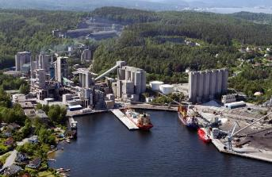
Case study: Heidelberg Materials’ Norcem plant scheduled to have the largest CCS operation by 2025
2
Cement
Plant overview
CCS expansion
Key Statistics
The project directly captures the same amount of CO₂ emissions as 80,000 cars, which is then stored and pumped a mile beneath the seabed of the North Sea.
Announced in 2020 and mechanically completed in December 2024, the project is an industrial-scale plant at Heidelberg’s cement plant in Brevik, Norway.
Effective reduction of hard-to-abate emissions: Cutting cement production emissions allows the company to work toward its goal of saving 10 million tons of CO₂ by 2030.
Heidelberg as a product innovator: New evoZero cement brand provides an opportunity to leverage CCS as a first mover in providing verifiable net-zero products.
Reduces CO₂ emissions by
400,000 tons per year
Reduces plant emissions by
50% per year
Heidelberg is investing…
For context, China’s 13 CCUS-equipped power and cement plants captured 856,000 tons of CO₂ per year as of 2022.
€1.5B in CCUS projects by 2030
Received investment through a…
$2.6B cost-sharing initiative launched by the Norwegian government in 2020 to advance industry-wide CCS development
Sources: Heidelberg Materials, Brevik CCS (2024); Bloomberg, Norway Carbon-Capture Plant Hits Longship Project Milestone (2024); World Cement, Heidelberg Materials has launched the worlds first net-zero cement (2023); Norwegian government, Longship goes into operation (2025); Liu et al., China’s pathways of CCUS under carbon neutrality vision 2060 (2022).
Credit: Shaurir Ramanujan, Anda Wang, Hyae Ryung Kim, and Gernot Wagner. Share with attribution: Kim et al., “Capturing Carbon” (7 November 2025).

Slide 50
Freight transport emissions are high and only increasing; CCUS is a critical intermediary solution necessary to meet NZE scenarios
3
Freight Transport
Global CO₂ transport emissions are set to decline but only with abatement
Observations
Under the NZE scenario, CO₂ emissions from transport are projected to drop to ~0.7 Gt by 2050.
Freight transportation represents 8% global GHG emissions (11% with warehouse and port emissions).
  Demand for freight will increase 3x by 2050, which will increase GHG emissions 2x and cause freight to be the highest emitting sector by 2050, without intervention.
Ships represent the majority of cargo, but trucks and vans are 65% of freight emissions; ships are more energy efficient, but road transport is the faster growing subsector.
Sources: IEA, Net Zero by 2050 Report (2021); MIT Climate Lab, Freight Transportation (2023); Lloyd’s Register, Carbon capture in maritime energy transition (2023).
Credit: Michelle Priscilla, Sean Lee, Petr Jenicek, Hyae Ryung Kim, and Gernot Wagner. Share with attribution: Kim et al., “Capturing Carbon” (7 November 2025).

Slide 51
Cost of capturing carbon in the freight transport industry is extremely high; current prototypes are at $769 per ton of CO₂
3
Freight Transport
Freight transport levelized cost is far beyond industry standards
Observations
Due to logistical and technological constraints, freight transport CCUS costs are very high and expected to stay at the top end of industry average.
Technology is currently nascent; CCUS for shipping is ahead of road transport CCUS with first prototypes developed.
The first shipping CCUS prototype was tested by the Oil & Gas Climate Initiative together with cargo ship operator Stena Bulk.
The first prototype had very high costs, $769/ton, due to high CapEx, low efficiency, and high fuel penalty (10%).
Costs of onboard CCUS for cargo ships is expected to decrease to $150/ton by 2050, remaining at the top end of expected CCUS costs across industries.
Levelized cost of CO₂ capture across
sectors (in US$/ton)
Industrial carbon capture
Belfer estimated carbon capture
Iron & steel
$40-$133
Cement
$60-$205
$150
$750-
$800
Freight transport
2050 goal
Chemicals & refining
(High-purity CO2)
$15-$20
Chemicals & refining
(Refineries)
$88-$163
Chemicals & refining
(Ammonia)
$20-$35
Hydrogen (SMR with CCS)
$50-$136
DAC
$100-$345
Other
$200-$300
Sources: IEA, Net Zero by 2050 Report (2021); MIT Climate Lab, Freight Transportation (2023); Lloyd’s Register, Carbon capture in maritime energy transition (2023); OCGI, Engineering study charts potential of carbon capture technology to help decarbonize shipping (2024); IEA, Levelized Cost of CO2 Capture by Sector and Initial CO2 Concentration (2019); Harvard Kennedy School Belfer Center, Carbon Capture Utilization and Storage: Technologies and Costs US Context (2022).
Credit: Sean Lee, Petr Jenicek, Michelle Priscilla, Hyae Ryung Kim, and Gernot Wagner. Share with attribution: Kim et al., “Capturing Carbon” (7 November 2025).

Slide 52
Shipping: Onboard carbon capture and storage (OCCS) decreases emissions significantly, suffers from cost and energy constraints
3
Freight Transport
In shipping, CCUS can achieve up to 90% reductions and net zero with blending
Observations
Onboard technologies have the potential to capture ~90% of all CO₂ emitted by ships at sea, and net-zero or even negative lifecycle emissions with blending.
Post-combustion capture is the best fit for maritime travel, as it does not require large changes to engine design and reduces costs.
Several shipping and manufacturing companies, such as Dutch Value Maritime, have installed OCCS tech on vessels.
However, OCCS systems are costly, adding ~25% to ships’ annual expenses due to installation and operational fees, in addition to fuel penalties, loss of cargo capacity, and carbon discharge costs.
Pricing of carbon and development of the value chain are critical to adoption decisions, which are altered by fossil fuel and green fuel prices and policy factors.
Shipping onboard carbon capture and storage (OCCS) CO₂ emissions reduction potential relative to conventional shipping (in %)
100
80
75
60
40
20
0
Current achievements
Maximum potential
Blending (30%)*
*Potential for negative lifecycle greenhouse gas emissions when blending combustible fuels with at least 30% green fuels; with baseline 100%, applying biofuel leading to $30 reduction, CO₂ captured: 70 tons * 0.90 = 63 tons of CO₂. CO₂ remaining (slipped): 70 tons - 63 tons = 7 tons of CO_{2.}
Sources: ShipNerd News, Carbon Capture Systems Cost ‒ Revealed (2021); Lloyd’s Register, Carbon capture’s role in maritime energy transition (2023); Maritime Impact, What are the key considerations of onboard carbon capture? (2024); DNV, Onboard Carbon Capture and Storage on Ships (2024); Wärtsilä, Wärtsilä Unveils Commercial Carbon Capture System for Ships (2025).
Credit: Sean Lee, Petr Jenicek, Anda Wang, Hyae Ryung Kim, and Gernot Wagner. Share with attribution: Kim et al., “Capturing Carbon” (7 November 2025).

Slide 53
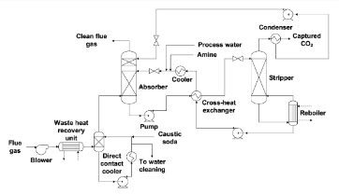
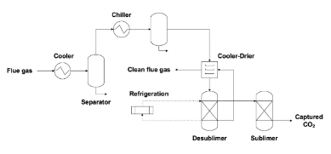
Shipping: Chemical adsorption by amine scrubbing and advanced cryogenic carbon capture are most feasible
3
Freight Transport
Chemical absorption by amine scrubbing (AS)
Advanced cryogenic carbon capture (A3C)
Observations
The two strategies highlighted, AS and A3C, are the most feasible solutions in development considering fuel penalties and onboard energy requirements.
AS is the most effective
short-term solution from a sustainability and cost perspective:
  Displaces only 4% of ship volume
  Additional equipment
  can boost performance and abatement rates
  Does not exceed capture cost of $290/ton* of CO₂
Although research is in early stages, costs of cryogenic separation can be ~70% lower than conventional adsorption processes (A3C specifically).
Pros
Cons
Pros
Cons
Technology is mature and use cases exist
Captured CO₂ has high purity
Given onboard energy requirements, application is feasible
Increased hazard levels on ship due to solvent used
High cost of raw material inputs
Captured CO₂ is high purity
Allows for simultaneous CO₂ and water removal
Feasible given onboard energy requirements
Higher cost effectiveness
Lack of solvents makes it safer than AS
Extremely energy intensive, leading to higher energy penalties and more negative environmental impact
High capital costs
*Based on a euro-U.S. dollar exchange rate of €1 to US$1.05.
Sources: Journal of Cleaner Production, Onboard carbon capture and storage (OCCS) for fossil fuel-based shipping: A sustainability assessment (2024); Mærsk Mc-Kinney Møller Center, The Role of Onboard Carbon Capture in Maritime Decarbonization (2022).
Credit: Sean Lee, Petr Jenicek, Anda Wang, Hyae Ryung Kim, and Gernot Wagner. Share with attribution: Kim et al., “Capturing Carbon” (7 November 2025).

Slide 54
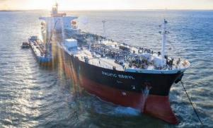
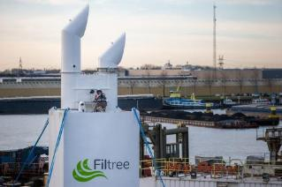

Value Maritime’s Filtree OCCS system reduces emissions and extends the lifetime of ships, among many other incentives
3
Freight Transport
Technology overview
Key benefits
Current adoption
The gas cleaning system eliminates sulfur, particulate matter, and carbon dioxide from tanker exhausts using liquid storage.
  Results in 99% reductions in particulate matter and up to a 30% reduction in CO₂ emissions.
Filtree is a modular plug-and-play system that can be retrofitted on small and medium-sized ships with engine sizes from 3MW to 15MW.
Stores CO₂ on board at ambient temperatures, making the technology more energy efficient by avoiding the need for cooling or compression processes and allowing for easy discharge of CO₂ at ports.
Filters its own wash water, preventing ocean acidification.
Improves vessels’ carbon intensity indicator (CII) ratings from D/E categories to higher classifications, extending the longevity of ships by decades.
  Provides ship users with significant cost savings and makes their operations more sustainable.
  Complies with the International Maritime Organization’s 0.1% sulfur cap.
As of early 2025, Value Maritime has secured orders for over 30 Filtree systems.
Ardmore Shipping Corp. has agreements to install the system on all suitable tankers in their fleet.
Sources: Lloyd’s Register, LR award AiP for Value Maritime’s Carbon Capture and Storage System (2022); Value Maritime, Filtree transforms low-performing vessels (2023); Carbon Herald, Value Maritime Wins Funding For Onboard Carbon Capture (2025).
Credit: Sean Lee, Petr Jenicek, Anda Wang, Hyae Ryung Kim, and Gernot Wagner. Share with attribution: Kim et al., “Capturing Carbon” (7 November 2025).

Slide 55
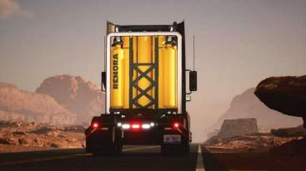
Trucking: Mobile CCS is currently in research stages, showing promising emissions reductions, but far from commercialization
3
Freight Transport
Role of CCUS in trucking
Example CCUS technologies in trucking
CCUS plays an important role in short- to medium-term decarbonization of trucks, as electrification is infeasible and alternative fuels are still in development.
  Battery-powered trucks would not be able to carry as much payload and could travel only short distances.
  They depend on a grid that still draws energy from majority fossil fuels.
Trucks and vans make up a significant portion of transport and global emissions:
  Road transport can emit >100 times as much CO₂ as ships but is the fastest growing sector and consumes significant amounts of fossil fuels.
Capturing emissions from moving vehicles is difficult due to energy requirements, limited space on vehicles, and changing engine conditions in vehicles, but novel solutions are being developed.
Metal organic frameworks (MOF)
Remora CCUS for semitrucks
MOFs are microscopic compounds that can store CO₂ in a cage-like structure.
  Little energy is required to separate gas from the chemical structure.
Systems are designed using MOFs that can capture 50% of emissions at 98% purity.
  Requires only 7.6% extra engine power
  Occupies less than 1.5 cubic meters of volume
Costs are undetermined, as MOFs are newer technologically and cannot currently be created using industrial processes.
Draws CO₂ directly from the exhaust using a modular and repeatable model for Class 8 tractors.
Uses zeolite to filter out CO₂ and uses heat from the exhaust itself to release captured CO₂.
Captures 90% of carbon from tailpipes.
Has raised a $5.5 million seed round from venture capital and other tech players.
Sources: Anthropocene, Capturing carbon on moving vehicles (2023); Trellis, Remora is ready to roll with carbon capture for trucks (2021); Remora, Carbon Capture for Vehicles (2025).
Credit: Sean Lee, Petr Jenicek, Michelle Priscilla, Hyae Ryung Kim, and Gernot Wagner. Share with attribution: Kim et al., “Capturing Carbon” (7 November 2025).

Slide 56
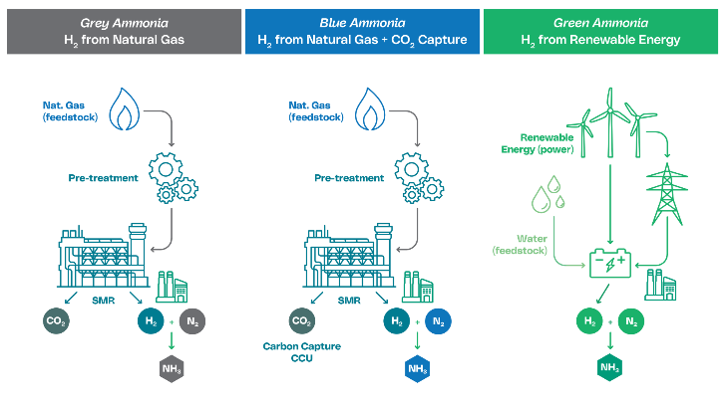
From grey to blue: How CCUS transforms hydrogen and ammonia production
4
Blue Hydrogen and Ammonia
Carbon capture technologies can transform grey hydrogen and ammonia (produced from fossil fuels) into their low-carbon blue counterparts by capturing carbon in the production process
Observations
The color of ammonia production depends directly on the source of hydrogen.
If the hydrogen is blue, the resulting ammonia is blue; if hydrogen is green, the ammonia is green.
CCUS enables the shift from grey to blue hydrogen by capturing CO₂ during steam methane reforming.
This makes blue ammonia a lower-emission alternative while leveraging existing fossil-based infrastructure.
Compared with green pathways, blue hydrogen and ammonia offer a more immediate solution for emission reduction at scale.
Sources: National Grid, Hydrogen Color Spectrum (2023); IEEFA, Blue hydrogen: not clean, not low carbon, not a solution (2023); SCI, How green is blue hydrogen? (2021); Green Hydrogen Organisation, Mirage of blue hydrogen fading (2022); Journal of CO2 Utilization, Blue hydrogen production from natural gas reservoirs (2023); Energy Education, Types of hydrogen fuel (2024); Hydrogen Tech World, Green ammonia, right where you need it (2024).
Credit: Xiaodan Zhu, Sean Lee, Hyae Ryung Kim, and Gernot Wagner. Share with attribution: Kim et al., “Capturing Carbon” (7 November 2025).

Slide 57
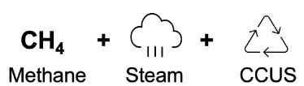
Scaling blue hydrogen and CCUS to enable near-term emission reductions
4
Blue Hydrogen and Ammonia
Technology overview
Current status
Role in decarbonization
Less than 1% of global hydrogen production uses CCUS (blue hydrogen).
Production cost: $2-$5 per kg H₂.
Energy intensity: Approximately 60 kWh per kg H₂ produced.
Deployment is limited to pilot projects; commercial adoption is early stage.
High operational and infrastructure costs continue to constrain scalability.
Risk of methane leakage during upstream natural gas extraction remains a concern.
CCUS transforms conventional hydrogen into a viable low-carbon solution, accelerating industrial decarbonization toward net zero.
Blue hydrogen leverages CCUS to cut emissions by up to 90%, reducing CO₂ output to 0.2-3.2 kg per kg of H₂ compared with 11-13.7 kg for grey hydrogen.
CCUS is essential to make hydrogen production from natural gas compatible with net-zero emissions goals.
Provides a scalable near-term solution by utilizing existing infrastructure, addressing the cost and deployment barriers green hydrogen faces.
Acts as a transitional technology, supporting decarbonization today, while renewable-based green hydrogen scales for the future.
Overview
Blue hydrogen is produced from natural gas through steam methane reforming or autothermal reforming combined with carbon capture and storage.
This process generates CO₂ as a byproduct, but up to 90% of emissions can be captured through CCUS technologies.
Captured CO₂ can be stored or utilized, enabling the use of existing fossil fuel infrastructure for faster and more cost-effective decarbonization.
Sources: National Grid, Hydrogen Color Spectrum (2023); IEEFA, Blue hydrogen: not clean, not low carbon, not a solution (2023); SCI, How green is blue hydrogen? (2021); Green Hydrogen Organisation, Mirage of blue hydrogen fading (2022); Journal of CO2 Utilization, Blue hydrogen production from natural gas reservoirs (2023); Energy Education, Types of hydrogen fuel (2024).
Credit: Xiaodan Zhu, Sean Lee, Hyae Ryung Kim, and Gernot Wagner. Share with attribution: Kim et al., “Capturing Carbon” (7 November 2025).

Slide 58
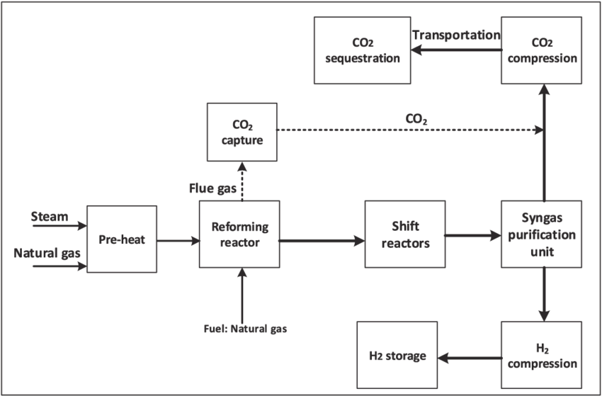
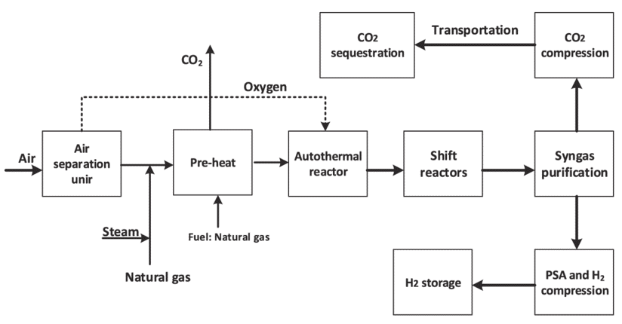
SMR leads today, but ATR is gaining momentum with superior carbon capture efficiency
4
Blue Hydrogen and Ammonia
Steam methane reforming (SMR) with CCS
Autothermal reforming (ATR) with CCS
  SMR has been the dominant tech for decades and typically has lower capital costs compared to ATR plants, which require additional equipment like an air separation unit.
  ATR requires a source of high-purity oxygen, necessitating the construction of a large air separation unit, which is both capital and operationally expensive; it also poses safety concerns.
Air separation unit
Carbon capture rate: 60-90%
Carbon capture rate: 93-98%
Reaction mechanism: SMR uses hydrocarbons, typically methane with steam.
Heat requirement: SMR is an endothermic reaction (requiring external heat input).
CO₂ concentration: SMR concentrates 60% of CO₂ in the process gas stream, with the remainder in flue gas.
Reaction mechanism: ATR uses the reaction of methane with oxygen and either carbon dioxide or steam.
Heat requirement: ATR is exothermic, generating heat within the process.
CO₂ concentration: ATR concentrates about 90% of CO₂ in the process stream, making capture easier.
Sources: ScienceDirect, Comparative Assessment of Blue Hydrogen from SMR and ATR (2022); Digital Refining, Blue Hydrogen a Low-Carbon Energy Carrier (2024).
Credit: Yosafat Partogi, Xiaaodan Zhu, Michelle Priscilla Hyae Ryung Kim, and Gernot Wagner. Share with attribution: Kim et al., “Capturing Carbon” (7 November 2025).

Slide 59
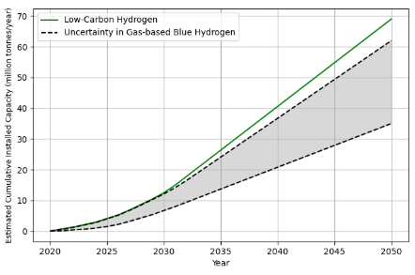
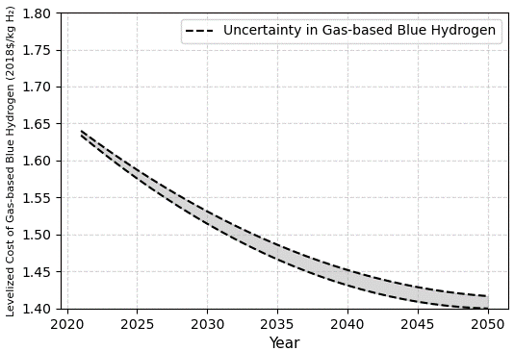
Blue hydrogen expected to grow, but cost remains a major challenge to achieving net-zero emissions
4
Blue Hydrogen and Ammonia
Diffusion of cumulative installed capacity
Learning curve of blue hydrogen production cost
Observations:
Growing role of blue hydrogen: As achieving net-zero emissions is urgent, the share of blue hydrogen in total low-carbon hydrogen capacity will increase significantly over the next few decades.
Green hydrogen is too expensive for large-scale adoption in the short term.
Blue hydrogen is the more practical option to meet decarbonization targets so far.
To facilitate a cost-effective transition, policymakers and industries must support blue hydrogen deployment while continuing to drive innovation and cost reductions.
  While cost reductions for blue hydrogen are expected over time, achieving the U.S. cost target of $1/kg by 2030 is highly unlikely. Even by 2050, blue hydrogen may struggle to compete on price with alternative energy sources.
Sources: National Grid, Hydrogen Color Spectrum (2023); IEEFA, Blue hydrogen: not clean, not low carbon, not a solution (2023); SCI, How green is blue hydrogen? (2021); Green Hydrogen Organisation, Mirage of blue hydrogen fading (2022); Journal of CO2 Utilization, Blue hydrogen production from natural gas reservoirs (2023); Energy Education, Types of hydrogen fuel (2024); Nature Communications, Technological evolution of large-scale blue hydrogen production toward the U.S. Hydrogen Energy Earthshot (2024).
Credit: Xiaodan Zhu, Sean Lee, Hyae Ryung Kim, and Gernot Wagner. Share with attribution: Kim et al., “Capturing Carbon” (7 November 2025).

Slide 60
Blue H₂ is financially attractive provided CCUS costs decrease and policy incentives continue
4
Blue Hydrogen and Ammonia
Cost breakdown of H₂ production, $/kg H₂
Finance analysis
Policy incentives
Blue hydrogen is slightly costlier than grey hydrogen but much cheaper than green hydrogen.
Fuel costs dominate grey and blue hydrogen, with CCUS capital expenditure making blue hydrogen more expensive.
Green hydrogen is the most expensive due to high fuel and capital costs (e.g., renewable electricity).
CCUS increases upfront costs, reducing short-term financial appeal despite lower emissions.
Blue hydrogen is a transition option, but its viability depends on policy, carbon pricing, and CCUS cost reductions.
Blue hydrogen can improve energy security, leveraging existing natural gas infrastructure and reducing reliance on imported fuels.
The Inflation Reduction Act provides the 45V tax credit to clean hydrogen projects, ranging from $0.6-$3 per kg of H₂.
The 45V clean hydrogen production tax credit now requires facilities to begin construction before January 1, 2028 (accelerated from the original 2032 deadline).
OBBBA does not apply foreign entity of concern (FEOC) rules to section 45V, unlike many other clean energy credits.
The 45Q tax credit on carbon utilization and storage:
  $85 per metric ton of CO₂ stored in saline reservoirs; $60 per metric ton of CO₂ used for enhanced oil recovery
The DOE confirmed it was considering reducing or eliminating funding for four of the seven selected hubs in March 2025 — those based in California, the Mid-Atlantic, the Pacific Northwest, and the Midwest — representing nearly 60% of the $7 billion in federal support initially committed.
Companies are advised, "Hydrogen and CCUS projects must move quickly — and entities with complex ownership should review eligibility."
Carbon dioxide price
Fuel cost
Operating expenditure
Capital expenditure
Green hydrogen
Grey hydrogen
Blue hydrogen
Sources: Shell Catalysts, The Shell blue hydrogen process (2025); Frazier & Deeter, Final rules for the production of clean hydrogen and energy credit (2025); Nature Communications, Technological evolution of large-scale blue hydrogen production toward the U.S. Hydrogen Energy Earthshot (2024); Barnes & Thornburg, Shifting Energy Priorities Are Reshaping the H2Hubs Program (2025).
Credit: Xiaodan Zhu, Michelle Priscilla, Sean Lee, Hyae Ryung Kim, and Gernot Wagner. Share with attribution: Kim et al., “Capturing Carbon” (7 November 2025).

Slide 61
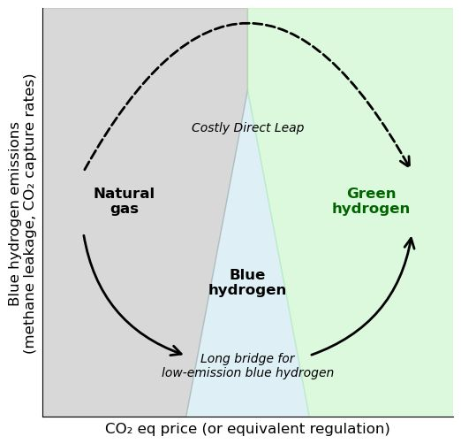
Future of H₂ within the energy transition to determine importance of CCUS technology within the industry
4
Blue Hydrogen and Ammonia
Potential benefits of blue hydrogen
Leverages existing infrastructure – Utilizes current natural gas pipelines and facilities, minimizing new investments.
Lower emissions than natural gas – Blue hydrogen production technology enables the capture of up to 90% of CO₂ emissions through CCUS.
Scalability potential – Can serve as a bridge until green hydrogen and renewables become more viable.
Under current circumstances, blue hydrogen will be the inevitable path toward the renewables.
Limitations and challenges
Not at scale: No large-scale blue hydrogen production exists.
Low capture rates: Even at 90%, not enough for net-zero goals.
Slows progress: Diverts resources from nearly zero-carbon green H2.
Real-world example: Blue hydrogen’s economic viability in question
Shell canceled its blue hydrogen project in Norway (Aukra Hydrogen Hub) due to weak demand and high costs.
Equinor scrapped a similar project, citing economic challenges.
This highlights the uncertainty surrounding blue hydrogen’s role in the energy transition.
Sources: National Grid, The hydrogen colour spectrum (2023); IEEFA, Blue Hydrogen: Not clean, not low carbon, not a solution (2023); SCI, How green is blue hydrogen? (2021); Green Hydrogen Organisation, The mirage of blue hydrogen is fading (2022); Journal of CO2 Utilization, Blue hydrogen production from natural gas reservoirs: A review of application and feasibility (2023).
Credit: Michelle Priscilla, Xiaodan Zhu, Sean Lee, Hyae Ryung Kim, and Gernot Wagner. Share with attribution: Kim et al., “Capturing Carbon” (7 November 2025).

Slide 62
Ammonia production enables more cost-effective carbon capture than standalone hydrogen
4
Blue Hydrogen and Ammonia
Hydrogen and ammonia levelized cost is on the lower end of the overall industry range
Blue ammonia production offers lower cost pathway than green ammonia
Levelized cost of CO₂ capture across sectors (in US$/ton)
Simplified levelized cost of competing low-carbon tech in blue
hydrogen and ammonia production
Iron & steel
$40-$133
Industrial carbon capture
DOE estimated carbon capture
2,000
Blue hydrogen
Cement
$60-$205
Ammonia
Freight transport
$750-
$800
1,500
Chemicals & refining
(High-purity CO2)
$15-$20
By 2030, the cost of green ammonia is projected to fall to nearly half that of blue ammonia.
Chemicals & refining
(Refineries)
$88-$163
1,000
Chemicals & refining
(Ammonia)
$20-$35
Hydrogen (SMR with CCS)
$50-$136
500
DAC
$100-$345
Other
$200-$300
0
SMR + CCS
ATR + CCS
Blue ammonia
Green ammonia
Sources: IEA, Ammonia Technology Roadmap (2021); IRENA, Innovation Outlook Renewable Ammonia (2022); DOE, Pathways to Commercial Liftoff (2024)​; S&P Global, Global Blue Ammonia Prices Edge Lower, Europe Falls 10% MOM (2025); CRS, Hydrogen Production: Overview and Issues for Congress (2024); Montel, Hydrogen Production Cost Trends 2025 (2025); Argus, Argus Launches EU Low-Carbon Ammonia Benchmark (2025); IEA, Levelized Cost of CO2 Capture by Sector (2019); Harvard Kennedy School Belfer Center, Carbon Capture Utilization and Storage: Technologies and Costs US Context (2022).
Credit: Yosafat Partogi, Michelle Priscilla Xiaodan Zhu, Hyae Ryung Kim, and Gernot Wagner. Share with attribution: Kim et al., “Capturing Carbon” (7 November 2025).

Slide 63
Ammonia sustains agriculture but remains emissions intensive, requiring a shift to low-carbon supply
4
4
Blue Hydrogen and Ammonia
Global ammonia demand expected to triple, fueled by low-carbon supply, with fertilizer as its dominant application
Ammonia industry consumes more energy and emits more CO₂ emissions than steel and cement industries combined
Projected global ammonia demand (Mt)
610
Energy and emission intensities for key industrial products (2021)
Conventional ammonia
2,4
Low-cost ammonia
50
Energy intensity
2,4
45
Emission intensity
2,2
450
40
1,9
2,0
1,8
35
1,6
Emission intensity in CO2/ton
30
1,4
270
25
1,2
20
1,0
15
0,6
0,8
0,6
10
0,4
5
0,2
2020
2030
2040
2050
0
Ammonia
Steel
Cement
0,0
Sources: S&P Global, Global ammonia projection (2024); IEA, Energy and emission intensity for key industries (2021).
Credit: Yosafat Partogi, Hyae Ryung Kim, and Gernot Wagner. Share with attribution: Kim et al., “Capturing Carbon” (7 November 2025).

Slide 64
Ammonia with CCUS generates net financial benefits of $40-$90 per ton CO₂ on paper when tax credits are applied in the U.S.
4
Blue Hydrogen and Ammonia
Blue ammonia is economically viable with 45Q credits
Observations
For ammonia production, which typically involves storing captured CO₂, the $100-$150/ton credit can effectively offset most or all the capture, transport, and storage costs.
If total CCUS costs are $40-$60 per ton CO₂, the $100-$150/ton credit results in a net gain of $40-$90 per ton CO₂ captured and stored.
All in all, CCUS in ammonia production is economically viable and can even generate net financial benefits when tax credits are applied.
This makes it a practical near-term solution for decarbonizing ammonia production while renewable hydrogen technologies continue to mature.
Ammonia with CCUS and 45Q credit monetization, in $/ton CO₂
100
50
$40-
$90
-$15
0
-$15
+$100-
$150
Financial viability depends on U.S. 45Q tax credit policy stability, but given the current climate policy, tax credits may not be guaranteed.
-50
-$30
-100
LCOC
45Q credit
Transport
Storage
Net value
Notes: Higher end estimate of carbon capture cost in ammonia production is $35/ton per previous slide and regarded as LCOC. 45Q credit of $85/ton is baseline.
Sources: IEA, Ammonia Technology Roadmap (2021); IRENA, Innovation Outlook Renewable Ammonia (2022).
Credit: Yosafat Partogi, Michelle Priscilla, Hyae Ryung Kim, and Gernot Wagner. Share with attribution: Kim et al., “Capturing Carbon” (7 November 2025).

Slide 65
Blue ammonia's viability depends on stable policy, CCS infrastructure, and low-carbon mandates
4
Blue Hydrogen and Ammonia
Although blue ammonia is economically viable with IRS, its adoption remains limited despite financial incentives
Policy uncertainty
Demand-side gaps
Infrastructure hurdle
Competition with LNG
Innovation delays
The OBBBA was relatively kind to clean fuel producers, and it was mostly positive for 45Q and the carbon-capture industry.
45V Clean Hydrogen Credit: The termination date was accelerated to January 1, 2028 (instead of 2032), but no prohibited foreign entity restrictions apply.
45Q Carbon Capture Credits: Enhanced from $60/Mt to $85/Mt for both CCS and CCUS/EOR, establishing rate parity.
Tax credits target production, not consumption.
Industries like steel and shipping lack binding mandates to adopt low-carbon ammonia, creating the chicken-and-egg market dilemma.
Capturing 90-95% of CO₂ form SMR plants using CCS requires retrofitting existing facilities, which entails high upfront cost.
Blue ammonia’s carbon footprint hinges on reducing methane emissions across the gas supply chain. Verified leakage rates remain inconsistent, complicating tax credit claims.
U.S. gas exporters prioritize LNG because it has established infrastructure and higher margins. Blue ammonia must compete for feedstock (natural gas) and investment.
Project cancellations: Nutrien scrapped a 1.2 Mtpa blue ammonia plan in Louisiana in 2023 due to rising capital costs and uncertain demand.
Proprietary constraint: Key CCS and ammonia synthesis technologies are held by private firms, slowing knowledge-sharing and standardization.
Sources: Wood Mackenzie, US LNG export restrictions underline case for blue ammonia (2024); Climate Portal, Implications of IRA on deployment of low-carbon ammonia (2023).
Credit: Yosafat Partogi, Hyae Ryung Kim, and Gernot Wagner. Share with attribution: Kim et al., “Capturing Carbon” (7 November 2025).

Slide 66
The two key categories of carbon management – point source and ambient – differ based on the origin and dispersal of emissions
 | Point Source Capture | Ambient carbon removal
Description | Separation and entrapment of CO₂ before it is released from large stationary sources (e.g., industrial plants) | Removal of CO₂ already in the atmosphere or from biomass energy by targeting diffuse CO₂ concentrations rather than capturing emissions at the source
Examples | Applications to Iron & Steel, Cement, Freight, Blue Hydrogen & Ammonia | DAC, field weathering, mineralization, direct ocean removal, ocean alkalinity enhancement
% share of total CO₂ captured using carbon capture technologies, by method
Current CO₂ absorption (per year) | ~50 MtCO₂ | <1 MtCO₂
Technological readiness level | High with immediate scalability | Low to medium with limited scalability; DAC is medium while the others are relatively low
Cost of CCUS per ton of CO₂ | $27-$150 depending on industry | DAC: $135-$345 Enhanced weathering: $50-$200 Ocean methods: $50-$150
1
2
Others
Cement
29%
18%
15%
Steel & Iron
Chemical
Vast majority of current capture is industrial point source
<1%
Sources: IEA, CCUS (2025); IEA, BECCS (2023); IEA, DAC (2022); DOE, Pathways to Commercial Liftoff: Industrial Decarbonization, (2023).
Credit: Yosafat Partogi, Anda Wang, Hyae Ryung Kim, and Gernot Wagner. Share with attribution: Kim et al., “Capturing Carbon” (7 November 2025).

Slide 67
Of other carbon technologies, all of which remain nascent, mineralization may be most economical (1/2)
 | Direct air capture (DAC) | Enhanced weathering | Mineralization
Description | Captures CO₂ directly from ambient air and sequesters it underground or reuses it. | Spreads crushed silicate rocks such as basalt or olivine on fields to accelerate natural CO₂ absorption from the atmosphere, enhancing soil health and long-term carbon storage. | Converts CO₂ into stable carbonates by reacting with minerals, locking carbon permanently in rocks, concrete, or underground formations.
Current carbon capture market share | Low | Low | Low
Estimated $/ton | $100-$345 | $50-$200 depending on type of rock used (dunite $60 per ton while basalt $200 per ton) | $10-$30
Challenges | Expensive technology, energy-intensive process, and scalability issues | Lack of public perception and awareness, scalability, and infrastructure; verification and monitoring of carbon removal at large scale remains a challenge | Metal contamination from enhanced rock weathering, high water consumption for in situ methods, and increased mining demands
Leaders | Climeworks is a pioneer in DAC, developing modular CO₂ collectors that extract carbon from the atmosphere, with captured CO₂ permanently stored underground using Carbfix’s mineralization technology. | Project Vesta – Spread ground olivine sand along coastlines Terradot – Spread crushed basalt over farmland | Carbfix – Large-scale terminals in locations with favorable rock formations for industrial and DAC
1
2
3
Sources: USGS, Making minerals (2019); World Resources Institute, 5 Things to Know About Carbon Mineralization (2023); UArctic, Enhanced weathering (on land) (2024).
Credit: Yosafat Partogi, Xiaodan Zhu, Grace Frascati, Hyae Ryung Kim, and Gernot Wagner. Share with attribution: Kim et al., “Capturing Carbon” (7 November 2025).

Slide 68
Emerging carbon removal pathways remain early-stage with high cost uncertainty (2/2)
 | Direct ocean removal | Biomass carbon removal and storage | Ocean alkalinity enhancement
Description | Extracts CO₂ directly from seawater, enhancing the ocean’s natural ability to absorb atmospheric carbon, reducing overall CO₂ levels. | Uses plants to remove carbon dioxide from the air and store it. | Adds alkaline minerals to seawater to boost its capacity to absorb CO₂ while counteracting ocean acidification and improving marine ecosystems.
Current carbon capture market share | Low | Low | Low
Estimated $/ton | $55-$200 | $15-$85 | $70-$120
Challenges | High energy demand and upfront cost; potential disruption to marine life and ecosystems | Lack of data and standards to quantify and verify permanent carbon removal | Mineral sourcing, supply chain infrastructure, and adverse environmental impacts
Leaders | Captura utilizes an electrochemical process to extract CO₂ directly from seawater, leveraging renewable energy sources to enhance scalability while minimizing emissions. | Drax Group-Elimini focuses on large-scale carbon removal by utilizing bioenergy with carbon capture and storage technology, aiming to generate renewable electricity while actively pulling carbon dioxide from the atmosphere. | Equatic and Planetary Technologies are key OAE players, but technology is limited to smaller scale testing.
4
5
6
Sources: USGS, Making Minerals (2019); World Resources Institute, 5 Things to Know about Carbon Mineralization (2023); UArctic, Enhanced weathering (on land) (2024).
Credit: Yosafat Partogi, Grace Frascati, Xiaodan Zhu,Hyae Ryung Kim, and Gernot Wagner. Share with attribution: Kim et al., “Capturing Carbon” (7 November 2025).

Slide 69
Capturing carbon directly from the air is the most expensive method of carbon capture, at $100-$600 per ton
1
DAC
DAC levelized cost is on the lower end of the overall industry range
Liquid solvent DAC shows lower current cost trajectory than solid sorbent DAC
Levelized cost of CO₂ capture across sectors (in US$/ton)
Simplified levelized cost of competing DAC low-carbon tech
Iron & steel
$40-$133
Industrial carbon capture
1,500
DOE estimated carbon capture
Cement
$60-$205
Freight transport
$750-
$800
Chemicals & refining
(High-purity CO2)
1,000
$15-$20
Chemicals & refining
(Refineries)
$88-$163
Chemicals & refining
(Ammonia)
$20-$85
500
Hydrogen (SMR with CCS)
$50-$136
DAC
$100-$345
Other
$200-$300
0
Solid sorbent DAC
Liquid solvent DAC
Sources: ArcelorMittal, LanzaTech partnership (2021); IEA, CCUS Projects Explorer (2024); IEA, Iron and Steel Technology Roadmap (2020); IEA, Is carbon capture too expensive? (2021); Masdar, CCUS at Emirates Steel (2012); Carbon180, DAC (2025); DoE, Pathways to Commercial Liftoff (2024)​; Carbon Engineering, Research Round-Up: Evaluating Direct Air Capture Pathways (2022); WRI,
6 Things to Know About Direct Air Capture (2022); DSpace@MIT, Direct Air Capture as a Carbon Removal Solution (2019); Harvard Kennedy School Belfer Center, Carbon Capture Utilization and Storage: Technologies and Costs US Context (2022).
Credit: Christian Sandjaja, Michelle Priscilla, Hyae Ryung Kim, and Gernot Wagner. Share with attribution: Kim et al., “Capturing Carbon” (7 November 2025).

Slide 70
Significant reduction in LCOC and financial incentives key to achieving economically feasible DAC projects
1
DAC
The ‘pure play’ DAC for permanent storage, combined with a voluntary carbon market, presents a positive value proposition
EOR and California's Low Carbon Fuel Standard (LCFS) on their own do not provide a viable pathway for value creation
Permanent storage and VCOM monetization, in $/ton CO₂
EOR and LCFS monetization, $/ton CO₂
300
300
200
+$137
200
-$15
-$22
100
100
+$250
0
0
-$15
-$22
+$44
-$37
-100
-100
+$82
-$257
-$257
+$180
+$130
-200
-200
-300
-300
LCOC
45Q credit
VCOM
Transport
Storage
Net value
LCOC
45Q credit
LCFS
Transport
Storage
EOR revenue
Net value
Notes: Under the 45Q tax credit, DAC facilities are eligible for up to $130/MT for captured QCO used in EOR.
Source: Pickering Energy Partners, Getting to Know Direct Air Capture (DAC) (2023).
Credit: Christian Sandjaja, Hyae Ryung Kim, and Gernot Wagner. Share with attribution: Kim et al., “Capturing Carbon” (7 November 2025).

Slide 71


Future technology developments expected to drive DAC LCOC to <$300 per ton CO₂ in 2030
1
DAC
Companies project a substantial LCOC reduction
Observations
Achieving <$300/tCO₂ will require better capture materials, efficient system designs, large-scale deployment, clean energy integration, and steady funding.
Carbon Engineering is advancing its KOH-based liquid solvent process with centralized regeneration units to cut costs, supported by industrial partners, U.S. DoE funding, and 45Q incentives.
Climeworks is scaling Gen 3 solid-sorbent modules that boost capacity, lower energy use, and extend material life, backed by $650M in funding, renewable power, and long-term offtake deals.
LCOC before (2024)
$600-$1,000/tCO₂
$600/tCO₂
LCOC after (future)
$341/tCO₂
$250-$300/tCO₂ by 2030
Key technology (innovation)
KOH-based air contactor, pellet reactor, and calciner loop
Gen 3 modular DAC with 2x capacity, 50% less energy, 3x sorbent life
R&D improvement
Optimize solvent regeneration and
thermal integration
Develop high-stability solid sorbents and modular collectors
Air contractor design
Cooling tower-style structure for large air throughput
Compact modular collectors with higher capture efficiency
Scale strategy
Large modular plants with centralized calciner/slaker
Standardized megaton DAC blocks (e.g., Mammoth)
Energy source
Natural gas or waste heat for calciner
100% renewable (mainly geothermal)
Funding & support
Backed by 1PointFive (Occidental), U.S. DOE, 45Q tax credit
$650M funding, Microsoft and Stripe offtake, Swiss government support
Sources: Carbon Herald, New Study Places Future Direct Air Capture Costs in a $230-$540 Range (2024); Climeworks, Next generation tech powers Climeworks’ megaton leap (2024).
Credit: Michelle Priscilla, Christian Sandjaja, Hyae Ryung Kim, and Gernot Wagner. Share with attribution: Kim et al., “Capturing Carbon” (7 November 2025).

Slide 72
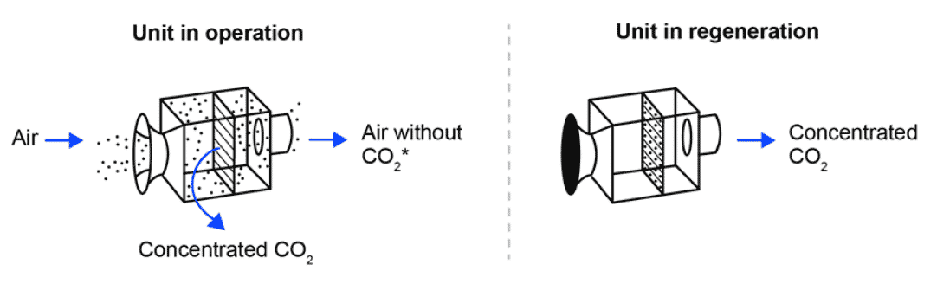
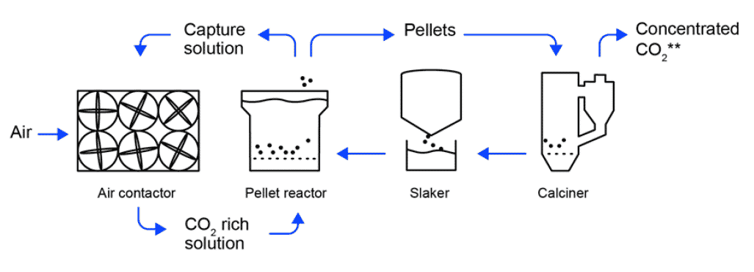
DAC leverages solid or liquid filtration technologies to extract CO2 from the atmosphere
1
DAC
Air capture process
 | Solid-DAC | Liquid-DAC
Description | Uses solid filters or sorbents to capture CO₂; filters are heated to release concentrated CO₂. | A liquid chemical solution, typically potassium hydroxide, absorbs CO₂, which is then released through high-temperature processing.
Energy consumption | 7.2-9.5 KWh | 5.5-8.8 KWh
Capture capacity | Modular (e.g., 50 tCO₂/year per unit) | Large-scale (e.g., 0.5-1 MtCO₂/year)
Land requirement (km2/MtCO₂) | 1.2-1.7 | 0.4
Estimated levelized cost ($/ton)* | $100-$600 | $95-$230
L-DAC is more
efficient in energy
consumption and
land use.
*Notes: Levelized costs are estimates. Cost divergence reflects the wide range in estimated $/ton values due to differences in technology, plant scale, energy input, and capital cost.
Sources: Carbon Credits, How Direct Air Capture Works and 4 Important Things About It (2023); DOE, Pathways to Commercial Liftoff (2023)​.
Credit: Christian Sandjaja, Michelle Priscilla, Hyae Ryung Kim, and Gernot Wagner. Share with attribution: Kim et al., “Capturing Carbon” (7 November 2025).

Slide 73
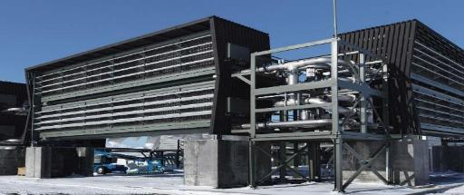
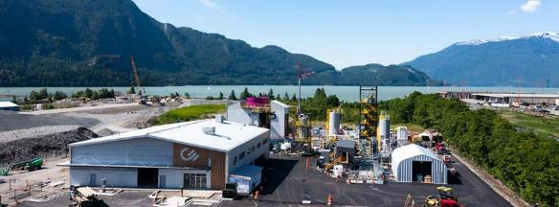
S-DAC leads current market due to its modularity, while L-DAC expected to lead in the future due to its scalability
1
DAC
Air capture process
 | Solid-DAC (e.g., Project Orca – Climeworks) | Liquid-DAC (e.g., Project Squamish – Carbon Engineering)
 | + Lower energy requirements: Operates at lower temperatures (80-120°C), allowing waste heat and utilization of renewable sources. + Modular design: Systems allow for flexible scaling and placement of capture units. + Lower water usage: Advantageous in water-scarce regions. Sorbent regeneration: Solid sorbent materials can be energy intensive and may require frequent replacement. Scaling challenges: While modular, scaling up still presents engineering and cost challenges. | + Higher capture efficiency: Capture rates per unit volume can reach up to 98%. + Well-established technology: Use of liquid solvents for gas separation is a more mature technology, with applications in natural gas processing. High energy requirements: Requires higher temperatures (~900°C) to release captured CO₂, which translates to greater energy consumption. Water intensity: Systems have higher water requirements, which can be a significant drawback in water-scarce regions. Complexity: Involves more complex chemical processes and equipment, potentially increasing operational costs and maintenance requirements.
Sources: NETL, Solvent-Based Direct Air Capture Systems for the Removal of Atmospheric (2021); WRI, Direct Air Capture (2021); DOE, Direct Air Capture (2022); IEA, Direct Air Capture (2021); Google Patents, Solvents and methods for gas separation from gas streams (2017); Yale Environment 360, As Carbon Air Capture Ramps Up, Major Hurdles Remain (2023); Naan Group, What Is Direct Air Capture (DAC) Technology and Its Advantages? (2023).
Credit: Christian Sandjaja, Hyae Ryung Kim, and Gernot Wagner. Share with attribution: Kim et al., “Capturing Carbon” (7 November 2025).

Slide 74
Despite the potential for negative carbon emission, technology not yet proven at commercial scale
1
DAC
Capture facility available today
Considerations
Estimated CCUS capture capacity
in 2025, in ktCO₂ per year
Pros
3,750
Permanent CO₂ removal: DAC can permanently remove CO₂, addressing past and current emissions, which is crucial for NZE targets.
Location flexibility: DAC plants can be built anywhere with low-carbon energy and storage, enabling strategic placement.
Low land use: DAC needs far less land than reforestation, using 0.4-66 km² per million tons vs. 862 km² for forests.
Cons
High costs: DAC costs $400-$1,000 per ton, much higher than desired for large-scale adoption.
Energy intensive: High energy needs increase costs and emissions unless powered by clean energy.
Limited capacity: About 30 facilities exist, capturing 540,000 tons/year.
Operating
Under construction
(end of 2025)
Planned
(by 2032)
No. CCUS facilities:
53
31
114
Sources: AZO Cleantech, The Advantages and Disadvantages of Carbon Capture (2022); Center on Global Energy Policy, Low-Carbon Production of Iron and Steel (2021); IEA, Iron and Steel Technology Roadmap (2020); IEA, Is carbon capture too expensive? (2021); Allied Offsets, The Current State of Direct Air Capture (2025).
Credit: Christian Sandjaja, Hyae Ryung Kim, and Gernot Wagner. Share with attribution: Kim et al., “Capturing Carbon” (7 November 2025).

Slide 75
Iceland and U.S. are key hubs for DAC, capitalizing on geothermal energy and natural gas reserves
1
DAC
Major CCS facilities are concentrated in Iceland and the United States
Observations
Project concentration in the U.S. and Iceland is driven by private funding, geological sites suitable for permanent CO2 storage, and availability of renewable energy.
  Planned megaprojects Cypress and Monarch
  can achieve higher capacity due to technology advancement that combines solid- and liquid-DAC, intention for scale design, and supportive infrastructure like pipelines, geological storage, and shared energy sources.
 | Description | Country | Status | Established | Type of technology | Capture capacity (Mtpa CO2) | Currently captures (Mtpa CO2)
Project Cypress | Large-scale DAC hub in Louisiana, funded by DOE | U.S. | Planned | 2024 | Solid-DAC | 1 | N/A
Project Stratos | World's largest DAC facility in Ector County, Texas | U.S. | Commissioning | 2025 | Liquid-DAC | 0.5 | N/A
Project Monarch | Large-scale DAC facility in California's Central Valley | U.S. | Demo | 2023 | Solid-DAC | 1 | N/A
Project Mammoth | Largest operational DAC plant, powered by geothermal energy | Iceland | Operating | 2024 | Solid-DAC | 0.036 | 0.036
Project Orca | World's first large-scale DAC and storage plant | Iceland | Operating | 2021 | Solid-DAC | 0.004 | 0.004
Sources: Carbon Credits, How DAC Works (2023); DOE, Project Cypress Fact Sheet (2024); Climeworks, The Reality of Deploying DAC (2023); Singularity Hub, Project Orca (2022); Batelle, Project Cypress (2023); Climeworks, Project Mammoth (2023); Climeworks, Orca Plant (2023); Capture6, Project Monarch (2023); Capture6, Carbon Removals (2023); OXY, Occidental and 1PointFive Secure Class VI Permits for STRATOS Direct Air Capture Facility (2025).
Credit: Christian Sandjaja, Michelle Priscilla, Hyae Ryung Kim, and Gernot Wagner. Share with attribution: Kim et al., “Capturing Carbon” (7 November 2025).

Slide 76
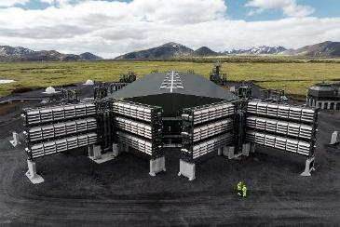
Case study: Project Mammoth paved the way for future DAC cost reduction, 10-20% reduction in CapEx per ton of CO2 capture
1
DAC
Plant overview
CCS implementation and expansion
Key statistics
Climeworks' Mammoth is one of the world’s largest DAC and storage plant, located in Hellisheidi, Iceland.
It uses modular technology to capture CO₂ directly from the air and permanently stores it underground by mineralizing it into basaltic rock through a natural process.
Climeworks successfully completed the construction and ramp-up of Mammoth; it has been fully operational since the end of 2024.
The plant is powered by renewable geothermal energy, ensuring that the carbon removal process remains carbon-negative.
Mammoth represents a significant scale-up from Climeworks' previous DAC plant, Orca, with a 10x increase in capacity.
Generation 3 technology will be deployed in future plants, aiming for a cost reduction of up to 50%. The goal is to reach a total cost of $400-$600 per tonne of CO₂ by 2030, a much larger leap than the 10-20% CapEx reduction achievable from a single project.
Designed to capture…
36,000 tons of CO₂ per year
Secured offtake
contract for…
more than 1/3 of running capture capacity
Raised funding for DAC projects of…
$650M in 2022 equity round
Sources: AWE International, Project Mammoth (2023); Peter Fisk, Project Mammoth (2024); ESG Voices, Climeworks' Plant Starts Mammoth Operations (2023); Climeworks, Mammoth: our newest facility (2023).
Credit: Christian Sandjaja, Hyae Ryung Kim, and Gernot Wagner. Share with attribution: Kim et al., “Capturing Carbon” (7 November 2025).

Slide 77
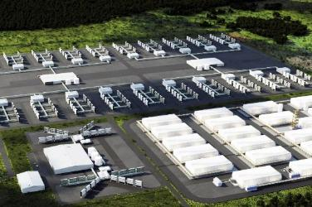
Case study: Project Cypress set a standard for large-scale CCS, tackling the technical, operational challenges of an early adopter
1
DAC
Plant overview
CCS implementation & expansion
Key statistics
Project Cypress, set to be the biggest DAC by capacity, will be built in Louisiana by Battelle, Climeworks, and Heirloom.
It will use renewable energy to power DAC technology, capturing carbon dioxide for permanent storage on privately owned land in Calcasieu Parish.
The project partners with Gulf Coast Sequestration for carbon storage and prioritizes community engagement through local outreach and plans for a Community Engagement Council.
The actual capacity will depend on various factors, including technological advancements, operational efficiencies, and successful implementation.
Designed to capture…
1M tons of CO₂ per year
Expected to start operations in...
2026-27
Received public funding by the U.S. DOE for...
$600M
Sources: JPT, U.S. DOE Green Lights Project Cypress DAC Hub (2024); Batelle, Project Cypress DAC Hub Team Awarded Funding from U.S. Department of Energy (2024); Climeworks, Project Cypress Team Awarded Funding from U.S. DOE (2024).
Credit: Christian Sandjaja, Hyae Ryung Kim, and Gernot Wagner. Share with attribution: Kim et al., “Capturing Carbon” (7 November 2025).

Slide 78
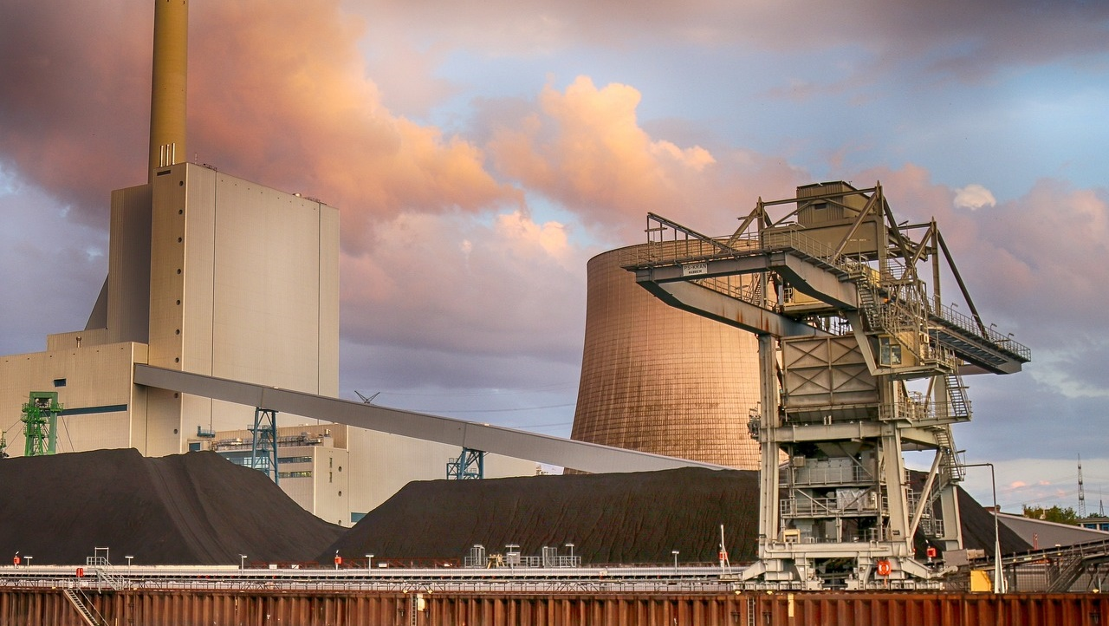
CCUS Policy

Slide 79

Government policies and financial incentives: Governments are intensifying carbon capture deployment through mature policy frameworks.
The U.S. 45Q tax credits are now the dominant global driver. The key metric is no longer the credit value itself ($85/ton for point-source capture, $180/ton for DAC) but the number of projects that have reached final investment decision based on it.
In Canada and Europe, the focus is on the rising cost of carbon prices and their effectiveness in closing the economic gap for emitters.
Regional hubs and infrastructure efficiency: The UK's HyNet and East Coast Clusters have offtake agreements finalized and are in early construction phases.
The Port of Rotterdam's Porthos in the Netherlands, one of Europe's most advanced carbon capture projects, is operational or nearing completion, serving as a critical proof-of-concept for the hub model.
Carbon capture targets and global commitments: The gap between targets and reality is becoming clearer:
The UK's target of capturing 10 Mtpa by 2030 is under pressure, with current deployment rates lagging. The original U.S. target (50 Mtpa by 2050) is likely a significant underestimate; the DOE's "Liftoff" reports envision a scale of 400-1,800 Mtpa by 2050 to meet climate goals. The key story is the immense acceleration required to meet these more realistic figures.
Deployment challenges: The primary challenges have sharpened:
Permitting for Class VI storage wells in the U.S. remains the single largest bottleneck, with a multiyear backlog at the EPA, though states with primacy like Louisiana are moving faster.
Public opposition (NIMBYism) to CO₂​ pipeline construction has intensified, causing delays and route changes for several key projects. Supply chain constraints for specialized components like compressors and absorbers are also beginning to bite as more projects move forward simultaneously.
Key messages
Carbon Capture Policy and Financials
Credit: Anda Wang, Yosafat Partogi, Hyae Ryung Kim, and Gernot Wagner. Share with attribution: Kim et al., “Capturing Carbon” (7 November 2025).

Slide 80
Diverging policies in the U.S., EU, and UK have shaped distinct CCUS investment climates and emission reduction pathways
 | United States | European Union | United Kingdom
Main policies | Federal: IIJA allocated $2.5 billion for carbon storage validation and testing, including funding for CarbonSAFE Phase III large-scale storage projects and the development of new regional carbon sequestration hubs $3.5 billion designated for direct air capture (DAC) hubs supports the development of four regional DAC hubs to deploy large-scale carbon removal tech State: California’s Low Carbon Fuel Standard; Texas's tax exemptions for CCUS infrastructure | EU Innovation Fund setting aside $1.5B for CCUS R&D and pilot projects Connecting Europe Facility (CEF) allocating $0.5B for CO₂ transport and storage infrastructure The Industrial Carbon Management Strategy and the Net-Zero Industry Act target 50 Mt CO₂ storage by 2030, mandate oil and gas contributions, streamline CCUS permitting, and mobilize €100B for industrial decarbonization | Net-zero strategy Track-1 clusters (selected in 2021): HyNet and the East Coast Cluster; moving toward final investment decisions Track-2 clusters (selected in 2023): Acorn project and the Viking project CCUS Infrastructure Fund: $1 billion fund for clusters contracts for difference (CfD) for CCUS Industrial Decarbonization Strategy New transport and storage licensing regime
Subsidies offered | The Inflation Reduction Act’s 45Q credits allow for $85/ton for geological storage and $60/ton for utilization/EOR (effective only when prevailing wage requirements are met) | CCUS dedicated funds have been set up by various institutions, e.g., €1.5B in the latest Innovation Fund and €0.5B dedicated to CO₂ transport and storage from CEF | $28.5 billion in funding: The UK government's stated ambition for the private investment it aims to unlock by 2030 through its comprehensive support policies (the CfDs, T&S model)
Emission abatement potential | Up to 15% of CO₂ emissions abated in 2050 NZE scenario | Up to 30% of CO₂ emissions abated in 2050 NZE scenario | Up to 30% of CO₂ emissions abated in 2050 NZE scenario
Carbon capture target | Reduce the cost of industrial CO₂ capture to < $30/ton by 2035 and develop regional storage hubs that can store at least 50M tons of CO₂ p.a. by 2050 | 50 million tons of CO₂ by 2030, 280 million by 2040, and 450 million by 2050 | 10 million tons of CO₂ annually by 2030 and up to 50 million tons by 2050
Share of global CCUS (planned, under construction, and operational)
1
2
3
21%
11%
42%
Sources: Alberta, CCUS; ANU, ANU sets a new standard for high-quality carbon removal (2022); Australian government, Australian Carbon Credit Unit Scheme, Australia’s Energy Commodity Resources; EY, Why carbon just became an economic fastball (2022); Journal of Cleaner Production, The impact of CCUS (2024); Canadian government, Canada’s Carbon Management Strategy, 2030 Emissions Reduction Plan; IEA, CCUS Projects Explorer (2024); IEA, NZE (2021); NETL, CarbonSAFE; UK government, The Carbon Capture and Infrastructure Fund (2021); CCSA (2023).
Credit: Grace Frascati, Yosafat Partogi, Anda Wang, Michelle Priscilla, Hyae Ryung Kim, and Gernot Wagner. Share with attribution: Kim et al., “Capturing Carbon” (7 November 2025).

Slide 81
Canada, China, and Australia adopt distinct CCUS policies shaping deployment and abatement potential
 | Canada | China | Australia
Main policies | Federal: Specific CCUS investment tax credits 60% for DAC, 50% for other capture 37.5% for transportation, storage, and use Bill C-59 passed in June 2024, establishing the CCUS tax credits Provincial: Alberta’s CCUS Incentive Program | National 1+N policy system for emission peaking and carbon neutrality National 15th Five-Year Plan (2026-30) Emission trading system: CCUS included in official implementation plans and the Green Industry Catalogue | Federal: Geoscience Australia's Exploring for the Future program issued AU$225 million over 10 years to map subsurface resources, including for CO₂ geological storage Regional: Western Australia announced $26 million for CCUS projects in November 2024
Subsidies offered | The CCUS Investment Tax Credit is a multibillion-dollar program that provides a direct refund on capital costs (up to 60% for direct air capture and 50% for other capture projects) | No large-scale, direct national subsidy for commercial CCUS deployment | The $50 million CCUS Development Fund was designed to support pilot, pre-commercial, and research projects (grants have already been awarded to a portfolio of projects)
Emission abatement potential | Up to 15% of CO₂ emissions abated in the 2050 NZE scenario | Up to 20% of CO₂ emissions abated in 2050 NZE scenario | Up to 25% of CO₂ emissions abated in 2050 NZE scenario
Carbon capture target | The 2030 Emissions Reduction Plan includes capturing and storing 15M tons of CO₂ annually by 2030 | To peak CO₂ emissions before 2030 and achieve carbon neutrality before 2060; no official, government-mandated targets for carbon capture specifically | No formal nationwide target
Share of global CCUS deployment (planned, under construction, and operational)
4
5
6
8%
5%
2%
Sources: IEA, CCUS Projects Explorer (2024); NETL, CarbonSAFE; UK government, The Carbon Capture and Storage Infrastructure Fund (2021); CCSA (2023), North Sea Transition Authority, Carbon capture and storage (CCS) is critical to the UK achieving net zero (2024); IEA, CCUS in Clean Energy Transitions; BloombergNEF, Faster Scale-Up of Clean Technologies Could Get China on Track for Net-Zero Emissions by 2050 (2024); Energy, Exploring incentive mechanisms for the CCUS project in China's coal-fired power plants (2024); EC, Climate Action (2025).
Credit: Grace Frascati, Shaurir Ramanujan, Petr Jenicek, Anda Wang, Michelle Priscilla, Hyae Ryung Kim, and Gernot Wagner. Share with attribution: Kim et al., “Capturing Carbon” (7 November 2025).

Slide 82
Since 2022, U.S. IRA accelerated CC adoption, enabling large-scale emission reduction and positioning the U.S. as a climate tech leader
U.S.
45Q offers a tax credit for every ton of CO₂ captured and permanently stored in geological formations
Increases tax credit values
Extends eligibility
Encourages investment
Up to $180 per metric ton of CO₂
for DAC projects storing CO₂ geologically (with prevailing wage requirements); $85/metric ton for non-DAC geologic storage, $60/metric ton for utilization
(e.g., enhanced oil recovery)
Credit can be realized for 12 years
after carbon capture equipment is placed in service; will be inflation-adjusted beginning in 2027 and indexed to 2025 base year
Taps $12 trillion global market
through direct pay, making the carbon capture market more attractive to a broader array of investors not operating in the tax equity market
By extending 45Q to $85/ton, the U.S. makes the tax credit significantly more accessible to a wide array of investors and developers, unlocking potential for hard-to-abate sectors.
Industrial sectors are now more likely to wield carbon capture tech at more feasible price points.
Reduces minimum capture thresholds for industrial emitters, from 100,000 tons of CO₂ emitted per year to 12,500 tons.
  For DAC, capture thresholds decreased from 100,000 tons to 1,000 tons per year
Extends the deadlines for projects seven years, to January 1, 2033 (projects must begin physical work by then to qualify).
Infrastructure Investment and Jobs Act (IIJA):
  $3.5 billion for DAC hubs through IIJA
  $2.5 billion for carbon storage validation and testing (CarbonSAFE)
Direct pay allows developers to receive a fully refundable tax credit, eliminating the need for tax equity partnerships and reducing transaction costs.
Transferability enables equipment owners to sell tax credits to any tax-paying entity for a non-taxable cash payment, increasing financing flexibility.
Note: Developers must pay workers prevailing wages (Davis-Bacon Act) and meet specific ratios of apprentices to journeymen on projects.
Sources: Clean Air Task Force, CC and the IRA (2022); Clean Air Task Force, The Inflation Reduction Act creates a whole new market for carbon capture (2022); S&P Global, IRA Challenges Persist (2023).
Credit: Grace Frascati, Anda Wang, Hyae Ryung Kim, and Gernot Wagner. Share with attribution: Kim et al., “Capturing Carbon” (7 November 2025).

Slide 83
One Big Beautiful Bill Act brings both opportunities and challenges for the U.S. carbon capture industry
U.S.
OBBBA (2025) maintains support for carbon capture while introducing new restrictions and modifications
Modified project economics via 45Q changes
Federal support maintained with new constraints
Foreign entity of concern
OBBBA equalizes rates for sequestration and utilization at a $17/ton base rate and $36/ton for qualified facilities
Parity provision maintains $85/ton for CCS and $180/ton for DAC, whether stored permanently or used in products or enhanced oil recovery (EOR)
EOR now receives the same credit as permanent storage, potentially increasing oil production
Specified foreign entities become ineligible for credits in tax years after enactment
Foreign-influenced entities lose eligibility two years later
Unlike other credits, FEOC for 45Q applies only to the entity claiming credit, not to supply chain, making compliance easier
IRA's 45Q credits remain in place with modifications
IIJA funding for CarbonSAFE and DAC hubs continues
Projects must move quickly due to new construction deadlines
DOE programs continue but face potential future appropriations risks
Updates
Impact
Positive: Maintains 45Q credits with potential for increased EOR projects due to parity provision.
Challenge: Foreign entity restrictions may limit international partnerships and investment.
Opportunity: Simplified FEOC compliance compared to other clean energy credits maintains project viability.
Key takeaway:
While OBBBA significantly rolled back many clean energy incentives under the IRA, it preserved and modified the 45Q carbon capture credit – underscoring how CCUS remains compatible with U.S. fossil fuel and energy security objective and remains bipartisan support.
Sources: Frost Brown Todd, One Big Beautiful Bill Act Cuts the Power (2025); Columbia University Center on Global Energy Policy, Assessing the Energy Impacts of the One Big Beautiful Bill Act (2025); ClimeCo, What the One Big Beautiful Bill Act (OBBB) Means for Your Company: 5 Key Takeaways (2025).
Credit: Maitreyi Menon, Grace Frascati, Anda Wang, Hyae Ryung Kim, and Gernot Wagner. Share with attribution: Kim et al., “Capturing Carbon” (7 November 2025).

Slide 84
EU dedicating €2B of funding to reach 50 MtCO₂ annual capture and storage by 2030 and 450 million captured p.a. by 2050
European Union
EU is ahead on framework development and regulation of CCUS; direct investments and incentives are lagging behind
Goal
Regulation
Incentives and funding
450 Mt CO₂/year
expected to be captured by 2050 through various CCUS projects across the EU, with anticipated capture of 50 MtCO₂ per year by 2030
3 existing directives and industry acts
regulating the development and implementation of CCUS and regulating the geological storage of the carbon captured by the CCUS technologies
€2 billion
across various European funds and EU Parliament subsidies
Initial deployment is focused on hard-to-abate sectors like cement and steel production.
TSOs and other players along the energy value chain are expected to participate in phase 2.
The primary focus is on development of transport and storage infrastructure prior to implementation of the CCUS tech.
Net-Zero Industry Act:
  Identifies CCUS as a key technology and mandates EU countries to invest into CCUS technology across hard-to-abate industries
  Mandates the 50 Mt of annual CO₂ injection capacity target by 2030 and streamlines permitting for strategic projects
The EU Innovation Fund dedicated €1.4 billion to support CCUS R&D efforts in European countries and development of pilot projects across the CCUS value chain.
Connecting Europe Facility, an EU Commission fund, dedicated €0.5B to develop CO₂ transport and storage network and infrastructure across EU countries.
EU’s Carbon Trading Mechanism
Creates a direct financial incentive: By putting a high price on carbon (often over €80/ton), the EU ETS makes it cheaper for industries to pay for capturing and storing their CO₂ rather than buying expensive permits (EU Allowances) to emit it.
Protects investment with a carbon border tax (CBAM): The Carbon Border Adjustment Mechanism ensures that EU companies investing in CCUS are not undercut by foreign competitors that produce goods with higher emissions, as those imports will face an equivalent carbon price at the border.
Defines captured CO₂ as not emitted: Under the ETS rules, any CO₂ that is captured and permanently stored does not require a company to surrender a carbon allowance. This is the fundamental rule that makes capturing CO₂ a direct and legally recognized method of compliance.
Sources: IEA, CCUS Projects Explorer (2024); CATF, EU pushes forward climate action in Europe with Industrial Carbon Management Strategy (2024); EC, Industrial Carbon Management (2025).
Credit: Petr Jenicek, Anda Wang, Hyae Ryung Kim, and Gernot Wagner. Share with attribution: Kim et al., “Capturing Carbon” (7 November 2025).

Slide 85
UK is slowly streamlining government incentives to create the market environment needed to accelerate carbon capture adoption
United Kingdom
The UK’s incentive system is rather simple, offering support in the form of direct grants and tax breaks
Targeted investment
Project finance
Market incentives
20-30 MtCO₂ per year
expected to be captured by 2030 in low-carbon industrial clusters, with anticipated capture of
50 MtCO₂ per year by 2035
$28.5 billion invested
in long-term projects focused on two clusters, and their associated infrastructure needs, over 25 years
$5 billion
in contracts were unlocked when the UK granted Net Zero North Sea Storage a transport and storage license in December 2024
East Coast cluster:
  - Hydrogen production facilities and £4 billion net-zero gas-fired power plant built by BP and Equinor
  Initial construction on pipeline and onshore facilities commenced in early 2025
HyNet cluster:
  Decarbonizing cement plant, equipping oil refinery with waste-to-hydrogen tech, and building energy-from-waste plant
  Expected for a significant portion of the UK's initial low-carbon hydrogen production target
  Received final government go-ahead for construction in April 2025, with site preparation now underway
CO₂ to be collected from 14 planned industrial hubs and stored in saline aquifers and the North Sea
Plans to establish a robust CCUS market by 2035, with a faster and more competitive allocation process by 2027
The government is expected to provide tax relief for oil and gas companies that decommission assets by transferring them to a CCUS company.
  With Track-1 clusters now in early construction, the government is advancing the Track-2 cluster sequencing process (e.g., Acorn and Viking projects) to expand the network.
  The Energy Profits Levy (EPL) provides investment allowances for decarbonization projects. EPL, a windfall tax, remains a contentious issue, with the government working with industry to develop a long-term successor regime to provide certainty beyond its current 2030 sunset date.
Sources: Clean Air Task Force, UK’s £21.7 billion funding for carbon capture and storage projects is a significant step forward (2024); UK government, Relief for Payments Made into a Carbon Capture Usage and Storage Decommissioning Fund (2024); Pinsent Masons, UK Budget: CCUS and tax relief measures may soften oil and gas energy profits levy blow (2024); NSTA Authority NSTA awards Endurance first ever UK carbon storage permit (2024); UK government, Carbon capture, usage and storage (2024).
Credit: Shaurir Ramanujan, Anda Wang, Hyae Ryung Kim, and Gernot Wagner. Share with attribution: Kim et al., “Capturing Carbon” (7 November 2025).

Slide 86
Canada leverages federal and provincial policies for carbon capture, but economic viability remains a key hindrance in scalability
Canada
Policy | Policy | Description | Key features | Challenges
Federal policy | Investment Credit Tax (ITC) for CCUS | CCUS refundable tax credit for eligible and qualified CCUS projects Enacted by Parliament in June 2024 Considered the cornerstone of Canada’s CCUS Policy Framework | Applies to eligible expenditures incurred from Jan. 1, 2022, to Dec 31, 2040, which can vary from equipment to property Credit rates (up to 2030): 60% for DAC, 50% for CO₂ capture, 37.5% for carbon transport and storage | Economic viability: High up-front cost, which requires significant capital Credit rates reduced by half for expenses after 2030-2040 Rates reduced by 10% if labor requirements not met
Federal | Emission Reduction Target Plan | Canada pledged to reduce GHGe by 40-45% below 2005 level by 2030 and to net zero by 2050 | Increase national CCS capacity more than 3x and store at least 15 MT of CO₂ per year by 2030 Energy Innovation Program; budgeted $319M over seven years in CCUS R&D | Incomplete policy framework: Only 45% of the measures have an implementation deadline 95% of measures don’t have target for emission reduction
Federal | Carbon Pricing | Maintains a carbon pricing system for large industrial emitters; the federal consumer fuel charge was eliminated | Applies a carbon price to large industrial facilities through the Output-Based Pricing System (OBPS) and ensures a market for emissions credits | Complexity in ensuring fairness and international competitiveness for trade-exposed industries under the OBPS
Federal | Clean Fuel Standard | Designed to reduce GHGe and promote the adoption of cleaner fuels by creating a market-based credit system that incentivizes CC projects | Takes a lifecycle approach to measuring carbon intensities and extends credit generation time frame for longer period | Economic viability: Gap between price of carbon and the cost of implementing full-scale CC facility Policy design: Often perceived as hypertechnical and difficult to fully understand
Provincial policy | Alberta CC Incentive Program | The cornerstone of Alberta’s CC policy, focused on financial support | 12% grant for eligible CCUS capital costs $3.2 billion to $5.3 billion expected between 2024 and 2035 Preapproval applications open as of 2025, with retroactive eligibility to 2022 | Economic viability of CCUS project Uncertainty over long-term revenue potentials from carbon credits
Sources: Canada ITC, ERM Policy Alert (2024); Torys, Cross-country carbon capture and sequestration check-in (2024); OAG Canada, Emission Reduction Plan (2023); Climate Choices, The State of Carbon Pricing in Canada (2021); Global CCS Institute, Global status of CCS 2024 report at a glance (2024); McCarthy Tétrault, Clean Economy Tax Credits: Investment Tax Credit for Carbon Capture, Utilization and Storage (2024).
Credit: Yosafat Partogi, Anda Wang, Hyae Ryung Kim, and Gernot Wagner. Share with attribution: Kim et al., “Capturing Carbon” (7 November 2025).

Slide 87
Alberta Carbon Capture Incentive Program (ACCIP) provides incentive to accelerate CCUS capital development through grants
Canada
About ACCIP
Provincial initiative designed to accelerate carbon capture, utilization, and storage projects in Alberta
Preapproval applications opened in 2024; full program launched in spring 2025 with finalized guidelines
Key focus is to reduce emissions in hard-to-abate industries while supporting economic growth
Key projects
1
Shell Canada (Quest Project):
Announced new CCUS expansion at a Scotford refinery with ATCO EnPower, targeting 810,000 tons per year by 2028
Project is a prime candidate for ACCIP funding
Entropy Inc.:
Expanded its Glacier Gas Plant CCS project near Grande Prairie (2026 start), leveraging federal and provincial incentives
Wolf Midstream (Alberta Carbon Trunk):
Operational since 2020, storing 4.5M+ tons of CO₂ from fertilizer and refining facilities
Pathways Alliance:
Plans to invest $16.5M in a carbon capture network for oils and emissions, likely using ACCIP alongside federal tax credits
12% grant for eligible CCUS capital costs, paid in three annual installments starting one year after project operations begin
$3.2B-$5.3B allocated between 2024 and 2035, with potential to leverage up to $35B in private investments
Retroactive eligibility: Costs incurred as early as January 1, 2022 qualify for support
Key features
2
Projects must be in Alberta and focus on capturing, preparing, compressing, transporting, storing or utilizing CO₂
Supported sectors include oil sands, oil and gas production, power generation, cement manufacturing, petrochemicals, and hydrogen
Grants cover capital costs only, such as equipment installation and retrofitting; payments are tied to operational milestones to ensure accountability
Eligibility criteria
3
4
Sources: Alberta, Alberta Carbon Capture Initiative (2024); Invest Alberta, New Investment Incentive (2023).
Credit: Yosafat Partogi, Anda Wang, Hyae Ryung Kim, and Gernot Wagner. Share with attribution: Kim et al., “Capturing Carbon” (7 November 2025).

Slide 88
China leverages national policies, large-scale demonstration projects, and source-sink matching to achieve carbon neutrality
China
China’s carbon neutrality strategy integrates CCUS as a key technology for achieving the 2030/60 goals
National policy and demonstration projects
CCUS potential based on source-sink matching
CCUS cost assessment
70 national-level policies related to CCUS have been issued; CCUS was included in the 14th Five-Year Plan (2021-2025) and is expected to feature even more prominently in the upcoming 15th Five-Year Plan (2026-2030)
1.21-4.13 trillion tons (Tt)
theoretical geological storage capacity, mainly including
saline aquifers, oil and gas fields, and other geological
formations
$20-$40 US$/ton
by 2060
for the whole CCUS process
China’s national policy encompasses R&D and demonstration projects while placing greater emphasis on technical standards and investment/financial support.
Besides the oil and gas industries, CCUS has been taken into account in the policy guidelines for more hard-to-abate industries.
Over 100 demonstration projects have been announced or are in development, with a potential total capture capacity exceeding 15 Mt per year.
China is home to one of Asia's first and largest full-chain CCS projects in a saline reservoir (Sinopec Qilu-Shengli), with several larger scale projects now under construction.
Onshore deep saline aquifers can reach a large scale and have a storage potential of 2.417 Tt.
In the northern part of the country, large basins like the Songliao Basin and Bohai Bay Basin have great potential for carbon storage.
In the southern and coastal areas, offshore geological storage is the best solution because basin storage is limited.
The CO₂ pipeline length will be capped to 250 km due to the cost of pipeline and the CO₂ relay compressor station.
China is transitioning from demonstration to commercial deployment. With over 100 projects announced or in development and several large-scale facilities already operational, China has moved beyond the early stage of CCUS and is now a world leader in its development.
The primary cost is the cost to make the whole system operate (input price); the cost is expected to decrease from 2025 to 2060:
  Capture (US$/t): $15-$80 to $3-$20
  Transport (US$/t*km): $0.1-$0.2 to <$0.1
  Storage (US$/t): $7-$9 to ~$3
Sources: Carbon Management, China’s pathways of CO₂ capture, utilization and storage under carbon neutrality vision 2060 (2022); Global CCS Institute, CCS Progress in China – A Status Report (2023; PR Newswire, Sinopec Completes China's First Megaton Scale Carbon Capture Project (2022); USEA, China's Carbon Capture Utilization and Storage (CCUS): Development Status and Prospect (2024).
Credit: Xiaodan Zhu, Anda Wang, Hyae Ryung Kim, and Gernot Wagner. Share with attribution: Kim et al., “Capturing Carbon” (7 November 2025).

Slide 89
Australia leverages targeted funding, legislative action, and resource mapping to drive carbon capture adoption
Australia
Australia’s federal budget allocates funding accessible through grants, spurring transboundary CCUS
Federal geoscience storage funding
Formal national strategies around CCUS
Transboundary infrastructure expansion
$345M over 10 years
allocated in the 2024-25 federal budget for geoscience; Australia to map subsurface resources, including CO₂ geological storage potential
Grants of up to $15M for pilot or
pre-commercial projects
from the Carbon Capture, Use, and Storage Development Fund, underscoring the impact of the Future Gas Strategy (2024)
Western Australia’s $16M under the CCUS Action Plan helping to fund the CCUS transboundary industry
as part of a general push to energy transition and the state’s economic diversification
Australia boasts an estimated 31 Gt of sub-commercial CO₂ storage capacity and 470 Gt of undiscovered storage resources, highlighting a vast potential for long-term carbon sequestration.
  Significant storage resources are located in offshore basins such as Gippsland Basin in Victoria.
The Oil and Gas Climate Initiative of 2022 utilized a CO₂ storage management system to catalog Australia’s storage resources, emphasizing the country’s readiness to support CCUS as part of decarbonization.
Future Gas Strategy (FGS) emphasizes CCUS as essential for Australia's transition to net-zero emissions by promoting geological storage of CO₂.
The Climate Change Authority is consulting on sectoral decarbonization strategies, with initial papers for key industries released for review throughout late 2024 and early 2025.
Western Australia, whose gas industry is central to the country, passed the Petroleum Legislation Amendment Act, providing a legislative framework for transport and geological storage of GHG.
Action Item 5 of FGS, which promotes geological storage of CO₂ and supports transition to net zero, establishes the Transboundary CCS Program, providing energy security and carbon management solutions for regional partners.
Vopak and the Northern Territory government are progressing on a joint development agreement for a CO₂ terminal, following a 2024 MOU. The project is currently in the pre-FEED stage.
Sources: Ashurst, Transboundary CCUS for AUS (2023); Australian government, CC and Storage (2024), Funding for CC, Future Gas Strategy (2024); Global CCS Institute, Status Report (2024); Reuters, Vopak agreement (2024); S&P Global, Western Australia unveils CCUS action plan with funding boost (2024); WA.gov, CC and Storage Bill Passes (2024).
Credit: Grace Frascati, Anda Wang, Hyae Ryung Kim, and Gernot Wagner. Share with attribution: Kim et al., “Capturing Carbon” (7 November 2025).

Slide 90








Scaling CCUS requires coordinated action across technology development, policy support, infrastructure build-out, and market creation
Point-source focus
Tax credits and subsidies
Regional hubs
Green public procurement
Focus deployment on ready-to-commercialize sectors with high CO₂ purity streams like cement and ammonia production where capture costs are lowest.
Extend and enhance programs like 45Q credits ($85/ton storage, $180/ton DAC) while ensuring policy stability across political transitions.
Develop shared transport and storage infrastructure through coordinated regional clusters to achieve economies of scale and reduce per-project costs.
Establish government purchasing programs for low-carbon cement, steel, and fuels to create early demand for CCUS-enabled products.
R&D investment
Carbon pricing
Pipeline networks
Performance standards
Accelerate cost reduction in high-potential technologies through targeted research, with DAC costs needing to drop from $600-$1,200 to <$100/ton by 2030.
Implement robust carbon pricing mechanisms and border adjustments to create economic incentives for CCUS adoption across industries.
Build dedicated CO₂ pipeline infrastructure, leveraging existing oil and gas assets where possible to minimize capital requirements.
Set mandatory emission reduction targets for hard-to-abate sectors, making CCUS economically necessary rather than voluntary.
Sources: IEA, CCUS in Clean Energy Transitions (2020); DOE, Pathways to Commercial Liftoff (2024); McKinsey, Scaling the CCUS industry to achieve net-zero emissions (2022); Global CCS Institute, Global Status Report (2024).
Credit: Maitreyi Menon, Hyae Ryung Kim, and Gernot Wagner. Share with attribution: Kim et al., “Capturing Carbon” (7 November 2025).

Slide 91












CKI Carbon Capture Team
Hyae Ryung (Helen) Kim
PhD in Sustainable Development
Senior Research Fellow
hk2901@columbia.edu
Maitreyi Menon
Master of Public Administration
CKI Fellow
Christian Sandjaja
Master of Science in Sustainability Management
CKI Fellow
Grace Frascati
Bachelor of Arts in Business Management and Sustainable Development
CKI Fellow
Anda Wang
Master of Science in Accounting and Fundamental Analysis
CKI Fellow
Yosafat Partogi Simbolon
Master of Business Administration
CKI Fellow
Petr Jenicek
Master of Business Administration
CKI Fellow
Michelle Priscilla
Master of Business Administration
CKI Fellow
Xiaodan Zhu
Master of Science in Financial Economics PhD in Chemical Engineering
CKI Fellow
Sean Lee
Bachelor of Arts in Economics and Political Science
CKI Fellow
Shaurir Ramanujan
Bachelor of Arts in Financial Economics and Sustainable Development
CKI Fellow
Gernot Wagner
Senior Lecturer, Columbia Business School
Faculty Director, Climate Knowledge Initiative
gwagner@columbia.edu
Attribution: Kim et al., “Capturing Carbon," Columbia Business School Climate Knowledge Initiative (2025).

Slide 92
Appendix

Slide 93
Component-level cost modeling enables precise CCUS cost projections by 2035
STEP 1: Decompose total costs into capital and operational components
STEP 2: Apply differentiated cost reductions by component
Capital and operational costs reduce at different rates; separate them to apply targeted reductions
Capital % = Capital Cost ÷ (Capital + O&M + Energy)
Operational % = (O&M + Energy) ÷ (Capital + O&M + Energy)
2030 Cost = (Current Cost × Capital %) × (1 - CapEx Reduction %) + (Current Cost × Operational %) × (1 - OpEx Reduction %)
Cost-reduction drivers:
CapEx (15-30%): Learning curves, collaborative contracting, design optimization
OpEx (5-25%): Process improvements, operational learning, economies of scale
Technology | Capital % | Operational % | Implication
Ammonia | 89% | 11% | CapEx reductions drive total cost down
Hydrogen | 88% | 12% | Energy efficiency gains also matter
Cement | 87% | 13% | Process optimization more important
STEP 3: Calculate final cost ranges using conservative and optimistic scenarios
Lower cost scenario: Lower CCSA reduction rates (15% CapEx, 5% OpEx)
Higher cost scenario: Upper CCSA reduction rates (30% CapEx, 25% OpEx)
Capital costs dominate across all technologies (80-90%)
STEP 4: Final cost ranges
Technology | Current range | 2035 projected range
Ammonia | $25-$35 | $19-$32
Hydrogen | $50-$80 | $38-$72
Cement | $60-$120 | $46-$109
Why ranges vary: Technologies with higher capital percentages (like ammonia at 89%) see greater cost reductions because CapEx improvements have more impact than OpEx improvements based on CCSA's industry consultation findings.
Sources: IEA, CCUS in Clean Energy Transitions (2020); IEA, Levelized Cost of CO2 Capture by Sector and Initial CO2 Concentration (2019); Harvard Kennedy School Belfer Center, Carbon Capture Utilization and Storage: Technologies and Costs in the US Context (2022).
Credit: Maitreyi Menon, Michelle Priscilla, Hyae Ryung Kim, and Gernot Wagner. Share with attribution: Kim et al., “Capturing Carbon” (7 November 2025).

Slide 94
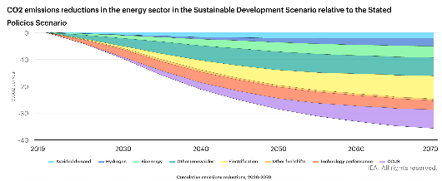
Analyzing technology-specific cost data informs strategic investment for industrial decarbonization
Abatement potential based on planned facilities, 2030
IEA scenario specification
Abatement potential
Technology | Potential %
Fuel transformation | 90%
Ammonia | 90%
Bioethanol | 90%
Cement | 61%
Hydrogen | 90%
Iron & steel | 25%
Natural gas power | 15%
Power generation | 7%
Technology | Potential % based on planned facilities
Natural gas processing | 1.74%
Power & heating | 0.59%
Iron & steel | 1.7%
Other industries | 0.51%
Cement | 0.7%
Key global CCUS indicators in Sustainable Development Scenario
CapEx and energy cost breakdown
CCUS contribution to sector CO₂ reductions | 2030 | 2050 | 2070 | Cumulative
Iron & Steel | 4% | 25% | 31% | 25%
Cement | 47% | 63% | 61% | 61%
Chemicals | 10% | 31% | 33% | 28%
Fuel transformation | 86% | 86% | 92% | 90%
Power generation | 3% | 13% | 25% | 15%
 | Ammonia | Ethanol | Natural gas processing(low) | Hydrogen | Cement | Steel & iron | Natural gas processing (high) | Coal power plant | Natural gas power plant | Refinery-FCC | Industrial furnaces
CC capital cost | 71 | 71 | 80 | 196 | 199 | 275 | 276 | 327 | 354 | 412 | 472
Non-energy O&M cost | 3.55 | 4.97 | 4.8 | 9.8 | 13.93 | 13.75 | 16.56 | 13.08 | 17.7 | 16.48 | 18.88
Energy cost | 5 | 6 | 5 | 18 | 17 | 17 | 5 | 17 | 18 | 16 | 17
Sources: IEA, CCUS in Clean Energy Transitions (2020); IEA, Levelized Cost of CO2 Capture by Sector and Initial CO2 Concentration (2019); Harvard Kennedy School Belfer Center, Carbon Capture Utilization and Storage: Technologies and Costs in the US Context (2022).
Credit: Anda Wang, Hyae Ryung Kim, and Gernot Wagner. Share with attribution: Kim et al., “Capturing Carbon” (7 November 2025).

Slide 95
CCUS costs span 40x range with capture driving 75% of total system costs while transport offers greatest scale economies
Technology | Technology | Sectors | Cost range (US$/tCO₂) | Cost drivers/assumptions
 | Chemical absorption | Power generation, fuel transformation, industrial production, natural gas processing | $15-$100+ | Grouped diverse chemical solvents (MEA, CANSOLV, advanced amines) under single category
 | Physical separation | Natural gas processing, ethanol/methanol production, hydrogen production | $15-$50 | Combined pre-combustion and high-purity separation technologies
 | Oxyfuel separation | Coal power generation, cement production | $50-$120 | Oxygen production costs, equipment integration
 | Membrane separation | Natural gas processing, biogas treatment, flue gas | $30-$80 | Grouped polymer, ceramic, and mixed-matrix membranes together; membrane material costs, selectivity limitations
 | Calcium looping | Coal power, cement production | $40-$90 | High-temperature operation, sorbent makeup costs
 | Pipeline transport | Onshore CO₂ transport, industrial hubs | $1-$8 | Capacity utilization, distance, terrain
 | Ship transport | Long distance, offshore storage, cross-border | $10-$50 | Distance, cargo size, port infrastructure
 | Deep saline aquifers | Dedicated geological storage | $5-$35 | Site characterization, injection infrastructure
 | Depleted oil & gas reservoirs | Storage using existing infrastructure | $3-$25 | Well recompletion, existing infrastructure reuse
 | Enhanced oil recovery | Oil production with CO₂ storage | -$10-$20 | Oil prices, reservoir characteristics, CO₂ purity
 | Synthetic fuels | Aviation kerosene, diesel, gasoline | $200-$600/ton fuel | Hydrogen costs, energy intensity, scale
 | Chemicals and polymers | Methanol, polymers, primary chemicals | $100-$400/ton product | Hydrogen costs, process complexity, market size
 | Building materials | Concrete curing, aggregates, cement additives | $50-$150/ton material | Process integration, material properties, scale
 | Food & beverage | Carbonation, food preservation, greenhouses | $100-$300/ton CO₂ | Range noted as conservative; actual market prices higher
Capture
Transport
Storage & use
Sources: IEA, CCUS in Clean Energy Transitions (2020); IEA, Is carbon capture too expensive? (2021); NETL, Cost and Performance Baseline for Fossil Energy Plants (2022); NETL, Cost of Capturing CO₂ from Industrial Sources (2022); NETL, FECM/NETL CO₂ Transport Cost Model (2023); Global CCS Institute, Global Status of CCS Report (2024); McKinsey & Company, Scaling the CCUS industry to achieve net-zero emissions (2021); ScienceDirect, Techno-Economic Analysis of Amine-based CO₂ Capture Technology: Hunter Plant Case Study (2022); ScienceDirect, Calcium looping processes for low CO₂ emission cement plants (2019); Thunder Said Energy, Costs of liquefied CO₂ carriers (2024); IEAGHG, Oxy-combustion Processes for CO₂ Capture from Power Plant (2005); IPCC, Climate Change 2022: Mitigation of Climate Change Report (2022).
Credit: Maitreyi Menon, Hyae Ryung Kim, and Gernot Wagner. Share with attribution: Kim et al., “Capturing Carbon” (7 November 2025).

Slide 96
CCUS faces a key imbalance, as transport and storage are ready but 70% of capture tech is still in demonstration
CO₂ capture
Transport
Storage
Use
CO₂ to chemicals
Iron & steel
Power generation
Urea
Ammonia
Direct reduced iron
Coal
Pipeline
EOR
Concrete
Methanol
Blast furnace
Natural gas
Ship
Saline aquifers
Methanol
Cement
Fuel
Biomass
Ship (offshore)
Depleted O&G
Synthetic methane
Chemical absorption
Natural gas processing
DAC
Synthetic hydrocarbons
Calcium looping
Hydrogen
Liquid-DAC
Mature
Oxyfueling
Ethanol from sugar
Solid-DAC
Early adoption
Demonstration
Hydrogen from coal
Large prototype
Source: IEA, CCUS Technology Innovation (2020).
Credit: Maitreyi Menon, Hyae Ryung Kim, and Gernot Wagner. Share with attribution: Kim et al., “Capturing Carbon” (7 November 2025).

Slide 97
Glossary (1/2)
A3C
ACCIP
ACCU
ACTL
APAC
ARENA
AS
ATR
BECCS
BF-BOF
BIL
BNEF
CAGR
CapEx
CBAM
CCS
CCUS
CEF CEMBUREAU
Advanced cryogenic carbon capture Alberta Carbon Capture Incentive Program Australian carbon credit unit
Alberta Carbon Trunk Line
Asia Pacific
Australian Renewable Energy Agency Amine scrubbing
Autothermal reforming
Bioenergy with carbon capture storage Blast furnace-basic oxygen furnace Bipartisan Infrastructure Law
Bloomberg New Energy Finance
Compound annual growth rate
Capital expenditure
Carbon border adjustment mechanism Carbon capture and storage carbon Capture, utilization, and storage Connecting Europe Facility
European Cement Association
CfD
CFPP
CFS
CII
CPP
DAC
DOE
DRI
EAF
EBITDA
EOR
EPL
ERF
ESG
ETS
EWR
FCC
FEED
FGS
FID
FYP
GCCA
GHG
GPP
Gt
ICM
IEA
IMO
IRA
IRR
ISR
ITC
kWh
L-DAC
LCFS
LCOC
LNG
Future Gas Strategy
Final investment decision
Five-Year Plan
Global Cement and Concrete Association Greenhouse gas
Green public procurement
Gigatons
Industrial carbon management
International Energy Agency
International Maritime Organization
Inflation Reduction Act
Internal rate of return
Iron and steel recycling
Investment Credit Tax
Kilowatt-hour
Liquid direct air capture
Low Carbon Fuel Standard
Levelized cost of capture
Liquefied natural gas
Contracts for difference
Carbon Free Power Project
Clean Fuel Standard
Carbon Intensity Indicator
Clean Power Plan
Direct air capture
Department of Energy
Direct reduced iron
Electric arc furnace
Earnings before interest, taxes
depreciation, and amortization
Enhanced oil recovery
Energy Profit Levy
Emissions Reduction Fund
Environmental, social, and governance
Emissions trading system
Enhanced water recovery
Fluid catalytic cracking
Front-end engineering and design

Slide 98
Glossary (2/2)
MEA
MMt
MOF
MOU
Mt
Mtpa
MWh
NG
NZIA
NZE
O&M
OAG
OCCS
OGCI
OpEx
PCA
PSA
R&D
S-DAC
Monoethanolamine
Million metric tons
Metal-organic frameworks
Memorandum of understanding
Million tons
Million tons per annum
Megawatt-hour
Natural gas
Net-Zero Industry Act
Net-zero emissions
Operations and maintenance
Office of the Auditor General
Onboard carbon capture and storage
Oil & Gas Climate Initiative
Operating expenditure
Portland Cement Association
Pressure swing adsorption
Research and development
Solid direct air capture
SMR
SRMS
TRL
TSO
TWh
USD
VCOM
WtE
Steam methane reforming
Storage resource management system
Technology readiness level
Transmission system operator
Terawatt-hour
United States dollar
Voluntary carbon offsets market
Waste to energy

