Slide 1
Greening Hydrogen
12 December 2024
Friedrich Sayn-Wittgenstein, Grace Frascati,
Hoshi Ogawa, Nadine Palmowski, Ellie Valencia, Linfei Zhang, Hyae Ryung Kim, and Gernot Wagner

Slide 2

H₂ Sector Overview

Slide 3

Hydrogen (H₂) is a gaseous energy molecule that functions as a fuel source to produce electricity and heat. It also serves as an input for chemical processes―for example, in refining.
Global H₂ demand today remains low at ~100 Mt in 2022, accounting for less than 1% of the global energy mix. And while there are three types of H₂, most of this demand is met by grey H₂, the most carbon-intensive option.
            Grey H₂ is produced using natural gas and therefore produces significant greenhouse gas emissions. It accounts for ~98% of current global H₂ production.
            Blue H₂ is also generated using natural gas, incorporating carbon capture, utilization, and storage to cut emissions. It consists of <1% of current global H₂ production.
            Green H₂ is produced by electrolysis using water and renewable energy and has the potential to be a zero-carbon fuel. It makes up <1% of the global H₂ supply.
Green hydrogen holds significant potential as a low-carbon energy source for the heat and power sector and for decarbonization of difficult-to-abate sectors, including steel, cement, chemicals, and potentially transportation.
However, it currently faces large-scale infrastructure and investment hurdles.
Key messages
H₂ Sector Overview
For hydrogen using renewable energy to be truly green, electricity generation needs to be additional, localized, and time aligned to effectively reduce emissions.
Credit: Friedrich Sayn-Wittgenstein, Ellie Valencia, Nadine Palmowski, Hyae Ryung Kim, and Gernot Wagner (12 December 2024); share/adapt with attribution. Contact: gwagner@columbia.edu

Slide 4
Green H₂ targets industry, power, and transport with an estimated emission abatement of ~3 billion tonnes by 2050
CO₂e emissions in 2024*: ~50 billion tonnes
Abatement in International Energy Agency (IEA) net-zero scenario
28%
28%
21%
16%
7%
100%
Oil 3%
Agricultural fuel combustion 4%
Refining 3%
1-2% in refining
Aviation 8%
Commercial
combustion
20%
Coal mining 7%
Land use, land use change
and forestry
17%
2-3% in aviation
Natural gas 20%
Marine 3%
Aviation 2-3%
80%
Chemicals 10%
Marine 7-8%
3-4% in chemicals
3-4% in natural gas
7-8% in marine
Chemicals 3-4%
Natural Gas 3-4%
HFCs from
refrigeration
and A/C
27%
Waste 21%
Remaining industry 17%
60%
Iron and steel 16%
Crops 27%
Road 62%
40%
1-2% in iron and steel
Coal 74%
Residential
combustion
53%
Cement 17%
<1% in cement
20%
Cement <1%
Livestock 32%
Oil and gas 21%
13-14% in road
Road 13-14%
0%
Industry
Power and heat
Agriculture, land use, and waste
Transport
Buildings
Sources: Scope 1 emissions from Rhodium Group ClimateDeck (September 2024); Scope 2 iron and steel estimate from IEA (2023); abatement estimates from IEA Net Zero Roadmap (2023);
BNEF Energy Outlook (2024); other industry sources *2024 emissions based on projections
Credit: Theo Moers, Hyae Ryung Kim, and Gernot Wagner (12 December 2024); share/adapt with attribution. Contact: gwagner@columbia.edu

Slide 5



Almost all existing H₂ production today uses fossil fuels, leaving green H₂ with <1% market share
Hydrogen ‘colors’ represent production method and indicate carbon intensity*
 | Grey hydrogen | Blue hydrogen | Green hydrogen
Production process | Produced from natural gas steam methane reforming (SMR), where CO₂ emissions generated during the production are released. | Produced through SMR of natural gas, but the carbon emissions are captured, utilized, or stored (CCUS). | Produced by electrolyzing water (electrolysis) using electricity generated from renewable energy sources.
Main inputs
CO₂e per kg of H₂ (Scope 1) | 11.0 – 13.7 kg | 0.2 – 3.2 kg | ~0.0 kg
Energy input per kg of H₂ | ~ 60 kWh | ~ 60 kWh | ~ 50 kWh
Current market share | ~98% (all fossil fuels) | <1% | <1%
Production cost per kg of H₂ | ~$1-3/kg | ~$2-5/kg | ~$4-12/kg (High variation due to early-stage technologies and global differences in cost of renewable energy.)
Observations | Demand for grey hydrogen is expected to decline as demand for green hydrogen becomes cost competitive. | Some question the effectiveness of blue hydrogen for a net-zero economy, as carbon capture does not abate all carbon emissions. | Potential challenges currently include high costs, inability to scale, and large ranges of demand forecasts.
CH₄ +
CH₄ + +
H₂O +
Methane Steam
Methane Steam CCUS
Water Renewable power
*Other types of hydrogen include pink (electrolysis with nuclear electricity), yellow (electrolysis with mixed electricity, e.g. from grid) and turquoise (produced via pyrolysis of natural gas).
Sources: S&P Global Commodity Insights, Atlas of Energy Transition (2023); World Economic Forum, Grey, blue, green—why are there so many colours of hydrogen? (2021); IEA, Global Hydrogen Review 2022 (2023); McKinsey, Global Energy Perspective 2023: Hydrogen Outlook; various industry sources
Credit: Friedrich Sayn-Wittgenstein, Ellie Valencia, Nadine Palmowski, Hyae Ryung Kim, and Gernot Wagner (12 December 2024); share/adapt with attribution. Contact: gwagner@columbia.edu

Slide 6



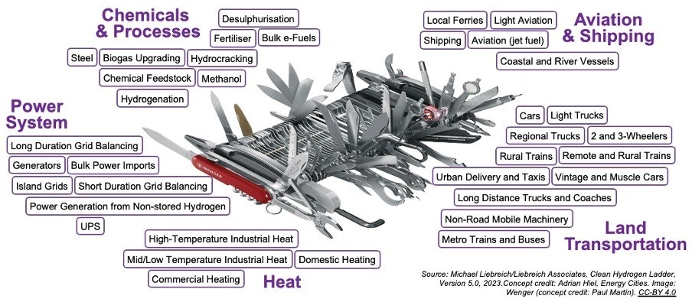
H₂ dubbed Swiss Army knife of decarbonization, but application potential varies significantly across sectors
Varying levels of technical and economic potential
Observations
Some refer to hydrogen as the Swiss Army knife of decarbonization for its extensive applications across sectors.
While the feasibility of theoretical technology has been proved for many H₂ applications, the true potential varies significantly between sectors.
  Some technologies are more in prototype stage and have not yet been tested on large-scale applications.
  Despite its many theoretical applications, hydrogen can fall short on cost advantages and efficiency.
Hydrogen is best utilized in hard-to-abate sectors, e.g., in industry or certain subsectors of transportation, where applications come with a large potential for future growth.
High application potential
Mid application potential
Low application potential
¹
¹
¹
²
¹ Long-haul overseas shipping using ammonia or synthetic e-fuels as a clean energy source; ² uninterruptible power supply
Sources: Liebreich & Associates (with concept credit to Paul Martin), The Clean Hydrogen Ladder (2021); Redefining Energy, Hydrogen…it’s complicated! (2021)
Credit: Friedrich Sayn-Wittgenstein, Ellie Valencia, Nadine Palmowski, Hyae Ryung Kim, and Gernot Wagner (12 December 2024); share/adapt with attribution. Contact: gwagner@columbia.edu

Slide 7
True potential for green and blue H₂ determined by viability of use cases as well as economic feasibility
Evaluation of selected H₂ technology use cases
Observations
Beyond theoretical technological feasibility, two main factors determine whether blue and green H₂ are a realistic decarbonization solution for a specific use case
  Technological scalability: Is the technology sufficiently mature, scalable and viable for commercial application?
  Economic feasibility: Is H₂ the best available decarbonization technology? Are there other technologies that are more (cost-) efficient?
Evaluation among the two metrics shows how use case viability is in many cases driven by economic feasibility; i.e., the availability of better or cheaper alternative technologies (electric vehicles for cars, heat pumps for heating)
High application potential
Commercially scalable; economic feasibility dependent on weight and distance
Fertilizer
Mid application potential
Low application potential
Regional trucks
Long-duration grid balancing
Shipping
Cars
Domestic heating
Metro trains and buses
Currently moving from pilot stage to first large-scale commercial demonstration plants
Steel
Technology scalability
Aviation (jet fuel)
Short-duration grid balancing
Scalability more difficult than for long-duration storage as short-duration more distributed, resulting in higher infrastructure needs; lithium-ion batteries more cost-competitive for short-term storage.
Not yet at a commercially viable production level; few alternative options for aviation decarbonization
Economic feasibility
Source: IEA, Net Zero Roadmap (2023); Liebreich & Associates (with concept credit to Paul Martin), The Clean Hydrogen Ladder (2021); various industry sources
Credit: Friedrich Sayn-Wittgenstein, Ellie Valencia, Nadine Palmowski, Hyae Ryung Kim, and Gernot Wagner (12 December 2024); share/adapt with attribution. Contact: gwagner@columbia.edu

Slide 8
Potential of H₂ in technologically viable sectors requires political support to become economically competitive
Expected levelized cost of green hydrogen (USD/kg)
Green hydrogen benefits from cheaper renewable electricity under the US Inflation Reduction Act (IRA)
Three requirements for H₂ to be green
5,0
Additionality
Localized
Time matching
4,5
Renewable electricity must be specifically built for H₂ production.
Diverting power from existing clean plants increases dependence on conventional power sources and carbon emissions.
Dedicated local clean energy sources are linked to electrolyzers.
The mere buying of ”green” certificates is insufficient.
H₂ production is synchronized with clean electricity procurement.
Some electrolyzer technologies (e.g., PEM) work with intermittent input.
4,0
3,5
3,0
Impact from 45V clean hydrogen production credit
2,5
2,0
1,5
1,0
Observations
Integrating these production requirements with public support (tax credits, subsidies) enables the scale-up of green hydrogen in technologically viable sectors.
Although potentially delaying ramp-up, this ensures effective allocation of public funds and avoids stranded assets or lock-in of less ideal solutions.
0,5
0,0
LCOH (unsubsidized, status quo renewables price)
LCOH (unsubsidized, post-IRA renewables price, blue hydrogen pathway)
Subsidized H2 cost (green hydrogen pathway)
Average US grey hydrogen production cost in 2023
Sources: Roland Berger, Green Hydrogen Report (2023); BNEF, Green Hydrogen to undercut grey sibling by end of decade (2023); Cullenward and Wagner, The Washington Post (2023)
Credit: Friedrich Sayn-Wittgenstein, Ellie Valencia, Nadine Palmowski, Hyae Ryung Kim, and Gernot Wagner (12 December 2024); share/adapt with attribution. Contact: gwagner@columbia.edu

Slide 9

Green H₂
Technology and Financials

Slide 10

Green H₂ production costs remain substantially higher than those of grey and blue H_{2,} presenting a major barrier to widespread adoption. The H₂ sector faces infrastructure and investment limitations. However, progress is underway through increased subsidy incentives, technological advancement, and expansion of renewable energy production.
  Grey H₂ costs an average of $1-3/kg, driven by the low cost of fossil fuels and natural gas.
  Blue H₂, while similarly benefiting from lower fossil fuel prices, incurs additional expenses due to carbon capture, utilization, and storage, raising its cost to $2-5/kg.
  Green H₂, in contrast, averages between $4-12/kg, with the higher costs attributed to the development of electrolyzer technology and reliance on renewable energy sources.
Green H₂ remains significantly more expensive than H₂ from less sustainable sources, with a cost premium of approximately $2-10/kg as of 2023. These price variations are influenced by regional factors, levels of private investment, and the extent of government support.
Today, alkaline water electrolysis (AWE) is the most widely used method for green H₂ production, primarily due to its low cost. Proton exchange membrane (PEM) electrolysis, however, is also expected to play a significant role in the future, as it is better suited to manage the variability of renewable energy inputs.
Research and development in electrolyzer technology could lead to significant cost reductions and enable specialized applications. For instance, solid oxide electrolyzers can leverage excess industrial heat for enhanced efficiency, while anion exchange membranes offer a compact solution for space-constrained environments.
Key messages
Green H₂ Technology and Financials
Credit: Friedrich Sayn-Wittgenstein, Ellie Valencia, Nadine Palmowski, Hyae Ryung Kim, and Gernot Wagner (12 December 2024); share/adapt with attribution. Contact: gwagner@columbia.edu

Slide 11
Primary challenge for green H₂ is balancing its high production cost with its significant emissions abatement potential
Green hydrogen on a carbon abatement cost curve ($/t CO₂e)
Observations
The diverse applications for green H₂ provide decarbonization solutions with varying cost implications.
  The use of H₂ for chemical production, energy storage, and power generation is currently cost efficient, with an abatement cost of 100 USD/t CO₂e equivalent.
  The use of H₂ for producing synthetic aviation fuels represents the highest price point of ~900 USD/t CO₂e.
Carbon abatement costs are expected to decrease in the future, driven by reductions in the costs of electrolyzers and renewable energy.
The adoption of H₂ applications will be determined not only by the cost per ton of carbon abatement but also by the competitiveness of alternative decarbonization technologies.
1,000
900
800
700
600
Significant increase in carbon abatement per dollar invested in green hydrogen
500
400
300
200
~180
100
Chemicals CCS
H2 energy storage
H2 power turbines
H2
DRI-EAF steel
Electrol. ammonia
Electrol. methanol
FC trucks
Ammonia ships
FC buses
FC trains
H2 heat pumps
H2 boilers
Synthetic fuel aviation
Source: Goldman Sachs, Carbonomics: The clean hydrogen revolution (2022)
Credit: Friedrich Sayn-Wittgenstein, Ellie Valencia, Nadine Palmowski, Hyae Ryung Kim, and Gernot Wagner (12 December 2024); share/adapt with attribution. Contact: gwagner@columbia.edu

Slide 12
Current production costs of green H₂ carry a substantial price premium over fossil-based alternatives
Average green hydrogen premium more than double that of grey hydrogen in 2023 ($/kg)
Observations
In 2023, green H₂ production costs ranged from $4.50 to $12.00/kg, averaging $6.40/kg.
  Blue hydrogen costs are lower, ranging from $1.80 to $4.70/kg.
  Grey hydrogen is the least expensive, varying between $0.98 to $2.93/kg.
The largest cost drivers for green H₂ are electrolyzers and the price of renewable electricity.
Despite its current premium, green H₂ could achieve cost parity with blue and grey H₂ through economies of scale and advancements in technology.
To enable hydrogen offtake, infrastructure, transport, and storage costs must be added to production costs.
Weighted average
12
10
8
6.40
6
4
3.10
2.13
2
0
Grey H₂
Blue H₂
Green H₂
Sources: BNEF, Green Hydrogen to Undercut Gray Sibling by End of Decade (2023); Center on Global Energy Policy, Columbia University, Demystifying Electrolyzer Production Costs (2023)
Credit: Friedrich Sayn-Wittgenstein, Ellie Valencia, Nadine Palmowski, Hyae Ryung Kim, and Gernot Wagner (12 December 2024); share/adapt with attribution. Contact: gwagner@columbia.edu

Slide 13
Relatively small green H₂ premium in US compared to EU and Japan
Green hydrogen premiums vary regionally, ranging from $2-5/kg
Observations
Green H₂ premiums refer to
the additional cost of green H₂ compared to more carbon-intensive alternatives, such as grey and
blue H₂.
The Gulf Coast reported the lowest average price for green hydrogen among three major regions, reflecting the impact of significant US government investments aimed at reducing costs.
  The US Department of Energy’s Hydrogen Shot initiative targets a reduction in clean hydrogen production costs to $1/kg by 2031.
Key efforts to lower green H₂ hydrogen costs include substantial investments in infrastructure and tax incentives, such as the 45V tax credit.
+4.69
Grey hydrogen
Green hydrogen
7
6.74
+2.65
6
5.66
5
4
+2.13
3.04
3.01
3
2.05
2
1
0.91
0
US Gulf Coast
Netherlands
Japan
Source: S&P, Global Commodity Insights Report (restricted)
Credit: Friedrich Sayn-Wittgenstein, Ellie Valencia, Nadine Palmowski, Hyae Ryung Kim, and Gernot Wagner (12 December 2024); share/adapt with attribution. Contact: gwagner@columbia.edu

Slide 14
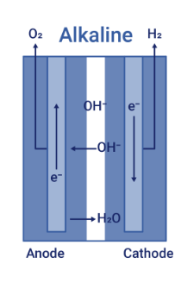
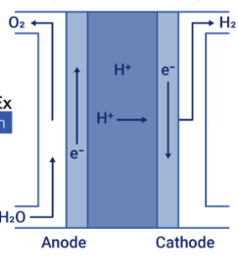
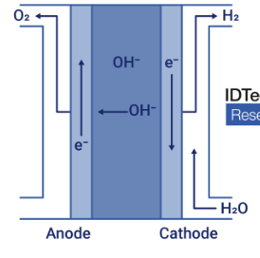
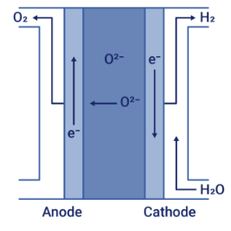










Alkaline water electrolysis now dominant; proton exchange membrane costlier yet suitable for intermittent electricity
Scalability, cost, temperature, and use cases to shape future technology adoption
 | Alkaline water electrolysis (AWE) |  | Proton exchange membrane (PEM) |  | Anion/ hydroxyl exchange membrane (AEM/HEM) |  | Solid oxide electrolyzer (SOEC)
Description and schematic overview | Electrolysis of alkaline water using nickel electrodes |  | Water electrolysis with solid polymer membrane and precious metal electrodes |  | Like PEM design; replaces precious metals and titanium with nickel and steel |  | Water steam electrolysis at high temperature (700-1000°C) via solid oxide or ceramic membrane
Market share | 60% market share, leading technology |  | 30% market share (higher in Europe and North America) |  | Small market share, future growth potential |  | Small market share, ideal for high waste-heat use cases
Advantages | Scalability of manufacturing, cost |  | Compact size, controllability of production allows management of intermittent renewable energy input |  | Compact size, potential cost reduction because made with more easily obtained materials than PEM |  | More efficient than AWE and PEM due to lower voltage levels
Limitations | Continuous electricity supply needed for optimal operation |  | Higher cost, potential shortage of rare metals such as iridium |  | Reduced durability |  | High capital investment, high temperatures required
Investment cost | ~$600/kW |  | ~$800-1,250/kW |  | >$930/kW |  | >$1,850/kW
Big players
Sources: Center on Global Energy Policy, Demystifying Electrolyzer Production Costs (2023); US Department of Energy, Hydrogen Production: Electrolysis (2022); IEA, Electrolyzers (2023); IRENA, Green Hydrogen Cost Reduction (2020); Hydrogen Council, Hydrogen Insights May 2023 (2023); graphics by ID Tech Ex from Alex Holland at EE times; various industry sources
Credit: Friedrich Sayn-Wittgenstein, Ellie Valencia, Nadine Palmowski, Hyae Ryung Kim, and Gernot Wagner (12 December 2024); share/adapt with attribution. Contact: gwagner@columbia.edu

Slide 15
Both AWE and PEM expected to follow renewables cost reductions and efficiency improvements
Clean tech CapEx for green hydrogen indexed to 2020 levels ($/kW or GW)
Observations
The cost of acquiring and operating green hydrogen electrolyzers is expected to decline significantly over the next decade compared to 2020 levels.
  Among the various renewable energy sources, solar PV is projected to experience the fastest cost reductions, while offshore wind is expected to take longer, to lower its capital expenditures.
  Clean H₂ electrolyzers are anticipated to follow a similar trend, with a projected CAGR of -60% for both PEM and alkaline technologies.
Green H₂'s cost reductions will primarily be driven by technology advancements, increased productivity in PEM and alkaline electrolyzers, and greater capital investments in the sector.
PEM (kW)
AWE (kW)
Batteries (kW)
Offshore wind (GW)
Onshore wind (GW)
Solar PV (GW)
Sources: Goldman Sachs, Investment Research Carbonomics (2022); McKinsey, Global Energy Perspective 2023: Hydrogen outlook (2023)
Credit: Friedrich Sayn-Wittgenstein, Ellie Valencia, Nadine Palmowski, Hyae Ryung Kim, and Gernot Wagner (12 December 2024); share/adapt with attribution. Contact: gwagner@columbia.edu

Slide 16
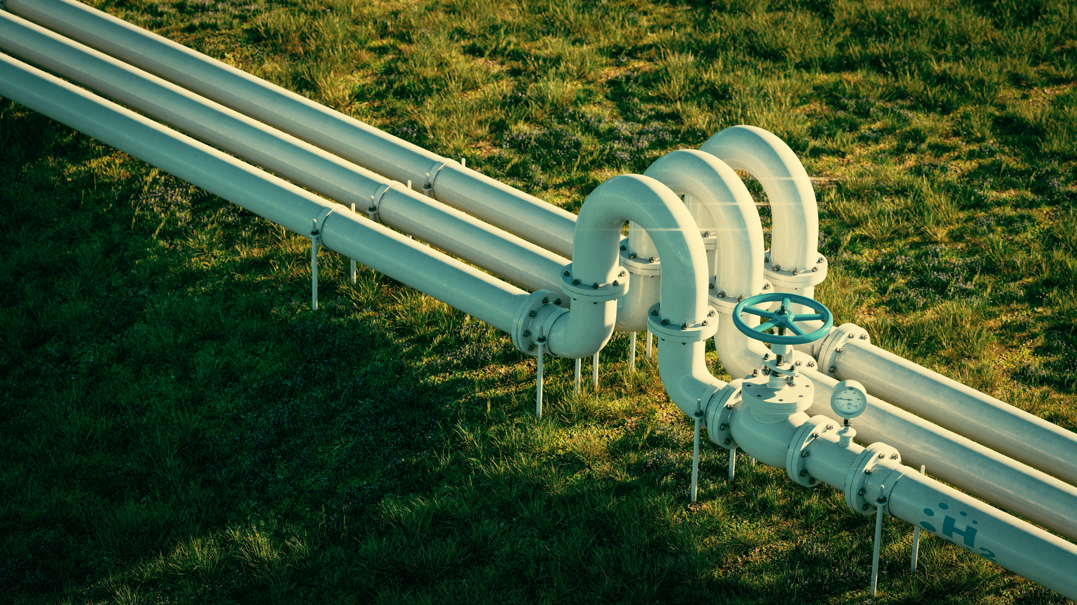
Green H₂
Industry Trends

Slide 17

Hydrogen sector industry trends:
Key points
Global demand for green and blue H₂ is expected to grow substantially, with estimates indicating an increase from 125 million tonnes per annum in 2030 to 460 Mtpa by 2050. This growth will be driven by both traditional industrial uses and emerging applications, particularly in commercial transport, which is projected to become the largest new demand driver by 2040.
By 2050, green H₂ is forecasted to dominate global hydrogen production, accounting for 50 to 65% of the total supply.
  Regional demand growth will initially be led by China and North America, while at the sector level, industry will dominate with offtake agreements, followed by transport, especially in long-haul shipping.
  Green and blue H₂ trade is projected to expand fivefold between 2030 and 2050, with North America emerging as the largest net exporter.
  The US and Canada are expected to lead green and blue H₂ exports, supported by robust policy frameworks. Long-distance transportation of H₂ will be driven by its use in end products like ammonia and synthetic kerosene.
Key players in the fossil fuel, energy, and utility sectors are recognizing H₂’s potential as a critical energy carrier. They are incorporating H₂ into their strategies, acquiring large-scale hydrogen assets, and increasing investments in green and blue hydrogen projects.
Key messages
Green H₂
Industry Trends
Credit: Friedrich Sayn-Wittgenstein, Ellie Valencia, Nadine Palmowski, Hyae Ryung Kim, and Gernot Wagner (12 December 2024); share/adapt with attribution. Contact: gwagner@columbia.edu

Slide 18



H₂ currently used primarily in industrial processes and petroleum refining, with limited application in heat and power sectors
Large-scale use of grey H₂ in industry and refining, with some early green H₂ in heat and power
 | Industry | Refining | Heat and power
Role of H₂ | H₂ is used as feedstock for synthetic fuels (e.g., methanol) or fertilizers (e.g., ammonia). Other industries such as steel and cement aim to adopt H₂ to decarbonize their production processes. | The oil refining process uses H₂ for hydrotreating and hydrocracking, reducing sulfur content of oil to produce cleaner fuels like diesel and jet fuel. | H₂ can generate electricity through fuel cells or be blended into gas turbines for power generation in internal combustion engines and heating applications.
Current market dynamics | The industry sector consumed 53 Mt of H₂ in 2022, with 60% used for ammonia production, 30% for methanol production, and 10% for iron and steel production. | H₂ use in refining reached 41 Mt in 2022, driven to record levels by strong demand in North America and the Middle East. | As of 2023, H₂ accounted for only 0.2% of the global electricity mix.
Green H₂ adoption challenges | Cost reductions are crucial in the green H₂ sector to compete with low natural gas and grey H₂ prices. | Most H₂ used in refining is produced on-site as a byproduct of catalytic reformers or ethylene crackers, rather than sourced externally. | H₂ use in electricity generation faces compatibility challenges with existing infrastructure and combustion systems.
Sources: EIA, Hydrogen Explained (2023); IEA, Global Hydrogen Review 2023 (2023); Methanol Institute, Renewable Methanol; Wood Mackenzie, Low-carbon hydrogen demand in refining could reach 50 Mtpa by 2050 (2022); Yara, Green fertilizers: everything you need to know
Credit: Friedrich Sayn-Wittgenstein, Ellie Valencia, Nadine Palmowski, Hyae Ryung Kim, and Gernot Wagner (12 December 2024); share/adapt with attribution. Contact: gwagner@columbia.edu

Slide 19



While commercial transport applications remain limited today, they are expected to play a bigger role in the future
Green H₂ is expected to play a key role in decarbonizing the commercial transport sector
 | Road transport | Shipping | Aviation
Role of hydrogen | H₂ fuel cell electric vehicles (FCEVs) provide faster refueling, longer ranges, and lighter fuel weight compared to electric vehicles. | H₂ can power vessels either directly as liquid hydrogen or through synthetic fuels like ammonia and methanol. | H₂ fuel cells could power planes for short-haul flights. H₂-based sustainable aviation fuel (H₂-SAF) has the potential to replace traditional jet fuel.
Current market dynamics | In 2023, China represented 95% of FCEV trucks globally, while South Korea accounted for 50% of private FCEV cars. | In 2023, the global shipping industry ordered 298 vessels designed to operate on alternative fuels, including 138 on methanol, 11 on ammonia, and five on H_{2.} | In 2022, Rolls Royce and easyJet successfully ran an aircraft engine on H_{2..} Airbus plans to introduce a H₂-powered aircraft to market by 2035.
Green hydrogen adoption challenge | FCEVs face limitations due to insufficient fueling infrastructure and competition with battery electric vehicles for market share. | H₂’s lower energy density compared to alternative marine fuels makes transport on ships more challenging, necessitating carriers like ammonia or liquid hydrogen. | The main challenge for H₂-SAF is its high cost. Sustainable aviation fuel is an existing drop-in fuel for aircrafts, requiring no retrofitting of aircrafts or infrastructure.
Sources: Airbus, ZEROe; CSIS, Hydrogen: The Key to Decarbonizing the Global Shipping Industry? (2021); DNV, Maritime decarbonization efforts propelled as orders for alternative-fueled vessels grow (2024); European Maritime Safety Agency, Potential of hydrogen as a fuel for shipping (2023); Global Maritime Forum, Ammonia as a shipping fuel (2023); IEA, Global Hydrogen Review 2023 (2023); International Air Transport Association, Liquid hydrogen as a potential low-carbon fuel for aviation; Rolls Royce, Rolls Royce and easyJet set new world first (2022)
Credit: Friedrich Sayn-Wittgenstein, Ellie Valencia, Nadine Palmowski, Hyae Ryung Kim, and Gernot Wagner (12 December 2024); share/adapt with attribution. Contact: gwagner@columbia.edu

Slide 20
Under IEA’s full decarbonization scenario, demand for green and blue H₂ is expected to increase to ~400 Mt by 2050
Projected demand for green and blue hydrogen by sector (Mtpa)
Observations
Green and blue H₂ adoption across existing and emerging applications could drive H₂ demand to ~240 Mt by 2030 and ~390 Mt by 2050, compared to less than 1 Mt in 2023.
The transport sector will be the main driver of demand, accounting for ~34% in 2040 (across aviation, marine, and road transport) and ~46% of total demand in 2050.
Industry (including chemicals and iron and steel) and power generation will also be significant contributors to demand.
  Industry demand will be driven by both conventional uses (replacing grey H₂ with green and blue H₂) and new applications.
Oil refining will continue to have relatively low demand for green and blue H₂, as grey H₂ is a byproduct of refining and unlikely to be replaced by green or blue H₂ in the near term.
400
Aviation and marine fuel
~390
Road transport
350
Power generation
Iron and steel
30%
300
Chemicals
Oil refining
Other industry
250
~240
16%
200
25%
9%
19%
150
29%
12%
100
~60
14%
50
16%
15%
2%
5%
3%
5%
0
2030
2040
2050
Note: Demand scenarios differ a lot; demand numbers derived from IEA’s net-zero scenario
Sources: IEA, Net-zero scenario hydrogen outlook (2023); McKinsey, Global Energy Perspective 2023: Hydrogen outlook (2024)
Credit: Friedrich Sayn-Wittgenstein, Ellie Valencia, Nadine Palmowski, Hyae Ryung Kim, and Gernot Wagner (12 December 2024); share/adapt with attribution. Contact: gwagner@columbia.edu

Slide 21





Green and blue H₂ industry demand projections vary widely around IEA’s ~400 Mt per year by 2050
Projected demand for green and hydrogen, 2030-2050 (Mtpa)
Observations
In nearly all scenarios, a substantial increase in demand for green and blue H₂ is expected.
  Projections suggest total annual volumes could approach 400 Mt by 2050.
  With 50 kWh/kg of green H₂, this would require ~20,000 TWh of green electricity by 2050 (today: ~25,000 TWh).
Meeting future demand will require a significant scale-up in production; in 2022, demand for green and blue H₂ was ~1 Mt.
At the same time, the IEA estimates the demand for a 1.5°C pathway will be around ~390 Mt in 2050, even under its ambitious net-zero scenario. This is much lower than several industry projections, such as Deloitte’s estimate of ~600 Mt.
~600
Deloitte
IRENA 1.5°C scenario
~520
McKinsey Further Acceleration scenario
IEA net-zero scenario
BP Upper Bound
~ 436
Wood Mackenzie
~390
BP Lower Bound
Following research based on IEA’s net-zero scenario with average demand
~ 237
~ 208
~ 210
~170
~ 125
~90
~ 85
~80
~ 63
~ 38
~20
~ 32
Note: Demand and abatement differ due to varying carbon intensities and emission proportions across sector. Clean H₂ includes both blue and green H_{2.}
Sources: IEA, Net-zero scenario hydrogen outlook (2023), BP, Hydrogen (2023); Deloitte, Green hydrogen: Energizing the path to net zero (2023); McKinsey, Global Energy Perspective 2023: Hydrogen outlook (2023), IEA, Hydrogen (2023), IRENA, World Energy Transition Outlook (2023), Wood Mackenzie, 2050: The Hydrogen Possibility (2024)
Credit: Friedrich Sayn-Wittgenstein, Ellie Valencia, Nadine Palmowski, Hyae Ryung Kim, and Gernot Wagner (12 December 2024); share/adapt with attribution. Contact: gwagner@columbia.edu

Slide 22
Chemicals industry dominates H₂ offtake agreements
Industrial sector expected to dominate hydrogen offtake agreements by 2030 (Mt)
Observations
The industrial sector is leading in securing offtake agreements, with ~1.3 Mt of demand, half of which has already been firmly implemented.
  Within the industrial sector, the chemicals subsector accounts for 85% of the agreed volumes, largely driven by ammonia production.
While progress in the transport sector has been slower, significant agreements have been made, particularly in shipping.
  Major logistics companies have signed agreements for synthetic methanol and synthetic marine diesel.
1.50
Chemicals
Other transport
1.36
Other industry
Refining
1.25
Shipping
Not specified
1.00
0.91
0.75
0.50
0.27
0.25
0.00
Industry
Transport
Other
Source: IEA, Global Hydrogen Review 2023 (2023)
Credit: Friedrich Sayn-Wittgenstein, Ellie Valencia, Nadine Palmowski, Hyae Ryung Kim, and Gernot Wagner (12 December 2024); share/adapt with attribution. Contact: gwagner@columbia.edu

Slide 23
North America expected to become the largest green H₂ net exporter, while China and Europe lead as net importers
Long-distance green and blue H₂ supply projections, share by region (Mt, 2050)
Long-distance green and blue H₂ demand projections, share by region (Mt, 2050)
Observations
North America is anticipated to lead in blue and green H₂ production, driven by supportive policies in the US and Canada.
By 2050, North America and China are projected to contribute 58% of global blue and green hydrogen supply and 53% of demand.
North America is expected to become a net exporter, with ~30% of its blue and green H₂ supply transported over long distance.
Europe and China are projected
to be net importers, relying on importing for ~59% and ~25% of their hydrogen demand, respectively.
In addition to long-distance trade, robust inner-continental hydrogen transport is anticipated, such as from Iberia and the Nordic countries to Central Europe.
43% 15% 10% 9% 8% 15%
29% 24% 24% 15% 10% 10%
90
90
80
80
70
70
60
60
58
50
50
40
40
30
30
26
20
17
16
20
17
17
10
10
0
0
North America
China
Middle East
Europe
Australia
Rest of world
North America
Europe
China
Japan, Korea
Asia
Rest of world
Source: Hydrogen Council, Global Hydrogen Flows - 2023 Update (2023)
Credit: Friedrich Sayn-Wittgenstein, Ellie Valencia, Nadine Palmowski, Hyae Ryung Kim, and Gernot Wagner (12 December 2024); share/adapt with attribution. Contact: gwagner@columbia.edu

Slide 24
Green hydrogen value chain is global, with production and end-use applications often separated by significant distances
Green hydrogen value chain spans three main fields
Observations
The H₂ value chain from production to distribution and application operates globally, as supply and demand are often geographically distant.
Inner-continental H₂ transport is primarily conducted via pipelines, with three options:
  Blending into existing gas pipelines (up to ~5% of the mix can be H₂)
  Retrofitting old gas pipelines
  Building new hydrogen-only pipelines
Long-distance H₂ transport relies on marine shipping technologies such as:
  Liquified hydrogen
  Ammonia
  Liquid organic hydrogen carriers
H₂ storage is essential at various points along the value chain, including pre- and post-shipping as well as pre-industry use.
Production | Distribution | Application
Production will be concentrated in regions with abundant and low-cost renewable energy. | Depending on the distance, transport occurs via pipelines or is shipped long distance, with storage hubs along the transport route. | Location of end-use applications is mainly determined by regional demand; some use cases might move to places with low-cost renewables.
Grid power
Electrolyzer
Hydrogen storage unit
Hydrogen transportation
Hydrogen fuel cells
Hydrogen
fuels
Industrial plants
Power market
Transportation
Solar Power
Wind Power
Other
Source: IRENA, Geopolitics of the Energy Transformation (2022)
Credit: Friedrich Sayn-Wittgenstein, Ellie Valencia, Nadine Palmowski, Hyae Ryung Kim, and Gernot Wagner (12 December 2024); share/adapt with attribution. Contact: gwagner@columbia.edu

Slide 25
Three potential H₂ carriers are suitable for marine transport
Shipping technologies face significant adoption challenges at various stages
Observations
Marine H2 transport requires cooling or carriers due to H₂’s low energy density.
Different H₂ carriers face bottlenecks related to infrastructure and costs, with technology choices influenced by specific use cases:
  Ammonia synthesis is relatively cost efficient but expensive to crack, making it ideal for direct use as green ammonia (e.g., fertilizers).
  Liquid H₂ liquefaction is expensive but suitable where liquefaction is necessary for end use as fuel.
The market’s dominant shipping technology is still undecided:
  Half of announced shipping projects have yet to decide on a specific technology.
  Among projects specifying a carrier, ammonia accounts for 35% of volume, followed by LOHC at 10% and liquid hydrogen at 5%.
 | Liquified hydrogen (LH₂) | Ammonia (NH₃) | Liquid organic hydrogen carriers (LOHC)
Description | Produced via extreme cooling, it can be used directly as fuel or converted back into gas at the destination. | Synthesized into ammonia for transport, enabling either direct use as green ammonia or conversion back into H₂ through racking. | Transported through hydrogenation and post-transport dehydrogenation by covalently bonding with liquid organic molecules, such as dibenzyl toluene.
Energy density¹ | 0.071 kg/L (at -253°C) | 0.12 kg/L (at -33°C) | ~0.05 kg/L (at 25°C)
Process steps
Adoption challenges | Energy intensive; liquefaction is expensive | Energy intensive and expensive cracking; health risks | Expensive hydrogenation; lack of technology readiness for scale-up
Share of volume of announced projects² | ~5% | ~35% | ~10%
Market readiness | Pilot stage, infrastructure not yet widely available | Established shipping, cracking at pilot stage | Pilot projects, infrastructure for some molecules available
Green H₂
Green H₂
Green H₂
Liquefaction
NH3 synthesis
Hydrogenation
Marine transport, storage
Marine transport, storage
Marine transport, storage
Regasification
NH3-cracking to H2
Dehydrogenation
Distribution and end use
Distribution and end use
Distribution and end use
¹Energy density of gaseous H₂ at 1 atm. Temperature and pressure is 8.9E-10 kg/l; ² only 50% of announced projects have already decided on technology.
Sources: Spotalisano et al., Liquefied hydrogen, ammonia and liquid organic hydrogen carriers for harbour-to-harbour hydrogen transport (2024); Hydrogen Council, Global Hydrogen Flows-2023 Update (2023), Hydrogen Council, Hydrogen Insights (2022)
Credit: Friedrich Sayn-Wittgenstein, Ellie Valencia, Nadine Palmowski, Hyae Ryung Kim, and Gernot Wagner (12 December 2024); share/adapt with attribution. Contact: gwagner@columbia.edu

Slide 26



As forecasts for clean H₂ demand increase, major oil companies and utilities are positioning themselves to capture market share
Multibillion-dollar investments and equity stakes are becoming increasingly popular
Large-scale investment in M&A
for blue H₂
$36B investment in green and blue H₂ production and export hub
Allocating significant funds to transition from gas to H₂ in power generation
In 2024, Aramco acquired a 50% equity stake in Blue H₂ Industrial Gases Company.
Blue H₂ will be transported by pipeline through Saudi Arabia's Eastern Province, with potential for regional exports.
The investment aligns with Saudi Arabia’s National Green Hydrogen Strategy, which aims to invest $36 billion in green and blue hydrogen by 2030.
In 2022, BP acquired a 40.5% equity stake worth $36 billion in the Australia Renewable Energy Hub (AREH).
Upon completion, AREH will produce 1.6 Mt of green H₂ or 9 Mt of green ammonia annually, supported by 26 GW of clean power.
The H₂ and ammonia produced by AREH will supply both Australia and regional markets, including Japan and South Korea.
In 2023, the utility announced a commitment of $20 billion to decarbonize its operations in the US.
A key part of its decarbonization strategy is converting 16,000 MW of natural gas power plants to operate on green hydrogen
Florida Power & Light, the largest utility in the US, established the Cavendish NextGen Hydrogen Hub to test hydrogen blends for turbines.
Sources: Air Products, Air Products, Aramco, ACWA Power, and Air Products Qudra Reach Financial Close (2023); Aramco, Aramco to acquire 50% stake in Air Products Qudra’s Blue Hydrogen Industrial Gases Company (2024); BP, BP to lead and operate one of the world’s largest renewables and green hydrogen energy hubs based in Western Australia; NextEra Energy, Climate Change 2023 (2023); NextEra Energy, Florida Power & Light company announces completion of clean hydrogen hub (2023); NextEra Energy, NextEra Energy sets industry-leading Real Zero goal (2022)
Credit: Friedrich Sayn-Wittgenstein, Ellie Valencia, Nadine Palmowski, Hyae Ryung Kim, and Gernot Wagner (12 December 2024); share/adapt with attribution. Contact: gwagner@columbia.edu

Slide 27
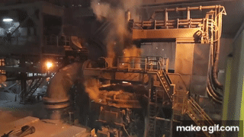
Green steel production possible key driver for green H₂ demand, with each tonne of Green H₂ DRI-EAF steel requiring ~50-60kg H₂
Case study: Green H₂ in Steel
Green H₂ direct reduced iron with decarbonization potential of ~90% compared to now dominant Blast Furnace-Basic Oxygen Furnace (BF-BOF)
H₂ demand for steel (Mt)
45
40
100% H₂ plants in early stages of development, with first industrial-scale plants planned to operate in 2026
Green H₂ Direct Reduced Iron-Electric Arc Furnace (DRI-EAF) uses green hydrogen to replace natural gas as an iron ore reductant; byproduct is water instead of CO₂
35
30
25
Iron ore
Iron
Steel
20
15
10
5
0
0
2022
2030
2035
2050
Sources: Center on Global Energy Policy at Columbia University, Low-Carbon Production of Iron & Steel (2021); IEA, Iron and Steel Technology Roadmap (2020); IEA, Net-zero scenario hydrogen outlook (2023); McKinsey, Decarbonization challenge for steel (2020); BNEF, Scaling Up Hydrogen (2024)
Credit: Friedrich Sayn-Wittgenstein, Ellie Valencia, Nadine Palmowski, Hyae Ryung Kim, and Gernot Wagner (12 December 2024); share/adapt with attribution. Contact: gwagner@columbia.edu

Slide 28














~40 Mt of green steel project announced in Europe by 2023, implying 2-2.4 Mt green H₂ demand
Case study: Green H₂ in Steel
As of 2023, ~40 Mt of green steel projects announced in Europe alone
1-2 Mt
2-3 Mt
>3 Mt
Four green steel plants announced as of 2021
2025 | 2026 | 2027 | 2028 | 2029 | 2030
As of 2023, ~40 Mt green steel announced in Europe by 2030
Source: Columbia Business School, H2 Green Steel (2024)
Credit: Friedrich Sayn-Wittgenstein, Ellie Valencia, Nadine Palmowski, Hyae Ryung Kim, and Gernot Wagner (12 December 2024); share/adapt with attribution. Contact: gwagner@columbia.edu

Slide 29

Green H₂ Policy

Slide 30

Over 30 governments, representing ~80% of energy-related CO₂ emissions, have adopted national green H₂ strategies. The EU and US are at the forefront, supporting research, development, and demonstration projects, while deploying grants and tax incentives to mitigate investment risks and establish standards for large-scale hydrogen initiatives.
Financial incentives have significantly reduced electrolyzer costs and accelerated green hydrogen adoption. However, challenges such as high initial investments, uncertainty in long-term returns, and the need for infrastructure and storage remain significant.
Additional policy frameworks and collaborations are required to scale production and build efficient supply chains despite legal and financial barriers.
  The EU, US, Australia, Japan, and other countries have set ambitious electrolyzer capacity and hydrogen production goals. The EU aims for 40 GW of electrolyzers by 2030, while the US aims to achieve a green H₂ price of $1/kg within the next decade.
  Research initiatives, such as the US Department of Energy’s $64 million H2@Scale program, are focused on reducing costs and advancing hydrogen technologies. Infrastructure projects in the US include retrofitting natural gas pipelines and developing new hydrogen storage facilities.
  The US Bipartisan Infrastructure Law dedicates $8 billion to establish seven Regional Clean Hydrogen Hubs, targeting emissions reductions of 1 to 9 Mt/year. In addition, the Inflation Reduction Act introduces the Clean Hydrogen Production Tax Credit (45V), offering incentives up to $3/kg for low-carbon-intensity projects.
Government subsidies, tax credits, and financial initiatives are essential for making green H₂ cost competitive with fossil-based grey H₂, driving its adoption in the industrial sector and improving its scalability and economic viability.
Key messages
Green H₂ Policy
Credit: Friedrich Sayn-Wittgenstein, Ellie Valencia, Nadine Palmowski, Hyae Ryung Kim, and Gernot Wagner (12 December 2024); share/adapt with attribution. Contact: gwagner@columbia.edu

Slide 31
Over 30 governments, representing ~80% of energy-related CO₂ emissions, have implemented green H₂ strategies
Global adoption of hydrogen strategies
Observations
Around 30 countries have established national H₂ strategies, with an additional 23 countries in the process of developing their own proposals.
The EU and US are leading
efforts to support the research, development, and demonstration of H₂ projects and technologies.
Governments are introducing mechanisms such as grants, loans, and tax incentives to mitigate investment risks, alongside growing efforts to implement standards and certification schemes for green H_{2.}
Despite growing governmental involvement, large-scale green H₂ projects remain underdeveloped in many emerging markets.
In policy discussions or pilot projects
Preparing a national strategy
Published national strategy
Source: IRENA, Green Hydrogen Supply (2023)
Credit: Friedrich Sayn-Wittgenstein, Ellie Valencia, Nadine Palmowski, Hyae Ryung Kim, and Gernot Wagner (12 December 2024); share/adapt with attribution. Contact: gwagner@columbia.edu

Slide 32
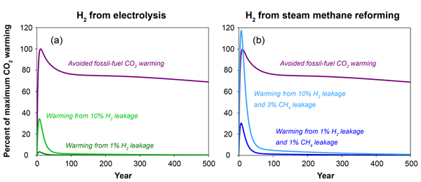
Methane and H₂ leakage a concern for the production of grey and blue H_{2,} not for green H₂
Green hydrogen with less warming even with large H₂ leakage
Observations
While H₂ production and transport play a crucial role in reducing carbon emissions, they can also contribute to the greenhouse gas effect if not managed properly.
  Methane, a greenhouse gas 28x more potent than CO₂, can leak into the atmosphere during blue and grey H₂ production.
  H₂ itself is an indirect greenhouse gas and can contribute to global warming if significant leakages occur.
Other potential environmental effects of H₂ production include water and land use, though these effects appear small compared to the overall benefits in most regions.
Despite these challenges, H₂'s potential to significantly reduce carbon emissions far outweighs the global warming impact of its potential leakage.
Green H₂ is better than fossil alternative, even with 10% H₂ leakage
Methane (CH₄) leakage is a potential concern with grey or blue H₂ production, not with green H₂
Sources: Ocko and Hamburg, Climate Consequences of Hydrogen Emissions (2022), Duan and Caldeira, Comment on “Climate Consequences of Hydrogen Emissions” by Ocko and Hamburg (2022) (2023)
Credit: Friedrich Sayn-Wittgenstein, Ellie Valencia, Nadine Palmowski, Hyae Ryung Kim, and Gernot Wagner (12 December 2024); share/adapt with attribution. Contact: gwagner@columbia.edu

Slide 33




Government incentives play a critical role in accelerating green H₂ adoption, with the EU, US, and other regions leading the charge
Countries are actively exploring various incentives to accelerate the adoption of green and blue H₂
 | Description | EU | Australia | Japan | United States
Financial incentives | Temporary subsidies can boost green H₂ production by reducing investment risks and lowering costs. Public investment in infrastructure, such as pipelines and storage, is essential for the rapid scaling of a H₂ economy. | Infrastructure grants through the Important Projects of Common European Interest support investments in pipelines and storage. | Hydrogen Headstart supports large-scale green and blue H₂ production with $4 billion in grants. The country provides a $2 tax incentive for each kg of clean H_{2.} | Contracts for Difference program aims to bridge the price gap between clean H₂ (domestic and imported) and fossil fuels. | The Inflation Reduction Act and 45V tax incentives promote the adoption of green and blue H₂ production.
Policy and regulatory frameworks | Government targets, strategies, and standards such as criteria defining green H₂ can build market trust and accelerate scaling efforts. | The EU aims to roll out 40 GW of electrolyzer capacity by 2030. EU-wide CertifHy certification program is being implemented to standardize green and blue H_{2.} | Australian Renewable Hydrogen Hub supports development of export routes. | Country has a target of 3 Mt green and blue H₂ production by 2030, increasing to 20 Mt by 2050. | Hydrogen Energy Earthshot initiative aims to reduce the cost of green and blue H₂ to $1/kg within a decade.
Education, research, and partnerships | Investments in research and pilot projects can drive technological advancement and facilitate scaling. Educational initiatives and international partnerships can foster public support and global collaboration. | EU is forming partnerships with North African countries to import their green H₂ production. | H₂ Industry Workforce Development Roadmap focuses on upskilling workers for H₂ production and related industries. | Significant investments in H₂ technology research have enabled Japan to account for 24% of global H₂-related patent applications between 2011 and 2020. | The Department of Energy’s Hydrogen and Fuel Cell Technologies office focuses on advancing research, education, and project implementation.
Sources: IRENA, Green Hydrogen Supply (2023); EU Clean Hydrogen Partnership (2024); CGEP, Energy Institute, Statistical Review of World Energy (2024); various government sources
Credit: Friedrich Sayn-Wittgenstein, Ellie Valencia, Nadine Palmowski, Hyae Ryung Kim, and Gernot Wagner (12 December 2024); share/adapt with attribution. Contact: gwagner@columbia.edu

Slide 34




Regulatory and economic factors are driving the transition from grey to green H₂
Case study: H₂ Transition Scenarios Across Regions
Three scenarios outline potential shift from grey to green and blue H₂ through 2030
Observations
The phase-out of grey H₂ will depend on carbon pricing and supportive policies such as blending mandates for clean fuels or ammonia.
These measures are expected to drive industry commitments and amplify consumer demand for a green H₂ transition.
  Current scenario: By 2030, around 10% of grey H₂ could shift to renewable or low-carbon alternatives, primarily driven by industry pressure.
  Accelerated trajectory: Carbon costs of $50 to $100 per ton could result in around 30% of grey H₂ transitioning, particularly in regions with lower green and blue H₂ costs and facilities that can be readily upgraded.
  Ambitious trajectory: High carbon pricing and additional incentives could enable a 50% conversion rate. Examples include EU’s RED II/III and California’s Low Carbon Fuel Standard.
 | Current scenario | Accelerated trajectory | Ambitious trajectory
Share of grey H₂ converted (% by 2030)
Required CO₂ price and policy (USD/ton CO2) | Low or zero CO₂ cost | ~50-100 USD/ton CO₂ | 100+ USD/ton CO₂
 | Industry commitments and consumer demand are key drivers of decarbonization efforts. | Most cost-optimal use cases convert grey H₂ (e.g., close to carbon storage). | Policy incentives (e.g., RED¹ and the phase-out of free allowances) further accelerate the transition.
Progress across focused regions
50%
30%
0-20%
Level of ambition
¹Renewable Energy Directive
Source: McKinsey, Global Energy Perspective 2023: Hydrogen outlook (2023)
Credit: Friedrich Sayn-Wittgenstein, Nadine Palmowski, Ellie Valencia, Nadine Palmowski, Hyae Ryung Kim & Gernot Wagner (12 December 2024); share/adapt with attribution. Contact: gwagner@columbia.edu

Slide 35


While the EU has established ambitious green H₂ targets, implementation efforts have fallen behind schedule
Case study: EU Green Hydrogen Regulations
Companies like Air Liquide and Siemens have made significant progress in advancing green hydrogen projects
EU regional overview | By setting clear objectives, providing financial incentives, and fostering collaboration, the EU has accelerated the green H₂ transition. However, progress on deployment of green and blue H₂ projects has not kept pace with these goals. Achieving a sustainable hydrogen economy will require continued policy support, effective implementation, and stronger alignment between targets and execution.
 | Pre-policy adoption (pre-2020) | Policy adoption phase (2020-2024) | Post-policy impact (as of mid-2024)
EU policy landscape | H₂ production has mainly relied on fossil fuels, with fragmented national and regional policies, limited infrastructure, and low adoption of hydrogen technologies. | EU launches EU Hydrogen Strategy, aiming for 6 GW of electrolyzer capacity by 2024 and 40 GW by 2030. | Electrolyzer supply has surpassed the targets outlined in the Net Zero Industry Act. However, progress toward 2030 production goals remains slow, with only 3.6% of 2030 projects having reached the FID* stage.
 | Operated hydrogen production facilities but invested minimally in H₂ R&D due to regulatory uncertainty and high production costs. | Increased renewable H₂ production, expanded H₂ refueling stations, and developed optimization tools within its infrastructure across the EU. | Became leader in green H₂ production with established initial refueling network. Committed to investing €8 billion in low- emission H₂ by 2035 and targeting 3 GW of electrolysis capacity by 2030.
 | Focused on PEM electrolyzers with a few pilot projects, like Hyflexpower, integrating H₂ into natural gas infrastructure. | Expanded its H₂ activities with investment in large-scale projects, including an 8.75 MW electrolyzer plant in east Germany and a 20 MW electrolyzer in partnership with Air Liquide. | Increased production with large-scale projects, such as Voestalpine in Austria, producing 1,200 cubic meters of green H₂/hour to decarbonize steel production.
*Final Investment Decision
Sources: CGEP, Low-Carbon Production of Iron & Steel (2021); Energy Institute, Statistical Review of World Energy (2024); IEA, Iron and Steel Technology Roadmap (2020); Journal of Cleaner Production, Towards fossil-free steel (2023); The Oxford Institute of Energy Studies, 2024 State of the European Hydrogen Market Report (2024); Air Liquide, Air Liquide Hydrogen (2024); Siemens Energy, Siemens Hydrogen (2024)
Credit: Friedrich Sayn-Wittgenstein, Ellie Valencia, Nadine Palmowski, Hyae Ryung Kim & Gernot Wagner (12 December 2024); share/adapt with attribution. Contact: gwagner@columbia.edu

Slide 36
In the US, the Inflation Reduction Act provides further support for green and blue H₂ with a production tax credit
Case study: US Infrastructure Subsidies for Green Hydrogen
Clean Hydrogen Production Tax Credit (45V) provides incentives up to $3/kg
Observations
The Inflation Reduction Act 's Clean Hydrogen Production Tax Credit (Section 45V) is the largest tax credit for green H₂ to date.
  Producers can collect a tax credit of up to $3/kg for projects constructed by 2033.
  Both green and blue H₂ are eligible, with subsidy values determined by greenhouse gas emissions as measured, as defined under the US Clean Air Act.
Section 45V credit will be key in making the levelized cost of blue and green H₂ competitive with grey H₂ .
Additional support includes the Advanced Energy Project Credit, offering a 30% tax credit for investments in fuel cells, electrolyzers, or hydrogen infrastructure.
Eligibility for 45V tax credit
Carbon intensity* (kg CO₂/kg H₂) | Hydrogen color | Percentage of full 45V tax credit (%) | Applicable credit value ($/kg H₂) | Additional requirements
< 4.0 |  | 20 | 0.60 | Must start construction before 2034 Cannot be combined with the Carbon Capture and Sequestration Tax Credit (45Q) Can be combined with the renewable energy production tax credit and the zero-emission nuclear credit Must promote well-paying jobs
< 2.5 |  | 25 | 0.75
< 1.5 |  | 33 | 1.00
< 0.45 |  | 100 | 3.00
*Scope 1-3 carbon intensity
Sources: PV Magazine, The Hydrogen Stream (2023); US Department of Energy, Financial Incentives for Hydrogen and Fuel Cell Projects; US Department of the Treasury, U.S. Department of the Treasury, IRS Release Guidance on Hydrogen Production Tax Credit to Drive American Innovation and Strengthen Energy Security (2023)
Credit: Friedrich Sayn-Wittgenstein, Ellie Valencia, Nadine Palmowski, Hyae Ryung Kim, and Gernot Wagner (12 December 2024); share/adapt with attribution. Contact: gwagner@columbia.edu

Slide 37
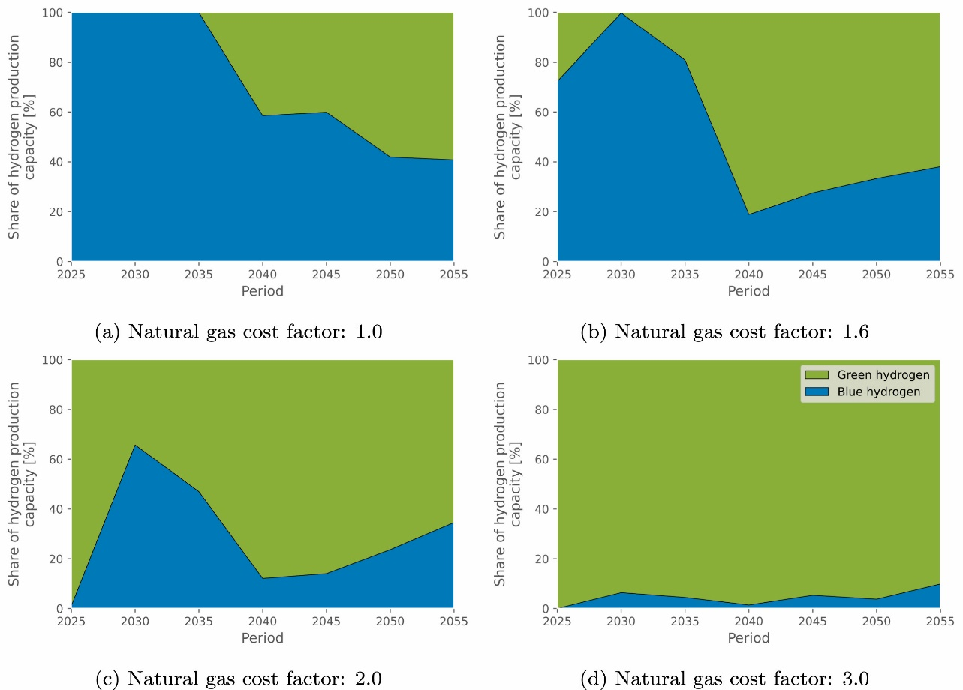
Policy a key driver for the shift away from grey H₂, while gas prices determine the balance between blue and green H₂
Projected H₂ demand (in Mt)
Green H₂ share depends on cost factors such as gas prices
Observations
Green and blue H₂ are expected to complement grey H₂ initially but will almost completely replace it by 2050.
  Government policies and incentives are crucial for rapidly scaling H₂ production to meet demand.
  Economies of scale and declining CapEx will accelerate the transition to green and blue H_{2.}
The future split between green and blue H₂ is difficult to estimate.
  Green H₂ is expected to become competitive as renewables and electrolyzer costs decline.
  The share of blue H₂ is highly sensitive to natural gas prices due to its reliance on carbon capture, utilization, and storage.
450
Green and blue H2
402
400
Grey H2
350
300
282
250
200
150
143
100
50
0
2030
2040
2050
Note: Natural gas price in base case is 31.3EUR/MWh in 2025-2030 and 39.0 EUR/MWh in 2050-2055 (Durakovic et al., 2023)
Sources: IEA, Net-zero scenario hydrogen outlook (2023); Durakovic et al., Are blue and green hydrogen competitive or complementary? (2023)
Credit: Friedrich Sayn-Wittgenstein, Ellie Valencia, Nadine Palmowski, Hyae Ryung Kim, and Gernot Wagner (12 December 2024); share/adapt with attribution. Contact: gwagner@columbia.edu

Slide 38








CKI Green H₂ Team
Friedrich Sayn-Wittgenstein
Master of Public Administration in Environmental Science and Policy
Team Lead
Ellie Valencia
Master of Business Administration
CKI Fellow
Grace Frascati
Bachelor of Science
CKI Fellow
Linfei Zhang
Master of Public Administration in Climate, Energy, and Environment
CKI Fellow
Hoshi Ogawa
Master of Business Administration
CKI Fellow
Hyae Ryung (Helen) Kim
PhD in Sustainable Development
Senior Research Fellow
hk2901@columbia.edu
Nadine Palmowski
Master of Public Administration in Environmental Science and Policy
CKI Fellow
Gernot Wagner
Senior Lecturer, Columbia Business School
Faculty Director, Climate Knowledge Initiative
gwagner@columbia.edu
Attribution: Sayn-Wittgenstein et al., "Greening Hydrogen,“ Columbia Business School Climate Knowledge Initiative (2024).

Slide 39
Appendix

Slide 40
Glossary
AWE | Alkaline water electrolysis
BOS | Balance of system
CAPEX | Capital expenditure(s)
CAGR | Compound annual growth rate
CCUS | Carbon capture, utilization, and storage
CH₄ | Natural gas
CO | Carbon monoxide
CO₂ | Carbon dioxide
CO₂e | CO2 equivalent, using global warming potential as conversion factor
DOE | Department of Energy
DRI-EAF | Direct Reduced Iron-Electric Arc Furnace production process
ETS | Emissions Trading System
Fe | Iron
FeO₂ | Iron oxide
FCEV | Fuel cell electric vehicle
FID | Final Investment Decision
GHG | Greenhouse gas
Gt | Gigatonne, equal to 1 billion metric tonnes
H₂ | Hydrogen
IRA | Inflation Reduction Act
kWh | Kilowatt-hour
LCOH | Levelized cost of hydrogen
LH₂ | Liquid hydrogen
LOHC | Liquid organic hydrogen carrier
Mt | Million metric tonnes
Mtpa | Million metric tonnes per annum
MWh | Megawatt-hour
NH₃ | Ammonia
PEM | Proton exchange membrane
PGM | Platinum group metals
PPM | Parts per million
R&D | Research and development
ROI | Return on Investment
SAF | Sustainable aviation fuel
SOEC | Solid oxide electrolyzer cell
Tonne | Metric ton
TWh | Terawatt-hour

