Slide 1
Scaling Solar
20 March 2025
Hyae Ryung Kim, Marcelo Cibie, Max de Boer, Lara Geiger, Isabel Hoyos, Taicheng Jin, Hassan Riaz, and Gernot Wagner

Slide 2
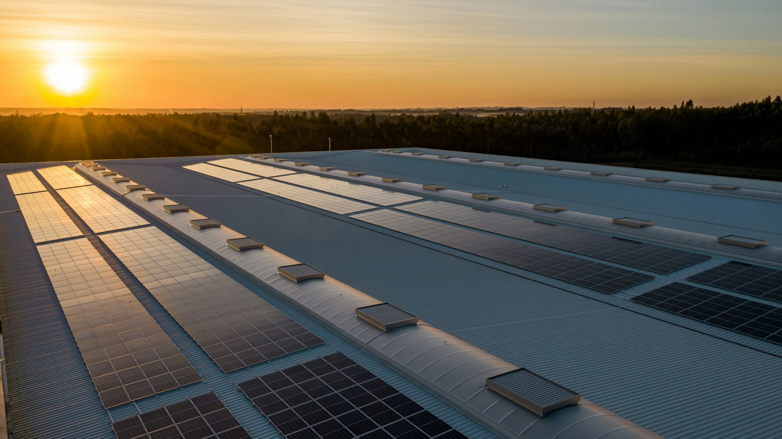
The Solar Opportunity

Slide 3
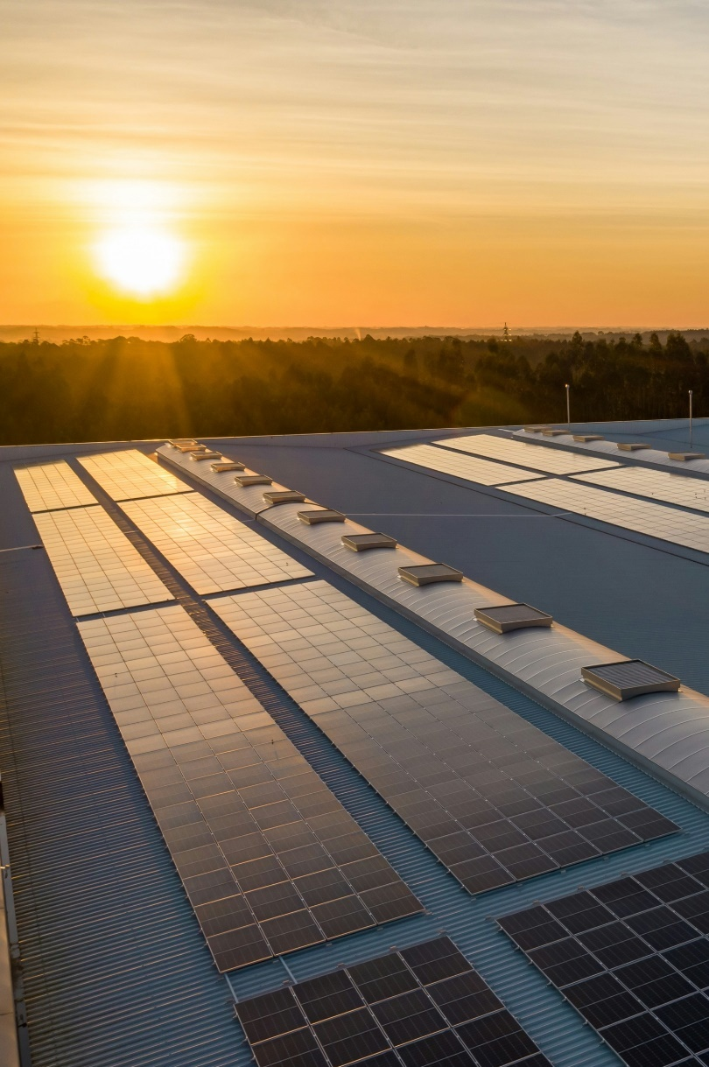
Solar can abate 5.5 to 10 gigatonnes (Gt) of CO₂e by 2050 in select subsectors, including 24% to 43% of power and heat, depending on the transition scenario.
Solar PV prices dropped ~99.8% since 1975, driven by economies of scale known as Swanson’s law, in which each doubling of installed capacity has led to an average price drop of ~20%. This was initially caused by the improvement of module efficiency; after 2001, scale economies became more significant.
Solar electricity generation reached ~1,600 terawatt-hours (TWh) of global capacity in 2023 with 23% CAGR from 2018 to 2023, exceeding growth expectations at every stage.
Solar PV systems can be classified according to purpose and size:
  Residential system typically ~0.002 to 0.02 megawatts (MW); installed capacity is ~319 GW (2023)
  Commercial and industrial system typically ~0.02 to 5 MW; installed capacity is ~371 GW (2023)
  Utility system typically ~1 to 1,000 MW*; installed capacity is ~794 GW (2023)
Solar projects require a substantial upfront investment in equipment, installation, and site preparation:
Typical system cost is ~2.68$/Watt for residential; ~1.76$/Watt for commercial & industrial, and ~1.16$/Watt for utility-scale. However, they have relatively low maintenance costs relative to other energy sources, and given electricity savings, tax benefits, and potential revenue generation, the payback period typically ranges from ~2 to 10 years.
Key messages
The Solar Opportunity
(*) Exact classification boundaries vary by sources; the authors present a rough estimation from a combination of sources.
Credit: Hassan Riaz, Isabel Hoyos, Max de Boer, Lara Geiger, Marcelo Cibie, Hyae Ryung Kim, and Gernot Wagner. Share with attribution: Kim et al., “Scaling Solar” (23 September 2024).

Slide 4
Solar can abate 5.5 to 10 Gt of CO₂e by 2050 in select subsectors depending on the transition scenario
Abatement in Economic Transition Scenario
CO₂e emissions in 2024*: ~50 billion tonnes
Additional Abatement in Net Zero Scenario
28%
28%
21%
16%
7%
Refining
4%
Non-ferrous metals
2%
Other
2%
Rail
1%
Non-metallic minerals
2%
LULCF
17%
Marine
11%
10% to 17%
in buildings
Coal mining
7%
24% to 43%
in all power and heat
Agriculture fuel
4%
Aviation
10%
Chemicals
13%
Commercial
15%
Waste
21%
10%
Cement
17%
16% to 26%
in road
Oil
3%
HFCs
21%
Natural gas
9%
Oil and gas
21%
Livestock
32%
Residential combustion
47%
3% to 5%
in iron and steel
Iron and steel
13%
Coal
45%
Road
50%
Crops
27%
Remaining industry
17%
Industry
Power and Heat
Agriculture, land use and waste
Transport
Buildings
(*) 2024 emissions based on projections.
Sources: Scope 1 emissions from Rhodium Group Climate Deck (September 2024); abatement estimates from BloombergNEF, IRENA, IEA (2023), and Way et al. (2022).
Credit: Hassan Riaz, Theo Moers, Hyae Ryung Kim, and Gernot Wagner. Share with attribution: Kim et al., “Scaling Solar” (1 October 2024).

Slide 5
Price reduction of ~80% since 2009 coincides with a 15x expansion in capacity, following Swanson’s law
PV price has become competitive with the price of conventional fossil fuel
China has led most of the growth since 2010s
Observations
The decreases in price that coincide with increases in installed capacity have been supported by Swanson’s law:
  Each 20% price drop is accompanied by a doubling of installed capacity
This creates a virtuous circle in which increased deployment and price decreases lead to increasing proliferation and demand increase
Levelized cost of energy (LCOE) from ’09 (in dollars per MWh)*
Global installed solar capacity (in TWh)
1,750
1,580%
Nuclear
Geothermal
Gas Peaking
Gas Combined Cycle
1,500
Solar Thermal Tower
Solar PV
ROW
Coal
Wind - Onshore
1,250
India
-83%
1,000
USA
750
EU-27
Prices fall
500
Increased solar PV deployment
Solar PV competitive in new markets
250
China
Demand increases
0
’09
’10
’11
’12
’13
’14
’15
’16
’17
’18
’19
’20
’21
’22
’23
’12
’13
’14
’15
’16
’17
’18
’19
’20
’21
’22
’23
(*) LCOE is the average minimum price at which electricity generated must be sold to offset the total cost of production over the project’s assumed lifetime.
Sources: Lazard and Roland Berger, LCOE v16; Our World in Data
Credit: Taicheng Jin, Hassan Riaz, Max de Boer, Lara Geiger, Marcelo Cibie, Hyae Ryung Kim, and Gernot Wagner. Share with attribution: Kim et al., “Scaling Solar” (23 September 2024).

Slide 6
Price decreased initially due to R&D in module efficiency; since 2001, economies of scale have been main driver
Micromechanisms (technical)*
Macromechanisms (economical)
∆ Efficiency
Public R&D
∆ Non-Si material cost
Learning by doing
12%
∆ Silicon price
Economies of scale
23%
∆ Silicon usage
Other
∆ Wafer area
14%
∆ Plant size
3%
∆ Yield
21%
8%
∆ p0
16%
Observations
Micromechanisms represent technical improvements, while macromechanisms include R&D, learning by doing, economies of scale, etc.
Kavlak et al., found that module efficiency was the leading micromechanism of cost reduction from 1980 to 2012.
Public and private R&D was the most important macromechanism over this period.
After 2001, however, scale economies became a more significant driver of cost reduction.
17%
14%
36%
10%
8%
7%
7%
4%
-5%
1980-2001
2001-2012
1980-2001
2001-2012
(*) 1980-2001 price reductions scaled to 100% and align data with 2001–2002. The pre-factor in Equation (5) reflects the baseline operational costs—such as electricity, labor, maintenance, and depreciation—for a plant of fixed size over time.
Source: Kavlak et al. (2018)
Credit: Taicheng Jin, Isabel Hoyos, Hassan Riaz, Hyae Ryung Kim, and Gernot Wagner. Share with attribution: Kim et al., “Scaling Solar” (23 September 2024).

Slide 7

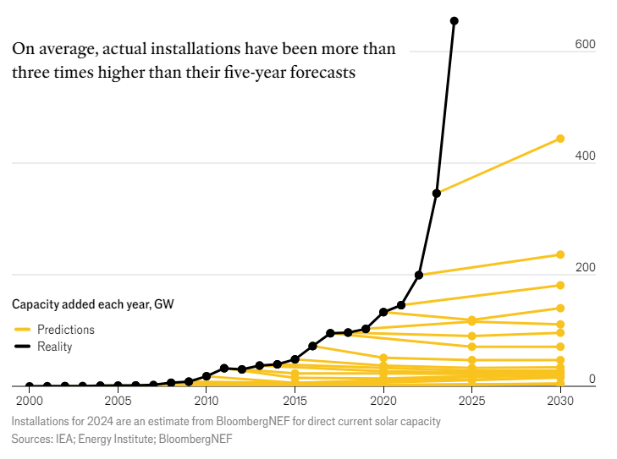
Past solar adoption has exceeded expectations at every stage; solar, together with wind, will drive most renewable deployment
Observations
Solar has consistently exceeded expectations since forecasted from 2005 due to Swanson’s law; as solar becomes cheaper, the use cases for solar also become more abundant.
In the IEA’s Net Zero by 2050 Scenario, this supports solar taking a significant share of energy production.
The main bottlenecks for solar are not technological maturity, economics, or supply constraints.
Rather, the main bottlenecks are practical concerns such as grid stability, interconnection delays, supportive policies, and deployment method.
Expectation vs. reality for solar deployment (from The Economist)
Net Zero Scenario (NZS) from the BloombergNEF
NZS in thousands TWh
90
80
Unabated coal
Nuclear
Coal with CCS
Unabated oil
70
Unabated gas
Other
Gas with CCS
Solar
60
Other renewables
Wind
50
Hydrogen
40
30
20
10
0
2000
2005
2010
2015
2020
2025
2030
2035
2040
2045
2050
Sources: Sun Machines, The Economist; Our World in Data using IRENA (2023); Nemet (2009); Farmer and Lafond (2016); Kavlak et al. (2018); Our World in Data using Lafond et al. (2017), IRENA and de la Tour (2013); BloombergNEF (2024)
Credit: Taicheng Jin, Hassan Riaz, Isabel Hoyos, Hyae Ryung Kim, and Gernot Wagner. Share with attribution: Kim et al., “Scaling Solar” (23 September 2024).

Slide 8
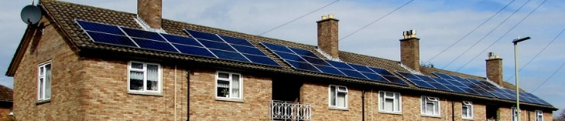
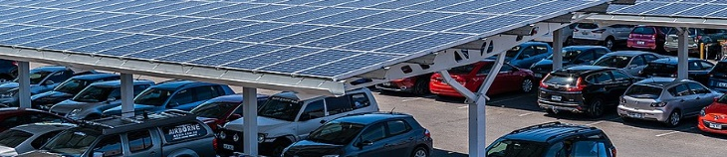
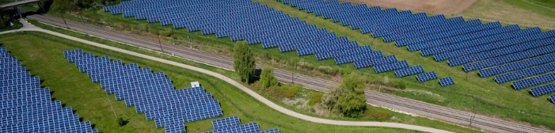
Residential, commercial & industrial distinct from utility solar PV
 | DISTRIBUTED SOLAR PV |  | UTILITY SOLAR PV
 | Residential | Commercial & industrial | Utility
Description | Small systems, most often on rooftops of homes Produce electricity directly for the homeowner’s use; could export excess to the grid | Midsize systems, often mounted on the ground or flat roofs of commercial buildings Produce electricity directly for the business’s use; could export excess to the grid | Large, ground-mounted array that delivers power to the grid Often sells through a power purchase agreement to a utility off-taker Supply electricity to a large number of customers through the grid
Typical system size | ~0.002–0.02 MW | ~0.02–5 MW | ~1–1,000 MW
Typical cost per kWh (LCOE*, 2023, US) | $0.117–$0.282 | $0.049–$0.185 | $0.024–$0.096
Global installed capacity (2023) | 319 GW | 371 GW | 794 GW
(*) Unsubsidized LCOE (levelized cost of energy) is the average minimum price at which electricity generated must be sold to offset the total cost of production over the project’s assumed lifetime. The LCOE for commercial and industrial is an average of a commercial rooftop and a commercial ground system.
Sources: IEA, Renewables 2023; US DOE, 2030 Solar Cost Targets; Lazard and Roland Berger, LCOEv16; Nuveen, Infrastructure Energy Transition Update
Credit: Taicheng Jin, Max de Boer, Lara Geiger, Marcelo Cibie, Hyae Ryung Kim, and Gernot Wagner. Share with attribution: Kim et al., “Scaling Solar” (23 September 2024).

Slide 9

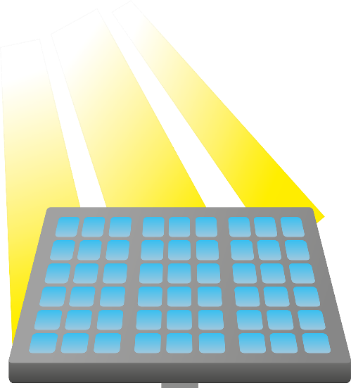


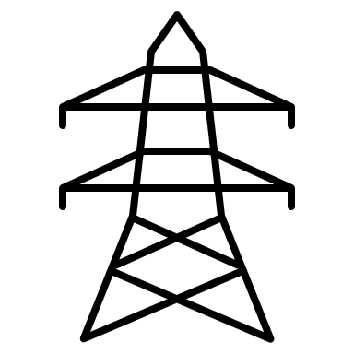
Typical solar project economics result in payback periods ranging from 2 to 10 years
Solar expenses
High CapEx: Solar projects require substantial upfront investment in equipment, installation, and site preparation. The average residential system cost is $10,000 to $25,000, with a levelized cost of energy of $0.117 to $0.282 per kWh. Typical LCOE for commercial and industrial is $0.049 to $0.185 per kWh and for utility-scale $0.024 to $0.096 per kWh.
(Relatively) Low OpEx: Low maintenance costs relative to other energy sources and no fuel costs result in low operating expenses.
Solar revenue
Tax incentives: Under the IRA, Residential Solar Energy Credit, Investment Tax Credit, and Production Tax Credit can reduce ~30% of the initial cost. Other state and local incentives can reduce it further.
Long-term savings: Savings depend on project size and local grid electricity price. Average annual savings could be $1,500 for residential projects and range from $10,000 to $100,000 for commercial and industrial projects. The payback period typically ranges from ~2 to 10 years.
Additional revenue: Net metering allows surplus to be sold, including via Renewable Energy Credits (REC) such as performance based SREC in NJ which require utilities to meet RPS requirements; consumers can access solar revenue through off-site community solar projects.
Increased value: Solar installations can boost property value and commercial appeal, attracting potential buyers, residents, employees, and investors.
Solar technology 101
Photons from sunlight hit solar cells and release electrons
Solar panels consist of photovoltaic (PV) cells made of silicon semiconductors with a negative and positive layer
Freed electrons flow through the circuit and produce an electric charge
Wiring in the panels captures the direct electric current (DC) generated
An inverter converts the DC electricity into alternating current (AC) electricity to directly power buildings
The system is integrated with the energy grid to supply excess AC electricity
Sources: SEIA (2022); SEIA (2024); IEA (2023); SolarKal (2023; Revision Energy
Credit: Isabel Hoyos, Taicheng Jin, Hassan Riaz, Hyae Ryung Kim, and Gernot Wagner. Share with attribution: Kim et al., “Scaling Solar” (23 September 2024).

Slide 10
~50% of solar cost structure is soft costs or gross margins
Solar system cost breakdown
Observations
Historically, the price of panels is ~10-30% and other components an additional ~15-25%; Labor is a larger percentage of costs due to rising wages and high demand; The remaining ~50% is soft costs / gross margins
Soft costs / gross margins are high in part due to lack of transparency as well as ultra-low conversion rates and high Customer Acquisition Costs (CAC)
Higher prices are exacerbated in 3rd-party agreements like site leases where complexity adds to the opacity, resulting in lower payments to customers
Installed system cost benchmark: US 2023 (in dollars per watt)
3
Solar panel
$2.68
Inverter (BOS component)
Other BOS components
Installation labor
Other costs*
2
54%
Case study: SolarKal saves businesses costs through a competitive marketplace model
SolarKal acts as dedicated solar advisors for commercial real estate asset owners
Asset portfolios are evaluated for solar potential by leveraging a database of national pricing, injecting transparency into the marketplace
By fostering a competitive RFP process involving 200+ pre-vetted and approved vendors, clients' economics are improved by 43% on average
Savings are structural - with an 80% RFP success rate, higher conversion deal flows reduces CAC and therefore lowers costs
$1.76
56%
$1.16
1
9%
12%
37%
9%
11%
12%
12%
15%
3%
4%
13%
21%
32%
0
Residential PV
(8 kW)
Commercial PV
(3 MW)
Utility PV
(one axis 100 MW)
(*) Other costs include permitting, inspection and interconnection, transmission line costs, sales tax, overhead, and profit.
Sources: NREL, US solar PV system cost benchmark (Q1 2023); SolarKal
Credit: Taicheng Jin, Max de Boer, Lara Geiger, Marcelo Cibie, Hyae Ryung Kim, and Gernot Wagner. Share with attribution: Kim et al., “Scaling Solar” (23 September 2024).

Slide 11
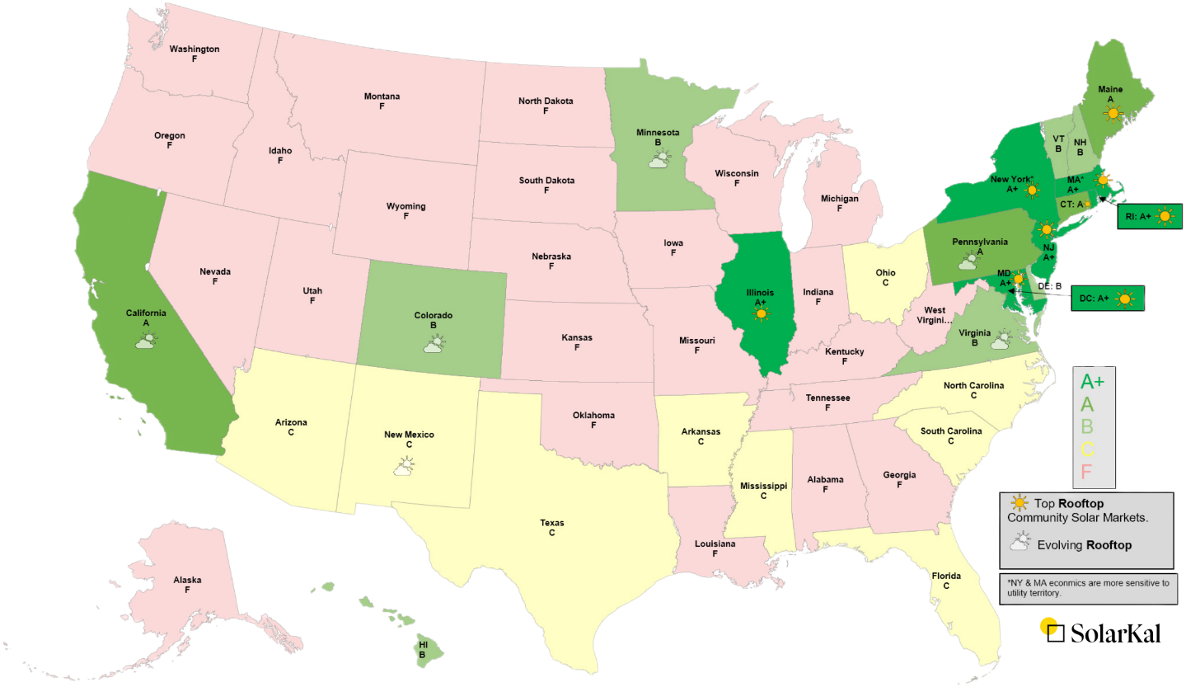

Deployment environments differ across states and energy markets, with ISO-NE and CAISO leading in the US
State-level solar receptiveness graded on a letter scale
Observations
A state’s solar attractiveness is principally determined by:
  Incentives including state rebates, SRECs (solar renewable energy certificates), and community solar
  Electricity rates determining energy saving, which make up the bulk of the revenue to repay investment
  Net metering rules setting rates utilities pay for returned solar energy; e.g. “net metering” pays the retail unit energy cost (same a customers pay to receive energy), whereas “net billing” applies wholesale rate, reducing revenue a customer receives
  Solar irradiation measuring how much sunshine an area receives, on average, over a period of time
CA and Northeastern states are the friendliest solar states due to state level incentives like NJ’s SREC, PA’s elevated electricity rates, or NY’s offering of Tax Credit Bridge Loans and VDER net-metering arrangement
Note: CAISO is the California Independent System Operator and ISO-NE is the Independent State Operator North-East.
Sources: SolarKal (2025); NREL; EIA, Electric Power Annual Reports (2024); Berkeley Labs (2024).
Credit: Taicheng Jin, Hassan Riaz, Isabel Hoyos, Hyae Ryung Kim, and Gernot Wagner. Share with attribution: Kim et al., “Scaling Solar” (20 March 2025).

Slide 12
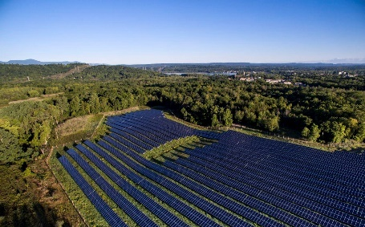

ELP Greenport project demonstrates the economics of storage and the delicate balance of community interests
Case study 1: ELP Greenport
Facts
Developer: Eight Light Partners
Location: Greenport, Columbia, New York
Status: Operating
Commission date: March 2020
Capacity: 7 MWac
Operator: Conductive Power
Off-takers: Hudson community subscribers
Finances
Viability and net present value depended on multiple factors: solar generation capacity, CapEx, availability of project financing, New York state’s Value of Distributed Energy Resources (VDER)
Metrics:
  NPV: $23 million
  IRR: (15% solar; 16% +storage)
  Margin: ~23%
  MOIC: ~2.12x
Issues
Solar only or + storage?
  $1.4M additional equity contribution
  + 30% generation = $175K additional per year
  Capital cost of battery = - $1.5M
  Government incentive for storage ($940K)
    $390K from ITC
    $550K from NYSERDA
Community Opposition and Conservation
  Scenic Hudson and Historic Hudson banded together to oppose the construction.
  Solar field initially sat across from the Oliver Bronson House, a viewshed that gave birth to the Hudson River School of American landscape painters.
  Consultation was conducted to revise site plan according to the “Clean Energy, Green Communities” guide to relocate visible panels away from the view of house.
CapEx → Required equity contribution (solar PV + storage)
Assumptions: 21% tax rate; -0.5% rate of solar depreciation; depreciation (year 1); 8% discount rate
Electricity generated (number of modules x watts per module) x the specific production (kWh per year) *kW of installed capacity
Rate of $0.09 per kWh to determine revenue of electricity generated
Rate of $0.28 per kWh for added value for electricity generated in summer hours between 1 PM and 6 PM (June, July, and August)
Capital Expenditure Solar Only
CapEx Battery (LiFe)
Debt (at 5% for 10 years)
Investment Tax Credit (ITC) for Solar
ITC for Battery
New York State Incentives
Year 1 Investment Required
Sources: Columbia CaseWorks; Scenic Hudson
Credit: Taicheng Jin, Hassan Riaz, Isabel Hoyos, Hyae Ryung Kim, and Gernot Wagner. Share with attribution: Kim et al., “Scaling Solar” (23 September 2024).

Slide 13
Federal ITCs and PTCs provide limited relief, but state incentives play a crucial role in pushing projects past investors’ hurdle rate
Case study 2: New Jersey vs. Florida or Texas
e.g. REC could boost IRR by 7-15% and cut payback by 2-5 years
Observations
Federal incentives provide a significant boost, but strong state-level incentives can push a project over hurdle rate
  Federal level: ITC, PTC, Accelerated Depreciation
  State level: state Credits, RECs, rebates, state tax exemption, net-metering, renewable portfolio standards (RPS), interconnection standards
  County level: rebates & grants, buildings standards
  Community level: energy-efficient organizations, regional partnerships
NJ, FL, and TX offer varying levels of state-incentives, resulting in different levels of project IRR
  New Jersey: The Successor Solar Incentive (SuSI) program rewards solar energy production with SREC-II certificates, valued at $85-$90 per MWh for 15 years. Solar equipment is exempt from sale and property taxes, and net metering allows generators to sell excess electricity back to the grid.
  Florida: The state exempts added value of solar energy system from property taxes and sales taxes. Statewide net metering policy allows full credit on utility bills. Local utilities offer $2,000-$4,000 rebates for solar battery installations.
  Texas: Several utilities provide $2,500-$3,000 rebates for solar PV of at least 3 kW. Some utilities and retail energy providers offer solar buyback programs that provide bill credits or cash for surplus energy fed back into the grid.
Waterfall of a 1MW project without state-incentives
Return Profile if based in:
$1,900,000
Annual income in New Jersey
(+) Energy Savings: $150,000
$400,000
$(450,000)
(+) REC Revenue: $125,000
Project IRR: 24-26%
$(100,000)
Payback Period: 6 Years
$(550,000)
$(175,000)
$(225,000)
Annual income in Florida
(+) Energy Savings: $128,000
$1,500,000
Project IRR: 11-13%
Payback Period: 7 Years
Annual income in Texas
(+) Energy Savings: ~$128,000
Project IRR: ~8-16%
System Price
ITC
Depreciation Benefit
Upfront Investment
Payback Period: ~5-10 Years
* Diagonal represent additional cost/savings for range estimate.
** Assuming a standard 1 MW solar project (BTM/direct ownership): On-site system, behind the meter, for self-consumption; direct ownership provides full control, access to tax incentives, and long-term savings.
Note: Texas has a larger band of uncertainty around buybacks depending on location
Sources: Solar.com’s Solar Rebates by State; Forbes (2024); Energysage (2025); Texas Power Guide; DSIRE; Canary Media (2025); Data for solar project IRR models provided by SolarKal.
Credit: Taicheng Jin, Hassan Riaz, Hyae Ryung Kim, and Gernot Wagner. Share with attribution: Kim et al., “Scaling Solar” (20 March 2025).

Slide 14


Deregulated Texas energy market boon for solar, surpassing California in 2024
Case study 3: Texas vs. California
Total installed utility-scale solar capacity in Texas and California, GW
Observations
Texas surpassed California as the leading utility-scale solar PV state after adding 1.6 GW in Q2 of 2024 (ACP).
Texas installed nearly 9 GW of new utility-scale solar by the end of 2024 – over one-fourth of the U.S. 2024 additions – for a total capacity of 27.5 GW (ACP).
Texas is expected to install 11.6 GW new utility-scale solar in 2025 (EIA).
Texas’ advantage:
  Deregulated, electricity-only energy market
  Streamlined approval process
  Abundant land
  Minimal state-incentives
California’s challenge:
  Strong state incentives
  Strict regulations
  Interconnection delays
CAGR ‘10-’15
CA: 71%
TX: 87%
CAGR ‘15-’20
CA: 15%
TX: 73%
CAGR ‘20-’24
CA: 10%
TX: 46%
22
California
20
Texas
18
16
14
  Texas solar capacity annual growth started outpacing California in 2014
12
  Texas solar capacity annual growth started outpacing California in 2014
10
8
6
4
2
0
Source: ACP, Clean Power in 2024 (2025); EIA, Solar, battery storage to lead new U.S. generating capacity additions in 2025 (2025).
Credit: Hyae Ryung Kim, Taicheng Jin, Isabel Hoyos, and Gernot Wagner. Share with attribution: Kim et al., “Scaling Solar” (20 March 2025).

Slide 15
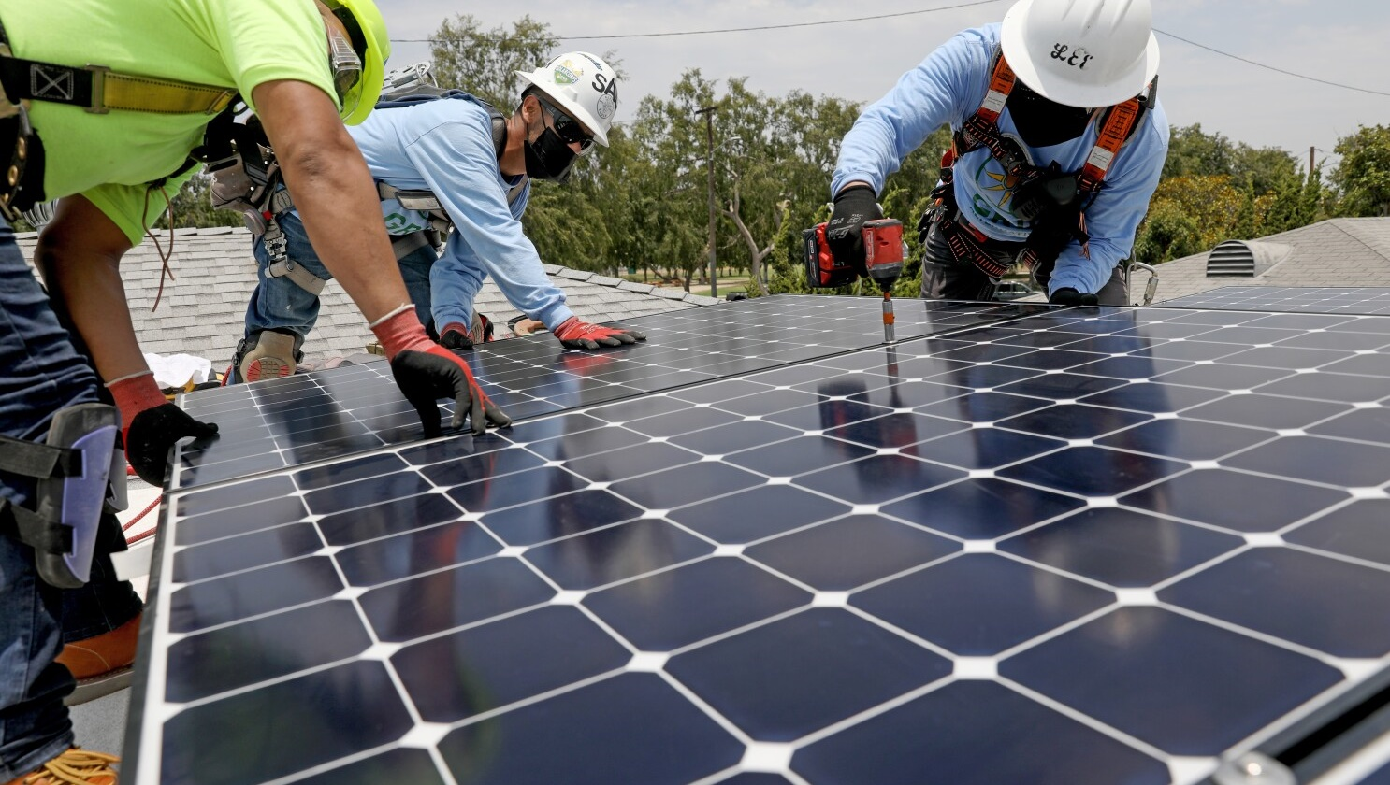
Solar Technology Landscape

Slide 16
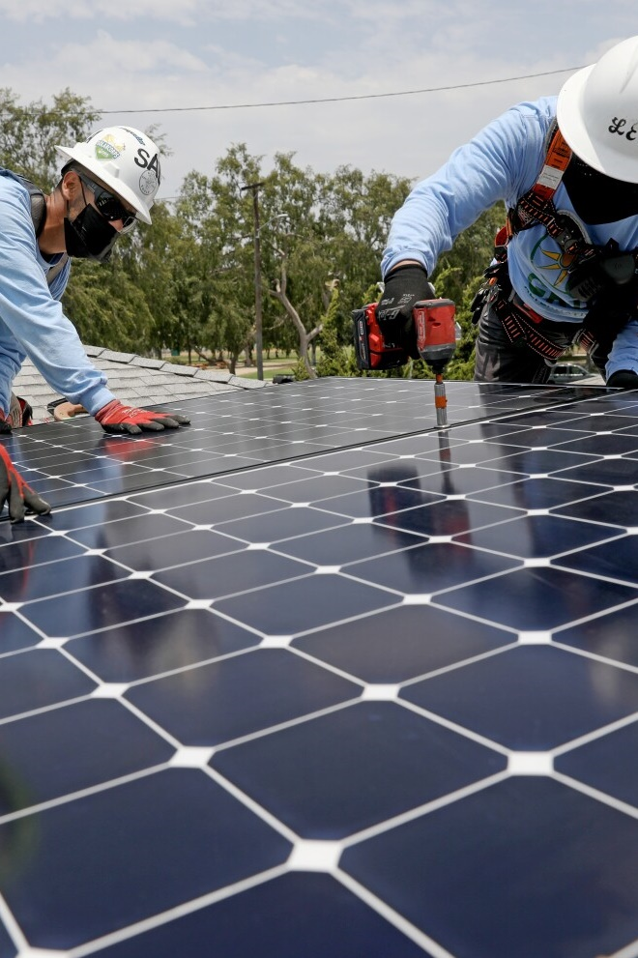
Two main solar PV cell technologies:
  Crystalline Silicon (c-Si): Rigid cells made from either mono- (mono-Si) or polycrystalline silicon (poly-Si), with a commercial efficiency between 17% and 25%; cost ranges between $0.26 for utility-scale projects to $0.6 per watt for residential projects.*
  Thin-film: Cells can be flexible, have a 7% to 8% commercial efficiency, and cost between $0.75 and $1.10 per watt.*
Trends across the production chain:
  Polysilicon: After a recent spike to $39 per kilogram, prices have come down to about $6 per kg as production restarted post-COVID. Prices could continue to decline with continued capacity additions.
  Wafers: The industry has started to shift to larger wafer sizes, resulting in a 50% decrease in polysilicon use per watt of capacity, and to N-type wafers.
  Cells: Production has shifted from BSF cells to PERC cells in the past decade, resulting in an average 1% efficiency gain for mono-Si cells, but could move to TOPCon or HJT in the future. Production has also shifted from poly-Si cells to mono-Si cells, driven by higher efficiency and a drop in price.
Innovations in solar PV:
  Novel technologies: Silicon heterojunction cells, perovskite cells, and multi-junction cells have not been able to replace c-Si cells at scale yet. However, their growing efficiencies coupled with potential cost improvements could make them more competitive.
  Panel modifications: Solar trackers, bifacial panels, and concentrator PV can boost c-Si cell efficiencies by up to 45%.
  Deployment locations: New developments in location include building integrated PV (BIPV), floating PV (FPV), agrivoltaics, and vehicle integrated PV (VIPV).
Key messages
Solar Technology Landscape
(*) Price estimates are based on US market panel costs; ROW c-Si panel costs range from $0.10 to $0.23 per watt
Credit: Isabel Hoyos, Taicheng Jin, Max de Boer, Lara Geiger, Marcelo Cibie, Hyae Ryung Kim, and Gernot Wagner. Share with attribution: Kim et al., “Scaling Solar” (23 September 2024).

Slide 17
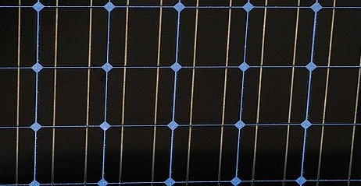
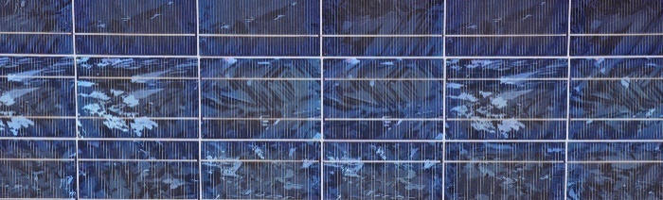

Crystalline silicon (c-Si) is main cell type, while thin-film is often reserved for highly specific use cases
 | CRYSTALLINE SILICON CELLS |  | THIN-FILM
 | Monocrystalline (mono-Si) | Polycrystalline (poly-Si, ‘multi-Si’)
Description | Cells of polysilicon that have crystallized into a single Si crystal (Czochralski process) One panel is made up of 32 to 96 silicon wafers Black or very dark blue with round corners | Cells of polysilicon that consists of many square blocks of multiple Si crystals Has a visible grain, giving the cell a blue hue without rounded corners | Solar cells produced by depositing thin layers of photovoltaic material on a base material PV material determines color, potentially flexible depending on base layer
Commercial efficiency (2024) | ~17–25% | ~13–18% | ~7–18%*
Panel cost per watt (2024) | $0.26–$0.50 | $0.28–$0.50 | $0.75–$1.10
Use cases | Limited space or need for maximum output subject to a surface area constraint | Price is main concern | Price is main concern
(*) Peak commercial efficiency of copper indium gallium selenide (CIGS) thin-film cells has reached 22% in lab settings and 18.7% in field tests.
Sources: PVPS, Trends in Photovoltaic Applications (2022); Encyclopedia Britannica (2024); Encyclopedia of Sustainable Technologies (2017); NREL; InsideClimateNews
Credit: Max de Boer, Lara Geiger, Marcelo Cibie, Taicheng Jin, Hassan Riaz, Hyae Ryung Kim, and Gernot Wagner. Share with attribution: Kim et al., “Scaling Solar” (23 September 2024).

Slide 18
The industry shifted to mono-Si and larger wafer sizes, driven by higher efficiency and cost reduction
Mono-Si makes up ~95% of solar PV production
Wafer sizes have increased since 2017
Observations
From 2018 to 2021, c-Si cell production has shifted dramatically from mostly poly-Si to almost only mono-Si.
This shift has been driven by the higher efficiency of mono-Si cells as well as efficiency improvements in manufacturing process, leading to lower prices.
Thin-film production has increased slightly over time as its applications in special use cases continue to grow.
Global wafer production shifted from <158.7 mm wafer sizes to larger sizes (210 mm max. size).
The shift to larger wafer sizes has been one of the main drivers of the decrease in polysilicon, resulting in cost savings.
Mono-Si
Poly-Si
Thin-film
< 158.7 mm
182.0 - 210.0 mm
Global PV module production by technology (in % of total GW)
158.7 - 166.0 mm
210.0 mm
12%
2%
21%
49%
39%
95%
39%
36%
4%
2011
2012
2013
2014
2015
2016
2017
2018
2019
2020
2021
2017
2018
2019
2020
2021
2022e
Sources: IEA, Solar PV Global Supply Chains (2022); IEA, Solar PV Global Supply Chains; PV Magazine, Polysilicon costs have slid by 96% watt over past two decades
Credit: Taicheng Jin, Hassan Riaz, Max de Boer, Lara Geiger, Marcelo Cibie, Hyae Ryung Kim, and Gernot Wagner. Share with attribution: Kim et al., “Scaling Solar” (23 September 2024).

Slide 19
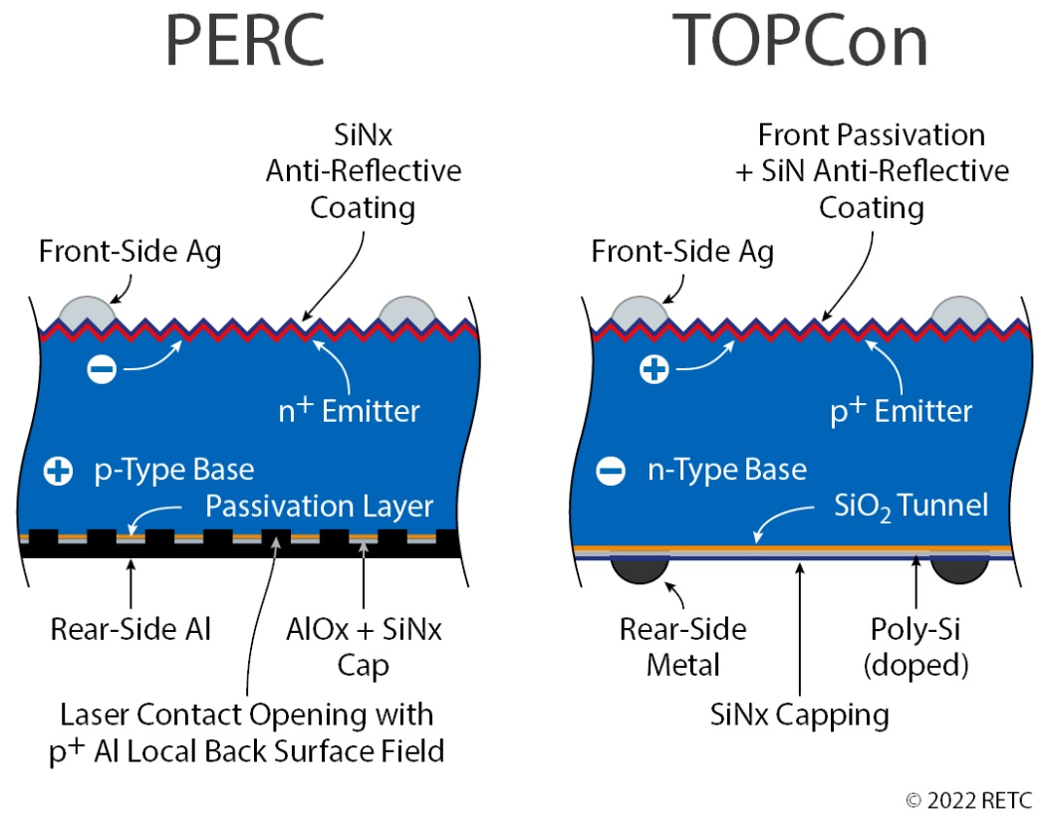
Momentum gathers behind n-type cells, motivated by lower degradation and better heat tolerance
Mechanisms behind PERC and TOPCon PV cell types
Observations
Solar cells are structured with a P-N junction, featuring a p-type and an n-type c-Si.
The upper, thinner layer is the emitter; the lower and thicker layer is the bulk region.
  P-type (PERC): Doped with boron and is positively (+) charged
  N-type (TOPCon): Doped with phosphorous and is negatively (-) charged
  Depletion zone is the “traffic zone,” where upward and downward electrons bump into each other.
P-type panels suffer from boron oxygen defects and light-induced degradation (LID)
  Boron reacts with any oxygen in the silicon, reducing effective power generation.
  LID happens in the early mornings when light first hits panels.
N-type panels do not suffer from LID nor thermal degradation, rendering it an appealing alternative.
Sources: Bhor, My Solar Quotes; RETC
Credit: Taicheng Jin, Hyae Ryung Kim, and Gernot Wagner. Share with attribution: Kim et al., “Scaling Solar” (23 September 2024).

Slide 20
PERC cells have gained 65% market share, quickly replacing BSF
(-81%) since 2019, but TOPCon looms large
P-type mono PERC has become the dominant cell type since 2019
Observations
Cell type refers to the materials and configurations applied to the polysilicon wafer to transform it into a functional PV cell.
Since 2015, we have seen a shift in cell production where the BSF cell type has been gradually replaced by the PERC cell type.
  BSF solar cells: Traditional crystalline silicon cells with an aluminum layer at the back that creates a back surface field. This reduces recombination losses and slightly improves efficiency.
  PERC solar cells: An advanced version of BSF cells. In addition to the aluminum back, they have a passivation layer and a dielectric layer that reflects more light back into the cell, improving efficiency.
The PERC cell type boosts the efficiency of monocrystalline cells by about 1%.
The share of other cell types is projected to keep increasing (TOPCon cells boost efficiency of PERC by about 2%).
Back Surface Field (BSF)
Passivated Emitter and Rear Cell (PERC)
Other Cell Types
100%
80%
60%
40%
20%
0%
2015
2016
2017
2018
2019
2020
2021
2022e
Note: Other cell types include TOPCon, heterojunction technology, and back contact.
Sources: IEA, Solar PV Global Supply Chains (p. 25) ; Solar Magazine, A Complete Guide to PERC Solar Panels; Solar Magazine, TOPCon Solar Cells; The New PV Module Technology
Credit: Taicheng Jin, Max de Boer, Lara Geiger, Marcelo Cibie, Hyae Ryung Kim, and Gernot Wagner. Share with attribution: Kim et al., “Scaling Solar” (23 September 2024).

Slide 21
HJT, perovskite, and multi-junction cells boast higher efficiency but have yet to replace c-Si at commercial scale
1
2
3
 | Silicon heterojunction cells (HJT) | Perovskite cells | Multi-junction cells
Description | HJT incorporates thin layer(s) of undoped and doped amorphous Si (a-Si:H) on both sides of the crystalline silicon (c-Si) core used in regular solar PV cells. Indium tin oxide is the preferred transparent conductive oxide layer. | Perovskites, or halide perovskites, are a family of metal-based halides that have a distinct octahedral crystal structure with the potential to replace crystalline silicon in PV cells. | Whereas traditional solar cells have only one layer of crystalline silicon, multi-junction solar cells contain multiple layers of photovoltaic material. Each layer is specifically designed to absorb a different sunlight wavelength.
Efficiency | ~26–29% | ~26–34%* | ~30–47%** (depending on number of layers)
Estimated cost per watt | ~$1.10–$1.60 (~10% more expensive than monocrystalline cells) | ~$0.32–$0.37 (~70% cheaper than monocrystalline cells) | ~$300 (~240x more expensive than monocrystalline cells)
Pros and cons | Has better performance at higher temperatures than crystalline silicon cells; ─ useful in desert environments, for example Requires more expensive materials for electrical contacts than regular silicon cells | Can be produced at much lower temperatures than crystalline silicon, leading to lower costs Degrade when exposed to moisture and oxygen, leading to shorter cell life spans | Require much less space because of higher efficiency — therefore, can be used in satellites, for example Different layers made of rare elements are much more expensive than crystalline silicon
(*) Highest efficiencies achieved for perovskite cells that also incorporate a crystalline silicon layer in a multi-junction setup; pure perovskite cell efficiency is ~26.1% (2023). (**) Highest efficiencies achieved in combination with concentrators.
Sources: Akkerman and Manna, 2020; US EERE, Perovskite Solar Cells; IEA, ETP Clean Energy Technology Guide; NREL, Photovoltaics Research; NREL, Crystalline Silicon Photovoltaic Module Manufacturing Costs; Pv-Manufacturing.org, Silicon Heterojunction Cells; SolarReviews; US DOE, Multi-junction PV research; US DOE, Perovskite Solar Cells; Z. Song et al., Manufacturing Cost Analysis of Perovskite Solar Modules
Credit: Taicheng Jin, Hassan Riaz, Max de Boer, Lara Geiger, Marcelo Cibie, Hyae Ryung Kim, and Gernot Wagner. Share with attribution: Kim et al., “Scaling Solar” (23 September 2024).

Slide 22
Efficiency of perovskite cells increased ~85% over 10 years
(6% CAGR) vs. multi-Si’s ~61% gain over 40 years (1% CAGR)
Significant efficiency gains have been achieved for most cell types in past 10 years
Observations
Poly-Si cells have still improved somewhat in recent years, but efficiency gains for mono-crystalline cells have been minimal since the 1990s.
Perovskite cells have booked the most impressive efficiency gains:
  Regular perovskite cells’ efficiency improved by 12% between 2021 and 2023 to 26%.
  Perovskite - Si tandem cells, which consist of a perovskite cell layered on top of a regular c-Si cell, improved by 10% between 2015 and 2023 to 34%.
In multi-junction cells, most efficiency gains have been booked recently for three-junction (three layer) cells (7% since 2002) ─ even getting close to four-junction cells.
Highest confirmed cell efficiency for research solar PV cells in lab conditions (in %)
40
Monocrystalline Si cell
Multicrystalline Si cell
35
Silicon heterojunction cell
Perovskite cell
Perovskite - Si tandem cell
30
Two-junction cell
Three-junction (or more) cell
25
20
+85%
15
10
Note: For the sake of simplicity, many nascent technologies have been left out of this chart. For the full interactive version of this chart, please see here. Source: NREL, Photovoltaics Research
Credit: Taicheng Jin, Max de Boer, Lara Geiger, Marcelo Cibie, Hyae Ryung Kim, and Gernot Wagner. Share with attribution: Kim et al., “Scaling Solar” (23 September 2024).

Slide 23
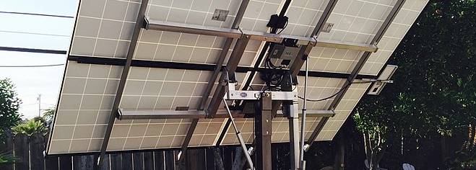
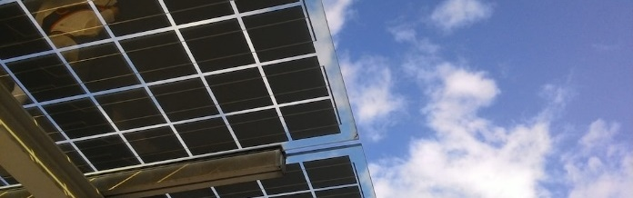
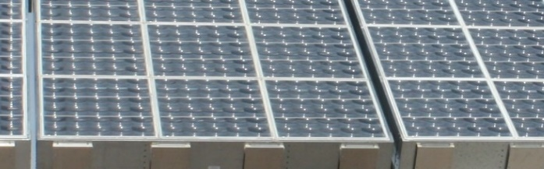
Panel modifications such as tracker and concentrators could increase efficiency by an additional 40+%
1
2
3
 | Solar trackers | Bifacial solar PV | Concentrator PV (CPV)
Description | Single-axis trackers follow the position of the sun as it moves from east to west; more common in utility projects. Dual-axis trackers follow the sun both east to west and north to south; more common in commercial projects. | Bifacial solar modules have solar cells on both sides of the panel. The backside uses light that is reflected off the ground. | Panels consist of a large array of mirrors angled at a single solar PV cell, which is often a more efficient and expensive cell like a multi-junction cell. Panels work only in areas with strong direct sunlight and need trackers to achieve the highest efficiency.
Estimated efficiency gain | Single-axis tracker: +25–35% Dual-axis tracker: +35–45% | Up to +30%, depending on the surface below the panels | Monocrystalline cell: +5–10% Multi-junction cell: +10–20%
Estimated additional cost | Residential scale: +40–100% Utility scale: +7–10%* | +10–20% | Price estimates vary — up to 30% cheaper in the right circumstances.
(*) For utility-scale, single-axis tracker.
Sources: California Energy Commission, Self-Tracking Concentrator Photovoltaics; EnergySage, Solar tracking systems; NREL, A Bottom-Up Cost Analysis of a High Concentration of PV Module; Marketwatch, A Guide to Bifacial Solar Panels; Renogy, Bifacial Solar Panels; Penn State, Concentrating Solar PV; PVPS, Trends in Photovoltaic Applications (2022); SolarReviews, Solar trackers
Credit: Taicheng Jin, Max de Boer, Lara Geiger, Marcelo Cibie, Hyae Ryung Kim, and Gernot Wagner. Share with attribution: Kim et al., “Scaling Solar” (23 September 2024).

Slide 24
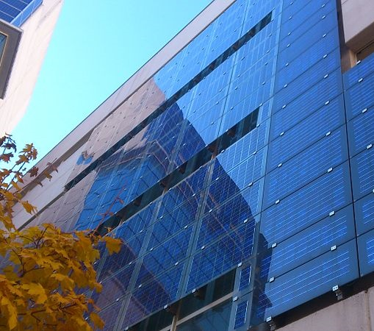
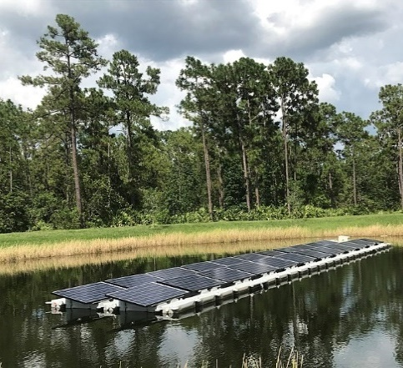
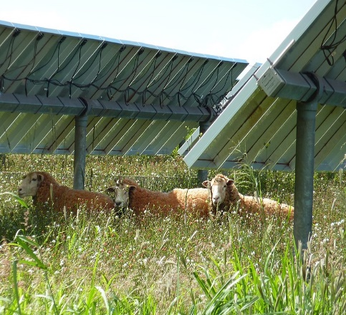
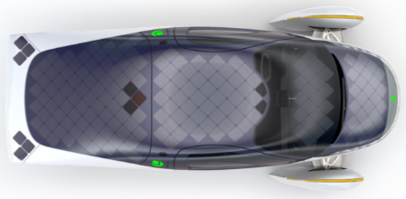
Solar has been tested in many deployment scenarios, integrating with agriculture, urban architecture, and personal mobility
Building integrated PV (BIPV)
 | BIPV serves a dual purpose: generating electricity and insulating building from the environment. Panels can be retrofitted; the greatest value is gained by including them in the initial building design. Aesthetically pleasing: Blends seamlessly to a building’s façade and roof, or when integrated into windows using semi-transparent thin-film Generation efficiency: Tends to be less efficient than traditional PV
Floating PV (FPV) or floatovoltaics
 | FPV consists of panels placed on water, often near hydroelectric dams. The panels can be rotated to track the sun; water below keeps the panels cool, increasing efficiency. Space efficiency: Doesn’t require scarce land, and available water surfaces are abundant; Japan, with scarce land, is a leader in FPV Higher costs: Currently, requires higher upfront investment and maintenance costs than traditional PV
Agrivoltaics
 | Agrivoltaics refers to the colocation of PV panels and crops, grassland, or animal husbandry. Space efficiency: By coexisting with existing farmland, expands available space for PV installation Dual income: Provides diversified income streams for farmers Higher costs: Currently, requires higher upfront investment in BoS components vs. traditional PV
Vehicle integrated PV (VIPV)
 | VIPV refers to the integration of thin-film PV into the roof or bonnet of electric vehicles. VIPV modules blend seamlessly into the vehicle’s exterior and connect to the electric loads or battery. Increases mileage Decreases load on charging infrastructure Generation efficiency: Vehicles are not oriented to optimize for the utilization of solar energy
Sources: BBC, Floating solar panels; Fraunhofer ISE, Vehicle-Integrated PV; PVPS, Trends in Photovoltaic Applications (2022); SEIA, BIPV; US DOE, The Potential of Agrivoltaics
Credit: Isabel Hoyos, Max de Boer, Lara Geiger, Marcelo Cibie, Hassan Riaz, Hyae Ryung Kim, and Gernot Wagner. Share with attribution: Kim et al., “Scaling Solar” (23 September 2024).

Slide 25
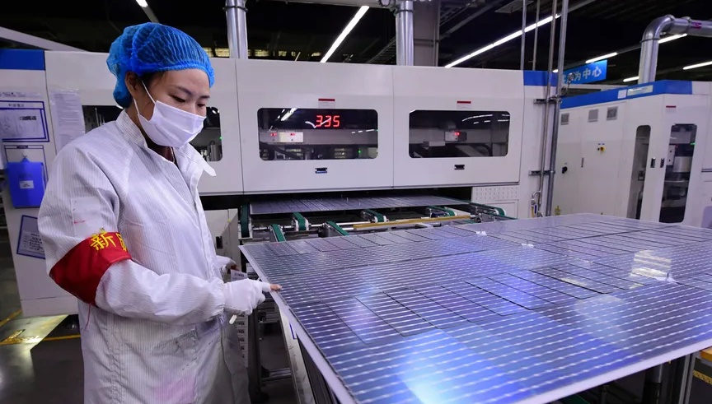
Solar Supply Chain

Slide 26
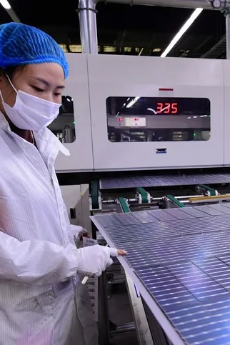
The solar panel production process consists of five main steps: (1) the carbothermic reduction of quartzite (SiO₂) to form metallurgical Si, (2) creation of polysilicon through CVD or FBR, (3) slicing of casted ingots into wafers, (4) transformation of wafers into cells, and (5) combination of cells into panels, which are stacked, laminated, and fitted with frames and junction boxes.
Silicon and silver make up >50% of the material costs of solar c-Si panels, with other major material costs being glass (~13%), aluminum (~11%), polymers (~9%), and copper (~9%).
Currently, manufacturing capacity exceeds demand along each step of the production process by at least 70%. Overcapacity is expected to persist until at least 2030.
Over time, China has become the dominant player along every step of the solar panel production chain, with at least 75% market share in every step. China’s market dominance is driven by low production costs and high investment barriers.
Solar module production is the most localized step of the supply chain, with 19 countries having more than 1 gigawatt of assembly capacity.
Key messages
Solar Supply Chain
Credit: Isabel Hoyos, Taicheng Jin, Max de Boer, Lara Geiger, Marcelo Cibie, Hyae Ryung Kim, and Gernot Wagner. Share with attribution: Kim et al., “Scaling Solar” (23 September 2024).

Slide 27


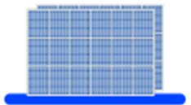


SiO₂ is refined to produce ingots, which are cut into wafers and then assembled into cells and modules
Polysilicon from (Si) is abundant but does not occur in pure form. First, SiO_{2,} the second most abundant mineral on earth, is refined to metallurgical-grade silicon (98-99% pure). Next, met-grade silicon goes through the Siemens process to remove final impurities. The result is chunks of polysilicon with >99.99999% (7-10N) purity. |  | Next, the chunks of polysilicon are melted into ingots. For poly-Si ingots, the polysilicon is simply melted and allowed to solidify, forming many small polysilicon crystals. Monocrystalline ingots are formed using the Czochralski process. A polysilicon seed is dipped into the molten polysilicon, slowly lifted, and rotated. The result is an ingot that consists of one large single crystal cylindrical column. |  | Polysilicon ingots are then sawn into wafers either through a slurry-based or diamond wire method. In the slurry method, the ingot is passed onto rotating wires spaced equidistantly and mixed with silicon carbide solution. The diamond wire that has been covered in small diamond particles is gradually replacing the slurry method. The product is a wafer that measures only 200 micrometers thick – about 2.5x the size of a human hair. |  | A wafer is transformed into a solar cell by applying several steps. The major ones are: Boron is added to create positive (p-type) wafers and phosphorous to create negative (n-type) wafers in a process called doping. Metallic contacts are applied to the front and back of the wafer through which electricity can flow. An antireflective coating is applied to help the cell absorb more sunlight. |  | In the final step, multiple solar cells are combined to form a single solar panel or module. First, solar cells are soldered together to form an array. The cells are then encapsulated in plastic, and a separate insulating back sheet is added. Finally, several arrays are soldered to a metal frame and a connector that connects the panel to the grid is added.
Polysilicon
Ingots
Wafers
Cells
Panels / modules
Sources: PV Education, Refining Silicon; PV Manufacturing, Wafering; images from IEA, Solar PV Global Supply Chains.
Credit: Taicheng Jin, Hassan Riaz, Max de Boer, Lara Geiger, Marcelo Cibie, Hyae Ryung Kim, and Gernot Wagner. Share with attribution: Kim et al., “Scaling Solar” (23 September 2024).

Slide 28
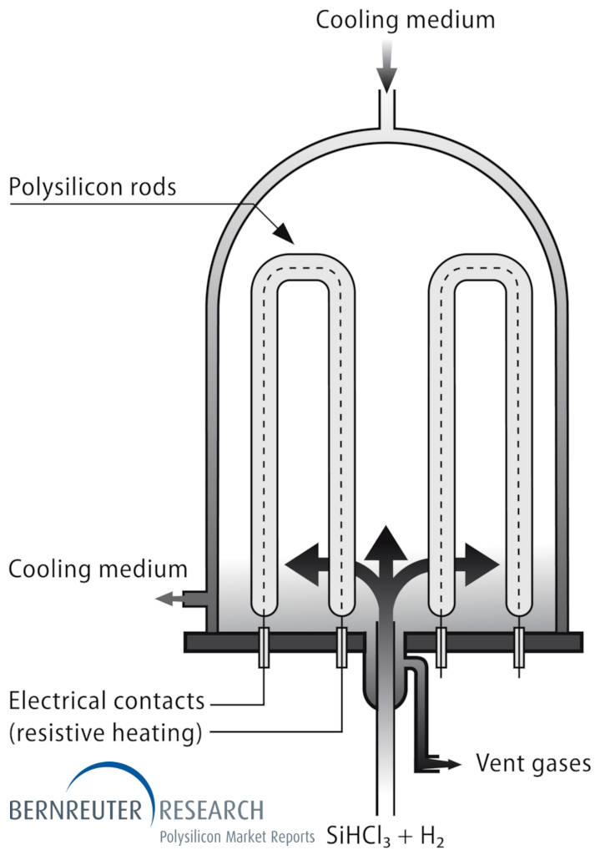
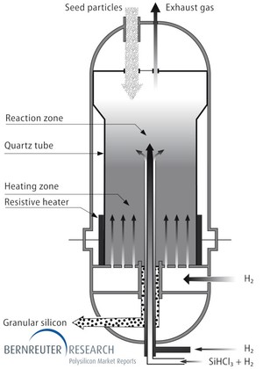
Demand for fossil fuels in the refinement step contributes most of the CO2 in the supply chain
… but FBR is catching up
Siemens dominates 80% of production
Observations
Silica undergoes carbon-thermic reduction, which requires arc furnaces to be heated up to ~1500 to 2000 degrees Celsius.
Next, Poly-Si is refined either through the Siemens process (left) or the FBR process (right)
The exergetic efficiency of silicon production is around 0.33 - 0.41, which means only about one-third of the available energy is successfully converted into useful work.
The high energy consumption of sustaining electro-arc furnaces means access to cheap energy sources, which until now has largely been fossil fuel-sourced electricity, is further contributing to GHG emissions.
Some look to FBR for energy reduction (10-12%). GCL-Poly’s 10K MT plant reduced CO₂ emission by 130,000 tonnes (-74% to the Siemens process).
Most carbon emissions are in the production phase, specifically 41% from poly-Si refinement.
PERC P-mono has a 10% higher life-cycle carbon emission than PERC P-poly.
Left figure: The Siemens process, which uses trichlorosilane, reacts with H₂ and accretes on rods through chemical vapor deposition.
Right figure: Silicon-containing gas is injected together with hydrogen (H₂) through nozzles at the bottom to form a fluidized bed that carries tiny silicon seed particles fed from above.
Source: Bernreuter Research, Takla et al. 2013, PVTech (2021), Yin et al. 2022
Credit: Taicheng Jin, Hyae Ryung Kim, and Gernot Wagner. Share with attribution: Kim et al., “Scaling Solar” (23 September 2024).

Slide 29
Silicon and silver make up the bulk of material cost; cell-to-module assembly represents the largest chunk of in-house cost (~60%)
Breakdown of total cost (cents per watt) – (Q3, 2023)
Material composition shares of c-Si
solar panels (in %) – (world, 2021)
Observations
Silicon input accounts for around 15% of total in-house cost:
  Silicon and silver make up >50% of materials costs of solar c-Si panels, but material use is becoming more efficient.
  Polysilicon intensity for c-Si cells dropped by more than six times between 2004 and 2020 thanks to cell efficiency improvements.
Cell to module is nearly 60% of total in-house cost.
  Cells are stringed and placed between sheets of EVA (ethylene vinyl acetate) and laminated; the structure is then supported with aluminum frames.
Big, integrated companies can exert pressure on small players that have less cost control.
  Companies with cost advantage and cash holdings will end up expanding market share.
100%
Other 4%
10
Silicon 4%
Silver
16%
Polymers 9%
80%
Aluminum
13%
Copper 9%
8
60%
6
Silicon
40%
4
40%
Glass
70%
Polymers
9%
2
20%
Aluminum
11%
Glass
13%
0
Silicon Cost
Silicon to Wafer
Wafer to Cell
Cell to Module
In-house Cost
0%
By weight
By value
Source: Sinovoltaics, adapted from BloombergNEF, data as of Q3 2023. Cash cost assumes in-house production from polysilicon modules to integrated solar makers, D&A, SG&A excluded.
Median used for silicon cost: $6 ~$7/kg, $2.14/g polysilicon, $1=¥7 when referring to mainland China factories.
Note: Material composition percentages are averages. Source: IEA, Solar PV Global Supply Chains; pv-manufacturing.org
Credit: Taicheng Jin, Isabel Hoyos, Max de Boer, Lara Geiger, Marcelo Cibie, Hyae Ryung Kim, and Gernot Wagner. Share with attribution: Kim et al., “Scaling Solar” (23 September 2024).

Slide 30
~60% cost reduction from R&D efficiency improvements, ~20% from economies of scale, ~10% from yield from learning by doing
Change in manufacturing parameters (’80-’20)
Polysilicon prices peaked in 2022
Observations
Polysilicon prices rose to $39 per kilogram due to COVID-related closures of Chinese production facilities between 2020 and 2022; as restrictions eased and new production capacity grew, prices fell back to less than $10 per kg.
  With new capacity still being added, analysts estimate the price could drop under $7 per kg in China in the near future.
Global wafer production has shifted from <158.7 mm wafer sizes to larger sizes since 2017.
Larger wafer sizes use fewer grams of polysilicon per watt, driving considerable cost savings.
Manufacturing overcapacity may temporarily decline in coming years as factories pause for upgrades needed to produce larger wafer sizes.
China’s actual polysilicon price by month ($/kg)
$39/kg
40
COVID (’19-’22)
Russia-Ukraine conflict (’22 - present)
+27%
-6%
30
Yield (%)
20
Share of material cost (θ)
Module efficiency (η)
Silicon usage = cm
10
$6/kg
-84%
+81%
0
2017
2018
2019
2020
2021
2022
2023
2024
Source: Our World in Data using IRENA data (2023); Nemet (2009); Farmer & Lafond (2016); Kavlak et al. (2018); Our World in Data using Lafond et al. 2017, IRENA, and de la Tour (2013); BloombergNEF (2024); IEA, Solar PV Global Supply Chains (p.24), Business AnalyticIQ; PV Magazine, Polysilicon prices can hit all-time low
Credit: Taicheng Jin, Isabel Hoyos, Hassan Riaz, Hyae Ryung Kim, and Gernot Wagner. Share with attribution: Kim et al., “Scaling Solar” (23 September 2024).

Slide 31
Solar PV manufacturing capacity exceeds demand at every step by at least 70%; overcapacity is expected to last at least until 2030s
Since 2017, solar PV manufacturing capacity has outstripped demand
Observations
Since 2015, global solar PV manufacturing capacity has consistently exceeded demand.
Global capacity is expected to more than double in the next five years, based on investment announcements and the expected impact of industrial policies:
  IRA – United States
  The Green Deal – EU
  Production Linked Initiative – India
With demand in 2030 expected at 800 gigawatts per year, all currently announced production capacity would result in a 30% overcapacity in 2030.
Global solar PV manufacturing capacity along steps of the value chain (in GW)
1,600
Solar PV demand
1,400
Polysilicon
Wafers
1,200
Cells
Modules
1,000
  In 2022, the lowest capacity in the production chain was for polysilicon at 439 GW vs. demand of 261 GW, resulting in 70% overcapacity.
800
600
400
200
0
2015
2016
2017
2018
2019
2020
2021
2022
Announced capacity
2030
exp.
demand
Note: Expected demand in 2030 is based on IEA’s Net Zero Emissions (NZE) scenario. Source: IEA, Solar PV manufacturing capacity (2023)
Credit: Taicheng Jin, Hassan Riaz, Max de Boer, Lara Geiger, Marcelo Cibie, Hyae Ryung Kim, and Gernot Wagner. Share with attribution: Kim et al., “Scaling Solar” (23 September 2024).

Slide 32
Panel production is the most localized step; various countries have added capacity, but China’s growth is unmatched
Panel production across the globe has increased but nowhere as fast as in China
Observations
Solar module production is the most localized step of the supply chain, with 19 countries having more than 1 gigawatt of assembly capacity.
  However, these facilities are often heavily dependent on the import of Chinese solar cells.
After China, Vietnam, Malaysia, Korea, and Thailand collectively make up 15% of global module capacity. However, capacity in these countries was developed by Chinese companies focusing on exports to the United States.
Many countries across the world are expected to add future capacity, but with China already having announced 300 gigawatts of future capacity, it is expected to remain dominant.
Global solar PV panel production (in GW)
0
20
40
60
80
100
120
140
160
180
200
220
240
2015
63
2016
87
2017
98
2018
105
2019
123
2020
145
2021
192
2022e
225
China
Vietnam
Malaysia
Korea
India
United States
Taipei
Germany
Other
Source: IEA, Solar PV Global Supply Chains (p. 28)
Credit: Taicheng Jin, Max de Boer, Lara Geiger, Marcelo Cibie, Hyae Ryung Kim, and Gernot Wagner. Share with attribution: Kim et al., “Scaling Solar” (23 September 2024).

Slide 33
China grew to dominate over ~75% of the market for every chain of the supply chain, especially in wafer production (>97%)
Polysilicon
Wafers
Cells
Modules
Observations
China’s share in all solar PV manufacturing stages exceeds 75%, which is more than double its 36% share in global PV demand.
In cells and modules production, China faces some competition from Southeast Asia. Mostly from Vietnam, Malaysia, and Thailand.
North America and India are projected to get more involved in wafers, cells, and modules production by 2027.
2010
2015
2021
2027e
2010
2015
2021
2027e
2010
2015
2021
2027e
2010
2015
2021
2027e
China
Europe
North America
APAC
India
Rest of world
Sources: IEA, Solar PV Global Supply Chains (p.18); IEA, 2027 Solar PV Global Supply Chain Projections
Credit: Taicheng Jin, Max de Boer, Lara Geiger, Marcelo Cibie, Hyae Ryung Kim, and Gernot Wagner. Share with attribution: Kim et al., “Scaling Solar” (23 September 2024).

Slide 34
China’s low production costs are enabled by vertical integration and a focus on mega-scale plants
Lowest production costs globally
Lowest investment costs for new plants
Observations
Driven by government investments in the early 2000s, China built an enormous lead in solar PV manufacturing
Over the past 10 years, producers have also vertically integrated along the value chain to realize further economies of scale
Finally, China now has extensive expertise in developing mega-scale PV manufacturing facilities that no other country can match
Total production costs for mono PERC c-Si solar components
by input (2022, USD per watt)
Investment required for new solar PV production capacity
(in USD millions per GW of production capacity)
0.50
160
152
Materials
China
Energy
Europe / US
0.40
Manufacturing labor
India
Depreciation
120
114
ASEAN
Other overhead costs
0.31
0.33
0.30
0.29
0.24
0.25
0.26
80
76
72
0.20
40
31
0.10
0.00
0
China
ASEAN
India
United States
Korea
Europe
Polysilicon
Ingots, wafers
Cells
Modules
Source: IEA, Solar PV Global Supply Chains
Credit: Max de Boer, Lara Geiger, Marcelo Cibie, Hyae Ryung Kim, and Gernot Wagner. Share with attribution: Kim et al., “Scaling Solar” (23 September 2024).

Slide 35
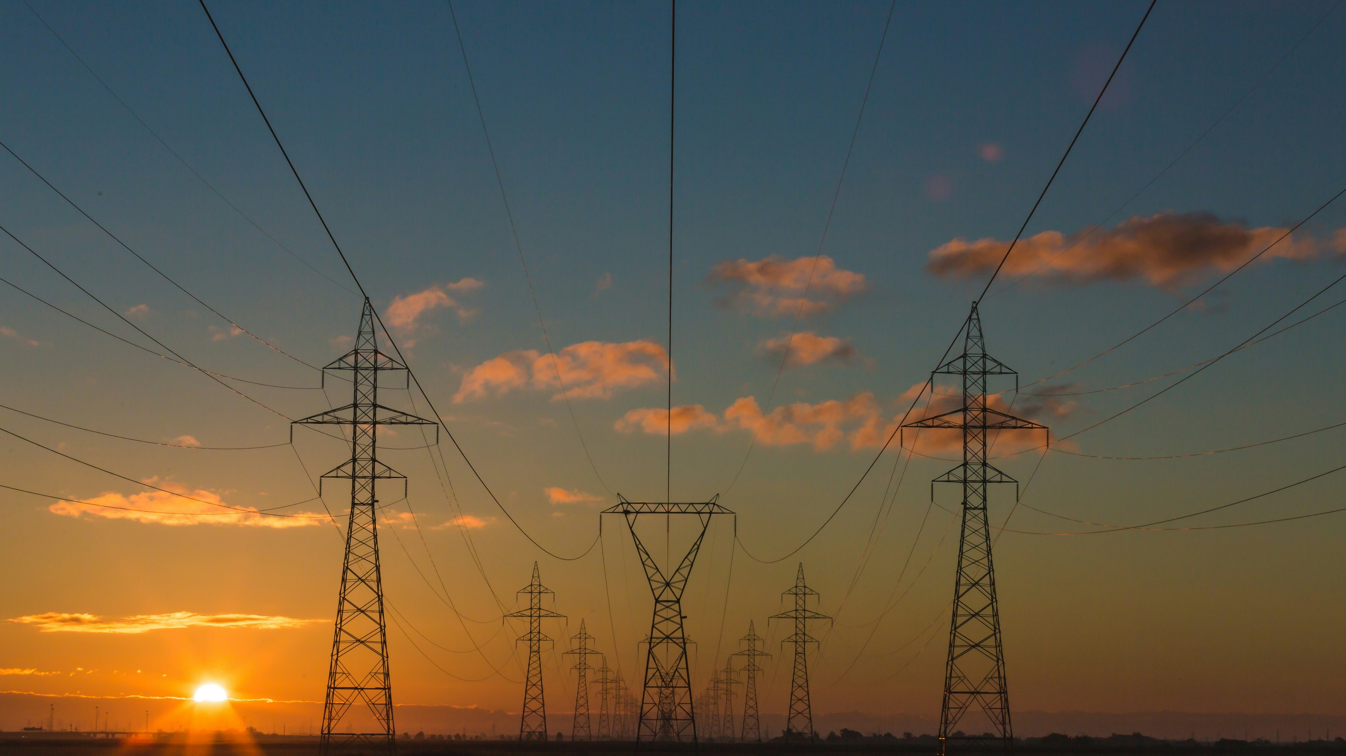
Solar Deployment Landscape

Slide 36
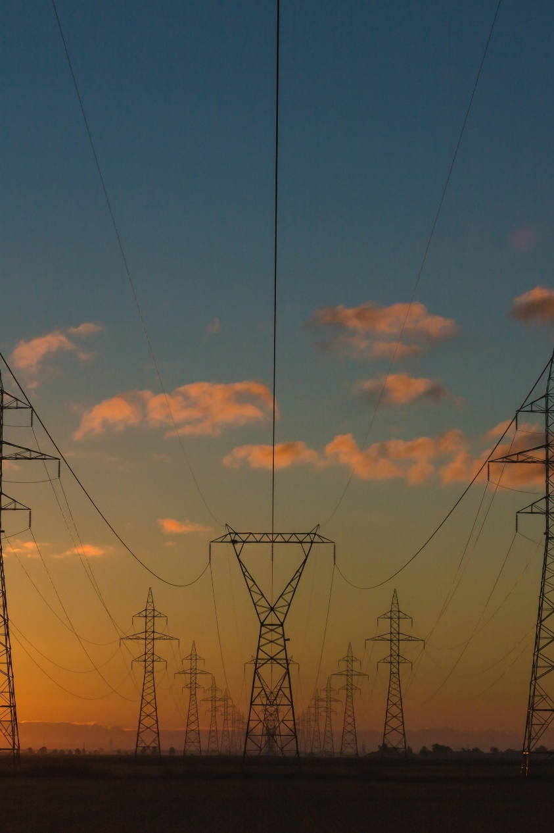
To achieve net zero by 2050, solar PV capacity must grow 15-fold — from 1,600 TWh in 2023 to 25,000 TWh in 2050.
  Only 55% of global solar PV generation capacity has been deployed by utility companies.
  Residential capacity has proportionally grown the fastest at +31% (’17–’22 CAGR), while utility capacity has grown the most in absolute terms from 230 TWh to 961 TWh (+731 TWh ’17-’22).
Residential solar challenges include financing access.
  Recently in the United States, solar loans and direct purchases gained traction over once-dominant third-party ownership models.
  Utilities either pay homeowners directly for their power (direct payment mechanisms) or give credits to offset future consumption (credit systems).
  Community solar projects are a different way for non-homeowners to get access to solar PV.
Commercial and industrial players can opt for on-site installation of solar panels, signing a power purchase agreement (PPA) or opting for a solar lease with a solar PV provider.
  PPAs have surged in popularity recently, with global volume covered by PPAs growing from 14 GW to 110 GW from 2016 to 2021.
  Solar leases have also grown in popularity in the Northeast corridor and recently California with very attractive lease rates ranging from $68,000 to $100,000 a year per 100,000 square feet.
Key messages
Solar Deployment Landscape
Project finance has become an increasingly popular financing method for utility-scale solar PV projects given a surge in projects covered by PPAs. Project finance benefits include:
  Risk isolation
  Ability to optimize capital structure
Credit: Isabel Hoyos, Taicheng Jin, Max de Boer, Lara Geiger, Marcelo Cibie, Hyae Ryung Kim, and Gernot Wagner. Share with attribution: Kim et al., “Scaling Solar” (23 September 2024).

Slide 37
To achieve net zero by 2050, solar PV capacity must grow 15-fold from current levels
Solar PV generation must grow from 1,600 TWh in 2023 to 25,000 TWh in 2050
Observations
Electricity generation is the largest source (36%) of energy‐related CO₂ emissions today.
Global electricity demand is expected to increase from ~25,000 TWh in 2022 to ~60,000 TWh in 2050.
Increase in electricity demand is driven by:
  Advanced economies: Increased electrification and expansion of hydrogen electrolysis
  Emerging economies: Population growth and increase in living standards
In the predicted NZS by 2050 scenario, solar is forecasted to reach 25,000 TWh of electricity per year (~100% of today’s energy production).
  Forecast is based on current solar adoption trends, competing economics between other technologies, and total forecasted power generation.
Economic Transition Scenario (ETZ) in thousands TWh
Net Zero Scenario (NZS) in thousands TWh
90
90
Unabated coal
Nuclear
80
Coal with CCS
Unabated oil
80
Unabated gas
Other
70
Gas with CCS
Solar
70
Other renewables
Wind
60
Hydrogen
60
50
50
40
40
30
30
20
20
10
10
0
0
2000
2005
2010
2015
2020
2025
2030
2035
2040
2045
2050
2000
2005
2010
2015
2020
2025
2030
2035
2040
2045
2050
Sources: BloombergNEF, IEA
Credit: Taicheng Jin, Hassan Riaz, Max de Boer, Lara Geiger, Marcelo Cibie, Hyae Ryung Kim, and Gernot Wagner. Share with attribution: Kim et al., “Scaling Solar” (23 September 2024).

Slide 38
~70% of solar PV investment comes from private sources, mostly commercial financial institutions and corporations
Global renewable energy finance,
by type of investor (2020)
Global renewable energy finance,
by technology (2020)
Observations
In 2020, 68% of funding for solar PV came from private sources.
  Private capital tends to flow to regions with low risk, making public investment in regions like Sub-Saharan Africa necessary.
  State-owned financial institutions and national development finance institutions provided most of the public funding for renewable energy in 2020.
Households and individuals accounted for 10% of investment in all renewable energy in 2020 — 85% of that for solar PV.
Commercial financial institutions and corporations accounted for ~59% of all renewable energy investment in 2020.
Institutional investors accounted for only 1% of investment in renewable energy in 2020 and tend to favor established technologies like solar PV and onshore wind.
  In 2020, solar PV accounted for 74% of renewable energy funding by institutional investors.
100%
$348B
$339B
2%
Commercial Financial
Institutions
100%
2%
2%
Solar PV
3%
3%
3%
90%
90%
Solar thermal
including CSP
Corporation
80%
State-Owned Financial
Institutions
80%
Bioenergy
Hydropower
70%
Households/Individuals
70%
Other
National Development
Finance Institutions
Onshore wind
60%
60%
Offshore wind
State-Owned Enterprises
50%
Multilateral Development
Finance Institutions
50%
40%
Government
40%
30%
Institutional Investors
Bilateral Development
Finance Institutions
30%
20%
Funds
20%
10%
10%
0%
0%
Investment by percentage
Sources: CPI and IRENA (2023); IRENA, Investment trends
Credit: Isabel Hoyos, Taicheng Jin, Hassan Riaz, Hyae Ryung Kim, and Gernot Wagner. Share with attribution: Kim et al., “Scaling Solar” (23 September 2024).

Slide 39
Residential solar incurs relatively high soft costs; commercial & industrial and utility-scale face long permitting processes
1
2
3
 | Residential | Commercial & industrial | Utility-scale
Description | Powers a single residence Typically installed on rooftops or backyard, consisting of an average of 8 to 20 panels 2–10 kW | Powers a commercial business, including small businesses and large manufacturing facilities Typically installed on rooftops or adjacent land 10 kW–10 MW | Large-scale solar projects that generate power to feed the energy grid, supplying a wide array of potential off-takers (spot market, commercial, industrial, and utility companies) 10 MW or larger
Global cumulative installed capacity, 2023 | 319 GW | 371 GW | 794 GW
US system price ($ per watt), 2024 | $3.25 | $1.46 | $0.98–$1.08
Deployment options | PPAs Lease Loan Direct purchase | PPAs Direct purchase for on-site installation Lease | Project-level financing (equity or debt) Balance sheet (equity or debt) Grants VPPAs
Stakeholders | Homeowners (off-takers) Financial institutions Contractors and installers Solar and energy storage equipment manufacturers | Corporate and industrial customers (off-takers) Project developers and EPCs (engineering, procurement, construction) Project financiers Contractors and installers Local government agency project owners Solar and energy storage equipment manufacturers Solar project owner | Off-takers Project developers and EPCs (engineering, procurement, construction) Project financiers Contractors and installers Local government agencies Solar and energy storage equipment manufacturers Solar project owners
Challenges | Relatively high soft costs Relatively high cost per watt | Relatively long permitting process Interconnection roadblocks | Relatively long permitting process Interconnection roadblocks
Sources: SEIA (2024); IEA; Wood Mackenzie (June 2024)
Credit: Isabel Hoyos, Taicheng Jin, Hyae Ryung Kim, and Gernot Wagner. Share with attribution: Kim et al., “Scaling Solar” (23 September 2024).

Slide 40
~55% of installed solar PV capacity comes from utility, rest from commercial and residential
Strongest growth in recent solar PV deployment comes from residential projects
Observations
Residential solar PV trends:
  Governments support residential solar PV rollout through net metering and tax breaks and credits.
  Electricity price increases in Europe make residential solar more attractive.
  Self-sufficiency concerns return to US.
Large-scale (C&I and utility) trends:
  High electricity prices in the EU (as a result of natural gas) drive profits for renewables.
  Considerable growth in China:
    New business models in China, like power transmission via underutilized ultra-high-voltage transmission lines, enable faster solar PV rollout.
    Rising electricity prices in China, due to internalization of externalities from coal-electricity, speeds up PV deployment.
Global cumulative installed solar capacity by producer type (in TWh)
CAGR
’15-’24
1,800
+25.2%
1,600
Residential
+31%
1,400
1,200
Commercial
& Industrial
+20%
1,000
800
600
Utility
+23%
400
200
0
2015
2016
2017
2018
2019
2020
2021
2022
2023
2024
Note: Off-grid capacity in 2022 is 9 GW.
Sources: IEA, Renewables 2022, IEA, Solar Power PV Capacity
Credit: Taicheng Jin, Hassan Riaz, Max de Boer, Lara Geiger, Marcelo Cibie, Hyae Ryung Kim, and Gernot Wagner. Share with attribution: Kim et al., “Scaling Solar” (23 September 2024).

Slide 41









Residential solar can be financed with different structures — key difference is actual ownership
Residential
 | Description | Who owns the system? | Upfront costs | Long-term benefits for homeowner | Example companies (US)
Solar PPA | Agreement where a company installs a solar system on a homeowner’s property. The company owns the panels and is responsible for maintenance. The homeowner buys the generated electricity from the company, at a rate that is often lower than the retail grid rate. | Company | None | Lower Also highly dependent on contract terms
Solar lease | Agreement where a company installs a solar system on a homeowner’s property. The company owns the panels and is responsible for maintenance. The homeowner pays the lease company a fixed monthly lease fee, giving them the right to use the produced electricity. Revenue from excess electricity production is allocated to either the company or homeowner, based on the lease agreement. | Company | None | Lower Also highly dependent on contract terms
Solar loan | The homeowner borrows money from a bank or other institution to finance the purchase and installation of a solar system on their home. The homeowner repays the principal and interest over time. | Homeowner | None – Low | Higher
Direct purchase | Direct purchase of a solar system by a homeowner, without the involvement of any other third party. | Homeowner | High | Highest | Not applicable
In the United States, the residential solar PV market has shifted over the past 10 years from third-party ownership models (PPA and lease) to solar loans and direct purchases.
Sources: EnergySage, Top solar leasing companies; NREL, Residential Solar PV: Comparison of Financing Benefits, Innovations, and Options; SEIA, Solar Power Purchase Agreements;
SolarReviews, Solar leases
Credit: Max de Boer, Lara Geiger, Marcelo Cibie, Hyae Ryung Kim, and Gernot Wagner. Share with attribution: Kim et al., “Scaling Solar” (23 September 2024).

Slide 42

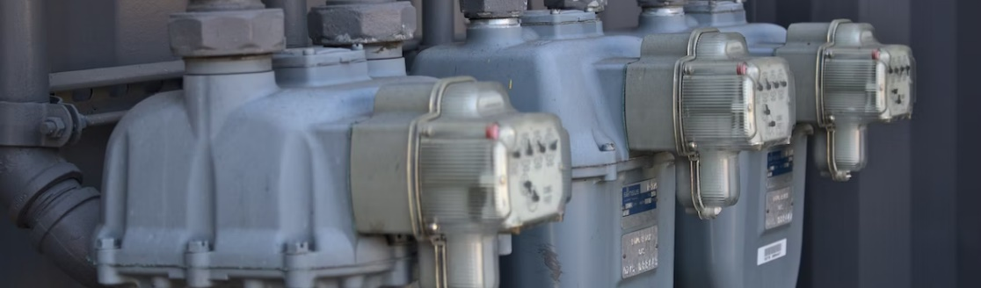
Consumers can receive either direct payments or credits for surplus electricity produced
Residential
Direct payment mechanisms
Credit systems
Description
Homeowners receive direct financial compensation for all the electricity they produce.
Typically, homeowners pay the retail rate for any electricity they themselves use.
Financial compensation can be set below, at, or above the retail rate of electricity depending on
policy goals.
Homeowners receive credits for any surplus electricity their solar panels feed back into
the grid, which can be used to offset future consumption.
When the received credit is valued at the retail price of electricity, we call it net metering; if the value is lower (e.g., at wholesale rate), it’s called net billing.
Examples
Feed-in tariffs, value-of-solar tariffs
Net metering, net billing
Sources: EnergySage, Feed-in tariffs, EnergySage, Net metering vs. net billing; NREL, Value of Solar Tariffs
Credit: Max de Boer, Lara Geiger, Marcelo Cibie, Hyae Ryung Kim, and Gernot Wagner. Share with attribution: Kim et al., “Scaling Solar” (23 September 2024).

Slide 43
Pay-as-you-go structure can bring affordability, expand service, and improve financial inclusion
Residential
Roles and responsibilities of different stakeholders
Observations
Electrification is a priority, but grid expansion is expensive and has a long lead time. Therefore, distributed solar PV, coupled with pay-as-you-go (PAYG) could be an answer.
  Kenya and Tanzania represent 85% of market share, but deployment is also in other countries, including Ethiopia, Uganda, Sierra Leone, Malawi, and Zimbabwe.
PAYG structure: A home solar system that customers pay for using mobile payment technologies and mobile phone credit.
  Certain rural populations have access to mobile internet and ample solar potential but don’t have access to financial accounts.
Combination of payment rules and ownership and financing schemes:
  Lease to own: Customers pay for the entire generation capacity (i.e., solar home system) in small installments over a period of one to three years.
  Usage-based: Customers prepay for the electricity supply (in kilowatt-hours).
Energy service provider
Financier
Mobile network operator
Provides system components, installation, and operations and management, and collects payments from customers
Provides funding to the ESP for installing solar home systems
Receives payment from user
Provides machine-to-machine tech and monitoring
Provides mobile services to enable payments
Process: Installation → Payment by user with Mobile Money → Activation code sent by ESP → User input coded into PAYG → System unlocked for a set allowance
Sources: IRENA, PAYG Models; USAID, PAYG Solar as a driver of financial inclusion
Credit: Isabel Hoyos, Taicheng Jin, Hyae Ryung Kim, andGernot Wagner. Share with attribution: Kim et al., “Scaling Solar” (23 September 2024).

Slide 44


Commercial companies can install panels or buy electricity through a power purchasing agreement
Commercial
On-site solar installation
PPA
Attribution required
No attribution required
Description
Companies can deploy larger solar systems on their properties (e.g., flat roofs of manufacturing halls) typically around ~500 kW, in contrast to 5 to 20 kW for residential setups.
These systems often operate “behind the meter,” with energy either consumed on site or sold back to the grid with feed-in tariffs.
An agreement between a company and an owner of a solar installation (e.g., a utility or a financial institution) to buy energy directly.
This long-term agreement locks in a fixed rate, ensuring stability for the provider and often securing discounted rates for the buyer compared to current wholesale prices.
Pros
Significant cost savings, as all produced energy comes at a marginal cost of zero dollars
Often allows company to make use of tax benefits (consisting of federal investment tax credit and accelerated depreciation)
Fixed prices provide certainty and stability for financial planning
Company has no concerns about installation or maintenance, which is all done by the solar installation owner
Cons
Requires CapEx for purchase and installation and has maintenance costs over time
Continued dependence on grid electricity at wholesale rate when panels are not producing electricity
Requires long-term commitment (10 to 20 years)
Company will not benefit financially if energy prices drop
Sources: Avana Capital, Solar PPAs; Coldwell Solar, What Is a Commercial Solar PV System; US DOE, Power Purchase Agreement
Credit: Max de Boer, Lara Geiger, Marcelo Cibie, Hassan Riaz, Hyae Ryung Kim, and Gernot Wagner. Share with attribution: Kim et al., “Scaling Solar” (23 September 2024).

Slide 45
PPAs have surged in popularity over the past few years, driven by companies looking to make credible sustainability commitments
Commercial
Strong growth in the signing of PPAs over past 5 years, especially in US
Observations
Corporate power purchase agreements have become increasingly popular.
  Companies are setting public sustainability goals with renewable energy as a focal point.
  A growing focus on additionality, which prioritizes adding new capacity over using existing ones, is shifting companies from buying green energy certificates to PPAs.
There is still potential for growth: Columbia University’s Center for Global Energy policy estimates that only 3% of the US commercial and industrial energy market is covered by PPAs.
  Despite being the largest PPA market, the US has seen deals decrease by 16% from a record high in 2022 due to interest rate and PPA price CGEP.
Regulatory challenges also remain a barrier in many markets, with issues ranging from state-controlled utilities to restrictions on transporting electricity to the end user for PPAs.
Global volume of corporate power purchase agreements signed per year (in GW)
50
Americas
PPAs are now active in 75 countries, including the US, EU, China, and India
46.0
45
EMEA
APAC
40.9
40
35
31.1
30
25
25.1
20
20.2
15
13.6
10
6.2
5
4.7
4.3
1.0
2.3
0
2013
2014
2015
2016
2017
2018
2019
2020
2021
2022
2023
Note: Graph excludes on-site PPAs. Pre-reform PPAs in Mexico and sleeved PPAs in Australia are excluded.
Sources: CGEP, The role of Corporate Renewable PPAs; Climate Group RE100; WEF, Clean Energy CPPAs
Credit: Max de Boer, Lara Geiger, Marcelo Cibie, Hyae Ryung Kim, and Gernot Wagner. Share with attribution: Kim et al., “Scaling Solar” (23 September 2024).

Slide 46
Community solar is an increasingly popular way for more consumers to access the benefits of residential solar PV
Commercial - Community
Community solar deployment focused on small number of states
Observations
Community solar is a solar project an asset owner pursues with residential participants signing up to receive a share of the benefits and funding the project.
Homeowners, renters, and businesses can have equal access to community solar, including low- to moderate-income customers. This builds a stronger, more distributed, and more resilient electric grid.
Customers either buy or lease a part of a larger, off-site solar PV site.
A utility company buys the electricity generated by the community solar project. In return, the participants receive credits to offset their own electricity bills.
New community solar capacity added by year and state (in MWac)
2,200
2,129
2,100
Florida
2,000
Minnesota
1,800
New York
1,600
Massachusetts
Texas
1,400
Illinois
1,250
1,282
1,200
New Jersey
1,000
Maine
Colorado
784
800
Arcanzo
712
600
Maryland
577
593
400
Other
Potential growth in 2024
200
143
8
25
44
0
2013
2014
2015
2016
2017
2018
2019
2020
2021
2022
2023
2024*
(*) Data through June 2024; annual growth estimated.
Sources: NREL, Community Solar Deployment (2024); NREL, Community Solar 101
Credit: Isabel Hoyos, Hassan Riaz, Max de Boer, Lara Geiger, Marcelo Cibie, Hyae Ryung Kim, and Gernot Wagner. Share with attribution: Kim et al., “Scaling Solar” (20 March 2025).

Slide 47
Utility-scale PV can take a variety of equity-debt structures, but project finance with tax equity remains a preferred staple
Utility-scale
Typical project finance waterfall (accounts)
Excelsior Energy’s $1.41 billion package for Faraday Solar
Observations
Since 2013, the share of debt financing in global renewable investments has increased from ~23% to ~55%, primarily driven by increased cash flow visibility through PPAs.
Since 2004, project finance has become an established financing alternative, increasing its share from ~15% to ~35% of renewable energy asset finance.
Project finance offers two main benefits to renewable projects vis-à-vis balance sheet alternatives:
  Corporate or balance sheet financing: Decision is based on the entire balance sheet of a company
  Project finance: On the cash flow generating capacity of a special purpose vehicle (SPV)
  Use of an SPV, legally and commercially separate from the project developer
  SPV financed with limited guarantees from the project developer; lenders do not have recourse on the other businesses of the project developer and rely on the project’s cash flows for repayment
Project Revenues
Tax Equity (PTC Partnership)
$1.41B
Syndicated Loan
Construction / Operating
C&O expenses
Tax Equity Bridge Loan
Ancillary Facilities
Debt Payment
Fees, interest / principal
Typical lending fees for project financing:
(i) 2–6% of the aggregate loan commitment as an arranging or structuring fee
(ii) 1% of aggregate loan commitment as a syndication fee
(iii) $75,000 annual administrative agency fee
(iv) $50,000 annual collateral agency fee
(v) Facility fees to each lender in the syndicate in an amount between 0.75–1.5% of each lender’s commitment.
In addition, the project company will be required to pay the professional fees and administrative expenses of each of the lenders in evaluating the transaction, negotiating the loan documents, and providing the loans.
Debt Service Reserve
Maintain debt service reserve
Maintenance Reserve
Maintain maintenance reserve
Subordinated Debt
Payment of sub-debt
Distribution
Distribute to equity holder
Sources: FS-UNEP (2020); CPI (2023); Steffen (2018), The importance of project finance for renewable energy projects; Pv magazine; WSGR
Credit: Isabel Hoyos, Taicheng Jin, Hassan Riaz, Hyae Ryung Kim, and Gernot Wagner. Share with attribution: Kim et al., “Scaling Solar” (23 September 2024).

Slide 48
There are many options for utility-scale solar to raise debt, each with its advantages regarding debt load, rate and tenor, and risks
Utility-scale
Options for utility project to raise debt
Syndicated and club loans (BSL)
Coordinated by one or more arranger bank, whereas in club deals, a handful of lenders take equal roles in leading
A group of banks each take a portion of a larger loan so minimize the risk
Syndicated loan structures are often preferred to accessing the capital markets through 144A offerings because:
  Capital markets investors are generally less likely to assume construction risk
  The disclosure documentation for a 144A offering is generally more extensive than that prepared in connection with syndicating a commercial loan
Project bonds (144A)
Private placement through 144A offerings:
  Exempt from registration with the SEC if the purchasers are “qualified institutional buyers under the Securities Exchange Act of 1933
Amount raised disbursed at closing, leads to negative carry
Less restrictive covenants
Issued in relatively small amounts (making them ideal for smaller project financing)
Fixed rate with certainty → removes the upside potential of floating rates that are available pursuant to commercial bank loans
Faster to execute andless inexpensive than BSL
Term loan B (TLB)
Shorter tenors and lower or delayed amortization, often with bullet payments due at maturity
Higher risk profiles and usually were non-investment grade
Terms and conditions less onerous than traditional project debt that amortized over a longer period
As a result of the subprime lending crisis and the subsequent credit crunch, TLB market all but disappeared
Construction loans
Used only for the period in which the project is under construction
Interest rate can be higher vis-a-vis a term loan (reflecting increased risk to lenders during the construction period), but more frequent drawdowns of construction loans permitted
At the end of the construction loan availability period, construction loan usually converts to a term loan
Working capital loans
Primarily for ordinary course expenses such as inventory purchases
Sized smaller than construction or term loans and subject to a maximum available amount tied to the value of a project company’s inventory and cash (often 80%)
Usually revolving in nature, meaning amounts borrowed can be reborrowed once they are repaid
Source: WSGR
Credit: Taicheng Jin, Hyae Ryung Kim, and Gernot Wagner. Share with attribution: Kim et al., “Scaling Solar” (23 September 2024).

Slide 49
Parties to a ‘bankable’ project generally include a sponsor, lender(s), the project company, and an off-taker
Utility-scale
Facility Agreement
Advantages of Project Finance
Easy project management:
  Customers invest less time and resources in the project than if they were to do it themselves. And contracting with the same company for operations and management later could mean (1) legal enforceability and (2) less of a learning curve with its own installment.
Better financing terms:
  Less need for owner’s equity contribution allows access to debt, as a cheaper form of capital financing; risk offloading also increases lenders’ appetite.
Risk allocation:
  The project risk is shifted to the EPC contractor. The contractor is responsible for all project activities from the design phase through to the turnkey moment.
Lenders
Off-taker
PPA
Guarantor / Security Trustee
Tripartite Agreement*
NSP
Connection Agreement
Landowner
Lease
Solar PV Project Company
O&M operator
O&M Agreement
Responsible Authority
Development Approval
EPC Contractor
EPC Contract
Sub-contract side deed
Buyer
Share Purchase Agreement
Supply Contract
Equity Investor(s)
Shareholder’s Agreement
Developer/ Sponsor
Supplier(s)**
(*) Tripartite agreements are between the project company, the security lender/guarantor, and one of: landowner, contractor, O&M, NPS, and off-taker.
(**) Key supplies could be directly purchased and allocated to the EPC by the project company.
Source: PwC, EPC Projects in the Solar Industry
Credit: Taicheng Jin, Hassan Riaz, Isabel Hoyos, Hyae Ryung Kim, and Gernot Wagner. Share with attribution: Kim et al., “Scaling Solar” (23 September 2024).

Slide 50
Project finance sequesters risk, optimizes cap structure, and offers alignment of interests for all parties involved
Utility-scale
Advantages of project finance
Risk isolation
Alignment of interests
Optimized capital structure
Flexibility in ownership
A special purpose vehicle (SPV) isolates risks, commercially and legally, and provides separation from project developer.
The only risk for the project developer is its invested capital.
If the project encounters difficulties, lenders would have claim only against the project's assets, not the broader assets of the developer.
By creating a distinct project entity, all stakeholders, from investors to suppliers, hold aligned incentivized for its success, as returns are tied to project performance, not the developer's broader assets.
Predictable cash flows from fixed-rate power purchase agreements can support a higher debt load.
Debt financing allows retaining of equity and overall is a more cost-effective form of capital with certain tax advantages.
A distinct project entity offers easier transfers in ownership or sales of the project to third parties at various stages of the project.
Sources: FS-UNEP, Global Trends in Renewable Energy Investment; Steffen (2018), The importance of project finance for renewable energy projects
Credit: Taicheng Jin, Isabel Hoyos, Max de Boer, Lara Geiger, Marcelo Cibie, Hyae Ryung Kim, and Gernot Wagner. Share with attribution: Kim et al., “Scaling Solar” (23 September 2024).

Slide 51
Most of operating period term loans in the US are back levered to tax equity, a unique form of equity with loan-like characteristics
Typical back-leverage financing structure
Observations
Projects have high levels of contracted revenue, limited variable OpEx, and relatively predictable cash flows, often held in an LLC and taxed as partnerships.
Tax equity typically covers 35% of the cost of a typical solar project, plus or minus 5%.
JPMorgan and Bank of America dominate 80% to 90% of the market but could face headwinds as capital requirement* is set to quadruple under Basel III.*
The market is forecasted to grow from $20 billion to $50 billion with recent innovations in transferability of tax credits.
  Blackstone’s Foss & Co. ITC transfer.
  Bank of America's launch of a tax credit transfer desk in 2023
Typical Structures
Partnership flip (P-flip): Investors contribute cash for tax benefits up to a certain date (~5 years), after which the partnership terms flip. The developer instead receives the bulk of the tax benefits
and cash.
Sale leaseback (SLB): The developer sells the solar system to a tax equity investor that leases the system back to the developer.
Sponsor
Back-Levered Lenders
Back-Levered Loans
Borrower
Tax Equity Investor
Tax Equity Partnership
Collateral Package
Typical flip schedule
 | Sponsor |  | Tax Equity Investor
Period | Tax | Cash | Tax | Cash
1 | 1% | Majority share | 99% | Minority share
2 | 95% | 95% | 5% | 5%
Project Co.
Project
(*) Currently at 100% risk weight if bank’s total equity investments are below 10% of its capital. The excess equity investments exceeding 10% of a bank’s capital would be assessed at 400% risk weight.
Sources: US DOE, GoCardless, YSGSolar
Credit: Taicheng Jin, Isabel Hoyos, Hyae Ryung Kim, and Gernot Wagner. Share with attribution: Kim et al., “Scaling Solar” (23 September 2024).

Slide 52
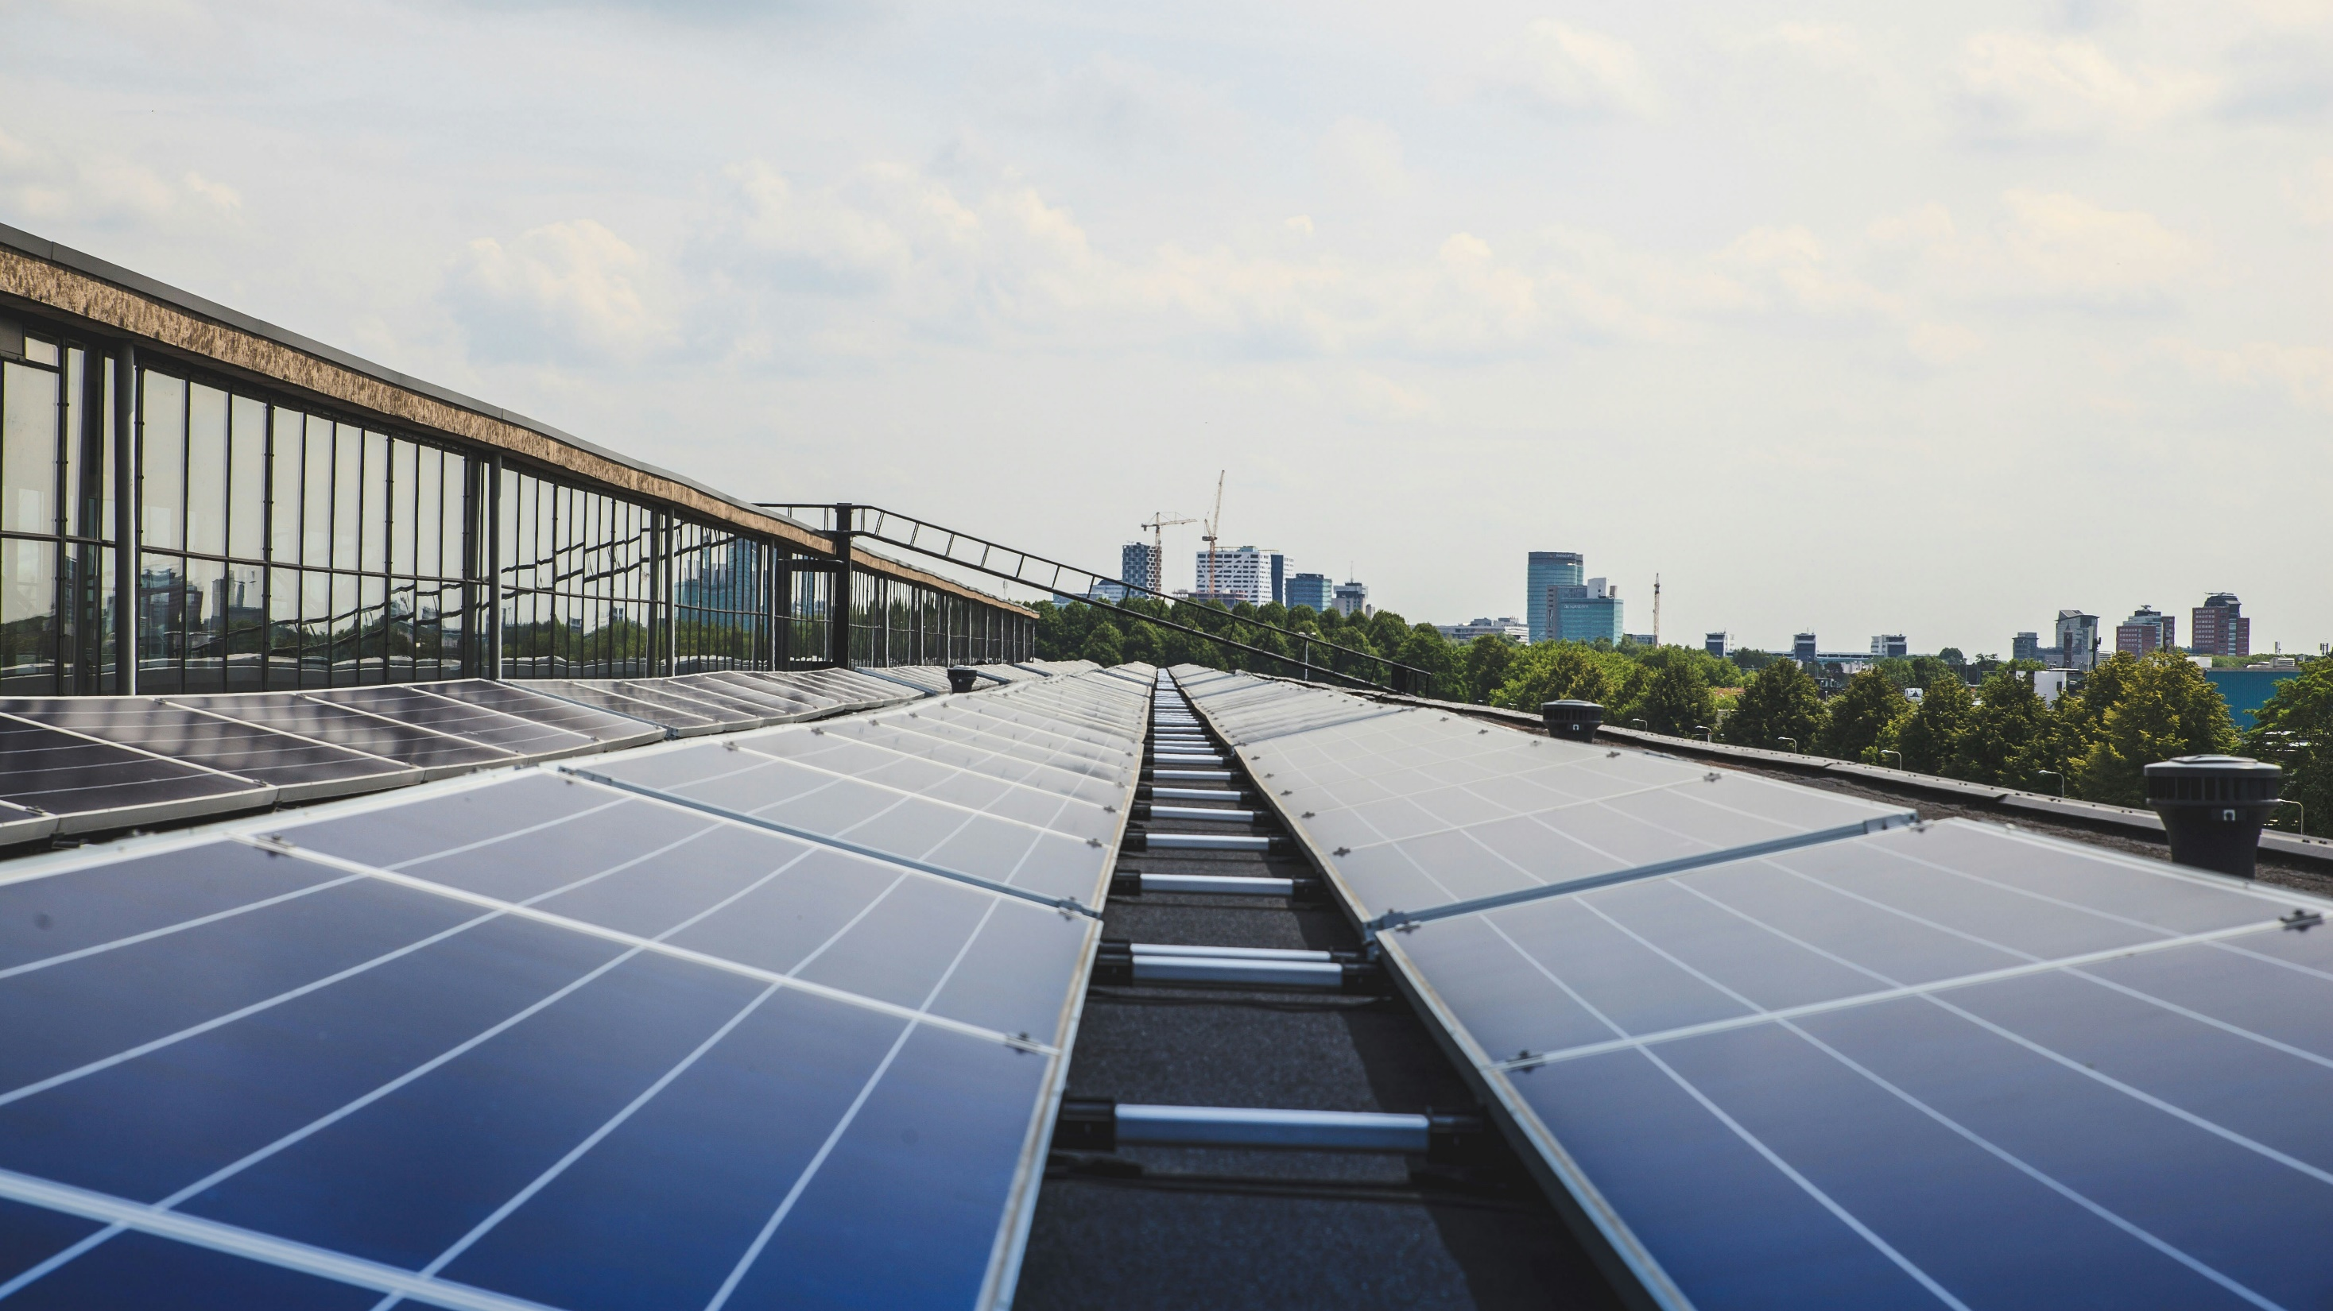
Solar Policy Landscape

Slide 53
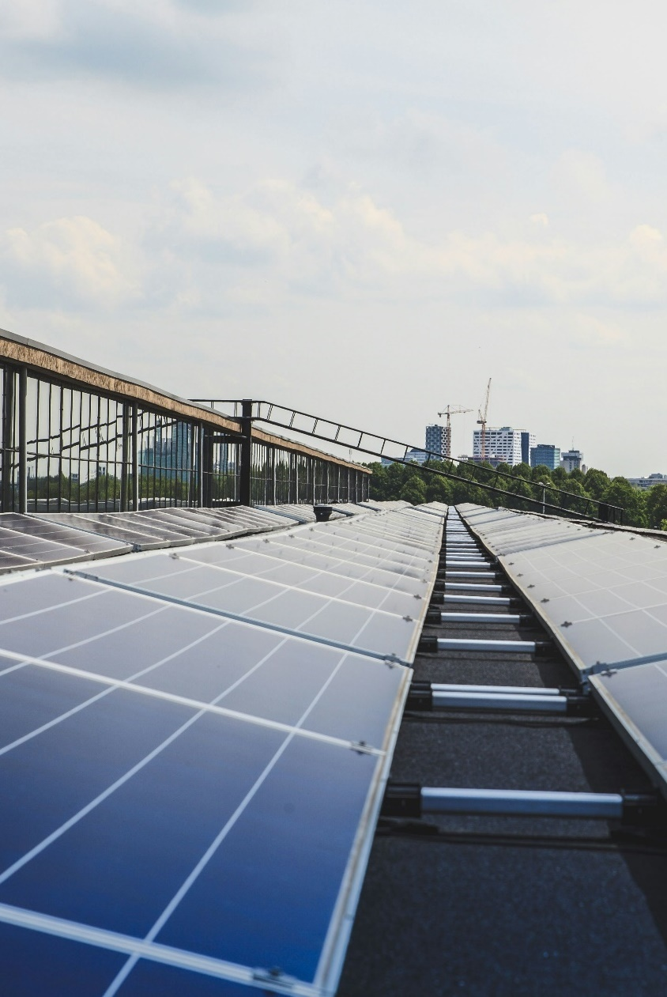
Governments worldwide have implemented solar PV supportive policies, including subsidies and tax breaks, feed-in tariffs, and net metering. In 2010, feed-in tariffs backed 85% of global solar PV; by 2021 that dropped to only 28%, with other policies covering 49% and 23% operating without support.
China has an installed solar capacity of ~6 GWh in 2023 (21% of total power generation capacity).
  China’s 11th to 14th Five-Year Plans, from 2006 to 2021, focus on electrification, supply-side support for renewable energy, and a “great push” for solar and wind.
In response to China’s market dominance, the US has introduced advanced manufacturing tax credits, put tariffs on imported solar PV components, and included a domestic content bonus in the solar tax credits for businesses to encourage domestic production.
By extending and increasing solar tax credits, the US Inflation Reduction Act of 2022 has mobilized $42 billion from 2022 to 2024 and is projected to generate an additional ~50% (~160 GW) of solar capacity by 2033.
  Residential Solar Energy Credit: 30% of the expenses of an installed solar PV system can be subtracted from federal income taxes
  Solar Investment Tax Credit (ITC): 30% (up to 50% if certain conditions are met) of the expenses of an installed solar PV system can be subtracted from federal income taxes*
  Solar Production Tax Credit (PTC): ¢2.75 per kWh (up to ¢3.35 if certain conditions are met) of produced solar energy can be subtracted from federal income taxes*
  *ITC and PTC are mutually exclusive
Key messages
Solar Policy Landscape
Credit: Isabel Hoyos, Taicheng Jin, Hyae Ryung Kim, and Gernot Wagner. Share with attribution: Kim et al., “Scaling Solar” (23 September 2024).

Slide 54
Most governments’ policies focus on risk reduction or subsidies
 |  | Can be used to encourage:
Policy | Description | Residential | C&I | Utility
Direct subsidies and tax breaks | Consists of governments providing direct financial support either in the form of subsidies or tax breaks for the purchase of a solar PV system
Feed-in tariff (FiT) | A long-term, guaranteed price (often above prevailing market prices) for generated electricity from a renewable source Fixed price eliminates market price risk for developers
FiTs through tender | Developers bid on FiTs they will accept for specified generation capacity Government picks the lowest bid, leading to lower overall costs while still eliminating market price risk for developers Similar tender setup can be used for commercial power purchase agreements
Net metering (self-consumption) | Policy allowing a utility customer to subtract any power they generate from renewable sources from the power they consume Customer billed only for the difference, regardless of when the power was produced
Renewable Portfolio Standard (RPS) | A regulatory mandate that requires a certain percentage of electricity produced by utility providers in an area to come from renewable sources A common feature of RPS is the Renewable Energy Credit (REC) trading system, which can reduce compliance costs A utility that generates more renewable electricity than required may sell RECs to other utilities that do not meet the RPS requirement
Sources: Clean Energy Solutions Center, Solar Power Policy Overview and Good Practices; PVPS, Trends in Photovoltaic Applications (2022); US EIA, Portfolio standards
Credit: Max de Boer, Lara Geiger, Marcelo Cibie, Hyae Ryung Kim, and Gernot Wagner. Share with attribution: Kim et al., “Scaling Solar” (23 September 2024).

Slide 55
US Inflation Reduction Act extends and improves solar investment and production tax credits
The residential and commercial solar investment tax credits have helped the US solar industry grow by a factor of more than 200x since it was implemented in 2006, with an average annual growth of 33% over the past decade alone
Homeowners
Businesses
Residential Solar Energy Credit
Solar Investment Tax Credit (ITC)
Solar Production Tax Credit (PTC)
30%
of the expenses of an installed solar PV system can be subtracted from federal income taxes
30%
of the expenses of an installed solar PV system can be subtracted from federal income taxes
(up to 50% if certain conditions are met)
¢2.75 per kWh
of produced solar energy can be
subtracted from federal income taxes
(up to ¢3.35 if certain conditions are met)
Expenses covered by the tax credit include:
  Solar PV panels or cells
  Contract labor for installation
  Balance-of-system equipment
  Energy storage
  Sales tax
The tax credit can also be used against participation in an off-site community solar project
Expenses covered by the tax credit include:
  Solar PV panels, inverters, racking, balance-of-system equipment, and associated sales and use taxes
  Installation costs
  Step-up transformer, circuit breakers, and surge arrestors
  Energy storage devices
  Interconnection costs (for projects of 5 MW or less)
The tax credit begins phasing out in 2032 and ends by 2035, or when the US treasury secretary determines there has been a 75% reduction in annual greenhouse gas emissions.
Large-scale utility farms that have access to ample sunshine are likely to benefit from the PTC.
Business owners cannot claim the ITC and PTC for the same solar PV installation. In general, large-scale projects that are expected to generate lots of electricity benefit more from the PTC.
Sources: US DOE, Homeowner’s Guide; US DOE, Federal Solar Tax Credits
Credit: Taicheng Jin, Max de Boer, Lara Geiger, Marcelo Cibie, Hyae Ryung Kim, and Gernot Wagner. Share with attribution: Kim et al., “Scaling Solar” (23 September 2024).

Slide 56
New transferability rule provides simple fungibility to investors, reducing soft costs and eliminating uncertainties
Direct transfer reduces uncertainties, but tax equity structure could still be valuable to capture depreciation and basis step-up
Observations
IRA allows sponsors without tax appetite to sell ITC to a third party, but direct transfer has disadvantages for the sponsor.
New hybrid structures, in addition to the traditional P-flip, inverted lease, and sale leasebacks, help address challenges.
A solution to the chicken-and-egg problem:
  Elegant solution to various risks that plague development (EPC, off-take, and financing), increasing project value & viability through decreased risk premium & debt load.
  Tax appetite prompts a tax equity check which help assure lenders and secures construction financing, positively (albeit indirectly) impacting a project viability
Transferability’s value to sponsors:
  Lowers sponsor’s aversion to construction risk, who will fund a large portion of the CapEx of the project, but demand seniority under the pre-negotiated cash-flow waterfall
  Taxpayers who claim the business solar ITC could use an accelerated depreciation schedule (MACRS curve), which allows for a greater depreciation expense in the early years of the life of an asset, reducing tax liabilities; full tax basis — half the ITC depreciated over a five-year schedule using a half-year convention.
Transferability’s value to developers:
  Long-term commitment helps raise construction finance and facilitate entrance of large buyers.
  Transferability rule diffuses this problem because construction lenders will underwrite loans without a hard tax equity commitment with a more liquid, simpler tax equity market.
Factors that favor using direct transferability
Loan proceeds | Debt is “front” leverage, sized against more cash flow; less subordination and no forbearance, reduced interest rate and DSCR → WACC ↓
Equity proceeds from cash flow ↑ | Without tax investor cash allocation, more cash for equity buyer to value
Equity proceeds from target return ↓ | Simpler structure with less subordination and bigger check size → equity returns will compress further
Soft costs ↓ | Eliminates or reduces legal-, independent engineer-, insurance consultant-related costs
No tax investor buyout | Eliminates uncertainty of cash equity to make assumptions about details around buyouts in 5 to 10 years
Factors that favor sticking to full tax equity structures
Credits purchased at discount | Transferrable credits often sold at discount (95 on the dollar)
Accelerated depreciation | Value of MACRS/bonus depreciation and the TVM of avoided taxes is lost
Basis step-up (↑) | Opportunity to step-up ITC basis in SLB/LPT
Q: Avoided soft costs + lower WACC > ITC buyer discount + lost MACRS + basis step-up value
Sources: ACORE; Bloomberg Tax; David Riester, Segue, White & Case
Credit: Taicheng Jin, Isabel Hoyos, Hyae Ryung Kim, and Gernot Wagner. Share with attribution: Kim et al., “Scaling Solar” (23 September 2024).

Slide 57
Adders over next 10 to 12 years aim to boost domestic content and labor and increase deployment in low-income areas
Step-down schedules and adders for ITC and PTC
Observations
Base ─ bonus two-tier setup:
  Adders boost domestic content sourcing, energy communities, and qualified areas.
  Prevailing wage and apprenticeship allow company to claim under full case.
Step downs motivate enterprises to take advantage of construction when need is critical through reduction in tax liabilities.
But step downs could create logjams and leave developers and consumers frustrated.
The 2035 to 2036 expiration indicates a compact timeline (10 to 15 years), while many utility solar projects may need long lead-in time.
 |  |  | Start of Construction (year)
 |  |  | ’06-’19 | ’20-’21 | ’22 | ’23-’33 | ’34 (2+*) | ’35 (3+*) | ’36 (4+*)
ITC | Full (Base) | Base | 30% (-) | 26% (-) | 30% (6%) | 30% (6%) | 22.5% | 15% (3%) | 0%
 |  | Domestic Content | No Incentive |  | None | 10% | 7.5% (1.5%) | 5% (1%) | 0%
 |  | Energy Community |  |  |  | 10% | 7.5% (1.5%) | 5% (1%) | 0%
 | Low-income adder | <5 MW (LMI) |  |  |  | 10% | 10% | 10% | 10%
 |  | Qualified Projects |  |  |  | 20% | 20% | 20% | 20%
PTC | Full (Base) | Base |  |  | ¢2.75 (¢0.55) | ¢2.75 | ¢2.0(¢0.4) | ¢1.3(¢0.3) | ¢0
 |  | Domestic Content |  |  | None | ¢0.3 | 0.2 ¢ (¢0) | ¢0.1(¢0) | ¢0
 |  | Energy Community |  |  |  | ¢0.3 | 0.2 ¢(¢0) | ¢0.1(-) | ¢0
(*) Applicable date is either as after 2032 or when US treasury secretary finds that 75% reduction in annual GHG emission has been achieved compared to 2022 baseline.
(**) Base rate refers to scenario if project does not meet labor requirement (prevailing wage and apprenticeship requirement).
Source: DOE
Credit: Taicheng Jin, Hyae Ryung Kim, and Gernot Wagner. Share with attribution: Kim et al., “Scaling Solar” (23 September 2024).

Slide 58
IRA mobilized $42B from 2022 to 2024; projected to generate an additional ~50% (~160 GW) of solar capacity by 2033
Post-Inflation Reduction Act solar projections
Actual Post-IRA Solar Growth
From August 2022 to August 2024, $42 billion in investment was realized, 33 GW of solar capacity was added, and 95 new solar manufacturing facilities were announced.
Residential clean energy credit adoption has surpassed expectations, boosting deployment of residential solar.
  Over 1.2 million Americans used residential clean energy tax credits
  The government budgeted $2 billion in 2023, but actual spending was more than triple
  30% more people filed for energy efficiency and/or rooftop solar tax credits in 2022 tax returns compared with 2021
Utility-scale solar expansion is leading clean electricity expansion post-IRA, generating the majority of renewable energy capacity additions. However, clean electricity is at risk of falling short of post-IRA growth projections.
  The IRA has made renewable electricity cost competitive with coal and natural gas. With reduced cost barriers, tackling remaining non-cost barriers like permitting, intermittency, and supply chain is critical to achieving climate change mitigation goals.
Clean energy investment is growing fastest in so-called energy communities — areas with coal mine or plant closures, brownfield sites, or previously high fossil fuel employment and high unemployment.
Annual US solar installations (GW)
65
  The IRA is projected to drive an additional 160 GW of solar deployment over the next 10 years when compared to a non-IRA scenario, according to the SEIA
60
No IRA
Post-IRA
55
50
45
40
35
30
  Projections include over $565 billion in new investment over the next decade, a $144 billion increase from baseline
25
20
15
10
5
0
’24
’25
’26
’27
’28
’29
’30
’31
’32
’33
Sources: Wood & Mackenzie, The Inflation Reduction Act and its impact so far; US Department of Treasury (2024 and 2023); HEATMAP (2024); SEIA (2023); Rhodium Group (2024); American Clean Power (2024)
Credit: Taicheng Jin, Isabel Hoyos, Hyae Ryung Kim, and Gernot Wagner. Share with attribution: Kim et al., “Scaling Solar” (23 September 2024).

Slide 59
Feed-in tariffs (FiT) used to be the predominant form of support; now phased out in favor of other policies or no support at all
Less solar PV requires policy support
Global trends
A significant increase has been observed for non-incentivized solar PV (generated energy is sold at the market rate, also called merchant PV).
FiTs are becoming less popular. Existing tariffs are reduced or replaced with new pricing mechanisms:
  Feed-in premiums: Instead of guaranteeing a fixed price, government guarantees a fixed premium on top of prevailing market prices.
  Contracts for difference: These also guarantee a fixed payout per energy unit, with the government covering the gap between the agreed upon and market price.
FiTs through tender are evolving to encourage competition and shifting away from single focus on price:
  Tech-neutral tenders specify an amount of generation capacity but do not specify what renewable energy technology must be used. This puts solar PV in direct competition with wind and other forms of renewable energy.
  Multiple-factor tenders add criteria on factors such as environmental protection and local origin of components.
Evolution of solar PV global policies over time (in % of global GW of solar PV covered)
100%
3%
2%
FiT
FiT through tender or PPA
80%
Direct subsidies or tax breaks
3%
Net metering (self-consumption)
Green certificates or RPS
No policy support
60%
No policy support (self-consumption)
40%
20%
0%
2010
2015
2021
Sources: Clean Energy Solutions Center, Solar Power Policy Overview and Good Practices; PVPS, Trends in Photovoltaic Applications (2022)
Credit: Max de Boer, Lara Geiger, Marcelo Cibie, Hyae Ryung Kim, and Gernot Wagner. Share with attribution: Kim et al., “Scaling Solar” (23 September 2024).

Slide 60
From the 11th to the 14th Five-Year Plan, China’s solar strategy adapts through each iteration from 2006 to 2021
2006 | 2011 | 2016 | 2021
Electrification through (1) cleaner coal, (2) larger plants, (3) new hydro, (4) nuclear, and (5) grid capacity and west-east transportation corridors Rapid expansion into renewables through financial incentives, for the first time making solar a priority | Solar again in focus (both PV and CSP); need for more detailed guidance on materials innovation and electric vehicles and plug-in hybrid electric vehicles as strategic sectors | “Energy revolution that builds a clean, low-carbon, safe, efficient, modern energy system” through improved supply-side support Building comprehensive energy “bases” and pushing for smart “management systems” on the demand side that interacts with traffic net and internet | A “great push” for wind and solar, acceleration in distributing across east and central China First target of 20% energy demand from renewables; still a heavy focus on coal for stability and security but willing to push to replace with electrification
Observations
China’s strategy is motivated by industrial competitiveness as a slowdown in GDP growth, rising labor costs, and pollution.
Energy bases that combine wind and solar arrays in areas with low populations are excellent learning projects.
Utility SOEs pushed to learn by doing, often politically backed to stomach upfront CAPEX costs through easy access to debt financing
Strategy was looking up the supply chain, all the way to mining and processing of the rare earth and strategic minerals.
China’s total installed power generation capacity (2006 vs. 2023, GWh)
7
29
100%
1%
1%
0%
2%
90%
Hydro
80%
Oil/Gas/Coal
70%
Nuclear
60%
Wind
50%
Solar
40%
  The strategy was motivated by industrial competitiveness as GDP slows, labor costs rise and pollution increases
30%
  China’s fossil fuel as a proportion of installed capacity decreased 41%
20%
10%
0%
2006
2023
Source: CEC China
Credit: Taicheng Jin, Hyae Ryung Kim, and Gernot Wagner. Share with attribution: Kim et al., “Scaling Solar” (23 September 2024).

Slide 61




US relies on import tariffs and tax credits conditioned on local labor and content requirements
2012 and 2015: The US Commerce Department under President Obama placed an AD/CVD of about 30% on Chinese solar cells and modules, alleging that the Chinese government was subsidizing solar PV producers.
2018: The United States imposed a section 201 tariff (sunset in 2026, starting at 30% and declining to 15%) on all imported solar cells and modules, not just Chinese made (includes Canada, Mexico, Indonesia, etc.), in part to counteract Chinese firms avoiding tariffs by producing in Southeast Asia.
February 2022: President Biden announced that the section 201 tariffs would be extended (at 15%) to provide continued support for the domestic solar industry.
June 2022: US Border Control banned imports suspected of having input from Xinjiang.
May 2024: Investigation began for a fourth AD/CVD on cells from Cambodia, Malysia, Thailand, and Vietnam; result pending ITC final determination in Nov.
Sources: Enel, Unlocking the domestic content bonus tax credit; New York Times, President Biden extends solar tariffs, The Conversation, Biden extended tariffs on solar panels, US ITA
Credit: Taicheng Jin, Isabel Hoyos, Hyae Ryung Kim, and Gernot Wagner. Share with attribution: Kim et al., “Scaling Solar” (23 September 2024).

Slide 62
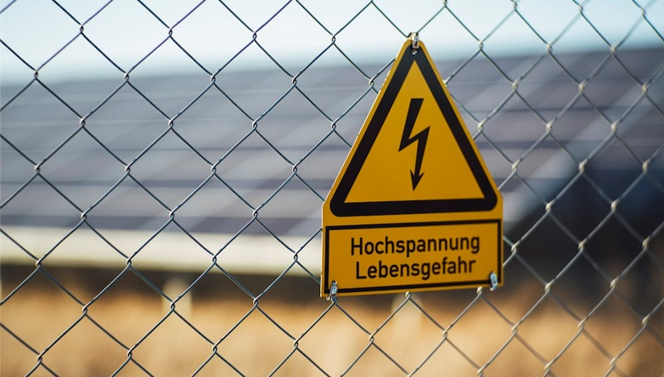
Solar PV: Overcoming Future Challenges

Slide 63
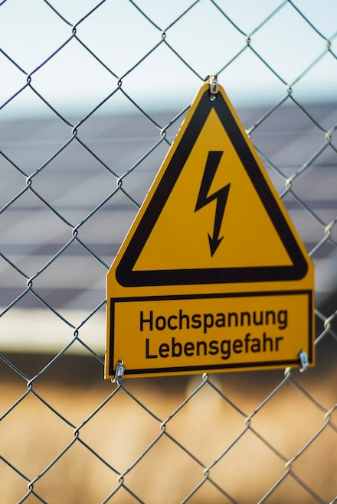
Delays caused by interconnection (connecting new solar PV projects to the grid) are now one of the biggest obstacles preventing new solar PV capacity from coming online.
  Solar and energy storage made up 80% of the US interconnection queue in 2022.
  New rules by the US Federal Energy Regulatory Commission force grid operators to study projects in batches instead of individually and prioritize those closest to construction to combat this problem.
Delays caused by permitting issues like zoning issues, environmental studies, complex regulations, and appeals are also significant obstacles to capacity deployment.
  The United States proposed the Bipartisan Permitting Reform Implementation rule in the summer of 2023 to speed up environmental assessments.
  The EU updated its Renewable Energy Directive to make permitting easier and appealing harder.
Solar PV is an intermittent source of energy.
  Demand response can incentivize power consumers to time their daily consumption during peak solar PV production hours.
  Energy storage in the form of batteries or pumped hydropower can help address both daily and seasonal variations in solar PV output.
Key messages
Overcoming Future Challenges
The annual number of solar panels reaching end of life will grow 25x in the next 30 years.
  EU panel producers are directly responsible for the costs of collecting and recycling end-of-life panels.
  China announced a national recycling program as of 2025.
  The United States has not announced a recycling initiative yet.
Credit: Isabel Hoyos, Taicheng Jin, Max de Boer, Lara Geiger, Marcelo Cibie, Hyae Ryung Kim, and Gernot Wagner. Share with attribution: Kim et al., “Scaling Solar” (23 September 2024).

Slide 64
Interconnection delay is one of the main obstacles preventing new solar capacity coming online
Solar and energy storage make up 80% of US interconnection queue in 2022
Observations
Connecting new solar PV projects to the grid is one of the largest obstacles in both the United States and EU.
These delays are caused by two major factors:
  Long feasibility studies by grid authorities, which were designed at a time when only a handful of new coal or gas plants would connect to the grid each year.
  Grids can also be at capacity, which means project developers may have to pay for new transmission lines and other upgrades or wait for grid authorities to expand the grid if major upgrades are needed.
Steps to reduce interconnection times are in the works.
  In the United States, for example, new rules by the Federal Energy Regulatory Commission force grid operators to study projects in batches vs. individually and prioritize those closest to construction.
Total capacity in the US interconnection queue at the end of each year (in GW)
800
758
700
Solar
Coal
Wind
Gas
600
Other renewables
Nuclear
597
Batteries, other storage
500
400
348
300
277
295
258
234
200
201
202
110
115
126
127
136
100
95
78
0
2007
2008
2009
2010
2011
2012
2013
2014
2015
2016
2017
2018
2019
2020
2021
2022
Note: Other renewables include geothermal; hydro; solar and wind; solar, wind, and battery; unknown and other. Sources: Berkeley Lab, Capacity in Interconnection queues;
FERC, FERC Transmission Reform; US DOE, Tackling High Costs and Long Delays for Clean Energy Interconnection; RES Policy Monitoring Database, Barriers and Best,
Practices for Wind and Solar Electricity in the EU27 and UK
Credit: Taicheng Jin, Max de Boer, Lara Geiger, Marcelo Cibie, Hyae Ryung Kim, and Gernot Wagner. Share with attribution: Kim et al., “Scaling Solar” (23 September 2024).

Slide 65






Permitting issues can cause serious delays as well, but both US and EU are taking steps to streamline the process
Typical permitting issues
The US aims to shorten environmental reviews
The Biden administration proposed the Bipartisan Permitting Reform Implementation rule in 2023 to speed up environmental assessments.
Proposed changes include:
  Two-year limit on environmental impact studies and a page limit on documents that need to be submitted for an environmental review
  Clarification of the roles of leading and cooperating agencies in conducting environmental reviews
  Climate change effects as consideration to environmental impact studies
Zoning issues
Environmental studies
For many types of suitable land (e.g., agricultural land), using it for solar PV requires rezoning.
Rezoning can take a long time, especially when there is the opportunity for appeals.
Studies assess the environmental impact of a solar PV project.
In the US, an environmental impact study for utility solar PV on federal land can take 2 to 4 years.
The EU makes applying easier and appealing harder
In response to the Russian invasion of Ukraine, the EU updated its Renewable Energy Directive, which outlines goals nation-states must achieve:
Proposed changes include:
  Two-year maximum duration for the permitting of new solar and wind projects
  Solar and wind classified as projects of overriding public interest, which reduces (but doesn’t eliminate) the possibilities for appeals
  Governments required to digitize the solar and wind permitting process
Complex regulations
Appeals
In the US, counties set regulations while following state guidelines, leading to strong variations.
In the EU, countries set their own solar PV deployment regulations.
NIMBYism* can lead to residents appealing against solar PV projects in their neighborhoods.
Even if an appeal does not lead to overturning a project approval, it can still cause significant delays.
* NIMBYism refers to “Not in my backyard” syndrome. Sources: Popular Science, Outdated Zoning Laws; RES Policy Monitoring Database, Barriers and Best Practices for Wind and Solar Electricity in the EU27 and UK;
SEIA, Utility-Scale Solar Power on Federal Land Permitting Process; Reuters, Europe on verge of permitting leap for wind, solar farms; White House, Reform to Modernize Environmental Reviews
Credit: Max de Boer, Lara Geiger, Marcelo Cibie, Hyae Ryung Kim, and Gernot Wagner. Share with attribution: Kim et al., “Scaling Solar” (23 September 2024).

Slide 66
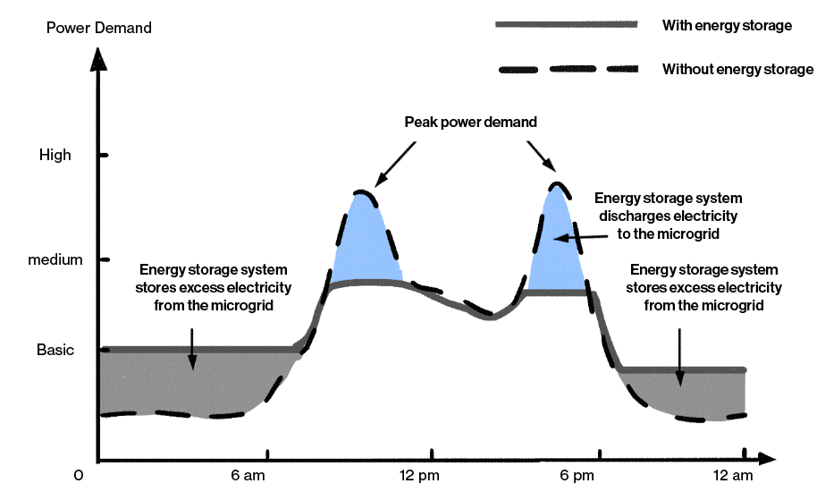
Daily and seasonal intermittency requires battery storage to smooth consumption
Energy storage helps smooth out the intermittency of output
Observations
As the sun moves across the sky during the day, it changes the angle at which the sunlight hits the panels. Generation typically peaks around noon, when sunlight directly strikes the panels.
Weather conditions also affect daily power generation. Overcast skies or fog reduce the amount of sunlight that reaches the solar panels.
Direct seasonal variation comes from the fact that the position of the sun in the sky changes throughout the year. In winter, days are shorter and the sun is lower in the sky, leading to less solar power generation.
This effect is more pronounced at higher latitudes. In regions closer to the poles, days shorten more drastically in winter.
Seasonal weather patterns also impact annual solar generation (e.g., less solar generation during rainy season in Southeast Asia).
High
Medium
Low
Sources: Scientific American, Renewable Energy Intermittency; Solar power calculator Australia; US EIA, Total Energy Overview; Tencent
Credit: Taicheng Jin, Isabel Hoyos, Hyae Ryung Kim, and Gernot Wagner. Share with attribution: Kim et al., “Scaling Solar” (23 September 2024).

Slide 67
Integrating Battery Energy Storage Systems (BESS) lowers emissions, reduces bills, and boosts reliability and self-sufficiency
Comparison of project parameter with and without storage component
Observations
Without energy storage, fossil fuels will be used to support energy deficit.
Solar can significantly reduce carbon emissions by up to 95%.
Solar-only systems designed with 100% usage usually offset only ~55% of the original bill. With storage, it is expected to offset the entire electricity bill.
The reliability as measured by LOLP can improve from 10% to 35%.
Integrating energy storage can improve residential self-sufficiency from 38% to 65%.
With energy storage, the renewable penetration could increase from between 20% and 25% to 50% in California.
Without storage
With storage
-95%
0
Carbon Emission (%)
Electricity Bill (%)
Reliability Index (%)
Self-Sufficiency (%)
Renewable Penetration (%)
Sources: Solar.com, Carbon footprint; Solar.com, Electricity bill; IEEE Xplore, Reliability Index; MDPI, Self-Sufficiency, Renewable Penetration
Credit: Xiaodan Zhu, Taicheng Jin, Hyae Ryung Kim, and Gernot Wagner. Share with attribution: Kim et al., “Scaling Solar” (23 September 2024).
Notes:
Email Xiaodan

Slide 68
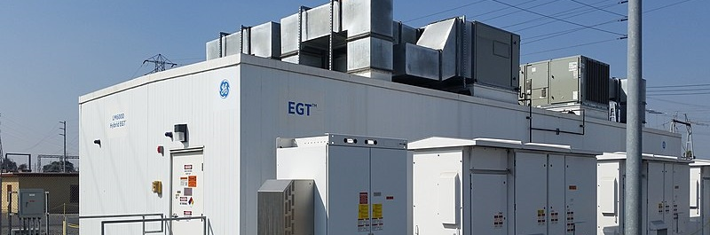
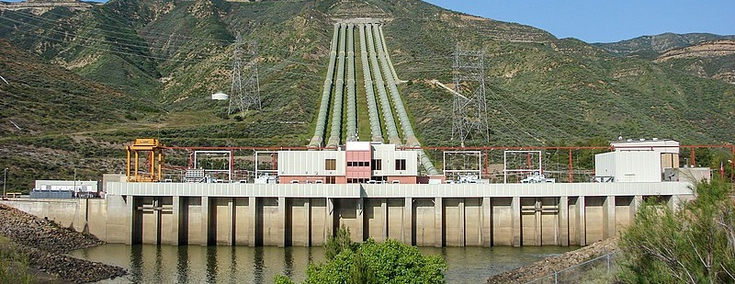
Batteries and pumped hydro are two ways to store energy
Batteries
Pumped Hydropower
Description
Solar PV power is stored as chemical energy in (most frequently) lithium-ion batteries and discharged later.
Excess solar energy is used to pump water from a reservoir of lower elevation to one of higher elevation. Later, the water is released and flows through a turbine to generate electricity.
Cost
($ per MWh)
$350 to $1,000 per MWh of annual energy output
(Lithium-ion batteries)
$200 to $260 per MWh of annual energy output
Pros
Increasing mass production of batteries (related to demand for electric vehicles) leading to continuing cost declines
Modular design allows for scalability, from residential systems to large-scale utility projects
Longest duration storage compared to alternatives like batteries
Tends to be cheaper at present than batteries for overnight and longer term storage
Cons
At present, batteries are still the more expensive option
Limited lifespan of batteries (currently about 5 to 15 years) requires replacement of equipment
Land-, water-, and capital-intensive to construct; dam construction may permanently damage surrounding ecosystems
Can be implemented only in certain geographies due to elevation required
Example installation
Kidston plant in Queensland, Australia
(250 MW storage capacity)
Victoria Big Battery in Victoria, Australia
(300 MW storage capacity)
Sources: AEI, Solar Panel Battery Storage; Understand Solar, Storing Solar Energy in Water ; BloombergNEF, Top 10 Energy Storage Trends; Greentech, Pumped Hydro; ABC News, Batteries, Solar, Wind, Hydro; The Conversation, Batteries Get Hyped; Victoria , Victorian Big Battery; Renewable Energy World, Commercializing; Entura, Batteries vs Pumped Hydro
Credit: Max de Boer, Lara Geiger, Marcelo Cibie, Hyae Ryung Kim, and Gernot Wagner. Share with attribution: Kim et al., “Scaling Solar” (23 September 2024).

Slide 69
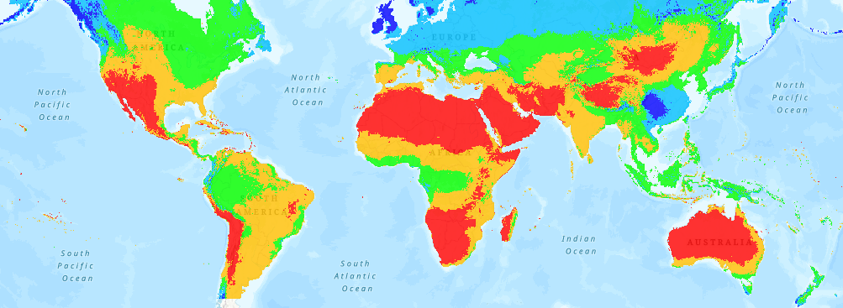
Developing countries with high solar irradiance and low seasonality can benefit from solar PV deployment
Average global solar potential (kWh/kWp)
Concentration of Solar PV Power
In approximately 70 countries worldwide, the solar PV daily output is at least 1,500 kWh/kWp. Most of the countries that demonstrate the highest energy production are in the Middle East, Sub-Saharan Africa, and North Africa, as well as desert regions in major countries.
High-potential countries tend to have low seasonality in solar photovoltaic output, meaning the solar resource is relatively constant between different months of the year.
Future Investment Potential
Solar power generation can help developing countries expand the agricultural sector in areas of irrigation, cold storage, and food processing.
Countries with high levels of solar radiation exposure are more optimally positioned. Ethiopia could cover its total energy demand with just 0.005% of its land dedicated to solar power.
Some solar-focused programs are bringing large-scale businesses to developing countries, such as Tata Power Solar in India and M-KOPA Solar in Kenya. The African Development Bank approved a US$49.92 million fund to build a 30 MW solar PV plant.
<1,000
1,000 - 1,250
1,250 - 1,500
1,500 - 1,750
>1,750
  Most developing countries exceed 1,500 kWh/kWp
*Note: Solar Atlas does not provide data on solar PV potential in northern regions (northern Canada, Russia, and Europe).
Sources: Solar Photovoltaic Power Potential by Country; Solar Power in Developing Countries
Credit: Hassan Riaz, Taicheng Jin, Max de Boer, Lara Geiger, Marcelo Cibie, Hyae Ryung Kim, and Gernot Wagner. Share with attribution: Kim et al., “Scaling Solar” (23 September 2024).

Slide 70
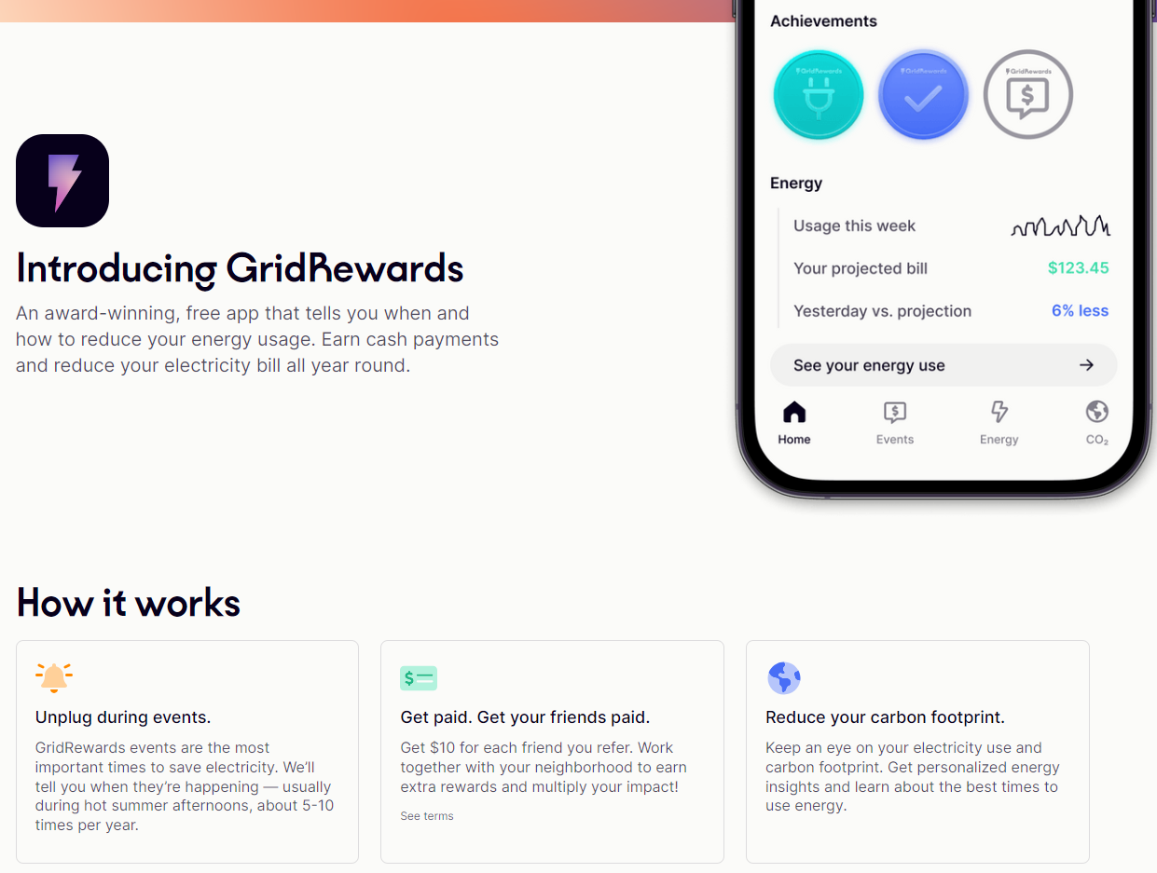


Demand response can help mitigate daily power fluctuations by incentivizing users to time their consumption
Demand response financially incentivizes consumers
NY state has an active demand response program
Demand response programs try to shift energy consumption based on energy availability.
Globally, the IEA projects that 500 GW of demand response availability will be needed by 2030. At present, only a fraction of that (<50 GW) is available.
Participation in these programs can be either active or passive:
  Active programs require explicit actions by participating consumers and companies (e.g., turning off the AC).
  When enrolled in a passive program, consumer devices or commercial machines automatically respond to signals sent by utilities (via a device like a smart thermostat).
Price-based
Incentive-based
Demand is managed through dynamic electricity prices, with prices peaking at times of low availability and prices dropping during high availability.
Consumers receive financial incentives to reduce their consumption when energy availability is low.
Sources: IEA, Demand Response; Steele and Breitenstein, History of electrical peak load control
Credit: Max de Boer, Lara Geiger, Marcelo Cibie, Hyae Ryung Kim, and Gernot Wagner. Share with attribution: Kim et al., “Scaling Solar” (23 September 2024).

Slide 71
By 2050, ~10 million tons of solar PV panels will retire; EU and China have announced recycling plans
Global annual amount of end-of-life PV panels will increase 25x by 2050
Observations
Recycling solar PV panels has two main benefits:
  Environmental damage prevention
  High-value material recovery
In the EU, panel producers are directly responsible for the costs of collecting and recycling end-of-life panels under the EU WEEE* directive.
  Often producers team up to centralize collection and recycling (e.g., Germany)
US and China do not have national recycling programs. However:
  China announced the ambition to establish a national recycling system for end-of-life panels by 2025.
  In the US, California and Washington have passed state laws addressing solar PV panel recycling.
Annual installed and end-of-live PV panel mass (in millions of kg)
12,000
Mass of installed capacity
Mass of end-of-life PV panels
10,000
9,157
  The average expected life span of a solar panel is about 30 years
8,000
6,552
6,769
6,000
5,453
4,867
4,000
3,400
2,000
1,304
217
0
2020
2030
2040
2050
(*) Waste Electrical and Electronic Equipment Directive. Sources: IRENA, End-of-Life Management: Solar Photovoltaic Panels report; NREL, Solar Photovoltaic Module Recycling;
PV-Tech, China to build solar recycling system; Solarwaste.eu, EU WEEE Directive
Credit: Max de Boer, Lara Geiger, Marcelo Cibie, Hyae Ryung Kim, and Gernot Wagner. Share with attribution: Kim et al., “Scaling Solar” (23 September 2024).

Slide 72








CKI Solar PV Team
Hyae Ryung (Helen) Kim
PhD in Sustainable Development
Lead Research Fellow / Engagement Manager
Email: hk2901@columbia.edu
Taicheng Jin
Master of International Affairs
CKI Fellow
Marcelo Cibie
Master of Business Administration
CKI Fellow
Hassan Riaz
Master of Business Administration
CKI Fellow
Lara Geiger
Master of International Affairs
CKI Fellow
Max de Boer
Master of Business Administration
CKI Fellow
Isabel Hoyos
Master of Science in Sustainability Management
CKI Fellow
Gernot Wagner
Senior Lecturer, Columbia Business School
Faculty Director, Climate Knowledge Initiative
Email: gwagner@columbia.edu
Attribution: Kim et al., "Scaling Solar," Columbia Business School Climate Knowledge Initiative (19 March 2025).

Slide 73
Appendix

Slide 74
~70% of renewables capacity additions through 2028 will consist of solar PV
IEA – Main case scenario
IEA – Accelerated scenario
Observations
Additions will be driven by (1) a continued drop in the price of solar PV generation capacity, (2) lower CapEx and OpEx of scaled projects, and (3) immense solar deployment in China through 2028.
  ~60% of additions are expected to come from new utility-scale deployment.
  ~40% of additions are expected to come from distributed solar (residential and commercial & industrial).
At this pace, solar PV is expected to overtake global natural gas generation capacity by 2027 and coal generation capacity by 2030.
From 2023 through 2028, China will deploy almost five times more renewable capacity than the EU and six times more than the United States.
Renewable global net capacity additions (GW per year)
Renewable global net capacity additions (GW per year)
1000
1,000
800
800
+10%
659
600
+7%
600
598
532
548
453
489
462
494
400
419
402
400
373
400
200
200
0
0
2023
2024
2025
2026
2027
2028
2023
2024
2025
2026
2027
2028
Utility-scale solar PV
Distributed solar PV
(*) IEA’s main case is based on current policy and market conditions, while the accelerated case assumes changes in policy or market to address current challenges.
Source: IEA (2024), Renewable Energy Progress Tracker
Credit: Taicheng Jin, Max de Boer, Lara Geiger, Marcelo Cibie, Hyae Ryung Kim, and Gernot Wagner. Share with attribution: Kim et al., “Scaling Solar” (23 September 2024).

Slide 75
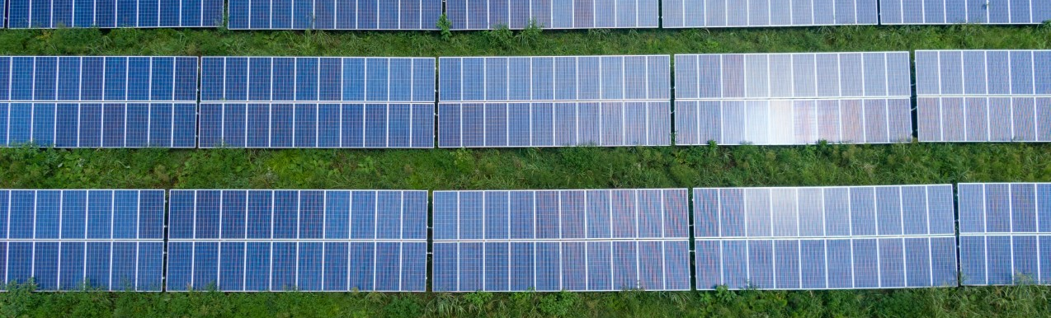
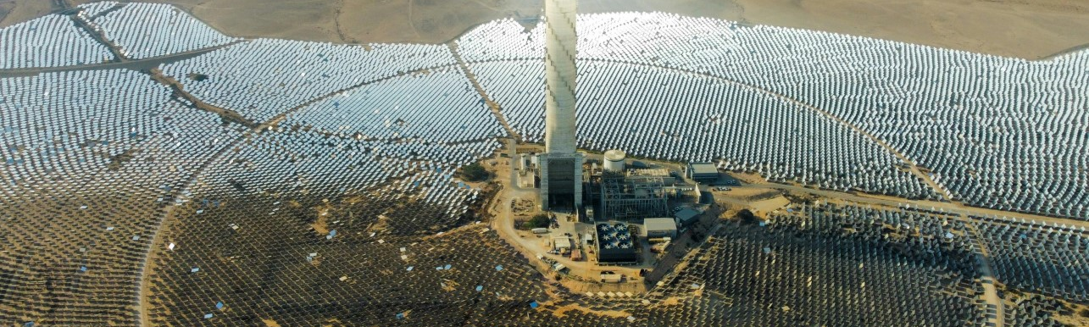
Solar PV makes up >99% of global installed solar capacity
1
2
 | Solar PV | Concentrated solar power
Description | Converts sunlight directly into electricity using semiconductors | Uses focused sunlight to heat a fluid (molten salt), which produces steam that is used to drive a turbine to generate electricity
Advantages | Ease of installation — solar panels can be easily installed in lots of different places Little maintenance required once installed | Comes with built-in energy storage — thermal energy can be stored for up to 16 hours Can be integrated with an existing fossil fuel plant (e.g., to share turbine)
Global installed capacity (2023) | 1,055 GW 99% of total installed solar capacity | 8.1 GW 1% of total installed solar capacity
Average cost (LCOE,* global) | $0.049 per kWh (Lazard LCOE v.16) | $0.118 per kWh (2022)
Main focus of this deck
(*) LCOE (levelized cost of electricity) is a way to compare the true costs of different energy sources.
Sources: International Renewable Energy Agency (IRENA); Our World in Data; HelioCSP (2023); Renewable Energy World; Statista; US DOE, 2030 Solar Cost Targets
Credit: Max de Boer, Lara Geiger, Marcelo Cibie, Hyae Ryung Kim, and Gernot Wagner. Share with attribution: Kim et al., “Scaling Solar” (23 September 2024).

Slide 76
Scenarios
ETS | The Economic Transition Scenario (ETS) reflects a world where policymakers pursue an energy transition relying only on historical efficiency trends and economically competitive, commercially at-scale clean energy technologies. The ETS requires no further support for clean technologies beyond existing measures, although it does hinge on a level playing field that allows these solutions to access markets and compete with incumbent technologies.
NZS | The Net Zero Scenario (NZS) reveals the sheer scale and scope of the challenge of remaining within 1.75C of global warming and achieving the goals of the Paris Agreement.
Source: BloombergNEF 2024 Outlook
Credit: Isabel Hoyos, Taicheng Jin, Hyae Ryung Kim, and Gernot Wagner. Share with attribution: Kim et al., “Scaling Solar” (23 September 2024).

Slide 77
Balance of System components [ref. Slide 10]
BoS component | Description
Inverters | Solar panels produce direct current (DC) while power grids are alternating current (AC). Inverters convert the DC power generated by the panels to AC, making them the most crucial component of PV systems after solar panels.
Wiring | Connects the solar panels and other electrical parts of the PV system.
Switches | Used for safety reasons (can disconnect the panels from the grid in case of a power surge or emergency) and to direct the flow of power (e.g., either to the grid or to a battery).
Junction boxes | Metallic or plastic boxes used as meeting points for electrical connections.
Mounting systems | Provide support for the panels and fixes them in place.
Metering systems | Measure the amount of electricity flowing through them.
Batteries | Optional item: Store energy generated by the panels. Can provide power when the sun is not shining.
Charge controllers | Optional item: Devices that manage the electricity flow to and from batteries and protect them from overcharging.
Sensors | Optional item: More common in utility-scale projects. Help to keep track of environmental variables like panel temperature and solar irradiance. Used for monitoring and maintenance purposes
Sources: NREL, US solar PV system cost benchmark (Q1 2023); SolarEdge
Credit: Max de Boer, Lara Geiger, Marcelo Cibie, Hyae Ryung Kim, and Gernot Wagner. Share with attribution: Kim et al., “Scaling Solar” (23 September 2024).

Slide 78
Material components in crystalline silicon (c-Si) solar panels
[ref. Slide 30]
Material | Main uses
Glass | Module cover
Aluminum | Module frame, mounting structure, connectors, back contact, inverters
Polymers | Back sheet of the solar module, encapsulation of solar cells
Silicon | Mono-Si or poly-Si wafers (core component of solar cells)
Copper | Cables, wires, ribbons, inverters
Silver | Electronic contacts, wiring across solar cells
Antimony | Added to glass to create solar-grade glass (reduces long-term impact of ultraviolet radiation on the solar performance of glass), added to encapsulant
Lead | Soldering paste and ribbon coating
Tin | Solder and ribbon coating
Material composition percentages are averages. Sources: IEA, Solar PV Global Supply Chains; PV-Manufacturing.org
Credit: Isabel Hoyos, Taicheng Jin, Hyae Ryung Kim, and Gernot Wagner. Share with attribution: Kim et al., “Scaling Solar” (23 September 2024).

Slide 79
Glossary
AD/CVD APAC ASEAN BIPV BoS BSF c-Si C&I CAGR CapEx CCS CO₂ CPV CSP EMEA | Antidumping and countervailing duties Asia Pacific Association of Southeast Asian Nations Building integrated PV Balance of System Back Surface Field Crystalline silicon Commercial & industrial Compound annual growth rate Capital expenditures Carbon capture and storage Carbon dioxide Concentrator PV Concentrated solar power Europe, Middle East, and Africa
EPC ESP EVA FiT FBR FPV HJT IRA IRR ITC LID MOIC mono-Si NPV OpEx | Engineering, procurement, and construction Energy service provider Ethylene vinyl acetate Feed-in tariff Fluidized bed reactor Floating PV Silicon heterojunction cells Inflation Reduction Act Internal rate of returns Investment tax credit Light-induced degradation Multiple on invested capital Monocrystalline silicon Net present value Operating expenses
O&M PAYG PERC Poly-Si PPA PTC PV REC R&D RPS SG&A SiO₂ SPV TCO VIPV VOST | Operating and maintenance Pay as you go Passivated emitter and rear cell Polycrystalline silicon Power purchase agreement Production tax credit Photovoltaic Renewable energy credit Research and development Renewable portfolio standard Selling, general, and admin. expenses Quartzite Special purpose vehicle Transparent conductive oxide Vehicle integrated PV Value-of-solar tariffs
Credit: Isabel Hoyos, Taicheng Jin, Hyae Ryung Kim, and Gernot Wagner. Share with attribution: Kim et al., “Scaling Solar” (23 September 2024).
AD/CVD APAC ASEAN BIPV BoS BSF c-Si C&I CAGR CAPEX CCS CO2 CPV CSP EMEA | Antidumping and countervailing duties Asia Pacific Association of Southeast Asian Nations Building integrated PV Balance of System Back Surface Field Crystal silicon Commercial & industrial Compound annual growth rate Capital expenditures Carbon capture and storage Carbon dioxide Concentrator PV Concentrated solar power Europe, Middle East, and Africa

Slide 80
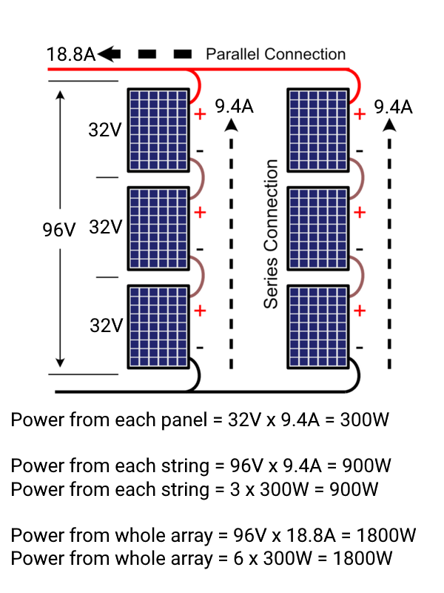
Units, calculations, and references
One watt equates to one joule of energy per second
In electrical systems, power (watts) is calculated by multiplying voltage (volts) by current (amps)
Kilowatt (kW) | 1,000 (one thousand) watts
Megawatt (MW) | 1,000,000 (one million) watts
Gigawatt (GW) | 1,000,000,000 (one billion) watts
Terawatt (TW) | 1,000,000,000,000 (one trillion) watts
Source: Sunshineworks
Credit: Isabel Hoyos, Taicheng Jin, Hyae Ryung Kim, and Gernot Wagner. Share with attribution: Kim et al., “Scaling Solar” (23 September 2024).

