Slide 1
Reconsidering Proteins
6 October 2025
Friedrich Sayn-Wittgenstein, Ariela Farchi Behar, Isabel Hoyos, Asya Ikizler, Elizabeth Robertson, M.A. Miller, Nadine Palmowski,
Raissa Coan Ribeiro, Hyae Ryung Kim, and Gernot Wagner

Slide 2
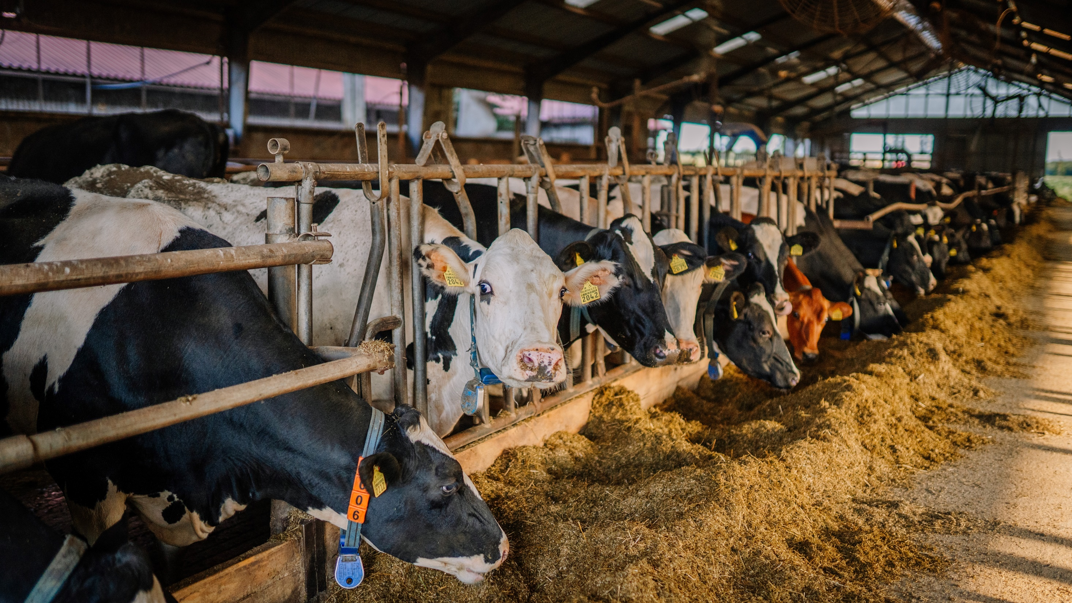

Protein Industry Overview

Slide 3
Key messages
Protein Industry Overview
Global food systems account for approximately 20% of global CO₂e emissions.
The United Nations estimates that by 2050, food production will increase 70% to sustain a global population of 9.1 billion.
Approximately 60-70% of agricultural emissions can be attributed to livestock production.
Production of animal-based proteins comes with other environmental problems, including significant methane emissions, which accounts for 80% of agricultural land emissions and drives half of the global tropical deforestation emitting CO₂.
Animal-based protein consumption is increasing.
Agricultural emissions are estimated to reach ~15 GtCO₂e by 2050 (30% higher than 2021 levels), with 60% related to animal protein.
Global protein consumption is dominated by vegetal sources. However, animal protein consumption has accelerated fast, from 27 grams per capita per day in 2020 to 37 grams in 2022.
Increasing income levels are one of the main reasons for increasing meat consumption, especially in Asia, where animal protein intake rose by ~300% over the past five decades.
Methane is inevitable in the animal industry and difficult to offset.
Agriculture is the largest source of methane emitter globally (~40%), ahead of oil and gas (~35%). Livestock accounts for most of the methane from (~32% of the total).
CH₄ is especially concerning in the short term, as it is 84 times more powerful than CO₂ on a 20-year timescale, and global methane emissions increased more rapidly than CO₂ in the past century.
Cutting methane emissions to slow down global warming is one of the main intentions of this research.
The current deforestation trend is not sustainable in the long term.
Animal proteins drive half of the global deforestation, mainly through feed (~80% of global soy production is used for animal feed) and forest clearing for cattle pastures.
Some 40% of global habitable land is used to meet animal protein demand.
Credit: Nadine Palmowski, Asya Ikizler, Friedrich Sayn-Wittgenstein, Hyae Ryung Kim, and Gernot Wagner. Share with attribution: Sayn-Wittgenstein et al., "Reconsidering Proteins" (6 October 2025).

Slide 4
Global food systems are complex and face competing priorities; CKI focuses on the intersection of proteins and climate change
System-level priorities:
Feed a growing world population of
9.1 billion people by 2050
Meet nutritional needs while respecting cultural food norms
Support healthy diets and prevent
diet-related chronic illnesses
Affordability of high-quality protein
Fair labor conditions across protein production industry
System-level priorities:
Protect and improve farmers’ livelihoods
Ensure continued viable business models of food enterprises
Address economic costs of transitioning to sustainable production, including initial investments in technology and infrastructure
Social
Economic
Shifts in suitable geographies for feed crops and livestock due to warming temperatures
Land-use competition (e.g., between carbon sinks and net emitting livestock activities)
Behavioral resistance to alternative protein consumption decisions
Climate finance for low-carbon protein solutions
Productivity loss (due to fewer pollinators, soil degradation)
Productivity challenges of sustainable agricultural practices and meat alternatives
Negative externalities of meat alternatives
Environmental
System-level priorities:
Mitigate greenhouse gas emissions from the agriculture and food industry supply chain
Prevent and reverse biodiversity loss from deforestation and unsustainable agriculture
Reduce intensity of land and fresh water use
This deck focuses on sustainable protein production in relation to climate change
Credit: Friedrich Sayn-Wittgenstein, Asya Ikizler, Nadine Palmowski, Hyae Ryung Kim, and Gernot Wagner. Share with attribution: Sayn-Wittgenstein et al., "Reconsidering Proteins" (6 October 2025).

Slide 5
Food systems account for ~20% of global emissions, of which sustainable protein solutions¹ can abate ~25-35% by 2050
Abatement potential by 2050
28%
28%
21%
16%
7%
100%
Agriculture fuel combustion 4%
Remaining industry
17%
Crops
27%
80%
Iron and steel
17%
Residential
combustion
53%
Coal
74%
LULUCF 9-11% (remaining)
Road
76%
60%
Oil and gas
21%
LULUCF 6-8% (abatement)
Livestock 8-10% (remaining)
Cement
17%
Livestock
22-24% (abatement)
HFCs from
refrigeration
and A/C
27%
40%
Chemicals
13%
20%
Natural gas
23%
Aviation 10%
Coal mining 7%
Waste
21%
Commercial
combustion
20%
Non-metallic minerals 2%
Marine 11%
Refining 4%
Oil 3%
Other 2%
Rail 1%
0%
Non-ferrous metals 2%
Industry
Power and heat
Agriculture, land use and waste
Transport
Buildings
¹Shifting to vegetal and plant-based proteins, sustainable pasture-based livestock production, and emissions reduction technologies for industrial livestock production.
Sources: Rhodium Group, ClimateDeck (2023); FAO, Climate change and food security report (2013)
Credit: Friedrich Sayn-Wittgenstein, Asya Ikizler, M.A. Miller, Nadine Palmowski, Hyae Ryung Kim, and Gernot Wagner. Share with attribution: Sayn-Wittgenstein et al., "Reconsidering Proteins" (6 October 2025).

Slide 6
Protein value creation takes place across the food system, focusing on areas from production to consumption
Industry Overview
Food system value chain and corresponding end products implicated in sustainable proteins
Main value chain
Core food system processes
Impacted by sustainable proteins
Pre-production
Fertilizer and pesticide
Machinery and equipment
Production
Crop production
Livestock production
Fisheries and aquaculture
Post-production
Processing
Packaging
Transportation
Refrigeration
Selling
Diets and consumption
Dietary choices
Food preparation
Utilizations in homes, restaurants, and retail
Institutional purchasing
Waste disposal
Composting and co-digestion
Landfills and open dumps
Wastewater
Incineration
Food-related land use
Deforestation
Draining wetlands and peatland
Expanding agricultural Rangelands and croplands
Shifting to agricultural cultivation
Food loss and waste
Sources: IOP Science Environmental Research Letters, Greenhouse gas emissions from food systems (2021); McKinsey, Food system GHG emissions (2022).
Credit: Friedrich Sayn-Wittgenstein, Asya Ikizler, Hyae Ryung Kim, and Gernot Wagner. Share with attribution: Sayn-Wittgenstein et al., "Reconsidering Proteins" (6 October 2025).

Slide 7
Scope of sustainable proteins broken down into four categories
Industry Overview
 | Vegetal proteins | Livestock proteins | Aquatic proteins | Alternative proteins
Description and key indicators | Soy, wheat, and pea are the largest sources. Soy dominates supply due to cost-effective mass production. 80% of soy supply serves as livestock feed. Brazil leads production (~20% increase over the past five years), while China leads imports. | Poultry and pig meat dominate supply, followed by beef and buffalo. High GHG emissions and extensive land and water use lead to negative environmental impact on biodiversity and soil health. Asia dominates global production and supply (mainly China), followed by the Americas. | Fish, shrimp, and algae are primary sources. About 60% of supply is from aquaculture, which is efficient but comes with significant environmental impacts, including water use, nutrient runoff, and habitat loss. Asia leads in aquaculture supply (mainly China), followed by Europe and the Americas. | Plant-based: Foods that aim to replicate the sensory feeling of eating animal protein (e.g., soy patties). Lab-grown/cultivated: Meat produced directly from animal cells. Fermentation-derived: Foods produced by the chemical breakdown of biomass by bacteria, yeasts, or other microorganisms (e.g., tempeh).
Products | Soy, corn, wheat, peas | Beef, poultry, pig, sheep, dairy | Fish, shrimp, algae, other aquatic protein sources | Plant-based protein, lab-grown meat, fermentation-derived proteins
Key benefits and challenges | Benefits: Cheap production, high scalability Long history and culture within global food systems Challenges: Lower bioavailability of protein Some sources overgrown, creating large monocultures with high land use and negative environmental impact | Benefits: High bioavailability of protein Meat, eggs, and dairy provide bio-available critical micro-nutrients that are not replicated in traditional plant proteins Challenges: Most land-inefficient source of proteins¹ One of the largest methane source globally Contributes to biodiversity loss through forest clearing and monocultures for industrial feed | Benefits: High bioavailability of protein High content of essential omega-3 fatty acids Can be sustainably farmed with tech advance Challenges: Overfishing, bycatch, and habitat destruction in wild-capture fisheries Water pollution, disease transmission, high wild fish stock feed, and significant energy input in aquaculture | Benefits: High protein content and digestibility Depending on the source, can have high micronutrient content and fiber Increased land and water efficiency Low methane or other GHG emissions Challenges: Adoption rate and scalability High energy use, high production cost, and high up-front capital investments (type-dependent)
Global protein supply 2021 | ~60% of global protein supply based on vegetal sources, making it the most prevalent source | ~35% of global protein from livestock, although it disproportionately has the most emissions | ~5% varying largely across regions according to access | <1%, as current scalability challenges lead to a low rate of implementation and expansion
Food system GHG emissions in 2021 | ~30% | ~60% | ~5% | Could mitigate ~30% of food system emissions by 2050
¹ Land efficiency and feed source varies based on management system. See slide 11 for a management system breakdown.
Sources: Nature, Global greenhouse gas emissions (2021); FAO report (2023); New Protein, Global Plant Protein: A Brief Outlook (2022); WWF, Soy (2024); FAO, The State of World Fisheries and Aquaculture (2022).
Credit: Nadine Palmowski, Asya Ikizler, Friedrich Sayn-Wittgenstein, Hyae Ryung Kim, and Gernot Wagner. Share with attribution: Sayn-Wittgenstein et al., "Reconsidering Proteins" (6 October 2025).

Slide 8
Up to ~70% of agricultural emissions come from livestock, driven by manure, enteric fermentation, and land use change
Industry Overview
Emissions
GHG emissions from agriculture from 1990 to 2022, GtCO₂e
Observations
Most livestock-related emissions are direct emissions, primarily from enteric fermentation in ruminants and manure management practices, both of which release large amounts of methane, a potent greenhouse gas.
The remaining livestock-related emissions are largely indirect, related to land use changes such as deforestation for feed crop production and grazing land.
While land-use change emissions come from various sources, agriculture-related deforestation is largely driven by the cattle industry.
Overall agricultural emissions are expected to grow by 60% by 2050 to meet the increasing global protein demand.
Land-use change
Up to 70% of agricultural emissions are related to livestock
Enteric fermentation
Manure
On-farm energy use
Synthetic fertilizers
Other crop-related
1990
1994
1998
2002
2006
2010
2014
2018
2022
Sources: FAOSTAT, Food and agriculture data (2024); WRI, Commodities replacing forest areas (2021).
Credit: Friedrich Sayn-Wittgenstein, Isabel Hoyos, Asya Ikizler, Nadine Palmowski, Hyae Ryung Kim, and Gernot Wagner. Share with attribution: Sayn-Wittgenstein et al., "Reconsidering Proteins" (6 October 2025).

Slide 9
Livestock demand expected to grow, driving carbon dioxide (CO₂), methane (CH₃), and nitrous oxide (N₂O) greenhouse gas emissions
Industry Overview
Emissions
Global livestock* count from 1960-2050
(in billion animals per year)
Livestock emission types and their sources
Observations
Livestock numbers have increased significantly from 1960 to today, from 8 billion to around 80 billion animals per year.
  The UN Environmental Programme expects demand to drive another 50% growth until 2050.
  Growth rates differ by region, with Asia a strong leader and potential stabilization in Europe.
Share of gases vary across locations, livestock species, and production systems. For example:
  Main GHG source for chicken is feed production in many regions (e.g., East Asia); for pigs, its manure management.
  For cattle, enteric CH₄ is dominant; for chicken, CO₂ from land use and feed is higher.
65
60
Africa
Northern America
Carbon dioxide
Land-use change
(deforestation)
Feed production
On-farm energy
Post-farm
Asia
South & Central America
55
Europe
Oceania
~30%
50
Projected regional growth rates based on the past 10 years, comparable with UNEP projection of +50% meat demand until 2050
45
40
35
Methane
Enteric fermentation
(ruminant digestion)
Manure
30
~55%
25
20
15
Nitrous oxide
Manure
Feed
10
5
~15%
0
*Livestock: Animals raised and slaughtered for food production, including producing animals (e.g., for dairy) and animals designated for slaughter.
Sources: Our World in Data, Meat and Dairy Production (2024); FAO, Pathways towards lower emissions (2023).
Credit: Nadine Palmowski, Raissa Coan Ribeiro, Friedrich Sayn-Wittgenstein, Hyae Ryung Kim, and Gernot Wagner. Share with attribution: Sayn-Wittgenstein et al., "Reconsidering Proteins" (6 October 2025).

Slide 10



Climate change impacts livestock health in a manner that impacts the entire animal protein value chain
Industry Overview
Emissions
The impacts affect farmers, animals, and consumers, economically, nutritionally, and health-wise
Outcomes
Livestock inputs | Increased energy use and cost of energy for livestock housing and management Increased cost of pasture crops and feed inputs from declining agricultural productivity Increased medical costs related to animal health
Impossible livestock cultivation economics
CLIMATE CHANGE
Increasing temperatures
Severe weather
Drought
Livestock | Increased incidence of disease and death as well as decreased animal reproduction and growth resulting from: Heat stress Immune suppression Oxidative stress Metabolic disorder Increased pests: midges, flies, ticks, mosquitoes
Poor livestock health and animal experience
Livestock outputs | Decreased quantity of animal products Increased consumer prices of animal products Negative impacts on nutritional quality, safety, and appeal of animal product
Reduced food security
Sources: NIH, Impact of climate change on livestock health (2020); NIH, Impacts of CC on livestock (2021); USDA, CC and Agriculture in the U.S. (2013); EPA, Climate impacts on food supply (2024).
Credit: M.A. Miller, Friedrich Sayn-Wittgenstein, Helen Kim, and Gernot Wagner. Share with attribution: Sayn-Wittgenstein et al., "Reconsidering Proteins" (6 October 2025).

Slide 11





Industry Overview
Livestock
Environmental implications of livestock are diverse and vary significantly based on management system and geography
The landscape of livestock management
202,351
Pasture
29,197
Industrial
9,610
Pasture-based | Management system is based on natural ecosystems to which large ruminant have been contributed for millions of years. | Contributes to the ecosystem’s natural equilibrium Can be based on natural grasslands or sown pastures, which might result in lower methane emissions and do not contribute to LULUCF Provides opportunity to regenerate natural grasslands and improve soil carbon-capture potential Can be created on cut or deforested terrains Produces the most emissions per kg of beef
Grain- or feedlot- based | Industrial management system is based on the rearing of cattle in large feedlots, where animals are fed with grain and hay. | Can enable several thousand animals to be raised for food production in a smaller area of land at a lower cost Produces least methane per kg of beef Presents concerns about animal welfare Requires high use of antibiotics and hormones Can contribute significantly to water contamination
Mixed management | Combines management practices from pasture- and grain-based systems. Pastures cycle between crops and cattle, and cattle rotate between grazing on pastures and feeding on grains and hay. | Enhances soil health, improving C and N retention in the soil Diversified agrifood system activities can reduce income vulnerability C Can be labor-, cost-, and infrastructure-intensive
Mixed
452
SD 15,789
SD 29,343
SD 555
SD 224
272
146
SD 113
SD 35
Adjusted GHG Intensity (kg CO2e/kg HQP)
Adjusted Land Intensity (ha/1k ton HQP)
It is important to note:
Averages are not the most accurate representation of the environmental impact of management systems.
There is great variability of impact within systems based on factors such as geography, particularly for pasture-based systems.
Feed procurement is a main source of variation.
Baseline emissions for pasture-based systems are not zero, as level emissions are part of a grassland’s natural ecosystem processes equilibrium.
Sources: Walter E. Baethgen, PhD, (2024); Karl et al., Framework to evaluate livestock-derived protein systems (2024); Giménez, Mixed crop/livestock systems in Pampas (2006).
Credit: Ariela Farchi Behar, Hyae Ryung Kim, and Gernot Wagner. Share with attribution: Sayn-Wittgenstein et al., "Reconsidering Proteins" (6 October 2025).

Slide 12
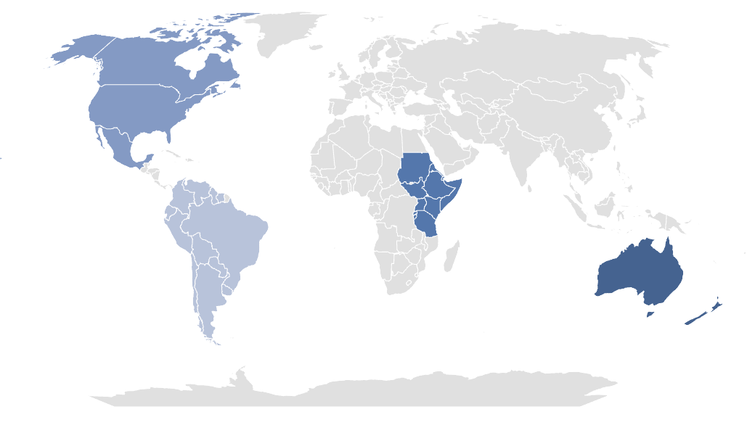
Environmental indicators of livestock management practices vary widely depending on regional conditions
Industry Overview
Livestock
Pasture livestock management
Industrial livestock management
Mixed livestock management
Observations
Regionality is key for sustainable practices in livestock management.
  Emissions and land use vary greatly based on region and management practice.
  Regional conditions make practices more relevant or adept for different livestock management systems.
  It is essential to understand what drives these environmental indicators in each geography.
  Pasture-based beef has the highest GHG emissions and land use but also the highest potential for change from sustainable intensification practices (such as rotational grazing) in developing geographies.
  Such practices could reduce emissions and land use while continuing to provide high-quality protein to food-insecure countries.
255,800
255,682
Adjusted GHG Intensity (kg CO2equiv/kg high-quality protein)
198,385
Adjusted Land Intensity (ha/1,000 tonnes high-quality protein)
182,280
173,583
61,696
23,268
21,613
10,370
9,485
9,133
647
766
600
400
200
0
Australia and New Zealand
Eastern Africa
North America
South America
Australia and New Zealand
Eastern Africa
North America
Australia and New Zealand
Eastern Africa
North America
Source: Karl et al., Framework to evaluate livestock-derived protein systems (2024).
Credit: Ariela Farchi Behar, Hyae Ryung Kim, and Gernot Wagner. Share with attribution: Sayn-Wittgenstein et al., "Reconsidering Proteins" (6 October 2025).

Slide 13
Of all animal protein sources, beef has the highest carbon footprint, mainly due to high methane emissions
Industry Overview
Livestock
Methane
Carbon footprint of different protein sources across the supply chain (total in CO₂e/kg)
Observations
Beef from beef herds (livestock with the main purpose to grow beef) has the highest carbon footprint, followed by lamb and mutton and beef from dairy herds (cattle bred primarily for milk production).
Methane emissions are the predominant cause of high Scope 1 emissions from farms, representing ~60% of beef’s footprint.
  Methane emissions result from enteric fermentation.
  Solutions include improved manure management, dietary changes, and adoption of methane-reducing technologies.
Reducing beef consumption would substantially decrease methane and thereby overall food system emissions.
110
99
Farm
Scope 1¹
100
Land use
90
Losses
15%
Animal feed
80
Processing
Scope 3
70
Transport
23%
Methane emissions from cattle represent ~55%-65% of beef’s carbon footprint
Other
60
50
40
40
33
30
57%
27
24
20
14
10
68%
66%
50%
55%
59%
0
Beef (beef herd)
Lamb and mutton
Beef (dairy herd)
Shrimps (farmed)
Cheese
Fish (farmed)
¹ Including negligible Scope 2 emissions for farm operations.
Sources: Rosado & Roser, Environmental Impacts of Food Production (2022); Science, Reducing Food’s Impact Through Producers and Consumers (2018).
Credit: Asya Ikizler, Nadine Palmowski, Friedrich Sayn-Wittgenstein, Hyae Ryung Kim, and Gernot Wagner. Share with attribution: Sayn-Wittgenstein et al., "Reconsidering Proteins" (6 October 2025).

Slide 14
Reducing methane is urgent due to high short-term GHG potency; emissions mainly stem from food systems, specifically livestock
Industry Overview
Livestock
Methane
Methane’s global warming potential in the atmosphere over 100 years
Global methane emissions breakdown by source, 2022
Observations
Agriculture is the largest source of global methane emissions, surpassing oil and gas. Livestock accounts for the majority of agricultural methane, mainly from enteric fermentation and manure, and contributes about 33% of total methane emissions.
Manure-related methane makes up a larger share of livestock emissions in high-income countries (up to ~18%) due to confined systems, while emissions are mostly enteric in lower-income countries, with manure contributing just 4–8%.
Cutting methane emissions is the fastest way to slow down the global average temperature increase due to its potent nature and short lifespan.
Methane concentration in the atmosphere is rising much faster than CO₂ concentration: From 1900 to 2020, CO₂ increased by 40%; methane increased by 120%.
Global warming potential (GWP) of CH₄
(compared to CO₂, per kg)
~350 MtCH4
Other, 5%
Waste
20%
28x
more potent than CO₂ after 100 years
Rice cultivation
7%
Oil, gas, and coal
35%
Manure, 3%
84x more potent than CO₂ after 20 years
~80% of agricultural methane emissions are livestock-related
Enteric
fermentation
30%
Agriculture
40%
0
20
40
60
80
100
Methane from all sectors
Methane from agriculture
Sources: NASA, Methane report (2024); BCG, Methane: Today’s High-Impact Greenhouse Gases (2023); FAOSTAT, Food and agriculture data; ClimateWatch, Historical GHG Emissions; Clean Air
Task Force, Accelerating Solutions in agriculture (2024).
Credit: Asya Ikizler, Isabel Hoyos, Nadine Palmowski, Friedrich Sayn-Wittgenstein, Hyae Ryung Kim, and Gernot Wagner. Share with attribution: Sayn-Wittgenstein et al., "Reconsidering Proteins" (6 October 2025).

Slide 15
Livestock-derived proteins are driving half of global deforestation, a trend that cannot continue under net-zero climate goals
Industry Overview
Livestock
Land Use
Livestock-related land use is still growing and will exceed the total available land area in the future, leading to land competition between agriculture and carbon sinks
Observations
With projected agricultural demand growth of +50% by 2050, land requirements for agriculture and reforestation¹ combined will exceed available habitable land by 1.56 billion ha — 2x the U.S. land area.
This highlights the competition for land, where reforestation and agricultural expansion cannot occur simultaneously.
Excessive agricultural land use also comes with several other challenges, such as biodiversity loss, loss of ecosystem services, and opportunity cost (land use for more nutritionally diverse food and carbon sequestration).
Today, 50% of habitable land¹ is used for agriculture. Over 80% of that is for animal agriculture only.
Pasture
+1,560 Mha
114%
Animal feed
Human crops
100%
100%
Urban
Forest
Fresh water
Shrub
1%
When combining land demands for agricultural expansion, urban growth, and reforestation,² the total land area exceeds available habitable land by 14%.
1%
1%
Total habitable land use today
Total habitable land use 2050
¹ Habitable land refers to all land on earth except glaciers and deserts.
² Planting trees for carbon sequestration to reach climate targets.
Sources: WRI, Managing the global land squeeze (2023); Bajželj et al., Importance of food demand management for climate mitigation (2014); McKinsey, The agricultural transition (2023).
Credit: Asya Ikizler, Friedrich Sayn-Wittgenstein, Nadine Palmowski, Hyae Ryung Kim, and Gernot Wagner. Share with attribution: Sayn-Wittgenstein et al., "Reconsidering Proteins" (6 October 2025).

Slide 16
Per-person meat consumption is correlated to income levels and is expected to continue its increase over the next several decades
Industry Overview
Diets
Industry overview
Meat supply in grams per capita per day in correlation to GDP and population size in 2023
Global protein consumption, 2000 to 2050, in g/capita/day
Observations
Meat consumption rates are closely related to income levels. Higher GDP per capita is related to higher meat consumption.
Related data on animal protein consumption — including not only meat but also fish, seafood, and other animal products (milk, butter, eggs) — also shows a significant increase:
  Animal protein consumption per person increased by 10g on average over the past ~20 years.
  Meat consumption is slowly increasing the share in overall animal protein consumption.
Current growth rates suggest that the trend is going to continue.
50
Meat
49
45
Fish and seafood
United States
Dairy and eggs
40
37
Brazil
35
54%
France
United Kingdom
Russia
30
27
Meat supply (g/capita/day)
China
Germany
51%
25
Vietnam
Italy
South Korea
20
47%
14%
Japan
Iran
15
15%
10
17%
Egypt
Thailand
34%
32%
Morocco
5
36%
0
2000
2022
2050¹
GDP (USD/capita)
¹ Conservative estimate, based on linear extrapolation based on growth in the past two decades.
Source: Our World in Data, Meat and Dairy Production (2023).
Credit: Nadine Palmowski, Friedrich Sayn-Wittgenstein, Hyae Ryung Kim, and Gernot Wagner. Share with attribution: Sayn-Wittgenstein et al., "Reconsidering Proteins" (6 October 2025).

Slide 17
Income-level increase drives growing animal protein consumption, with highest growth rates in South America and Asia
Industry Overview
Diets
Historic animal protein consumption by region from 1970 to 2022 in g/capita/day
Observations
Animal protein consumption per capita increased significantly over the past decades in all continents.
  Highest consumption is in the United States and Western Europe.
  Highest growth rates are in Asia and South America.
Meat consumption has the fastest growth rate among all animal proteins across all continents.
The trend is expected to continue, hence
the importance of decarbonizing livestock.
90
+27%
83
Fish and seafood
80
Dairy and eggs
+35%
72
72
Meat
70
62
66
%
Per-capita change in consumption
60
3
+110%
54
54
50
3
40
38
+288%
2
33
30
26
+39%
2
20
20
12
15
10
8
11
0
0
3
GDP in
$ trillions
1970
2000
2022
1970
2000
2022
1970
2000
2022
1970
2000
2022
1970
2000
2022
10.3
18.6
Western Europe
United States
South America
Asia
Africa
Source: FAOSTAT, Food balances (2024). Credit: Asya Ikizler, Nadine Palmowski, Raissa Coan Ribeiro, Friedrich Sayn-Wittgenstein Hyae Ryung Kim, and Gernot Wagner. Share with attribution: Sayn-Wittgenstein et al., "Reconsidering Proteins" (6 October 2025).

Slide 18
Industry Overview
Diets
Variations in meat production and consumption across regions highlight the need for tailored sustainable protein strategies
Beef and veal production – 2020-2024 summary,
1,000 kilograms per capita (carcass weight equivalent)
Estimated unprocessed red meat consumption among children and adults, by world region, in 2018 (g/day)
Observations
The standard recommended dietary allowance (RDA) for proteins is 0.8 kg of protein per kg of body weight.
  Animal protein can fulfill daily dietary minimum needs, especially in developing regions such as Africa, where 58% of the population is food insecure.
  Most American diets exceed recommended meat consumption. Reduction in red and processed meats is advised by the Dietary Guidelines for Americans.
Livestock production growth is driven by increased productivity — measured as total factor productivity (TFP), or production inputs and outputs — resulting in lower climate impact, less risk, and improved animal and human health.
  The livestock sector is one of the fastest growing economic sectors in middle- and low-income countries.
  There is a high association between a higher TFP and economic performance, presenting a major opportunity for small-holders in the agribusiness supply chain.
-1%
328
All ages
Children
Adults
+4%
259
203
0%
0%
147
125
109
-1%
+2%
79
7
73
0%
+4%
+5%
Canada EU U.S. Russia Argentina Brazil China India Mexico
7
World
Southeast and East Asia
Central or Eastern Europe and Central Asia
High-income countries
Latin America and Caribbean
Middle East and North Africa
South Asia
Sub-Saharan Africa
Developed countries
Developing countries
Sources: USDA, Livestock and Poultry: World Markets and Trade (2024); OECD, Agricultural Outlook (2024); FAO, SoFI (2024); USDA, DGA (2020); USDA, Global Changes in Agricultural Productivity (2024); World Bank, Moving Towards Su stainability (2024).
Credit: Ariela Farchi Behar, Isabel Hoyos, Hyae Ryung Kim, and Gernot Wagner. Share with attribution: Sayn-Wittgenstein et al., "Reconsidering Proteins" (6 October 2025).

Slide 19
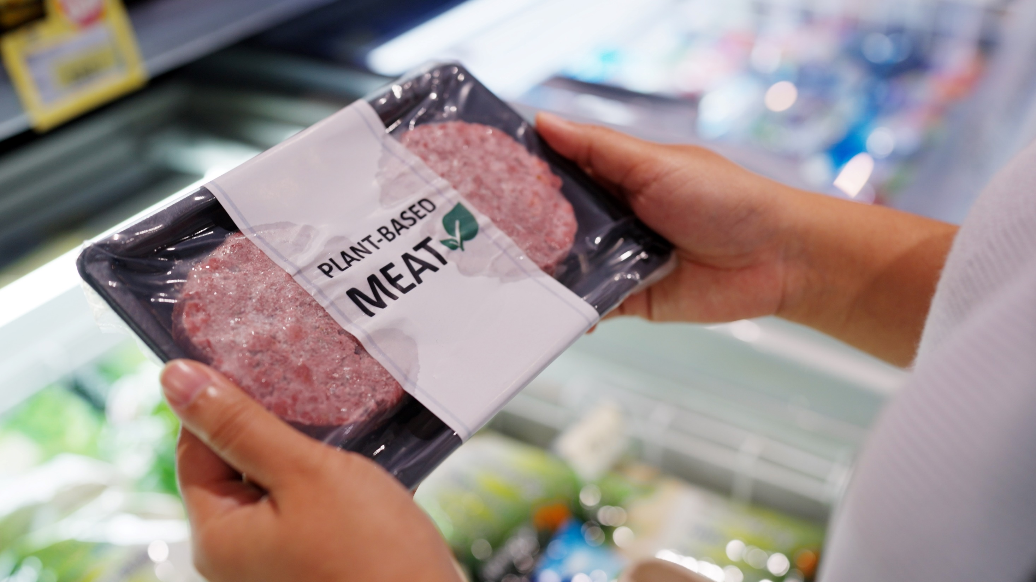

Technological and Industry Advancements

Slide 20
Key messages
Technological and Industry Advancements
Decarbonizing global protein supply requires a nuanced and multi-faceted approach.
A sustainable protein future will see a mix of animal protein from sustainable livestock management practices in developing economies, and a higher consumption of alternative proteins in developed economies.
A protein transition approach with diverse solutions—such as sustainable production practices, methane-inhibitor technologies, and alternative proteins—is essential to achieve that.
Different abatement solutions are being developed for animal-based protein emissions.
Sustainable management practices, productivity increases, and selective breeding present the greatest mitigation potential for livestock in developing countries.
Livestock methane reduction strategies and technologies are emerging, but their mitigation potential is still uncertain or depends on incentives for large-scale implementation by producers.
Reducing the CO₂ emissions of the sector relies on combatting deforestation. Switching to less land- and water-intensive animal feed and implementing deforestation-free corporate supply chain policies can cut over 60% of CO₂ emissions related to animal agriculture.
Aquaculture is the world’s fastest growing food industry. The species, feed, and production method determine its emissions. Focusing on expanding the right ones and innovating feed are critical for a sustainable protein supply.
A diet shift and adoption of alternative proteins are effective ways to reduce emissions.
  Alternative proteins fall under three categories: plant-based, fermentation, and cultivated.
  Plant-based proteins save 4.4 gigatonnes of CO₂e emissions per $1 trillion invested. Emissions abatement could increase when accounting for land-use changes and carbon sequestration from rewilding and afforestation.
  Consumers prioritize taste, price, and health over sustainability when purchasing food. Companies need to address these key concerns with product development and improved marketing strategies.
  Alternative proteins can use lessons learned from electric vehicles and the energy transition to accelerate the protein transition through alternative proteins, an innovation that is also struggling with consumer adoption and price parity at first.
  Strategies to tap into unexplored markets like frozen, ready-to-eat foods, displacing ultraprocessed meat and blended products, can help alternative proteins scale.
Credit: Asya Ikizler, Friedrich Sayn-Wittgenstein, Hyae Ryung Kim, and Gernot Wagner. Share with attribution: Sayn-Wittgenstein et al., "Reconsidering Proteins" (6 October 2025).

Slide 21
Decarbonizing proteins requires transforming livestock systems and accelerating growth of plant and alternative sources
Solutions
H
High
M
Medium
L
Low
 | Sustainable Pasture-Based Livestock Production | Emissions Reduction in Industrial Livestock Production | Shift to Vegetal and Alternative Protein Sources
Description | Rotational and adaptive grazing management Silvopasture system integration Selective breeding for lower methane Deforestation-free supply chains Improved animal health and productivity | Feed additives and vaccines Improved manure management Alternative animal feed Selective breeding for lower methane Deforestation-free supply chains Improved animal health and productivity | Increased adoption of plant-based, fermented, and lab-grown alternatives to meat and dairy Increased consumption of traditional protein-rich foods like legumes, pulses, tofu, tempeh, and seitan
Opportunities | Enhances soil carbon storage Improved ecosystem health Potential for value-added markets (e.g. regenerative, organic certification) | Methane and nitrous oxide reduction Potential for added value through energy production and nutrient cycling | Drastic reduction of all emissions, land, and water use relative to animal protein Aligned with health, sustainability, and ethical consumer trends
Challenges | Significant land and labor requirement Vulnerable to climate variability and requires long-term land management Lower productivity than industrial systems | High capital and operational costs Limited maturity and regulatory approval for feed additives and vaccines Don’t solve ethical concerns with industrial animal farming | Low consumer acceptance High production costs for alternatives Regulatory, infrastructure, and supply chain hurdles to scaling manufacturing
Abatement potential
Deployment readiness |  |  | Traditional: Alternative:
M
M
H
H
L
H
L
Sources: Climate and Clean Air Coalition, Global Methane Assessment (2021); Climate and Health Alliance, Methane Report (2023); Clean Air Task Force, Accelerating Solutions in agriculture (2024);
WRI, Opportunities for Methane Mitigation in Agriculture (2025); CIAT, Sustainable Livestock Farming Practices for Resilience (2024); FAO, Pathways toward lower emissions (2023).
Credit: Asya Ikizler, Nadine Palmowski, Isabel Hoyos, Friedrich Sayn-Wittgenstein, Hyae Ryung Kim, and Gernot Wagner. Share with attribution: Sayn-Wittgenstein et al., "Reconsidering Proteins" (6 October 2025).

Slide 22
Diet shift and sustainable food production can cut ~40% of emissions from agriculture and land use by 2050
Solutions
Levers to abate agriculture and land-use emissions on a 1.5ºC pathway in 2050, GtCO₂e
Observations
By 2050, without interventions (BAU), total emissions are projected to increase from the current 10.7 GtCO₂e to 14.4 GtCO₂e, making it essential to implement multiple strategies to stay on the 1.5°C climate pathway.
However, industrial and process changes alone cannot drive the sector to net zero. The study¹ considers that 25% of the reduction comes from dietary changes that reduce demand for animal proteins.
Sustainable food production also has an important role, accounting for a 16%, or 2.3 GtCO₂e, emission reduction.
Land conservation and natural carbon sinks are the main drivers of efforts to offset agricultural emissions,¹ representing almost 50% of abatement, highlighting the importance of preventing further deforestation.
Protein consumption reduction must be a priority in high-income countries; sustainable agriculture practices and increased productivity must be a priority in low- and middle-income countries.
+35%
3.4
10,6
24%
Waste
21%
2.3
There is significant overlap between sustainable food production and natural carbon sinks, as practices like improved grazing, silvopasture, and deforestation prevention can enhance soil carbon sequestration and support land conservation.
16%
6.7
Crops
27%
47%
Livestock
32%
LULUCF
17%
Series 3
2024 Baseline, Agriculture, Land Use, and Waste
2050 BAU forecast
Diet shift away from animal protein²
Sustainable food production
Land conservation and natural carbon sinks
Reduction in food loss and food waste
Other
¹ The McKinsey scenario.
² Carbon sequestration from spared land being used for nature-based solutions is addressed under “Land conservation and natural carbon sinks.”
Sources: Rhodium Group, ClimateDeck (2023); FAOSTAT, Emissions due to agriculture (2020); McKinsey, The agricultural transition (2023); WRI, Commodities replacing forest areas (2021).
Credit: Asya Ikizler, Raissa Coan Ribeiro , Friedrich Sayn-Wittgenstein, Hyae Ryung Kim, and Gernot Wagner. Share with attribution: Sayn-Wittgenstein et al., "Reconsidering Proteins" (6 October 2025).

Slide 23
Solutions
Sustainable Pastured Livestock
Sustainable livestock management mitigates emissions, and supports climate adaptation and food security
Goals
Outcomes
Strategies and Drivers
Mitigation
Carbon sequestration in soils and biomass
Deforestation prevention
Pasture management and grazing practices
Silvo-pastoral integration
Reducing emissions from livestock management
Reduced emissions per unit of output
Improved energy and resource efficiency
Low-carbon supply chain
Waste management and circular integration
Food Security
Increased efficiency and productivity
Selective herd
genetics
Improved animal health
Meeting the dietary needs of a growing global population
Access to shared information
Stimulated socio-economic development
Highest feed
quality
Manure
management
Adaptation
Reduced sensitivity to climate disasters
Diversification of species and assets
Adapted water management
Building resilience and reducing vulnerability to increasing climate change risks
Increased ability to adapt
Accessible and adaptable markets
Technical and financial capacity
Sources: FAO, Climate-smart livestock production, (2019); FAO, Livestock solutions for climate change, (2017)
Credit: Ariela Farchi Behar, Isabel Hoyos, Hyae Ryung Kim, and Gernot Wagner. Share with attribution: Sayn-Wittgenstein et al., "Reconsidering Proteins" (6 October 2025).

Slide 24
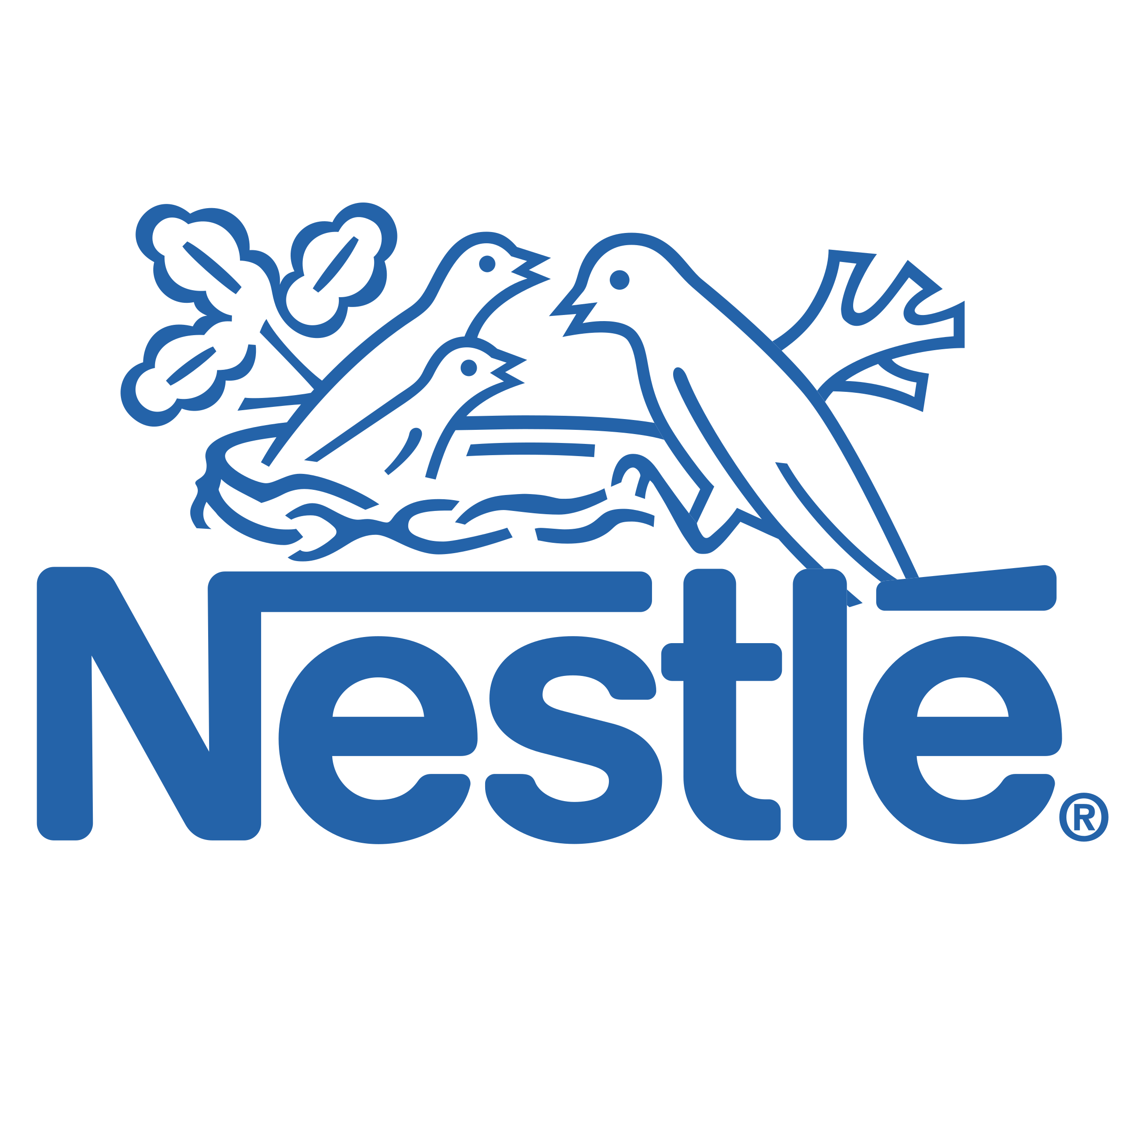
Solutions
Sustainable Pastured Livestock
Case Study: Nestle
Nestlé has made strides in deforestation traceability towards a deforestation-free supply chain across commodities
Founded | 1866 by Henri Nestlé
Headquarters | Vevey, Switzerland
Revenue | $91.72 million (2024)
Climate Impact | ~90% of primary supply chain assessed as “deforestation free” Raw materials are confirmed as deforestation-free when either they can be traced to low-risk origins or have been assessed as deforestation-free either from the sky or from the ground” Avoid sourcing raw materials from high-stock carbon forests, converted ecosystems (such as wetlands, savannas, or peatlands), UNESCO world heritage sites, etc.
Risk Assessment Tools | Supply chain mapping Desktop-based risk assessment On-the-ground assessment Satellite monitoring
Risk Mitigation Tools | Supplier engagement Landscaping projects Smallholder farmer initiatives Industry collaboration
Levers and Opportunities | Policy Regulation on Deforestation-free Products (EUDR) in the EU Task Force on Climate-related Financial Disclosures (TCFD) in the UK Controls aligned with individual countries’ NDCs Technology Maplecroft Trase Global Forest Watch (GFW) and GFW Pro Industry collaborations and global programs Digital Integration of Agricultural Supply Chains Alliance (DIASCA) Consumer Goods Forum (CGF) Forest Positive Coalition Reduced Emissions from Deforestation and Forest Degradation (REDD+)
Nestlé primary supply chain
(coffee, cocoa, meat, palm oil, pulp and paper, soy and sugar)
Nestlé meat supply chain
Unkown
Assessed from the sky
Assessed from the ground
Traceable to non-very-high-deforestation-risk
origins
100%
Sources: Nestle, Deforestation-free supply chains, (2024); Yahoo Finance, Nestlé S.A., (2025); WRI, Traceability and transparency in supply chains, (2023)
Credit: Ariela Farchi Behar, Isabel Hoyos, Hyae Ryung Kim, and Gernot Wagner. Share with attribution: Sayn-Wittgenstein et al., "Reconsidering Proteins" (6 October 2025).

Slide 25
Regenerative grazing shows emissions mitigation potential by sequestering soil carbon, but experts warn against limitations
Solutions
Sustainable Pastured Livestock
Regenerative Agriculture
Key practices of regenerative grazing systems
Observations
Some evidence has shown that regenerative grazing can reduce GHG emissions per kg of beef by 40% to 80% compared to conventional beef by improving soil health and, consequently, the pasture’s ability to sequester soil carbon (~2-3 MtCO₂e per hectare per year).
While it undeniably improves soil health, experts warn that increases in soil carbon sequestration cannot sufficiently mitigate livestock emissions.
Limitations of regenerative grazing:
  The effectiveness can depend on factors like specific management practices, soil type, and climate.
  May require more land than conventional systems, conflicting with other land uses like crop production.
  The carbon opportunity cost of using land for grazing instead of reforestation and conservation must be accounted for.
  Soil carbon sequestration is not guaranteed. The soil will sequester and hold carbon until it reaches a state of equilibrium, not permanently.
  Requires active management and increased investment in time, labor, fencing, and monitoring tools.
  Regional variability in pasture conditions and soil needs pose a barrier to scalability.
Regenerative agriculture is also called carbon farming and climate-smart agriculture. Regenerative grazing ranching can include specific systems like adaptive multi-paddock grazing, management-intensive grazing, and rotational grazing.
1
Rotational grazing with rest and regrowth periods
Adaptive management adjusted to ecosystem responses
Increased plant biodiversity, including native species
Minimal synthetic fertilizers and pesticides
Integration of trees and perennials
Focus on improved soil organic matter, plant cover, root systems, microbial activity, and water-holding capacity
The definition of regenerative practices by system. This list aims to outline the generally accepted principles of regenerative grazing that can be relevant across the board.
2
3
4
5
6
Example of emissions breakdown from regenerative beef from White Oak Pastures*, CO₂ e per kg of beef
40
29
20
0
-20
-40
-35
Enteric emissions
Manure emissions
Soil carbon
Plant carbon
Other farm activities
Slaughter/ transport
Net total emissions
* This is an example of emissions data from an individual farm practicing regenerative grazing but does not reflect emissions from all regenerative grazing farms.
Sources: Frontiers, Ecosystem Impacts and Productive Capacity of a Multi-Species Pastured Livestock System (2020); Quantis, Carbon Footprint Evaluation (2019); Forbes, Regenerative Agriculture (2025); Civil Eats, A New Study on Regenerative Grazing Complicates Climate Optimism (2021); Colorado State University, Regenerative Grazing, Carbon, and Climate (2021).
Credit: Isabel Hoyos, Ariela Farchi, Hyae Ryung Kim, and Gernot Wagner. Share with attribution: Sayn-Wittgenstein et al., "Reconsidering Proteins" (6 October 2025).

Slide 26





Methane mitigation solutions for industrial livestock are at different stages of development, with uncertain abatement potential
Solutions
Industrial Livestock
Enteric fermentation methane reduction strategies
Manure management methane reduction strategies
Solution
Description and tradeoffs
Enteric CH₄ abatement potential
Solution
Description and tradeoffs
Manure CH₄ abatement potential
Livestock efficiency
Improved feed quality, grazing management optimization, improved animal health
Mature, cost effective, and widely implemented
Limited room for improvement in already highly efficient industrial systems
~ 5-30%
Manure collection and storage interventions
Solid-liquid separation, covered lagoons, improved storage design
Mature and widely used in industrial systems, but costly for farmers and limited to confined, not pastured operations
Lower cost than anaerobic digesters
~ 40-70%
Selective breeding
Genetic selection for naturally less-methane emitting animals
Intermediate readiness
Slow progress from multi-generational timelines
~ 5-25%
Manure treatment
Anaerobic digesters (biogas production), chemical additives
Anaerobic digesters are commercially available and deployed in many regions; chemical additives still under development
High upfront infrastructure cost, but energy savings or sales can offset investment
~ 80-90%
Methane inhibition technologies
Feed additives: 3-NOP (Bovaer), Red seaweed, and Bromoform-based inhibitors
3-NOP Bovaer is commercially available for industrial systems and approved in 60+ countries
High capital costs and regulatory and consumer acceptance hurdles
Vaccines that neutralize methanogens are still in early stage research
~30-90%
Anaerobic digesters can abate the majority of manure-related livestock methane emissions, but total manure emissions are lower than enteric fermentation
Lab trials show up to 90% abatement, but field tests show ~30%
Sources: FAO, Pathways toward lower emissions (2023); Chang et al., The Key Role of Production Efficiency Changes in Livestock Methane Emission Mitigation (2021); GeoPard Agriculture,
Precision livestock farming (2024); AgFunder News, “CH4 Global raises $29m (2023); Clean Air Task Force, Accelerating Solutions in agriculture (2024); EDF, Livestock Methane Primer for Investors (2024).
Credit: Elizabeth Robertson, M.A. Miller, Asya Ikizler, Friedrich Sayn-Wittgenstein, Hyae Ryung Kim, and Gernot Wagner. Share with attribution: Sayn-Wittgenstein et al., "Reconsidering Proteins" (6 October 2025).

Slide 27





Investment in innovative methane abatement technologies shows some momentum, with Bovaer leading the market
Solutions
Industrial Livestock
Methane Reduction
Companies developing livestock methane mitigation technologies
 | Innovation: Feed ingredient that suppresses the enzyme that forms methane, manufactured by Royal DSM and Elanco Animal Health Opportunities: With FDA review, Bovaer has proved to be safe for animals, producers, and beef consumers Challenges: Applicability to grazing dairy cows, supply bottlenecks due to limited production
 | Latest funding: $4 million seed Innovation: Algae feed supplement with claims to reduce enteric emissions by up to 97% Opportunities: High emissions reduction potential Challenges: Applicability to grazing dairy cows
 | Latest funding: $12 million Series A Innovation: Feed supplement with claims to reduce cattle CH₄ emissions by up to 95% Opportunities: High emissions reduction potential Challenges: Applicability to grazing dairy cows
 | Latest funding: $26.5 million Series A Innovation: Anti-methanogen vaccine that reduces ruminant methane emissions Opportunities: Deployable at scale Challenges: Limited commercial viability, cost, R&D
Bovaer$®️$
Bovaer is the most widely accepted market-ready solution, with approval for use in 65 countries – including FDA approval in the USA.
Producers rely on grants, government subsidies, or support to finance the additive.
Sources: Climate Policy Initiative, Landscape of Methane Abatement Finance 2023; Alga Biosciences; ArkeaBio; Rumin8.
Credit: M.A. Miller, Asya Ikizler, Friedrich Sayn-Wittgenstein, Hyae Ryung Kim, and Gernot Wagner. Share with attribution: Sayn-Wittgenstein et al., "Reconsidering Proteins" (6 October 2025).

Slide 28

Bovaer is currently the only enteric methane inhibitor approved by the FDA for use in the United States
Solutions
Industrial Livestock
Methane Reduction
Case Study: Bovaer
Ownership and Manufacturing | DSM-Firmenich Geneva, Switzerland - 2010
Distribution in North America | Elanco Animal Health Greenfield, Indiana
Funding | Primarily privately funded by DSM-Firmenich and royalties.
Impact metrics | Significant emissions reductions by adding ¼ tsp to a cow’s feed per day. 30% less emissions for dairy cattle. 40% less emissions for beef cattle. 390,000+ MT CO₂e savings up to date.
Limitations | Primarily used for dairy cattle.
Global Scale | Developed by a Swiss-Dutch company, this solution has been authorized for sale in 70+ countries across the world. Has received approval by several food safety commissions, including the FDA (USA), EFSA (Europe), and FSCJ (Japan). Bovaer remains the most rigorously tested methane inhibitor, with 100+ trials across 20 countries, and 90 peer-reviewed scientific studies.
Public perception | Some dairy consumers, particularly in the UK, expressed concern in the food safety of dairy from Bovaer-using farms – despite being previously proven safe. Some consumers altered their purchasing, prompting dairy farmers to temporarily halt their use of the product. A consequent assessment by the EFSA further proved that there are no traces of Bovaer in dairy or any other consumer products, and is safe to drink with no safety issues.
Market | Bovaer (3-nitrooxypropanol) has been trademarked by DSM-Firmenich. Other methane inhibitors in the market rely on Tribromomethane or algae-based derivatives. Eleanco, Bovaer’s distributor in the US, encourages users to leverage financial mechanisms to generate additional income. Farms using Bovaer may be eligible for carbon credits and government incentives. Eleanco has allied with third party verifiers for eligibility guidance.
Estimated Methane Emissions per kg of Food Product (kgCO₂e, 2018)
-45%
BAU
Bovaer
-30%
Dairy Herd*
Beef Herd
* Data based on kg of beef from dairy herd
Sources: Bovaer, DSM-Firmenich, (2025); Bovaer, Elanco, (2025); Misinformation about cow feed additive, BBC, (2024); Safety and efficacy of Bovaer, EFSA, (2021)
Credit: Ariela Farchi, Isabel Hoyos, Hyae Ryung Kim, and Gernot Wagner. Share with attribution: Sayn-Wittgenstein et al., "Reconsidering Proteins" (6 October 2025).

Slide 29


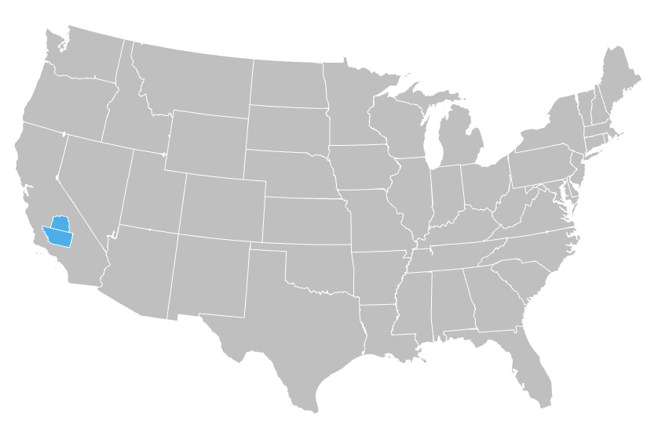


California Bioenergy’s South Tulare cluster leads the market in manure to biogas conversion
Solutions
Industrial Livestock
Methane Reduction
Case Study: CalBio
Founded | 2006 by N. Ross Buckenham, Neil Black, and John Bidart
Headquarters | Tulare, California
Funding | $506 million
Manure to CNG production process
Collection | Following its conversion from manure, biogas is collected onsite from each farm’s anaerobic digester
Conditioning | Hydrogen sulfide (H2S) and water are removed from the product on-site. Farms also performing other functions like measurement and analysis
Compression | The conditioned product is compressed into gathering and collection trunk lines for transportation from individual farms to a central upgrading plant
Upgrading | Here, the product is further refined, most notably to separate CO2 waste gas from biomethane. The latter is then compressed to become compressed natural gas (CNG)
Injection | CNG that meets pipeline specifications is injected into the Southern California Gas Company’s natural gas pipeline and is transported to retail fueling stations for use in CNG-powered trucks
Biogas production
(cubic feet/day)
~5.5 million
~105,000
South Tulare cluster
Cattle and dairy cows
Equivalent to one year of GHG emissions from ~234,000 gasoline-powered cars
19
Farms with anaerobic digesters
Tulare County, California
Emissions reduction
(MTCO2e/year)
1
Central upgrading plant
~1.0
million
Kern County, California
Note: California Bioenergy logo sourced from company website; Biogas production and emissions reduction statistics based in part on forward-looking construction data from the EPA website as of June 2024 for the Curtimade Dairy Digester, Lerda-Goni Farms Digester, P&M Dairy and VP Farms Digester and the Top O’ The Morn Farms Digester.
Sources: California Air Resources Board, California Bioenergy (2024); California Air Resources Board: Staff Summary: California Bioenergy (2024); US EIA, Natural Gas Conversions (2024); US EPA, Livestock Anaerobic Digester Database (2024); Pitchbook, California Bioenergy (2026).
Credit: Ellie Valenica, Isabel Hoyos, and Gernot Wagner. Share with attribution: Sayn-Wittgenstein et al., "Reconsidering Proteins" (6 October 2025). ​

Slide 30
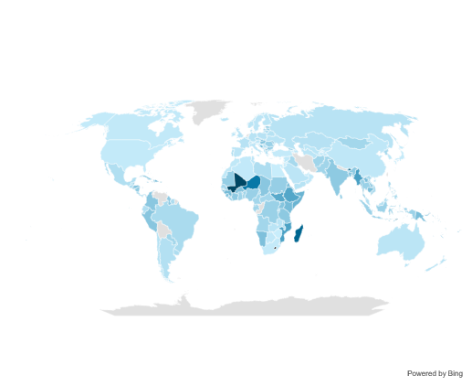
The greatest opportunity for enteric CH4 intensity reduction is the Global South, with values often above the 1.84 kg global average
Despite the volume of enteric CH4 emitted, the top-five emitters have relatively efficient intensities
Observations
The average intensity for enteric CH4 emissions is 1.84 kg of CH4 / kg of ruminant meat.
The top emitters of enteric CH4 are generally more efficient than the average global intensity due to modern livestock production systems.
  India is a notable exception with an intensity of 2.2 kg.
  Despite its large cattle population India does not produce a significant amount of meat from cattle amid religious considerations, contributing to a higher intensity.
Higher emissions per unit of output in the Global South can also be attributed to quality differences in animal feed, breeding and the overall health of the animal generating output.
Emissions intensity of top emitters of enteric CH4 (average, 2019-2023)
Emissions intensity of enteric CH4 (kg of CH4 / kg of ruminant meat) (average, 2019-2023)
Enteric CH4 Emissions (MT)
Enteric CH4 Emissions Intensity (kg of CH4/kg of ruminant meat)
Lowest intensity: Bahrain (0.03 kg)
Average intensity:
1.84 kg
Highest intensity: Lesotho (13.57 kg)
India
Brazil
China
United States
Pakistan
Minimum (0.03 kg)
Maximum (13.57 kg)
Note: For enteric CH4 intensities, CKI has calculated the ruminant livestock output using FAO data on kg of meat from ruminant animals (buffalo, camels, camelids, cattle, goats, sheep). Dairy products have not been included in these calculations to avoid double-counting derivative products (ex. cheese derived from milk).
Sources: CSIS, Methane Reduction in Livestock: Confronting the North-South Gap (2025); FAO, Emissions Totals (2023); FAO, Crops and livestock products (2023); Food Policy, Methane from cattle: facing realities in the global south (2025); University of Missouri, Calculating winter feed costs for beef cows (2022).
Credit: Ellie Valencia, Isabel Hoyos, and Gernot Wagner. Share with attribution: Sayn-Wittgenstein et al., "Reconsidering Proteins" (6 October 2025). ​

Slide 31




Replacing conventional animal feed with lower-emission alternatives is key to industrial livestock decarbonization
Solutions
Industrial Livestock
Alternative Feed
 | Conventional feed |  | Insects | Food leftovers | Alternative crops
Description | Soy and corn are the main global feed ingredients Soy production increased >2x in the past 20 years |  | Most promising insects: Black soldier fly, yellow mealworm, common house fly | Former food products (FFP) and bakery by-products (BBP) Food losses from food supply chain | Alternative grains (sorghum, millet, oats) Silage from corn and grass Seaweed
Land-use and emissions implications | Uses more habitable land (9%) than direct human consumption (6%) 2.69 GtCO₂e emissions annually |  | Uses 98% less land 61% less emissions-intensive Uses less water, pesticides, antibiotics Potentially more energy-intensive | No additional land and water use Reduces environmental cost related to grain production Reduces emissions from food waste | Alternative grains: More drought resistant Silage: Energy and nutrients Seaweed: Added minerals
Benefits and limits | Benefits Already in place Limits Deforestation and land use Biodiversity loss Corn not ideal for animal health High fertilizer use (N2O) |  | Benefits Meets animals’ dietary requirements High feed conversion efficiency Consumer acceptance not a barrier Limits Research needed to prove scalability Communication strategy is important | Benefits Highly digestible and nutritious Does not limit the growth of the animal Limits Low consumer acceptance Needs increased participation of food/feed processors Research needed to have a full lifecycle assessment | Benefits Alternative grains are more drought resistant Ingredient mixes can add minerals to livestock diets Limits Doesn’t represent a scalable set of solutions Lack of broad adoption
Production leader | China |  | China | European Union | European Union
Other key players | Brazil and United States |  | India and Brazil | Japan | India and United States
Sources: Van Huis and Gasco, Insects as feed (2023); Pinotti et al., Recycling food leftovers in feed (2021); Van Huis and Oonincx, Environmental sustainability of insects (2017); Sogari et al., Multi-
Perspective Review (2019); ClimateWorks Foundation, Global Innovation Needs Assessment (2021); BBC, Japan is recycling food waste (2024); FMI, Animal Feed Alternative Protein Market Outlook (2024).
Credit: Asya Ikizler, M.A. Miller, Hyae Ryung Kim, and Gernot Wagner. Share with attribution: Sayn-Wittgenstein et al., "Reconsidering Proteins" (6 October 2025).

Slide 32

Innovafeed leading the production of animal and aquaculture feed from insects, funded by Cargill, the EU, and the USDA
Solutions
Industrial Livestock
Alternative Feed
Case Study: Innovafeed
Founded | 2016 by Aude Guo, Bastien Oggeri, and Clément Ray
Headquarters | Paris, France
Funding | $490 million raised; key investors include Cargill, ADM, Temasek, the EU, the U.S. Department of Agriculture, and the Qatar Investment Authority
Revenue | $4.5 million (2023)
Climate impact | Insect meal reduces GHG emissions by 75% compared to fishmeal Insect oil reduces GHG emissions by 83% compared to traceable soy oil and 95% to untraceable soy oil Utilizes 89% less land, freeing up agricultural space for other uses or carbon sinks
Expansion | Its Nesle production site in France expanded three times and has the largest insect production capacity in the world Expanded into the United States in 2024 and opened its insect innovation center
Product & innovations | Cultivates black soldier flies and produces a range of products such as meals and oil to feed chickens, pigs, and aquaculture, as well as natural fertilizers Launched the world's first insect protein-fed trout value chain in 2018 and then launched insect oil-fed chicken and pork value chains in 2020 and 2021 Established a zero-waste framework, repurposing agricultural by-products from ADM Reduced its products’ emissions by 80% in three years Developed an industrial symbiosis model that allows it to colocate its production sites with large agricultural processing facilities, reducing plant emissions by 80%
Opportunities | Aligns with decarbonization goals by replacing high-emission animal-based proteins Addresses growing demand for biodiversity conservation and deforestation-free products Partners with global food producers like Cargill and ADM, as well as all types of stakeholders in the aquaculture value chain, for a farm/water-to-fork approach and business expansion
Benefits | Achieves significant reductions in GHG emissions, land use, and marine resource use for fishmeal and ultimately biodiversity loss
Challenges | Regulatory hurdles Consistent feedstock availability at scale Farmer and consumer acceptance
Fishmeal Blue
Whiting Norway
Soy Oil
With Deforestation
Soy Oil
No Deforestation*
Insect Oil
Insect Meal
-95%
-89%
-75%
-83%
GHG Emission (Kg)
GHG Emission (Kg)
Land Use (m²)
* Produced from traceable soy supply chains.
Sources: MDPI, LCA analysis (2020); Innovafeed, Impact report (2024); Crunchbase, Innovafeed (2024); Innovafeed, Our story (2024); Factset (2024).
Credit: Asya Ikizler and Gernot Wagner. Share with attribution: Sayn-Wittgenstein et al., "Reconsidering Proteins" (6 October 2025).

Slide 33
Solutions
Dietary Shift
Traditional Plant-Based
Traditional plant-based proteins are 26% of PBM dollar sales in U.S.
Tofu, tempeh, and seitan have a long history and well-established market presence but do not replace meat or PBM
Tofu | Tempeh | Seitan
Made by coagulating soy milk and then pressing the resulting curds into solid blocks | Prepared by fermenting cooked soybeans with a fungus called Rhizopus, which binds the beans | Wheat gluten is extracted by washing wheat flour dough until the starches are removed and only the gluten remains
Observations
Traditional plant-based proteins have a long presence historically, since they were developed in regions of Southeast Asia:
  Seitan: 900 BC-600 AD
  Tofu: 600-1500 AD
Majority of traditional plant-based protein consumers in the U.S. are of Asian descent or follow plant-based diets.
The decrease in 2023 unit sales is part of a market-wide return to pre-pandemic consumption levels.
Tofu, seitan, and tempeh have a relatively stable market performance and did well in 2023 compared to other meat alternatives.
Traditional alternatives do not fulfill or mimic the meat-eating experience as much as modern alternatives. As such, they are not considered a meat substitute in countries of origin or Western countries.
Dollar sales in $ millions, U.S. retail
Unit sales in $ millions, U.S. retail
2021
2022
2023
2021
2022
2023
Tofu, tempeh, and seitan
Tofu, tempeh, and seitan
Plant-based meat and seafood (PBM)
Plant-based meat and seafood
Sources: GFI, Retail insights for plant-based industry (2023); He et al., Review of research on plant-based meat alternatives (2020); CSIS, The Future Appetite for Alternative Proteins (2023).
Credit: Ariela Farchi Behar, Friedrich Sayn-Wittgenstein, Hyae Ryung Kim, and Gernot Wagner. Share with attribution: Sayn-Wittgenstein et al., "Reconsidering Proteins" (6 October 2025).

Slide 34





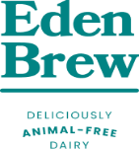


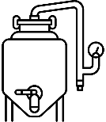




Plant-based leads the alternative proteins global market, with cultivated meat trailing in segment growth and commerciality
Solutions
Dietary Shift
Alternative Proteins
There are three types of alternative proteins, each with different tail- and headwinds
 | Description | Tailwinds | Headwinds | Leading players
Plant-based | Made from a combination of protein ingredients: soy, pea, lupin, or wheat, as well as oil and structural ingredients | Grantmaking for commercialization research to lower costs Slower projected growth in animal protein production, posing an opportunity to close price gap | Need to improve product taste and texture Persistent price premiums – 70% above conventional meat
Fermentation | Products made through traditional, biomass, or precision fermentation are used as inputs for food ingredients | Governments recognizing fermentation-enabled foods as a climate solution Closest solution for closing the alt. dairy texture and taste gap | Lack of product understanding Stressed fundraising landscape Low manufacturing capacity
Cultivated | Genuine meat produced by cultivating animal cells directly rather than through livestock | Growing public investment in research Regulatory approvals in the United States and other key markets | Regulatory and food safety barriers Production cost Ongoing challenges to scaling production
Sources: GFI, State of the industry: Plant-based meat (2023); GFI, 2023 State of the industry: Cultivated meat (2023); GFI, State of the industry: Fermentation (2023).
Credit: M.A. Miller, Friedrich Sayn-Wittgenstein, Hyae Ryung Kim, and Gernot Wagner. Share with attribution: Sayn-Wittgenstein et al., "Reconsidering Proteins" (6 October 2025).

Slide 35
Shifting diets from animal to alternative proteins in high-income countries is a highly effective solution to reducing emissions
Solutions
Dietary Shift
Alternative Proteins
Average GHG emissions by food product, CO₂e per kg
U.S. land for protein production, million acres
Observations
Even a partial shift in diets away from animal proteins can result in significant emissions reductions.
Reduction of beef consumption is the dietary shift with the highest emissions abatement potential. Further GHG abatement in high-income countries could come from methane reduction technologies for industrial livestock.
With the right policy support, alternative proteins can represent up to 22% of global protein market as early as 2035.
Land made available for additional
forage, feed, or crops
99.48
Food crops for alternative proteins
39.72
Livestock feed cropland
Livestock forage cropland
According to a report by the Good Food Institute, Americans could replace 50% of animal protein consumption with alternative protein sources and produce equal amount of grams of protein while reducing land use by around ~35%.
Beef
Lamb
Fish (farmed)
Pork
Poultry
Rice
Tofu
Other Legumes
Peas
Nuts
Current Diets
Partial Diet Shift
*GHG emissions from beef herd vary based on management system. See slide 11 for a management system breakdown.
Sources: Kuepper B, Impacts of a Shift to Plant Proteins (2023); BCG, The Untapped Climate Opportunity in Alternative Proteins (2022); Our World in Data, Impacts of Food Production, (2018);
GFI, Transforming Land Use: Alternative Proteins (2024)
Credit: Asya Ikizler, Ariela Farchi Behar, Friedrich Sayn-Wittgenstein, Hyae Ryung Kim, and Gernot Wagner. Share with attribution: Sayn-Wittgenstein et al., "Reconsidering Proteins" (6 October 2025).

Slide 36
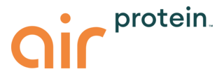







Air Protein creates high-density protein from CO₂ fed cultures, curbing environmental resource use
Solutions
Dietary Shift
Alternative Proteins
Case Study: Air Protein
Founded | 2019 by Dr. Lisa Dyson and Dr. John Reed
Headquarters | San Leandro, California
Funding | Series A: $32.1M Additional funding: $75M
Innovative process | The patented technology utilizes water, renewable energy, and – most importantly – air The elements are combined with a culture which produces protein through a process of Air Fermentation The protein is harvested, purified, and dried to produce a protein-dense versatile flour
Use-cases | The flour can be used widely across categories such as: Meat substitutes - The company produces Air Chicken and Air Seafood (scallops and fish) Dairy products Baking Alternative industries: animal & pet food, beauty & personal care, aquafeed, ag bio-stimulants
Opportunities | Carbon negative, as opposed to carbon and resource intensive traditional proteins Removes CO₂ from the atmosphere, using air as the main feedstock Process powered through renewable Affordable dense and bioavailable protein High-cost competitiveness, projected lower costs than whey, pea, soy, and meat 80% protein content – with all essential amino acids, and critical vitamins and minerals Performance Highly versatile across markets while meeting taste and texture requirements
Challenges | Pending FDA approval
Water required to produce 1kg of protein, 1/kg
-95%
-100%
1
Beef
Soy
Air Protein
Sources: Air Proteins Proprietary Data, 2025
Credit: Ariela Farchi, Isabel Hoyos, Hyae Ryung Kim, and Gernot Wagner. Share with attribution: Sayn-Wittgenstein et al., "Reconsidering Proteins" (6 October 2025).

Slide 37
Unlike the alternative dairy industry, the alternative meat industry has been struggling to expand its customer base
Solutions
Dietary Shift
Alternative Proteins
Alternative dairy products have gained consumers; alternative meat still struggles
Observations
Alternative dairy: Has appealed to mainstream consumers, with U.S. retail sales growing by 7% annually from 2020 to 2022. Success can be attributed to product innovation and marketing strategies.
Alternative meat: Saw an annual decline of 1% from 2020 to 2022.
Consumers prioritize taste and health over sustainability when purchasing food, meaning companies need to address these key concerns.
Reaching customers remains a challenge. The industry needs to take different approaches and invest in further product innovation and marketing to bring alternative meat to the customer’s table.
U.S. grocery retail sales ($ billions)¹
Almost flat since 2020
CAGR 2020-22
Total alternative proteins market
+1%
+9%
6.6
+25%
6.0
6.1
-1%
Alternative meat
4.8
Alternative
dairy
+7%
2019
2020
2021
2022
¹ Includes alternative refrigerated milk, shelf-stable milk, spreads (margarine, cream cheese, sour cream, etc.), yogurt, cheese, frozen/refrigerated meat; does not include alternative eggs and
ready-to-eat plant-based meals.
Sources: Profundo, Impacts of a Shift to Plant Proteins (2023); BCG, Taking Alternative Proteins Mainstream (2023).
Credit: Raissa Coan Ribeiro, Asya Ikizler, Friedrich Sayn-Wittgenstein, Hyae Ryung Kim, and Gernot Wagner. Share with attribution: Sayn-Wittgenstein et al., "Reconsidering Proteins" (6 October 2025).

Slide 38
A consumer-centric approach by brands is critical to achieving market share growth in alternative meat products
Solutions
Dietary Shift
Alternative Proteins
Mainstream consumers and easy wins should be the primary targets to accelerate market share growth
Know who they are…
Focus on what consumers want and need:
Improve taste and texture: Innovate to achieve parity of quality and price of animal protein, as these are top priorities for consumers
Reach price parity with animal-based proteins
Don’t underestimate the health impact perceptions
As in the EV market, alternative proteins will not scale until the new product is on par with the traditional one.
Unconcerned
consumers
It should target the mainstream consumer and what they are looking for.
Marketing strategies to target mainstream consumers:
Not labeling vegetarian or vegan but rather good or complete source of protein or antibiotic-free
Focus on the taste and sensory experience like “juicy,” “fresh”- food is a sensory choice and experience
Telling the consumer the protein source, like pea, lentil, or soy, instead of plant-based to increase the feeling of familiarity.
Core
consumers
Mainstream
consumers
Pre-made sandwiches
Ready meals
Focus on easy wins and unexplored markets where consumer resistance is lowest:
Frozen foods with meat as a side ingredient
Ultraprocessed meat
Convenience foods: It is easier, and more effective, to replace it than entrenched traditions.
50-50 blends: e.g., a beef burger with mushrooms
Pet food
Key segment to focus on
to drive growth in the alternative proteins sector:
Sustainability is not top priority
Taste and price are main barriers
Sources: BCG, Taking Alternative Proteins Mainstream (2023); McKinsey, Novel proteins: Consumer appetite for sustainably made ingredients (2024); CKI insights informed by expert and industry engagement (2024).
Credit: Asya Ikizler, Friedrich Sayn-Wittgenstein, and Gernot Wagner. Share with attribution: Sayn-Wittgenstein et al., "Reconsidering Proteins" (6 October 2025).

Slide 39

Impossible Foods is a pioneer in developing sustainable plant-based protein innovation to combat climate change
Solutions
Dietary Shift
Alternative Proteins
Case Study: Impossible Foods
Founded | 2011 by Patrick O. Brown
Headquarters | Redwood City, California
Funding | $2.01 billion raised; key investors include Bill Gates and Google Ventures
Revenue | $460 million (2022)
Climate impact | Reduces GHG emissions by 87% compared to producing beef Saves 89% water (3 gallons vs. 58 gallons per burger) Utilizes 96% less land, freeing up agricultural space for other uses or carbon sinks
Transparency | Conducted ISO-compliant LCAs, validating environmental claims Developed an environmental savings tool for consumers and companies to quantify their impact of switching to plant-based products
Innovations | Pioneered the use of soy leghemoglobin (heme) to replicate meat taste and texture Established localized manufacturing hubs, reducing transportation emissions Transitioned to renewable energy sources for production facilities
Opportunities | Aligns with decarbonization goals by replacing high-emission animal-based proteins Addresses growing institutional demand for sustainable food solutions (e.g., schools, hospitals, companies) Partners with global food chains like McDonald’s and KFC, increasing accessibility to plant-based options Collaborating on distribution efficiency technologies could cut emissions in logistics, while enhanced plant protein extraction processes could improve yield and texture
Benefits | Achieves significant reductions in GHG emissions, water, and land use Transparent environmental performance supports consumer trust and corporate ESG goals Demonstrates scalability as a viable alternative protein source in the global food system
Challenges | High R&D and production costs impact profitability Faces intense competition in the alternative protein market Needs to address consumer skepticism about the “processed” nature of plant-based products
Beef Burger
Impossible Burger
-86%
-95%
-97%
3,7
220,0
1,6
0,5
11,0
0,1
GHG Emission (Kg)
Water Use (L)
Land Use (m²)
* Case study based on Impossible Food’s impact report and public claims.
Sources: Quantis, Impossible Foods (2019); Impossible Foods, Impact Report (2023).
Credit: Vedant Bhansali, Friedrich Sayn-Wittgenstein, Hyae Ryung Kim, and Gernot Wagner. Share with attribution: Sayn-Wittgenstein et al., "Reconsidering Proteins" (6 October 2025).

Slide 40
Solutions
Dietary Shift
Alternative Proteins
EV Analogy
Finding parallels: The energy and protein transitions both face resistance, high costs, and large-scale infrastructure needs
Relevant for private investments
 | Leverage procurement (public and private) | Product appeal | Value chain buildup | Government support | Increase competitiveness with incumbent products
Transition parallels | Both energy and protein transitions require continuous large-scale adoption of technology | Neither EVs nor alternative proteins will scale until products are appealing | Both the energy and protein transitions require a new, large-scale value chain | Both EVs and alternative proteins won’t scale until products reach price parity and supply is stimulated | Both need price parity and wide availability to increase their comparative market share
Description | Public-private partnerships: Partnering with government (supply for schools, hospitals, prisons) poses as a scalable alternative vs. B2C market Leveraging large private procurements with food retailers | Overcome negative perceptions related to texture, smell, and overall sensory experience Nutrition: Consumers desire familiar, yet potentially healthier, options | Investing in all stages of alternative protein’s lifecycle, from raw material sourcing to R&D, manufacturing, distribution, marketing, and even culinary adoption support Industrial-scale manufacturing processes like fermentation tanks | Support with infrastructure and raw material needs has helped EVs to scale, similar to alternative proteins Tax and credit breaks to lower costs for both suppliers and consumers R&D support for startups and companies | Expand presence in restaurant chains (good way for customers to try new things) and grocery stores to normalize consumption Address price competitiveness to reach conventional meat price parity through scale-up in production
Advantages | Provides a stable, large-scale demand without requiring immediate mass-market consumer adoption Increases visibility of alternative proteins across various food service settings | Increases acceptability among consumers, hence adoption Reduces the feeling of making a “sacrifice” and focuses on food’s taste | To address and prevent bottlenecks Creates a more reliable supply chain, encouraging investment from larger corporations | Supports startup R&D, as well as public, open research and sharing of best practices Reduces cost and encourages private investment Public charging stations for EVs have been instrumental; supporting wide availability of alternative proteins in grocery stores can have a similar effect | Increased visibility in restaurants and stores positions alternative proteins as a mainstream rather than niche option Reaching price parity with conventional meat attracts price-sensitive consumers
Key examples | School meals, public institutions’ canteens USPS started procuring EVs and establishing charging stations nationwide, with plans to have 66,000 EVs by 2028 | Tesla for EVs Oatly, which has successfully marketed its oat milk as both healthy and enjoyable | Tesla’s investment in battery production and gigafactories EVs were able to scale after heavy investments in critical minerals and charging stations | The U.S. IRA and EU Green Deal have increased EV adoption by stimulating supply and driving demand China became a leader in EVs thanks to the $29 billion the government spent on credits and tax breaks from 2009 to 2022 | Supermarkets like Tesco in the UK are expanding plant-based sections in stores Starbucks’ has adopted alternative milk options globally
Sources: BCG, What the alternative protein industry can learn from EV companies (2024); MIT Technology Review, How did China come to dominate the world of electric cars? (2023);
Good Food Institute, Advancing solutions for alternative proteins (2024); USPS, USPS Intends to Deploy 66,000 Electric Vehicles by 2028 (2022).
Credit: Asya Ikizler, Hyae Ryung Kim, and Gernot Wagner. Share with attribution: Sayn-Wittgenstein et al., "Reconsidering Proteins" (6 October 2025).

Slide 41
Lessons from the electric vehicle market penetration for the alternative protein industry and widespread product adoption
Solutions
Dietary Shift
Alternative Proteins
EV Analogy
EV adoption milestones
Observations
It took government support and private investment for EVs to compete with conventional cars.
Significant product development and closer price parity are essential for mass market adoption.
When comparing the global market size relative to the years after introduction to the market, EVs and alternative protein forecasts follow a similar trajectory.
To enable the takeoff and scaling of alternative proteins, it will be essential to stimulate demand, achieve price parity, and invest in the supply chain to prevent bottlenecks.
Pre-takeoff
Takeoff
Post-takeoff (scaling)
EV: Different models like Nissan, Hybrid, Tesla 2012, government subsidies for EVs
AP: Beyond Meat, Impossible Foods launched their burgers in 2016 and gained large attraction in 2019
EV: Tesla Gen 3 affordable breakthrough (2017)
Tax credits to stimulate supply and drive down cost
EV: IRA and consumer tax credits
to stimulate demand
Investment in supply chain to avoid bottlenecks in scaling
Global market size of EVs vs. alternative proteins, $ billions
AP (low)
AP (high)
AP average
EV
EV baseline year: 2000
AP baseline year: 2020
Years after introduction to the market
Sources: UNEP, What’s Cooking? (2023); Yahoo Finance, EV market size (2023); Fortune Business Insights, EV market size (2022).
Credit: Asya Ikizler, Friedrich Sayn-Wittgenstein, Hyae Ryung Kim, and Gernot Wagner. Share with attribution: Sayn-Wittgenstein et al., "Reconsidering Proteins" (6 October 2025).

Slide 42




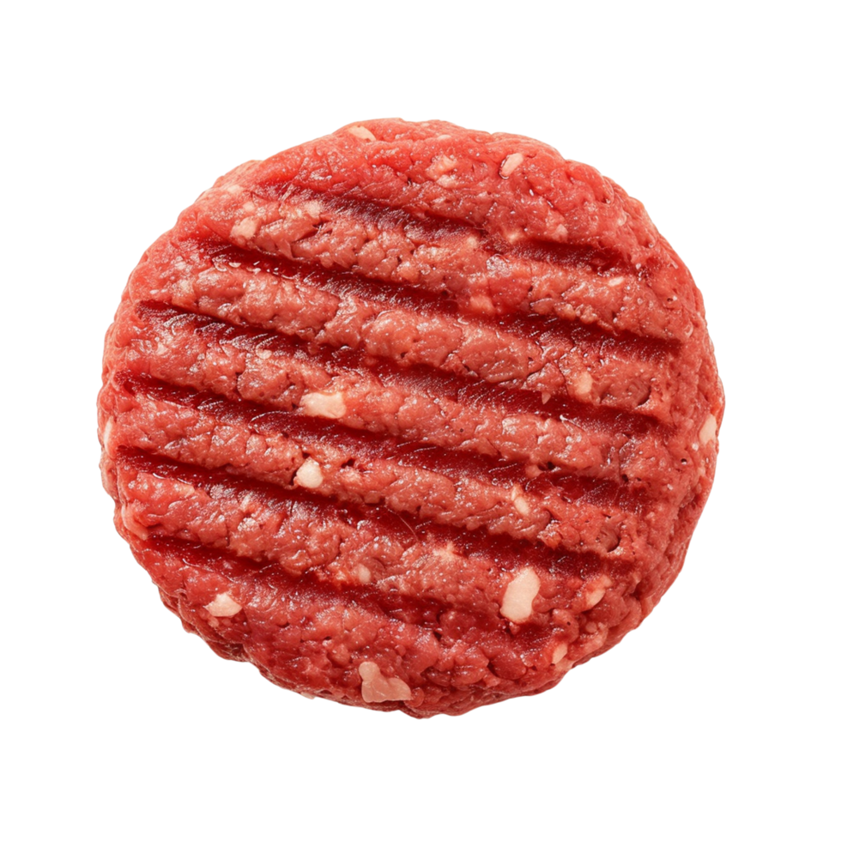
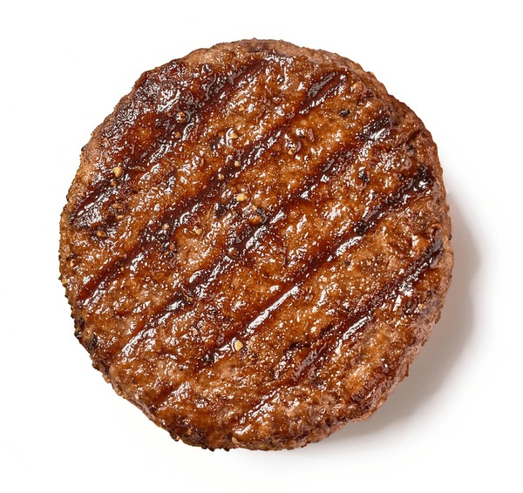


Solutions
Dietary Shift
Blended Proteins
Case Study: Spare Food Co.
Blended meat products like Spare Burgers reduce GHG emissions while preserving flavor and minimizing disruption to consumer habits
Founded | 2018 by Adam and Jeremy Kaye
Headquarters | Dobbs Ferry, New York
Market Size | Beef burgers are a ~ $100B market; ~ 20% are consumed through food service
Company’s focus | Healthier alternatives through plant-forward blends Emission reduction without major behavioral change Products crafted by professional chefs, prioritizing flavor Upcycled surplus farm produce to reduce food waste
The Spare Food Co. value creation: Spare Starter
Product innovation: 30/70 blended meat
Emission reductions kg CO₂e/lb
Farm-level Innovation
Processing Innovation
-79%
30%
70%
100%
Expanded specifications for edible surplus
Minimizing vegetable trimming/cutting
Manufacturing
Extending Shelf Life
Spare Starter
100% Grass-Fed Beef
Blended Meat
Spare Burger
Benchmark
Spare Burger
100% Grass–Fed
Optimize flavor and minimize residues
Prolonging surplus shelf life by 18-24 months
A cooked mix of 6 surplus farm vegetables that would otherwise go unsold.
Ex. Serving 500 burgers daily with 30% Spare Starter saves over 1,200 lbs of beef each month
Sources: The Washington Post, Plant-Based Meat (2025); The Spare Food Co., Official Website (2025); Planet FWD, About Spare Food (2024); Good Food Institute, Blended Meat (2024); Good Food Institute, U.S. Market Insights (2024); FactSet, Spare Food Co. (2024)
Credit: Andrea Castro, Ariela Farchi, Isabel Hoyos, Hyae Ryung Kim, and Gernot Wagner. Share with attribution: Sayn-Wittgenstein et al., "Reconsidering Proteins" (6 October 2025).

Slide 43
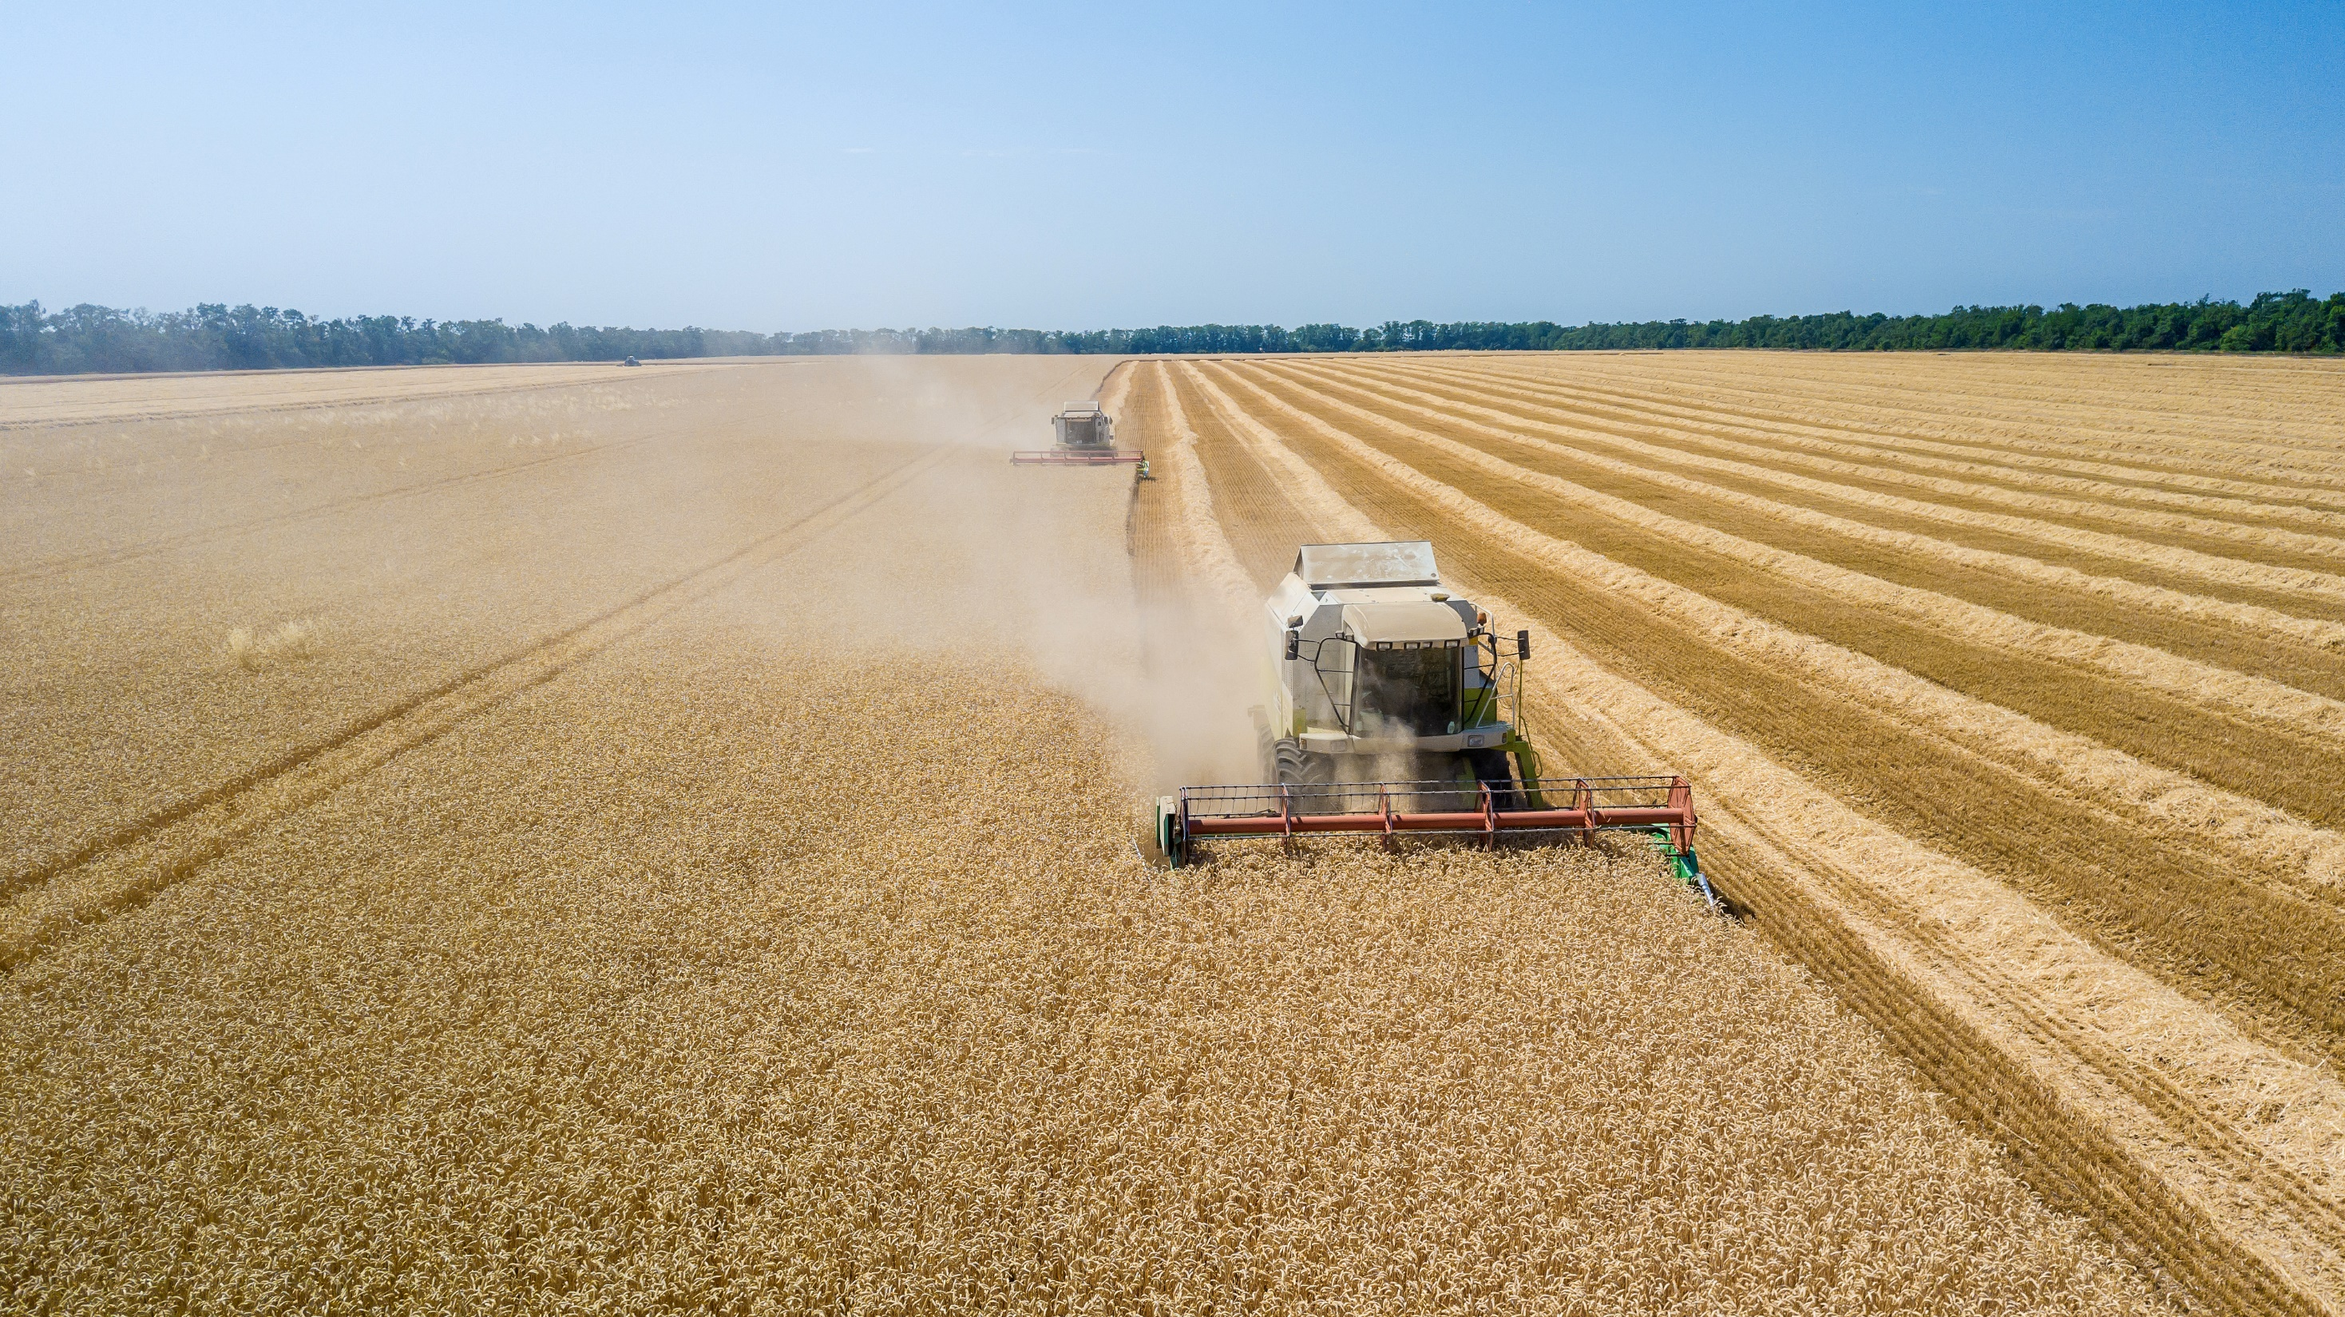
Protein Transition
Finance & Policy

Slide 44
Accelerating the global protein transition for net zero by 2050
Reaching net zero by 2050 requires a rapid decarbonization of global food systems, with approximately 60% of emissions coming from animal-based proteins. Carbon sequestration in soil and forests will not be sufficient to offset current animal-based protein production emissions. There needs to be a global protein transition.
Policymakers can and should step in to assist with the protein transition, providing incentives for adoption of technologies, shifting of diets, scaling of alternative proteins, and a holistic framework accounting for livelihoods, climate change, food security, and health.
Aligning livestock policies with climate goals through innovation and investment
Public policy actors can disincentivize land use for animal husbandry through several mechanisms, including the introduction of PES mechanisms that compensate livestock farmers for transitioning to ecosystem restoration as a function of reduced emissions from livestock and carbon sequestration.
Climate risks are often not considered while developing livestock policies, for the sector’s mitigation nor adaptation needs. They need to be better aligned with national climate plans and require cross-sectoral and stakeholder collaboration for effective emission reduction and adaptation.
Global public spending is not only necessary for R&D but also for commercialization efforts, especially for early-stage innovations that aren’t commercialized through private investments yet. Governments need to support policy and finance for alternative proteins to achieve their economic and climate benefits.
Necessary action supporting the uptake of technological and demand solutions
Technologies to reduce emissions from protein production are on their way and should be widely adopted. However, they are not enough to decarbonize the food and protein systems.
A global reduction of animal-based protein demand is imperative to reach food security and a net-zero pathway. Through national and global financial and policy frameworks, demand for alternatives can be supported.
Key messages
Finance & Policy
Credit: M.A. Miller, Friedrich Sayn-Wittgenstein, Hyae Ryung Kim, and Gernot Wagner. Share with attribution: Sayn-Wittgenstein et al., "Reconsidering Proteins" (6 October 2025).

Slide 45















Conventional animal proteins and alternative proteins overlap within the broader agrifood system
Finance & Policy
Food System: Conventional* & Alternative
The Agrifood System
Natural resources & environment
Upstream agro-industry
Agricultural production
Downstream agro-industry
Consumption
Conventional animal protein
Finance | Limiting land-use change is a problem/solution set affected mostly by policy change Current finance flows to methane-abatement solutions meets 45% of projected need
Policy | 158 countries have signed the Global Methane Pledge, with varied policy implementation Case study: Brazil
Alternative protein
Finance | Alternative protein finance grew significantly from 2014 to 2021 but has since slowed with negative incremental investment annually Corporate investment in alternative protein is concentrated in R&D and manufacturing
Policy | Inconsistent policies, subsidies, and lobbying remain important barriers for the protein transition Case study: Denmark, Singapore
*Animal protein
Source: Climate Policy Initiative, Landscape of Climate Finance for Agrifood Systems (2023).
Credit: M.A. Miller, Friedrich Sayn-Wittgenstein, Hyae Ryung Kim, and Gernot Wagner. Share with attribution: Sayn-Wittgenstein et al., "Reconsidering Proteins" (6 October 2025).

Slide 46
Food systems are significantly underinvested as a sector, with only 3% of total global climate finance flows despite 34% of emissions
Finance
Food System: Conventional* & Alternative
2019/2020 average funding vs. total investment gap under different scenarios, $ billions
Observations
To achieve conservative needs for climate transition, climate finance for agrifood systems needs to increase by 7x.
In the 2019-2020 period, only 20% of dollars invested in agrifood tech were directed towards companies focused on climate change solutions.
Partly repurposing public subsidies to agriculture and fisheries — most of which support harmful practices — could open up to $670 billion to boost climate interventions.
Upstream and downstream agro-industries received a low proportion of project-level finance flowing to agriculture, leaving potential capacity weaknesses at either end of the supply chain.
Project-level finance to agrifood systems vs. other sectors
All tracked finance to agrifood systems
Tracked finance to agrifood systems vs. low, medium, and high projected needs
Company-level
$631.7
Other sectors
Project-level
Agrifood systems
2019/2020 avg.
2019/2020 avg.
Climate finance tracked 2019/2022
Low: FOLU
Med: UNEP
High: Thornton et al.
*Project-level finance represents standalone investments most likely to be debt; company-level investments represent VC investments in companies, more likely to be equity. The difference between them is not significant, but they are not aggregated given the challenges and fragmentation collecting financial flows data for this sector.
Source: Climate Policy Initiative, Landscape of Climate Finance for Agrifood Systems (2023).
Credit: M.A. Miller, Elizabeth Robertson, Friedrich Sayn-Wittgenstein, Hyae Ryung Kim, and Gernot Wagner. Share with attribution: Sayn-Wittgenstein et al., "Reconsidering Proteins" (6 October 2025).

Slide 47
Forestry and agriculture receives ~80% of financing flows to agrifood systems but does not measure up to needs
Finance
Food System: Conventional* & Alternative
Current funding fulfills only 30% of need in best-case scenario (FOLU, published 2019)
Observations
42% of project-level finance to agrifood systems was to agriculture and 41% to forestry.
70% of project-level agriculture investments target production, e.g., climate-smart measures at farm level, lower carbon fertilizers, and cover crops.
94% of VC in agriculture (company level) targeted upstream agro-industries: farming systems and biotech for crop inputs.
Project-level finance for forestry funding dominated (75%) by investment in forest management, including afforestation and forest conservation.
In 2022, more than half of forestry-related tracked finance went to domestic investments in China, a significant funder of PES programs for farmers.
Funding concentrated at project level vs. high, medium, and low scenarios, $ billions
Forestry
Agriculture
753
219
55
218
146
Project-level finance
Company-level investments
FOLU, 2019
UNEP, 2022
Thornton et al., 2023
Source: Climate Policy Initiative, Landscape of Climate Finance for Agrifood Systems (2023).
Credit: M.A. Miller, Elizabeth Robertson, Friedrich Sayn-Wittgenstein, Hyae Ryung Kim, and Gernot Wagner. Share with attribution: Sayn-Wittgenstein et al., "Reconsidering Proteins" (6 October 2025).

Slide 48
Reducing agriculture emissions and combatting deforestation requires a multipronged, public-private approach
Policy
Cross-Strategies
Targeted strategies to reduce emissions and protect forests through collaborative efforts
Public policy interventions
Private sector
solutions
Public policy interventions will need to include a range of carrot-and-stick approaches.
Private innovations and practices may need public support to get on the path to commerciality.
Public forest designation
Cap-and-trade system for forest certificates
Intensify/increase productivity of cattle ranching
Precision cattle grazing technology deployment
Improved cattle tracing
Payments for ecosystem services
Corporate sustainable timber bonds
Improved, sustainable fertilizers to replace inefficient, nitrogen fertilizers (Pivot Bio)
Compensation mechanisms for farmers
Publicly funded education and training for farmers to increase productivity
Blended and catalytic finance
Business models relying on multiple financing sources, e.g., carbon markets and livestock management
Intensify/increase productivity of sustainable cattle ranching*
Corporate commitments to deforestation-free supply chains
Disincentivize deforestation
Reduce need for land transformation
Adapt livestock and land management practices
Corporate initiatives
Technological innovation
* Livestock production can de a driver of deforestation based on management type and practices being employed. Increased sustainable productivity should aim to curb deforestation.
Sources: FAO, The State of the World’s Forests (2022); Land Use Policy (vol. 91), Solving Brazil’s land use puzzle (2020); Breakthrough Energy, The State of the Transition (2024).
Credit: M.A. Miller, Elizabeth Robertson, Friedrich Sayn-Wittgenstein, Hyae Ryung Kim, and Gernot Wagner. Share with attribution: Sayn-Wittgenstein et al., "Reconsidering Proteins" (6 October 2025).

Slide 49

Land speculation and illegal activities worsen the deforestation problem in Brazil — beyond beef production
Policy
Land Use
Case Study: Brazil
Brazilian cattle industry and land use 2016-2021
Observations
Land speculation is the conversion of natural ecosystems, based on expected revenues from future agricultural land use.
A 60% increase in deforestation, mainly driven by land speculation and unfulfilled agricultural potential, misleadingly indicates a drop in cattle productivity. The amount of actual pastureland is decreasing.
Continued illegal deforestation is driven by:
  Ambiguous land ownership
  Lack of documentation and monitoring of agricultural areas
  Fires spreading from forest clearing and land clearing/management
Exports to China (32%) and Hong Kong (14%) drive continued production.
2016
2021
Deforestation - cattle (Mha)1
590
950
+60%
Pasture area (Mha)
164
163
-0.9%
Production - beef
-1.4%
Exports - beef
+38%
¹ According to the Trase methodology, cattle deforestation and conversion, which is calculated based on the area of pasture on areas of land deforested in the five preceding years; e.g.,
cattle deforestation and conversion in 2020 refers to the area of pasture in 2020 that was converted between 2016 and 2020 and linked to beef production.
Sources: Trase, Brazilian beef supply chain (2023); WRI, Commodities replacing forest areas (2021). Credit: Raissa Coan Ribeiro, Ariela Farchi , M.A. Miller, Friedrich Sayn-Wittgenstein, Hyae Ryung Kim, and Gernot Wagner. Share with attribution: Sayn-Wittgenstein et al., "Reconsidering Proteins" (6 October 2025).

Slide 50
Pasture area and cattle production see little change as deforestation and land-use change continue to increase
Policy
Land Use
Case Study: Brazil
Brazilian cattle industry and land-use change 1988-2020
Observations
Since 1988, different
parties in power have had conflicting approaches to deforestation policies, marked by Bolsonaro’s budget cuts from illegal deforestation protection groups and indigenous land tenure.
Bolsonaro’s recent policies have allowed space for increased land-use change from land speculation.
Brazil exports ~75% of its beef production, which makes supply chains vulnerable to international deforestation policies, affecting the economic prospects of unregulated land speculation and deforestation.
Cattle
Prod. (Mt)
Amazonia deforestation
Deforestation
(Mha)
Brazil cattle production
11
3,0
10
9
2,5
8
An increase in deforestation in recent years has not been followed by an increase in production.
7
2,0
6
1,5
5
4
1,0
3
2
0,5
1
0
0,0
José Sarney
Itamar Franco
Luiz Inácio Lula da Silva
Michael Temer
Brazilian presidents
Fernando Collor
Dilma Roussef
Fernando Henrique Cardoso
Jair Bolsonaro
¹ According to the Trase methodology, cattle deforestation and conversion, which is calculated based on the area of pasture on areas of land deforested in the five preceding years;
e.g., cattle deforestation and conversion in 2020 refers to the area of pasture in 2020 that was converted between 2016 and 2020 and linked to beef production.
Sources: Trase, Brazilian beef supply chain (2023); WRI, Commodities replacing forest areas (2021).
Credit: Raissa Coan Ribeiro, Ariela Farchi, Friedrich Sayn-Wittgenstein, Hyae Ryung Kim, and Gernot Wagner. Share with attribution: Sayn-Wittgenstein et al., "Reconsidering Proteins" (6 October 2025).

Slide 51
Unlike in the Amazon, Cerrado’s deforestation is legal and occurs on private property
Policy
Land Use
Case Study: Brazil
The second-largest biome in Latin America (~25% of Brazil) faces rapid legal deforestation
Observations
Over the past four decades, Cerrado has lost half of its native vegetation, driven by government programs promoting agricultural expansion under the narrative, “Breadbasket of the world.”
Unlike in the Amazon, deforestation in the Cerrado is legal and occurs on private property (up to 65%; 35% native vegetation must be kept).
Since 2023, when President Lula started his new mandate, Cerrado farm owners have begun to deforest legal areas, fearing new and more restrictive policies that could potentially hinder their business.
The Cerrado has largely remained invisible to society, receiving little media attention and lacking continuous satellite monitoring, which has led to outdated data on deforestation.
Annual increase of deforestation in the Cerrado, Brazil, 2002-2023, Mha
101.7
(54%)
70.1
(37%)
Over half of ~190 Mha native vegetation was suppressed
5.4
Farm owners’ anticipation to regulations; deforested land was not employed for pasture or crops
3.4
2.0
+12%
1.1
0.8
0.9
1.1
1.1
0.7
0.7
0.6
<2002
2002
2006
2010
2014
2016
2018
2019
2020
2021
2022
2023
Total
Sources: INPE, Land observation (2024); Brazil’s National Forests Monitoring Satellite Program, PRODES (2024); INPE. PRODES Technical Note (2022).
Credit: Raissa Coan Ribeiro, Ariela Farchi, Friedrich Sayn-Wittgenstein, Hyae Ryung Kim, and Gernot Wagner. Share with attribution: Sayn-Wittgenstein et al., "Reconsidering Proteins" (6 October 2025).

Slide 52
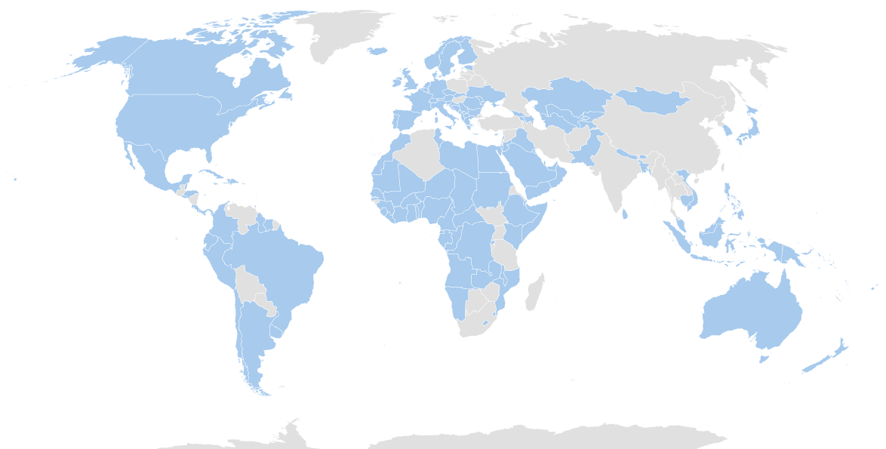
A wave of new policies and agreements worldwide are addressing methane emissions and food security
Policy
Methane
158 countries are participating in the Global Methane Pledge
Observations
Globally, food systems emissions and food security is coming under the spotlight. Multiple policies and initiatives have emerged, including:
  Enteric fermentation: $200 million USD
  160 countries pledged to include food in climate action at COP28
  Carbon tax for agriculture (Denmark)
  EU From Farm to Fork
  EDF Dairy Methane Action Alliance
  Global Methane Hub, launched to reduce methane emissions with $328 million USD
However, a lack of policy implementation exists despite growing government strategies.
Governments seem to avoid explicitly mentioning the need to reduce livestock and meat production.
In 2023, the United States established a methane regulatory policy to reduce emissions by 80% between 2024 and 2038, focusing on high-emitting industries.
The EU’s Methane Action Plan aims to reduce total methane emissions by 30% by 2030, with agriculture accounting for 54% of those emissions.
Key policies:
European Climate Law
Land Use, Land-Use Change, and Forestry (LULUCF) Regulation
Effort Sharing Regulation
EU Methane Strategy
Signed the Global Methane Pledge
Brazil’s Zero Methane Programme aims to reduce methane emissions by promoting biomethane and biogas production.
The program seeks to integrate methane credits and the dissemination of methane mitigation technologies through scientific and technological innovation, with the support of national and international financing.
Sources: Global Methane Pledge, Methane plan and policies (2024); COP28, Food and agriculture (2024); Ministry of Denmark, Livestock carbon tax (2024); IEA, EU Methane Action Plan (2023). Credit: Asya Ikizler, Ariela Farchi, Raissa Coan Ribeiro, Friedrich Sayn-Wittgenstein, Hyae Ryung Kim, and Gernot Wagner. Share with attribution: Sayn-Wittgenstein et al., "Reconsidering Proteins" (6 October 2025).

Slide 53
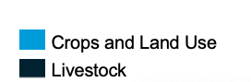
Delays in realizing methane abatement solutions result in part from financing flows not meeting financing needs
Finance
Methane
Methane abatement finance flows vs. needs and annual mitigation potential, $ billions, MtCH₄
Observations
Hard-to-abate methane emission sources such as enteric fermentation, food waste, and rice paddies have fragmented value chains that hinder solution scalability.
In 2021-2022, methane abatement finance to livestock-related activities attracted
$2.9 billion annually, a significant increase from $1.6 billion in 2019-2020.
  Enteric fermentation: $200 million USD
  Animal health and productivity: $410 million USD
  Manure-to-energy and manure management: $2.5 billion USD
Even with the increase in investment in enteric fermentation between 2019-2020 and 2021-2022, there has been a consistent lack of investment in such initiatives across the dairy and beef sector to date.
The public sector, namely development finance institutions, accounts for 95% of funding to animal health and productivity.
52
Investment needs of $16.5 billion USD per year until 2030 outpaces current finance flows by 2.2x
43.2
+117%
20
16.5
4.3
7.6
2019/2020
2021/22
By 2030
By 2050
By 2030
By 2050
Finance flows
($ billions)
Annual need
($ billions)
Annual mitigation potential
if financial needs are met (MtCH₄)
Sources: Climate Policy Initiative, Landscape of Methane Abatement Finance (2023).
Credit: M.A. Miller, Asya Ikizler, Friedrich Sayn-Wittgenstein, Hyae Ryung Kim, and Gernot Wagner. Share with attribution: Sayn-Wittgenstein et al., "Reconsidering Proteins" (6 October 2025).

Slide 54
Alternative proteins are commercially viable, but promising investment up to 2021 has stalled in recent years
Finance
Alternative Proteins
Cumulative investment in alternative proteins in the past decade surpassed $15B USD
Observations
The sector experienced a contraction in investment after 2021, aligning with global funding trends across the ecosystem, which fell 42% year over year in 2023.
  CAGR for the past 10 years has been 29%, drawn down from 64% in 2014.
  A higher interest rate environment slowed investment and fundraising significantly.
Many technologies for producing alternative proteins are now commercially viable, particularly plant-based innovations.
$40 billion in annual investment will be needed to stimulate and sustain adoption. Funders are now meeting only 7% ($3 billion) of this need.
Investment in cultivated meat and seafood is the most commercially nascent among the three innovation groups, and deal count is concentrated at the incubator and early/seed VC stages.
Annual and cumulative investment in alternative proteins, $ millions USD
-46%
+64%
2014
2015
2016
2017
2018
2019
2020
2021
2022
2023
Source: Good Food Institute, 2023 State of the Industry Report: Cultivated meat and seafood (2023).
Credit: M.A. Miller, Friedrich Sayn-Wittgenstein, Hyae Ryung Kim, and Gernot Wagner. Share with attribution: Sayn-Wittgenstein et al., "Reconsidering Proteins" (6 October 2025).

Slide 55
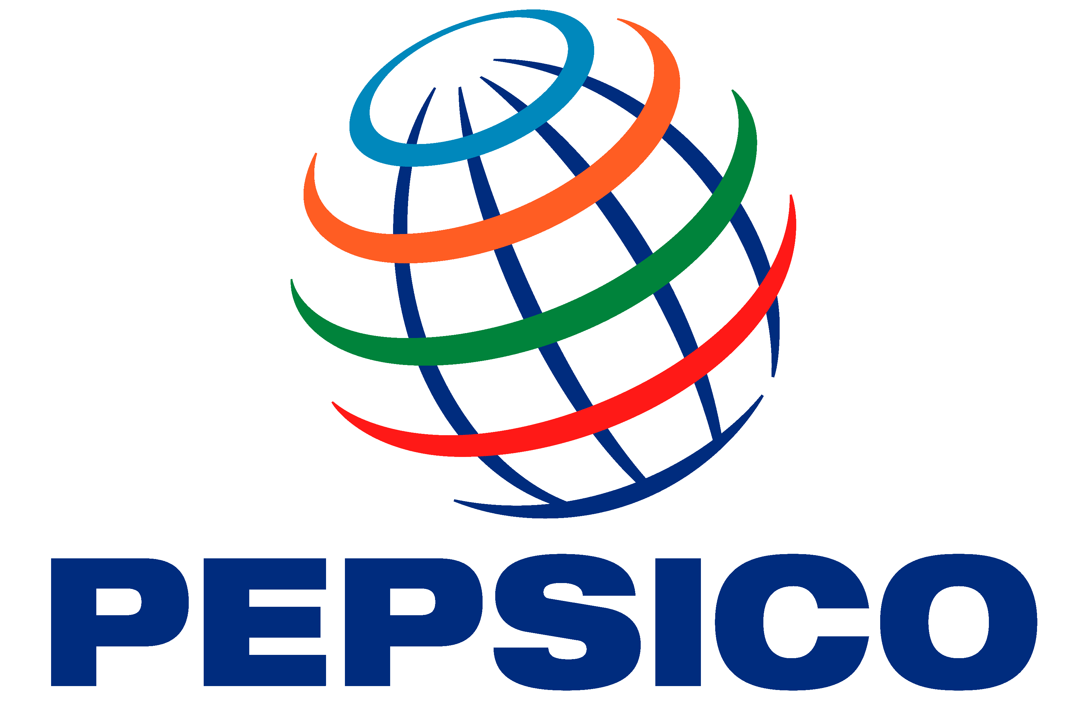










Conventional CPG companies’ participation in plant-based meat and alternative proteins is concentrated in investment and R&D
Finance
Alternative Proteins
Corporate Finance
Conventional companies with involvement in alternative proteins
Observations
In 2023, JBS broke ground on a
$62 million cultivated meat research center in Brazil.
In 2022, Tyson Foods participated in a $36.5 million Series A funding round for cultivated meat company Omeat. Tyson previously invested in cultivated meat companies UPSIDE Foods in 2018 and Believer Meats in 2021.
Relative involvement in acquisitions indicates the absence of any consolidation trends and lack of sector agreement on possible segment or technology “winners” and “losers.”
Sample companies’ concentration in investment and R&D/manufacturing can leverage incumbents’ scale but potentially misses out on maximizing innovations in consumer experience (taste, mouthfeel) without greater partnerships and acquisitions.
 | CPG companies |  |  |  |  |  |  | Meat companies
Investment
Acquisition
Partnership
R&D and manufacturing
✓
Cultivated meat
✓
Fermentation
✓
Plant-based
✓
✓
✓
✓
✓
✓
✓
✓
✓
✓
✓
✓
✓
✓
✓
✓
✓
✓
✓
✓
✓
✓
✓
✓
✓
✓
✓
✓
✓
✓
✓
✓
✓
✓
✓
✓
✓
✓
✓
✓
✓
✓
✓
✓
✓
✓
✓
✓
✓
✓
✓
✓
✓
Source: Good Food Institute, 2023 State of the Industry Report: Plant-Based (2023).
Credit: M.A. Miller, Friedrich Sayn-Wittgenstein, Hyae Ryung Kim, and Gernot Wagner. Share with attribution: Sayn-Wittgenstein et al., "Reconsidering Proteins" (6 October 2025).

Slide 56
Alternative protein market projections vary significantly, but even the lowest projections show exponential growth
Finance
Alternative Proteins
Market Projections
Meeting 2035 projections will require 25% CAGR from Euromonitor’s 2023 baseline
Observations
Demand for alternative proteins forecasts vary significantly, not only between different sources but also between the upper and lower bound projection of the same source.
Even reaching the lower bound market growth will require significant investment and advancement in technology.
Global alternative meat market, $ billions USD
A.T. Kearney
Credit Suisse (High)
Synthesis Capital
Blue Horizon
Credit Suisse (High)
Credit Suisse (Low)
Jeffries (High)
BCG
Barclays
Jeffries (Medium)
EY-Parthenon
Euromonitor
Credit Suisse (Low)
Jeffries (Low)
2022
2024
2026
2028
2030
2032
2034
2036
2038
2040
2042
2044
2046
2048
2050
Projection year
Year released
2019
2021
2022
Sources: UNEP, What’s Cooking? (2023); Good Food Institute, 2023 State of the Industry Report: Plant-based (2023).
Credit: M.A. Miller, Asya Ikizler, Friedrich Sayn-Wittgenstein, Hyae Ryung Kim, and Gernot Wagner. Share with attribution: Sayn-Wittgenstein et al., "Reconsidering Proteins" (6 October 2025).

Slide 57

Significant funding gaps in the alternative protein value chain
Finance
Alternative Proteins
Demand Increase
Observations
There are currently significant funding gaps in the value chain, with only R&D and production receiving sufficient funding.
Investment in critical infrastructure for industrial-scale production and consumer adoption is still lacking.
Investing in a strong value chain is necessary to successfully scale production and optimize costs of alternative proteins.
Most funding for alternative proteins comes from VC. Funding from industry, capital markets, and governments is not yet as prevalent.
Knowledge sharing and open access to information is key in such an interdisciplinary industry, in all development stages.
More research is needed, to not only develop better taste and texture but also understand what the general consumer wants — both of which are critical to generate demand at scale.
Only a few sections have sufficient funding for successful at-scale deployment
Research & development
Procurement of ingredients
Production
Distribution
Branding & marketing
Food service & retail
Is there sufficient funding?
How is value created?
Innovative product development and existing product enhancement
Sourcing of sustainably produced feedstock; understanding the functionality of protein structures
Processing of the feedstock to allow for further product development at scale
Leveraging existing food logistics channels to circulate alternative proteins
Increasing the public’s awareness, trust in, and demand for the product
Serving products to customers; catering to different tastes through product versatility
Optimize taste
Find and process novel sources of proteins
Conduct consumer preference studies
Expand scientific collaboration
Accelerate development of successful alternative proteins
Reduce cost
Optimize ingredients and
their processing
Improve market mechanisms for supply chain efficiency
Establish relationships between distributors and manufacturers
Upcycle and commercialize traditional food process by-products
Contract development to achieve necessary manufacturing capacity
Evolve past pilot-scale projects to serve greater populations
Scale up capacity
Utilize novel texturizing equipment
Optimize and
retrofit existing manufacturing equipment
,
Find distribution partners
Find early-adopter consumers to demonstrate market interest to sustain distribution
Expand into additional channels, including
e-commerce and direct to consumer
Conduct consumer preference studies to understand what appeals to consumers and drives demand
Highlight the sensory food experience over environmental benefits
Focus on the taste of the product
Reskill the relevant workforce for best practices on cooking different sources of protein that appeal to general consumers
Priorities
Sources: Good Food Institute, Advancing Solutions for Alternative Proteins (2024); BCG, What Alternative Proteins Can Learn from EV Companies (2024).
Credit: Asya Ikizler, Ariela Farchi, Friedrich Sayn-Wittgenstein, Hyae Ryung Kim, and Gernot Wagner. Share with attribution: Sayn-Wittgenstein et al., "Reconsidering Proteins" (6 October 2025).

Slide 58



Inconsistent policies, subsidies, and lobbying remain important barriers for the protein transition
Policy
Barriers
 | Inconsistent government policies | Subsidies | Lobbying
Global | Agriculture, climate, and health ministries around the world are not working together on food transition bills, creating inconsistent and incoherent policies surrounding food and protein systems. | From 2008 to 2017, the Brazilian government invested $22.2 billion in the beef industry, resulting in increased deforestation to make more room for cattle ranching. | The number of lobbyists representing meat and dairy industries tripled from 2022 to 2023 at the UN’s Conference of the Parties (COP).
U.S. | Providing further ethanol subsidies under the IRA has been criticized for being counterproductive for emissions reduction. Half of the IRA’s agriculture budget ($20 billion) is for “climate-smart agriculture.” In 2024, it added to this list new “provisional” methods that have not yet proved to reduce emissions. | Since 1995, the United States has provided $116 billion to corn and $44.9 billion to soybean production in subsidies for animal feed. U.S. subsidies to the meat and dairy industry total $38 billion a year. Between 1997 and 2005, through direct subsidies provided by various U.S. Department of Agriculture programs, Tyson Foods managed to save an estimated $288 million per year. | Six U.S. lobbying groups have spent over $200 million in political lobbying since 2000, including against climate regulations like the Clean Air Act and the Cap-and-Trade program. Tyson alone spent $25 million since 2000, which is 33% more than Exxon when comparing as revenue shares. In the United States, the meat industry spent 190 times more on political lobbying than on alternative proteins.
EU | EU From Farm to Fork vs. CAP investments Over 80% of the European Union’s Common Agricultural Policy supports emissions-intensive animal products. | An analysis of lobbying, subsidies, and regulations revealed that livestock farmers in the EU received 1,200 times more government funding than plant-based and cultivated meat organizations. | Meat and dairy lobbies have held over 600 top-level meetings with the European Commission in the past decade.
Sources: MIT Technology Review, Why ethanol aviation fuel tax subsidies aren’t a clear climate win (2024); Changing Markets Foundation, How Big Meat and Dairy Avoid Climate Action (2024);
The Daily Economy, The True Cost of a Hamburger (2022); Béné and Lundy, Political Economy of Protein Transition (2023); The Guardian, ‘Gigantic’ power of meat industry blocking green alternatives (2023); Nature Food, EU policy (2024).
Credit: Asya Ikizler, Ariela Farchi, Friedrich Sayn-Wittgenstein, Hyae Ryung Kim, and Gernot Wagner. Share with attribution: Sayn-Wittgenstein et al., "Reconsidering Proteins" (6 October 2025).

Slide 59

Denmark published world’s first national action plan for plant-based foods, which supports robust funding
Policy
Case Study: Denmark
Denmark is investing €195 million in the Fund for Plant-Based Foods until 2030 to promote its plant-based industry as a whole
Creating a strong plant-based value chain…
…with a robust funding plan
Transforming agricultural land to grow protein-rich crops, organic crops, and land-based seaweed cultivation
Green biorefining
Plant-Based Foods Grant (at least half of the fund):
To develop the plant-based food sector across the value chain, e.g., food companies, sales promotion, research institutions, innovation, and knowledge dissemination
Other uses of the fund:
Farmers planting protein-rich crops for human consumption
Strategy for Green Jobs in Agriculture
Overall promotion of the sector in Denmark
A good food base
Production and processing
Develop ingredients
Refine and scale the ingredients
Support producers in the fruit, vegetables, nuts, and mushrooms sectors
Healthy, plant-based foods for all
Green skill building through vocational training and higher education
Mainstreaming through public procurement
Strategy for Green Proteins (2024)
This plan is to increase production of green proteins for animals and humans, to not only boost plant-based food production but also replace animal feed such as soy.
Export and internationalization
Green skill building through vocational training and higher education
Mainstreaming through public procurement
R&D and innovation
For plant-based foods and technologies
For more sustainable agricultural and food production
Sources: FVM, Strategy for green proteins (2024); FVM, Danish Action Plan for Plant—Based Food (2023); GFI, National action plan for plant-based foods (2023); Food and Agriculture Council,
Food and farming (2023); Forbes, Denmark’s $195M Plant-Based Fund (2023).
Credit: Asya Ikizler, Friedrich Sayn-Wittgenstein, Hyae Ryung Kim, and Gernot Wagner. Share with attribution: Sayn-Wittgenstein et al., "Reconsidering Proteins" (6 October 2025).

Slide 60
Denmark wants to be the first mover and a leader in the sustainable proteins market by publishing the world’s first national action plan
Policy
Case Study: Denmark
Denmark’s sustainable proteins leadership strategy imitates wind energy trajectory
Observations
The comprehensive plan includes funding, new jobs, and creation of a value chain to add value to the Danish economy, allowing agricultural carbon tax without alienating farmers and creating mass political backlash.
Denmark’s plant-based action plan focuses on the attractiveness of plant-based food production rather than a crack-down on the meat industry.
The plan was developed closely with Denmark’s largest farmers’ association to avoid backlash.
22% of total Danish exports are agricultural products, notably pork, dairy, and fish, yet it also introduced the world’s first agricultural carbon tax.
How did Denmark pass this policy?
Beyond the environment, the case for simply smart business
The action plan is a strategic move based on the business case to make Denmark a front-runner in the plant-based food market and capture the growing market.
Denmark adopted a similar strategy to become a leader in wind energy; it's on track to do the same with plant-based food.
This precedent enabled the policy to gain bipartisan support.
Pragmatic and cooperative approach to avoid backlash
The action plan aims to make Denmark a front-runner in plant-based proteins. The role of its Strategy for Green Jobs in Agriculture is to grow jobs and develop plans with farmers' associations to avoid political backlash. Previously, countries trying to pass agricultural policies, like the Netherlands, faced mass protests.
Holistic framework
and planning
Supply chain development: Investment in agriculture, food innovation, and processing infrastructure to expand sustainable protein production and avoid bottlenecks.
Demand stimulation: Public awareness campaigns, chef training, and school curricula to promote plant-based diets and drive consumer adoption.
Research and innovation: Significant funding for R&D to improve plant-based product quality, alongside policies and incentives that support market growth.
Sources: FVM, Strategy for green proteins (2024); FVM, Danish Action Plan for Plant—Based Food (2023); GFI, National action plan for plant-based foods (2023); Food and Agriculture Council, Food and Farming (2023); Forbes, Denmark’s $195M Plant-Based Fund (2023).
Credit: Asya Ikizler, Friedrich Sayn-Wittgenstein, Hyae Ryung Kim, and Gernot Wagner. Share with attribution: Sayn-Wittgenstein et al., "Reconsidering Proteins" (6 October 2025).

Slide 61
Singapore is the global commercial and policy leader for cultivated meat and the first nation to approve its sale
Policy
Case Study: Denmark
Its leadership in cultivated meat innovation stems from national food security priorities, providing tailwinds for the market
6 million population, island country
Relies on imports for 90% of its food
Malaysia banned exports of chicken to Singapore during COVID
First country to approve cultivated meat for human consumption and to sell cultivated meat in retail locations¹
Investment in cultivated meat and seafood, top 6 countries, $ millions USD
Singapore context
1,750
1,700
650
2023 invested capital
30% of food produced nationally by 2030
Devised in May 2019
Addresses food insecurity and climate risk through three strategic pillars:
  Diversifying sources of food imports
  Increasing local production
  Growing food overseas
The Singapore Food Story R&D Programme has allocated more than $309 million in funds:
  A 2022 call for grant proposals under Theme 2 targeted productization, prototyping, and sustainability of production.
  Promised subsequent funding to projects that demonstrated commercial potential.
The targets, policies, and incentives facilitated by 30 by 30 have set the stage for cultivated proteins
2014-2022 invested capital
30 by 30 food security strategy
38
150
1,700
100
641
4
50
1
0
U.S.
Israel
Netherlands
UK
Singapore
France
Enthusiasm for cultivated meat in Singapore is at odds with policies around the world: The sale of cultivated meat has been banned in Italy and in at least two U.S. states (Alabama and Florida).
While Singapore does not represent the highest level of investment in cultivated meat, it does represent one of the largest investment markets proportional to its population.
Sources: Singapore Food Agency, 30 by 30 (2024); Singapore Agency for Science; Technology, and Research, Seed Grant (2022); Wired, Lab-Grown Meat Is on Shelves Now; GFI, National action plan for plant-based foods (2024); Good Food Institute, State of the Industry Report: Cultivated meat (2023).
Credit: M.A. Miller, Ariela Farchi, Friedrich Sayn-Wittgenstein, Hyae Ryung Kim, and Gernot Wagner. Share with attribution: Sayn-Wittgenstein et al., "Reconsidering Proteins" (6 October 2025).

Slide 62









CKI Food Systems ‒ Sustainable Proteins Team
Friedrich Sayn-Wittgenstein
Master of Public Administration in
Environmental Science and Policy
CKI Team Lead
Nadine Palmowski
Master of Public Administration in
Environmental Science and Policy
CKI Fellow
Ariela Farchi Behar
Master of Sustainability Management
CKI Staff Asscioate
Raissa Coan Ribeiro
Master of Business Administration
CKI Fellow
Isabel Hoyos
Master of Sustainability Management
CKI Staff Associate
Hyae Ryung (Helen) Kim
PhD in Sustainable Development
CKI Senior Research Fellow
hk2901@columbia.edu
Asya Ikizler
Master of Climate and Society
CKI Fellow
Gernot Wagner
Senior Lecturer, Columbia Business School
Faculty Director, Climate Knowledge Initiative
gwagner@columbia.edu
M.A. Miller
Master of Business Administration
CKI Fellow
Attribution: Sayn-Wittgenstein et al., "Reconsidering Proteins" Columbia Business School Climate Knowledge Initiative (2025).

Slide 63
Appendix

Slide 64


Nutritional profile of animal and alternative proteins depends on source and processing
Solutions
Demand Increase
Alternative Proteins
 | Animal-based proteins (ABP) | Alternative proteins (plant-based and fermentation)
Nutrients | Protein, zinc and iron, vitamins D, B6, and B12, but includes cholesterol | Protein, fiber, others (depends on specific ingredients used to produce the product)
Pros and cons | Can be a critical component of healthy diets especially in low- and middle-income countries Excessive consumption is associated with cardiovascular diseases and type II diabetes Zoonotic diseases, antimicrobial resistance, and 35% of foodborne diseases like salmonella are associated with animal agriculture A lot of ABP products are ultraprocessed | Can have ABP-comparable levels of protein, fat, and sodium but more fiber and no cholesterol Increased intake of plant-based foods is associated with improved health outcomes Some alternative meat products contain excessive amounts of sodium
Opportunity for improvement | Improved feed and antibiotic stewardship Moderate consumption – average individual in North America and Europe consume more ABP than recommended in dietary guidelines | Fortification and product development Further research and regulation to maximize the health and nutritional benefits of these products while minimizing excessive sodium Replacing unhealthy types of meats with alternative proteins Fermentation is known to improve the nutritional value of foods; expanding on precision fermentation techniques can be a solution
Observations
The health outcomes and nutritional value of both animal-based and alternative proteins are determined by the specific product formulation, rather than just the protein source.
Negative public perception of alternative proteins due to health concerns can be mitigated by addressing such issues during product development, enhancing consumer trust and acceptance.
While some alternative proteins are viewed negatively for being processed, dietary quality is a better determinant than processing level for nutrition-associated health outcomes. In some cases, alternative proteins have higher dietary quality than animal proteins.
Makers of alternative proteins can capitalize on nutritional benefits by targeting the replacement of less healthy meat options, positioning the products as a healthier choice for consumers.
Sources: UNEP, What’s Cooking? (2023); Fang, et.al., Association of ultra-processed food consumption and mortality (2024).
Credit: Asya Ikizler, Hyae Ryung Kim, and Gernot Wagner. Share with attribution: Sayn-Wittgenstein et al., "Reconsidering Proteins" (6 October 2025).

Slide 65




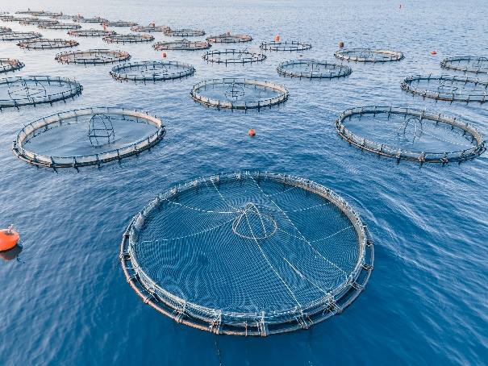
Switching to better feed for aquaculture and expanding unfed species can cut the sector’s CO₂ emissions by 50%
Solutions
Aquaculture
Blue foods are a vital protein source; selecting the right species can support a low-emission protein supply
Global blue-food consumption expected to increase 80% by 2050 | Emission and marine ecosystem concerns | Solution opportunities in the sector: Alternative aquafeed, bivalves, and more attractive fish products
Trends Aquaculture is the fastest growing food industry in the world, but its expansion should be done carefully. Production results in less emissions than land-based animals, with room for improvement. Most blue foods are dense in protein and other nutrients, like B12, vitamin A, and omega-3. Globally, 3 billion people depend on seafood for 20% of their diet. | Risks in the sector Aquaculture relies on wild fish for feed and is not a replacement for wild-caught fish. Using wild fish feed disrupts the ocean food chain and natural ecosystem. Overfishing is a high risk and has significant impacts on biodiversity. Switching to soy as feed drives mass deforestation and therefore is not a sustainable alternative. Blue foods are highly sensitive to climate change; their future availability depends on the health of ecosystems and environmental stressors. Species and production methods matter All blue foods are not the same when it comes to emissions and environmental impacts: Production methods and species matter. Salmon requires more resource-intensive feed than others and is one of the species with the fastest growing demand rate. 90% of salmon’s environmental impact is from feed. | Existing solutions For aquaculture, improving aquaculture feed to blue-food weight gain represents the biggest opportunity to improve environmental performance. Expand unfed aquaculture like bivalves (mussels, oysters, clams, and scallops). Sardines, anchovies, and mackerel are some of the most emission-efficient fish and packed with healthy nutrients. Innovation opportunities Innovations and businesses that increase the availability and attractiveness of these more sustainable species are important opportunities to increase the sustainable protein supply. Innovations for alternative salmon feed can be explored.. Microalgae, an unfed aquaculture type, is also an alternative protein source that can be explored.
Sources: The Blue Food Assessment, Science (2021); EIT Food, Fish feed: Why we need sustainable ; GFI, National action plan for plant-based foods (2023); WWF Aquafeed (2022).
Credit: Asya Ikizler, Friedrich Sayn-Wittgenstein, Hyae Ryung Kim, and Gernot Wagner. Share with attribution: Sayn-Wittgenstein et al., "Reconsidering Proteins" (6 October 2025).

Slide 66
Glossary
AFOLU | Agriculture, forestry, and other land uses
AA | Annual average percentage change
BAU | Business as usual
CapEx | Capital expenditure(s)
CCUS | Carbon capture, utilization, and storage
CH4 | Methane
CO₂ | Carbon dioxide
CPG | Consumer packaged goods (company)
EBITDA | Earnings before interest, taxes, depreciation, and amortization
FID | Final investment decision
GHG | Greenhouse gases
HQP | High-quality protein
IPCC | Intergovernmental Panel on Climate Change
LULUCF | Land use, land-use change, and forestry
N2O | Nitrous oxide
O&M | Operations and maintenance
PBM | Plant-based meat
PES | Payments for ecosystem services
R&D | Research and development
RED | Renewable Energy Directive
SMR | Steam methane reforming
UN | United Nations
VC | Venture capital
FAO | Food and Agriculture Organization
WWF | World Wide Fund for Nature
IPBES | Intergovernmental Science-Policy Platform on Biodiversity and Ecosystem Services
SDG | Sustainable development goals
WRI | World Resources Institute

