Slide 1
Reconsidering Wind
5 March 2025
Hyae Ryung Kim, Quint Houwink, Petr Jenicek, Taicheng Jin, Abha Nirula, and Gernot Wagner

Slide 2
Emerging Trends: The Case for Wind

Slide 3
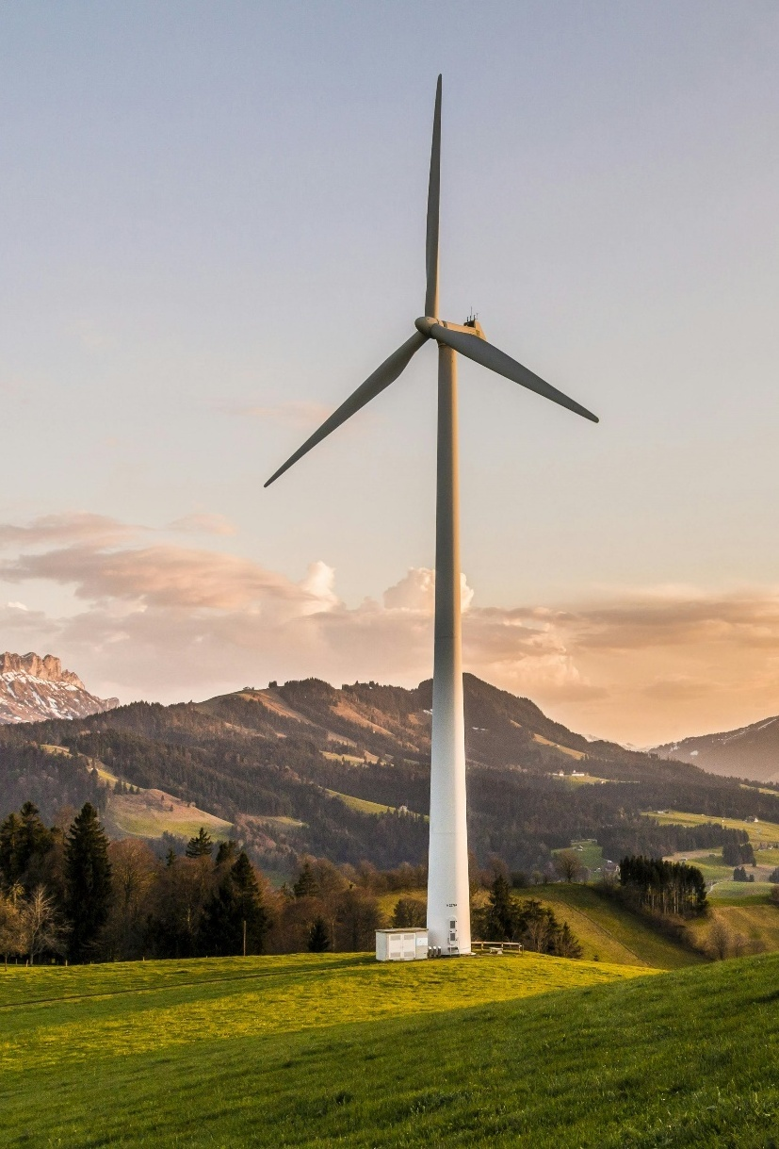
Wind has the potential to abate 10% to 20% of all CO₂e emissions by 2050 through the clean electrification of power, heat, and road transport.
To get to zero emissions by 2050, wind must grow sixteenfold to 38 TWh annual production; the more likely Economic Transition Scenario is wind growing sevenfold to 15 TWh.
Today, wind is the largest renewable electricity source, making up 8% of global production.
Wind electricity generation reached ~2,304 TWh in 2023 with 13% CAGR 2018-2023, driven by a 19% CAGR in China.
28% of global wind capacity is in China, 29% in the EU/UK, and 22% in the US.
Onshore wind LCOE has dropped 70% since 2009 to $50/MWh by 2023, significantly lower than fossil fuel costs, which are $75 to $120/MWh. Offshore wind is on par with fossil fuels, with LCOE decreasing 60% to $75/MWh today.
A steeper learning curve for wind will lead to wind becoming the most deployed and cheapest renewable as of 2025.
Wind LCOE has decreased at a stable learning rate of 15% for each doubling of capacity since 1982.
The learning curve for wind is driven mostly by innovations in turbine technology, which has led to 2-3x higher capacity factors, economies of scale resulting in cheaper CapEx, and a 50% longer project life.
Looking ahead, onshore and offshore LCOE is expected to decrease another 30% to 45% by 2035 and a total of 45% to 55% by 2050. Lower CapEx due to more installed capacity is the main contributor to lower LCOE.
Key messages The Case for Wind
Ørsted moved from 80% coal and gas in 2006 to 70% wind power in 2023, while increasing total heat and power production, the first fossil fuel company demonstrating such a major shift.
Sources: IEA, Net Zero Roadmap (2023); Our World in Data, Electricity generation from wind power (2024).
Credit: Taicheng Jin, Quint Houwink, Hyae Ryung Kim, and Gernot Wagner. Share with attribution: Kim et al., “Reconsidering Wind” (5 March 2025).

Slide 4
Wind can abate 6 to 9 Gt CO₂e by 2050 in select subsectors depending on the transition scenario
Abatement in Economic Transition Scenario
CO₂e emissions in 2024*: ~50 billion tonnes
Additional Abatement in Net Zero Scenario
28%
28%
21%
16%
7%
Refining 4%
Non-ferrous metals 2%
Other 2%
Rail 1%
Non-metallic minerals 2%
LULCF 17%
Marine 11%
11% to 16%
In Buildings
Coal mining 7%
24% to 37%
in all Power and Heat
Chemicals 13%
Agriculture fuel 4%
Aviation 10%
Commercial 15%
Waste 21%
Cement 17%
17% to 25%
in Road
Oil 3%
HFCs 22%
Natural gas 11%
Oil and gas 21%
Livestock 32%
Residential combustion 47%
3% to 4%
In Iron and Steel
Iron and steel 13%
Coal 49%
Road 51%
Crops 27%
Remaining industry 17%
Industry
Power and Heat
Agriculture, Land Use, and Waste
Transport
Buildings
(*) 2024 emissions based on projections.
Sources: Scope 1 emissions from Rhodium Group Climate Deck (September 2024); abatement estimates from BloombergNEF, IRENA, and IEA (2023). Credit: Hassan Riaz, Theo Moers, Hyae Ryung Kim, and Gernot Wagner. Share with attribution: Kim et al., “Reconsidering Wind” (5 March 2025).

Slide 5
Wind electricity generation to grow 16-fold until 2050 in net zero scenario, compared to only 7-fold in Economic Transition Scenario
Electricity generation by source, 2000-2050, thousands of TWh
Observations
Electricity generation is the largest source (36%) of energy‐related CO₂ emissions.
Global electricity demand is expected to increase from ~25,000 TWh in 2022 to ~60,000 TWh in 2050.
Projected increase in electricity demand is driven by:
Increased electrification, expansion of hydrogen electrolysis, population growth, and an increase in living standards.
To reach NZS by 2050, which envisions approximately 7,400 TWh of wind electricity generation in 2030, the CAGR needs to increase ~17%.
Achieving this will require increasing annual capacity from about 75 GW in 2022 to 350 GW in 2030.
Economic Transition Scenario (ETS)
Net Zero Scenario (NZS)
90
Unabated coal
Other renewables
90
80
Coal with CCS
Nuclear
80
Unabated gas
Solar
70
Gas with CCS
Wind
70
60
60
50
50
40
40
30
2.3
30
2.3
20
20
10
10
0
0
2000
2005
2010
2015
2020
2025
2030
2035
2040
2045
2050
2000
2005
2010
2015
2020
2025
2030
2035
2040
2045
2050
Sources: BloombergNEF, 1Q 2024 Global PV Market Outlook (2024); IEA Electricity (2024).
Credit: Taicheng Jin, Hyae Ryung Kim, and Gernot Wagner. Share with attribution: Kim et al., “Reconsidering Wind” (5 March 2025).

Slide 6
Wind now makes up ~8% of global electricity production, driven by China, Europe, and the US, representing ~87% of capacity
% of 2023 production
% of 2023 capacity
CAGR 2018-23
Electricity generation by source, 2000-2023, TWh
Capacity by country, 2000-2023, MW
30
World
100%
+13%
Wind
8%
Solar
6%
25
Hydro
14%
China
28%
+19%
Bioenergy
2%
20
Nuclear
9%
15
Gas
23%
US
22%
+9%
10
Oil
3%
EU/UK
29%
+7%
5
Coal
36%
Other
21%
+21%
0
2000
2005
2010
2015
2020
2023
2000
2005
2010
2015
2020
2023
Sources: Our World in Data, using Ember's Yearly Electricity Data; Ember's European Electricity Review; Energy Institute Statistical Review of World Energy.
Credit: Taicheng Jin, Hyae Ryung Kim, and Gernot Wagner. Share with attribution: Kim et al., “Reconsidering Wind” (5 March 2025).

Slide 7
Onshore wind LCOE dropped 70% since 2009 and offshore dropped 60%; only solar has seen a steeper decline in costs
LCOE by technology, $/MWh
Observations
Modern wind power adoption was motivated by the OPEC crisis in the 1970s.
Between 2010 and 2023, the onshore LCOE fell by 70%, from USD $107/MWh to $33/MWh.
Offshore LCOE fell by around 60%, from $197/MWh to $75/MWh.
The learning curve is by far steepest for solar PV, which saw the LCOE drop from ~$450/MWh in 2010 to $35/MWh in 2023.
This is likely to lead to solar PV overtaking wind as the dominant renewable in the years ahead.
360
Nuclear
Solar PV
Hydro
Wind (offshore)
240
Gas
Coal
Wind (onshore)
220
200
180
175
160
149
148
140
135
120
123
112
100
91
80
71
72
70
75
75
60
55
47
50
45
40
40
50
40
20
0
2010
2015
2020
2024
(*) LCOE breakdown for wind in Appendix
Sources: Ibenhalt, Explaining learning curves for wind power (2002); IRENA, Renewable Power Generation Costs (2024); Bolinger et al., Levelized cost-based learning analysis of utility-scale wind and
solar in the US (2022); Our World in Data, Levelized cost of energy by technology, World (2023); IEA, Wind Energy Annual Report (2000); DNV, Energy Transition Outlook (2024); Lazard, LCOE (2024).
Credit: Taicheng Jin, Quint Houwink, Hyae Ryung Kim, and Gernot Wagner. Share with attribution: Kim et al., “Reconsidering Wind” (5 March 2025).

Slide 8
Wind LCOE with stable learning rate of 15% for over four decades, driven by improving technology and economies of scale
LCOE, installed capacity and learning rate (LR*), 1982-2023
Observations
The normalized cost of wind energy has come down 87% since 1982 as the capacity has increased by 10,000x.
The learning rate for wind energy for the same period is 15%, a constant except for a slight decrease between 2005 and 2015.
The overall decrease in wind energy costs is driven by innovation in turbine technologies and economies of scale. For certain short-term decreases, the cost decline is driven by lower commodity prices or lower cost of capital (e.g., between 2008 and 2022).
Improvements in technology are represented by the longer project life of wind projects (30 years today vs. 20 years in the 1980s) and increased capacity factors (~45% today compared to ~15% in the 1980s).
LCOE ($/MWh)
Normalized LCOE**
Installed capacity
Installed capacity (MW)
1.000
1982-23 LR: 15%
1.000.000
100.000
1982-05 LR: 16%
2005-15 LR: 10%
2015-23 LR: 15%
10.000
100
1.000
100
10
10
Project life and capacity factor, 1982-2023
Project life (yr)
Capacity factor
Project life
Capacity factor (%)
+50%
60%
+260%
40%
20%
0%
(*) Learning rate defined as the % decrease in normalized LCOE for doubling of capacity. (**) Normalized LCOE controls for exogenous influences by excluding regional, economic, and policy factors.
Sources: Bolinger et al., Levelized cost-based learning analysis utility-scale wind and solar in US (2022); IRENA, Renewable Power Generation Costs (2023); NREL, Cost of Wind Energy Review (2022).
Credit: Taicheng Jin, Quint Houwink, Hyae Ryung Kim, and Gernot Wagner. Share with attribution: Kim et al., “Reconsidering Wind” (5 March 2025).

Slide 9
Wind prices projected to decrease 30%-50% by 2035 and another 10%-25% until 2050, with scale and efficiency driving down CapEx
Impact of drivers for median-scenario LCOE reduction in 2035 and 2050*, $/MWh
Observations
Onshore wind LCOE is expected to drop 44% until 2035. – Corrected for a bump in prices in 2022-2023, this drop is 26% with respect to 2021. A further drop is expected until 2050, although the pace slows.
Offshore wind LCOE is expected to drop 34% by 2035 and another 23% until 2050, halving the total price per MWh.
Capacity factors are unlikely to increase much further due to less attractive positioning of farms.
Most of the LCOE decrease comes from improvements in turbine capacity, hub heights, and rotor diameters. For example, typical turbine ratings are forecast to increase from 3.25 MW (2030) to 5.5 MW (2035) for onshore and from 11 MW (2030) to 17 MW (2035) for offshore wind.
2
-44%
-11%
3
2
Onshore
4
4
-34%
4
-23%
3
Offshore
2023
Capacity factor
Design life
CapEx
OpEx
WACC
2035
2050
(*) Future outlook numbers based on survey amongst experts, N=140
Source: Wiser et al., Expert elicitation survey predicts 37% to 49% declines in wind energy costs by 2050 (2021).
Credit: Taicheng Jin, Quint Houwink, Hyae Ryung Kim, and Gernot Wagner. Share with attribution: Kim et al., “Reconsidering Wind” (5 March 2025).

Slide 10
Ørsted transitioned from fossil fuel to 69% wind power in a decade, reducing gCO₂e/kWh by 92%
Case study: Ørsted
Ørsted heat and power production by source , 2006-23, TWh
Observations
Ørsted realized in 2008 that it needed to change from fossil fuel to sustainable energy, after the EU announced in 2007 that 20% of energy should be renewable by 2020.
The largest investments Ørsted made were in offshore wind, building 500 MW of offshore wind in 2009.
In the following decade, the company expanded its offshore wind capacity, and in 2018, Ørsted purchased Lincoln Clean Energy, a US onshore wind developer.
Between 2006 and 2023, Ørsted reduced its emissions per kWh by 92%, from 462 gCO₂e to 38 gCO₂e.
45
42.0
42.2
40
Wind (offshore)
35.0
37.0
Wind (onshore)
35
31.4
9%
32.1
39%
42%
Solar PV
30
5%
28.0
26.0
37%
Biomass
25
13%
22.4
23.6
48%
Hydro
20
18.0
21%
26%
39%
20%
27%
27%
Other renewables
4%
2%
Coal
15
18%
10
Gas
5
Other fossil
0
2006
2008
2010
2012
2014
2016
2018
2020
2021
2022
2023
Emissions from electricity production, 2006-23, gCO₂e/kWh
2006
2008
2010
2012
2014
2016
2018
2020
2022
2023
Sources: Ørsted, Powering the world with green energy; Ørsted, Annual Reports (2006-2023); Heal, Usher & Wagner, “Ørsted’s Case for Offshore Wind,” Columbia CaseWorks (2025).
Credit: Quint Houwink, Hyae Ryung Kim, and Gernot Wagner. Share with attribution: Kim et al., “Reconsidering Wind” (5 March 2025).

Slide 11
Emerging Trends: The Wind Challenge

Slide 12
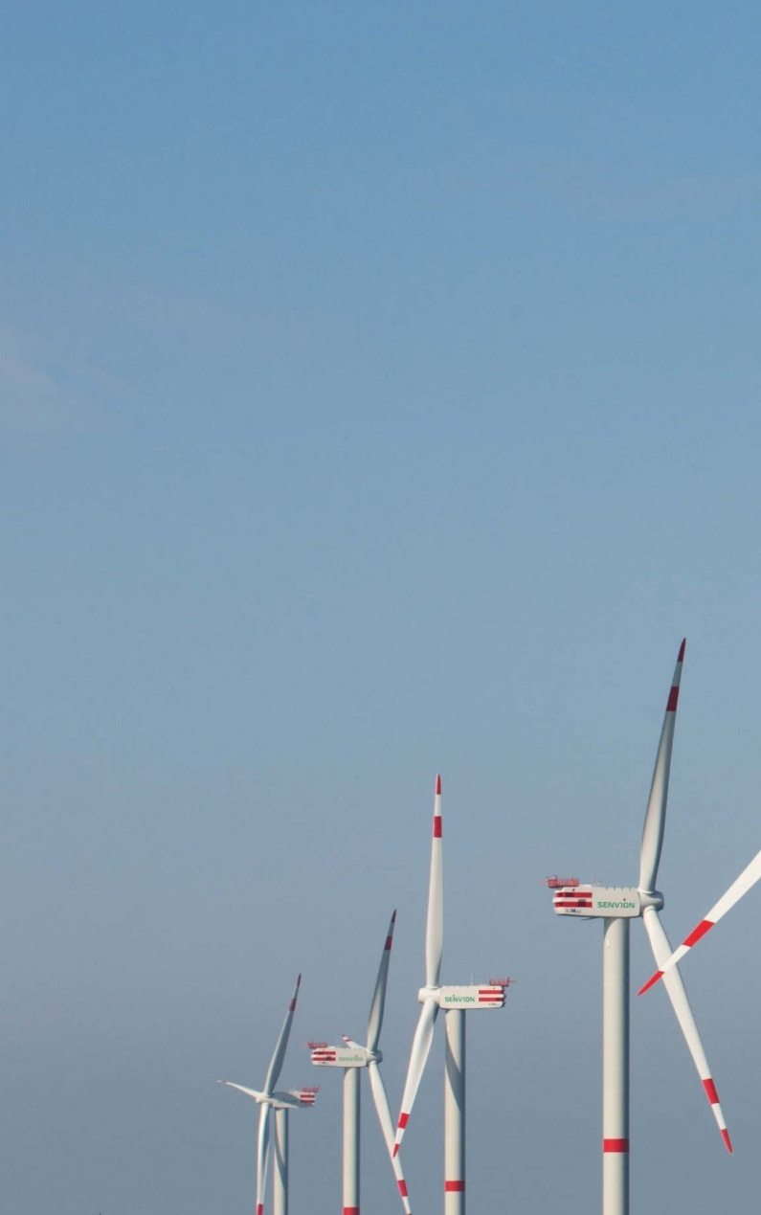
Key messages The Wind Challenge
Growth in investments in new wind energy projects slowed from 12% CAGR between 2013 and 2020 to 4% CAGR in the past three years, most significantly in onshore wind.
Also reflected in slowing of M&A transactions outside of China, specifically in onshore, where the transactions dropped 10% from 2022 to 2023.
The power and renewables sector has seen the steepest increase in cost of debt, from 1% to 4% WACC.
Renewables are especially vulnerable to interest rate increases, experiencing a 15% to 20% LCOE increase for a 2 percentage point interest rate increase.
Average power purchase agreement prices have declined from $83/MWh to $26/MWh since 2009, but higher commercial electricity prices since 2022 indicate a PPA increase is to be expected.
Gas prices have also decreased in recent years, becoming competitive with wind once again.
PPA prices vary widely among regions – e.g., prices are higher in California and New York.
Offshore wind projects rely on government support and higher electricity prices in coastal regions for PPA prices above the market average to compensate for higher LCOE.
Permitting delays and interconnection queues are creating practical obstacles for wind. In some states, onshore or offshore wind projects represent 50% to 70% of the interconnection queue.
40% of all wind projects in the pipeline are held up in the permitting phase.
A total of 246 GW of wind projects is in the queue for transmission connections.
30 GW of planned offshore wind capacity in the US is at risk with the new Trump presidency, which has indicated a halt on new land leases for offshore wind farms.
There is an expected gap of 125,000 workers in wind by 2030, especially wind development.
Image: Jan Oelker, 62M152, CC BY-SA 4.0.
Credit: Abha Nirula, Hyae Ryung Kim, and Gernot Wagner. Share with attribution: Kim et al., “Reconsidering Wind” (5 March 2025).

Slide 13
Investments in wind energy have plateaued since 2020-2023, was historically bad for onshore and good for offshore
Investment trends in wind energy, $ billions
Observations
During 2013-2022, onshore wind accounted for 80% of total investment in wind technologies.
In 2019, onshore wind investment witnessed an increase of 32% from 2018 to reach USD $133 billion before declining 9% in 2020.
Offshore wind investment reached USD $40 billion in 2020, nearly doubling the 2019 total.
The bulk of annual wind power investment goes to the installation of new onshore wind power capacities, despite disappointing results in recent years.
Offshore wind has offset some of the investment decrease in onshore but was unable to demonstrate significant growth for the sector as a whole.
Total CAGR decreased from 12% p.a. between 2013 and 2020 to 4% p.a. from 2020 until 2023.
Future investments are projected to expand from $181 billion in 2023 to an impressive $260.8 billion by 2034. The market is anticipated to grow at a CAGR of 10.2% over the next decade.
Onshore
The recent investments driven by China policies; as developers accelerated investments to meet FiT deadline in 2021.
+4%
Offshore
178
175
181
+12%
161
155
131
125
123
107
91
72
7
2013
2014
2015
2016
2017
2018
2019
2020
2021
2022
2023
Sources: Peak Wind, Global Renewable Energy M&A Report (2023); IRENA Investment (2023); IEA, World Energy Investment (2024); BNEF, Offshore Wind Investment Hit All-Time High in 2023 (2024); BNEF, Renewable Energy Investment Hits Record-Breaking $358 Billion in 1H 2023 (2023).
Credit: Abha Nirula, Hyae Ryung Kim, and Gernot Wagner. Share with attribution: Kim et al., “Reconsidering Wind” (5 March 2025).

Slide 14
In 2023, M&A transactions outside China recorded a decline due to economic uncertainty, but offshore and China did see growth
Summary of key findings from asset transactions 2023
Key deals
Observations
While the transactions for offshore wind remained stable, deals for onshore wind declined by 7% from 2022 to 2023.
However, the acquisition percentage of offshore wind was 41%, which can be due to higher capital expenditure, operational challenges, and lack of maturity for such projects.
In 2023, nearly 40% of offshore wind deals involved development projects, while for onshore wind, 62% of the deals were for operational projects, as they allow stable long-term returns.
Developers of off-shore wind are selling part of their stake prior to completion to manage risks and improve their finances.
 | Onshore |  | Offshore
 | 2022 | 2023 | 2022 | 2023
Deal count (excl. China) | 134 | 125 | 32 | 33
Transacted capacity (excl. China) | 41 | 27.6 | 12 | 24.8
Average deal size (excl. China) | 307 GW | 221 GW | 371 | 721 GW
Average deal multiple (excl. China) |  | €1.3M/MW | €3.3M/MW | €2.5M/MW
Deal count (China) | 71 | 113
Onshore wind 1.04 GW (100%)
Deal value: €1.49B
Deal multiple: €1.44M
Offshore wind 4.2 GW (100%)
Deal value: €1.1B
Deal multiple: € 0.2M
Regional deal composition for wind projects, number of deals, 2023
Europe
APAC
Onshore
Americas
Offshore
Sources: Peak Wind, Global Renewable Energy M&A Report (2023); PWC, Retrospective and Outlook of M&A in China’s New Energy Industry (2023).
Credit: Abha Nirula, Hyae Ryung Kim, and Gernot Wagner. Share with attribution: Kim et al., “Reconsidering Wind” (5 March 2025).

Slide 15
High interest rates are driving up the cost of capital for renewables and the power sector, affecting wind in particular
Weighted average cost of debt, 2013-24, %
Capital intensity of US generation, 2024, %
Observations
The recent rise in interest rates has a relatively large impact on the cost of debt for wind.
The renewables sector is experiencing a higher borrowing cost than comparable sectors.
Typically, renewables are funded through debt from bonds and project finance, which are secured against long-term power purchase agreements.
Given the high capital intensity of renewable energy projects, particularly wind, they are more exposed to interest rates.
Their high capital intensity and low returns indicate risk for future projects, which can impact investment sentiment for the sector.
China has lower interest rates, given its maturing economic development and lower growth, making it an exception.
Oil & Gas
Renewable technologies (wind and solar) have higher capital intensity (CapEx %) compared to gas-based technologies, while also showing higher sensitivity to changes in LCOE.
Metals & Mining
Power & Renewables
Technology | CapEx % | Change in LCOE (from 2 percentage point rate increase)
Offshore wind (Fixed) | 21% | 16%
Onshore wind | 21% | 19%
Utility solar | 18% | 20%
Gas with carbon capture | 9.5% | 17%
Gas (OCGT) | 9.5% | 14%
Gas (CCGT) | 6.5% | 11%
Cost of debt is rising fastest for power and renewables sector.
H1-13
H2-13
H1-14
H2-14
H1-15
H2-15
H1-16
H2-16
H1-17
H2-17
H1-18
H2-18
H1-19
H2-19
H1-20
H2-20
H1-21
H2-21
H1-22
H2-22
H1-23
H1-24
Assumption: Debt 55%, 15-year term
Source: Wood Mackenzie, The cost of investing in the energy transition in a high interest-rate era (2024).
Credit: Abha Nirula, Hyae Ryung Kim, and Gernot Wagner. Share with attribution: Kim et al., “Reconsidering Wind” (5 March 2025).

Slide 16
Average PPA prices have declined since 2009, but an increase in commercial electricity prices indicates increases in PPA trends
Power purchase agreement ranges, gas and commercial electricity prices, 1996-2024, $/MWh
Observations
The lowest PPA prices were recorded in 2018, due to the combined effect of declining capital and operating costs along with improved operating cost and improved performance.
The gas LCOE declined in 2023 and was lower than recent PPA prices in several regions.
PPA prices vary up to 3x by region.
Typically, PPA prices in the Southwest are on the lower end while California and New York are on the higher end.
Electricity prices have increased across the US since 2022, indicating higher PPA prices for wind are likely.
Offshore PPA prices are a recent phenomenon and much higher than onshore due to the higher LCOE of offshore wind, with the difference paid by the regional system operators.
Levelized gas price
Offshore PPA
Block Island Wind
LCOE (onshore)
Commercial
PPA range
Offshore wind PPA prices are much higher due to LCOE and higher electricity prices for coastal states (e.g., NY, NJ).
Sunrise Wind
Coastal Virginia
1996
2000
2005
2010
2015
2020
2024
Sources: Berkeley Lab, Wind Power Purchase Agreement (PPA) Prices (2024); Our World in Data, Levelized cost of energy by technology (2023); Offshorewind.biz, LCOE for Coastal Virginia Offshore
Wind Project Expected to Be Lower (2023); S&P, Dominion's Virginia offshore wind project cost rises to $10 billion (2021); DOE, Offshore Wind Market and Economic Analysis (2013).
Credit: Abha Nirula, Quint Houwink, Hyae Ryung Kim, and Gernot Wagner. Share with attribution: Kim et al., “Reconsidering Wind” (5 March 2025).

Slide 17
Permitting delays are slowing the deployment of offshore wind projects by 30%, compounded by interconnection queues
US project pipeline classification for wind by status, MW
RE capacity in queue in US, MW
Observations
The US ranks lowest in offshore energy deployment.
Nearly half of US wind projects face significant delays in development, and almost 30% get canceled.
The US finalized new rules that are expected to reduce the permitting time by half and save offshore wind stakeholders around $1.9 billion over the next 20 years.
The US Federal Energy Regulatory Commission adopted major interconnection reforms in 2023. However, they have not taken effect in most regions.
Of projects that submitted a request for interconnection during 2000-2018, only 19% reached commercial operations by 2023.
The timeline from an initial connection request to a operational plant has increased from <two years for projects built in 2000-2007 to more than four years for those built in 2018-2023.
Wind
Solar
Offshore
At least 1,008 distinct counties (i.e., 30% of US counties) have some form of ordinance (including state-level ordinances) restricting wind power siting.
The offshore wind capacity in queue (120 GW) is 4x the target of 30 GW by 2030, at risk with the Trump presidency.
24,596
246,100
119,800
20,978
515,100
252,900
932
0
50,900
Operating
Under Construction
Financial Close
Approved
Permitting
Site Control
Planning
Total Pipeline
2010
2023
Sources: DNV, Energy Transition Outlook (2024); NREL, Offshore Wind Market Report (2024); US Department of the Interior, Interior Department Finalizes Rule to Streamline and Modernize Offshore Renewable Energy Development (2024); NREL, Database for wind siting (2022); Berkeley Lab, Generation, Storage, and Hybrid Capacity in Interconnection Queues (2024).
Credit: Abha Nirula, Hyae Ryung Kim, and Gernot Wagner. Share with attribution: Kim et al., “Reconsidering Wind” (5 March 2025).

Slide 18
Wind represents 17% of the interconnection queue in the US; in some states, this is 70% for onshore and 85% for offshore wind
Interconnection queue by state and for US total, 2024,% of total MW
Observations
Interconnection queues are a large problem for wind adoption – although the problem is even larger for solar and batteries (52% and 24% respectively in the US as a whole).
In Midwest states (Wyoming, Montana, Iowa, South Dakota, and New Mexico), the queues are dominated by onshore wind. The largest is 13 MW in Wyoming.
In coastal states (New Jersey, New York, Delaware, Connecticut, and Massachusetts) the offshore wind waiting for interconnection is 35% to 85% of the total queue. The largest is 65 MW in New York.
Battery
Fossil
Nuclear
Solar
Wind (onshore)
Wind (offshore)
Other renewable
2,040,425
23,297
12,954
15,677
5,606
2,440
2.0%
3.9%
5.2%
1.3%
2.2%
100%
5.9%
Even though only 10%-15% of the capacity comes online, the growth in queue is indicative of a strained system.
11.4%
Top 5 states with onshore queues (% of total queue)
3.2%
2.2%
1.1%
52.3%
8.5%
6.7%
WY
MT
IA
SD
MX
121,619
25,272
28,249
8,139
10,362
100%
461,500
3.9%
0.5%
Top 5 states with offshore queues (% of total queue)
0.6%
8.4%
3.4%
4.8%
4.0%
54.8%
0.9%
6.4%
11.0%
24.1%
6.7%
8.2%
25.7%
NY
NJ
MA
DE
CT
2010
2023
Sources: BCG, Offshore Wind: Future of logistic (2022); NY ISO, NYISO’s 2024 Priorities Are Fueling New York’s Clean Energy Future (2024); Berkeley Lab, Generation, Storage, and Hybrid Capacity in
Interconnection Queues (2024).
Credit: Quint Houwink, Taicheng Jin, Hyae Ryung Kim, and Gernot Wagner. Share with attribution: Kim et al., “Reconsidering Wind” (5 March 2025).

Slide 19
Impact of Trump presidency on wind still uncertain; offshore wind at risk due to potential delay or canceling of offshore lease licenses
US leasing rounds
Risk | Impact
Offshore wind | 30 GW target of offshore wind to be affected
Leasing | 7 leases scheduled in 2025-2029 could be delayed or canceled
Permitting | Expected budget reduction for BOEM; could slow process of applications and extend timelines
Inflation Reduction Act | Uncertainty regarding IRA provisions; could increase costs, making projects unviable
Supply chain | Potential of higher tariffs on imports (particularly Europe and China)
Observations
The reelection of Trump can impact offshore wind in the short term in three different ways:
At the permitting level, by controlling the Department of Interior and the BOEM.
At the financial level, by killing parts of the Inflation Reduction Act.
By imposing tariffs on a supply chain reliant on foreign companies.
However, state-level support and approved project pipelines might help mitigate some of the federal-level challenges.
Progress is expected to slow down but unlikely to result in a complete halt.
ATLW-2 Rhode Island
Trump
Biden
Trump
ATLW-1 Virginia
ATLW-3 Maryland
ATLW-4 Massachusetts
ATLW-5 New Jersey
ATLW-6 New York
ATLW-7 North Carolina
ATLW-4A Massachusetts
ATLW-8 New York Bight
ATLW-9 North Carolina
PACW-1 California
At risk
GoM-1 Louisiana & Texas
Central Atlantic-1
ATLW-11 Maine
GoM-3 Louisiana & Texas
PACW-2 Oregon
Central Atlantic-2
GoM-4 Louisiana & Texas
Maine-2
Hawaii-1
2017
2021
2025
Source: Spinergie, Impact on Offshore Wind Sector (2024).
Credit: Abha Nirula, Hyae Ryung Kim, and Gernot Wagner. Share with attribution: Kim et al., “Reconsidering Wind” (5 March 2025).

Slide 20
There is an expected gap of 125K workers in wind by 2030; the need most often unmet is wind development
US wind workforce supply and demand, projected until 2050
Observations
There is a gap in wind workforce supply and demand that is projected to increase until 2035-40 in the US.
Non-entry-level roles are especially hard to fill due to a lack of qualified applicants. Applicants often indicate geography as one of the barriers to work in wind.
More training is needed in practical engineering skills to increase the supply of talent and student awareness of the industry.
Demand
Supply
Employers indicating ‘great difficulty’ in hiring talent by segment, % of employers
2022
2024
2022
2024
2022
2024
2022
2024
2022
2024
2022
2024
Operations
Development
Construction
Training/hiring
R&D
Manufacturing
Sources: NREL, National Wind Energy Workforce Assessment: Challenges, Opportunities, and Future Needs (2024); NREL, Defining the Wind Energy Workforce Gap (2022).
Credit: Quint Houwink, Taicheng Jin, Hyae Ryung Kim, and Gernot Wagner. Share with attribution: Kim et al., “Reconsidering Wind” (5 March 2025).

Slide 21
Wind Fundamentals: Technology

Slide 22
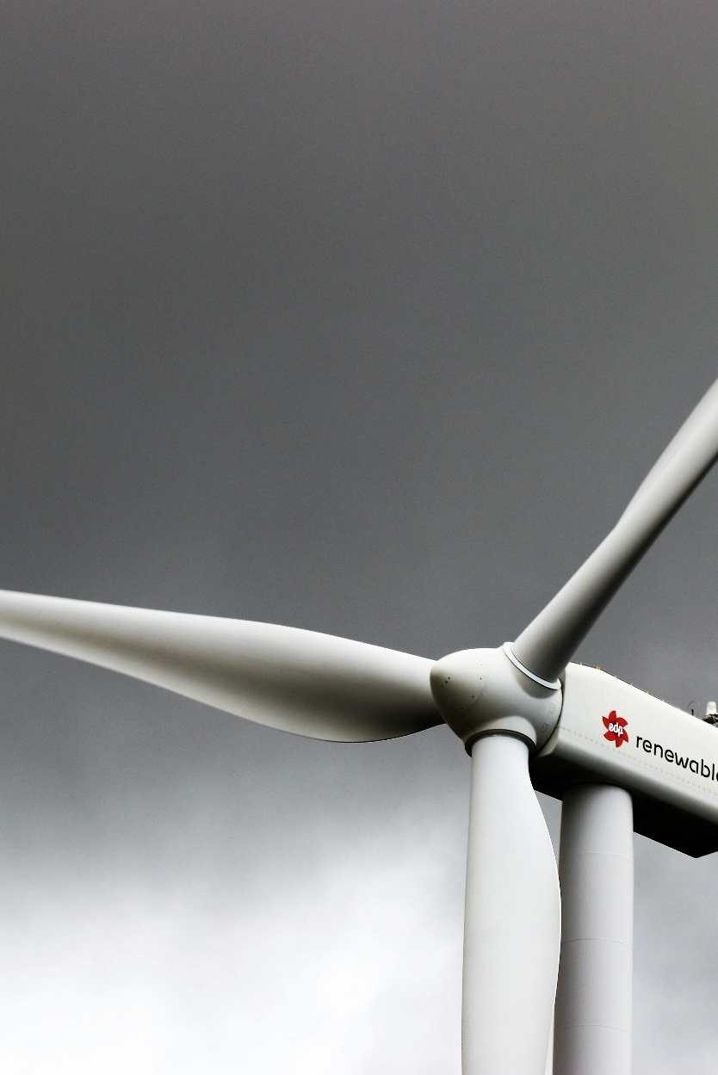
There is a total 424 TW of potential wind energy resource around the world, of which less than 0.5% is used. A lot of that unused potential is in the US, Russia, and Australia.
Wind turbines capture kinetic energy from an airflow and convert, at most, 60% of it into electric energy.
Although vertical-axis turbines exist in urban areas, nearly all (>99%) modern wind capacity comes from horizontal-axis turbines.
Most wind turbines use a gearbox to improve the efficiency of the generator (~90% of onshore turbines), with direct-drive gaining market share in the offshore segment (~60% of offshore turbines).
Utility-scale onshore wind dominates the sector, with >90% of installed capacity. Fixed-bottom offshore represents ~7% of installed capacity.
Wind is the least CO2-intensive electricity source at ~11 gCO2e per kWh, caused by fossil fuels used in raw materials and construction.
Wind energy faces technical opportunities and challenges that impact its cost and yield, as well as communities’ resistance to new installations.
Offshore wind offers a lot of additional capacity for wind energy, since it isn’t limited by space. Offshore has grown at >20% p.a. vs. 9% p.a. for onshore, but higher costs due to technical challenges (in construction and maintenance) prevent large-scale adoption.
Nameplate capacity has grown 6x for onshore wind and 10x for offshore wind since 2000, driven by higher wind speeds and a higher capacity factor (capacity per m²) for larger wind turbines. Further growth is expected, helping to decrease the LCOE of wind energy.
Because turbines are increasingly large, physical limits (e.g., road size, moving and construction equipment) need to be overcome when deploying turbines.
Wind farms need to maintain a capacity density of <3 MW/km2 to prevent wake loss. This trend has led to exponentially larger wind farms and concerns about the total availability of land suitable for wind turbines.
Wind farms increase local temperatures by mixing air from higher altitudes with surface air. Global warming has a much larger long-term impact, but local warming could affect some of the agriculture in the areas with high turbine density (e.g., the Midwest and Texas).
Wind intermittency causes a mismatch in supply and demand and thus a lower LCOE. One solution is smart-grid integration, whereby battery energy storage systems and hydrogen conversion are added to wind installations.
Key messages Technology
Sources: IEA, Net Zero Roadmap (2023); Our World in Data, Electricity generation from wind power (2024).
Credit: Quint Houwink, Hyae Ryung Kim, and Gernot Wagner. Share with attribution: Kim et al., “Reconsidering Wind” (5 March 2025).

Slide 23
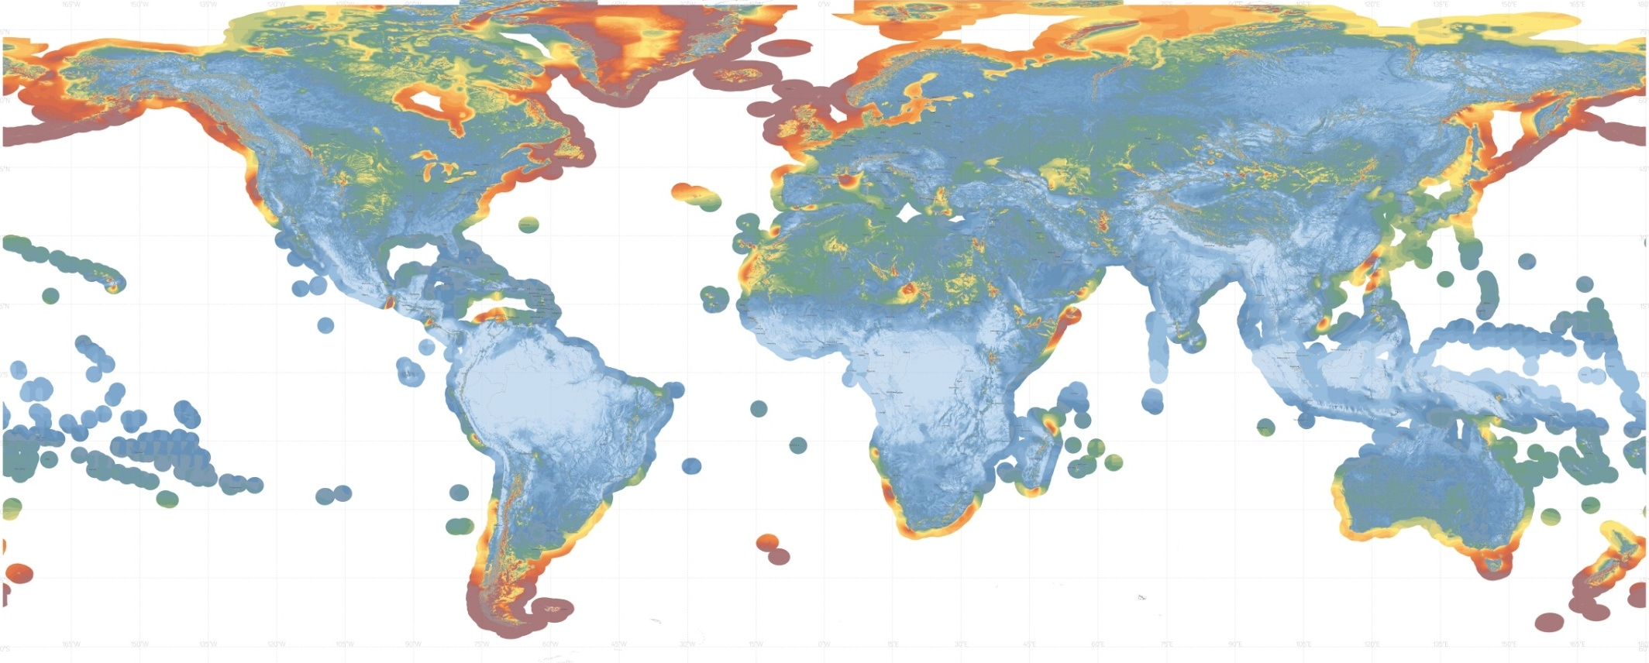
Global wind energy resource is 424TW – enough to power the world 10x in a 2050 Net Zero scenario; US, Russia, and Australia most unused potential
Global wind capacity potential at 90-meter turbine hub heights*, TW
Observations
Global wind capacity potential is 424 MW, of which ~75% comes from onshore potential.
This is equivalent to 872,000 TWh of annual electricity production.
The US currently uses only 2% of its potential wind capacity.
China uses 4% of its potential wind capacity.
The model accounts for wind speeds, terrain elevation and slope (for onshore), and water depth and distance to shore (for offshore and protected areas).
Onshore
Offshore
Canada
UK
Norway
3
4
Russia
15
24
US (48)
China
Japan
20
23
3
Global
Mexico
Indonesia
424
7
Brazil
14
18
Chile
South Africa
Australia
1
2
Argentina
40
11
5
(*) Selection of countries based on wind potential and economic capabilities.
Sources: GWA, Wind Power Density (2019), data provided by The World Bank and funded by ESMAP; NREL, An Improved Global Wind Resource Estimate for Integrated Assessment Models (2019).
Credit: Taicheng Jin, Quint Houwink, Hyae Ryung Kim, and Gernot Wagner. Share with attribution: Kim et al., “Reconsidering Wind” (5 March 2025).

Slide 24
Wind turbines convert kinetic wind energy into electricity using blades – typically around a horizontal axis, although vertical exists
Comparison of horizontal- and vertical-axis wind turbines
Observations
The theoretical maximum efficiency of any turbine is ~59%, known as the Betz Limit. HAWTs reach up to 80% of that limit in practice, compared to only half for VAWTs.
Because of their historic dominance in efficiency and reliability, HAWTs have seen much more development and deployment in the past decades. This has ultimately led to an even bigger technological and economic advantage.
Some recent academic research has indicated that VAWTs could have superior efficiency and be more serviceable than HAWTs. Nevertheless, it’s unlikely that a big shift to VAWTs will occur in the near future.
Global installed capacity, GW, 2024
Focus of this document
Airflow
900
<1
Vertical-axis wind turbine (VAWT)
Horizontal-axis wind turbine (HAWT)
Captures wind from any direction
Easy to service due to lower heights
Constrained to lower heights due to structure
Lower, uncertain efficiency (20%-40%)
Larger footprint
High efficiency – up to 50%
Captures stronger winds at greater heights
Long track record of reliability
Difficult to service due to heights
Needs yaw system to track the wind
Considerations
Applications
Residential
Urban
Commercial and utility scale
Onshore and offshore
Sources: Trepka, Wind Energy; EPA, Renewable Energy Fact Sheet (2013); Our World in Data, Installed wind energy capacity (2023)
Credit: Quint Houwink, Hyae Ryung Kim, and Gernot Wagner. Share with attribution: Kim et al., “Reconsidering Wind” (5 March 2025).

Slide 25
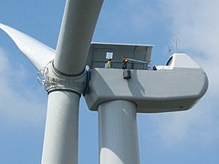
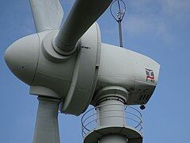
Blade rotation into electricity is either direct or through a gearbox, with direct drive growing offshore and geared dominant onshore
Global installed capacity, excl. China, 1990-2024, GW
Trend in average US wind farm size
Considerations
Geared
Onshore
Offshore
Gearboxes change the speed and torque of a rotating shaft. This allows for a smaller and cheaper power generator in turbines, reducing cost and stress on the tower structure.
Gearboxes fail frequently – one in every 145 turbine gearboxes fails annually. As such, they add to the maintenance of wind turbines, which is especially costly offshore.
Blades
Gearbox
Power converter
600
560.0
400
30
11.8
20
Low-speed axis
High-speed axis
200
3.1
10
0
8.7
0
Direct drive
Planned until 2026
A direct drive eliminates the need for a gearbox and thus the complexity and maintenance cost associated with gearboxes.
A direct-drive turbine can also maintain its efficiency across a range of wind speeds – if the total torque is large enough. Wind turbines of >7 MW are therefore not suitable for direct drive.
Blades
Power converter
600
400
30
24.4
200
12.6
20
60.0
11.8
10
Low-speed axis
0
0
Sources: Enercon, Track Record (2024); Wikipedia, List of offshore wind farms (2024); GWEC, Global Offshore Wind Report (2023); Pall, The Consequences of Gearbox Failures in Wind Turbines (2023); Spinning Wing, Direct Drive Wind Turbines; Picture top: Paul Anderson; Picture bottom: DKViolet.
Credit: Quint Houwink, Hyae Ryung Kim, and Gernot Wagner. Share with attribution: Kim et al., “Reconsidering Wind” (5 March 2025).

Slide 26
Onshore makes up >90% of global installed capacity; composition may shift toward offshore as cost declines
 | DISTRIBUTED SCALE |  |  | UTILITY SCALE
 | ONSHORE |  |  |  | OFFSHORE
 | Residential* | Commercial* | Mid and large* | Onshore | Fixed-bottom | Floating
Benefits | Serve on-site energy demand or support local electricity networks Can cover part or entire utility demand |  |  | Rapid rollout and connection; cheaper installation, easier O&M once installed | Higher wind speed, frequent and constant wind input offshore; far from residential areas
Description | Small systems, most often on rooftops of homes Produce electricity directly for the homeowner’s use; could export excess | Midsize systems, often mounted close to the source demand Produce electricity directly for the business’ use; could export excess to the grid | Industrial parks, factories | Large, ground-mounted array that delivers power to the grid Often sells to a utility offtaker through a power purchase agreement | Larger turbines, located off the coast in shallow water, often with platforms that are embedded into the seabed | Sited in deep ocean and complex seabed Flexible anchors such as chains and steel cables Less ecological impact
Installed capacity, MW
1040
977
’24
~2
~3
~7
70
0.2
12
2030
1,773
250
(*) Installed capacity for commercial and Mid & Large extrapolated based on U.S. numbers. CAGR based on 2016 projections
Sources: IEA, Renewables (2023); Energy.gov, Wind Energy Market Reports (2024); Nuveen, Infrastructure Energy Transition Update (2024); Incorrys, Wind Power Capacity Forecast 2022-2030 (2024);
NREL, Assessing the Future of Distributed Wind: Opportunities for Behind-the-Meter Projects (2016).
Credit: Taicheng Jin, Quint Houwink, Hyae Ryung Kim, and Gernot Wagner. Share with attribution: Kim et al., “Reconsidering Wind” (5 March 2025).

Slide 27
Wind is the least CO₂-intensive electricity source at ~11 gCO₂e/kWh due to fossil fuel use in raw materials and construction
Carbon intensity by electricity source, gCO₂e/kWh
By phase for wind
Observations
Wind emits about 1% of CO₂e/kWh compared to coal (820 gCO₂e/kWh) and about 2% compared to natural gas (490 gCO₂e/kWh), making it the best electricity source, even among other renewables.
Production of raw materials (e.g., fiberglass and steel) are responsible for ~70% of total emissions generated over a power plant’s lifetime. Emissions here mainly come from the usage of coal in the production of steel.
Installation is the second largest source of CO₂ for wind energy. These emissions come from diesel fuel used by construction equipment and personnel transport.
11
100%
End of life
O&M
Installation
Transportation
-94%
-99%
Raw materials
Deep dive in appendix
Coal
Natural gas
Biomass
Solar PV*
Geo- thermal
Hydro
Nuclear
Wind (offshore)
Wind (onshore)
Wind (onshore)
(*) Utility-scale solar
Sources: World Nuclear Association, Carbon Dioxide Emissions From Electricity (2024); Sikdar and Princiotta, Advances in Carbon Management Technologies (2021).
Credit: Quint Houwink, Petr Jenicek, Hyae Ryung Kim, and Gernot Wagner. Share with attribution: Kim et al., “Reconsidering Wind” (5 March 2025).

Slide 28
Wind energy faces technical opportunities and challenges that impact cost and yield, as well as community resistance
Non-exhaustive overview of technological opportunities and challenges (including impact on deployment)
Focus of this deck
Onshore
Offshore
Opportunities
Increasing size (lower CapEx/MWh)
Grid integration with hydrogen and solar (higher returns)
Predictive maintenance using AI (lower OpEx)
Low-specific-power turbines (more suitable areas)
Floating turbines (more space for wind)
Direct-drive transmission (lower OpEx)
Challenges
Logistical and manufacturing constraints due to turbine size (delay)
Wake losses in larger farms (lower yield)
Bird and bat killings (more community resistance)
Long transmission lines (higher CapEx)
Local warming (more community resistance)
Marine life influence (more community resistance)
Noise (more community resistance)
Turbine scour (higher OpEx)
Sources: EERE, Land-Based Wind Market Report (2023); EERE, Offshore Wind Market Report (2023); NREL, Technology Advancements Could Unlock 80% More Wind Energy Potential During This Decade (2023); NREL, Offshore Wind Market Report (2024)
Credit: Quint Houwink, Hyae Ryung Kim, and Gernot Wagner. Share with attribution: Kim et al., “Reconsidering Wind” (5 March 2025).

Slide 29
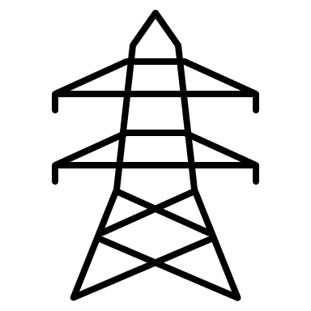
Offshore wind grows at >20% p.a. vs. 9% p.a. for onshore, but higher costs due to technical challenges prevent broad adoption
Opportunity
Comparison of horizontal- and vertical-axis wind turbines
Observations
Offshore wind has grown 14x in the past decade and is expected to grow an additional 4x by 2030. Nevertheless, the total installed capacity is still much smaller than onshore wind, which has steadily been growing at ~10% CAGR.
Offshore wind turbines are appealing for multiple technical reasons, including:
Less impact on residential areas.
Higher average wind speeds and more consistent.
Larger constructions can be shipped rather than transported by road.
There is no competition with other space-consuming projects (e.g., industry, agriculture, housing).
However, offshore wind comes with significant challenges compared to onshore wind:
Structures must overcome fatigue, erosion, and corrosion in tough ocean climates.
Structures need to be fixed to ocean bottoms at 30 to 50 meters depth.
Transmission lines need to connect offshore wind farms to the onshore power grid.
LCOE, $/MWh
145.3
95.2
38.9
+76% p.a.
~20% p.a.
~10% p.a.
Global installed capacity, GW
0.2
5
2023
2030
2010
2023
2030
2010
2023
2030
Floating offshore
Fixed offshore
Onshore
Transmission into grid
Floating turbines unlock 13 TW of potential capacity by allowing construction in water depths up to 200 meters; however, costs are still too high for mass deployment.
Offshore substation
Onshore substation
Transmission lines from offshore assets to the onshore grid are costly and fault prone, but offshore assets can typically be positioned closer to population centers.
Sources: Ørsted, Advantages of offshore wind; Asim et al., A Review of Recent Advancements in Offshore Wind Turbine Technology (2022); Incorrys, Wind Power Capacity Forecast 2022-2030 (2024); Blackridge, Top 7 Upcoming Floating Offshore Wind Projects In the World (2024).
Credit: Quint Houwink, Hyae Ryung Kim, and Gernot Wagner. Share with attribution: Kim et al., “Reconsidering Wind” (5 March 2025).

Slide 30
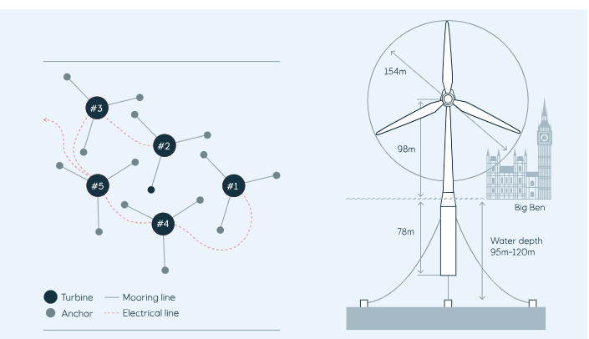
Hywind Scotland demonstrates the technical feasibility of floating wind, but the LCOE is 3x that of offshore wind (8x onshore)
Case study 1: Hywind Scotland
Facts
Developer: Equinor
Location: Scotland, Grampian, UK
Status: Operating
Commission date: October 2017
Capacity: 30 MW
Operator: Hywind Limited
Units operational: 5 x 6 MW
Make and model: Siemens Wind Power SWT-6.0-154 (direct drive)
Future ambitions
Hywind Tampen, an 88 MW floating wind farm, became fully operational in 2023, reaching a cost of £6.8/MW and an LCOE of $248/MWh.
The US launched Floating Offshore Wind Shot to reduce the cost of floating wind turbines to $45 per MWh.
Ørsted is working on two projects in Scotland: Project Salamander, with a capacity of 100 MW, and Project Stromar, with a capacity of 1 GW. Both should be operational by 2030.
Observations
Hywind Scotland is the first floating turbine wind farm, demonstrating that floating wind turbines are technically feasible and can operate in extreme weather conditions.
Unfortunately, its LCOE of $248/MWh is 3x as high as other offshore energy (~$80/MWh) and 8x that of onshore energy (~$33/MWh).
The higher LCOE is mostly driven by higher CapEx for the substructure and foundation (~45% of cost compared to ~30% for fixed-foundation offshore wind). More investments in standardized technology for floating offshore wind should bring this down by 80% by 2050.
Performance
Cost: £8.8m/MW (~3x compared to fixed offshore wind farms)
Average capacity factor: 54%
Survived storms such as Hurricane Ophelia and Storm Caroline, which caused up to 10-meter waves
Sources: Equinor, Hywind Scotland; Equinor, Our Floating Offshore Wind Projects; NREL, Cost of Wind Energy Review (2022); DNV, Floating Wind: Turning Ambition into Action (2023).
Credit: Quint Houwink, Hyae Ryung Kim, and Gernot Wagner. Share with attribution: Kim et al., “Reconsidering Wind” (5 March 2025).

Slide 31
Nameplate capacity increased 6x for onshore and 10x for offshore since 2000, driven by higher wind speeds and capacity factor
Opportunity
Overview of largest developed wind turbine in selected years, in capacity and rotation diameter
Observations
Taller towers benefit from higher wind speeds (~0.5m/s increase per 30-meter altitude).
Larger wind turbines have proportionally lower costs for construction of the tower (down to $200/kW from $500/kW).
A larger disk area leads to lower specific power (W/m²), which typically improves a turbine’s performance in slower wind conditions, unlocking an additional 80% economically viable onshore wind energy capacity in the US.
The capacity factor, defined as the average. power output divided by its maximum power capability, is higher for turbines with larger disk area and more altitude.
Currently, transporting and constructing the foundation of wind turbines form the biggest challenge in increasing turbine size further.
LCOE
$170/MWh
$124/MWh
$49/MWh
$50/MWh
Installed capacity
1.0 MW
1.9 MW
4.8 MW
7.2 MW
10 MW
Rotor diameter
50m
81m
158m
172m
~220m
50%
Onshore
Capacity factor
40%
30%
20%
10%
LCOE
$177/MWh
$197/MWh
$88/MWh
$75/MWh
Installed capacity
1.6 MW
3.0 MW
10 MW
14.7 MW
22 MW
Rotor diameter
44m
94m
164m
222m
~270m
60%
Capacity factor
50%
Offshore
40%
30%
20%
10%
2000
2010
2020
2025E
2030E
Sources: Berkely Lab, Land-based Wind Market Report (2024); NREL, Offshore Wind Market Report (2024); IRENA, Future of Wind (2019); NREL, Increasing Wind Turbine Tower
Heights: Opportunities and Challenges (2019); NREL, Annual Technology Baseline (2023); NREL, Technology Advancements Could Unlock 80% More Wind Energy Potential During This Decade (2023).
Credit: Quint Houwink, Hyae Ryung Kim, and Gernot Wagner. Share with attribution: Kim et al., “Reconsidering Wind” (5 March 2025).

Slide 32
Complex logistics of increasingly large components reduce the rate of adoption for bigger wind turbines
Challenge
Challenges associated with the increasing size of wind turbines
Observations
Wind turbines become more efficient at larger sizes, but logistical challenges in transportation and hoisting could cause delays in further growth.
For onshore, size is mostly limited by road transport.
For offshore, size is limited by the existing wind turbine installation vessel.
Technological innovations, such as a blade lifter, allow for larger blades without changing road infrastructure.
Tip height is often limited by local regulations (e.g., in Poland, max 10% of distance to nearest housing).
Hoisting the 300t nacelle to a height of 120m is pushing the existing cranes to the limit. New crawler cranes must be developed to support the biggest contemporary turbines. Offshore, existing wind turbine installation vessels have maximum hoist heights of 125m. New vessels are being produced to reach 160m hoisting heights.
Blade size is limited by road transport. Traditionally, this was a maximum of ~60m (3.8 MW turbine). Modern blade lifter transport vehicles have extended this ~80m (7-10 MW).
Tower base diameter is limited by road transport, at ~4.3m due to underpasses and bridges, leading to less efficient tower designs.
Sources: NREL, Analysis of Transportation and Logistics Challenges Affecting he Deployment of Larger Wind Turbines: Summary of Results (2014); EIA, Why are Midwest grid operators turning away wind
power? (2024); Wind Europe, Only a setback distance of 500 metres will support onshore wind in Poland (2023); Cranes Today, Reaching the limit? (2021); NREL, Analysis of Ideal Towers for Tall Wind
Applications (2018); Offshore Construction Associates, Larger Wind Turbines: What does this mean for offshore installation vessels? (2021).
Credit: Quint Houwink, Taicheng Jin, Hyae Ryung Kim, and Gernot Wagner. Share with attribution: Kim et al., “Reconsidering Wind” (5 March 2025).

Slide 33
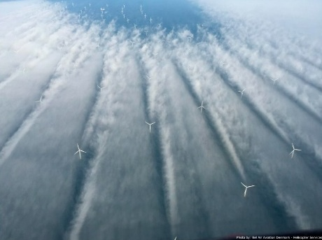
Wind farms need to maintain a capacity density of <3 MW/km2 to prevent wake loss, leading to exponentially larger wind farms
Challenge
Wake losses increase with larger turbines and decrease with more space …
... leading to exponentially more area being taken up by wind farms in the US.
Observations
As wind energy has become more competitive in LCOE, wind farms have gotten larger. The average number of turbines has increased from 30 to 80 in the past two decades. Similarly, the average capacity has increased sevenfold from ~30 MW to ~210 MW per farm.
This leads to wake losses, where the interaction between turbines reduces the production capacity by up to 50%.
New turbine designs steer wake away from downwind turbines and thus allow for slightly denser wind farms.
Observed realized power for various installed capacity densities
Median size of US wind farms 2000-2024
Trend
45% cap. factor
Observed
At a density of 3MW/km², ~80% of the US would need to be covered in wind farms to cover the energy need of 86MWh/cap.
Realized power (MW/km)
Area, km²
Turbines
00
02
04
06
08
10
12
14
16
18
20
22
24
Installed cap. density (MW/km²)
Sources: Baas et al., Investigating energy production and wake losses of multi-gigawatt offshore wind farms with atmospheric large-eddy simulation (2023); Miller and Keith, Observation-based solar and wind power capacity factors and power densities (2018); USGS, U.S. Wind Turbine Database (2024); Hasager et al., Wind Farm Wake: The 2016 Horns Rev Photo Case (2017).
Credit: Quint Houwink, Hyae Ryung Kim, and Gernot Wagner. Share with attribution: Kim et al., “Reconsidering Wind” (5 March 2025).

Slide 34
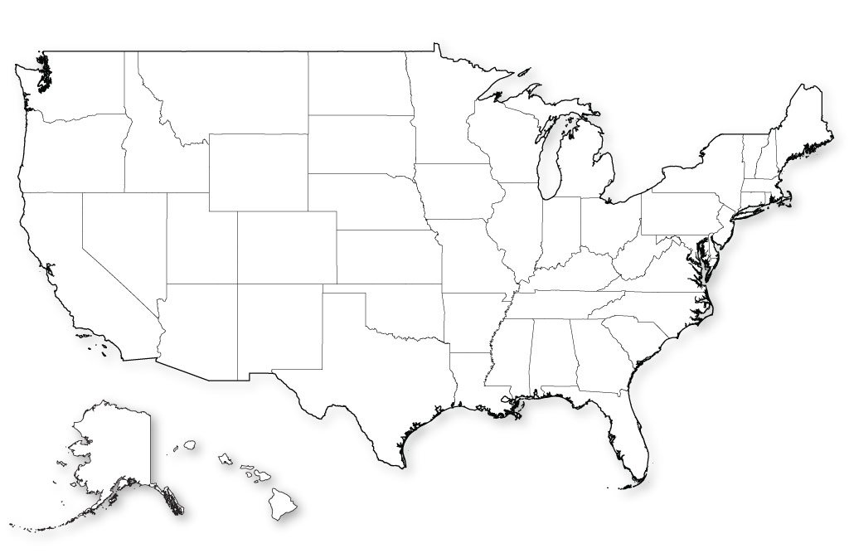
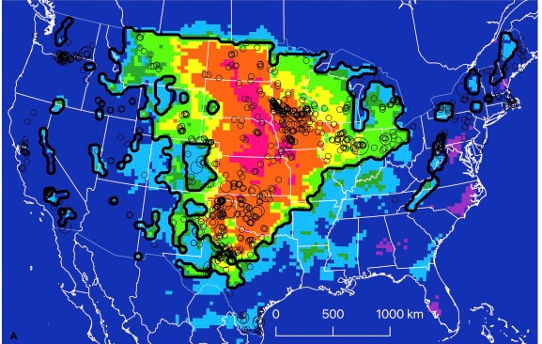
Wind farms have a significant impact on local temperatures, although global warming has a much larger long-term impact
Challenge
Wind farms lead to local effects on the environment …
… causing areas of the US to be up to 1°C warmer.
Observations
Wind turbines create turbulence, vertically mixing air from higher altitudes with the surface-level air.
The effect is largest during the night, when solar convection doesn’t naturally mix the air.
It is important to note that turbines do not add heat to the atmosphere as a whole, like global warming does, but instead redistribute the heat.
Effect of installed wind power on local surface temperatures
Installed power density of >100 MW wind farms in the US
Density (MW/km2)
Avoided warming if global emissions reach zero by 2080 is 0.4-1°C.
3
ΔT surface temp (°C)
0.5
Local warming due to wind farms
ΔT (°C)
~0
0.1-0.2
0.2-0.3
0.3-0.5
Installed cap. density (MW/km)
0.5-0.6
0.6-0.8
0.8-1.0
Sources: Miller and Keith, Climatic Impacts of Wind Power (2018); USGS, U.S. Wind Turbine Database (2024); EIA, How much energy does a person use in a year? (2023).
Credit: Quint Houwink, Hyae Ryung Kim, and Gernot Wagner. Share with attribution: Kim et al., “Reconsidering Wind” (5 March 2025).

Slide 35
Wind intermittency causes a mismatch in supply and demand; a lower LCOE smart grid integration offers a solution
Challenge
Hourly wind energy production in Texas, October 2024
Promising solutions for intermittency
Battery energy storage system (BESS)
A BESS can be charged during low grid prices and high wind speeds and discharged when prices are more favorable.
A BESS can be integrated with a wind farm or as a standalone system.
Theorized BESS’s have an optimal storage capacity of ~30%-40% of the farm’s capacity and have an IRR of 10%-20%.
MWh
Total
Wind
75
Grid
Wind farm
50
BESS
Wind-hydrogen integration
A wind-hydrogen integration allows for intermittency storage as well as cheaper transportation of energy from a wind farm to an energy demand center.
Offshore wind farms in particular can benefit from more efficient energy transport.
Although some European tenders require integrated electrolyzers, green hydrogen prices are insufficient to warrant a full system.
25
Grid
0
Fuel cell
Electrolyzer
1
2
3
4
5
6
7
8
9
10
11
12
13
14
Wind farm
October
Other H₂ applications
Sources: EIA, Hourly Electric Grid Monitor (2024); Hukkinen, Business Case Analysis of a Battery Energy Storage System Co-Located with a Wind Park (2024)
Credit: Quint Houwink, Hyae Ryung Kim, and Gernot Wagner. Share with attribution: Kim et al., “Reconsidering Wind” (5 March 2025).

Slide 36
Wind Fundamentals: Supply Chain

Slide 37
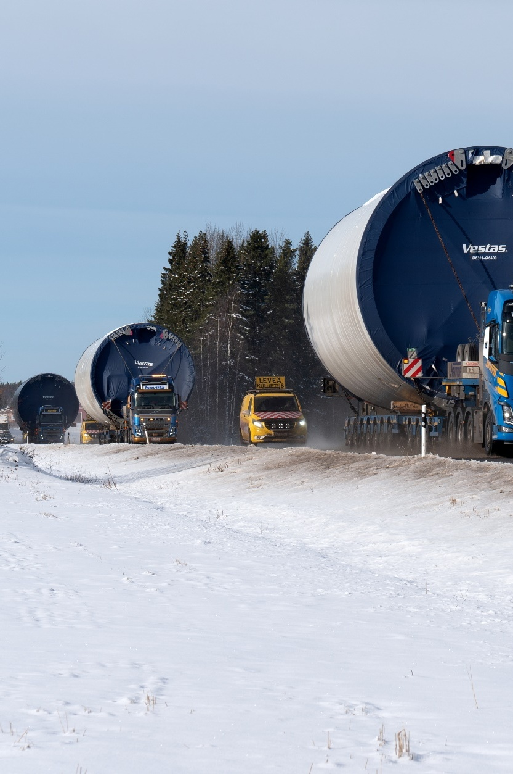
The wind turbine supply chain is divided into five tiers: raw materials, finished materials, subcomponents, subassemblies, and finished assemblies.
Uneven market concentration, particular in tier 3, creates pinch points and incentives for manufacturers to vertically integrate. The market for bearings, rotors, and blades represents the highest concentration with just a few players.
Despite making up 75% of the turbine weight, steel represents only 25% of the cost, whereas rare earth elements make up ~1% of weight but 25% of the cost.
The supply of rare earth materials is typically not in the manufacturing countries, leading to dependencies and a reliance on open borders.
Wind LCOE is therefore sensitive to commodity prices of rare earth materials (e.g., copper, nickel).
Most demand-supply dyads are healthy with pain points in fiber, neodymium, and balsa wood if deployment is high.
Working solutions include vertical integration, localization of supply chain, and improved risk management regimes.
China is leading wind tech manufacturing capacity with ~60% market share, and there is still a significant demand gap to be captured. China is the only market with production expected to surpass domestic demand in 2028; there are significant deficits in Europe and NAM.
Energy policy is largely in lockstep with five-year plans, with institution, market, and tech the three largest levers.
Energy bases in Inner Mongolia represent the largest strategic focus; most jobs are expected to come from supporting component manufacturing.
Key messages Supply Chain
Trade in raw materials also relies on open borders due to a mismatch in mines and manufacturers.
An open-door trade policy is instrumental to a resilient global wind supply chain, with healthy margins and decreasing LCOE.
Image: Santeri Viinamäki
Credit: Taicheng Jin, Hyae Ryung Kim, and Gernot Wagner. Share with attribution: Kim et al., “Reconsidering Wind” (5 March 2025).

Slide 38
Wind supply chain is composed of five tiers, from raw materials to finished components
A simplified materials breakdown of the wind value chain
Observations
A complete wind farm is generally composed of five elements:
The generation unit (turbine and tower)
Roads for maintenance, transmission station
Collector line: collects electricity from dispersed turbines
A substation: transforms and transmits the power externally
A monitoring station
Tier 1 – Finished components are major products, such as the turbine, foundation, or cables, that are purchased by a developer. Tier 1 suppliers contract directly with the project developer.
Tier 2 – Subassemblies have a specific function for a tier 1 component and may include smaller parts, such as a pitch system for blades. Tier 2 manufacturers contract with tier 1 suppliers as a subcontractor or vendor.
Tier 3 – Subcomponents are commonly available items that are combined into tier 2 subassemblies, such as motors, bolts, and gears. Tier 3 manufacturers are typically vendors that provide components to tier 2 suppliers.
Tier 4 – Primary processed materials, including steel, fiberglass, and glass, is directly processed into tier 2 or 3 components.
Tier 5 – Raw materials include iron, chromium, copper, oil, acrylonitrile, etc.
Wind lead time: 1-2 yrs. for blade, 1.5-2.5 yrs. for tower, 1.5-2 yrs. for nacelle.
Tier 5
Tier 4
Tier 3
Tier 2
Tier 1
Recycling or disposal
Wind turbine
Nacelle
Tower
Blades
Carbon fiber & fiber glass
Concrete
PMG generator
Non-PMG generator
Permanent magnets
Neodymium
Dysprosium
Copper
Steel
Aluminum
Mining and processing
Manufacturing
End use
Sources: NREL, A Supply Chain Road Map for Offshore Wind Energy in the United States (2023); Carrara S. et al., Raw materials demand for wind and solar PV technologies in the transition towards a decarbonised energy system (2020). Credit: Taicheng Jin, Hyae Ryung Kim, and Gernot Wagner. Share with attribution: Kim et al., “Reconsidering Wind” (5 March 2025).

Slide 39
Efficient turbines need rare earth elements; adaptation may cut neodymium use by ~12%, but supply constraints persist
Mineral demand for wind in the Stated Policies Scenario, kt
Observations
Wind turbines require concrete, steel, iron, fiberglass, polymers, aluminum, copper, zinc, and rare earth elements.
Mineral intensities depend on both turbine size and turbine type.
Turbines based on permanent magnet synchronous generators dominate the offshore market due to their lighter weight, efficiency, and lower maintenance costs, but they require rare earth elements (REEs).
Constrains capture tensions on these supply chains, possibly caused by rising demand or geopolitical events.
In constrained REE supply, manufacturers may:
Switch to non-magnet technologies
Adopt hybrid configurations with a gearbox and smaller magnets
Despite constraints, rare earth magnet technologies are expected to remain preferred for offshore wind due to higher performance.
In a constrained supply scenario, neodymium demand in 2030 could be reduced by about 12% under the Net Zero Scenario.
Terbium
Dysprosium
Praseodymium
Neodymium
Base case
Constrained case
+77%
+10%
2023
2025
2030
2035
2040
2045
2050
2023
2025
2030
2035
2040
2045
2050
Sources: NREL, A Supply Chain Road Map for Offshore Wind Energy in the United States (2023); IEA, Critical Minerals Data Explorer (2024).
Credit: Taicheng Jin, Hyae Ryung Kim, and Gernot Wagner. Share with attribution: Kim et al., “Reconsidering Wind” (5 March 2025).

Slide 40
Uneven market concentration (tier 3) leads to bottlenecks and motivates manufacturers to pursue vertical integration
Market for bearings, rotors, and blades represents highest concentration with few players
Observations
Procurement trends have led to distinct market structures within each component segment.
Major pinch points exist in the blade, bearing, and gearbox segments, where high market concentration and a limited number of suppliers constrain availability.
As pinch points ripple through the supply chain, component disparities intensify shortages. Ultimately, turbine assembly volumes are dictated by the component segment with the tightest pinch point in supply, limiting the total units available for production.
Lower entry barriers in segments such as controls, generators, castings, and towers have resulted in a more diversified and competitive supplier base.
Structural dynamics create a highly uneven market, incentivizing manufacturers to explore vertical integration as a risk mitigation strategy.
Towers
Castings
Generator
Controls
Gearbox
Bearings
Rotor/Blade
Concentration
Highly fragmented: Several metal works firms involved; localized sourcing
Highly fragmented: Dozens of sub-5-MW suppliers, at least a dozen supplying 1 MW or larger
Highly concentrated: Among independent suppliers, nearly half sourced in-house
Somewhat concentrated: 3 leading multi-MW players, 12 other competitors
Highly concentrated: Just 3 players supplying all segments, few multi-MW providers
Highly concentrated: One independent supplier of 2,000 MW or greater, half of OEMs supply internally
Typical sourcing approach
In-house supply strategic models, outsource older models and non-core markets
Maximize quality, vetted supply partners to avoid shortage
Heavy reliance on 1-2 major players for larger models; open to new, reliable suppliers
Single supplier sourcing, highly sensitive to turbine design
3-4 qualified external suppliers, usually 1-2 suppliers for larger turbines
Multiple suppliers selected by region
Select leaders
Source: Wind Energy - the Facts, Emering Energy Research, Supply Chain Key to Delivery (2023).
Credit: Taicheng Jin, Hyae Ryung Kim, and Gernot Wagner. Share with attribution: Kim et al., “Reconsidering Wind” (5 March 2025).

Slide 41
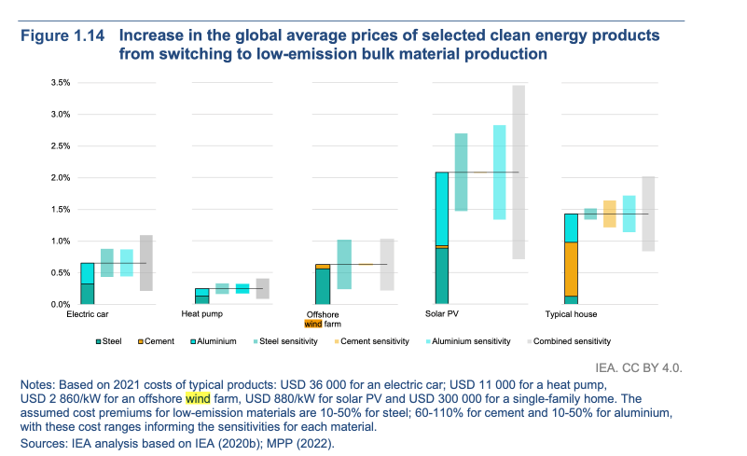
Cost-to-weight ratios of key materials influence wind’s economic viability and supply chain resilience
Commodities
Steel makes up the bulk of input, but rare earth is very cost intensive
Observations
Cost-to-weight ratios
Rare earth elements: A high cost-to-weight ratio (22.50) signifies vulnerability to supply chain disruptions, impacting turbine costs significantly.
Copper: An elevated ratio (3.57) highlights its critical role in electrical systems, suggesting potential cost pressures as demand for renewable energy grows.
Offshore wind turbines demand significantly more copper (7,500 kg/MW) than onshore turbines (3,000 kg/MW) due to greater electrical system needs, while onshore turbines use slightly more steel (130,000 kg/MW vs. 125,000 kg/MW) and require more cement (55,000 kg/MW vs. 35,000 kg/MW), reflecting differing structural and foundational requirements.
Other critical materials remain constant across both types at 6,000 kg/MW, highlighting consistent ancillary material needs regardless of the installation type.
There have been minimal price increases for clean energy products (e.g., electric cars +0.5% from steel hike). Decarbonization costs: heat pumps (<0.3%) and offshore wind farms (+0.6%).
Competitive markets challenge manufacturers in passing on costs.
Wind turbine and solar PV producers are better positioned due to rising wholesale prices.
There is consumer interest in premium clean products, e.g., automotive companies committing to “green steel” by 2025.
100%
Steel
Fiberglass/resin
Copper
Concrete
Rare earth element
Aluminum
Other materials
1%
1%
Weight percentage
Relative cost percentage
Sources: IEA, Energy Technology Perspectives (2023); Sikdar and Princiotta, Advances in Carbon Management Technologies (2021).
Credit: Taicheng Jin, Hyae Ryung Kim, and Gernot Wagner. Share with attribution: Kim et al., “Reconsidering Wind” (5 March 2025).

Slide 42
Wind is more sensitive to volatility in bulk material cost such as steel, aluminum, copper, and nickel than energy cost
Commodities
Prices for commodities like steel have experienced high volatility, fueling uncertainty
Observations
Levelized cost of production (LCOP): the total cost of producing one unit of output, such as 1 MW of solar modules, 1 MWh of battery cells, or 1 Mt of steel, considering all the up-front and ongoing costs incurred over the lifetime of the investment.
At high utilization rates, component and material costs are the main contributors to the LCOP of the clean energy technologies examined in this report, typically accounting for upward of 50% of total production cost.
Approximately 80% of the total cost of producing wind turbines (including nacelles, blades, and towers) is derived from materials and upstream components.
With an 85% utilization rate and financing costs between 5% and 20%, the CapEx contribution to total cost is between 5% and 15% for wind turbines, showing a moderate impact on LCOP when facilities are fully utilized.
Under high utilization, energy and labor costs drive LCOP regional variation in variable OpEx.
100
Aluminum
80
Iron ore, cfr spot
Copper
+113%
60
Nickel
40
GFC
COVID-19
20
Russia Ukraine
0
Historical Averages Hot Rolled Coil
2019
2020
2021
2022
2023
2024
2025
Sources: Unarco, Steel Averages (2024); InfoLink Consulting, How raw materials turbulence in past two years impact wind energy system suppliers? (2023).
Credit: Taicheng Jin, Hyae Ryung Kim, and Gernot Wagner. Share with attribution: Kim et al., “Reconsidering Wind” (5 March 2025).

Slide 43
Most demand-supply dyads are healthy, except for pain points in fiber, neodymium, and balsa wood if deployment is high
Commodities
Average US wind energy demand, 2020, % of US production
Materials | Recent past | Current policies | High deployment
Carbon fiber | <2%-20% | 21%-100% | >100%
Electric steel |  | <2%-20% | 21%-100%
Aluminum
Cobalt
Dysprosium
Neodymium
Nickel | >100%
Balsa
Glass fiber | 21%-100% |  | >100%
Balsa wood
Key benefits: Lightweight and strong; ideal for turbine blades
Source: Fast-growing trees from tropical Americas, including Ecuador (20.3%), Chile (3.92%), Brazil (3.77%)
Enhanced with glass or carbon-fiber composites
Illegal deforestation and pollution, especially around Pastaza, Bobonaza, Curaray, and Villano Rivers
Sintered NdFeB magnets
Key benefits: High magnetic strength relative to size → compact generators in high-capacity wind turbines
Thermal limits: Operates optimally up to 310°C (590°F); exceeding Curie temperature compromises magnetic properties
Performance consistency: Uniformity in size and magnetic strength is essential to system efficiency; variations can disrupt turbine performance
Nickel in steel alloys
Key benefits: Improves toughness (absorbs mechanical energy, prevents fractures), which is important for turbine durability
Weight reduction impact: 1 kg nacelle weight reduction can save 10 kg in the support structure
Critical for scaling up to larger turbines (20 MW)
Trends: Current gearbox steel: up to 2% nickel
Future designs may add 0.5% nickel in components to reduce weight and increase reliability
Sources: UNAV, Wind turbine propellers boost balsawood sales (2021), USITC, From Balsa Wood to Polymer Foam in Wind Turbine Blades: Material Input Substitutes in Low-Carbon Technologies (2022); Stanford Magnets, Application of Neodymium Magnets in Wind Turbine Generators (2024); Nickel Institute, Wind and water - Nickel in clean energy (2021).
Credit: Taicheng Jin, Hyae Ryung Kim, and Gernot Wagner. Share with attribution: Kim et al., “Reconsidering Wind” (5 March 2025).

Slide 44
Working solutions like vertical integration and localization of supply chain improve risk management regimes
Commodities
Strategy | Description | Effectiveness | Challenges | Case example
Vertical integration | Developers directly control the supply of turbine blades, nacelles, and gearboxes; enables in-house R&D and customization for performance and durability. | Predictable project budgets, long-term savings, and enhanced component customization suited to project locations. | Requires significant capital investment and expertise in upstream operations. | Ørsted and Salzgitter AG (2022): Collaboration to produce green steel using wind power, promoting circular economy.
Localization | Reduces dependency on global supply routes, minimizes logistics disruptions, and reduces transportation costs. | Accelerates project timelines, reduces costs, and fosters local economic growth through job creation. | High up-front costs for setting up localized manufacturing and potential dependency on regional policies and infrastructure. | Enel and Comal: Increased solar PV module production in Sicily fifteenfold, building local manufacturing capacity.
Price hedging | Long-term agreements through future and options contracts. | Helps stabilize costs and secure supply chain predictability. | Insufficient industry-wide adoption; requires proactive supplier evaluations and robust partnerships to identify and manage risks. | Price hedging using futures locks in stable steel costs, ensuring cost predictability and mitigating volatility for key raw materials like steel.
Source: McKinsey, Renewable-energy development in a net-zero world: Disrupted supply chains (2023)
Credit: Taicheng Jin, Hyae Ryung Kim, and Gernot Wagner. Share with attribution: Kim et al., “Reconsidering Wind” (5 March 2025).

Slide 45
China is leading wind tech manufacturing capacity with ~60% market share; a significant demand gap can still be captured
Suppliers
Current production capacity and gap to 2050 Net Zero targets, GW
World vs. Europe market share, 2023
Observations
Currently available wind production capacity and its predicted growth is not enough to meet 2050 Net Zero targets.
A total supply gap of 1,200 GW of capacity is available to be captured by OEMs until 2030.
EU and US OEMs should invest significantly to capture a part of the 1,200 GW supply gap.
Currently, China dominates the OEM market with ~60% market share, reaching up to ~80% in selected components.
China: 81.6 GW of installed capacity, ranking 4th among the top 5 and 6th among the top 10 globally.
In 2023, Vestas, Siemens Gamesa, and Nordex Group were the top three companies in Europe. Globally, Vestas ranked between 1st and 3rd, continues to supply to 36 countries.
* Ordered by descending %, top 3 are broken out China | Denmark | US
Germany | /// Others
Newly installed capacity
Cumulative installed capacity
Supply gap of 1,200 GW of wind production capacity is available to be captured by 2030.
Goldwind
Others
450
3,200 GW
400
3,000
Envision
350
2,500
300
2,000 GW
11%
2,000
Vestas
GE Vernova
250
200
1,500
Windey
Siemens Gamesa
Vestas
Mingyang
150
1,000
Others
100
100
190
135
150
157
169
180
500
50
115
125
Siemens Gamesa
0
2020
2021
2022
2023
2024
2025
2026
2027
2028
2029
2030
0
11%
Net Zero 2050 capacity targets
Supply gap
GE Vernova
Status quo pathway
Predicted production capacity
Goldwind
Envision
Sources: IEA, Energy Technology Perspectives (2023); Wood Mackenzie, China leads global wind turbine manufacturers’ market share in 2023 (2024); GWEC Global Wind Report (2024); GWEC, Global Wind Market Development Supply-side Data (2023).
Credit: Petr Jenicek, Hyae Ryung Kim, and Gernot Wagner. Share with attribution: Kim et al., “Reconsidering Wind” (5 March 2025).

Slide 46
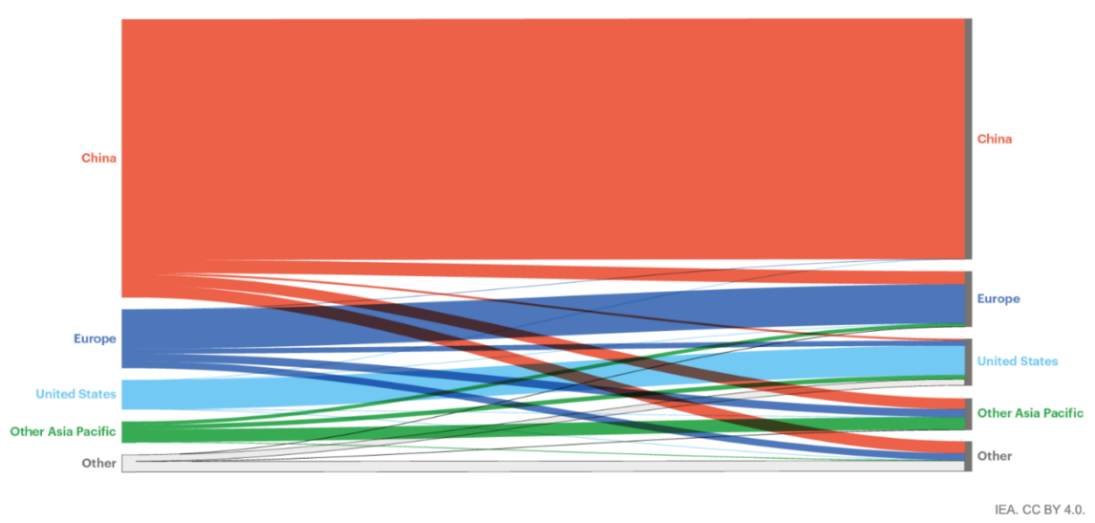
China is mostly self-sufficient; India is eager to position itself as a production hub along the supply chain
Trade
I. Trade flows of wind components | II. Manufacturing value vs. installation
Observations
China holds a positive trade balance for 2023-2025. Some 97% of Chinese wind turbine manufacturers' installed capacity in 2023 is in the domestic market, which is basically the same as the previous year. In 2023, Chinese manufacturers installed 2.3 GW outside the domestic market, of which 63% was in the APAC market.
India’s trade balance surpasses China, reflecting its growing strength as a production hub.
India’s growing role is driven by large conglomerates investing in cleantech and the "Make in India" policy. The country is positioned to become a global export hub for the wind industry.
The EU and US generate the most wind component value from and to internal markets; China receives very little wind components, in USD terms, from foreign markets.
The US and Japan run a wind turbine deficit that is even more significant compared to their trade position across other energy tech; all depend on the free flow of minerals.
Trade policy goals: Competitive industries without higher costs for end users.
Enable resource sharing across regions for cost reduction via supply chain capacity utilization.
Develop workforce skills and infrastructure.
Avoid prescriptive regulations that restrict cross-border trade.
100%
100%
ROW
3%
7%
7%
5%
South America
9%
North America
5%
3%
Europe
India
China
Total value (USD)
New Installations (GW)
Sources: GWEC, Global Wind Report (2024); IEA analysis based on Eurostat, US DOE (2022a), the US ITA; IEA investment data (2022e), IEA – Solar PV Global Supply Chains (p. 28).
Credit: Taicheng Jin, Hyae Ryung Kim, and Gernot Wagner. Share with attribution: Kim et al., “Reconsidering Wind” (5 March 2025).

Slide 47
US has a large deficit in turbines and is especially weak in refined nickel; China, Japan, and Korea are weak across ores
Trade
Trade balance (%) along supply chains in select countries, 2021
Observations
Nickel exports: Russia's main nickel exports are unwrought refined nickel and nickel matte; nearly all matte is processed at Nornickel's Finland plant, with refined nickel sold globally.
Post-2022 shifts: Imports of refined nickel from Russia dropped 41% in 2023 due to lower prices; US imports fell by 93% ($19M vs. $264M in 2022), with Germany and the Netherlands also declining.
China’s role: China, the Netherlands, and Taiwan accounted for 91% of Russian refined nickel imports in 2023; many Chinese firms shifted to cheaper nickel from Indonesia.
Balsa wood demand: Lightweight balsa is essential for wind turbine blades, with global demand at 400,000 to 465,000 m³/year.
China: Accounts for 50% of global balsa imports, driven by rapid wind energy expansion (60% capacity growth in 2020).
Key markets: The EU (20% of global imports, led by Denmark, Poland, and Germany) and the US (7.6%, top tropical wood species, 23% of imports in 2018).
China: modest surplus in turbine but depends on foreign ore and refining; EU weak on ore; US good on ore but weak in refining
 | China | EU | US | Japan | Korea
Wind turbines | 14% | 6% | -38% | -46% | 80%
Cobalt ore | -98% | -100% | 100% | -100% | 0%
Nickel ore | -88% | -66% | 100% | -100% | -100%
Copper ore | -80% | -40% | 30% | -100% | -100%
Nickel refined | -51% | -22% | -100% | 23% | -58%
Copper refined | -25% | -11% | -45% | 41% | -1%
Iron and steel | 5% | 2% | -24% | 31% | 17%
Aluminum | -7% | -53% | -80% | -100% | -100%
Energy tech average | 15% | -38% | -16% | 6% | 26%
CE average | -85% | -52% | 33% | -74% | -50%
Refined average | -43% | 1% | -43% | 35% | 2%
Bulk average | -8% | -20% | -28% | -21% | -13%
Note: Data for wind-power generating sets were used as a basis to estimate trade for wind nacelles and blades.
Sources: USITC, Impact of the Russian Invasion of Ukraine on Global Nickel Trade (2024); Eurostat, US DOE (2022a); US ITA, and analysis based on IEA investment data (2022e), Forest Trends, Forest Policy Trade and Finance Initiative (2022). Credit: Taicheng Jin, Hyae Ryung Kim, and Gernot Wagner. Share with attribution: Kim et al., “Reconsidering Wind” (5 March 2025).

Slide 48
China the only market with production expected to surpass domestic demand in 2028; significant deficits in Europe and NAM
Suppliers
Predicted production capacity and forecasted annual demand for wind generation tech, GW
Observations
China represents the largest market for wind generation technology worldwide, rapidly expanding its renewable generation capacity.
The trend is expected to continue into 2025 and onward, with a 21% increase in demand for wind generation technology within China, comfortably covered by domestic supply. This solidifies China as a key exporter in the market.
A significant demand increase for wind generation technology is expected in Europe (+125%), North America (+130%), and wider APAC, including India (+122%), driven by global decarbonization efforts.
Europe and the US will require significant imports of wind generation technology to cover expected demand in 2028 unless massive investments in production capacities are made within the coming years.
2028e production capacity
101
32
18
14
4
Annual demand
+21%
2023
2028e
+125%
+130%
+122%
+66%
China
Europe
NAM
Other APAC
RoW
Sources: IEA, Energy Technology Perspectives (2023); GWEC, Global Wind Report (2024).
Credit: Petr Jenicek, Hyae Ryung Kim, and Gernot Wagner. Share with attribution: Kim et al., “Reconsidering Wind” (5 March 2025).

Slide 49
Open doors trade policy is instrumental to building a resilient global wind supply chain with healthy margins and decreasing LCOE
Suppliers
Market size, supplier margins, and LCOE under three scenarios, indexed to 2023 levels
Observations
Due to the overall production- demand imbalance between regions and the EU’s and NAM’s reliance on China's production capacity, open-door policies are required to guarantee stable wind generation and deployment.
Any trade barriers (as is the current trend) and attempts to forcefully onshore production will stifle deployment and negatively impact margins across the value chain, eventually increasing LCOE.
Escalation of protectionism or war efforts will have a catastrophic effect on the wind market.
Market size (GW deployed)
Supplier margins (Across value chain)
Cost of wind power (LCOE)
250%
120%
120%
200%
105%
150%
105%
-33 p.p.
90%
100%
90%
0%
2024
2026
2028
2030
0%
2024
2026
2028
2030
0%
2024
2026
2028
2030
Open doors
Trade barriers
Global escalation
Free trade focus across regions
Continuation of current protectionist trends
Escalation of global conflicts and protectionist measures
Sources: GWEC, Global Wind Report (2024); BCG, The Hidden Dynamics of the Energy Transition (2024).
Credit: Petr Jenicek, Hyae Ryung Kim, and Gernot Wagner. Share with attribution: Kim et al., “Reconsidering Wind” (5 March 2025).

Slide 50
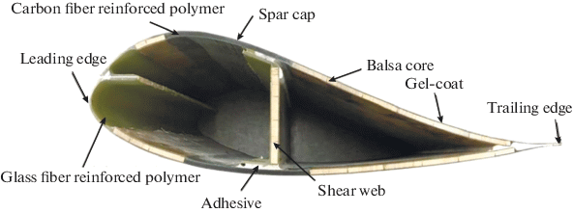
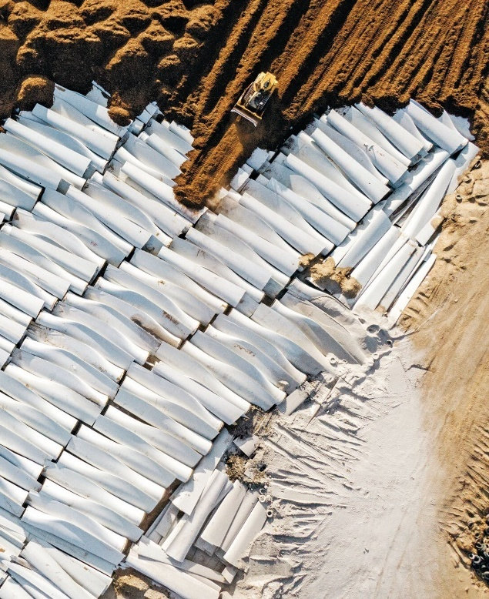
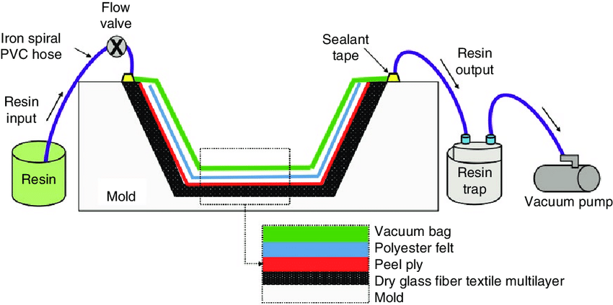
Resin infusion technique used to produce turbine blades and the large size of the blades complicate end-of-life recycling
End of life
The turbine involves some form of infusion of resin to a frame
Observations
Resin infusion mechanism: Fibers placed in molds; resin injected (under pressure or vacuum) to saturate fibers and then cured to form strong, durable blades
Prepreg technology: Aerospace-inspired; pre-impregnated fibers for complex shapes; used by Vestas and other turbine manufacturers
Resin infusion methods: Common for long blades
RTM: Resin injected at high pressure
VARTM: Resin injected under vacuum; widely used for rotor blades
EOL blade recycling challenges:
Composite complexity: Towers and generators recyclable; harder for blades due to thermoset resins (epoxies, polyesters)
Material waste: Projected global decommissioned blade material: 400,000 tons per year by 2030 and 2 million tons per year by 2050
US forecasts: 1.2 million tons by 2040; 2.1 million tons by 2050, with an annual potential of 50,000 to 300,000 tons by 2050
Alternative uses: Fiberglass in concrete, balsa wood applications, PVC/PET foams for various products
Top left: A cross-sectional illustration of component parts of a wind turbine
Bottom left: A diagram of the resin infusion technique
Right: Photo of cut turbines being shoveled into a landfill and buried (C&EN)
Sources: Benyahia et al., Delamination Defects Localization Using a New Time Frequency Algorithm Based on S-Transform for Ultrasonic Testing of Wind Turbine Blades Composite Materials (2022); Oliveria et al., Ultrasound-based identification of damage in wind turbine blades using novelty detection (2020); Cooperman et al., Wind turbine blade material in the United States: Quantities, costs, and end-of-life options (2020); C&EN, How can companies recycle wind turbine blades? (2022); National Grid, Can wind turbine blades be recycled? (2023); Ørsted, Can wind turbines be recycled? (2021)
Credit: Taicheng Jin, Hyae Ryung Kim, and Gernot Wagner. Share with attribution: Kim et al., “Reconsidering Wind” (5 March 2025).

Slide 51
Wind Fundamentals: Global Policy & Finance

Slide 52
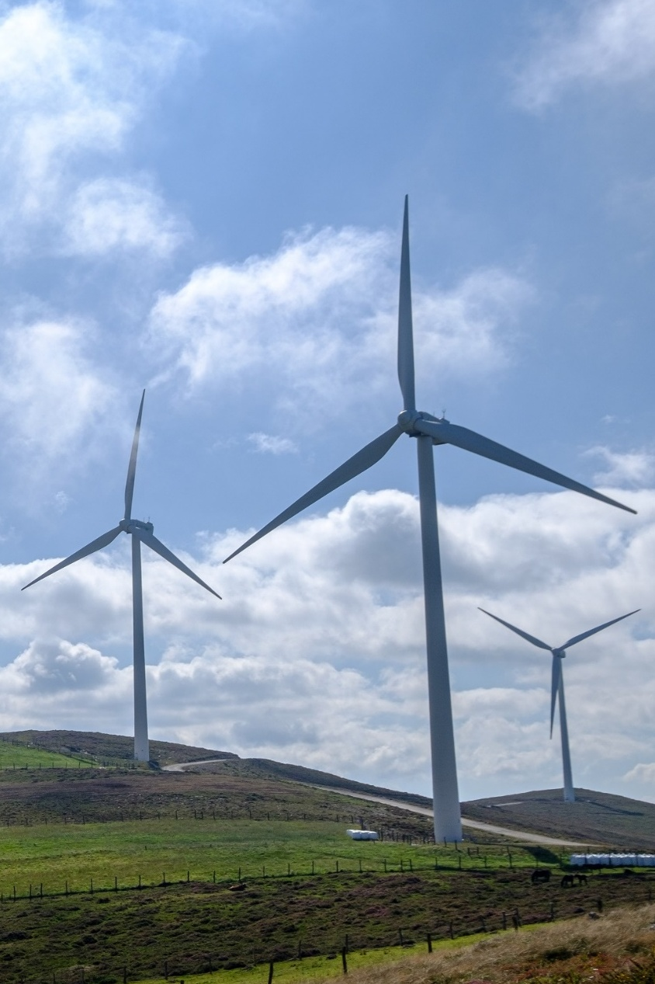
Governments worldwide have set 2030 targets for wind energy and provided policy incentives, including auctions, feed-in tariffs, and contracts, which have been the key drivers for deployment.
However, wind projects have been delayed due to inadequate permitting and licensing rules.
Regional collaboration and favorable trade policy are required for a continued attractive market environment.
Wind energy attracts the second largest share of renewables investments.
Onshore wind constitutes 80% of the investments. Meanwhile, global offshore wind investment reached a record $76.7 billion in 2023.
While the share of equity has fallen from 77% in 2013 to 43% in 2020, the share of debt financing has more than doubled given the increasing maturity of the technology.
In response to China’s market dominance, the US has introduced advanced manufacturing tax credits, put tariffs on imported wind towers, and included a domestic content bonus in the wind tax credits for businesses to encourage domestic production.
By extending and increasing tax credits for wind projects, the US Inflation Reduction Act of 2022 is expected to increase land-based wind deployment by 171 GW by 2030.
Since 2022, companies have announced 42 new projects, creating a total of 15,339 new jobs and $14.38 billion in new investments.
Key messages
Global Policy & Finance
The EU has been caught in the cross-wind between the US and China. While it boasts of a mature renewable energy market, it is pushing toward a regulatory environment that ensures a resilient supply chain and faster permitting processes.
Sources: ADB, China 14th Five-Year Plan (2021); EU Commission, European Wind Power Action Plan (2023); Office of Energy Efficiency & Renewable Energy, Inflation Reduction Act Spurs Breakthrough in Domestic Wind Production (2023); Ember Energy, Global Renewable Energy Target Tracker 2030; S&P, China’s 14th Energy Five-Year Plan: Pivoting toward a “modern energy system” (2022).
Credit: Abha Nirula, Hyae Ryung Kim, and Gernot Wagner. Share with attribution: Kim et al., “Reconsidering Wind” (5 March 2025).

Slide 53
Policy on wind is shifting from subsidies to market mechanisms
Key policy drivers across select countries
1
2
3
 | US | EU | China
Main policies | Federal: Inflation Reduction Act (IRA) State: Renewable Performance Standard | Green Deal Industrial Plan; Fit for 55 package | 14th Five-Year Plan; Wind Energy Development Roadmap 2050
Policy focus | Boost domestic manufacturing, create jobs, and build more resilient supply chains | Facilitate improved auction design; provide dedicated funding support, enhanced skills, and open trade for clean energy projects | Reduce the carbon intensity of the economy and peak carbon dioxide emissions before 2030
Target for renewable energy (RE) | No explicit target; expected to achieve 938 GW RE by 2030 | RE target 2030: At least 42.5% of RE Total: 1,236 GW; solar 592 GW; wind 510 GW; offshore 111 GW | RE target 2030: 1.2 TW (achieved) (No offshore wind target)
Investment | $400 million for onshore wind and $6.9 billion for offshore wind manufacturing | Innovation Fund: Dedicated RepowerEU funding windows InvestEU programme: €1.8 billion (approved) | Investment in R&D for clean energy technologies and fiscal incentives to attract private investments
Incentive for onshore and offshore wind | Tax credits on production, investment, and manufacturing | Electricity Market Design (proposal) to improve power purchase agreements and contracts for difference; cross-border cost sharing and regional development to coordinate planning for offshore wind and other RE projects | National and regional subsidies and tax breaks; Industrial wind policy and market mechanisms such as green power trading
Manufacturing | Advanced manufacturing production tax credit for wind components; bonus credit for domestic content threshold | Net Zero Industry Act (proposal) and Critical Raw Materials Act to scale up manufacturing facilities for clean energy | Direct and Indirect subsidies for manufacturing (including steel); tax incentives and custom duties
Permitting reforms/grid Integration | Outside of IRA, finalizing new rules that streamline regulations for wind permitting | Digitalizing permitting processes and technical assistance to members under the Accele-RES initiative | Creating spot markets among multiple province and interprovincial transmissions
Sources: ADB, China 14th Five-Year Plan (2021); EU, European Wind Power Action Plan (2023); Office of Energy Efficiency & Renewable Energy, Inflation Reduction Act Spurs Breakthrough in Domestic Wind Production (2023); Ember Energy, Global Renewable Energy Target Tracker 2030; S&P, China’s 14th Energy Five-Year Plan: Pivoting toward a ‘modern energy system’ (2022).
Credit: Abha Nirula, Hyae Ryung Kim, and Gernot Wagner. Share with attribution: Kim et al., “Reconsidering Wind” (5 March 2025).

Slide 54
US Inflation Reduction Act extends and improves wind investment and production tax credits
United States
The residential and commercial wind investment tax credits aim to ease the cost inflation for wind power projects in the US
Homeowners
Businesses
Residential Wind Energy Credit
Wind Investment Tax Credit (ITC)
Wind Production Tax Credit (PTC)
30%
of the expenses of an installed wind system (100 kW or less) can be subtracted from federal income taxes.
30%
of the expenses of an installed wind system can be subtracted from federal income taxes (up to 50% if certain conditions are met).
¢2.60 per kWh
of produced wind energy can be subtracted from federal income taxes.
The tax credit begins phasing out in 2032 and ends by 2035, or when the US treasury secretary determines there has been a 75% reduction in annual greenhouse gas emissions.
The inflation-adjusted PTC for projects sold in 2023 was ¢2.75 per kWh.
Expenses covered by the tax credit include:
Labor costs for on-site preparation, assembly, or original system installation
Piping or wiring to interconnect a system to a home
The tax credit applies to existing homes, newly constructed homes, principal residences, and second homes. It is not applicable for rental properties.
Expenses covered by the tax credit include:
Cost of installed equipment
Advanced Manufacturing Credit
30%
for companies that domestically manufacture and sell clean energy equipment.
Business owners cannot claim the ITC and PTC for the same wind installation.
Components produced in facilities that received the manufacturing ITC are not eligible for the advanced manufacturing production credits.
Source: Office of Energy Efficiency & Renewable Energy, Production Tax Credit and Investment Tax Credit for Wind Energy (2024)
Credit: Abha Nirula, Hyae Ryung Kim, and Gernot Wagner. Share with attribution: Kim et al., “Reconsidering Wind” (5 March 2025).

Slide 55
IRA expected to mobilize ~85 GW of additional wind capacity and ~$160 billion in investments by 2030
United States
Post-Inflation Reduction Act wind projections
Observations
The IRA is expected to add 85 GW to existing onshore wind projects, with cumulative capacity likely to reach 280 GW by 2030.
Increased investments and jobs:
These new wind developments are estimated to result in an additional investment of $160 billion.
The IRA is expected to create 250,000 additional wind-related jobs by 2035. This includes domestic demand for 55,000 jobs in wind manufacturing.
Building supply chain and manufacturing:
The 45X tax credits under the IRA are estimated to make US-manufactured onshore and offshore wind components less expensive to produce than imported products.
The IRA is also contributing to supply chain expansion with 15 new, reopened, or expanded land-based wind manufacturing facilities.
Annual installations for wind capacity (GW)
Top 10 states benefitting from IRA for wind projects
Base
As of 2024, there have been 42 additional wind projects, resulting in $14.38 billion in investment
State | Project | Est. Inv. ($B) | Est. Jobs
Georgia | 33 | 15.42 | 16,703
Michigan | 33 | 12.10 | 12,205
South Carolina | 29 | 15.46 | 14,087
Texas | 26 | 8.00 | 9,602
North Carolina | 23 | 21.09 | 11,633
Tennessee | 19 | 5.44 | 4,921
Ohio | 18 | 7.07 | 4,854
California | 14 | 1.60 | 160
New York | 13 | 0.79 | 3,079
Indiana | 12 | 8.32 | 5,262
Additional
2017
2019
2021
2023
2025
2027
2030
Sources: Wood and Mackenzie, The Inflation Reduction Act and its impact so far (2023); Berkeley Lab, Land-based Wind Market Report (2024); Blue Green Alliance, Effects of Renewable Energy Provisions of the Inflation Reduction (2023); E2, Clean Economy Works: Inflation Reduction Act Two-Year Analysis (2024); Rystad Energy.
Credit: Abha Nirula, Hyae Ryung Kim, and Gernot Wagner. Share with attribution: Kim et al., “Reconsidering Wind” (5 March 2025).

Slide 56
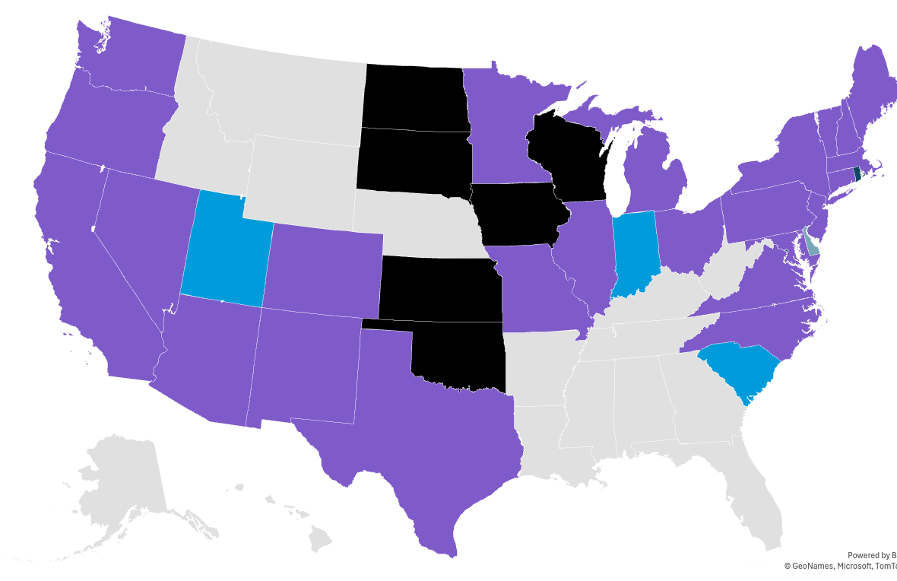
29 US states have a Renewable Portfolio Standard, increasing wind capacity by 44%
United States
States with renewable energy performance standards or voluntary targets
Observations
In the US, 29 states and Washington, D.C., have a Renewable Portfolio Standard (RPS) and 16 states have a Clean Energy Standard (CES).
Among those with an RPS, 16 have RPS targets of at least 50% of retail sales and 4 states have a 100% RPS. Sixteen states have adopted a broader 100% CES, most of which also have an RPS.
Several states in the Northeast and MidAtlantic have established procurement targets for offshore wind.
RPS policies increased wind generation capacity by between 600 and 1,200 MW, an increase of about 44% relative to the installed wind capacity.
13 states have policies that collectively support 115,130 MW of offshore wind by 2050.
WA
3069
ND
3665
MN
4184
OR
2843
SD
3462
NV
152
IA
10014
UT
391
CO
4884
CA 6194
KS
8796
MO
2835
AZ
857
NM
4.024
OK
11790
States with an RPS
TX
37,172
States with a voluntary
RE standard or target
States with an expired
RPS/CES
Sources: NBER, Causal Effects of Renewable Portfolio Standards (2023); NCSL, State Renewable Portfolio Standards and Goals (2021).
Credit: Abha Nirula, Hyae Ryung Kim, and Gernot Wagner. Share with attribution: Kim et al., “Reconsidering Wind” (5 March 2025).

Slide 57
EU Green Deal sets ambitious targets for expansion of renewable energy
European Union
RE share in energy mix | Accelerate deployment for offshore wind | Increased investment and focus on R&D | Interconnected energy systems | Focus on R&D
At least 42.5% renewable energy by 2030, with an ambition to reach 45% renewables | Expected to increase the EU's offshore wind capacity from its current level of 12 GW to 300 GW by 2050 | Investment of almost €800 billion between now and 2050 in offshore energy infrastructure | Build inter-connected, digitized and integrated grids to support RE sources | 35% of the EU’s research and innovation program ring-fenced for new clean technologies
Observations
Europe now has 272 GW of installed wind power capacity: 238 GW onshore and 34 GW offshore.
Germany led the new installation of wind capacity in 2022 due to rapid wind expansion.
Wind energy was 19% of all the electricity consumed in the EU 27 in 2023.
It was 56% in Denmark, 36% in Ireland, 31% in Germany, 29% in the UK, and 27% in Spain and the Netherlands.
To meet its 2030 climate and energy targets, the EU now needs to build 33 GW per year on average.
The new EU rules on permitting have already boosted permitting volumes for new wind farms.
Germany and Spain both permitted 70% more onshore wind in 2023 than in 2022, with Germany reaching 7.5 GW.
Trend in installed capacity of wind energy in Europe (GW)
New installation by countries (%)
Onshore
19
Offshore
17
18
18
16
15
13
14
14
12
Germany
France
Others
NL
UK
Sweden
Finland
2014
2015
2016
2017
2018
2019
2020
2021
2022
2023
Source: Wind Europe, Statistics and Outlook for 2024-2030 (2023).
Credit: Abha Nirula, Hyae Ryung Kim, and Gernot Wagner. Share with attribution: Kim et al., “Reconsidering Wind” (5 March 2025).

Slide 58
Energy policy is largely in lockstep with five-year plans, with institution, market, and technology the three largest levers
China
Trend in cumulative installed capacity of wind energy in China, GW
Observations​
China maintains a lead globally with a total cumulative wind capacity of 442 GW.
Grid expansion strategy:
China has budgeted $455 billion for grid investment from 2021 to 2025, including long-distance transmission lines.
Onshore
Offshore
442
+19%
366
37
282
329
30
9
26
164
185
210
132
149
3
4
6
77
97
1
2
0
1
2013
2014
2015
2016
2017
2018
2019
2020
2021
2022
2023
2006-2010 (11th 5-year plan) | 2011-2020 (12th and 13th 5-year plan) | 2021-2030 (14th and 15th 5-year plan) | 2031-2040 (16th and 17th 5-year plan)
Prioritize wind power with financial incentives, setting wind power as a priority. Focus on cleaner coal, large plants, new hydro, nuclear, and grid capacity, along with building west-east transportation corridors. Implement a regional fixed electricity price system with grid-connected prices above the coal benchmark covered by a surcharge and a distance-based subsidy for wind farms (0.01-0.03 yuan/kWh). | Align onshore wind pricing with coal, expand both onshore and offshore wind power, and increase subsidies (210-300 billion yuan), with a focus on offshore wind development. Subsidies reach peak around 2020. Wind power costs reach parity with coal, with a large-scale market and an industrial system that incorporates advanced technology standards. Focus on wind power development in Inner Mongolia and distributed wind in central and eastern regions, supporting expansion and electrification efforts across the country. | Achieve lower wind costs than that for coal (excluding transmission); push onshore and offshore projects. Promote transmission infrastructure and flexible systems; accelerate power system reforms and direct subsidies mainly to offshore wind power. Develop integrated, smart energy management systems with a target of 20% energy from renewables, ensuring wind power development accelerates across the country. | Advancements in wind power, energy storage, and grid integration, to ensure stability and efficiency in power delivery. Wind power will reach saturation by 2040, achieving balanced development while pushing for 20% of energy demand from renewables, transitioning to electrification with a gradual reduction in coal reliance.
Sources: China Power, 2023-2024 National Electricity Supply and Demand Situation Analysis and Forecast Report (2024); IRENA, China (2024). Credit: Abha Nirula, Hyae Ryung Kim, and Gernot Wagner. Share with attribution: Kim et al., “Reconsidering Wind” (5 March 2025).

Slide 59
China’s wind goal relies on energy bases in Inner Mongolia; most jobs are expected to come from supporting component manufacturing
China
China focuses on a select few energy bases, plus transmission from high-potential to high-intensity areas
Observations
Subsidies and incentives have been the backbone of China’s RE expansion:
China introduced FiTs to support onshore wind development in 2009 and subsequently expanded them to support offshore wind projects.
With the declining cost of wind projects, the government withdrew FiTs for RE projects in 2022 to move toward a market-based mechanism and reduce the subsidy burden for the government.
The wind sector continues to receive indirect support from state banks.
Domestic manufacturing of turbines:
China introduced FiTs to support onshore wind development in 2009 and subsequently expanded them to support offshore wind projects.
Western Inner Mongolia (and surrounding areas)
Equipment manufacturing
Eastern Inner Mongolia (and surrounding areas)
Management, R&D, marketing
Northeast Base
30,000
Supporting components
Hebei Base (and surrounding areas)
Raw materials
Gansu Base (and surrounding areas)
Installation & transportation
Xinjiang Base (and surrounding areas)
O&M
Central and Eastern China
Offshore wind power
Far offshore wind power
10,000
4,000
650
2010
2020
2030
2050
2010
2020
2030
2050
Sources: IEA, Energy system of China (2022); Wood Mackenzie, China leads global wind turbine manufacturers’ market share in 2023 (2024); GWEC, China Wind Power (2024).
Credit: Petr Jenicek, Hyae Ryung Kim, and Gernot Wagner. Share with attribution: Kim et al., “Reconsidering Wind” (5 March 2025).

Slide 60
CKI Wind Team
Hyae Ryung (Helen) Kim
PhD in Sustainable Development
Senior Research Fellow
hk2901@columbia.edu
Abha Nirula
Master of Public Administration
CKI Fellow
Gernot Wagner
Senior Lecturer, Columbia Business School
Faculty Director, Climate Knowledge Initiative
gwagner@columbia.edu
Quint Houwink
Master of Business Administration
CKI Fellow
Petr Jenicek
Master of Business Administration
CKI Fellow
Taicheng Jin
Master of International Affairs
CKI Fellow
Attribution: Kim et al., “Reconsidering Wind,“ Columbia Business School Climate Knowledge Initiative (5 March 2025).

Slide 61
Appendix

Slide 62
The steel tower represents ~40% of wind energy raw material CO₂e emissions; fiberglass is the most emission-dense raw material
Deep dive: Carbon intensity wind by material
Mass and respective CO₂e emissions for raw materials in a Gamesa 2 MW turbine
Observations
Concrete makes up three-quarters of the weight of a wind turbine but represents only 11% of emissions.
On the flip side, alloy steel makes up only 15.5% of the weight but represents 38.9% of the emissions.
Fiberglass has the highest emission density, as it represents only 1.1% of the weight but 14.7% of the emissions.
Steel offers the largest opportunity to reduce total emissions from wind energy. This can be achieved by using recycled steel and renewables in the steel production process.
Replacing the steel tower with a reinforced cement tower would decrease emissions by ~6% overall.
1,473.6 t
100%
961 tCO₂e
100%*
Concrete
Alloy steel
Corrugated steel
75.7%
Cast iron
High-alloy steel
Fiberglass
Aluminum
15.5%
Electronics
Polymer
Copper
Adhesive
Painting
Lubricant
Brass
0.1%
0.3%
Other: 0.6%
2.5%
Other: 3.4%
Mass
CO2e
(*) Percentages may not add up to 100% due to rounding Sources: ICF, Recycling initiatives and carbon considerations that propel wind energy past other renewable sources (2021); Sikdar and Princiotta, Advances in Carbon Management Technologies (2021).
Credit: Quint Houwink, Taicheng Jin, Hyae Ryung Kim, and Gernot Wagner. Share with attribution: Kim et al., “Reconsidering Wind” (5 March 2025).

Slide 63
Turbine and BoS CapEx compose most of the LCOE, with OpEx representing around ~15% to 25% of cost
Deep dive: Breakdown of wind LCOE
LCOE breakdown by deployment type, $/MWh, 2023
Observations
Among utility-scale wind projects:
Onshore represents the most capacity (~90%).
Offshore floating is the most expensive ($145/MWh) due to the elevated cost of the foundation and electrical infrastructure.
Capital expenditure includes the turbine structure as well as balance of system (BoS) components.
The turbine/rotor, tower, and nacelle represent anywhere from ~20% to 40% of total cost.
BoS similarly is around ~20% to 40% of cost; the foundation and electrical infrastructure represent the largest contributor to BoS CapEx.
Turbine CapEx and BoS CapEx collectively represent roughly 60% of total cost.
Financial CapEx is relatively stable (~11% to 14%); O&M expenses are anywhere from ~17% to ~26%.
Among distributed projects, BoS represents an increasingly smaller portion of the total project cost as the system size (in kW) increases:
Residential (>50%), commercial (30%), industrial (~20%).
Turbine CapEx
+ Balance of system CapEx
+ Soft cost
+ OpEx
= LCOE
41%
22%
11%
26%
0.2
10.1
Onshore
27%
32%
15%
26%
25.1
Fixed offshore
23%
45%
14%
18%
25.9
22.4
Floating offshore
33.1
Rotor
Nacelle
Tower
Dev.
Management
Foundation
Site access
Assembly
Electrical infra.
Turbine transport
Finance
Contingency
Turbine warranty
Other financial
OpEx
Total
Source: NREL, Cost of Wind Energy (2023).
Credit: Taicheng Jin, Quint Houwink, Hyae Ryung Kim, and Gernot Wagner. Share with attribution: Kim et al., “Reconsidering Wind” (5 March 2025).

Slide 64
Among renewables, wind is forecasted to make up ~20% of capacity additions from 2023 to 2028; solar makes up ~70%
Deep dive: Role in reducing emissions
Renewable global net capacity additions, GW/yr, 2023-28
Observations
In absolute capacity terms, onshore will still lead in scenarios, but offshore will play an increasingly important role, reaching 30% of added capacity by 2028.
Solar has taken the lead in renewables due to its significantly lower LCOE and fewer obstacles in manufacturing capacity.
APAC (including China) will lead capacity expansion:
Onshore: 50% of capacity addition in 2050, followed by North America (23%) and Europe (10%).
Offshore: 60% of capacity addition in 2050, followed by Europe (22%) and North America (16%).
Investment needs to significantly scale:
Onshore needs to triple by 2050: $67B (2018) to $146B (2030) to $211B (2050).
Offshore needs to increase 5x by 2050: $19B (2018) to $61B (2030) to $100B (2050).
IEA – Main case scenario*
IEA – Accelerated scenario
1,000
1,000
900
+10%
906
822
800
+8%
725
800
760
700
660
696
623
639
600
547
574
600
555
500
503
400
400
300
200
200
100
0
0
2023
2024
2025
2026
2027
2028
2023
2024
2025
2026
2027
2028
Onshore wind
Utility-scale solar PV
Hydropower
Offshore wind
Distributed solar PV
Bioenergy
(*) IEA’s “main case” is based on current policy and market conditions, while the “accelerated case” assumes changes in the policy or market to address current challenges.
Source: IEA, Renewable Energy Progress Tracker (2024).
Credit: Quint Houwink, Taicheng Jin, Hyae Ryung Kim, and Gernot Wagner. Share with attribution: Kim et al., “Reconsidering Wind” (5 March 2025).

Slide 65
Scenarios
ETS | The Economic Transition Scenario reflects a world where policymakers pursue an energy transition relying only on historical efficiency trends and economically competitive, commercially at-scale clean energy technologies. The ETS requires no further support for clean technologies beyond existing measures, although it does hinge on a level playing field that allows these solutions to access markets and compete with incumbent technologies.
NZS | The International Energy Agency's Net Zero Scenario reveals the sheer scale and scope of the challenge of remaining within 1.75°C of global warming and achieving the goals of the Paris Agreement.
Source: BloombergNEF, 2024 Outlook (2024).
Credit: Quint Houwink, Taicheng Jin, Hyae Ryung Kim, and Gernot Wagner. Share with attribution: Kim et al., “Reconsidering Wind” (5 March 2025).

Slide 66
Balance-of-system components (ref. slide 63)
BoS component | Description
Inverters | Solar panels produce direct current (DC), while power grids are alternating current (AC). The inverter converts the DC power generated by the panels to AC. The most crucial component of a PV system after solar panels.
Wiring | Connects the solar panels and other electrical parts of the PV system.
Switches | Used for safety reasons (can disconnect the panels from the grid in case of a power surge or emergency) and to direct the flow of power (for example, either to the grid or to a battery).
Junction boxes | Metallic or plastic boxes used as meeting points for electrical connections.
Mounting systems | Provides support for the panels and fixes them in place.
Metering systems | Measure the amount of electricity flowing through them.
Batteries | Optional item: Store energy generated by the panels. Can provide power when the sun is not shining.
Charge controllers | Optional item: Devices that manage the electricity flow to and from batteries and protect them from overcharging.
Sensors | Optional item: More common in utility-scale projects. Help to keep track of environmental variables like panel temperature and solar irradiance. Used for monitoring and maintenance purposes.
Sources: NREL, U.S. solar PV system cost benchmarks Q1 2023 (2023); SolarEdge, Balance of System and Energy Production Comparison. Credit: Quint Houwink, Taicheng Jin, Hyae Ryung Kim, and Gernot Wagner. Share with attribution: Kim et al., “Reconsidering Wind” (5 March 2025).

Slide 67
Glossary
AD/CVD APAC ASEAN BIPV BoS BSF c-Si C&I CAGR CapEx CCS CO₂ CPV CSP EMEA EPC | Antidumping and countervailing duties Asia Pacific Association of Southeast Asian Nations Building-integrated PV Balance of system Back surface field Crystalline silicon Commercial and industrial Compound annual growth rate Capital expenditures Carbon capture and storage Carbon dioxide Concentrator PV Concentrated solar power Europe, Middle East, and Africa Engineering, procurement, and construction
ESP EVA FiT FBR FPV HJT IRA IRR ITC LID LULCF MOIC mono-Si NAM NPV OpEx | Energy service provider Ethylene vinyl acetate Feed-in tariff Fluidized bed reactor Floating PV Silicon heterojunction cells Inflation Reduction Act Internal rate of return Investment tax credit Light-induced degradation Land use, land-use change and forestry Multiples of invested capital Mono-crystalline silicon Non-Aligned Movement Net present value Operating expenses
O&M PAY PERC Poly-Si PPA PTC PV REC RPS SG&A SiO₂ SPV TCO VIPV VOST WACC | Operations and maintenance Pay as you go Passivated emitter and rear cell Poly-crystalline silicon Power purchase agreement Production tax credit Photovoltaic Renewable energy credit Renewable Portfolio Standard Selling, general, and admin. expenses Quartzite Special purpose vehicle Transparent conductive oxide Vehicle-integrated PV Value-of-solar tariffs Weighted average cost of capital
Credit: Quint Houwink, Taicheng Jin, Hyae Ryung Kim, and Gernot Wagner. Share with attribution: Kim et al., “Reconsidering Wind” (5 March 2025).

Slide 68
Units, calculation, and references
One watt equates to one joule of energy per second.
In electrical systems, power (watts) is calculated by multiplying voltage (volts) by current (amps).
Kilowatt (kW) | 1,000 (one thousand) watts
Megawatt (MW) | 1,000,000 (one million) watts
Gigawatt (GW) | 1,000,000,000 (one billion) watts
Terawatt (TW) | 1,000,000,000,000 (one trillion) watts
Credit: Quint Houwink, Taicheng Jin, Hyae Ryung Kim, and Gernot Wagner. Share with attribution: Kim et al., “Reconsidering Wind” (5 March 2025).

