Slide 1
Mining for the Energy Transition
10 April 2026
Gernot Wagner, Ariela Farchi, Isabel Hoyos, Pia Doris Morrow, Khande Jae Fisher, Leo Gordon, Hyae Ryung Kim, Brenda Rain, and Zacharia Thurston
Cite as: Wagner et al. “Mining for the Energy Transition,” Columbia Business School Climate Knowledge Initiative (10 April 2026).

Slide 2
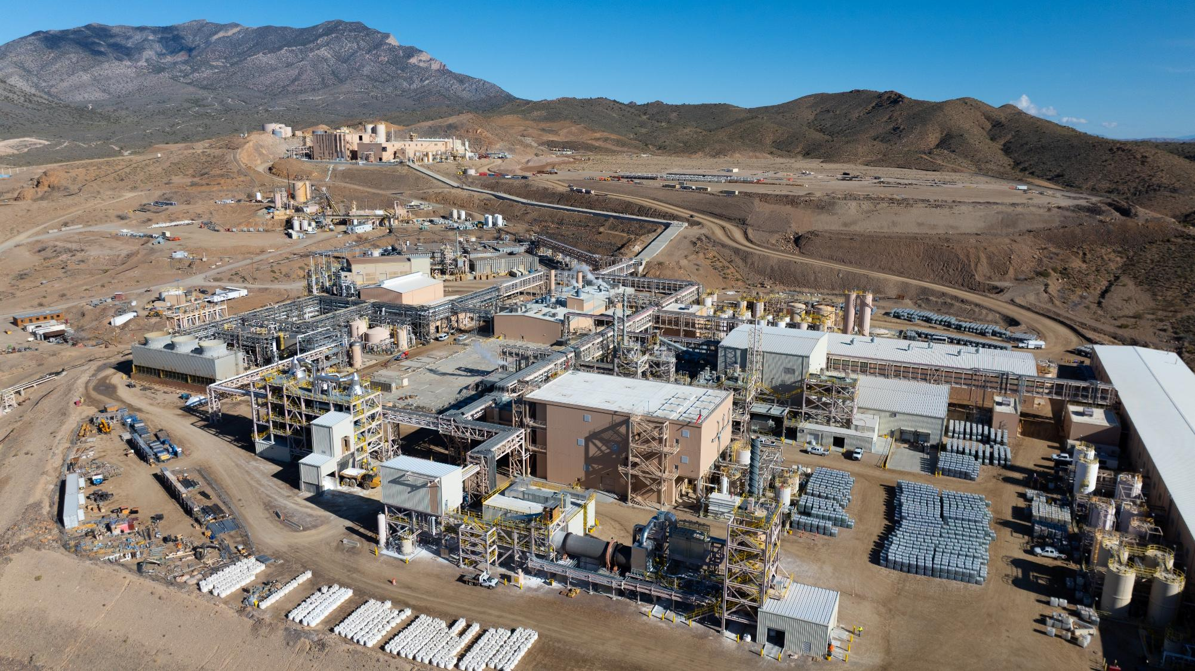
The Opportunity

Slide 3
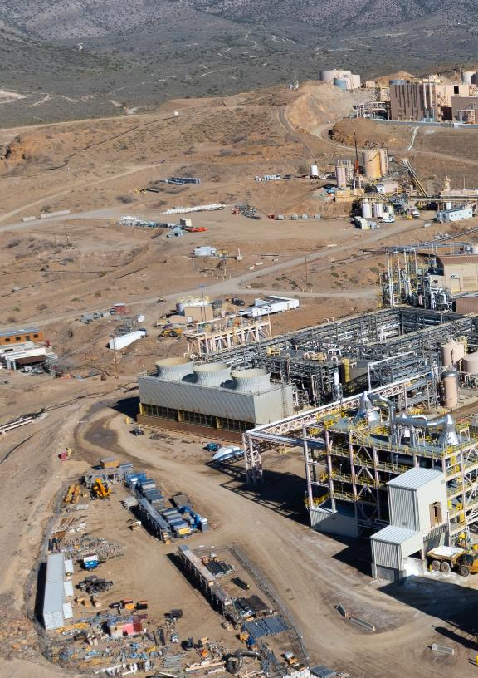
Demand for critical minerals is growing as the world shifts toward renewables and other innovations in the energy transition. Even with higher emissions per ton according to lifecycle assessments, this shift could offset emissions from coal and gas by 89% and 83%, respectively.
Demand for critical minerals and rare earth elements is expected to increase significantly as demand for frontier technologies and products — EVs, renewables, medical equipment, military defense, and digital devices — continues to rise. Copper is the mineral in highest demand for EVs and renewables.
Investment in the sector showed signs of slowdown in 2024, and startup funding declined, likely due to supply chain uncertainty. Meanwhile, exploration continued to increase.
Reserves are diversified across the globe, but China maintains a near global monopoly on critical mineral refining, renewable tech, and rare earth element procurement.
China has a large market footprint, controlling >90% of graphite and rare earth refining and dominating downstream solar, battery, and EV manufacturing. It is expected to maintain a high market share until 2040.
>40% of nickel and rare earth reserves are located in Indonesia and China, respectively, while Congo has 56% of cobalt reserves. Lithium is more diversified, though most reserves are concentrated in Chile, Australia, and Argentina. The U.S., Indonesia, and others are working to reduce dependence on China.
Heightened environmental and social issues related to mining will require stronger policy and a regulatory push to alleviate water stress, land impact, and community tensions.
Declining ore grades and high material throughput in mining require enhanced management practices and improved recovery techniques from tailings.
A significant share of mining occurs in water-stressed locations, heightening risks to local communities and underscoring the need for less water-intensive extraction methods.
Technological advances in material recovery will enable projected recycled inputs to meet up to 40% of demand by 2050. Electrification and other advances in efficiency are also critical to decarbonize.
The private sector is innovating for a circular economy, improving the recovery of minerals and the reuse and repurposing of products to maximize mineral utility in the supply chain.
Policy remains fragmented globally, though state-level recovery incentives and targets are being implemented to encourage recycling of key minerals.
Key messages
Critical Minerals:
The Opportunity

Slide 4
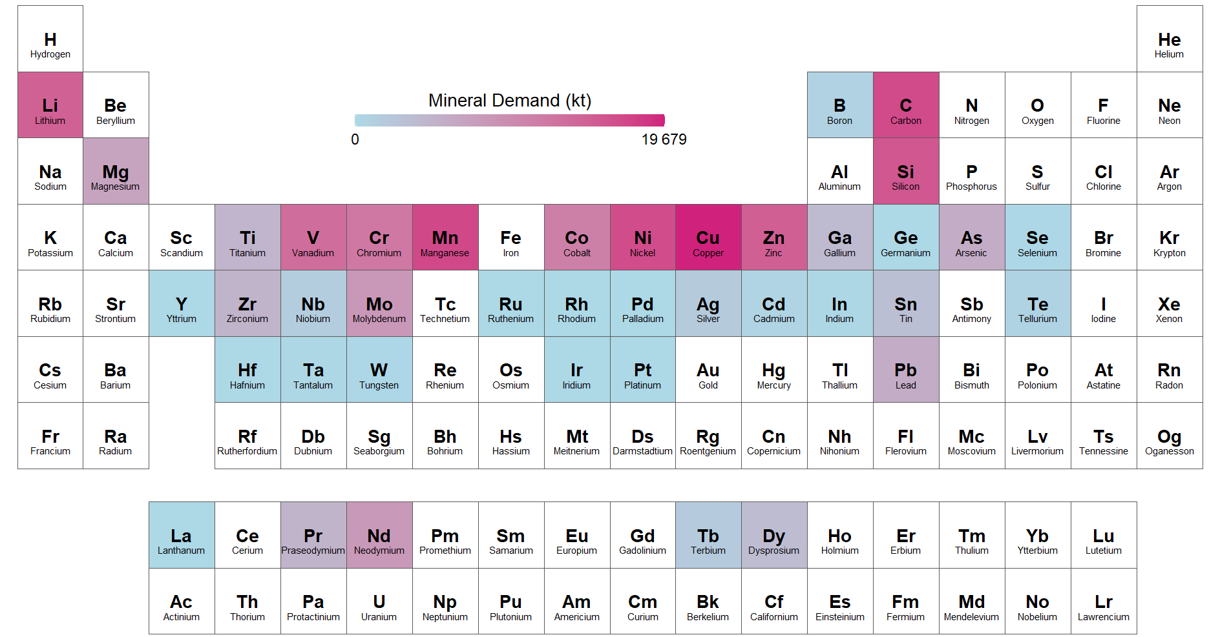
Minerals designated as ‘critical’ based on their importance to national economies and security
Critical minerals demanded for clean technologies, under Net Zero by 2050 scenario
Observations
Mineral criticality is country and context specific. Minerals are designated ‘critical’ depending on economic, supply-chain, technology, geopolitical, and geological factors.
  While some countries adopt an approach based on control supply and national security (U.S., Europe, Japan), others focus on capturing value given the mineral’s abundance in their territory (Indonesia, Nigeria), and some follow a mixed pattern (China).
  The U.S. defined 50 key critical minerals, whereas the European Union defined 17.
Critical minerals are scarce
but essential for modern technologies, economies, and national security, with supply chains vulnerable to disruption.
Rare earth element
IEA key transition minerals
Cu
Copper
Li
Lithium
Ni
Nickle
Co
Cobalt
C
Carbon
REE
Rare Earths

Slide 5
Despite its dependence on critical minerals, energy transition’s material footprint lower than that of the fossil-fuel economy
Fossil fuels have higher material intensity and, unlike renewables, require continuous mining & extraction
The energy transition will increase mineral demand, but decrease total material footprint, despite growing energy supply
Mining requirements for energy sources, tonnes of material/GWh
Material requirements of the energy transition (electricity and transport) v. growing global energy supply¹, 2015-2050, Gt/year v. EJ/ year
~1,200
Metals
Fossil fuels
Energy Supply
1,200
Mined materials
1,100
Oil & gas extracted
2.7
56.2
2.7
56.2
4.0
51.0
1,000
5.5
45.4
4.0
51.0
5.5
45.4
600
7.9
35.1
7.9
35.1
Internal combustion engines ~20-40% efficient, compared to EVs’ 80-90%
Internal combustion engines ~20-40% efficient, compared to EVs’ 80-90%
500
10.9
26.2
10.9
26.2
400
400
14.3
21.7
14.3
21.7
18.1
19.2
300
21.5
16.1
200
100
0
Coal
Oil
Gas
Wind (onshore)
Solar PV
Battery storage
Wind (offshore)
Nuclear
2015
2020
2025
2030
2035
2040
2045
2050

Slide 6
Global critical minerals demand expected to see 4-6x surge, driven energy transition
Key sectors leading demand for critical minerals
Electric Vehicles
Renewable Energy
Digital Technology
Medical Equipment
Military Defense
Focus of deck
~ 20-29%
(CAGR to 2030)
2030 market value: $360B
~13-17%
(CAGR to 2030)
+5,500 GW capacity addition between 2024 and 2030
~7%
(CAGR to 2028)
$4.9T global tech spend in 2025
~5-6%
(CAGR to 2030)
2030 market value: $800B
~4%
(CAGR to 2030)
95% of critical minerals imported for U.S. defense tech
Minerals Required
Batteries: Lithium, Nickel, Cobalt, Manganese, Graphite, Phosphorus, Platinum, Dysprosium, Lanthanum, Neodymium, Praseodymium | Wind turbines: Copper, Aluminum, Zinc, Molybdenum Solar: Silver, Copper, Gallium, Tellurium | Personal computers; Silver, Aluminum, Copper, Gold iPhones: Dysprosium, Neodymium, Samarium, Terbium | CAT scans: Tungsten, Copper, Lead, Aluminum, Gold X-rays: Thullum, Yttrium, Gadolinium Lasers: Yttrium, Praseodymium, Neodymium, Samarium | Jet engines: Rhenium, Nickel Night vision: Lanthanum, Gadolinium, Yttrium Military aircraft: Aluminum, Copper

Slide 7
Mineral demand for solar and wind expected to grow ~40% and ~150% by 2050, respectively, driving demand for Cu, Zn, and Si
Solar’s mineral demand¹ is expected to increase ~40% by 2050, primarily for Cu and Si
Wind’s mineral demand¹ is expected to increase ~150% by 2050, primarily for Zn and Cu
Observations
Cu, Zn, and Si will account for 49%, 21%, and 22% of cumulative wind and solar demand until 2050, respectively.
Solar will comprise ~7% of cumulative Cu demand until 2050 under NZE; wind will comprise ~ 4%.
Chromium, manganese, and nickel are essential for offshore wind as key elements for steel alloy manufacturing.
“Other” key minerals for solar are arsenic, silver, and tin; “other” key minerals for wind are nickel and molybdenum.
For solar, gallium demand will increase ~385x, while demand for cadmium, germanium silver, and tellurium will decrease.
  Silver per kW of PV to decline due to design and efficiency improvements; recycling to supply two-thirds of silver demand between 2040 and 2050
Mineral demand under NZE, kt
Mineral demand under NZE, kt
Copper
Silcon
Zinc
Other
Zinc
Copper
Manganese
Chromium
Other
+39%
5,108
4,861
25
28
+149%
25
27
4,324
4,396
4,379
24
46
26
43
4,096
3,733
3,788
23
40
164
3,171
3,157
15
18
167
3,004
138
157
1,522
83
105
2024
2030
2035
2040
2045
2050
2024
2030
2035
2040
2045
2050

Slide 8
Electric vehicles ~50% of clean tech’s critical mineral demand
Critical mineral demand by technology, kt
Observations
EVs surpassed 20% of global share of clean tech in 2024, which is projected to increase as much as ~82% by 2050, led by increased competitiveness.
While clean tech’s demand for critical minerals continues to increase, digital tech and AI will add more pressure to the global mineral supply.
This will lead to global demand increases of 2% for copper and silicon, 3% for REEs, and 11% for gallium between 2024 and 2030.
EVs
Electricity networks
Batteries
H2 technologies
Solar PV
Wind
Other low-emission PG
EVs demand share (%)
30-35%
41- 44%
45-48%
46-50%
46-49%
40,264
41,095
40,698
41,869
NZS³
36,543
APS²
32,979
34,007
29,637
28,608
SPS¹
27,115
24,663
25,463
23,247
22,544
19,675
12,281
2024
2030
2035
2040
2045
2050

Slide 9
Copper accounts for ~ 30-60% of cumulative mineral demand for renewables and EVs; demand from EV to outpace renewables 3x
Demand¹ from EVs will grow 10x by 2050; solar and wind will increase by 40% and 150%
>50% of EV demand¹ is for Cu and graphite; renewables demand driven by Cu, Si, and Zn
Observations
Copper is essential for all sectors; it covers the greatest mineral share of solar PV demand.
Cu is widely used for its conductive properties in cables, wiring, and electrical components for tech.
Cu, Zn, and Si - the most crucial minerals for renewables - will account for 49%, 21%, and 22% of cumulative wind and solar demand through 2050, respectively.
EVs are expected to drive demand for lithium; they accounted for 85% of lithium demand in 2023.
Annual critical mineral demand under NZE, Mt
Distribution of cumulative mineral demand to 2050, %
22
Breakdown of “other” 13%
EVs
20.5
20.4
Copper
20
Solar
19.9
Lithium
Silicon
18
Wind
17.8
EVs
Silicon
Zinc
Cobalt
Graphite
16
Demand for EVs
is projected to outpace wind and solar by ~7x and ~5.5x respectively; nearly 3x combined renewable demand.
Magnet REEs
Nickel
Other
Manganese
14
Breakdown of “other” 1%
Chromium
12
Arsenic
Other
10.3
Silver
10
Solar PV
Tin
Lead
8
Gallium
6
Other
4.861
5.108
4.396
Breakdown of “other” 12%
4.096
4.369
4.324
3.733
3.788
4
3.157
3.004
4%
3.171
Manganese
2
1.9
1.522
Wind
Nickel
0
Molybdenum
Neodynium
Other
8%
4%

Slide 10
Increasing demand expected to drive Cu deficit by 2035, with supply facing increased climate risks
Cu deficit projected to reach ~7M metric tons by 2035, growing ~300% from 2027 to 2035
Global Cu supply will grow only 2% by 2030 in face of high flood and drought risks
Observations
Cu demand for electricity networks, electricity generation, and electric vehicles is set to rise by 49%, 51%, and 555%, respectively; data centers will require more than 4.3 million metric tons by 2035.
Fewer mine discoveries, declining ore grades, and disaster risks limit Cu supply production.
  Cu ore grade has drastically declined by ~40% since 1991
  Average lead times from discovery to production increased from 12.7 to 17.9 years; only four new sites were discovered between 2019 and 2023
  Over 50% of current Cu production occurs in areas with high water stress
Recycling of copper will be necessary: In 2023, secondary sources supplied nearly 20% of copper.
Annual Cu surplus and deficit to 2035, thousand tons
Share of supply at high risk, %
2.9x
2024
2030
~25% of total Cu supply to be at some level of low to high risk by 2030.
Thousand tons
% of supply at high risk
2025
2026
2027
2028
2029
2030
2031
2032
2033
2034
2035
Global
Australia
Central/South America
North America
Asia
Africa

Slide 11
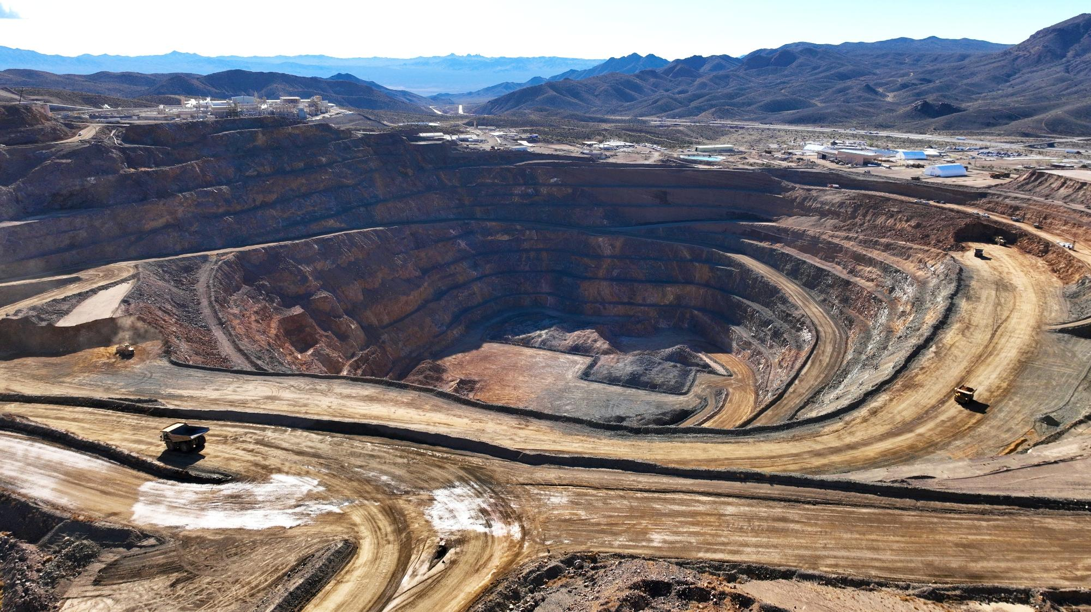
Supply Outlook

Slide 12
Existing reserves of all critical minerals fulfill projected clean tech needs through 2050, despite growing pressure on lithium supply
Current reserves and resources far outnumber production, particularly for copper
Across scenarios, production is projected to meet demand for minerals, except for lithium
Observations
Overall, critical minerals market gaps are the result of long lead times and permitting issues around opening new mines and extending current capacity.
For lithium, beyond production increased 35% from 2023 to 2024, driven by the growing demand of EVs.
The gap between base case supply of lithium and climate-aligned demand calls attention to the need for refining capacity additions.
Resources and reserves vs. global production of critical minerals, Mt 2023
Projected demand vs. supply scenarios¹ for critical minerals used in clean tech², Mt
APS
NZE
Resources
Reserves
Production
Graphite
Lithium
STEPS
+3,600%
Mt
Mt
Supply
2024
2035
2045
2024
2035
2045
Lithium demand is projected to outgrow supply by 2035 in all scenarios
Rare earths
Copper
Mt
Mt
+17,400%
+31,300%
2024
2035
2045
2024
2035
2045
+3,500%
+4,700%
Nickel
Cobalt
+15,500%
Mt
Mt
1
2
0.35
0.018
Copper
Graphite
Nickel
Rare earths
Lithium
Cobalt
2024
2035
2045
2024
2035
2045

Slide 13
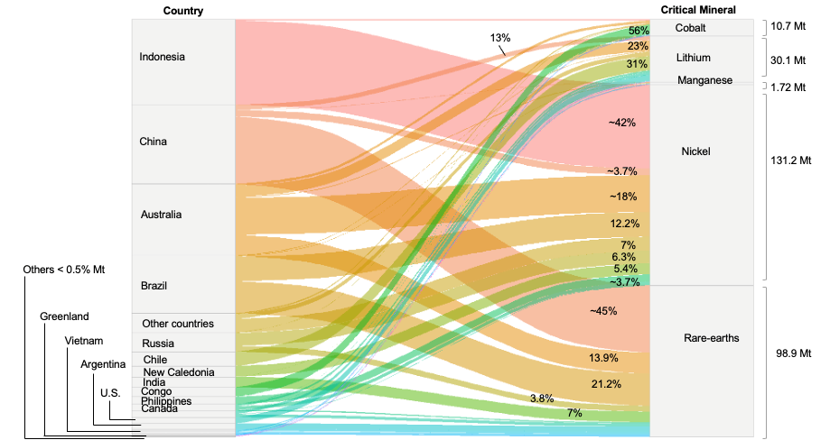
Among minerals for batteries, reserves of nickel and rare earths are the most regionally concentrated; lithium more diversified
Global reserves¹ distribution of battery’s critical minerals in 2024
Observations
97% of global lithium reserves can be found in seven countries; Chile (31%) and Australia (23%) have the largest reserves.
Rare earth reserves are 3.2x more abundant than lithium, but 45% of reserves are in China; 42% of nickel reserves are in Indonesia and 56% of cobalt reserves are in DRC.
These countries have significant influence in the NCX battery market. The concentration influences strategic investment decisions by major EV producers in China looking to diversify their supply chain by investing in mining assets across Africa and Latin America, and even overseas facilities for refining and downstream processing.

Slide 14
China largest critical mineral importer of semi-processed and raw materials, Australia and Chile key trading partners
Global trade flows¹ of material in 2023
Observations
China imports ~4x as much as it exports, sourcing US$500 billion+ from several major exporters.
Africa, South America, and Australia are net exporters, while Asia and Europe are heavily reliant on imported minerals.
The largest global trade flow is Australia-China, valued at
US$95 billion.
The South China Sea transported 24% of global trade in 2023; disruptions in this region may significantly impact critical mineral supply chains.
The U.S. and Canada are each other’s primary critical mineral trading partners.
Major trade flows (US$B)
>90
>30
15-30
10-15
Net exporter (net trade in US$M)
>250,000
50,001 – 250,000
1001-50,000
500-1000
<500
Net importer (net trade in US$M)
>250,000
50,001 – 250,000
1001-50,000
500-1000
<500

Slide 15
Upstream critical mineral production dominated by few key players, midstream capabilities concentrated in China
Upstream: DRC, Indonesia, and Australia lead Co, Ni, and Li; China leads graphite and REE¹
Midstream: China dominates global refining with ~90%+ of rare earth and graphite capacity
Observations
Average market share of the top three refining nations grew from 82% in 2020 to 86% in 2024.
Supply chain imbalances have triggered countries to employ market restrictions; levers include export bans, export licensing, stockpiling, and tax incentives for domestic companies.
  Market restrictions may stimulate more domestic value addition, boosting fiscal revenues
Zimbabwe and Namibia banned lithium ore exports as of 2022 and 2023, respectively; Indonesia banned nickel ore exports in 2014 and 2020.
China is the dominant supplier of refined materials both by geography and ownership; it owns 65% of global nickel refining production.
Geographical distribution of mined/raw material production, 2023 %
Geographical distribution of refined material production, 2023 %
China
Mozambique
Peru
Myanmar
Rest of world
Finland
DRC
Philippines
Australia
U.S.
Japan
Indonesia
Chile
Copper
Lithium
Nickel
Cobalt
Graphite
Rare earths
Copper
Lithium
Nickel
Cobalt
Graphite
Rare earths

Slide 16
China focuses on upstream capabilities while U.S. investments spread across rare earths value chain
China has invested $74B in upstream capacity since 2000s to diminish earlier vulnerabilities
The U.S. is developing the rare earths supply chain through public-private collaboration from mining to magnet production
Annual investment, US$B
US$600 million conditional funding from U.S. Export-Import Bank to Australia Dubbo “mine to metals” project under U.S.-Australia collaboration.
Upstream
Midstream
Upstream
China has invested $74B in strengthening the upstream supply chain of copper (64%), cobalt (22%), nickel (10%), lithium (4%), and REE (0.4%) across 29 countries between 2000 and 2021
MOU between U.S.-based MP Materials and Saudi Arabia-based Maaden to build a mine-magnet supply chain; mine production expected to begin in 2028.
Since 2020, DOD has awarded over $439 million to companies to develop separating and processing capabilities for permanent magnets, aiming to increase U.S. production by 10,000 mt by 2028 (~1% of China’s capacity and ~3% of global demand).
Billion USD investment
Midstream
$400 million equity investment by DOD in MP Materials.
10-year offtake agreement between DOD and MP Material to purchase 100% of magnets.
Downstream
10-year price protection agreement with DOD guarantees price floor of $110/kg for MP Material NdPr products (2x market price).
2000
2003
2005
2007
2009
2011
2013
2015
2017
2019
2021

Slide 17


China with persistent refining dominance over U.S. across critical minerals
Share of global mine and refined production of the U.S. and China, ~2014-2024
Mineral
Mine
Refine
U.S.
Strategies
China
Cobalt (Co)
82%
Attempts to increase its influence in Central Africa Copperbelt through Lobito Corridor Railway
Continues to invest in TAZARA (Tanzania Zambia Railway Authority)
Percentage
(%)
2%
U.S.
47%
0%
0%
0%
1%
China
0%
2014
2024
Copper
(Cu)
10%
8%
34%
44%
Companies continue to accelerate their joint ventures to build smelter plants near mines in Africa and Latin America
0%
0%
5%
3%
Refining capacity continues to decline
Lithium (Li)
70%
Continues to invest in lithium triangle ABC but faces pushback from local governments and indigenous communities
Continues to invest in lithium triangle ABC but faces pushback from local governments and indigenous communities
11%
0%
17%
~0%
33%
1%
1%
Manganese (Mn)
18%
Includes manganese in broader critical mineral strategies; in April 2025, released an Executive Order to develop subsea mineral deposits
Strengthening policies to support manganese processing within broader critical mineral strategies
4%
7%
5%
0%
0%
0%
0%
Nickel
(Ni)
35%
31%
Attempting to increase its production, providing $20.6M funding to Talon Nickel mine
Expanded its production to Indonesia, which owns 75% of its mining production and ~65% of its refined production
0%
5%
0%
3%
0%
0%
Graphite
(Gr)
75%
79%
95%
While facing supply chain risks, domestic investment and tariff strategies have been implemented to close the gap
Continues employing export control to the U.S
0%
0%
0%
1%
Rare earths (REEs)
84%
85%
Stopped production in 2022, and currently 80% of its consumption comes from China; the remaining comes from second exporters
Faces minor risk in using REEs as a trade dispute, apart from issues related to illegal mining
69%
92%
4%
12%
0%
6%

Slide 18
Many including Indonesia and U.S., increasing mineral refining capacity to reduce their dependence on China
Global planned mining and refining mineral production (non-China), 2024-2040, Mt¹
Observations
Average market share of the top three refining nations grew from 82% in 2020 to 86% in 2024.
Supply chain imbalances have triggered countries to employ market restrictions; levers include export bans, export licensing, stockpiling, and tax incentives for domestic companies.
  Market restrictions may stimulate more domestic value addition, boosting fiscal revenues.
Zimbabwe and Namibia banned lithium ore exports as of 2022 and 2023, respectively; Indonesia banned nickel ore exports in 2014 and 2020.
China is the dominant supplier of refined materials both by geography and ownership; it owns 65% of global nickel refining production.
Observations
Diversification is useful to cushion countries against external shocks, derive more mineral benefits, and prevent resource-rich developing countries from becoming dependent on external economies.
Global FDI greenfield mineral projects numbered 117 in 2023; approximately 75% of those were in developing economies and half were dedicated to mineral processing.
Between 2024 to 2035, the average share of the top three refining nations is set to decline by 4%.
Indonesia
Rest of world
Russia
Australia
Argentina
Canada
Korea
India
U.S.
Mining
Refining
Mining
Refining
4.6
4.3
23
31
3.9
3.3
27
India, Russia, and Indonesia are increasing refined production by 60%, 12%, and 170%, respectively. Russia’s mining production will increase by only 1%
Indonesia is set to increase mined and refined production by 36% and 38%, respectively
15
Ni
Cu
2024
2040
2024
2040
2024
2040
2024
2040
0.42
0.47
0.27
0.33
All countries are expected to increase both mining and refining. Mining: Argentina by +280%, U.S. by 250%, and Australia by 10%.
Refining: U.S. by >1,000%, Australia by >300%, and Argentina by >250%
0.21
0.25
Indonesia, Canada, and Korea will increase refined production by 600%, 400%, and 30%, respectively; Indonesia is set to increase mining by >85%
0.26
0.25
Li
Co
2024
2040
2024
2040
2024
2040
2024
2040

Slide 19














Small number of companies, many in China, dominate EV battery supply chain by locking in economies of scale
Upstream is mostly managed by LATAM and Australia, downstream is led by Asia
While mining for battery and EV materials is more geographically diversified, most of the refining and production happens in China
Share of total production of top three companies across supply chain,¹ 2021
Geographical distribution of the global EV battery supply chain,² 2023
Other
Russia
Indonesia
Australia
DRC
Korea
Chile
Japan
United States
65%
Europe
China
42%
27%
Li
Ni
Cathode
Anode
Cells
Li
Ni
Co
Gr
Li
Ni
Co
Gr
Cathode
Anode
Battery
EVs
Upstream
Downstream
Mining
Refining
Active materials
Cell production
Mining
Active materials
Cell production

Slide 20
Value-adding policies increased Indonesia’s global processed Ni share by 29% from 2014 to 2022, increasing trade revenue ~7x
Deep Dive: Indonesia
Traded quantity and traded value, 2010-2022, million tons/US$B
Observations
In addition to the export ban in 2014, Indonesia introduced a local content clause for firms investing in domestic smelters.
In 2017, the export ban was relaxed due to falling Ni revenues; instead, miners were required to allocate at least 30% of smelter capacity to processing and the remainder was allowed for exporting.
Value addition in Indonesia increased from $1.1 billion in 2015 to $20.8 billion in 2021.
Indonesia’s strategy has significantly expanded hydrometallurgy and pyrometallurgy smelting capacity, leading to an increase in stainless steel exports ($4 billion in 2022).
Nickel ore
Ferronickel
Nickel Oxide sinters and other intermediates
Nickel matte
Global share of refined Ni: 1%
46
38
Export ban on Ni ore
Export ban relaxed
Export ban reinstated
29
27
Million tons
Global share of refined Ni: 30%
16
17
12
9
7
5
5
1
1
2010
2011
2012
2013
2014
2015
2016
2017
2018
2019
2020
2021
2022
~+600%
20
US$B
9
4
6
5
6
6
6
3
2
2
3
4
2010
2011
2012
2013
2014
2015
2016
2017
2018
2019
2020
2021
2022

Slide 21






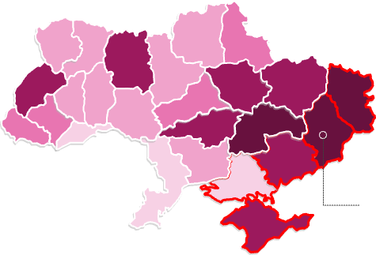

U.S.-Ukraine critical mineral deal strengthens future partnerships and supports U.S. strategy to reduce reliance on China
Deep Dive: U.S.-Ukraine
Deal breakdown: U.S. vs. Ukraine
Observations
The U.S.-Ukraine Reconstruction Investment Fund (50/50 co-managed by the U.S. and Ukraine) was designed to funnel investment into Ukraine’s postwar rebuilding for priority sectors like mining, energy, and infrastructure.
Investments, payments, and incomes associated with the deal will benefit from tariff waivers and tax exemptions for both countries if transparency is upheld.
Russian offensive has created a high-risk environment for deal security.
Contribution
Military
Half public royalties
Military assistance (weapons, technology, training)
50% of public royalties, license fees, and similar payments from natural resource projects in Ukraine
Prioritization
Asset ownership
Benefits
The U.S. International Development Finance Corp. is prioritized in offtake agreements plus has right of first refusal.
Agreement pertains only to net new assets, with 100% ownership being maintained for assets currently generating revenue.
Ukrainian mineral deposits
Ukrainian mineral deposits $ reserve value
Estimated reserve value
Li
Lithium
Zn
Zinc
REEs
Rare Earths
Estimated recoverable value of critical mineral deposits in Ukraine:
$350B
Higher value deposits located in Eastern Ukraine are at risk of loss due to Russian military offensive.
Cu
Copper
$3,000B-$4,000B
Ti
Titanium
Co
Cobalt
Mn
Manganese
Be
Beryllium
$2,000B-$800B
Ni
Nickle
$50B-$200B
$10B-$50B
Russia Seizes Key Lithium Field in Challenge to U.S.-Ukraine Mineral Deal
Up to $10B
Russian occupied
June 2025

Slide 22
Trump administration sees deep sea mining as an alternative to China’s market dominance, despite environmental concerns
Deep Dive: U.S. Deep Sea
Deep sea mining has many unknowns
The Metals Company share price, US$
Environmental impacts
TMC applies for license
Deep sea ecosystems under-researched, risk of irreversible damage
Downstream consequences for fragile ecosystems
Uncertain environmental trade-offs vs. terrestrial mining (deforestation, local water pollution)
EO signed
Cost
Uncertain economic viability compared with terrestrial sources, e.g., Indonesian nickel
High OpEx due to the extreme depth and technological challenges of deep sea environments
Tech unproven and costly
4/4/25
4/6/25
4/8/25
4/10/25
4/12/25
4/15/25
4/17/25
4/22/25
4/24/25
4/28/25
4/30/25
5/2/25
5/6/25
5/8/25
5/12/25
5/14/25
5/16/25
5/20/25
5/22/25
5/27/25
5/29/25
6/2/25
6/4/25
6/6/25
6/9/25
6/12/25
6/11/25
06/16/25
Trump’s executive order opens the backdoor to deep sea mining
On April 24, 2025, the Trump administration issued an Executive Order (EO) to speed up permitting for deep sea mining operations. Following the EO, The Metals Company (TMC) applied for a U.S. license to extract minerals from the Clarion-Clipperton Zone (CCZ), a region of the Pacific stretching from Hawaii to Mexico.
The CCZ and the rest of the ocean floor in international waters falls under the jurisdiction of the International Seabed Authority (ISA), a body with 170 members including the EU but excluding the U.S. The ISA’s mandate regulates mineral-related activities in the “Area” (the seabed and ocean floor beyond national jurisdiction, which is ~50% of the earth’s seabed); it has granted over 30 exploration contracts but no exploitation contracts. TMC has partnerships with Tonga and Naura to work through the ISA, but the EO obviates the need to work through the organization to exploit deep seabed. TMC could start exploitation as early as 2026.
Geopolitics
U.S. securing supply chains for critical minerals
U.S. unilateralism undermines the global governance of the ISA; China supportive of ISA’s multilateralism
Increased risk of resource conflict in international waters
Sources: Unleashing Americas Offshore Critical Minerals and Resources (The White House, 2025); TMC The Metals Company Inc. (MarketWatch.com, 2025).
Credit: Leo Gordon, Zacharia Thurston, Isabel Hoyos, Hyae Ryung Kim, and Gernot Wagner. Share with attribution: Kim et al., "Mining for the Energy Transition" (31 October 2025)

Slide 23
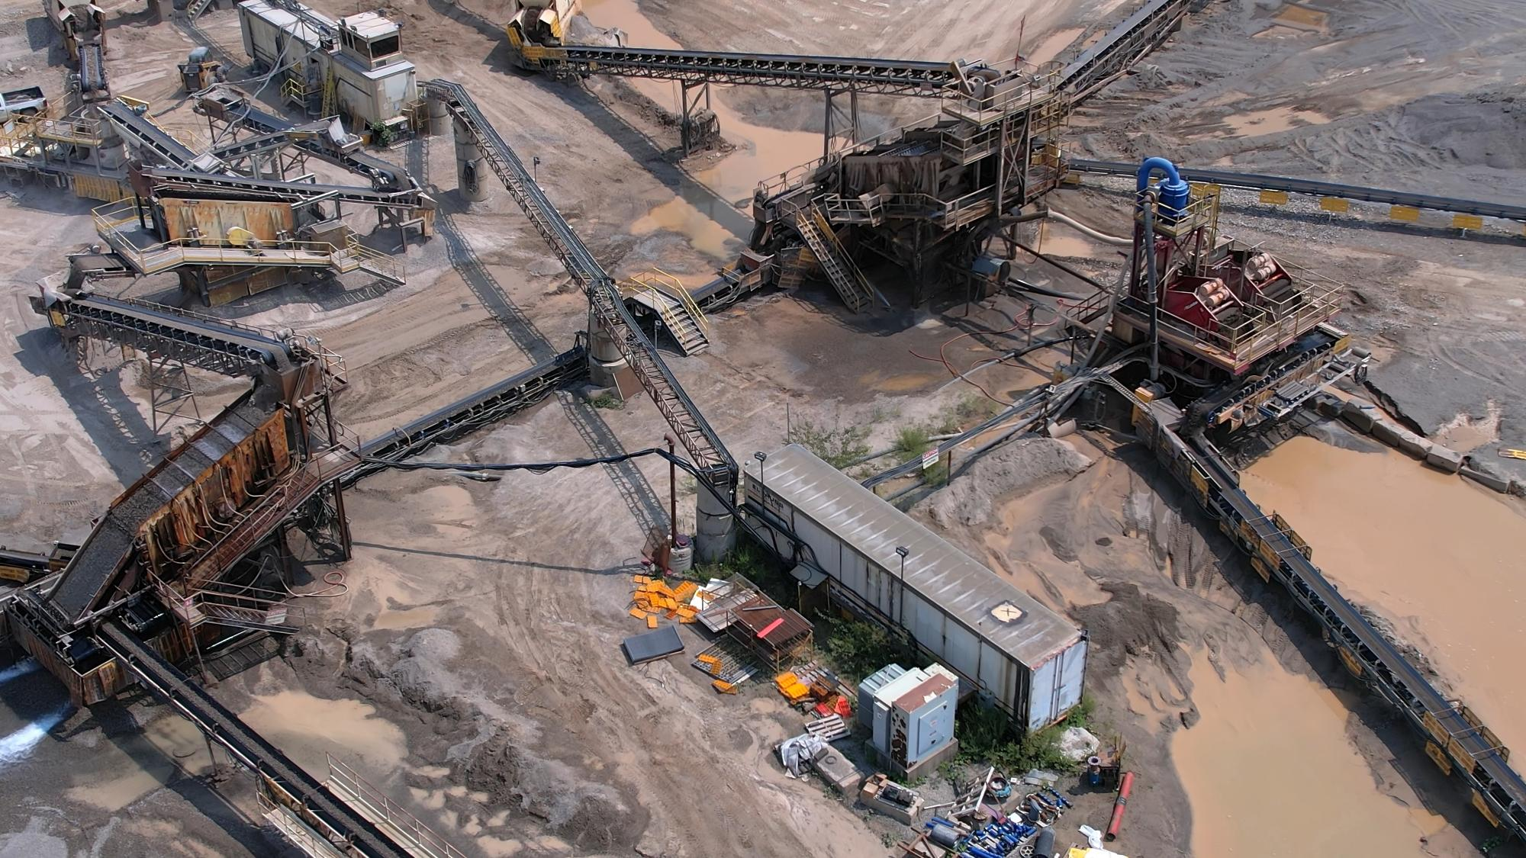
Environmental & Social Impact

Slide 24

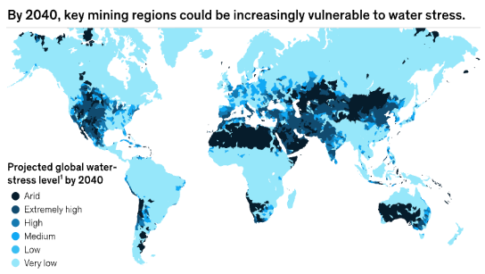
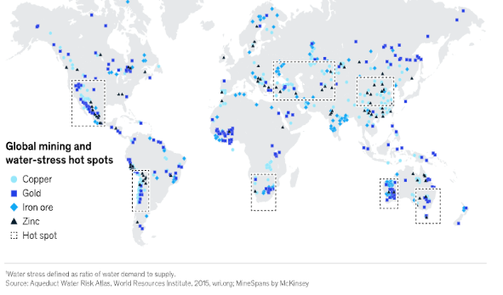
Water stress in key mining regions poses operational and reputational risks for companies sourcing critical minerals
Projected water stress and mining sites
Case Study: Chile
Observations
Climate change is intensifying the physical risks of heat, drought, floods, and extreme rainfall, threatening mining operations and local communities.
Chile, the No. 1 global exporter of copper, with one-third of all supply, is in a megadrought.
  Nearly half of global copper, gold, iron ore, and zinc production occurs in high water-stress regions
Flooding, heat, and sea-level rise jeopardize safety, infrastructure, and productivity, while worsening drought restricts freshwater access.
Even as companies like BHP invest in resilience, escalating climate pressures pose growing operational challenges.
Innovations and investments in desalination and water technologies have reduced climate risk amid worsening drought, but sustaining gains will require urgent action as megadrought impacts intensify.
2019
2025
Los Bronces Copper Mine
2019 marked one of the driest years on record
Mine closed after significant production loss, leading Anglo to sign a deal with Codelco’s Andina division to share water
Escondida Copper Mine
Chile remains in megadrought (15 years)
Profound effects on Chile’s water resources, agriculture, and ecosystems, forcing mining operations to stop
Chile
28%
Quarterly loss in copper production
$47M
Fine imposed on BHP for depleting freshwater resources
44%
Decline in processing capacity
$4B
Investment in desalination and water recycling infrastructure
Chile
9%
Annual production
16%
Production increase
Map Credit: McKinsey & Co.
Sources: Climate risk and decarbonization: What every mining CEO needs to know (McKinsey, 2020); Worst drought in years pushes Anglo to sign water deal with Codelco (Mining.com, 2020); Mining companies are pumping sea water into the driest places on Earth. But has the damage been done? (The Guardian, 2025)​.
Credit: Zacharia Thurston, Isabel Hoyos, Hyae Ryung Kim, and Gernot Wagner. Share with attribution: Wagner et al., "Mining for the Energy Transition" (10 April 2026).

Slide 25
Aging mines and decreasing ore grade quality means exponentially more energy is required for optimal mineral production
Mined head grade, % copper
Age of copper mines operating in 2023
Observations
As mines age, ore grades typically decline, leading to lower recovery rates and the need to use significantly more energy to extract and refine each unit of metal.
This not only increases operating costs but also heightens the environmental footprint of production.
The same trend is evident across other critical minerals, such as zinc, nickel, and rare earth elements, posing serious implications for supply chain stability, national security, and long-term resource resilience — especially as demand accelerates in the clean energy and technology sectors.
Forecast
The percent of recoverable copper per unit of ore is declining
0-10 years
31-40 years
% Grade
11-20 years
41-50 years
21-30 years
50+ years
Year
Energy consumption, GJ/ton
Copper
Exponentially more energy is required to extract copper, zinc, and other minerals as ore grades decline and recovery rates fall
Zinc
GJ
ton
Copper & zinc unit costs, $/lbs.
Declining ore grades as well as higher input costs are pushing up production costs
$/lbs.
Copper
Zinc
Year
Sources: Decreasing ore grades in global metallic mining: A theoretical issue or a global reality? (MDPI, 2016); How copper will shape our future (BHP, 2023);
Base metals miners continue to fight against inflationary pressures (Fastmarkets, ​2024).​
Credit: Zacharia Thurston, Hyae Ryung Kim, and Gernot Wagner. Share with attribution: Wagner et al., "Mining for the Energy Transition" (10 April 2026).​

Slide 26
Mining critical minerals removes much more material than when extracted as metals; regulation of environmental impacts required
13B mt of waste rock is generated per year from mining metals for energy transition²
Material moved per unit of metal
Observations
Clean up at large mine sites may cost up to billions of dollars over long remediation timelines; reprocessing tailings can offset site remediation costs; tailings often containing millions of dollars in recoverable materials.
  Co, Li, and REEs are commonly found in tailings
The EU’s Mining Waste Directive requires operators to have effective waste management. The U.S. has shown interest in recovering minerals from tailings.
Mitigating material impacts requires effective governance and best practices: land use planning and zoning, strict impact assessments, land rehabilitation, and consistent reporting for transparency.
Minerals
billion Mt
Total material moved
Total ore mined
860x
1 kg metal
13
Cu
Co
Ag
Waste rock
billion Mt/year
510x
860x
100,000x
480x
160x
x43
Li²
Ni
Pt
1600x
250x
670,000x
120x
170x
0.3
1) Based on ETC 100% decarbonization by 2050 scenario. 0.3B estimate is a maximum one-off scale-up that will decrease over time with recycling and circular economy. Total material moved refers to total rock that needs to be shifted to retrieve ore, including waste rock, overburden, and other material moved during mining process. Ag is typically mined as a byproduct for other metals; quantification of environmental impacts is limited, as waste is distributed with other metals. 2) Hard rock mining for lithium.
Sources: Material and Resource Requirements for the Energy Transition (ETC, 2023); Geopolitics of the Energy Transition (IRENA, 2023); EU directive on the management of waste (IEA, 2025); Department of the Interior launches effort to unlock critical minerals from mine waste (U.S. Department of the Interior, 2025); Reuse of Solid Mining Waste (ITRC, 2024).
Credit: Khande-Jae Fisher, Isabel Hoyos, Hyae Ryung Kim, and Gernot Wagner. Share with attribution: Wagner et al., "Mining for the Energy Transition" (10 April 2026).

Slide 27
Mining is vulnerable to environmental and social impacts that can overshadow clean energy’s promise
71% of transition mines impact ecosystems¹; lithium and graphite have the largest footprint
Tailings and acid create lasting damage on water systems; lithium and REEs lead impact
Observations
Compliance related to land, water, and social impacts are critical to mining companies maintaining a license to operate. Failure to comply implies legal, capital-raising, and reputational risks.
Such challenges are addressed through Environmental and Social Impact Assessments (ESIAs), which are mandatory for almost all mining companies. ESIAs address mitigation and eventual compensation events, adaptative measures, and closure plans.
Beyond that, companies follow country-specific initiatives related to water and waste management, such as the Directive on the Management of Waste from Extractive Industries in the EU.
Land Impact
Water Impact
Eutrophication (kgPeq/kg)
1.0
10,000.00000
Ecotoxicity (CTUeco/kg)
Ecosystem significance index (min.-max., 0-1)
0.8
1,000.00000
100.00000
0.6
Lithium global output occurs mostly (75%) in areas with moderate water scarcity risk, higher than copper, which reaches 39%.
10.00000
Graphite
0.4
Cobalt
0.10000
0.01000
0.2
Nickel
Copper
0.00100
Lithium
Minimum index score to be significant ecosystem
0.0
0.00001
Cobalt
Copper
Nickel
REE
Lithium
Degree of integral impact on ecosystem (ha eq.)²
Social
10-20% of global cobalt production comes from artisanal small-scale mines, associated with poor working conditions and child labor
Copper is also associated with the release of toxic chemicals (mercury, sulfuric acid, lead, PCBs), causing major harm to local ecosystems and communities
1) Significant ecosystems are those relevant areas for preserving biodiversity and nature and that contribute to people’s lives through ecosystem services, locally or globally. 2) Hectare equivalent.
Sources: Metals for Clean Energy: Pathways to solving Europe’s raw materials challenge (KU Leuven, 2022); Natural and synthetic graphite production emissions worldwide as of 2021 (Statista, 2025); How copper mines pollute (Environment America, 2025); Rocks and hard places: The ecosystem risks of mining for energy transition minerals (S&P, 2024).
Credit: Brenda Rain, Isabel Hoyos, Hyae Ryung Kim, and Gernot Wagner. Share with attribution: Wagner et al., "Mining for the Energy Transition" (10 April 2026).

Slide 28










System-based water management and reuse/reprocessing tailings innovations lead efforts to reduce water and waste impact
Water consumption
Waste reduction
Selective extraction of lithium through adsorbents, ion exchange, solvent extraction membrane separation, or electrochemistry; currently experimental
Albemarle piloted a DLE plant in Mongolia in 2024
YLB is building a semi-industrial DLE plant to produce 14,000 mt of lithium carbonate per year
Reduces tailings production and emissions by repurposing tailings for direct capture. Tailings can then be stored underground or used to produce carbon-negative concrete for infrastructure projects
Newmont’s partnership with NREL to research tailings for capture received $4.38M in research funding from DOE
Direct lithium extraction (DLE)
Tailings for CO₂ capture
Techniques include air classification as well as electrostatic, magnetic, and gravity separation
DryFlow’s stacked magnetic technique is effective
in moisture levels >10%
Dry processing techniques
Implementing new metallurgic processes
to recover minerals from existing tailings
Antofagasta uses chloride salts and sulfuric acid for leaching copper with a recovery rate of 70%
Cerro de Pasco offers mineral extraction from tailings at $1 to $2 per ton (~2-15x cheaper than open-pit and ~30-200x than underground mining)
Tailings reprocessing
Closed-loop water circuits and real-time monitoring systems
Freeport’s advanced bioreactor reduced freshwater requirements by 65% and improved discharge quality
ABB’s AI-powered copilot displays 30% faster troubleshooting times vs. traditional methods
Real monitoring & water recycling
Sources: Climate risk and decarbonization (McKinsey, 2020); The journey of the electric submersible dewatering pump (Atlas Copco, 2023); Mining & Minerals (Sigma Thermal, 2025); Energy Technology Perspectives 2023 (IEA, 2023); 11 lithium stocks betting on direct lithium extraction (Investing News Network, 2024); Lithium mining (McKinsey, 2022); Innovative water management strategies transforming the mining industry (Discovery Alert, 2025); Research the Use of Mine Tailings in Conducting Direct Air Capture of CO₂ (Newmont, 2023); Cuprochlor-T (Antofagasta Minerals, Cuprochlor-T 2023); Production & Extraction in Magnolia (Albemarle, 2025); YLB and the Russian company Uranium One Group (Bicentennial of Bolivia, 2023); Seven Ways ICMM members are exploring innovative technologies (ICMM, 2024); ABB launches AI-powered GMD Copilot (Discovery Alert, 2025); Extracting Critical Minerals from Historic Tailings (Crux Investor, 2025).
Credit: Brenda Rain, Khande-Jaé Fisher, Hyae Ryung Kim, and Gernot Wagner. Share with attribution: Wagner et al., "Mining for the Energy Transition" (10 April 2026).

Slide 29
The impact of transitioning to a clean economy remains net positive, despite emissions from carbon-intensive minerals
The high carbon intensity of critical mineral supply chains remains a key challenges for a clean energy future, as demand rises; with nickel being the toughest obstacle
~135 GtCO₂ can be avoided by replacing process coal with renewable power
Carbon intensity from mining and refining,
Additional mineral requirements and emissions under Net Zero Scenario by 2050
Cumulative GWP under 2DS¹ Scenario by 2050 through C-t-G methodology, GtCO₂e
CO₂ tonnes/tonne of crude oil
2.9 – 3.4
CO_{2 e}missions
Mineral demand
Nickel
51
69
kt
Million mt of CO₂
Cobalt
2
38
120
Rare earths
32
100
-38%
Lithium spodumene
14
22
Mining
Refining
80
Lithium brine
5
9
-89%
Synthetic graphite
Range variability
60
Complete process
Copper
5
40
Silicon
4
Natural graphite
2
20
0
10
20
30
40
50
60
70
0
Tonne of CO₂ /tonne of mineral produced
Cu
Graphite
Ni
Li
Si
Co
REEs
Coal
Gas
Renewable

Slide 30
Emissions reductions achieved by EVs, enabled by critical minerals, far exceed emissions from their mining and processing
Case Study: EVs
Passenger EVs require 6x more minerals than ICEs, raising upstream emissions from mining and refining
Increased emissions from EVs mineral needs (91% compared to ICEs) are far outweighed by reductions during vehicle use phase
Critical mineral used in EV¹ compared to ICE by car components, kg
LCA (WTW) GHG emissions comparison of ICE vs. BEV in the U.S.
Glider
EV motor + generator
Minimum use in battery
Variable use in battery
Battery
Car (no-battery)
Fuel: WtT
Fuel: TtW
The size of emission reduction is highly local for EVs. For example, while some evidence set CO₂e emissions from BEVs at 50 g CO₂e/km in Belgium, others set it at ~ 290 CO₂e/km in Denmark.
The level of BEVs emissions depends on several factors, including the electricity generation mix that is available to power the grid and technical characteristics such as:
Engine efficiency
Vehicle size and weight
Auxiliary systems (heating, air conditioning)
It also depends on behavioral and contextual patterns, such as driving style and weather.
ICE
34
-34%
-56%
282
2
BEV
91
235
Critical mineral used in BEVs by type of mineral² and car components, kg
GHG emissions (CO_{2e} g/km)
Manganese
105
126
187
Copper
17
81
Graphite
12
76
123
Nickel
Cobalt
Lithium
3
11
REEs
0
20
40
60
80
100
120
140
160
180
200
220
240
0
0
Required mineral per vehicle (kg)
ICE
BEV–U.S. grid
BEV–CA grid

Slide 31
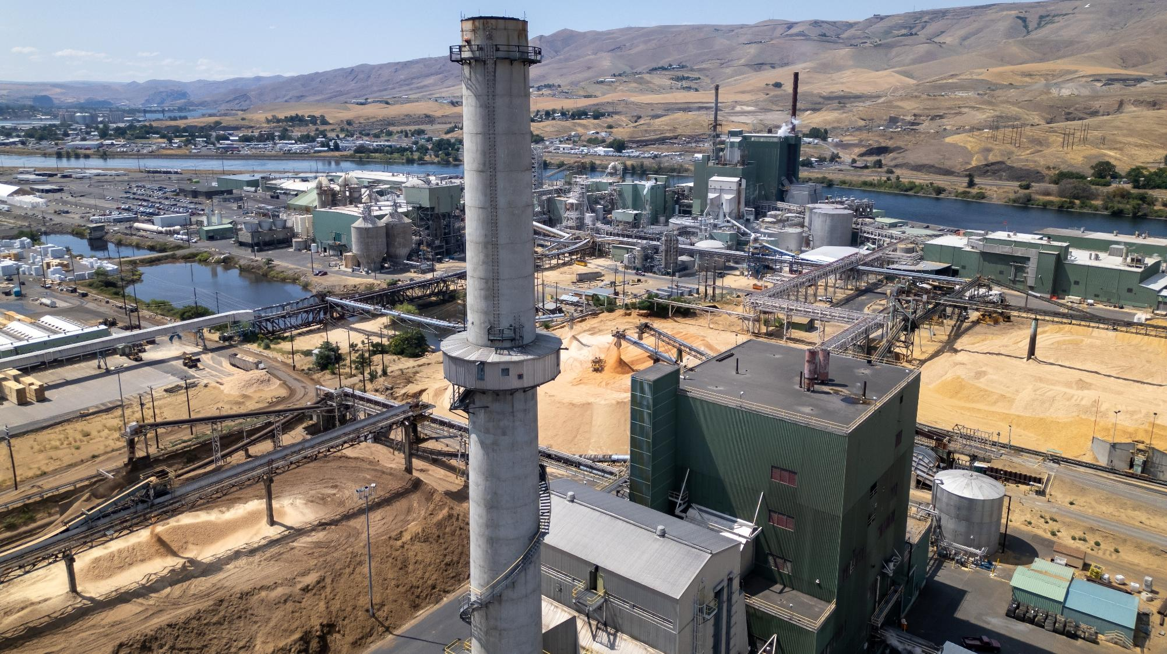
Decarbonization Solutions

Slide 32
Recycling emerges as a key solution; rates are set to significantly increase for Co, Li, Ni, and Cu and alleviate primary demand
As share of recycled mineral input increases, demand for mined material is projected to decrease by 40% for Cu, 25% for Ni, 27% for Li and 48% for Co
Recycled input rates are expected to grow +25%
Percentage market share of recycling for specific CRMS, %
Historical and projected recycled input rates for critical metals in Net Zero Scenarios, 2024, %
Mt
Mt
~-40%
Ni
~-25%
Cu
Copper
Cobalt
Lithium
Nickel
2020
2030
2040
2050
2020
2030
2040
2050
Mt
kt
~-48%
Li
~-27%
Co
2020
2030
2040
2050
2020
2030
2040
2050
Observations
Recycled metals produce 80% less emissions than mined metals.
Less than 1% of battery metals are currently from recycled inputs, but recycling is projected to lower total new mining demand for critical metals by 25-40% by 2050.
If all announced projects come online, global recycling capacity could rise to 6x more than available feedstock by 2030.
Recycling is projected to reduce mining investment needs by 30% by 2040.

Slide 33
Circular models are essential to help fragmented supply chains, as poor design for recovery limits recycling scalability and profitability
Barriers to Critical Mineral Recovery
Cathode costs vs. weight per cell
CRMs are ~20% of every 1,000 pounds by weight of a Li cell.
Circular economy principles may address recycling gaps and complexities
Heterogenous waste streams | Diverse chemistries, hazardous materials, and inconsistent product quality in black mass limit process optimization for recyclers Compositional and price variability of shredded batteries within black mass makes value unpredictable (e.g., LFPs are less profitable), leading to discounted payables, lower margins, and revenue uncertainty
High dispersion, low concentration of CRMs | CRMs exist as trace amounts in many products, increasing processing needs Extraction techniques vary in selectivity and cost; variability in waste streams reduce recovery performance
Fragmented supply chain and infrastructure | Recycling facilities and underdeveloped collection infrastructure require high CapEx Supply chains are geographically concentrated; nations export feedstocks for further processing Low waste feedstock and manufacturing scrap dominate the waste stream: EVs and storage are only one-third of recyclable feedstock
Lack of design for disassembly | Products are not designed for EOL recovery; disassembly is time consuming and expensive Battery designs are not standardized; products often do not disclose compositional profiles, making identification and recovery of critical minerals difficult
Li
Co
Mn
CRM circular economy (CE) ideal lifecycle
Other
Cathodes comprise 40% of total lithium cell costs and 66% of total core component costs.
Reuse
Repurpose
Recycle
CE principles prioritize reuse (extended life) and repurposing (second-life applications) over recycling to minimize waste and maximize value, keeping CRMs in use longer
Replacing product-oriented with service-oriented business models shifts lifecycle responsibility to producers, promoting Extended Producer Responsibility and incentivizing recovery
Strategies like track-and-trace programs, automation of disassembly, and optimized product transport and collection routes promote streamlined recovery at EOL and more uniform waste streams
CE is projected to reduce cumulative mineral demand by 18% by 2050
Cathodes
Other core components
Non-core materials
Manufacturing
Pretreatment and material recovery distribution by country in 2023
~2,700 kt
~2,100 kt
75%+ battery pretreatment and black mass recovery capacity is located in China.
China
NA & Europe
Other
Pretreatment
Material recovery

Slide 34
Hydrometallurgy is projected to dominate recovery capacity as a mature, flexible, selective, and low-energy process
 | Hydrometallurgy | Pyrometallurgy | Direct Recycling
Description | Chemical dissolution using aqueous materials to extract metals | Extraction of metals by smelting at elevated temperatures >1000 °C | Reconditioning of active materials without breaking them down into elemental metals
Recovery rate | Up to 99% | <50% for Li; ~98% for Co, Cu, and Ni; *up to 97% for Li when combined with hydro | Up to 98% in lab
Energy consumption¹ (MJ/kg LFP) | 30.6 | 18.4 | 3.5
Advantages | Lower emission than pyro High recovery rates for most metals | Batteries require minimal pretreatment High Ni, Co, and Cu recovery rates | Lower emissions and energy than hydro/pyro High Li recovery rates
Disadvantages | Liquid waste; extensive water use Battery requires pretreatment – primary inputs are black mass Slow processing times | High hazardous gas and liquid waste emissions Battery requires additional processing (usually hydrometallurgy) for higher recovery rates Lower recovery rate than hydrometallurgy for Li | Requires customization based on cathode type Recovered material may display lower level of performance Only demonstrated in pilots; high operational and equipment costs
H
M
H
Hydrometallurgy will dominate recovery processes by ~90% in 2030 due to high yields, mature economics, and flexibility with various chemistries.

Slide 35
Achieving profitability in battery recycling is challenging due to feedstock shortages and mining’s competitive advantages
Profit opportunities across the value chain
Key challenges
Collection, logistics,
and sorting
Discharge and
dismantle
Pretreatment
Battery materials
recovery
Feedstock shortages
Due to extended battery life, recyclers supplement their supply with waste material from battery cell manufacturing. However, scrap rates are expected to fall as battery manufacturers improve production efficiency
Having battery manufacturers as both key suppliers and primary customers, recycling companies are facing massive margin pressure from both sides of the market
Business Model | Collection point Transport and charging Sorting and warehousing | Discharging and dismantling Material sorting | Pack disassembly Shredding and sorting | Pyro- and hydrometallurgy Hydrometallurgy Refining
EBITDA estimate by 2030 in Europe, $M
Profit potential | Smaller margin potential Lower commodity price risk and requires fewer skills | Smaller margin potential Lower commodity price risk Requires specialized safety protocols for battery handling | Activities with low entry barriers, such as shredding face overcapacity Lack of scrap for recycling, resulting in lower margin. | Highest upside potential, if given large enough scale and additional value Steepest entry barriers due to high CapEx and intellectual capital requirements
100
60
180
500
40
Lack of scale
Current lack of scale makes it difficult for recyclers to compete with incumbent raw material producers, given that the core recycling technologies are not fundamentally different from primary material processing
10
10
30
60
30
30
170
Collection point
460
Transport & discharging
Discharging & dismantling
Pack disassembly
Pyro- & hydrometallurgy
Limited profit pool
Traditional recycling players are advised to compete for the overall materials recovery profit pool, not just the front end
  Building a cross-value-chain ecosystem through partnerships may be an option
  Investing in technologies that bring better material recovery rates, product quality, and process efficiency is essential to be chosen by OEMs
Others
Material sorting
Shredding & sorting
Hydrometallurgy

Slide 36
Policies that assign recycling responsibilities to OEMs strengthen the battery recycling supply chain
The number of companies registered for battery recycling rose 5,000%+ since 2017
The majority of retired batteries are processed through uncertified companies
Observations
Since 2018, China has enshrined end-of-life recycling responsibilities to original equipment manufacturers (OEMs).
Although 156 companies have been certified as battery recyclers, most batteries are recycled by uncertified and illegal small firms.
Policy actions to address this concern include:
  Subsidies for compliant recyclers to increase recycled volumes, and a crackdown on unregulated recyclers
  A battery leasing model (e.g., NIO) where batteries are leased by OEMs to consumers, increasing the recycling network
  Battery traceability standards to serialize all produced batteries for government third-party agencies to track (e.g., EU Battery Passport policy announced by the EU in 2023)
Number of yearly registrations of companies related to power battery recycling in China
Share of retired batteries flow throughout certified companies, 2023, %
% through certified firms
% through uncertified firms
In China, uncertified companies are cheaper, faster, and better networked at the sourcing of batteries.
But they face a challenge: They pose environmental and safety risks and lack recycling, safety, and hazardous waste management licenses, creating a paradox for the battery recycling industry: Bad drives out good.
2017
2018
2019
2020
2021
2022
2023
2024

Slide 37




NIO’s battery swapping and BaaS model promotes extended battery lifespan and streamlines collection for easier recycling
Case study: NIO
NIO leases EV batteries to consumers, enabling easier reuse, repurposing, and recycling
Observations
NIO has streamlined battery management while simultaneously developing infrastructure and supply chains for scalable deployment.
Batteries are approximately one-third of total upfront costs of EVs; NIO’s subscription model improves affordability for consumers.
NIO’s laddering model aligns with circular economy principles and assigns batteries to different use cases based on their state of health.
NIO has achieved a >90% recovery rate for lithium.
By 2021, NIO completed more than 2 million swaps and converted ~40% of its consumer base to battery swapping.
About
User
NIO has also expanded globally, having launched its first swap station in Abu Dhabi in early 2025 and surpassed 30 swap stations in Europe.
Founded:
2014
Headquarters:
Shanghai, China
~785,714 delivered as of July 2025
Offerings:
BaaS with battery subscription, charging
2316 Power swap stations
3594 Power charger stations
Customer enrolls in a battery subscription for ~$1,760 per year, with a battery swap fee of ~$11 to $14.
EV sale without battery component:
~$11,000 less
NIO
Second-Life Usage
Batteries at 60-80% performance level are repurposed for renewable energy storage.
Batteries with <60% performance level are recycled.
Laddering
model
NIO has constructed over 2,000 swapping stations, allowing for a robust infrastructure and resilient supply chain
80% of drivers in China have access to a swapping station within 3 kilometers
When depleted, batteries can be swapped in ~3 to 4 minutes, faster than the average time it takes to charge EVs (4 to 10 hours for 80% of Level 2 vehicles and 5 to 6 hours for Level 1 PHEV)
Sources: EV Charging Redefined (NIO, 2025); What’s new with NIO in 2025 (NIO, 2025); NIO’s BaaS Strategy (SMU, 2022); Charger Types and Speeds (U.S. Department of Transportation, 2025); NIO’s Big play: How battery swapping stations can drive growth (MarketBeat, 2024); The Chinese Company that made battery swapping work (INSEAD, 2024).
Credit: Khande-Jae Fisher, Isabel Hoyos, Hyae Ryung Kim, and Gernot Wagner. Share with attribution: Wagner et al., "Mining for the Energy Transition" (10 April 2026).

Slide 38
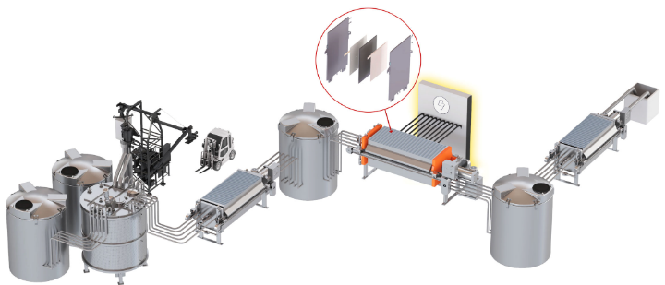

Nth Cycle tackles critical mineral waste variability, recovery efficiency, and supply chain gaps in one integrated system
Case study: Nth Cycle
Nth Cycle’s electroextraction process reduces emissions and enhances recovery logistics
Observations
Oyster refining system, replaced fossil fuels with electricity, followed by precipitation and filtration for highly efficient recovery of metals.
Tech compatible with diverse inputs, including renewable energy, EVs, scrap metal, black mass, and mined ore.
First commercial installation launched in Ohio in 2024; processes black mass and Ni scrap.
Received $7.2 million from the IRA Advanced Energy Project 48C Tax Credit allocation in 2024.
Company’s business model supports the development of domestic refining capacity and strengthens supply chain resilience.
About
Oyster refining system for metal extraction
Founded:
2017
Headquarters:
Massachusetts
40+
employees
Patents
3
15+ years of R&D, with ~$60 million raised in seed to Series B and non-dilutive funding
Recycling capacity of 3,100 mt per year
Technology
Supply Chain
Nth Cycle’s electroextraction produces 44% less emissions than current recycling methods
Avoids environmentally harmful smelting and waste generation of traditional recovery methods
Modular design allows multiple units to be installed in parallel to scale production or in series to extract multiple metals from the same feedstock
Extracts Li, Ni, Mn, and Co (Cu, Dy, Pr in development)
System improves upon logistics issues within the CRM supply chain: modular, collocated, and compatible with multiple industries, mines, recyclers, and metals
Integrates with consumers’ physical facilities and equipment; fully customizable
Rapid deployment: Six-month permitting time and 12-month installation time, reducing the long and costly approval times with traditional refineries
Sources: Technology (Nth Cycle); Operations Begin of First Domestic Commercial-Scale Scrap Refining System (Nth Cycle, 2024); Nth cycle receives $7.2 million 48c tax credit (Nth Cycle, 2024); Nth Cycle closes $44 million financing (Nth Cycle, 2023); Nth Cycle secured $2.3 million seed funding (Nth Cycle, 2021); Nth cycle secures $12.5 million in Series A (Nth Cycle, 2022).
Credit: Khande-Jae Fisher, Isabel Hoyos, Hyae Ryung Kim, and Gernot Wagner. Share with attribution: Wagner et al., "Mining for the Energy Transition" (10 April 2026).

Slide 39
Most countries have implemented extended producer responsibility (EPR) measures for recycling for batteries
Policies and incentives implemented in each region to date
EPR
Strategic plans
Financial incentives
Planned material recovery capacity from recycled Li batteries 2030 (kt/%)
U.S.
25 states have passed legislation for electronics recycling
Over $3B in grant funding has been allocated to support demonstration projects and facilities for battery recycling
Section 45x of the Inflation Reduction Act offers credits to manufacturers using recovered materials; set to phase out in 2034 under OBBBA
North America
Europe
CAN
EU
EU
Circular Economy Action Plan (2020): Introduces EPR for end-of-life management, mandates accessible product composition data, and sets guidelines to optimize waste streams and extend product lifespans
Critical Raw Minerals Act (2023): Sets minimum recycled content targets for batteries by 2035 (20% Co, 10% Li, 12% Ni), aims for 15% of demand to be met from recycled sources, and standardizes project classification
U.S.
UK
East Asia excl. China
557 kt
(21%)
China
JAP
497 kt
(19%)
SK
1196 kt
(46%)
264 kt
(10%)
Africa
South Asia
Nigeria
India
China
The Ministry of Industry and Information Technology raised lithium recovery targets to 90% (from 85%), and 98% for nickel, cobalt, & REEs
Under the Plan for the Implementation of the Extended Producer Responsibility System, battery producers must publish recovery data, adopt product coding, and implement full lifecycle tracking
New EV recycling guidelines standardize recycling plants for electric vehicles with digital tools to trace and collect data
South America
South Africa
Chile
Ghana
71 kt
(2.7%)
Colombia
Brazil
Australia

Slide 40
Electrification and renewable power can reduce mining and refining process emissions
Mining: Electrification is the key to decarbonizing the critical minerals supply chain
Refining: Though emission intensity varies by commodity and location, electricity is the main postmining emission source
Sources of emission
Decarbonization levers
Emission intensity, kg CO₂ /ton metal
Input materials
Electricity
Fossil fuel
2,512
1,879
1,891
2,305
Mt CO₂ emissions
983
747
713
713
230
241
CuO Heap Leach
Cu Underground
Cu Open Pit
Cu Underground
Cu Open Pit
Cu Underground
Cu Open Pit
CuO Heap Leach
Cu Underground
Cu Open Pit
1
2021 emissions
+ Activity
Lower
ore grade
Recycling
Efficiency gains
Electrification
2050 emissions
Mining
Beneficiation
Smelter
Refinery

Slide 41










Most accessible ways to decarbonize include electrifying gas appliances, using low-carbon energy, and electrifying trucks
 | Electrify gas appliances | Favor low-carbon electricity sources | Electrify trucks
Technology readiness
Capital requirement
Emission reduction potential, %
Note: | Emission reduction potential depends on emission intensity of the local grid’s electricity mix.
Leading companies
-100%
-100%
-100%
0
0
0
Sources: Climate risk and decarbonization: What every CEO mining needs to know (McKnsey, 2020).
Credit: Brenda Rain, Khande-Jae Fisher, Ariela Farchi, Isabel Hoyos, Hyae Ryung Kim, and Gernot Wagner. Share with attribution: Wagner et al., "Mining for the Energy Transition" (10 April 2026).

Slide 42






Technological advances with proven impact are improving efficiency and adding value across the critical mineral pipeline
Company | Description | Series¹ | Founded + total raised | Investors | Activity
 | Mineral exploration company using AI and an “efficacy of information” approach to reduce uncertainty and accelerate discovery of critical materials for EVs and renewables. HQ: Berkeley, CA | C | Founded 2018 Raised $941M | Bossa Invest, Climate First, Durable Capital Partners, Equinor, and Maple Capital (5/31 investors) | Backed by Bill Gates and Jeff Bezos Valued at $2.96B Operational internationally and scaling
 | Developer of an AI-powered platform that analyzes complex data to detect hidden mineral deposits in underexplored terrain, helping the industry uncover concealed resources. HQ: Boston, MA | B | Founded 2020 Raised $39.6M | Insight Partners (New York), Orion Innovation, T. Rowe Price Group, Bloomberg Capital, and Chrysalix Venture Capital | Capable of locating REE at 9.1% to as high as 20% purity
 | Vertically integrated mineral exploration company that uses AI to predict ore locations for metals like copper, nickel, cobalt, and rare earths, boosting discovery rates while cutting risk and costs. HQ: San Mateo, CA | B | Founded 2017 Raised $32.1M | Alpaca VC, Deep Acre, Intrepid Financial Partners, Overmatch (Austin), and Sparkwave Capital (5/35 investors) | Successful operations —discovered 117 ppm of indium, typically found at 1 ppm
 | Operates the Mountain Pass Mine, the only large-scale rare earth site in North America, and is developing a magnet manufacturing facility in Texas. Its operations span materials and magnetics. HQ: Las Vegas, NV | Public | Founded 2017 | Pentagon, JPMorgan Chase, Goldman Sachs | Building U.S. supply chain for rare earth elements Building second magnet manufacturing facility in the U.S.
 | A platform that boosts mine productivity and recovery through real-time, sensor-based sorting to detect low-grade ore and subtle mineral differences, enabling more efficient sorting and resource planning. HQ: Vancouver, British Columbia | C | Founded 2008 Raised $147M | Mining Innovation Commercialization Accelerator, Evok Innovations, JP Morgan Asset Management, North Sky Capital, and Aberdeen Group | JPMorgan made $42M investment in 2022 Named Deloitte Technology Fast 50 winner.
 | Explores and processes polymetallic nodules from the Clarion Clipperton Zone, rich in nickel, copper, cobalt, and manganese, which are critical metals for energy and manufacturing. It focuses exclusively on deep sea resource development and metallurgy. HQ: Vancouver, British Columbia | Public | Founded 2011 | First Manhattan Co., Old West Investment Management, Baird Financial Group, UBS Group, and Korea Zinc | U.S. backed subsidiary, waiting for approval to begin mining per U.S. Executive Order; Korea Zinc recently invested $85 million

Slide 43




CKI Team
Research Fellows
Leo Gordon
Master of Public Administration
CKI Fellow
lmg2257@columbia.edu
Khande-Jae Fisher
MS in Sustainability Science
CKI Fellow
kjf2153@columbia.edu
Brenda Rain
MS in Sustainability Management
CKI Fellow
brr2135@columbia.edu
Zacharia Thurston
MS in Sustainability Management
CKI Fellow
zt2326@columbia.edu

Slide 44

CKI Staff and Faculty
Hyae Ryung (Helen) Kim
PhD in Sustainable Development
Senior Research Fellow
hk2901@columbia.edu

Slide 45
Glossary
AD/CVD APAC APS ASEAN BaaS BIPV BoS BSF c-Si C&I CAGR CapEx CCS CO₂ CPV CRM | Antidumping and countervailing duties Asia Pacific Announced Pledges Scenario Association of Southeast Asian Nations Battery as a service Building integrated PV Balance of system Back surface field Crystalline silicon Commercial & industrial Compound annual growth rate Capital expenditures Carbon capture and storage Carbon dioxide Concentrator PV Critical mineral
CSP EMEA EPC EPR ESP EVA FiT FBR FPV HJT IRA IRR ITC LID LFP MOIC | Concentrated solar power Europe, Middle East, and Africa Engineering, procurement, and construction Extended Producer Responsibility Energy service provider Ethylene vinyl acetate Feed-in tariff Fluidized bed reactor Floating PV Silicon heterojunction cells Inflation Reduction Act Internal rate of return Investment tax credit Light-induced degradation Lithium iron phosphate battery Multiple on invested capital
Mono-Si NPV NZE OBBBA OEMs OpEx O&M PAYG PERC Poly-Si PPA PTC PV REC REE R&D | Monocrystalline silicon Net present value Net Zero Scenario One Big Beautiful Bill Act Original equipment manufacturers Operating expenses Operating and maintenance Pay as you go Passivated emitter and rear cell Polycrystalline silicon Power purchase agreement Production tax credit Photovoltaic Renewable energy credit Rare earth elements Research and development

Slide 46
Glossary
RPS SG&A SiO₂ SPV SPS TCO VIPV VOST XaaS | Renewable portfolio standard Selling, general, and admin. expenses Quartzite Special-purpose vehicle Stated Policies Scenario Transparent conductive oxide Vehicle integrated PV Value of solar tariffs X as a service

