Slide 1

1 July 2026
Rethinking Plastics
Gernot Wagner, Anika Behrndt, Paula Sanchez, Yosfat Partogi Simbolon, Una Oljaca, Mariana Castaño, Khande Jae Fisher, Smarth Galhotra, Hyae Ryung Kim, Isabel Hoyos, and Ariela Farchi
Cite as: Wagner et al., “Rethinking Plastics,” Columbia Business School Climate Knowledge Initiative (1 July 2026).
BOS CKI Steel Background v231101-GF

Slide 2
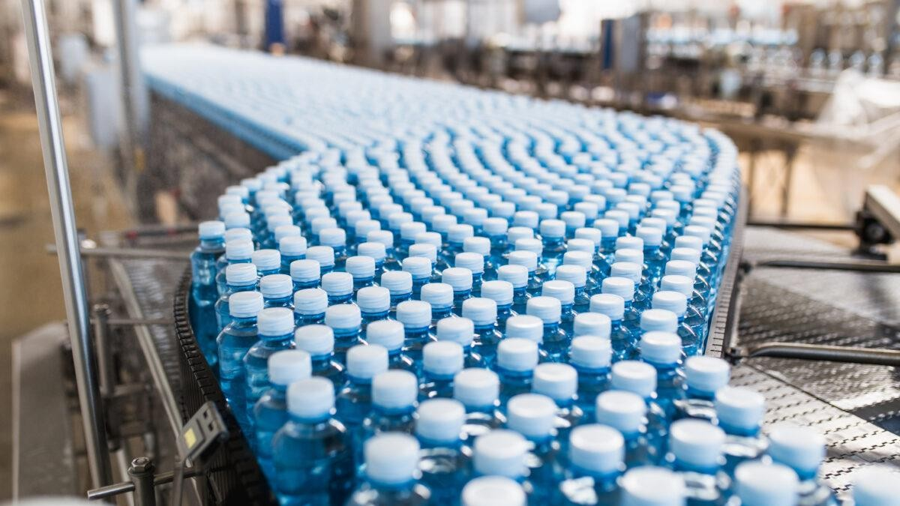
Industry Overview

Slide 3
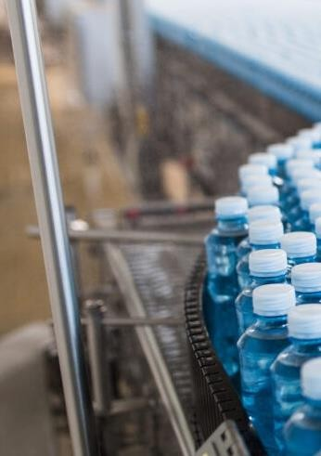

Landscape: Plastic production and demand are rising
3 of total
~450 million metric tons of plastics were produced in 2025, with China and the U.S. accounting for half of that
— 32% and 14%, respectively
Plastics demand could exceed ~100 billion metric tons by 2060 if current investment and policy trends continue
The current plastics system generates ~2 Gt of CO₂e, with limited progress in reuse and energy capture. Plastic production and related emissions are expected to double, or even triple, until 2060
Problem: Plastics generate negative climate impacts across the value chain
While this deck focuses on climate, plastics also have health, social, and economic impacts
Emissions are present across the full plastics value chain, from fossil-based feedstocks and energy-intensive production to high-volume industrial uses and end-of-life treatment
Weak incentives and regulation further reinforce the problem; policy does not incentivize consumption reduction, plastic alternatives, recycling, or waste management
Solutions: Tackling plastics’ impact requires coordinated action across five levers
An integrated, across-the-value-chain approach is needed to address plastics’ climate impact
Five key decarbonization levers are: (1) reducing demand; (2) enabling substitution; (3) scaling recycling; (4) electrifying production; and (6) applying carbon capture, utilization, and storage (CCUS)
Solutions vary in overall impact and feasibility, driven by investment needs, technology readiness, policy alignment, and key barriers to scale
Key Messages
Industry Overview
Key requirements to unlock change: Finance and policy
Current capital is concentrated in downstream segments, while upstream innovation and infrastructure remain
underfunded despite their mitigation potential
Fragmented or outdated regulation, such as lack of mandates for recycling and inconsistent public procurement standards, can delay or block viable alternatives from scaling

Slide 4
Plastics account for around 4% of global CO₂ emissions
4 of total
CO₂e emissions in 2025: ~55 billion tons
22%
23%
18%
15%
8%
13%
Non-ferrous metals
Oil
2%
Rail 1%
Aviation 10%
0.2%
Chemicals
16%
Agriculture fuel
5%
Land use & forestry
12%
Marine
5%
Commercial combustion 18%
Natural gas
31%
Cement
20%
Waste
22%
F-gases
36%
Iron & steel
27%
Livestock 23%
Residual
100%
Road 84%
Coal 67%
Residential combustion 46%
Other Industry
37%
Crops
38%
Industry
Power and heat
Agriculture, land use, and waste
Transport
Buildings
Residuals
Source: Network for Greening the Financial System, NGFS 2025 climate scenarios (2024).
Credit: Theo Moers, Isabel Hoyos, and Gernot Wagner. Share with attribution: Wagner et al., “Rethinking Plastics” (1 July 2026).

Slide 5
Decarbonizing plastics could help uphold development and quality of life, while reducing negative externalities from overconsumption
5 of total
Plastics have enabled human development and economic growth …
… while overconsumption has created multidimensional costs; this deck focuses on decarbonization
Focus of this deck
Food security
Packaging extends shelf life and reduces spoilage in transit. This enables affordable food distribution to
remote and low-income regions.
Climate & environmental degradation
Growing GHG emissions (2.5%-4% annually) contribute to a warming climate. Insufficient waste management leads to pollution and other environmental costs.
Critical healthcare
Sterile, single-use medical plastics lower infection
rates and make scalable care possible in low-
resource settings.
Social & health harms
Pollution burdens fall disproportionately on low-income, frontline communities. Microplastics have been detected in human blood, lungs, and placentas.
Economic development
Plastics have democratized everyday goods by driving down material costs. Low- and middle-income consumers can now afford products that were once
out of reach.
Economic burden
Externalized costs of cleanup, healthcare, and lost ecosystem services total billions of dollars annually. Emerging economies that import plastic waste bear a disproportionate share of the cost.
The opportunity: Reposition plastics from single-use applications to high-quality materials with an extended lifetime, supported by system-level post-use infrastructure
Sources: Strategies to reduce the global carbon footprint of plastics (Zheng & Suh, 2019).
Credit: Anika Behrndt, Ariela Farchi, Isabel Hoyos, Hyae Ryung Kim, and Gernot Wagner. Share with attribution: Wagner et al., “Rethinking Plastics” (1 July 2026).

Slide 6
Current system generates ~450 Mt of plastics and ~2 Gt CO₂e; projected to grow significantly if current trends continue
6 of total
Plastics demand expected to grow ~2 to 3x by 2060 under “business as usual” projections
Plastics emissions increased ~28% in the past five years; projected to grow 150% by 2050
Key Assumptions
Plastic demand projections assume no changes in production technologies or
regional demand structure. They reflect three forward-looking scenarios:
– OECD (2022): ~2.5% to 4%
annual growth driven by income and population growth in non-OECD economies
  Dokl et al. (2024): CAGR of
~2.2%; regression-based optimization on historical trends (extrapolated to 2060)
  Pottinger et al. (2024): CAGR
of ~1.1%; machine learning + Monte Carlo; explicitly more conservative than OECD
All three exclude microplastics
(tires, textiles), PFAS, behavior/system change, and informal-sector waste flows
Emissions based on OECD
projection, which assumes 2.5% annual demand growth and current recycling trends
Plastics production¹ (million metric tons/year)
Total annual emissions and future projections from
plastics⁵ (Gt CO₂e/year)
OECD
Dokl et al.
Pottinger et al.
GHG emissions
High-ambition Uncertainty range⁶ scenario⁵
1,400
6
+150%
1,200
5
1,000
4
800
+28%
600
3
400
2
200
1
0
0
2050
2020 2025 2030 2035 2040 2045 2050 2055 2060
2015 2020 2025 2030 2035 2040 2045
Sources: Global projections of plastic use and potential changes to 2050 (Dokl et al., 2024).
Credit: Anika Behrndt, Mariana Castaño, Isabel Hoyos, Hyae Ryung Kim, and Gernot Wagner. Share with attribution: Wagner et al., “Rethinking Plastics” (1 July 2026).

Slide 7
China and the United States are the leading plastic producers (~50%) and consumers (~40%)
7 of total
Observations
The scale of China’s dominance is larger than it appears. It has a production surplus of 12% of the global total
The consumption gap highlights global dependency. The ROW is the most dependent, with those countries consuming more than they produce by over 60%
Geopolitical concentration of the plastics value chain: A small number of Middle Eastern oil-rich nations control the feedstock but just two countries (the U.S. and China) operate half of the global manufacturing of primary plastics
Africa has 18% of the world’s population but represents just 4% of global production
Global plastic production and consumption by geography
Million metric tons (Mt), 2022
460
460
ROW
Japan Africa India
Middle East
EU28
8%
13%
Largest feedstock supplier for plastics manufacturing
3%
4%
4%
5%
4%
5%
6%
14%
7%
16%
15%
Other Asia
14%
12%
Net Exporter¹
U.S.
18%
China
32%
20%
Net Exporter¹
Production Consumption
¹Net Exporter occurs when a country’s production volume is larger than consumption volume; global consumption of plastic is considered equal to production based on global material flow
accounting.
Source: Complexities of the global plastics supply chain revealed in a trade-linked material flow analysis (Houssini et al., 2025).
Credit: Yosafat Partogi, Una Oljaca, Ariela Farchi, Hyae Ryung Kim, Gernot Wagner. Share with attribution: Wagner et al., “Rethinking Plastics” (1 July 2026).

Slide 8
Plastics demand is concentrated in a few countries, with the U.S. leading both current use and future growth at ~3% CAGR
8 of total
High-income countries, led by the U.S., have the highest per-capita plastics consumption
Plastics demand expected to rise >20% by 2050, with the U.S. driving the largest growth
Observations
There is a stark disparity in plastics consumption between developed and developing nations, with the U.S. positioned as the highest per capita, highlighting a critical area for environmental concern and policy intervention
Several factors likely to contribute to elevated plastic consumption in the U.S. are:
  The convenience and low cost of plastic materials, which have made them ubiquitous in daily life
  Strong single-use plastic packaging for food, beverages, and other goods
  Widespread use of plastics in industries such as construction, automotive, and textiles
Global plastic consumption, kg per capita, by country, 2022
Projected plastics market demand per region, Million metric tons per region, per year²
216
Europe China
U.S.
Rest of the world
+20%
129
705
730
745
750
625
675
14%
13%
13%
-1%
-1%
16%
15%
86
18%
30%
27%
24%
33%
31%
62
56
34%
26%
29%
+3%
19%
21%
23%
29
42¹
18%
16
13
30%
32%
33%
33%
34% 34%
+1%
U.S. Japan Europe ME China ROW India Africa 2025 2030 2035 2040 2045 2050
¹ World average. ² Values shown correspond to the business-as-usual (BAU) scenario that assumes continued consumption and waste management trends, driven by historical use patterns, sectoral
applications, and population growth, without transformative interventions or GDP growth after 2023.
Sources: Complexities of the global plastics supply chain revealed in a trade-linked material flow analysis (Houssini et al., 2025); Pathways to reduce global plastic waste by 2050, (Pottinger et al.,
Science, 2024).
Credit: Yosafat Partogi, Mariana Castaño, Anika Behrndt, Isabel Hoyos, Hyae Ryung Kim, and Gernot Wagner. Share with attribution: Wagner et al., “Rethinking Plastics” (1 July 2026).

Slide 9

Material demand will rise with economic development; efficiency efforts should target excessive use
9 of total
Plastic supports build-out of basic services in lower HDI regions
Human development rises quickly at low levels of material use
Challenge: Access is still incomplete in lower HDI countries (e.g., only 90% in India)
Role of plastics: Plastics enable affordable pipes, storage
systems, and sanitation infrastructure
Per-capita material consumption vs. Human Development Index (HDI)
Water & Sanitation
70
Per-capita material footprint (t)
60
United States
Material footprint: 28.7
HDI score: 0.94
50
Challenge: Infection control and sterile care capacity remain limited
Role of plastics: Single-use medical plastics enable sterile delivery of diagnostics, medicines, and care
40
India
Material footprint: 4.9
Healthcare
30
HDI score: 0.68
20
Challenge: Poor housing quality and thermal efficiency affect health and energy outcomes
Role of plastics: Insulation and affordable construction materials improve building performance
10
Housing
0
0.3
0.4 0.5 0.6 0.7
Human Development Index Score (2023)
0.8
0.9
1.0
Early increases in material use strongly improve human development, but gains
diminish at higher consumption levels
Implication: Demand-reduction strategies should prioritize high-consumption economies, while allowing targeted growth in essential plastic use in lower HDI countries to support development
Food Security
Challenge: 20% to 25% of food is lost before consumption due to poor storage and transport
Role of plastics: Packaging reduces spoilage and contamination where cold chains are weak
Sources: Global Material Flows Database (International Resource Panel, 2025); Human Development Index (HDI) by Country 2026 (World Population Review, 2026); Valuing Plastics (UNEP, 2014);
Turning Off the Tap (UNEP, 2023).
Credit: Anika Behrndt, Ariela Farchi, and Gernot Wagner. Share with attribution: Wagner et al., “Rethinking Plastics” (1 July 2026).

Slide 10


Investment in plastics is projected to grow, led by petrochemical companies with strategic interests to prolong demand
10 of total
Seven firms account for ~30% of global plastic production
Oil and gas companies continue to invest in new single-use plastics assets (2023)
Company | Project Name | Location | Cost | Polypropylene | Ethylene | Polyethylene
ExxonMobil | Corpus Christi | U.S. | $10B |  | x | x
ExxonMobil | Baton Rouge | U.S. | $0.5B | x
ExxonMobil | China Petroleum Complex | China | $10B | x
Total Energies | Port Arthur | U.S. | ~$2B |  | x | x
Chevron Phillips Chemical | Ras Laffan Petroleum Complex | Saudi Arabia | $6B |  | x | x
Chevron Phillips Chemical | Golden Triangle Petrochemical Company | U.S. | $8.5B |  | x | x
Shell | Pennsylvania Petrochemical | U.S. | $6B |  | x | x
LyondellBasell | Hub Thailand Parnets HMC Polymers | Thailand | N/A | x | Single-u applicati | se ons
LyondellBasell | Ulsan PP/ Poly Mirae | South Korea | $0.42M | x
Top 7
producers
Sinopec | 5%
ExxonMobil | 5%
LyondellBasell | 5%
Saudi Aramco | 4%
PetroChina | 4%
Dow | 4%
INEOS | 3%
Reliance Industries | 2% ^{2%} Major 2% petrochemical _{2%} players are also oil and gas 2% companies. 2% 2% 2% 1% 1%
Indorama Ventures
Borealis
TotalEnergies
Formosa Plastics
Lotte Chemical
SIBUR
Energy Investment Group
Alpek SAB de CV
PTT
China
~50% of production from top 17 plastic producers globally, 2023
Sources: Plastic Waste Makers Index (Minderoo Foundation, 2023); Majority of the world’s plastics (Zero Carbon Analytics, 2025); Once Seen as Industry Savior, Petrochemicals Losing Financial
Appeal (IEEFA, 2024).
Credit: Yosafat Partogi, Hyae Ryung Kim, and Gernot Wagner. Share with attribution: Wagner et al., “Rethinking Plastics” (1 July 2026).

Slide 11
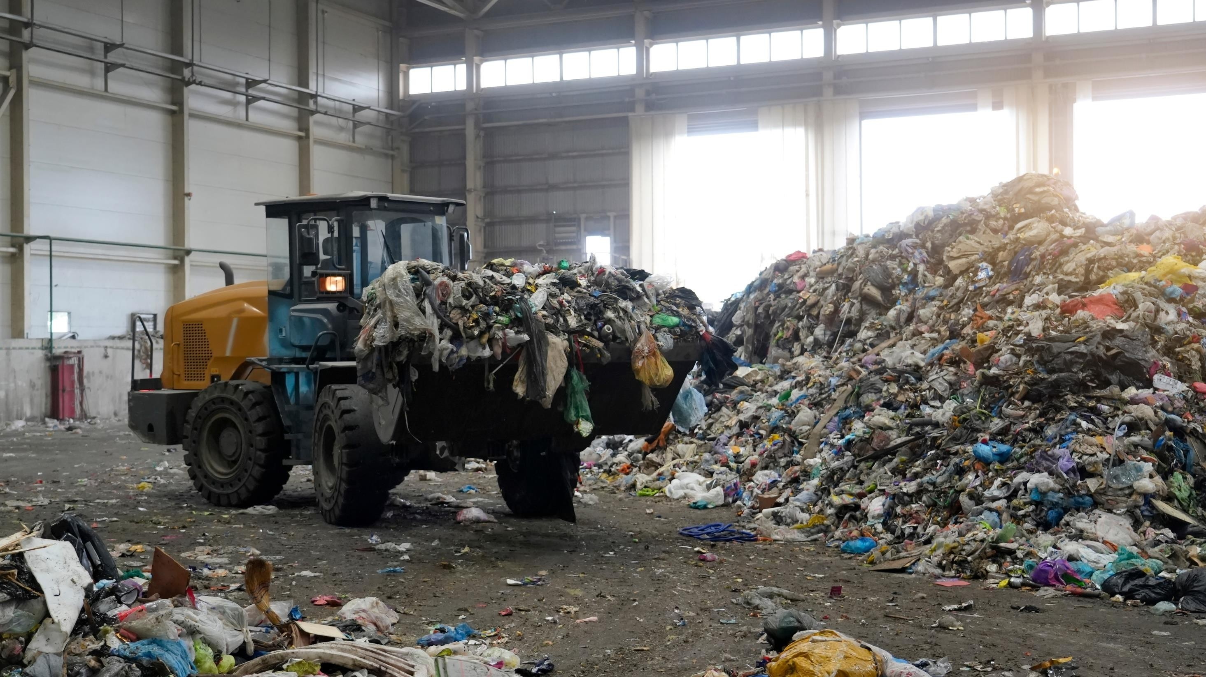
The Plastics Problem

Slide 12
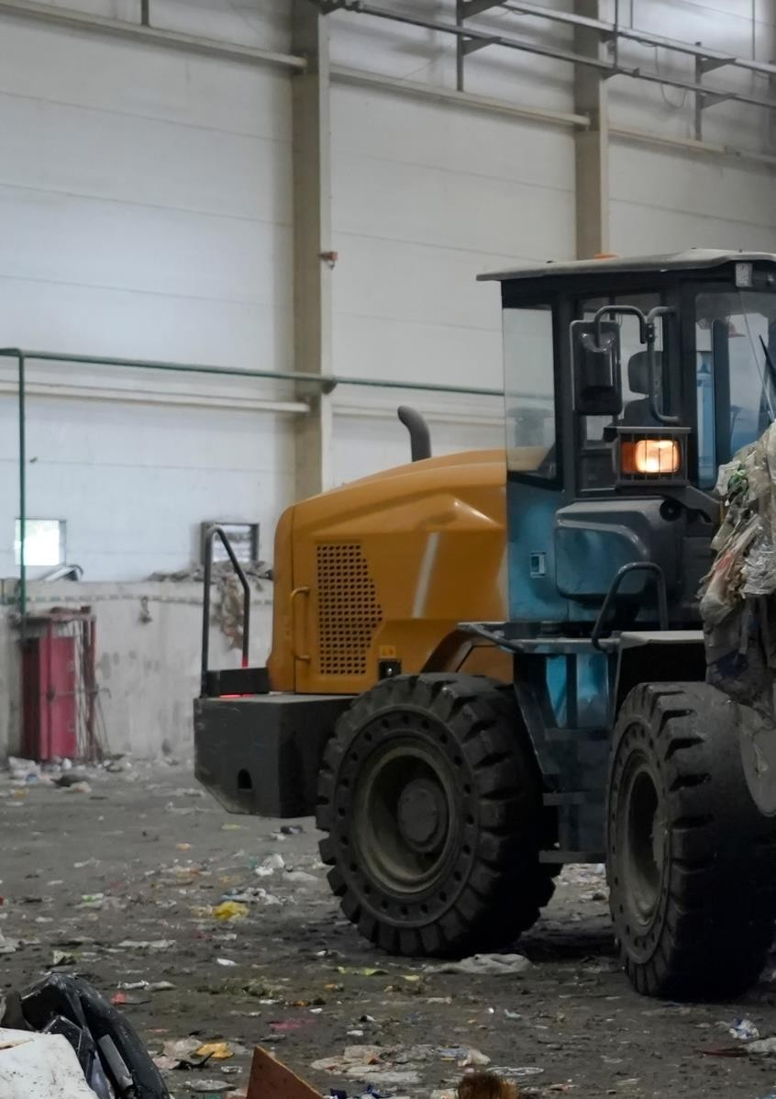
12 of total
Emissions intensity is linked to dual fossil dependency for feedstock and process fuel
Plastics are overwhelmingly fossil-based, with approximately 99% of plastics derived from fossil fuels.
~20% of plastic emissions are tied to upstream feedstock extraction/mining
~70% of emissions are tied to the energy-intense production process, which requires high temperatures. Polymer cracking is the most energy-intense stage, with >30% of emissions coming from this production stage
Plastics are difficult to substitute, driving persistently high consumption
Plastics’ versatility means they can be used for multiple applications across nearly all industries
Plastics remain substantially cheaper than most substitutes and can outperform many alternatives with more favorable strength-to-weight ratios, durability, insulating capacity, and resistance to breakage
Low cost and low weight enable widespread single-use applications, encouraging “disposable” consumption patterns that lead to excessive use
End-of-life systems fail to address plastics management
Structural weaknesses in collection, sorting, and recycling economics result in avoidable GHG emissions, loss of material value, and widespread terrestrial and marine pollution
Globally, ~23% of plastics are landfilled, ~19% are incinerated, ~49% are mismanaged, and >10% are recycled
Key Messages
The Problem
Uncontrolled pollution deteriorates environmental health
~50% of global plastics are mismanaged at end of life, leading to significant pollution across different ecosystems
Microplastics impair plants’ photosynthesis and the ocean’s carbon-sequestration capacity

Slide 13







~70% of plastic lifecycle emissions come from the production process, ~20% from fossil feedstocks, ~10% from end of life
13 of total
Key Decarbonization Challenges
Stage 1 (upstream): Around 18% of emissions come from the extraction of fossil fuels, used as feedstock and fuel energy sources of plastic production. Extraction of fossil fuels causes direct emissions, like CH₄ leakage and flaring, along with emissions from fuel combustion
Stage 2 (production): Around 71% of CO₂ emissions are generated in the production phase, where fossil fuels are burnt to achieve the high temperatures needed for the production of monomers and subsequent final plastics materials
Stage 3 (downstream): The remaining emissions come from end-of-life management,
primarily from incinerating plastic
waste using fossil fuels, the most
common disposal method
Breakdown of emissions by lifecycle stage in traditional fossil fuel-based plastics
Upstream Production Downstream
0.4 GtC0 1.6 GtC0
0.3 GtC0
2 2 2
11%
2.3 Gt
15%
7%
23%
12%
14%
18%
71%
Hydrocarbon Other
refining and chemical Monomer
processing production production Polymerization
Product shaping
End-of-life management
Extracting
Source: Strategies to reduce the global carbon footprint of plastics (Zheng and Suh, 2019).
Credit: Anika Behrndt, Isabel Hoyos, Hyae Ryung Kim, Gernot Wagner. Share with attribution: Wagner et al., “Rethinking Plastics” (1 July 2026).

Slide 14





PE, PP, PET, PVC, and PS are the dominant types of plastic polymers produced and have common uses across industries
14 of total
+50% of global plastics production comes from PE, PP, and PET
polymer type, 2019)
(% of global primary plastic production by Type of plastic | Common uses | Classification Identification
PE (all types of polyethylene) | Food packaging films, shopping bags, insulation layers, and shampoo bottles | Single use ₂ ₄
21% PP (polypropylene) | Rigid containers, automotive parts, and construction materials | Durable ₅
14% PET (polyester¹) 16% | Beverages bottles and textile fibers | Durable ₁
^{10%} PVC (polyvinyl chloride) 4% | Pipes, window frames, and medical tubing | Durable ₃
PS (polystyrene) 35% | Food disposable packaging and insulation | Durable/ 6 Single use
Other polymers² 2019 | Foams, engineering plastics, and specialty coatings | Single use ₇
¹Include fibers. ² Include marine and road marking coatings, elastomers tires, AB, ASA, SAN, PUR, and bioplastics, among other polymers.
Sources: Plastic Use by Polymer (OECD, 2019); How Plastic Is Made, (British Plastic Federation, 2025).
Credit: Mariana Castaño, Anika Behrndt, Ariela Farchi, Hyae Ryung Kim, Gernot Wagner. Share with attribution: Wagner et al., “Rethinking Plastics” (1 July 2026).

Slide 15

Packaging has the largest share of plastic waste and consumption; textiles and construction have the highest associated emissions
15 of total
Global plastics consumption by industrial sector (Mt/year)
Main types of plastics consumed*
Avg. emissions
(kg CO₂e/kg material)
Annual emissions
(MtCo2e)
Estimated annual waste generated (Mt)
Lifetime (in years)
474
4% | Electronics
10% | Other
10% | Textile
11% | Consumer products
14% | Transportation
High
Share of materials Low
PET
ACR
NYL
21
666
43
~5
PE
PP
PET
2
224
47
~3
PP
PUR
PA
3
103
48
~13
19%
Construction
PVS
PP
EPS
7
995
38
~35
32%
Packaging
LDPE
PP
PET
2
364
156
~ 0.5
Sources: Projections of Plastic Use (OECD, 2019); Microfibres from apparel and home textiles (Beverley et al., 2019); Carbon Footprint of Textile and Clothing Products (Rana et al., 2015) Deployment of mechanical and chemical recycling in European automotive plastics (Arca et al., 2025); Life-Cycle Assessment of Polypropylene Production (Alsabri et al., 2021); Building and Construction Plastics Market Size; All Plastics Aren’t Created Equal (Market.us, 2024); Assessment of carbon emission potential of polyvinyl chloride plastics (Liang et al., 2023); Production, use, and fate of plastics (Geyer et al., 2017); Factors Influencing the Recycling of Plastic and Composite Packaging Waste (Torkelis et al., 2024); Clean Energy 101: All Plastics Aren't Created Equal (Rocky Mountains Institute 2023).
Credit: Anika Behrndt, Isabel Hoyos, Hyae Ryung Kim, Gernot Wagner. Share with attribution: Wagner et al., “Rethinking Plastics” (1 July 2026).

Slide 16
Plastics remain difficult to replace because of significant material and cost advantages compared with alternative materials
16 of total
Plastics have a higher insulating capacity and are significantly more resistant and lighter than alternative materials
Plastics are 2 to 3x cheaper than other materials with similar use cases
Relative behavior of selected chemical capabilities of other materials compared with plastics
Average cost of materials in the U.S. ($/Kg)
Insulating Capacity
Impact Resistance²
Corrosion Resistance
Weight³
~2.80
Glass & Fiberglass
Poor conductivity of plastics make it a good thermal and electrical insulator, increasing design flexibility
Durable properties of plastics help them absorb and distribute energy from sudden impacts or shocks
Plastics resist damage when exposed to acids, lubricants, paint strippers, and other substances
Plastics’ flexible qualities allow for the production of ultra-lightweight materials
~1.60
Aluminium & Steel
Metals, paper, and glass do not have the same insulating capabilities as plastics
Metals and glass, which can crack or fail over time, are less resistant to fatigue compared with plastics
Chemical substances may cause rust or corrosion in other materials, such as metals and paper
Material density of metals and glass result in heavier materials
Paper
~1.30
~1.10
Plastic¹
¹Using PE as a proxy for overall plastics prices, representative given high market share. ²Impact resistance (robustness): The ability to withstand sudden force or shock without breaking, cracking, or
deforming. ³Comparing the weight of a 0.5L container using different materials.
Sources: Climate impact of plastics (McKinsey, 2022); The Advantages of Plastics Compared to Other Materials (Atlas Fibre, 2023); Aluminum (Trading Economics, 2025); Steel (Trading Economics,
2025); Spot Offers (The Plastics Exchange, 2025).
Credit: Anika Behrndt, Una Oljaca, Isabel Hoyos, Hyae Ryung Kim, and Gernot Wagner. Share with attribution: Wagner et al., “Rethinking Plastics” (1 July 2026).

Slide 17
Global plastic waste remains largely unrecovered; treatment varies by region, but recycling stays low everywhere
17 of total
Observations
U.S.: Landfilling dominates, locking in long-term environmental liabilities (methane, land use, and leakage) despite relatively strong collection systems
Europe: High reliance on incineration reflects constrained landfill capacity, creating significant CO₂ emissions and limited circularity
Asia and MENA: Mismanagement remains the dominant pathway, driven by insufficient collection and waste infrastructure, presenting the largest source of environmental leakage
Breakdown of end-of-life treatments for plastic waste, by method and region (Mt, 2019)
 | Landfill | Incineration | Recycling | Mismanagement
Description | Burial of plastics, alongside other mixed waste, in designated facilities | Combustion of plastic waste | Collecting, sorting, and processing for reuse as new feedstock | Waste uncollected or improperly disposed of (open dumping, burning, leakage into environment)
Pros | Limits waste to a delimitated area Well-engineered facilities can have low emissions and capture methane | Less land intensive then landfilling Limits pollution and leakage | Reduces pollution and emissions compared with other waste practices | Low cost in absence of formal systems
Cons | Poorly mantained facilities may cause leakage of hazardous materials into the environment | High direct CO₂ emissions, limiting its role in long-term decarbonization | Requires social-behavioral changes, which can be hard to adopt | Major source of pollution (oceans, soils) Direct human health impacts
49%
23%
9%
19%
Global
U.S. 3
53
14 73
3
China
17
23
15
8
63
EU 3 23
20
6
53
India
8
¹ 18
7
2
MENA
7
⁰ 17
9
1
Sources: Annual plastic waste by disposal method: World, 2000 to 2019 (OECD – Our World in Data, 2023).
Credit: Anika Behrndt, Isabel Hoyos, Hyae Ryung Kim, and Gernot Wagner. Share with attribution: Wagner et al., “Rethinking Plastics” (1 July 2026).

Slide 18



Plastics pollution exacerbates negative ecological impacts and further accelerates global climate change
18 of total
Difference in size of plastic pollution creates diverse environmental and climate impacts, many of which remain poorly understood
Long half-lives extend the warming potential of plastic
Estimated fragmentation half-lives of common plastic items (years)
Macroplastics
Microplastics & Nanoplastics
Food storage container | 5
Plastic bottles |  | 250
Single-use water bottle |  |  | 2,500
Plastic bags |  |  | 2,500
Insulating packaging |  |  | 2,500
Pipes |  |  |  | 5,000
Kills ~100,000 marine mammals annually due to ingestion or entanglement, affecting >65% of marine mammal species
Reduce photosynthesis by 7%-12% in algae and
terrestrial plants, stunting primary production
Plastics in dumpsites block drainage systems, release GHGs, and leak toxic chemicals into soil and water
Can decrease surface albedo by 28%-77%, accelerating glacial melting and releasing microplastics previously stored in ice
Macroplastics degrade via sunlight, heat, and wave
action — but breakdown ≠ elimination.
Smaller fragments = faster per-gram methane and ethylene release
Long half-lives commit the atmosphere to centuries of continuing emissions — a long-tail climate cost lifecycle analyses miss
Micro/nanoplastic effects on carbon cycling (photosynthesis, ocean carbon pump, albedo) are still nascent research
Floating macroplastics reduce PAR¹ by up to 80%, impairing CO₂ production, carbon uptake, and primary productivity
Emit up to 5.8 nmol of methane and 14.5 nmol of ethylene daily per gram of plastic during degradation
¹Photosynthetically active radiation is the range of sunlight (400-700 nm) used by plants and algae for photosynthesis.
Sources: Plastic in Our Oceans (WWF, 2023); Multiecosystem photosynthesis losses under microplastic pollution (Zhu et al., 2025); Direct radiative effects of airborne microplastics (Revell et al., 2021); The fundamental links between climate change and marine plastic pollution (Ford et al., 2022); Microplastics in sandy soils (Aminzadeh et al., 2025); The links between marine plastic litter and the air-sea flux of greenhouse gases (Goddijn-Murphy et al., 2023); Degradation Rates of Plastics in the Environment (Chamas et al., 2020).
Credit: Una Oljaca, Isabel Hoyos, Hyae Ryung Kim, Gernot Wagner. Share with attribution: Wagner et al., “Rethinking Plastics” (1 July 2026).

Slide 19
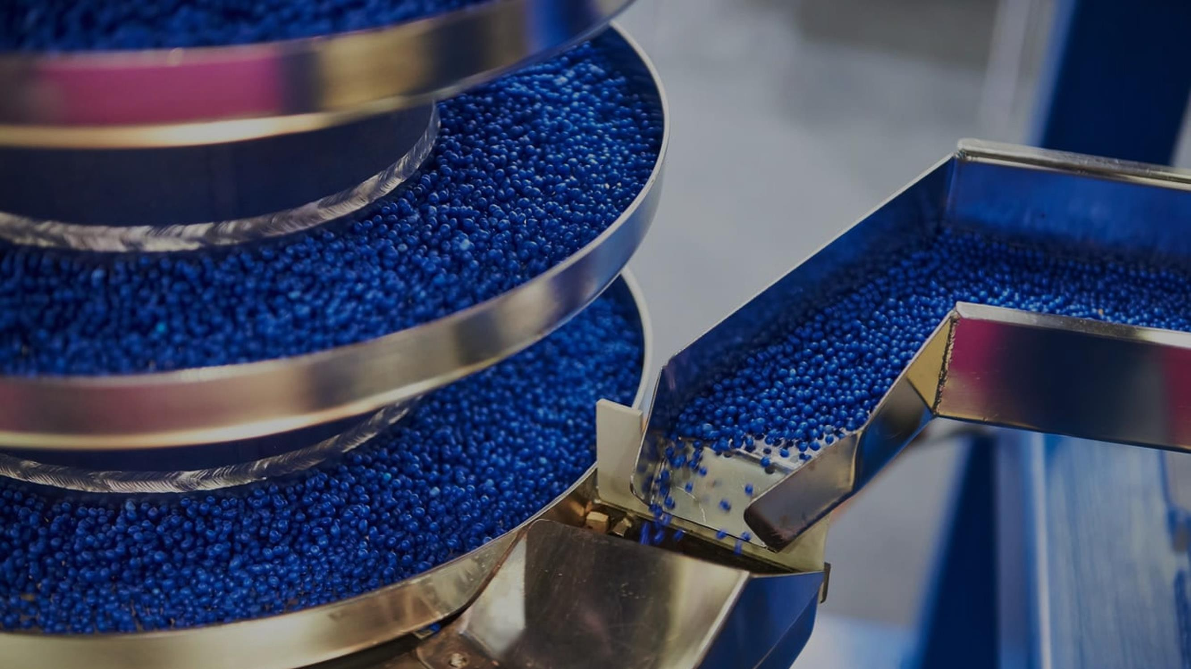

Plastics Decarbonization Solutions

Slide 20
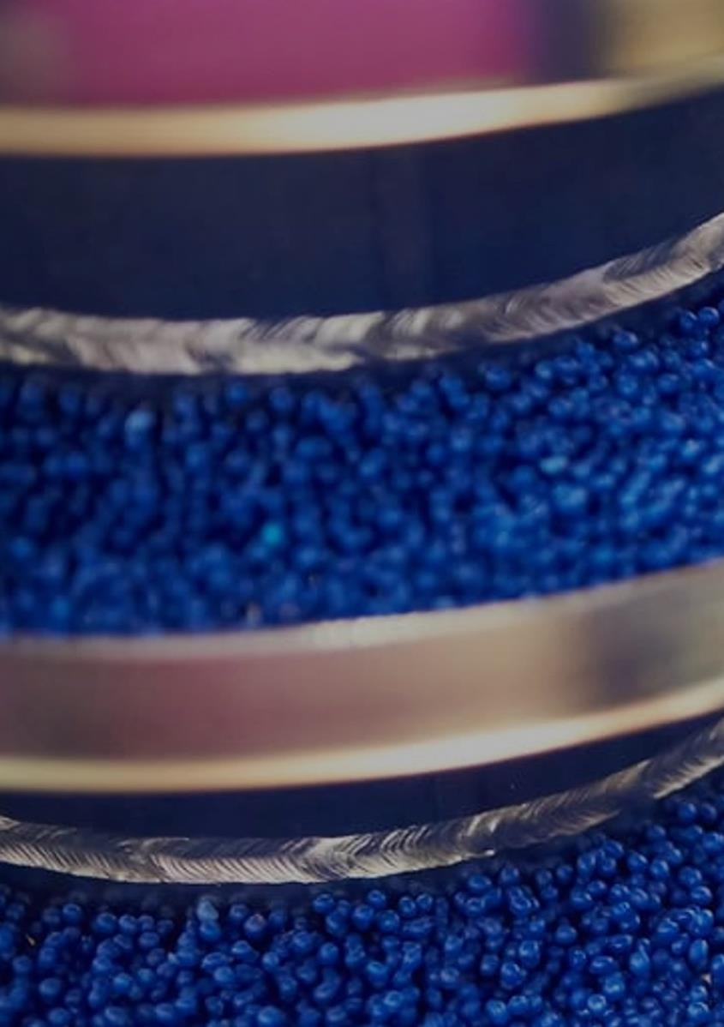
20 of total
Reduction
Demand reduction measures can curb demand for fossil-based short-lived plastics
  Overall plastic waste can be reduced by ~30%; elimination and reuse models can reduce demand by 10% and 20%, respectively
The most significant opportunities to reduce demand lie in the packaging and consumer goods plastics sector
Scaling reuse needs industry alignment and policy support to overcome logistical and behavioral barriers
Substitution
Bioplastics could abate 20% to 70% of CO₂ emissions, depending on the production feedstock
Bioplastics make up <1% of production capacity due to cost and performance constraints. Within bioplastics, packaging is the largest segment at ~45%
Recycling
Only ~10% of plastic waste is currently being recycled, and ~60% is deemed “unrecyclable”
20% to 35% of total plastics emissions can be abated if 40% to 50% of plastics are recycled
Scaling chemical and mechanical recycling requires redesigning products for recyclability, improving collection and sorting systems, scaling existing infrastructure, and developing physical infrastructure
Key Messages
Solutions
Electrification
Steam cracking is the most carbon-intensive part of the value chain; electrified steam cracking (E-SC) offers a potential solution
E-SC monomer production is bottlenecked by heat intensity, power infrastructure, cost parity, and TRL
Carbon capture, utilization, and storage (CCUS)
CC can be applied during steam cracking or end-of-life incineration to reduce up to 25% and 9% of chain emissions, respectively; captured carbon can replace fossil fuels upstream in the plastics chain
Use remains limited, but targeted policies and a coordinated CO₂ value chain can improve viability

Slide 21
Solutions
21 of total
Plastics decarbonization will need five levers to decouple from fossil fuels and reduce production emissions
Multi-tiered breakdown of solutions for plastics decarbonization
Goal | Reduce r | eliance on virgin fossil fuel | feedstock Dec | arbonize production proce | sses
Intervention | Reduce | Substitute | Recycle | Electrify | Carbon capture
Description | Eliminate redundant plastics and switch to reuse models where possible | Replace virgin fossil-based plastics with bio-plastics and other lower carbon alternatives | Scale mechanical and chemical recycling to extend material lifetime and reduce emissions-heavy incineration | Switch energy inputs for industrial processes from fossil fuels to renewable energy | Capture process emissions and repurpose CO₂ to offset hard-to-abate residual emissions in production
Impact (Mt of CO₂)¹ | 6,000-9,000 | 900-3,800 | 2,800-4,100 | 250-3,300 | 210-380
Cost (US$B)² | ~150 | Medium | ~160 | ~700 | Medium
Implementation complexity | Medium | Medium to high | Medium to low | Medium | High
Challenges | Strong policy alignment required | Technology readiness level still low; more R&D required | Requires high up-front investment | High up-front investment for infrastructure investment | Technology highly ambiguous, expected to be ready in next 10 years
¹All values are indicative, rounded, non-exhaustive, and based on current trajectory. See Appendix 1 for detailed notes of sources and assumptions. ² Low: $0 to US$50 billion; Medium: US$51billion to US$300 billion; High: US$301 billion+. Refer to section “Key requirements to unlock change” for more cost details and assumptions.
Sources: Plastic Waste by region and end of life fate (OECD, 2023); Plastic Recycling: Techno Economic Analysis (Salahuddin et al., 2023);
Credit: Anika Behrndt, Isabel Hoyos, Hyae Ryung Kim, Gernot Wagner. Share with attribution: Wagner et al., “Rethinking Plastics” (1 July 2026).

Slide 22
Solutions Reduce
22 of total
Eliminating unnecessary plastics and scaling reuse models can reduce demand for short-lived plastics by up to ~30%
Elimination and reuse can reduce the need for short-lived plastics¹ by ~10% and ~20%, respectively, ~125 Mt in total
Elimination
Reuse
Million metric tons of plastic produced per year; BAU scenarios
Removal of redundant, problematic², or virgin plastics from products and supply chain
Redesign of packaging to use less plastic or avoid it entirely
Controls (e.g., taxes, phaseouts, complete bans) on the highest polluting plastics
Taxes or caps on virgin plastics production to make secondary markets more competitive
Tax breaks for secondary plastics
Removal of fossil fuel subsidies
Scaling of reusable/refillable packaging
Ecodesign to improve product durability
and lifespan
Market shift toward service-based reuse/refill systems (e.g., dispensing stations plastic washing pool systems)
Eliminate
Market Levers
450
Remaining short-lived plastic
400
350
300
Policy Levers
Develop product standards at the international level for longer lifespan and improved durability
Invest in coordinated reuse systems, reverse logistics, and delivery model infrastructure
Advance research on environmental impacts to inform better product design
Educate citizens on environmental benefits of reuse models through awareness campaigns
250
200
150
100
50
0
2025 2030 2035 2040
¹Short-lived plastics are packaging and consumer products; average use cycle is 0.5 to three years, with the highest likelihood of ending up as plastic pollution. ² Plastics that contain hazardous chemicals,
hinder circularity, disrupt the environment, or are non-reusable or recyclable.
Sources: Turning off the tap (UNEP, 2023); Policy Scenarios for Eliminating Plastic Pollution by 2040 (OECD, 2024); Plastics and the circular economy – deep dive (EMF, 2019); Reshaping Plastics
(Systemiq, 2022); How Can We Incentivize Plastics Reduction (Sustainability Directory, 2025).
Credit: Khande-Jae Fisher, Ariela Farchi, Isabel Hoyos, Hyae Ryung Kim, and Gernot Wagner. Share with attribution: Wagner et al., “Rethinking Plastics” (1 July 2026).

Slide 23

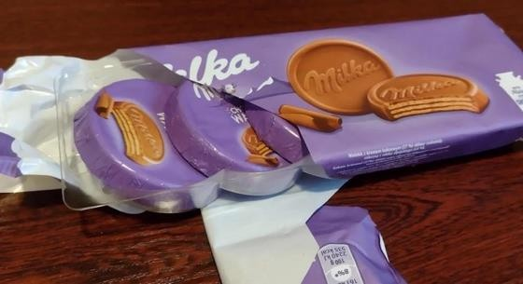

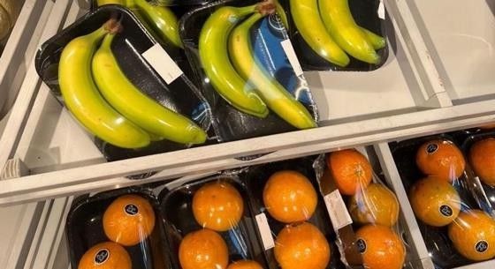
Solutions Reduce
23 of total
Plastics often show lower per-item emissions, but excessive use adds significant avoidable emissions
Plastics have lower weight, material input, and emissions when compared with alternatives across use cases
UK example: Redundant plastics packaging is especially prevalent in food and consumer goods items
GHG increase from substituting plastics with alternative materials
Paper Aluminum/Steel Glass/Fiberglass
GHG decrease GHG increase by alternatives
Excess plastics packaging, at 16% of total annually consumed plastic
Annual UK plastics
consumption
Grocery bag Fresh meat packaging Soft drink container Wet pet food packaging
Industrial drum Hybrid fuel tank
BEV battery top enclosure
Soap container
Insulation
80%
68%
35%
50%
70%
Other
-30%
90%
10%
16%
Redundant
Packaging
15%
Total
packaging
80%
16%
-40% -20%
0% 20% 40% 60% 80% 100%
Sources: Climate impact of plastics (McKinsey, 2022); The Advantages of Plastics Compared to Other Materials (Atlas Fibre, 2023); UK Supermarkets Drowning in Unnecessary Plastics Packaging
(Sustainability Magazine, 2024).
Credit: Anika Behrndt, Isabel Hoyos, Hyae Ryung Kim, Gernot Wagner. Share with attribution: Wagner et al., “Rethinking Plastics” (1 July 2026).

Slide 24

Solutions Reduce
24 of total
Packaging and consumer products with the highest potential for plastic reduction
Plastic elimination is most relevant for packaging and household products, while reuse applies across industries
Elimination and reuse measures can reduce plastic waste by ~30%, with the highest reduction in packaging²
Mt plastic waste in 2050³
~500
Packaging Household Construction Automotive
Eliminated plastics
Applicable¹ | Elimination | Reuse
Packaging | ✓ | ✓
Household | ✓ | ✓
Construction | ✓
Automotive | ✓
Responsible stakeholder | Retailers, consumer goods brands | Consumer goods brands, OEMS, construction companies
220
84
136
76
10
66
Short lifecycles and high turnover of packaging and consumer products results in plastic elimination having the highest impact in these categories
131
4
127
96
18
78
Baseline waste
Reduction impact on waste
¹ Can be more easily implemented/adapted and lead to a higher impact. ² Absolute values for global plastic waste reductions are approximated by applying EU sectoral reduction rates from Systemiq’s Circularity Scenario to global plastic-use baselines. ³ Based on the four largest contributing sectors, which together account for ~80% of total plastic waste generated. Sources: Reshaping Plastics (Systemiq, 2022); Pathways to reduce global plastic waste mismanagement and greenhouse gas emissions by 2050 (Pottinger et al., 2024).
Credit: Khande-Jae Fisher, Ariela Farchi, Isabel Hoyos, Hyae Ryung Kim, and Gernot Wagner. Share with attribution: Wagner et al., “Rethinking Plastics” (1 July 2026).

Slide 25

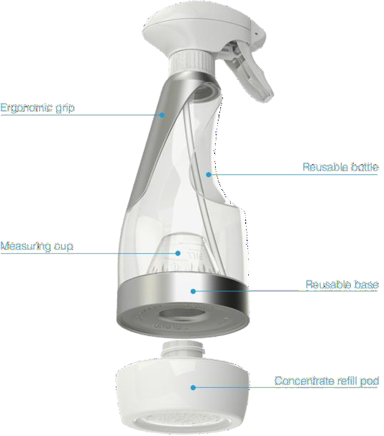
Solutions Reduce Case Study: Replenish
25 of total
By using a concentrate-based model, Replenish reduces plastic packaging volume by up to 90% and lowers transport costs
Overview | U.S.-based company founded in 2010 Provides customizable packaging platform for liquid concentrates
Product | The company offers a reusable, durable spray bottle that attaches to pods with concentrates; ingredients are 99% plant-derived One pod provides enough product for six bottles
Business model | Replenish retails ~50% below competitors’ premixed cleaners; one truckload of pods = 17 truckloads of conventional bottles, cutting freight and warehousing costs proportionally
Results | The concentrate model also reduces resin input costs by ~90% per unit of cleaner delivered The reduced volume of packaging shipped results in lower transport costs and emissions Water transport distances are reduced due to concentrate product Integration into online shopping platforms maximizes consumer convenience and incentivizes adoption
Refill-on-the-go models similarly reduce transport costs and emissions by lowering the volume of packaging shipped; however, widespread and accessible refill stations are essential to drive consumer adoption
¹As of 2020.
Sources: Rethinking Packaging (EMF, 2019); A smart reuse system for household products: Replenish (EMF, 2021); Replenish homepage.
Credit: Khande-Jae Fisher, Ariela Farchi, Isabel Hoyos, Hyae Ryung Kim, and Gernot Wagner. Share with attribution: Wagner et al., “Rethinking Plastics” (1 July 2026).

Slide 26
Solutions Reduce Circular Redesign
26 of total
~33% of packaging is hard to recycle and poorly suited to current reuse formats, creating the need to redesign for circularity
Four main packaging plastic segments most easily targeted for redesign
Plastic segment Examples Share of packaging Key barriers Redesign examples
Small format packaging (40-70 mm) | Straw packages, sweet wrappers, lids, tear-offs, sachets, films | 1 | 0% |  | Easily escapes collection due to small size _{~20 Mt} • No viable economic reuse or recycling pathway | Edible or water-soluble films (Notpla seaweed sachets for condiments; dissolvable detergent pods) Refill/bulk dispensers for sauces, cosmetics, and personal care
Multi-material packaging | Plastics in inseparable layers with other materials - e.g., pouches, snack packaging |  | 13% |  | Cannot be economically recycled ~26 Mt • Recycling causes significant loss of material value | Mono-material recyclable pouches (all-PE or all-PP stand-up pouches — e.g., Amcor AmPrima, Mondi Retort Pouch Recyclable)
Uncommon materials | PVC, EPS, and ES¹ |  | 10 | % | Small volumes in market prevent economies of scale ~20 Mt | Replace EPS (Styrofoam) with molded pulp, mushroom mycelium (Ecovative), or corrugated inserts
Nutrient-contaminated | Coffee capsules, organic waste bags, to-go food _{Not} packaging |  | qua | n | High contamination with organic materials makes ^{tified} cleaning and high-quality recycling difficult | Industrially compostable coffee capsules (Halo, Notpla, Nespresso) Reusable to-go container schemes (DeliverZero, Vytal)
¹ Count accurate as of 2020. ² CAGR calculated using FY2024 revenue of £690 million and 2007 revenue of US$292 million, with the 2007 figure converted from U.S. dollars to pounds using average
2007 USD/GBP exchange rate of ~2.00 over a 17-year period.
Sources: Naked Products (Lush, 2025); Environmental policy (Lush, 2025); Create a cosmetic revolution (Lush, 2025); Lush pays customers to recycle plastics cosmetics packaging (Wink, 2024);
Clean Scrub (Forbes, 2007); Lush Fresh Handmade Cosmetics Financial Report FY24 (Lush, 2024).
Credit: Khande-Jae Fisher, Ariela Farchi, Isabel Hoyos, Hyae Ryung Kim, and Gernot Wagner. Share with attribution: Wagner et al., “Rethinking Plastics” (1 July 2026).

Slide 27
Solutions Reduce Reuse & Return
27 of total
Coca-Cola’s Latin America rollout shows the three enablers reuse needs: shared infrastructure, standard design, and digital tracking
Despite declines since 2021, Latin America retains the highest reusable share per bottler and largest share of global reusables
Favorable reuse infrastructure, enhanced bottle tracking, and standardized design support Coca-Cola rollout in Latin America
Share of reusable packaging in Coca-Cola bottler company 2021 to 2023, %
Reuse infrastructure maintained since 1990s because refillable bottles remained cost-competitive with virgin packaging, particularly for lower income consumers (especially with deposit return schemes)
Reusable packaging market valued at $9 billion in
2024; estimated CAGR of ~5% to 2030
National goal of 30% of bottles to be reusable by 2026
in Chile; public-private Colombia Plastics Pact
Standard “universal bottle” design to streamline collection, cleaning, and refilling process; introduced in Brazil in 2018
Made from refillable PET
Coca-Cola scales reusable and refillable bottles in Latin America by laser-engraving each bottle with a unique QR code using GS1 Digital Link, developed in partnership with WIPTEC and OPTEL
Enables full tracking of every bottle’s refill cycles and lifecycle
35
34%
FEMSA (LA/Phillippines)
Arca Continental (LA/US)
Coca-Cola HBC (Europe/Africa)
CCEP (Western Europe/APAC)
Favorable landscape & economics
~25%
32%
30
26%
25
~10%
23%
Share of global reusable sales
%
20
Standardized design
15
14%
5%
13%
10%
11%
10
<5%
Only FEMSA and Arca Continental have released pledges of 25% reusable packaging by 2030
5
Enhanced tracking
0
x-axis
2021
2022
2023
Sources: GS1 Coca-Cola’s reusable bottles, refillable bottles benefit from innovative QR codes powered by GS1 (GS1, 2024); Coca-Cola fails to increase reusable packaging (Oceana, 2024); Coca-Cola
Latin America’s reusable refillable bottles (GS1 UK); Latin America shows the world (Business Reporter, 2025); Colombia Plastics Pact (Cembre, 2024).
Credit: Khande-Jae Fisher, Ariela Farchi, Isabel Hoyos, Hyae Ryung Kim, and Gernot Wagner. Share with attribution: Wagner et al., “Rethinking Plastics” (1 July 2026).

Slide 28

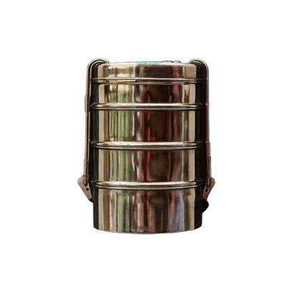

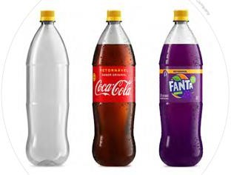
Solutions Reduce Reuse & Return Case Studies: Reuse & Return
28 of total
Return models are driving customer adoption of reuse and plastic elimination by offering at-home returns and financial incentives
Return at home
Overview | Founded in the UK, 2018
Product | Stainless steel food container (Dabba)
Business model | Food is delivered weekly to customers; with each delivery, the previous Dabba is collected, cleaned, and put back into circulation for future deliveries Meals are delivered by electric bikes
Results | Has saved >203,000 plastic containers from being used, avoided 18,360 kg of GHG emissions and 2,500 kg of food waste² Unit economics: Container amortizes in ~10 deliveries (~2.5 months for a weekly subscriber). Over a Dabba's 100- to 200-cycle useful life, it displaces ~40-80 pounds of disposable packaging — a 10 to 20x return on container CapEx. Across the 203,000 containers saved to date, ~£60K to £100K in packaging costs have been avoided, before counting waste disposal and plastic tax savings
Overview | Founded in the U.S., World Without Waste initiative launched in 2018
Product & business model | Reusable PET bottle; can be reused up to 25 times US$425 million has been invested in redesign and reuse infrastructure Customers pay an indirect deposit upon bottle purchase and receive a discount on the next purchase once the bottle is returned
Results | 1.2% of bottles company-wide are reusable as of 2023; 7% of reusable bottles by volume are sold in Latin America >90% return rate; 15% higher likelihood of repurchase. In Brazil, reduced new bottle production by 1.8 billion units annually Reduces emissions by 47% and water use by 45% Refillable bottles break even at about three to five cycles. Over a 25-cycle useful life, each displaces ~24 single-use bottles and saves Coca-Cola ~$1.00 to $1.50 in net materials cost — a 6 to10x return on the incremental bottle CapEx. At Brazil's 1.8 billion bottles per year displaced, annual materials savings are ~$70M to $110M, implying a four- to six-year payback on the $425M infrastructure investment
Return on the go
¹ Count accurate as of 2020. ² As of December 2025.
Sources: Rethinking packaging (EMF, 2019); Can Coca-Cola once again become a leader in refillable bottles (PIRG, 2025); Coca-Cola’s 25% reusable packaging goal (Beverage Daily, 2022); Coca-Cola lowers ambition with new 2035 packaging sustainability targets (Packaging Dive, 2024); DabbaDrop homepage (2025); DappaDrop (Planetfood.news, 2024); How It Works (DabbaDrop, 2025); A
reusable bottle design for multiple brands: Universal bottle (EMF, 2021).
Credit: Khande-Jae Fisher, Ariela Farchi, Isabel Hoyos, Hyae Ryung Kim, and Gernot Wagner. Share with attribution: Wagner et al., “Rethinking Plastics” (1 July 2026).

Slide 29
Solutions Reduce Overview
29 of total
Reduction is constrained by packaging redesign and infrastructure gaps, higher upfront costs, and uneven consumer adoption
Lack of necessary
infrastructure
Consumption behavioral patterns
Economic
limitations
Legacy design systems
Bottlenecks
Investment skewed downstream
Disposable models quicker and more familiar to consumers
Reuse models still expensive for users, disincentivizing adoption
Reuse and elimination unprofitable for certain plastics
High upfront costs for reuse
models
Lack of standardization in plastic products
~30% of plastics designed to be disposed of, unrecoverable, or non-reusable
toward recycling
Limited reverse logistics
infrastructure
Solutions
Pool resources
Prioritize mature sectors to roll out infrastructure more quickly
Institute deposit return schemes (DPRs) for easier collection
Incentivize adoption of reuse by making models more convenient (e.g., standardized DPRs, return-at-home models)
Design out hard-to-collect plastics in consumer products
Government subsidies to de-risk investment
Resource pooling to share collection and sorting costs
Maximizing return and reuse rates
Government measures to disincentivize single use (taxes, bans, EPR schemes)
Investment in product standardization and education campaigns
Credit: Khande-Jae Fisher, Ariela Farchi, Isabel Hoyos, Hyae Ryung Kim, and Gernot Wagner. Share with attribution: Wagner et al., “Rethinking Plastics” (1 July 2026).

Slide 30


Solutions Substitute
30 of total
‘Bioplastics’ refers to a wide range of materials that emerge as a lower emission substitute for traditional plastics
Polymer material matrix, categorized by source and
biodegradability Abatement potential
Bioplastics Traditional plastics
Bioplastics is an umbrella term; “drop-in” bio-based materials are chemically
identical to petrochemicals, while new polymers have different structures
Kg of CO₂e saved per kg of polymer produced, against traditional plastic
No CO²
savings
1
4
Bio-based
Commonly referred
to as bioplastics
Bio-based &
biodegradable
Drop-in (e.g., bio-based PE, bio-based PET,
bio-PE or -PS) or non-drop-in
Material substitution (e.g., PLA, PHA,
PBS, starch blends)
Bio-based & non - biodegradable
-0.25
4
Non-biodegradable
Biodegradable
Fossil-based & biodegradable
0.25
0.5
e.g., PE, PP, PET
e.g., PBAT, PCL, PBS
Traditional plastics
Baseline
0
Illustrative, directional
metrics
Fossil-based
-1 0 1
2
3 4 5
Sources: The New Plastics Economy (Ellen MacArthur Foundation, 2015); The role of bioplastics in the Circular Economy (McKinsey & Company, 2019); European Bioplastics website; Biobased
plastic (European Union, 2022); Bioplastics for a circular economy (Nature Reviews Material, 2022).
Credit: Paula Sánchez, Ariela Farchi, Isabel Hoyos, Hyae Ryung Kim, and Gernot Wagner. Share with attribution: Wagner et al., “Rethinking Plastics” (1 July 2026).

Slide 31

Solutions Substitute
31 of total
The emission reduction potential of bioplastics depends significantly on the type of feedstock used for production
Feedstock type | 1st Generation | 2nd Generation | 3rd Generation
 | Traditional agricultural crops: Corn Sugarcane Beets | Cellulosic crops and agro-industrial waste: Corn and wheat straw Sugar cane bagasse Beet pulp | Novel, non-land-based: Algae Biowaste
Advantaged and challenges | Potential for lower emissions compared to fossil-based plastics – Depending on crop used and land management practices Can be land-efficient¹ if the land management practices are optimized for crop growth Can lead to land-use change, if land is adapted for feedstock cultivation | Reduces land-use change pressure by leveraging by-products as key feedstock – Removes problematic feedstock vs. food competition Can have lower emissions compared to 1st generation Can be less land-efficient compared to 1st generation (requires more land per ton of plastic produced) | Potential for carbon-negative outcomes Low technological readiness and high costs compared to 1st and 2nd generation
Bioplastic applications | Lactic acid, PLA, thermoplastic starch, PHA | PHA, lactic acid, reinforced composites | PHA, PLA, functional additives, fillers for polymers
Key considerations
The environmental impact of a feedstock cannot be determined by generation alone Must be assessed on an individual basis to evaluate the specific impact on land-use change, local socio-economic trade-offs, etc. Must be considered for regionally specific impacts The productivity and efficiency of a feedstock – which are key determinants of its environmental impact varies greatly by feedstock type and region
¹ Hectares of land used per ton of plastic produced
Sources: Leveraging biogenic sources for plastic decarbonization (Roijen & Miller, 2025); Feedstocks fact sheet, (Bioplastics Feedstock Alliance, 2020); Biofuels (ScienceDirect, 2024).
Credit: Ariela Farchi, Sean Lee, Isabel Hoyos, and Gernot Wagner. Share with attribution: Wagner et al., “Rethinking Plastics” (1 July 2026).

Slide 32
Solutions Substitute
32 of total
Bio-based and biodegradable plastics lead on climate; cost and fossil system lock-in keep all bioplastics under 1% of capacity
Observations
Bioplastics plants aren’t fully utilized. Global capacity is ~2.47 Mt (2024) with average utilization of ~58% (~1.44 Mt produced); capacity is projected to be ~5.73 Mt by 2029
Fossil plastics are a century-old, massively optimized system (~400 Mt per year of output), with resin prices often roughly half those of biopolymers (with end prices 2 to 3x the prices of traditional plastic). The whole system is tuned to their properties
Substitutes must beat both cost and system lock-in, not just match performance
Key features of bio-based and biodegradable plastics
Bio-based |  |  | Fossil-based
 | Biodegradable | Non-biodegradable | Biodegradable | Non-biodegradable
Main use cases | Food service packaging, agricultural mulch, and 3D printing | Bottles, caps/films, textiles, and auto parts | Compostable films/bags and some medical uses | Packaging, construction, automotive, and electronics
Global production capacity (Mt) | ~1.0 Mt ^{0.25%} | ~1.1 Mt ^{0.27%} | _{1.2 Mt} 0.30% | > 400 Mt
Polymers | PLA, PHA, PBS, starch blends | Biobased PE, PET, PA, PTT | PBAT, PCL | PE, PP, PET
End of life/ pollution | Industrial composting | Landfill, recycle | Industrial composting | Landfill, recycle
Biodegradability life | 2-6 months | Not biodegradable (>100 years) | 3-6 months | Not biodegradable (>400 years)
Sources: The greenhouse gas emissions and fossil energy requirement (Yu and Chen, 2008); Comparative cradle-to-grave (Gursel et al., 2021); Comparative life cycle assessment (Luo et al., 2024);
Market development update (European Bioplastics, 2024).
Credit: Smarth Galhotra, Paula Sánchez, Ariela Farchi, Isabel Hoyos, Hyae Ryung Kim, and Gernot Wagner. Share with attribution: Wagner et al., “Rethinking Plastics” (1 July 2026).

Slide 33
Solutions Substitute
33 of total
Narrowing performance and cost gaps is key for scaling bioplastics adoption; polylactic acid is closest to reaching parity
Bioplastics face two key parallel challenges: reducing costs and improving performance¹
Observations
20+ FDA-approved products show polylactic acid’s (PLA) highest technology readiness is in medical applications
Bio-resins still carry a clear premium vs. commodity petro-plastics
PLA is often quoted at $3 per
kg, PBS at $3.20, PHA at $4 to
$6, and PBAT (lower cost biodegradable) at about
$1.85 to $1.90; in contrast, PP
generally trades close to $1 to
$1.30 per kg
Performance and cost of bioplastics compared with traditional plastics
1.8x
The cost gap is driven by expensive bio-feedstocks and monomers, extra unit operations, and lower utilization plants
Attractive Cost Better Performance
High Cost
Better Performance
1.4x
Performance*
1.0x
PBS
TPS
PLA PBAT
PHA
0.6x
The functional performance gap is closing faster than the cost premium
0.2x
Attractive Cost Suboptimal Performance
High Cost
Suboptimal Performance
-6.0x
-5.0x -4.0x -3.0x -2.0x -1.0x 0.0x 1.0x 2.0x 3.0x 4.0x 5.0x 6.0x 7.0x
Cost
¹Performance is measured considering tensile strength, elongation at break, heat deflection, and water vapor permeability.
Sources: CKI analysis; BusinessanalytiQ; Physical and thermal properties (Nazrin et al., 2020); Tensile Behavior of High-Density Polyethylene (Amjadi and Fatemi, 2020); Poly(Butylene
Adipate/Terephthalate-Co-Glycolate) (Wang et al., 2020); A review on bio-based polymer (Rajendran et al., 2024); Poly(Lactic Acid)-Based Microparticles (Vlachopoulos et al., 2022).
Credit: Smarth Galhotra, Paula Sánchez, Ariela Farchi, Isabel Hoyos, Hyae Ryung Kim, and Gernot Wagner. Share with attribution: Wagner et al., “Rethinking Plastics” (1 July 2026).

Slide 34
Solutions Substitute
34 of total
Bioplastics remain niche but are growing, with performance-matched materials winning and packaging leading adoption (~45%)
Global production capacities of bioplastics in 2024 by market segments, showing a variety of applications
Observations
Adoption is still small but concentrated in packaging. Bioplastics are ~0.9% of global plastics. Within bioplastics, packaging is the largest segment at ~45% (~1.12 Mt)
In 2024, biodegradable resins were 56.3% of capacity (PLA 37.1%, PHA 4.1%)
Bio-based drop-ins are 43.7% of capacity (bio-PE 11.0%, bio- PET 2.7%, PTT 13.2%). By
2029, biodegradables are
forecast to reach 66% of plastics (PLA 42.3%, PHA 17.0%)
PLA is a key resin for rigid and flexible food packaging and food service items in that mix, which makes it a winner, as packaging is the main use case
Illustrative, directional metrics
PE has a strong moisture barrier in films, can fit existing recycling streams, and even has a bio-based drop-in option.
PLA is chosen for packaging with end-of-life aligned with food waste: It
is rigid, clear, and easy to thermoform for cups, lids, and trays.
PTT leads in fibers: Its bio-PDO monomer delivers natural
stretch, softness, and stain resistance — ideal for carpets
and apparel.
Others
Functional (coatings & adhesives)
PBAT
Electrics & electronics
Agriculture & horticulture
Fibers (incl. Rigid packaging woven & non-
woven)
CR CP PET PE PEF PA PP PTT APC
Automotive & transport
Consumer goods
Flexible packaging
PBS PLA PHA SCPC
Sources: Processing technologies (European Bioplastics); A Review of Bioplastics (Di Bartolo et al., 2021); Drop-in plastics (Sharada et al., 2022).
Credit: Paula Sánchez, Ariela Farchi, Hyae Ryung Kim, and Gernot Wagner. Share with attribution: Wagner et al., “Rethinking Plastics” (1 July 2026).

Slide 35









Solutions Substitute Case Study: Xampla
35 of total
Drop-in plant protein technology makes Xampla a key player in the plastic-replacing natural polymer industry
Funding | £25.8 million (Emerald Technology Ventures, Amadeus Capital Partners, BGF, Matterwave Ventures, Horizons Ventures, Cambridge University)
Founded | Cambridge, U.K., 2018
Overview & mission | Developing natural polymer materials from plant proteins to replace polluting single-use plastics with scalable (drop-in) biodegradable technology
Core differentiation & technology | MorroTM materials: World’s first plant-protein polymer, derived from abundant feedstocks (e.g. peas, rapeseed) Completely plastic-free, fully biodegradable, and home-compostable High performance, drop-in material replacement matches plastic functionality, is ready for at-scale production on existing manufacturing lines Multi-patented technology delivers high barrier performance
Business model | Materials innovation and R&D: Develop new materials made from plant proteins Manufactured by global licensed partners (e.g., 2M Group of Companies) to enable rapid market entry Capital-light, licensing/supply model leverages partners’ existing production capabilities and distribution networks for scale
Market opportunity | Global bioplastics and biopolymers market is projected to grow from $17.6 billion in 2025 to $45 billion by 2030 (20% CAGR) The barrier coatings segment alone is estimated at $30 billion+ by 2032 Market dynamics: Strong demand, regulatory support for eco-friendly materials
Market competition
Challenges | Industry mind-set: Single-use plastics can be overengineered; alternatives don’t need to match this yet are often measured against it Greenwashing: Misinformation causes confusion and distrust Regulation: Needs to support new materials
Xampla’s materials are made from plant feedstocks
Abundant
feedstock
Natural plant
protein
Unfolded
structure
Rearranged
structure
Multiple
applications
On track to replace 10B+ plastic
units in the next five years.
Materials with “no chemical modification”
Morro TM coating, used to coat paper
and board for packaging
Morro TM edible film, used as a single-
use sachet
Morro TM soluble film, for home care and
personal care pods
¹Cambridge University spin-out (backed by 15+ years of research).
Sources: Xampla (Cambridge Enterprise, 2024); Xampla (2025); Demonstrating that Xampla’s paper coatings are plastic free (NPL Case Studies); Xampla (LinkedIn, 2025). Credit: Paula Sánchez Encinar, Ariela Farchi, Hyae Ryung Kim, and Gernot Wagner. Share with attribution: Wagner et al., “Rethinking Plastics” (1 July 2026).

Slide 36



Solutions Substitute Summary
36 of total
Both product- and system-side gaps must be closed for bioplastics to become a mainstream decarbonization lever
Product limitations¹
System limitations²
High costs and limited scale of biopolymers
Material performance and feedstock issues
Waste management and recycling gaps
Lack of standards and misconceptions
Bottlenecks
Cost gap vs. fossil plastics
Small global production capacity: Less than 1%
Underutilized plant capacity: Average utilization below 60% of installed capacity
Barrier properties: Higher permeability, variability
Thermal and mechanical limits: Lower heat tolerance, weaker durability
Feedstock availability: High dependency on biomass
Recycling incompatibility: Bioplastics require a separate recycling process
Lack of infrastructure
Landfill danger: Due to poor or missing infrastructure
Terminology confusion: Bioplastics are a big group of varied materials
Unstable demand
Patchy policy and standards:
Varied across market
Solutions
Increase scale and efficiency: Through higher risk investments
Carbon pricing: To support
low-carbon alternatives
Biopolymers R&D support: Develop blends, copolymers, and additives to boost heat deflection and toughness
Explore non-food feedstocks
Build composting and collection: Invest in industrial composting and separate biowaste/compostable streams
Design for end of life
Consumer education: About fossil and bioplastics
Stable long-term policy: Consistent regulations of minimum bio-content
¹Production limitations: Product-level barriers inherent to bioplastic materials and manufacturing. ²Systemic limitations: Broader external barriers in the surrounding system. Sources: What Challenges Hinder Bioplastics Adoption (Sustainability Directory, 2025); Applications (European Bioplastics), Biodegradable Plastics (360 Research Reports, 2025); Cost competitiveness (Wellenreuther et al., 2022); The Truth About Bioplastics (Columbia Climate School, 2017).
Credit: Paula Sánchez, Ariela Farchi, Hyae Ryung Kim, and Gernot Wagner. Share with attribution: Wagner et al., “Rethinking Plastics” (1 July 2026).

Slide 37

Solutions Recycle
37 of total
Only ~10% of plastic waste is recycled; design and sorting issues render over 60% of collected plastics unrecyclable
Global plastics recycling stages (material flow and losses)
Incurred losses
Plastic waste across recycling stages
Amount (in Mt) | % of total waste | Description
350 | 100% | Total annual post-consumer plastics waste
280-300 | 80-85% | All plastic waste formally collected; the remaining share is mismanaged
55-65 | 20-25% | Plastics sorted as recyclables
40-55 | 10-15% | Yield after removing contamination from food and beverages
30-40 | 5-10% | Washed, shredded, and pelletized for resale
~30 | ~5% | Cascaded recycling: Recycling into other, lower value recycling applications
>10 | <2% | Closed-loop recycling: Recycling into same or similar value material
Total waste
15-20% loss
Collected waste
60-65% loss
Recyclables
5-10% loss
Uncontaminated
recyclables
~5% loss
Recycled waste
High-value recyclate
Low-value recyclate
Sources: Policy Scenarios for Eliminating Plastic Pollution by 2040 (OECD, 2024); Plastics and the circular economy – deep dive (Ellen MacArthur Foundation, 2019).
Credit: Anika Behrndt, Isabel Hoyos, Hyae Ryung Kim, and Gernot Wagner. Share with attribution: Wagner et al., “Rethinking Plastics” (1 July 2026).

Slide 38


Solutions Recycle
38 of total
Recycling can abate 20% to 35% of total plastics emissions
Scaling mechanical and chemical recycling methods has the potential to abate up to 35% of total lifecycle emissions…
…but requires redesign, collection, infrastructure, and stimulating demand
Monomer Fabrication
Polymerization
Compounding &
Processing
Design for recyclability
>70% of plastics remain non-recyclable due to
complex design and mixed materials
1
4
1
Sale and Consumer Use
Develop collection systems
Around 2 billion people lack access to regular waste collection, leading to widespread mismanagement
2
3a
Chemical
Recycling
3b
Scale recycling infrastructure
Mechanical
Recycling
Reuse
3
a) Scale chemical recycling: New facilities in regions with limited processing infrastructure
EOL Disposal
2
b) Advance mechanical recycling: Improve efficiency and operations
~15-25% of CO2e reduction¹
~5-10% of CO2e reduction¹
Stimulate market for recycled materials Policies are needed to enforce both recycling as an end-of-life methodology, as well as mandatory use of recycled materials
4
Waste/Incineration
¹ Mechanical recycling can reduce the lifecycle emissions of plastics by ~40% compared to incineration and chemical recycling by around 20% compared to incineration.
Source: Breaking the Plastic Wave (Pew, 2020).
Credit: Anika Behrndt, Ariela Farchi, and Gernot Wagner. Share with attribution: Wagner et al., “Rethinking Plastics” (1 July 2026).

Slide 39
Solutions Recycle Redesign
39 of total
Redesigning can improve recycling by reducing material complexity, preventing contamination, and improving product quality
>70% of collected plastic waste is
deemed unrecyclable
Key challenges Possible solutions
Most plastics remain unrecyclable due to material complexity, contamination, and product design
With better design, recyclability could increase by >30 percentage points
Design changes are a low-cost lever with
outsized impact
Material complexity
Standardization
1,000+ combinations of mixed and layered plastic types make separation and recycling technically complex and economically unviable
Adopt mandatory design-for-recyclability standards that phase out non-separable, multilayer, and incompatible polymer combinations
Incentivize producers to use mono-material or compatible blends
Total collected plastic waste
Unrecyclable Recyclable plastic waste
Contamination
Clear guidance
Up to 40% of packaging plastics are food-contaminated, making them unrecyclable without additional cleaning and processing
Implement clear, harmonized labeling systems (e.g., “recyclable/not recyclable,” disposal instructions) to reduce consumer error
Promote deposit return systems for food containers
Support advanced washing and decontamination technologies for food-grade recyclate
21%
54%
79%
46%
Low-value, single-use items
Abatement of single-use
About 30% to 40% of plastics are single-use packaging — too cheap and thin to reuse or recycle economically
Set minimum durability targets for packaging
Substitute ultralightweight, non-recyclable plastics with recyclable mono-material formats
Encourage reuse models (refillable, returnable) and fiscal incentives
Current
With design changes
Sources: Technical, Economic, and Environmental Comparison of Closed-Loop Recycling Technologies for Common Plastics (Uekert et al., 2023); Breaking the Plastic Wave (Systemiq, 2020).
Credit: Anika Behrndt, Isabel Hoyos, Hyae Ryung Kim, and Gernot Wagner. Share with attribution: Wagner et al., “Rethinking Plastics” (1 July 2026).

Slide 40
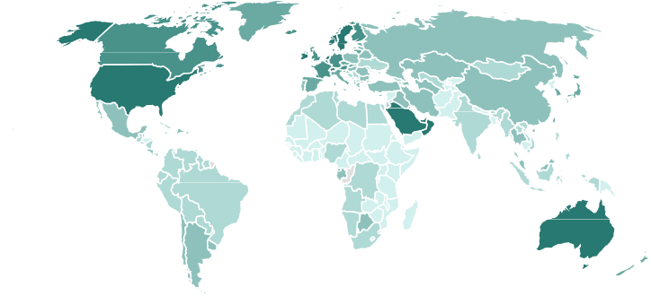
Solutions Recycle Collection Systems
40 of total
Better collection and sorting systems, supported by infrastructure and behavior change, are needed to fully capture plastic waste
+20% of the global population lacks collection coverage, especially in rural areas of emerging economies
Developing economies need better
collection infrastructure
Developed countries need behavioral and technological changes for sorting
Coverage of waste collection, as % of total waste*
79%
86%
94%
97%
98%
Collection coverage remains below 60% in many regions across Sub- Saharan Africa and South Asia
Informal waste pickers handle 40% to 80% of recyclables in many cities
Rural and island states lack the economic density to justify large infrastructure investments
Behavioral confusion: 25% to 30% of recyclables in the U.S. are contaminated by non-recyclables
Aging sorting infrastructure: Many MRFs still operate with 1990s-era mechanical systems
Fragmented collection standards
hinder consumer participation
49%
Bottlenecks
<5K 5K-15K 15K-30K 30K-40K 40K-50K
GDP per capita worldwide; a visual proxy for waste collection coverage
50K+
Invest in collection logistics (transfer stations, trucks, bins, data systems)
Formalize the informal sector via cooperatives or social enterprise models
Leverage extended producer responsibility (EPR) to fund local collection
Use AI-based sorting tech to
improve material purity
Standardize collection systems
Use pay-as-you-throw schemes to reduce contamination and incentivize correct sorting
Solutions
Powered by Bing
© Australian Bureau of Statistics, GeoNames, Microsof t, N avinfo, Open Places, OpenStreet Map, O vert ure Maps Fundation, TomTom, Zenrin
The dark areas are the high-coverage countries from the bar chart; the light areas reflect collection gaps
*Based on World Bank data on a global waste study; not all countries are represented – only about 52 countries for this statistic.
Sources: What a Waste Global Database (World Bank, 2024); 2019 Impact Report (Closed Loop Partners, 2020); An Assessment of the U.S. Recycling System: Financial Estimates to Modernize Material
Recovery Infrastructure (EPA, 2024); Women and men in the informal economy: A statistical picture; Third edition (International Labor Organization, 2018).
Credit: Anika Behrndt, Isabel Hoyos, Hyae Ryung Kim, and Gernot Wagner. Share with attribution: Wagner et al., “Rethinking Plastics” (1 July 2026).

Slide 41
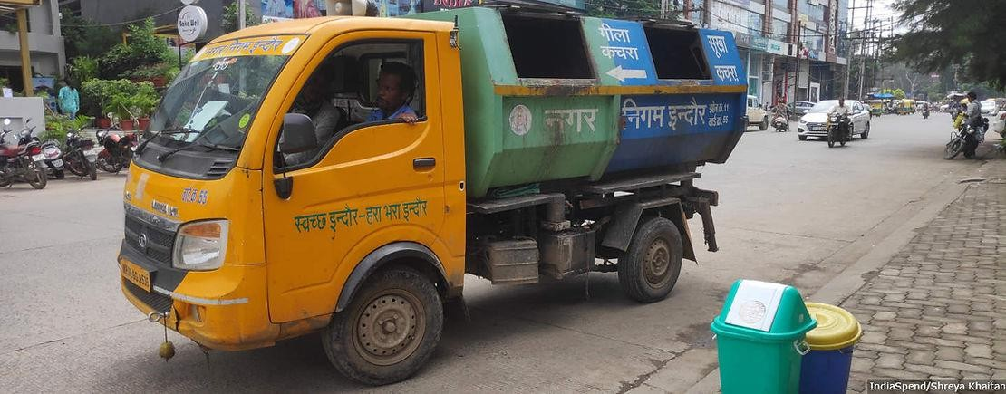
Solutions Recycle Collection Systems Case Study: India
41 of total
A new door-to-door waste collection system achieved a 100% waste collection rate in Indore, India
Build-out of a door-to-door waste collection infrastructure
Overview & mission | Ensure full collection of up to ~1,500 metric tons of municipal waste per day while enabling upstream segregation and downstream recovery, particularly for plastics and organic waste
Measures | Citywide door-to-door waste collection rollout: Replacement of communal bins with daily, household-level collection, covering residential, commercial, and institutional waste Mandatory source segregation at household level: Two-stream (wet/dry) segregation enforced through bylaws, inspections, and penalties, enabling efficient downstream processing Decentralized collection infrastructure and routing optimization: Deployment of dedicated collection vehicles (handcarts, auto-tippers, compactors) and optimized ward-level routing to ensure full coverage Formalization and expansion of the sanitation workforce: Recruitment and training of sanitation workers with clear role definitions, uniforms, and performance monitoring Strong enforcement and behavior-change mechanisms: Public awareness campaigns and fines for non-segregation and littering Digital monitoring and accountability systems: GPS-tracked vehicles, attendance systems, and real-time ward-level reporting
Results | Since 2017, Indore has consistently been ranked India’s number one cleanest city (>100,000 population), reflecting sustained system performance. Collection costs declined from ~₹2,900 per ton to ~₹1,660 following the update
Waste collection hauler in Indore, India
Sources: Shreya Khaitan
Context | Indore, the ninth biggest city in India with a population of 3.5 million, has a growing waste issue: Daily waste is expected to grow from 1,200 metric tons to 2,000 within 10 years. The city is also subject to the new national Solid Waste Management Rules from 2016
Timeline | The first pilot project launched in January 2016, with full rollout to all 84 wards achieving 100% waste collection by January 2017
Project cost | ~US$20 million (₹180 crore) in capital investment for collection, transport, and processing infrastructure¹; recurring operating expenditures of ~US$18 million (₹155 crore) per year during early implementation
¹ Capital investment included fleet expansion, transfer stations, material recovery facilities, decentralized composting, and digital monitoring systems.
Sources: Municipal solid waste management in the City of Indore: A case study (Singh R., 2021); Solid Waste Management in Indore, Madhya Pradesh, India: Insights from a Survey of Literature (Saifi et
al., 2023); How Indore Became India’s Cleanest City (And How Others Can Follow) (Indiaspend, 2019); Solid Waste Management in Indore (Centre for Science and Environment, 2019).
Credit: Anika Behrndt, Isabel Hoyos, Hyae Ryung Kim, and Gernot Wagner. Share with attribution: Wagner et al., “Rethinking Plastics” (1 July 2026).

Slide 42
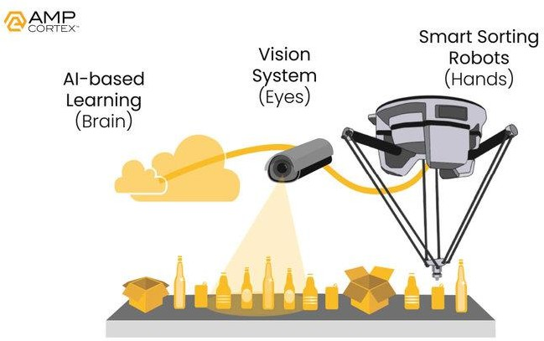



Solutions Recycle Collection Systems Case Study: APM Sorting
42 of total
AMP Robotics can automate up to ~75% of manual sorting with AI-driven computer vision
The AMP Cortex combines off-the-shelf robots with machine vision and AI in the cloud. Source: AMP Robotics
Automated sorting systems with AI robots – AMP Robotics
Overview & mission | AI-supported robotic sorting system to increase recycling purity and efficiency of single-stream waste (plastics, paper, aluminum, etc.)
Technology | Three key components: AMP Cortex high-speed robotics system automates the identification and sorting of recyclables from mixed material streams AMP Neuron deep learning computer vision (CNNs) is trained on millions of material images — not generative/LLM-based. Identifies materials by type, polymer, color, and brand. Hardware is commodity (ABB/Omron delta arms); IP is the perception model and training dataset AMP Clarity provides data and material characterization
Efficiency | Can process up to 68,000 tons of waste annually, with >95% identification accuracy; has up to 200%+ higher pick rates vs. manual sorting; reduced labor requirements by ~75%
Drivers | Labor shortages in MRFs, rising demand for cleaner recyclables, EPR rollout in U.S., and rPET demand
Total capital + valuation | ≈US$267 million, current valuation of $424 million to $612 million
Timeline | AI robots launched 2016; >400 AI systems installed by 2025 across North America, Asia, and Europe
Cost | ~ $300,000 per machine, lasting 5-10 years; break even at 2-3 years
History | Founded in 2014 by Matanya Horowitz and James Bailey, AMP Robotics is a company focused on modernizing and scaling the recycling infrastructure using artificial intelligence and automation
Sources: Advanced-sorting-technologies in the waste sector (IEA Bioenergy, 2024); AMP Named to 2025 Global Cleantech 100 (Amp Sortation, 2025); AMP Company Profile (Tracxn, 2025);
Rise of the Recycling Robots (Forbes 2020); AMP Robotics applies AI, robots to mounting recycling challenge (The Robot Report, 2019); AMP to Operate Waste Connections Recycling Facility with
AI-Powered Sortation Technology (AMP Sortation, 2024).
Credit: Anika Behrndt, Isabel Hoyos, Hyae Ryung Kim, and Gernot Wagner. Share with attribution: Wagner et al., “Rethinking Plastics” (1 July 2026).

Slide 43




Solutions Recycle Infrastructure
43 of total
Mechanical recycling is the most cost- and energy-efficient solution to treat plastic waste, followed by chemical recycling
Overview of different recycling methods
Common use cases
Energy use per kg processed (MJ/kg)
Global capacity (M tons)
Cost (in $) per TRL ton processed
(indicative)
Technology
Description
Challenges
Processing plastics to
Bottles, HDPE crates,
Backbone of today’s system but limited to clean, single-polymer streams (e.g., PET bottles, HDPE crates)
Mechanical be reused in new
PP packaging
~ 6
~50
120-250
products
Breaking down into
their basic chemical Plastics not suited to
Chemical
~25
< 1
~500-700
Fills a gap for mixed or hard-to-recycle plastics, but costs and energy demand remain high
components using heat mechanical recycling
or chemicals
Using waste plastics as a source of fuel
Non-recyclable,
103
Manages large volumes of contaminated waste (>400 Mt), but it locks in emissions and should be treated as a last-resort pathway
Thermal
contaminated plastics
~ 4
>400
Breaking down plastics using natural microorganisms
Emerging for biodegradable plastics and specific single-use items; current impact is marginal, but future innovations (e.g., microbes) could broaden scope
Biological
Biodegradeable,
~10
< 1
> 1K
single-use products
Sources: Technical, Economic, and Environmental Comparison of Closed Loop Recycling Technologies for Common Plastics (Uekert et al., 2023); Techno-economic assessment of mechanical
recycling of challenging post-consumer plastic packaging waste (Larrain et al., 2020).
Credit: Anika Behrndt, Isabel Hoyos, Hyae Ryung Kim, and Gernot Wagner. Share with attribution: Wagner et al., “Rethinking Plastics” (1 July 2026).

Slide 44
Chemical recycling costs 3 to 4x more than mechanical recycling but is necessary to process less standardized waste streams
44 of total
High energy use and chemical
Process flows of mechanical and chemical recycling inputs drive costs (€700/ton)
Monomer Fabrication
Cost of plastics recycling in €/ton processed*
CapEx OpEx
Oil & Gas Extraction
Polymerization
Compounding & Processing
Sale and
Consumer Use
~3x higher
700
170
Monomer Polishing
7.
Pelletization 4.
Distillation
6.
Extrusion
3.
Washing & Drying
250
Shredding
EOL Disposal
530
100
Solvent Recovery
5.
2.
1.
150
4.
3.
2.
1.
Phase Condensation Reactor
Separation
Fine Shredding &
Drying
Mechanical recycling
Chemical recycling
*CapEx and OpEx are based on an average from different survey results, detailed in Larrain et al., 2020 (below).
Sources: Environmental and economic assessment of plastic waste recycling (European Commission, 2023); Techno-economic assessment of mechanical recycling of challenging post-consumer
plastic packaging waste (Larrain et al., 2020).
Credit: Anika Behrndt, Isabel Hoyos, Hyae Ryung Kim, Gernot Wagner. Share with attribution: Wagner et al., “Rethinking Plastics” (1 July 2026).

Slide 45



Solutions Recycle Demand
45 of total
Alongside price parity, policy drivers are needed to drive large-scale adoption of recycled plastics
Observations
Europe: rPET remains structurally more expensive than virgin plastic, yet demand persists due to binding recycled-content mandates
U.S.: rPET has reached near price parity, but weak mandatory use leads to oversupply and depressed prices
China: Large-scale infrastructure and mandatory use policies enable a cost-efficient and stable rPET market
Costs of virgin polyethylene terephthalate (PET) vs. recycled PET (food grade), US$/kg
rPET food grade
Europe
U.S.
China
Polyethylene
terephthalate
4
3.5
3
2.5
2
1.5
1
0.5
0
3.62
2.23
2.53
1.56
1.31
1.15
1.29
1.33
0.83
Policy intervention levers
Collection and sorting infrastructure | High | Low-medium | High
Scale and efficiency of recycling | Low-medium | Low | High
Policies for mandatory use of recyclates | High | Low | Medium
Policies for mandatory recycling | High | Low | High
Plastics recycling rate per region, % of total waste
 | 12% | 5% | 13%
¹ Regional averages taken into account for country and state level ranges.
Sources: Plastic waste by region and end of life (OECD, 2023); Plastic Recycling: A review on life cycle (Salahuddin, 2023); Virgin PET prices (Businessanalytiq, 2025); rPET prices
(Businessanalytiq, 2026); Exploring Plastic-Management Policy in China: Status, Challenges and Policy Insights (Liu et al., 2023); Recycled PET Prices Trending Down Amid Weak US Demand
(PlasticsToday, 2023).
Credit: Anika Behrndt, Isabel Hoyos, Hyae Ryung Kim, and Gernot Wagner. Share with attribution: Wagner et al., “Rethinking Plastics” (1 July 2026).

Slide 46



Solutions Recycle Summary
46 of total
Recycling must overcome product complexity, collection, and sorting challenges to scale successfully
Design for recycling
Collection and sorting
Scaling chemical and mechanical recycling
Ensuring market stability of recyclates
Bottlenecks
infrastructure
Material complexity: Multi-material products hinder recycling
Contamination: Food residue leads to >40% sorting losses
Low value: ~30% of plastics refer to single use
>20% of plastics waste remains uncollected globally
Inefficient sorting leads to
>70% of collected waste not
being recycled
Most economies lack behavioral incentives to change
Invest in curbside collection and access: Target underserved regions
with collection systems
Upgrade MRF technologies: Deploy AI-based sorting, NIR spectroscopy, robotics
Mechanical recycling is more energy-efficient but requires clean, standardized waste streams
Chemical recycling has 2 to 3x higher CapEx and significant operating costs
Low demand for recyclates: Virgin plastics remain cheaper and more predictable, leading to underinvestment in recycled-content markets
Quality concerns: Inconsistent quality of recycled materials reduce buyer confidence
Solutions
Standardize packaging to reduce sorting complexity and enable higher quality recyclate streams
Scale mechanical recycling wherever feasible to maximize low-energy, low-cost circularity
Deploy chemical recycling selectively, colocated with existing industrial assets to improve economics
Enforce policy to make use of recyclates mandatory, e.g., minimum recycled content standards
Improve material quality and certification systems to increase buyer confidence
Credit: Anika Behrndt, Isabel Hoyos, Hyae Ryung Kim, and Gernot Wagner. Share with attribution: Wagner et al., “Rethinking Plastics” (1 July 2026).

Slide 47





Solutions Electrify
47 of total
Electrifying plastics production could tackle >50% of emissions; monomer fabrication is the largest lever but has lowest TRL
Value chain stage | Feedstock processing (extraction of non-renewables and refining to produce naphtha, ethane, etc.) | Monomer fabrication (cracking hydrocarbons to produce monomers such as ethylene) | Polymerization (converting monomers to polymers such as polyethylene) | Product manufacturing (fabrication of finished plastic products) | End-of-life disposal (incineration, landfill, leakage of plastics waste)
Key electrifica-tion levers & implications | Petrochemical feedstock production using carbon-free generated electricity Electrification tech is commercially available but in pilot phase for large-scale furnaces | Significant emissions abated by avoiding burning fossil fuels in steam cracking FOAK crackers in pilot, to be powered with renewables | Electric heating available Mature technology, given lower temperatures, but not industry-standard | Stage already largely electrified All-electric machines are mature and should use low-carbon electricity | Limited impact from electrification Embedded carbon released in incineration
Limiting factor | Retrofitting cost | High temperatures required | Retrofitting cost | Retrofitting cost | Emissions inherent to combustion
TRL
Retroffiting cost range | $$$ | $$$ | $$ | $$ | $
Abatement potential | ~15% | >20% | ~10% | ~15% | 0-5%
Sources: Tackling heat electrification (McKinsey, 2024); Can carbon help decarbonize chemicals (BCG, 2023); Seadrift (X-Energy); Electrification (ETA, 2022); Levelised cost of petrochemicals for
selected feedstocks and region (IEA, 2018); Carbon capture, utilization & storage in the energy transition (Energy Transitions Commission, 2022).
Credit: Paula Sánchez, Ariela Farchi, Hyae Ryung Kim, and Gernot Wagner. Share with attribution: Wagner et al., “Rethinking Plastics” (1 July 2026).

Slide 48
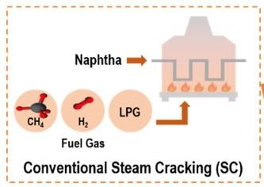
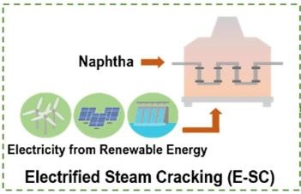
Solutions Electrify Monomer Fabrication
48 of total
Electrified steam cracking (E-SC) could decarbonize monomer fabrication but is limited by renewable energy availability
~25% of emissions from plastic production come from steam cracking at >850ºC
CO₂ emissions of steam cracking and E-SC by electricity generation method (KgCO₂ kgC₂H₄¹)
Conventional steam cracking Electrified steam cracking
Observations
E-SC powered by renewables could decrease CO₂ emissions from ethylene production by 18%*
The share of renewables in net
U.S. electricity generation is set
to grow from 24% in 2024 to
~70% in 2050. As E-SC remains energy intensive, renewable generation will be key for at-scale production
Production facilities can implement on-site renewable power generation to ensure source of energy for on-site
E-SC
Steam cracking*
Fossil
hydrocarbons
After extraction, separation, and purification…
Polymerization
3.4
U.S. mix
4.4
Monomers are then chemically bonded into long-chain polymers, the base material for plastics
…hydrocarbons are then broken down into monomers
Coal
3.7
6.3
Natural gas
3.5
4.4
Conventional steam cracking
Electrified steam cracking¹
Geothermal
3.3
3.2
Hydropower
3.2
2.8
Preferred energy sources
Solar
3.2
2.8
Illustrative (directional metrics for ethylene)
Wind
3.2
2.8
¹ Still in the pilot and demonstration phase.
Sources: Electrified steam cracking for a carbon neutral ethylene production process (Gu et al., 2022); Annual Energy Outlook 2025 (U.S. Energy Information Administration, 2025); Aligning the value
chain to decarbonize plastics (McKinsey, 2025); Electric Cracking (Coolbrook); Piloting RotoDynamic Technology (Coolbrook).
Credit: Una Oljaca, Paula Sánchez, Isabel Hoyos, Hyae Ryung Kim, and Gernot Wagner. Share with attribution: Wagner et al., “Rethinking Plastics” (1 July 2026).

Slide 49
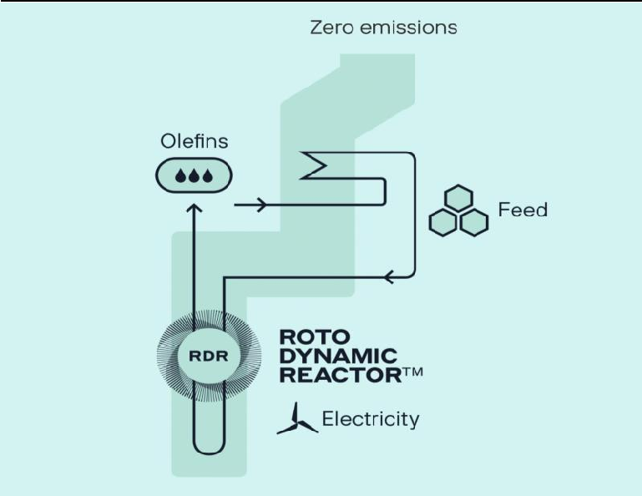
Solutions Electrify Case Study: Coolbrook
49 of total
Coolbrook’s RotoDynamic Reactor (RDR) demonstrates E-SC potential in the short to medium term
Location & year | Founded in 2008, with dual headquarters in Espoo, Finland (corporate), and Geleen, Netherlands (pilot and R&D at Brightlands Chemelot Campus)
Funding | ~$59M raised across multiple rounds; backers include Cemex Ventures, Norrsken VC, and Plug and Play
Overview & mission | Industrial decarbonization technology company commercializing electrified high-temperature heat. Mission: Replace fossil-fuel combustion in the most carbon-intensive industrial processes — steam cracking, cement, and iron and steel
Core differentiation & technology | RDR uses high-velocity rotor blades to convert electricity into process heat above 1,700°C in milliseconds; 100% scope 1 emissions reduction vs. conventional fired crackers, plus ~20% higher ethylene yields, less coke formation
Business model | Technology licensing + equipment supply to petrochemical, cement, steel producers Co-development partnerships with anchor customers (SABIC for steam cracking, Cemex for cement) de-risk first-of-a-kind deployments Revenue from RDR/RDH unit sales, licensing fees, and aftermarket service
Market opportunity | Steam cracking alone: ~300 million tons of CO₂ per year globally and >$200 million in additional annual profit per million metric tons of ethylene from yield uplift Broader addressable market: high-temperature industrial heat across chemicals, cement, and steel
Market competition | Joint electric-cracker pilots from BASF-SABIC-Linde and Shell-Dow (resistive-heating designs); Technip Energies' electrified furnace concepts Coolbrook's rotodynamic approach differentiates on temperature ceiling, footprint, and yield
Challenges | Scaling from pilot to commercial demonstration (2026: still in large-scale validation) Access to abundant, low-cost renewable electricity at petrochemical-site scale Customer willingness to commit before policy/carbon-pricing certainty
RotoDynamic Reactor schematic
¹Cambridge University spin-out (backed by 15+ years of research).
Sources: Electric Cracking (Coolbrook); Piloting RotoDynamic Technology (Coolbrook); Coolbrook 2026 Company Profile: Valuation, Funding & Investors (PitchBook, 2026).
Credit: Anika Behrndt, Una Oljaca, Ariela Farchi, Hyae Ryung Kim, and Gernot Wagner. Share with attribution: Wagner et al., “Rethinking Plastics” (1 July 2026).

Slide 50


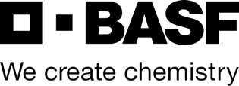
Solutions Electrify Monomer Fabrication Case Study: BASF-Sabic-Linde
50 of total
BASF-Sabic-Linde E-SC demonstration plant is built, operating, and able to abate 90% of emissions
Ownership | BASF-Sabic-Linde Partnership
Location | Ludwigshafen, Germany (BASF Verbund site)
Description | Pilot-scale e-steam cracking furnace integrated into existing BASF steam cracker at Ludwigshafen, Germany
Technological overview | Process: Electrified steam-cracking furnace(s) – two parallel heating concepts: (1) direct resistive heating (electric current through cracking coils), and (2) indirect/radiative heating (heating elements around coils) Feedstock/throughput: ~4 tons hydrocarbon feed per hour collectively Electric power input/load: 6 MW electrical input for the furnaces
Efficiency metrics | Target reduction of at least 90% CO₂ emissions (versus conventional steam cracking) when powered by renewable electricity*
Key success drivers | Two heating modes tested to compare flexibility and material behavior Fully integrated into existing BASF steam cracker utilities
Funding | Undisclosed private funding Received €14.8 million in public funding
Unit economics | Cost competitive in principle: Published TEA (Gu et al., 2022) puts electrified steam cracking at ~$790 per ton of ethylene vs. ~$832 per ton for conventional — the process itself is not inherently more expensive Economics hinge on power prices, not technology: Commercial viability is driven by the industrial electricity-to-gas price spread, not CapEx — implying a $0 to $170 per ton ethylene green premium (~$0 to $100 per ton of CO₂ abated) depending on geography and grid mix
Timeline | Construction started in 2022. Final transformers were installed by the end of 2023, with commissioning in early 2024. No commercial deployment as of 2026
E-SC process overview, proven to reduce 90% of emissions
Feedstock (naphtha and ethane)
Two electric ways to deliver heat: direct (electric current through tubes) and indirect (radiation)
E-SC does not burn fossil fuels to generate heat to crack naphtha.
E-SC
800-850ºC
Delivering the same product with the same chemistry, changing exclusively the heat source
Olefins
¹BASF estimates that electrifying furnaces could cut about 750,000 metric tons of CO2 per year.
Sources: News (2024); BASF (Industry Decarbonization, 2024); Electrified steam cracking for a carbon neutral ethylene production process (Gu et al., 2022).
Credit: Paula Sánchez, Anika Behrndt, Ariela Farchi, Hyae Ryung Kim, and Gernot Wagner. Share with attribution: Wagner et al., “Rethinking Plastics” (1 July 2026).

Slide 51



Solutions Electrify Summary
51 of total
Electrifying monomer production is currently bottlenecked by heat intensity, power infrastructure, and cost parity
High-temperature process
electrification
Power grid & renewable
integration
Economic &
capital discipline
Technology & value-chain
readiness
Bottlenecks
Technology readiness: Options being deployed are in early stages
Engineering gap: Adapting electric heating is non-trivial
Reliability: 24/7 operation with
>99% uptime
Power demand: E-SC (electrified steam cracking) requires 100 to 150 MW cont. power
Grid readiness: Legacy petrochemical hubs near feedstock and gas supplies
Renewables integration: Electricity must be low carbon to abate emissions
CapEx: FOAK E-SC will likely carry a >20% to 40% premium
OpEx: Studies indicate a break-even point for electric furnaces when power price falls to ≈ $40 to $41/MWh
TRL: E-SC is in pilot phase, and net-zero alternatives have been proven by industry leaders
Adoption barriers: Industry conservatism, safety, and lack of performance guarantees for new heating systems
Solutions
R&D of electric steam-cracking furnaces: Government grants and industry consortia can accelerate FOAK
Electric heating investment: Early investment in lower heat to validate performance
Grid upgrades and firm power: Private-public coordination to ensure power capacity
Industrial heat storage: Buffering intermittency and allowing for carbon-free energy
Phased retrofits and ROI-driven decisions: Upgrade of existing assets, and phasing engineering and construction
Incentives and risk-sharing: Carbon pricing regimes and green premiums
Definition of shared standards; alliances to promote TRL and market adoption
Upstream-downstream integration: Tying together the value chain to transition
Credit: Paula Sánchez, Anika Behrndt, Ariela Farchi, Hyae Ryung Kim, and Gernot Wagner. Share with attribution: Wagner et al., “Rethinking Plastics” (1 July 2026).

Slide 52





Solutions CCUS
52 of total
Carbon capture can be applied to feedstock production, monomer fabrication, and end-of-life treatment with utilization
 | Carbon Capture and Utilization (CCU) | Carbon Capture (CC)
Value chain stage | Feedstock production | Monomer fabrication | EOL disposal
Application and reduction potential | Conversion of CO₂ to precursors and/or monomers through chemical and biological pathways Reduction varies with pathway, energy inputs, product grade, and regional economics | Retrofit steam crackers with carbon capture systems | Retrofit WtE incinerators with carbon capture systems
Cost – $/ton CO₂ avoided | CO₂-methanol: ~$120 to $300 CO₂-ethylene: ~$300 to $1,880 CO₂-to-formic acid: Highly variable, lab-scale only | ~$56 to $108 per ton CO₂ saved | Up to $288 per ton CO2 saved, but economics can be improved through power and heat integration¹
TRL | TRL varies with some pathways already reaching commercialization while other pathways being developed | Most plants in feasibility study phase | Most plants in development/ pilot phase
Key challenges | Stoichiometric limits for polymer (up to ~50% CO2 by weight) High energy requirements; abundant, low carbon electricity necessary to significantly reduce footprint (ideally <6 g of CO_{2e} per kWh ) Most pathways not yet at parity | Energy penalty of retrofitting CC lowers economic feasibility of capture Small waste-to-energy (WtE) plant sizes limit economics when compared with alternative power generation | Energy penalty of retrofitting CC lowers economic feasibility of capture
¹Based on MEA capture and 60 MWe plant; LCA reduction for CCU based on GWP-100.
Sources: How the plastics industry can go green and at what cost (ING, 2023); Putting CO2 to use (IEA, 2019); Integration of CCUS in WtE plants (Acampora et al., 2025); Can the Plastics Industry
become a carbon capture leader (IDTechEx, 2022); Life cycle assessment of polyols from polyurethane production using CO2 as feedstock (von der Assen et al., 2014); Achieving net-zero greenhouse
gas emissions plastics by a circular carbon economy (Meys et al., 2021); Designing the Ethylene Factory for Products of CO2 Reduction (Pinto et al., 2025); Economic Feasibility tool for CO2 Utilization (NREL); Challenges and Opportunities of CO2 utilization (Pappjin et. al, 2020); Co2-based polyurethane foam (Karulf et al., CO2 Utilization, 2025); Current challenges and perspectives in Co2-based polymers (Liu et al, 2023).
Credit: Khande-Jae Fisher, Ariela Farchi, Isabel Hoyos, Hyae Ryung Kim, and Gernot Wagner. Share with attribution: Wagner et al., “Rethinking Plastics” (1 July 2026).

Slide 53







Solutions CCUS Feedstock production
53 of total
For feedstock production, CO₂ to polyols is one of the most mature pathways
CO₂-based plastics market expected to reach
~$10B by 2034, accounting for <1% of market
Observations
CO₂-based plastics’ projected abatement in 2030 is only <5%
of 2024 emissions
Maximum technical storage potential of CO₂ to plastics could reach up to 200 metric megatons of CO₂ per year, but only if:
  Capture costs fall
  Supportive regulation and
incentives are implemented
  CO₂ becomes a valuable resource through technological advancement
CO₂ to polyols can lower up to 20% of plastics production emissions
Polyols used to create polyurethane for foams, coating and semi-rigid plastics
Methanol and ethanol converted to olefins through further multi-step processing
Commercialized pathways¹
US$B
1% of market
CO₂ to polyols (chemical conversion)
CO₂ to polyester (chemical conversion)
CO₂ to methanol (chemical conversion)
CO₂ to ethanol (bioconversion)
CO₂ to PP (bioconversion)
Abatement potential of 10 million metric tons CO₂/year
10
9
8
7
6
5
4
3
2
1
0
10
9
~+12%
8
0.4% of market
7
6
5
5
4
4
3
3
2024 2026 2028 2030 2032 2034
¹ Non-exhaustive.
Sources: Plastic market growth analysis (EMR, 2025); Plastics market 2025-2034 (Towards Chem & Materials, 2025); CO2-based plastics market size (IMARC, 2024); CO2-based plastics
market size (Insight Ace Analytics, 2025); Driving CO2 emissions to zero and beyond with CCUS (McKinsey, 2023); Plastic Market (Grandview Research, 2025); Econic Technologies
homepage; Twelve and LanzaTech partner to produce the world’s first propylene from CO2 (LanzaTech, 2021); Fairbrics homepage.
Credit: Khande-Jae Fisher, Ariela Farchi, Isabel Hoyos, Hyae Ryung Kim, and Gernot Wagner. Share with attribution: Wagner et al., “Rethinking Plastics” (1 July 2026).

Slide 54

Solutions CCUS Monomer Fabrication
54 of total
Monomer fabrication can be decarbonized through pre- or post-combustion carbon capture, with capture rates of ~90%
Steam cracking to produce olefins is high emitting due to direct fuel combustion; post- and pre-combustion carbon capture can capture 85% to 95% and >90% of CO2, respectively
Observations
Post combustion capture is a more mature technology, and is used in 80-90% of industries - largely due to easier retrofitting of facilities
Carbon capture is less efficient when applied to downstream production, as emissions come mostly form electricity – not direct combustion
Naphtha and ethane are traditionally sourced from oil and natural gas, respectively
Methods for CO₂ capture vary
widely
  Chemical adsorption is the most mature for high-value chemicals like olefins
  Other methods include absorption and membrane separation
Option 1: Pre-combustion capture
Air
Fuel
Reformer/ Gasifier
H -rich syngas
2
CO₂ captured from a ~40
volume % stream
H₂-rich syngas replaces combustion fuel as lower emitting fuel
H₂O
Business as usual
Steam cracker
Fuel combusted at
~850°C
Feedstock (naphtha and ethane)
Olefins (mainly ethylene and propylene)
Naphtha: (~1.6 to 2.4 tons CO₂ emitted/ton olefin) Ethane: (~0.4 to 1.2 tons CO₂ emitted/ton olefin)
Option 2: Post-combustion capture
Flue gas (N2, CO_{2,} H₂O,
CO captured and compressed from a 3 to 15
SO , NO etc.)
2
volume % stream
X X,
Sources: Carbon Capture Utilisation and Storage (IEA, 2024); Capture and Reuse of Carbon Dioxide (CO₂) for a Plastics Circular Economy (Mada Costa et al., 2021); Carbon dioxide capture approaches
(NETL); Plastic and Climate (CIEL, 2019); Pre-combustion Carbon Capture Research (U.S. DOE); Making Plastics Emissions Transparent (COMET, 2022); Methods and Techniques for CO₂ Capture:
Review of Potential Solutions and Applications in Modern Energy Technologies (MDPI, 2022).
Credit: Khande-Jae Fisher, Ariela Farchi, Isabel Hoyos, Hyae Ryung Kim, and Gernot Wagner. Share with attribution: Wagner et al., “Rethinking Plastics” (1 July 2026).

Slide 55
Solutions CCUS EOL Disposal
55 of total
~20% of plastics are incinerated at end of life, primarily in WtE facilities; integration of CCUS is limited to <0.5% of plants
Most waste is incinerated in waste-to-energy facilities for energy recovery; most currently operating WtE-CCUS plants are located in Europe
Observations
WtE-CCUS is a complementary solution, not a replacement one. Best practice is to recover a significant share of plastic before incinerating:
  Recovery and recycling are still preferred methods for EOL management according to circular economy models; only unrecoverable plastics must be incinerated.
  Countries with high incineration rates also display high recycling rates, as landfilling is avoided.
When incinerated, plastics emit
~ 1 - 3 kg CO₂ per kg of plastic
19% of plastics incinerated
>90% of incinerated waste in WtE plants¹
<0.5% of WtE plants utilize CCUS
All but one WtE-CCUS pilot plants are in Europe and process ~3,700 kt of waste per year
 | 19%
 | 9%
 | 23%
 | 49%
90%
8
Total waste processed
CO2 captured
HVC Alkmaar Project 1 & 2 79
682
Netherlands
AVR Duiven
400
60
Hengelo Twence
608
102
2,692
AEB Amsterdam
1,284
450
Finland
Fortum
469
414
Incinerated Recycled Mismanaged
France
Le Havre
200
12
WtE
non-WtE
WtE-CCUS
WtE
74
~3,700 kt of waste processed
10%
Japan
Saga City
3
Landfilled
¹ Analysis based on Europe, North America, and OECD Asian countries.
Sources: CCS on Waste to Energy (IEA GHG, 2020); The integration of CCUS in WtE plants (Acampora et al., 2025); An Overview of WtE Incineration (Bertone et al., 2024); Making Plastics
Emissions Transparent (Comet, 2022); Share of plastic waste that is incinerated (Our World in Data, 2023); 10+1 Things to know about CCUS and WtE (WWW, 2024); Waste to energy boom
takes a break (Recycling Magazine, 2024); Waste incineration pollution and health impacts (GAIA, 2019).
Credit: Khande-Jae Fisher, Ariela Farchi, Isabel Hoyos, Hyae Ryung Kim, and Gernot Wagner. Share with attribution: Wagner et al., “Rethinking Plastics” (1 July 2026).

Slide 56
Solutions CCUS EOL Disposal
56 of total
Even in high-potential markets, WtE-CC[US] remains cost prohibitive, requiring state funding and a coordinated value chain
Norway benefits from coordinated CCS pipelines, innovative
WtE-CCUS is cheaper in U.S., but only Norway has active projects uses of CO_{2,} and state support; U.S. requires tailored incentives
LCOE-WtE ICOE-WtE/CCUS CAC
Norway
Success factors
U.S.
Levers to incentivize deployment
+328%
+203%
No. of projects: 1
Economic and market measures
WtE-CCUS integrated as part of broader capture to storage pipelines to improve economics: e.g., Longship project
Innovative CCU pipelines for added revenue: e.g., production of biofuels from captured gas
No. of projects: 0
462
402
293
233
Exploration of innovative market mechanisms: e.g., sales of plastics certificates to incinerate unrecoverable plastics
Developing infrastructure for district heat market to improve profitability of WtE
133
108
U.S. (50+ MW)
Norway (40 MW)
Regulatory and policy measures
Significant state and international support: e.g., 1) the EU Innovation Fund;
waste taxed at 238 NOK/tCO2; tax exemptions available for captured CO₂ under ESR; tax to triple by 2030;
EU Projects of Common Interest initiative
Identification of CO₂ storage sites to benefit from IRA 45Q tax credit (*for projects constructed before 2033)
Active CCUS market but no specific WTE-CCUS policies
MSW plants lack nearby heat-offtake markets, limiting economical feasibility of district heating integration
WtE profitability is limited due to low processing capacity
Large heating market
Almost all existing plants are considering WtE-CCUS retrofits
Historical inclusion of WtE in national policy aimed to replace fossil fuels and enhance energy profitability
Inclusion of WtE in national carbon framework to incentivize adoption (e.g., rewards for carbon-negative emissions)
¹ U.S. prices calculated on inflation-adjusted 2012 dollar values at 41.11%.
Sources: The potential of WtE in reducing GHG emissions (Chandel et al,. 2012); Impact of Uncertainties on the Design and Cost of CCS from a WtE Plant (Roosanaly et al., 2020);
Share of plastics that is incinerated (Our World in Data, 2023); 10+1 things to know about CCUS and WtE (WWW, 2024); Waste to energy boom takes a break (Recycling Magazine, 2024); EU funds
acknowledge CC’s potential (ESWET, 2024); WtE from municipal solid waste (U.S. DOE, 2019); Full-scale WtE CCS in Norway (IEA, 2025); Legislative framework and circular economy impacts
(Nordic Council of Ministers); Can carbon capture make incinerators a net zero solution? (Waste Dive, 2022); 45Q Tax Credit (Carbon Capture Coalition, 2025).
Credit: Khande-Jae Fisher, Ariela Farchi, Isabel Hoyos, Hyae Ryung Kim, and Gernot Wagner. Share with attribution: Wagner et al., “Rethinking Plastics” (1 July 2026).

Slide 57







Solutions CCUS EOL Disposal Case Study: Norway
57 of total
Norway’s Longship project is the first open-source CO₂ transport and storage network
The Longship project connects industry capture to storage
Overview & mission | First-ever cross-border, open-source CO2 transport and storage infrastructure network; Europe’s first complete value chain for carbon capture and storage
Ownership | Public-private collaboration spearheaded by Norwegian government
Location | Norway
Business model | Point source emissions captured and transported to offshore facility Recovered heat from WtE to produce district heating and electricity Exploring Sales of Plastics certificates for incinerated plastics
Capture opportunity | Hafslund Celsio projected to capture 350 kt per year of CO₂ (~1% of Norway’s annual total emissions)
Policy landscape | ~60% of waste in WtE plants is biogenic, resulting in negative emissions; provides important opportunity for Norway to achieve emissions targets
Funding history | NOK 22 billion in public funding €131 million from the EU as a Project of Common Interest
Partner companies
Heidelberg
cement
Transport and
Subsea reservoir
storage of CO
2
Hafslund Celsio WtE
Managed by Northern Lights JVA consortium
~2,600 meters
below seabed
Project timeline for Hafslund Celsio WtE-CCUS
Feasibility study
and pilot
Microsoft and Frontier offtake agreements for carbon removal
→ Final investment decision
2016 2020
2023 2025
Q3 2029
Parliament approves NOK 16.8B (~two-
thirds of project costs)
Project halted due to ballooning costs (+30% of initial budget)
Anticipated operational start
Sources: Full-scale WtE CCS in Norway (IEA, 2025); About the Longship Project (Northern Lights, 2025); The Longship CCS Project (Gassnova, 2025); Longship project goes into operation
(Norwegian government press release, 2025); EU funding awarded (Northern Lights, 2023).
Credit: Khande-Jae Fisher, Anika Behrndt, Ariela Farchi, Isabel Hoyos, Hyae Ryung Kim, and Gernot Wagner. Share with attribution: Wagner et al., “Rethinking Plastics” (1 July 2026).

Slide 58
Solutions CCUS Summary
58 of total
CCUS bottlenecked by costs, policy, and technology maturity but can scale with more targeted investment in CO2 use infrastructure
Limited scaling and Infrastructure
Uncompetitive costs
Uneven regulation
Bottlenecks
Commercial development: There are no commercial plants with CCUS during monomer fabrication; less than 0.5% of WtE plants are retrofitted
Offtake: There is weak demand for CO2-based products; CO2-based-plastics pathways are still nascent
Transportation and storage: Access to
networks and large-scale storage is uneven
Capture at facilities: Retrofits are complex, expensive, and energy intensive. Flue with low CO₂ concentrations amplify all three challenges
Captured CO₂ as feedstock: Monomer fabrication from captured CO₂ is ~10% more expensive (>200% if sourced from WtE-CCUS) compared to conventional
Unaligned policies: CCUS relies heavily on policy incentives, which remain fragmented globally
Unalignment of policy-cost: Policy in Europe for WtE-CCUS is more developed with more significant deployment, despite higher costs
Solutions
Development of regional pipelines: An example is the Longship project, alongside retrofits to ensure end use for CO2
Leveraging initiatives: Plastics facilities must leverage existing cross-sector CO2 incentives to support early scaling
Investment: Billions of dollars in investment is necessary to achieve 2050 CCUS goals
Unit economics: Build integrated CO2
value chain to reduce per-ton costs
Inclusion of WtE-CCUS in national carbon framework to improve economics
Public-private co-financing of projects to reduce upfront capital risk
Credit: Khande-Jae Fisher, Anika Behrndt, Ariela Farchi, Isabel Hoyos, Hyae Ryung Kim, and Gernot Wagner. Share with attribution: Wagner et al., “Rethinking Plastics” (1 July 2026).

Slide 59

Finance and Policy Levers

Slide 60

60 of total
Investment is skewed toward recycling, while upstream levers remain underfunded
Over 60% of 2018-2023 investment went to recycling; unlocking full abatement (10 to 20.5 Gt CO₂)
requires >$1 trillion and greater upstream allocation
Reduce lever accounts for nearly 50% of total abatement potential and could lower required investment in other levers by ~30% if demand is reduced
Structural barriers, especially high CapEx and unclear business models, constrain feasibility across levers
Reduce and Recycle levers show the strongest fundamentals with higher abatement potential and technology maturity
Substitute faces critical feedstock and infrastructure limitations; Electrify is constrained by high CapEx; and CCUS by high investment needs and low maturity across business model and technology
Unlocking plastics levers requires risk-tolerant capital and blended structures to de-risk investments and attract traditional investors
~90% of plastics circularity capital comes from low-risk, return-oriented investors such as corporates,
private equity firms, and banks
Incentivizing early-stage capital and concessional structures is essential to unlock plastics decarbonization; in particular, attracting the public sector is key to supporting model testing and de-risking investment
Key Messages Levers
Policy clarity, enforcement, and alignment are essential to close the investment gap
Policy efforts are more advanced in midstream and downstream, but upstream remains under-regulated and lacks long-term targets and enforcement
Stronger national policies are needed to reduce virgin plastic use, increase uptake of recycled content,
and limit production emissions

Slide 61
Policy & Finance Investment
61 of total
Current capital deployment is skewed toward recycling; greater upstream investment is needed to reach decarbonization potential
Investors favor more tangible, infrastructure-heavy and commercially familiar levers, while lower-demand and material-substitution pathways offer better abatement efficiency but get less capital
Estimated plastic decarbonization investments by activity¹ (US$B, 2018-2023, 2024-2050e)
2018-2023 2024-2050e
750
700
650
~704
250
200
150
100
50
0
~212
~167
~700
~160
~94
~150
~88
~80
8
~90 4
17
52
4
Reduce
Substitute
Recycle
Electrify
CCUS
Abatement potential, 2050 (~Mt of CO₂)
6,000–9,000
900–3,800
2,800–4,100
250–3,300
210–380
¹All values indicative, rounded, non-exhaustive and based on current trajectory. See Appendix 1 for detailed notes of sources and assumptions.
Source: Plastic demand could reduce by up to 30% in an accelerated energy transition scenario (Wood Mackenzie, 2024).
Credit: Mariana Castaño, Anika Behrndt, Paula Sánchez, Khande-Jae Fisher, Ariela Farchi, Isabel Hoyos, Hyae Ryung Kim, and Gernot Wagner. Share with attribution: Wagner et al., “Rethinking
Plastics” (1 July 2026).

Slide 62

Policy & Finance Investment
62 of total
Decarbonization levers must overcome key financial barriers for investment, especially high CapEx and unclear business models
Comparison of decarbonization levers across TLR, business model, finance, and policy
Favorable factor
!
Major constraint
Solution | Abatement potential | Required investment |  | Business model Technology Policy & regulation _{Key financial barrier} maturity maturity readiness
Reduce | High |  | Medium | ! | Low |  | High |  | Medium | Lack of scalable business models and limited policy¹
Substitute | Medium |  | Medium | ! | Low |  | Medium | ! | Low | Scale-up limited by feedstock supply, downstream infrastructure, and weak policy
Recycle | High |  | Medium |  | Medium |  | High |  | Medium | High infrastructure costs from decentralized setup and dual system scaling²
Electrify | Medium | ! | High |  | Medium |  | Medium | ! | Low | High CapEx for low-carbon infrastructure and limited policy robustness
CCUS | Low³ |  | Medium | ! | Low | ! | Low | ! | Low | Limited economies of scale and unclear monetization pathways
¹ Current reduction strategies face challenges including limited profitability, complex reverse logistics, behavioral inertia from consumers, and insufficiently robust policy frameworks to create demand or enforce adoption. ² Recycling requires high capital due to asset-heavy infrastructure, the need for decentralized deployment, and parallel investment across mechanical and chemical technologies. ³ Abatement potential assessment for CCUS reflects only plastics’ share of global CCUS deployment (~4%); global potential is substantially higher.
Credit: Mariana Castaño, Ariela Farchi, Hyae Ryung Kim, and Gernot Wagner. Share with attribution: Wagner et al., “Rethinking Plastics” (1 July 2026).

Slide 63











Policy & Finance Investment
63 of total
Unlocking key levers requires risk-tolerant capital and blended structures to de-risk investments and attract traditional investors
~90% of $170B circular plastics funding
comes from low-risk, return-oriented investors
Patient capital Low-return tolerant Early-stage supporter
Plastic circularity investments by investor type¹ (%, 2018-2024)
Early-stage capital is critical to unlock potential; public sector investments should be incentivized to test models and de-risk upfront CapEx
Investor fit
Can help fund high CapEx?
Can enable business model testing?
Can support commercial scaling?
Levers with unlock potential
Corporate investors
36%
*If there’s
strategic fit
Recycle, Electrify, CCUS
Recycle
Private equity
27%
*If proven and scaling
Commercial banks
24%
Recycle
Venture capital
9%
Reduce, Substitute
Recycle, Reduce, Electrify, CCUS
Reduce, Substitute
Recycle, Substitute, Electrify, CCUS
Reduce, Substitute
Reduce, Substitute, Electrify
Public sector
3%
*If co-investing with private capital
*If enabled
by policy
Accelerators
1%
DFIs¹
*If concessional structure available²
Philanthropic inst.
Family offices
¹ Development Finance Institutions are government-backed entities (e.g., IFC, EIB, IDB Invest) that deploy public capital through instruments like concessional loans, equity, and guarantees to mobilize
private investment in emerging markets. ² Financial instruments offered on below-market terms, like low-interest loans, risk guarantees or subordinated equity.
Sources: Plastics Circularity Investment Tracker (The Circulate Initiative).
Credit: Mariana Castaño, Ariela Farchi, Hyae Ryung Kim, and Gernot Wagner. Share with attribution: Wagner et al., “Rethinking Plastics” (1 July 2026).

Slide 64


Policy & Finance
64 of total
Policy alignment, risk-sharing tools, and robust data are essential to mobilize capital toward plastics solutions
Comparison of current barriers and potential actions across critical enablers of plastics investment
Policy & Regulation
Focus of next section
Data & Tracking Systems
Investment Risk Mitigation
Clear mandates, stable incentives, and long-term targets provide visibility, demand certainty, and market signals that reduce investor risk
Robust, standardized, and transparent data systems enable investors to assess risks, track impact, and evaluate returns across the plastics value chain
Targeted financial tools reduce exposure to early-stage risks, enabling private capital to enter and scale innovative or unproven solutions
Why it
matters
Policies remain fragmented across geographies and solutions, with limited long-term clarity, weak enforcement, and scarce demand-pull mechanisms
Data is inconsistent, siloed, and lacks standard formats for emissions, material flows, and solution performance, limiting investor confidence
Financial instruments like concessional loans, guarantees, and insurance remain underused, especially for technologies with uncertain revenue streams or infrastructure lock-in
Current
gap
Enabling moves
Align national policies across all levers
Commit to targets that reduce virgin plastic use and increase recycled material uptake
Enforce emission limits for plastics production
Develop interoperable traceability platforms.
Standardize digital product passports¹
Mandate emissions disclosure standards
across the value chain
Ensure third-party impact verification
Expand blended finance models
Deploy public guarantees²
Offer first-loss capital³
Co-design risk-sharing tools⁴ with public-private investment vehicles
¹ Digital profiles capturing content, emissions, and recyclability per product. ² Government or multilateral guarantees that backstop investment risk, reducing downside exposure. ³ Public or catalytic actors that absorb early losses, improving the risk-return profile for commercial investors in the future. ⁴Joint instruments like guarantees, subordinated debt, or insurance mechanisms. Credit: Mariana Castaño, Ariela Farchi, Isabel Hoyos, Hyae Ryung Kim, and Gernot Wagner. Share with attribution: Wagner et al., “Rethinking Plastics” (1 July 2026).

Slide 65

Policy & Finance Policy
65 of total
Policy focus is uneven: Reduce and Recycle dominate today, with electrification and CCUS unevenly developed across jurisdictions
Effectiveness Level: High Mid Low
Reduce
(Raw material)
Substitute
Recycle
(Product design, manufacturing, and distribution)
Electrify CCUS
Patchwork of state and local bans on single-use plastics (SUPs)
Only California, with federal procurement for 100% recyclable or compostable packaging by 2032
Emerging state-level Extended Producer Responsibility laws
Container deposit laws in 10 states
Recycling ordinances in many cities and counties
Emerging state-level requirements for recycled content
IRA + BIL: $6B
DOE Industrial
Demonstrations Program §48C tax credit (30%) for clean industrial equipment
IRA provides tax credits for carbon capture
U.S.
SUPs Directive
EU • Minimum recycled
content targets for
beverage bottles (25%
by 2025)
Mandatory compostability for specific packaging from Feb. 2028
Eco-design requirements for durability, reusability, recyclability
Mandatory EPR for packaging
Plastic Packaging Tax levied on non-recycled plastic packaging
Mandatory targets for plastic packaging recycling (55% by 2030)
Separate collection of plastic waste
EU carbon market reform: Free emission permits for petrochemical producers phase out between 2026 and 2033, making fossil- fuel-based production increasingly expensive
Nationwide bans on identified SUPs
BioE3 Policy (2024) subsidizes bioplastics manufacturing to close cost gap
EPR framework requiring producers to finance waste collection and recycling infrastructure
No direct •
electrification policy
~$2.4B for CC in its 2026-2027
budget; captures CO₂ to make plastics feedstock
IN
Nationwide bans on production and sale of specific SUPs
Promotion of biodegradable substitutes in government procurement
Mandatory waste sorting programs in major cities like Shanghai and Beijing
National targets for increasing recycling rates
Ban on the import of most plastic waste, improving domestic recycling
National climate goals push for electrification in petrochemicals
State-owned enterprises investing in pilot projects CCUS
CH
Sources: California SB 54 (CalRecycle, 2025); Impact Report (CRI, 2024); Plastics Strategy (EU Commission, 2025); EU Green Deal (EU Commission, 2025); Impact of China’s National Sword Policy
(Lin et al., 2022); China’s Policies and Actions for Addressing Climate Change (Ministry of Ecology, 2022); India on Track to Plastic Waste Management (Banerjee et al., 2024). Credit: Anika Behrndt, Yosafat Partogi, Hyae Ryung Kim, and Gernot Wagner. Share with attribution: Wagner et al., “Rethinking Plastics” (1 July 2026).

Slide 66
Policy & Finance Policy Deep Dive: U.S.
66 of total
U.S.’s decentralized model creates significant challenges for harmonization and building a national circular economy
A handful of pioneer states have moved first on bans,
recycled content, and EPR, creating a domino effect since 2014
State-Level Policies
Extended Producer Responsibility (EPR) law – California SB 54: Mandates a 25% reduction in SUP packaging and food ware by 2032 and requires 65% to be recycled
Creates a producer-funded system to manage packaging and food ware waste
Reinforces and builds on California’s existing recycled-content mandate, strengthening demand for recycled plastics
Pushes firms to go beyond “make it recyclable” and figure out how to use less
plastic overall, while investing in advanced sorting and reprocessing capacity
Main limitation: A single Producer Responsibility Organization (PRO) must define fee structures, manage data reporting, and coordinate thousands of brands, creating a major logistical and administrative burden
Timeline: Implementing regs have been withdrawn twice (March 2025 and January 2026); statute is intact, with deadlines unchanged, but rollout is uncertain
Container deposit laws – “Bottle Bills”: A fully refundable deposit is placed for the purchase of a beverage container at the point of sale (typically ~10 cents)
Requires refundable deposit per container at purchase
Reframes empty containers from “trash” into a “valuable asset,” a more active approach than passive curbside recycling with no financial incentive
Provides a powerful financial incentive that encourages consumers, individuals,
nonprofits, and community groups to collect littered containers
Main limitation: Cover only beverage containers, a narrow slice of total waste
2014 – California enacts the first statewide plastic ban. This scaled the municipal-level ban to the entire state of California, signaling a major shift in the political viability of statewide consumption-focused policies
2020 – Washington state passes a comprehensive recycled content mandate; it requires a significant percentage of post-consumer recycled content in a wide range of products (e.g., beverage containers, dairy tubes)
2021 – Maine and Oregon pass the first EPR laws for packaging. States were the first in the U.S. to place financial and operational responsibility for managing packaging waste directly onto producers, a model long established in the EU
2022 – California passes SB 54, the nation’s strongest plastic law. It combined EPR laws with an aggressive and mandatory target for source reduction , effectively setting the gold standard for state-level action
2023 onward – U.S. sees a domino effect of state action. Following the lead of pioneering states, CA, CO, MN, ML, and WD have passed their own EPR laws, with others debating similar policies
2025 – Trump II targets federal plastics policy, not state EPR: A paper straw executive order, a reversal of national parks phaseout, and an EPA pivot from preventing plastic pollution to "advanced recycling,” but no federal preemption
Sources: California SB 54 (CalRecycle, 2025); Impact Report (CRI, 2024); Seven States and Counting: The 2025 Guide to EPR Packaging Compliance (Proskauer, 2025); Ending Procurement and
Forced Use of Paper Straws – The White House (The White House, 2025); Administrator Zeldin in The Hill: The Trump EPA has a Plan to ‘Unmake’ Plastic Waste (EPA, 2026). Credit: Yosafat Partogi, Anika Behrndt, Hyae Ryung Kim, and Gernot Wagner. Share with attribution: Wagner et al., “Rethinking Plastics” (1 July 2026).

Slide 67
Policy & Finance Policy Deep Dive: EU
67 of total
EU leads global circularity policy and is closing the loop on production emissions via ETS, CBAM, and ETS2
EU has built a multifront policy package — from ETS to circular economy — tackling plastics emissions across the lifecycle
Key Policies
Packaging and Packaging Waste Regulation (PPWR) – Regulation (EU) 2025/40: Adopted Dec 2024, applies from Aug 2026. EU-wide rules across the full packaging lifecycle
Mandatory recycled-content targets by 2030 (e.g., 30% in contact-sensitive PET, 65% in non-contact-sensitive); stricter targets by 2040
Reuse and refill targets for transport, grouped, and beverage packaging; bans on specific single-use formats (e.g. hotel toiletries, fresh-produce wraps under 1.5 kg)
All packaging recyclable by 2030, graded A/B/C by design-for-recycling performance;
non-recyclable formats banned from market by 2035
Why it’s working: binding Regulation (not Directive), directly applicable in all 27 Member States, no transposition gap; combines design rules, content mandates, and demand- side reuse targets, closing loopholes that fragmented the old SUP
2005 – Emissions Trading System (ETS) launches. Cap and trade system is the world's first major carbon market and the cornerstone of EU climate policy
2008 – Waste Framework Directive is revised. It prioritizes waste prevention, followed by reuse, recycling, recovery, and last, disposal (landfill), fundamentally shifting the perspective on waste management
2015 – First Circular Economy Action Plan is adopted. It introduces
ambitions for higher recycling rates and better product design
2019 – Single-Use Plastics (SUP) Directive comes into force
2020-21 – Green Deal era begins. New Circular Economy Action Plan (2020); Fit for 55 strengthens ETS: faster cap reduction plus phaseout of free allowances for CBAM sectors
2024 – ESPR comes into force; PPWR is adopted. Ecodesign for the Sustainable Products Regulation (July 2024) mandates durability, recycled content, and Digital Product Passports across most goods. PPWR, adopted Dec. 2024, includes mandatory recycled content and reuse targets
EU Emissions Trading System (ETS): Cap and trade system designed to reduce greenhouse gas emissions from energy-intensive industries, including petrochemicals:
Places overall cap on the total greenhouse gases that the industrial system can emit. The cap declines annually; firms trade to cut emissions where it's cheapest
CBAM (transitional 2023; definitive Jan. 2026) puts a carbon price on imports of cement, steel, aluminum, fertilizers, hydrogen, and electricity - closing the leakage loophole that justified decades of free allowances
ETS2 (compliance 2028) extends carbon pricing to fuels for buildings, road transport, and small industry; paired with Social Climate Fund to cushion low-income households
2025 onward – Clean Industrial Deal and plastics circularity push. PPWR enters into force 2025; the Clean Industrial Deal (Feb. 2025) targets doubling the EU circularity rate to 24% by 2030; plastics circularity package (Dec. 2025) adds end-of-waste criteria for recycled plastics. ETS2 to launch 2027-2028
Sources: Regulation EU 2025/40 - EN - PPWR - EUR-Lex (European Union, 2025); About the EU ETS – Climate Action (European Commission), Carbon Border Adjustment Mechanism – Taxation and
Customs Union (European Commission); Climate Action: ETS2: buildings, road transport and additional sectors (European Commission).
Credit: Anika Behrndt, Yosafat Partogi, Hyae Ryung Kim, and Gernot Wagner. Share with attribution: Wagner et al., “Rethinking Plastics” (1 July 2026).

Slide 68
Policy & Finance Policy Deep Dive: China
68 of total
China leads on plastic waste regulation, but no policy yet caps the production driving emissions
Key Policies
National Sword Policy (2017): Bans the import of most post-consumer plastic waste.
Prior to 2017, China was the world's largest importer of plastic scrap
Implemented in response to severe environmental and health concerns related to
low-quality, contaminated imported waste that was difficult to process
Asserted environmental sovereignty by signaling that China would no longer be the world’s dumping ground for plastic waste
Why it’s working: Cutting off foreign scrap forced industries to rely on domestic plastic waste, driving investment in a more formal and efficient recycling system. Globally, the ban pushed other countries to build their own recycling capacity
15th Five-Year Plan (2026–2030): Moves plastic governance from the 14th FYP's "establishment phase" into a consolidation phase - full-chain regulation paired with concrete national circular economy targets
Priority areas: Waste classification systems, recycled content uptake in key products, biodegradable mulch films, and formalization of EPR schemes. Aligns with China's "dual-carbon" goals (peak by 2030, neutrality by 2060)
Why it's working: Keeps regulatory momentum after the 2021-2025 cycle; pivots from bans and targets to building a domestic secondary materials market
All policies to date target waste and circularity, not upstream production in China
2008 – First “Plastic Ban.” China announces a nationwide ban on the free distribution of plastic bags in all retail outlets and prohibits the production and sale of ultra-thin plastic bags (less than 0.025 mm thick)
2017 – National Sword Policy. Reshapes the global recycling landscape. Bans the import of 24 types of solid waste, forcing China to reckon with its domestic plastic waste and build its own recycling infrastructure
2020 – New Plastic Ban: A Comprehensive Roadmap. Landmark policy sets a multiyear timeline for the phased reduction and elimination of SUPs, providing a nationwide roadmap with specific deadlines for different types of plastics and regions
2021 – The 14th Five-Year Plan. Included goals to strengthen the governance of plastic pollution, promote plastic alternatives, and develop the circular economy
2022 – Extended Producer Responsibility (EPR) pilot. China begins to more
seriously explore and pilot EPR schemes
2024 – INC-5 UN Plastics Treaty talks. Aligns with oil producers against binding
caps on virgin plastic production; talks collapse but resume at INC-5.2
2026 – 15th Five-Year Plan. Consolidation phase for full-chain plastic governance;
targets 4.5 billion tons of solid waste utilized by 2030
The gap these policies don't close: China produces ~32% of global plastic. Petrochemical capacity is mid-buildout. Global virgin plastic production is projected to almost double by 2050. None of the listed policies cap virgin production — and China actively opposed binding caps at INC-5
Sources: China’s plastic import ban increases prospects of environmental impact mitigation of plastic waste trade flow worldwide (Nature Communications, 2021); Key Players and Positions in the
Global Plastic Treaty Negotiations (Earth.org, 2025); Plastics – the fast facts 2023 (Plastics Europe, 2023); The Carbon Brief Profile: China (The Carbon Brief, 2023).
Credit: Yosafat Partogi, Anika Behrndt, Hyae Ryung Kim, and Gernot Wagner. Share with attribution: Wagner et al., “Rethinking Plastics” (1 July 2026).

Slide 69
Policy & Finance Policy Deep Dive: India
69 of total
For India, policy focuses narrowly on the waste crisis — with early EPR steps but little attention to production emissions
India’s plastics policy now combines bans on high-litter SUP with early moves to formalize its vast informal recycling sector
Key Policies
The maturing EPR system — now the regulatory engine, not the SUP ban
Scope: Mandatory recycled content and reuse targets across Categories I to III, plus QR-code-level traceability on every package
Mechanism: Tradable EPR certificates clearing on CPCB's digital portal; resin suppliers (new in 2026) must register and report sales
Why it matters: First serious attempt to make India's vast informal recycling sector
legible to a compliance infrastructure
Main limitation: ~700K fake certificates exposed; over 70% of registered PIBOs missed their plastic collection and recycling targets; the system's reliance on self- reported data is the structural weakness
Digital traceability via QR codes: From July 1, 2025, every plastic package placed on the Indian market must carry a QR code, barcode, or unique identifier tied to its registered producer
2016-2022 (background). PWM Rules establish the regulatory framework; the 2022
nationwide SUP ban and first EPR guidelines bring producers into scope
April 2025 – Mandatory recycled content takes effect. Producers must use recycled plastic in packaging on a rising schedule: Category I rigid 30% → 60% by 2028-29; Category II flexible 10% → 20%; Category III multilayered 5% → 10%
July 2025 – Digital traceability. All packaging must carry QR codes or unique identifiers linking each batch to its registered producer; 3,000+ PIBOs registered on CPCB's portal
2024-2025 – The fake certificate scandal. CSE and CPCB audits find ~700,000 fraudulent EPR certificates — 38x the actual processing capacity of issuing recyclers. Investigations expose "ghost" recycling plants (31 of 41 audited e-waste units). NGT issues notices; CPCB orders environmental compensation
August 2025 – Geneva (INC-5.2). India aligns with Saudi Arabia, China, Russia, and Iran to block binding caps on virgin polymer production in the UN Global Plastics Treaty. Treaty talks collapse
March 31, 2026 – PWM (Amendment) Rules 2026. Brings resin and pellet “sellers" inside the framework for the first time; decentralizes enforcement to Urban Local Bodies with registered environment auditors; introduces reuse mandates (up to 85% for large rigid water containers); allows three-year carry-forward of unmet targets
Mechanism: Identifiers feed CPCB's centralized EPR portal; over 3,000 PIBOs already registered; registered environment auditors (added in the 2026 amendment) verify the chain
Why it matters: Converts EPR compliance from paper claims into an auditable, data-based chain - directly responding to the ghost-recycler scandal that exposed the limits of self-reporting
Where it's straining: Small producers and the informal collection layer still sit largely outside the QR-coded chain. Traceability works only if enforcement follows
Sources: India’s Plastic Waste Management Rules 2025 (PolyNext, 2025); CSE Report Exposes Major Flaws in India's EPR System: 70k Fake Certificates and Missing Polluters(DownToEarth, 2024);
Plastics treaty talks expose India's economic dilemma (PolicyCircle, 2025).
Credit: Anika Behrndt, Hyae Ryung Kim, and Gernot Wagner. Share with attribution: Wagner et al., “Rethinking Plastics” (1 July 2026).

Slide 70







CKI Team
Fellows
Anika Behrndt
Team Lead arb2321@columbia.edu
Paula Sanchez
CKI Fellow ps3529@columbia.edu
Yosfat Partogi Simbolon
CKI Fellow
Una Oljaca
CKI Fellow
Mariana Castaño
CKI Fellow
Khande Jae Fisher
CKI Fellow
Smarth Galhotra
CKI Fellow

Slide 71

CKI Team
Staff
Isabel Hoyos
M.S. in Sustainability Management Former Senior Staff Associate ih2428@columbia.edu
Ariela Farchi Behar
M.S. in Sustainability Management Staff Associate af3487@columbia.edu
Pia Doris Morrow
M.S. in Sustainability Management Staff Associate pm3346@columbia.edu
Faculty and Advisors
Gernot Wagner
Senior Lecturer, Columbia Business School Faculty Director, Climate Knowledge Initiative gwagner@columbia.edu
Helen Kim
PhD in Sustainable Development Former Senior Staff Associate

Slide 73
Glossary
73 of total
ACR | Acrylic | PA | Polyamides
APC | Aliphatic polycarbonates | PBAT | Poly(butylene adipate-co-terephthalate)
BAU | Business as usual | PBS | Polybutylene succinate and copolymers
CCUS | Carbon capture, utilization, and storage | PE | Polyethylene
CP | Casein polymers | PEF | Polyethylene furanoate
CR | Cellulose regenerates | PET | Polyethylene terephthalate
CX | Customer experience | PHA | Polyhydroxyalkanoates
EOL | End of life | PLA | Polylactic acid
EPR | Extended producer responsibility | PP | Polypropylene
EPS | Expanded polystyrene | PTT | Polytrimethylene terephthalate
E-SC | Electrical steam cracking | PUR | Polyurethane
LDPE | Low-density polyethylene | PVC | Polyvinyl chloride
MENA | Middle East and North Africa | SCPC | Starch containing polymer compounds
NYL | Nylon | SUP | Single-use plastic

Slide 74




Appendix CCUS Monomer Fabrication
74 of total
Carbon capture has the potential to reduce up to 50% of monomer production emissions
Average annual investment in CC to reduce fossil fuels processing costs by 18%²
CC can reduce ~50% of emissions during SC but is up to 10% more expensive than BAU¹
Observations
Costs for monomer fabrication as of today: ~$56 to $108 per ton of CO₂ .
For pre-combustion, for the same amount of gas, more CO₂ can be captured (due to higher CO2 concentration), which leads to lower capital costs and smaller equipment sizes, making pre-combustion more cost effective.
An uneven regulatory landscape, unestablished revenue streams, long lead times, and a lack of industry coordination for infrastructure build-out have limited scaling to date — coordinated government policy is necessary.
60% of future CCUS investment will go to capture (vs. transport, storage, and utilization).
Global average annual investment (US$B) and CapEx for CC in fossil fuels processing ($/tCO₂)
CapEx Investment
Impact of CCUS on emissions (ton CO2/ton olefin)
-49% -52%
1.38
120
110
100
90
80
70
60
50
40
30
20
10
0
370
370
360
350
340
330
320
310
300
290
280
270
260
109
111
0.70
0.66
335
72
81
US$B
75
$/tCO₂
Business as usual Post-combustion Pre-combustion
Impact of CCUS on cost (US$K/ton olefin)
+10% +4%
315
303
1,648
1,819
1,713
2
2022-
2025
2026-
2030
2031-
2035
2036- 2041- 2046-
2040 2045 2050
Business as usual Post-combustion Pre-combustion
¹ Point estimates based on ING analysis; assumptions: gas price (€55/MWh), carbon price (€85/ton), naphtha price (€620/ton), capture efficiency of 85% and 75% for pre- and post-combustion capture,
respectively; dollar prices converted from euros at an exchange rate of $1 = $0.94. ² Investments reflect McKinsey Achieved Commitments scenario.
Sources: How the plastics industry can go green and at what cost (ING, 2023); Scaling the CCUS industry (McKinsey, 2022); Global Energy Perspectives Outlook (McKinsey, 2023); Reaching net-zero
carbon emissions from hard-to-abate sectors (ETC, 2018); Carbon dioxide capture approaches (NETL); Carbon Capture, Utilisation and Storage in the Energy Transition (ETC, 2022).
Credit: Khande-Jae Fisher, Ariela Farchi, Isabel Hoyos, Hyae Ryung Kim, and Gernot Wagner. Share with attribution: Wagner et al., “Rethinking Plastics” (1 July 2026).

Slide 75












Appendix CCUS EOL Disposal
75 of total
U.S. and Netherlands lead in WtE-CCUS potential (1/2)
Desirability
Score: 1-2
3-4 5-6 7-8 9-10
Criteria | Description |  | U.S. | Netherlands | Norway | India
All factors are given 10% weight for final score, except for CCUS/CCS and CCUS regulation (20%), WtE diffusion (15%), and plant size (5%) |  |  | Overall score: 7.85 – U.S. has high access to onshore CO₂ storage sites, large WtE plants, and high plant diffusion | Overall score: 7.65 – Hosts 4/7 of current WtE-CCUS plants; existing incentives for CC and common DH integration makes CC favorable | Overall score: 7.65 – Existing incentives, DH integration, and high social acceptance; however, smaller plant sizes | Overall score: 3.8 – Lack of CCUS policy, low DH integration, and low social acceptance limit deployment
Opportunity for CCU/CCUS |  | Availability of market to store and use captured CO2 | High number of industry emission sources to incentivize CCS/CCU | North Sea basin projected to store up to 1,700 megatons of CO₂ | High storage capacity in Norwegian continental shelf | Projects examining feasibility of CO₂-Enhanced Oil Recovery (EOR) and CO₂-materials
Integration with DH |  | Lower retrofit cost when integrated with existing district heating network | ~30 plants integrated with DH | All plants have combined heat and power (CHP) | Incineration a key source of district heating | More wet solid waste than dry; WSW has a lower heating value
CO2 emissions factor |  | Higher local emissions factors result in higher CO2 avoidance benefits | ~350 CO_{2eq}/kWh | ~370 CO_{2eq}/kWh | 18 g CO_{2eq}/kWh | 716 g CO_{2eq}/kWh
Sources: Norwegian WtE in 2030 (2015); CCS in the Untied |  |  | States (Congressional Budget Office, 2023); The | potential of WtE in reducing GHG emissions (Ch | andel et al,. 2012); Impact of
Uncertainties on the Design and Cost of CCS from a Wte Plant (Roosanaly et al., 2020); 10+1 things to know about CCUS and WtE (WWW, 2024); EU funds acknowledge carbon capture’s potential (ESWET, 2024); Emissions Factors (EPA, 2024); TNO estimates storage capacity beneath the Nort Sea (TNO, 2025); Nowtricity (2025); CO2 baseline for the Indian Power Sector (CEA, 2023); India’s largest WtE plant to come up in Gurugam (ET,2022); Why over 50% of Indiia’s WtE plants have already shut down (BharatNama, 2025).
Credit: Khande-Jae Fisher, Ariela Farchi, Isabel Hoyos, Hyae Ryung Kim, and Gernot Wagner. Share with attribution: Wagner et al., “Rethinking Plastics” (1 July 2026).

Slide 76











Appendix CCUS EOL Disposal
76 of total
U.S. and Netherlands lead in WtE-CCUS potential (2/2)
Desirability
1-2 3-4 5-6 7-8 9-10
Score:
Criteria | Description | U.S. | Netherlands | Norway | India
CCUS regulation | Favorable carbon pricing mechanisms increase retrofit attractiveness | Active regulatory landscape driven by tax credits, emissions standards, and federal funding programs | Strong framework with incentives and regulation for storage | Highly centralized and integrated framework | Policies under development but none currently enforced
WtE diffusion | Higher number of WtE plants indicates higher potential for local market | 75 plants | 12 plants | 18 plants | 12 operational, 8 non-operational
WtE/CCUS social acceptance | Public and general acceptance of CCUS | Mixed: Low familiarity with technology and some opposition | Higher acceptance than in U.S.; high opposition to CO₂ imports | High social acceptance; Longship project creates synergies for CCUS | Low acceptance due to toxins and ash from emissions gas
NOx/SOx emission limits | Low flue gas NOx/SOx emissions lower degradation of amine in CC | Stricter EPA standards for emissions as of 2024 | Emissions limits strictly regulated by the EU | Strict national emissions limits and reporting requirements | Emissions are regulated but less stringent
Plant size | Higher capacity increases economies of scale | Plant sizes: 10-100 MWe | Plant sizes: ~40-100 MWe | Small plant sizes (average ~40 MWe) | Small sizes (up to 25 MWe)
Sources: Waste-to-energy plants are a small but stable source of electricity in the US (EIA, 2023); Norwegian WtE in 2030 (2015); Northern Lights (Total Energies); The potential of WtE in reducing GHG emissions (Chandel et al., 2012); Preferences and behaviors around CCS technology in different social and geographic contexts (Anders et al., Public 2024); Impact of Uncertainties on the Design and Cost of CCS from a WtE Plant (Roosanaly et al., 2020); 10+1 things to know about CCUS and WtE (WWW, 2024); EU funds acknowledge carbon capture’s potential (ESWET, 2024); Energy Recovery from the combustion of MSW (EPA); Waste-to-energy as a source of renewable energy (Haush, 2024); How India can rejuvenate its WtE sector (ET, 2023); Factors shaping for more CC in the United States
(Fikru et al., 2024); Common HW Incinerators (CPCB, 2025); Perspectives on CCUS Deployment on Large scale in India (Hupta et al., 2024); A comprehensive insight (Karmakar et al., 2023); India’s
largest WtE plant to come up in Gurugam (2022); Why over 50% of India’s WtE plants have already shut down (BharatNama, 2025).
Credit: Khande-Jae Fisher, Ariela Farchi, Isabel Hoyos, Hyae Ryung Kim, and Gernot Wagner. Share with attribution: Wagner et al., “Rethinking Plastics” (1 July 2026).

Slide 77
Appendix 3 I: Investment and abatement sources and assumptions
77 of total
Lever | Abatement assumptions and sources | Investment assumptions and sources
Reduce | Abatement potential was based on cumulative reduction across packaging, consumer products, transport, and construction — sectors representing ~80% of plastic waste (MDPI, link; Market.us, link; Science Direct, link; NIH, link). | Current cumulative investment is based on investments in “Redesign” and “Refill/Reuse” (The Circulate Initiative, link). Projected investment is derived by applying a scaling factor of 8% share of reduction levers based on Systemiq’s EU circularity scenario and $65B/year UNEP projected global investment needed (Systemiq, link; UNEP, link).
Substitute | Lower and upper abatement bounds assume 12% and 46% bioplastics adoption, respectively (Project Drawdown, link). | Projected investment reflects constant average production cost over 2020-2050, based on historical and projected price data (Project Drawdown, link).
Recycle | Abatement bounds, adapted from Breaking the Plastic Wave, are based on modeled improvements in collection, mechanical, and chemical recycling pathways (Systemiq, link). | Current cumulative investment assumes ~$120B across collection ($54B), mechanical ($32B), and chemical recycling ($35B) (Systemiq, link). Projected investment from 2024-2050 is calculated as a linear extrapolation of the 2021-2040 estimate, based on an average of $6.3B/year (Systemiq, link).
Electrify | Lower bound abatement assumes a 25% share of total plastics emissions (1,000-1,200 MtCO₂/year) from monomer production, considering 100% abatement efficiency (McKinsey, link). Upper bound abatement assumes linear ramp-up in abatement impact till 600 MtCO₂/year from 2030 to 2050. | Current cumulative investment assumes average CapEx of ~$2B/1 Mt per year electric steam cracker, based on the reported cost range of $1.3B to $3B applied to Dow and BASF projects (ScienceDirect, link). Projected investment until 2050 assumes the same level of average CapEx but reflects required CapEx to expand from 250 to 600 MtCO₂/year of abatement capacity.
CCUS | Lower bound abatement reflects announced WtE capacity adjusted by an estimated 2% share of plastic waste in total waste incinerated, using EU packaging waste share (~40%) and total waste generation as proxies (Europarl, link; OECD, link). An additional ~10,000 kt from announced CCUS and ~1,000 kt in monomer production is included (Dow, link; Mckinsey, link). Upper bound reflects IEA’s NZE scenario, assuming 8% of global CO₂ captured (~6,040 Mt/year by 2050), scaled down to ~4% for plastics sector (IEA, link). Starting in 2029, the Longship project is expected to contribute ~175 kt/year with an additional 350 kt per year thereafter (Gassnova, link). | Investment estimates apply same 4% plastics share to McKinsey’s cumulative CCUS capital projection (McKinsey, link).

