Slide 1
Powering Grids
Deep Dive
Gernot Wagner, Hasan Alawadhi, Sevgi Helin Tilkicioglu, Dominica Wambold, Ilayda Tezcan, Gunay Kiran, Stephanie Chen, Christy Wong, Ryon Roque, Vincent Sandow-Straesser, Isabel Hoyos, Ariela Farchi, and Pia Doris Morrow
Cite as: Wagner et al. “Powering Grids,” Columbia Business School Climate Knowledge Initiative
(29 October 2026).

Slide 2
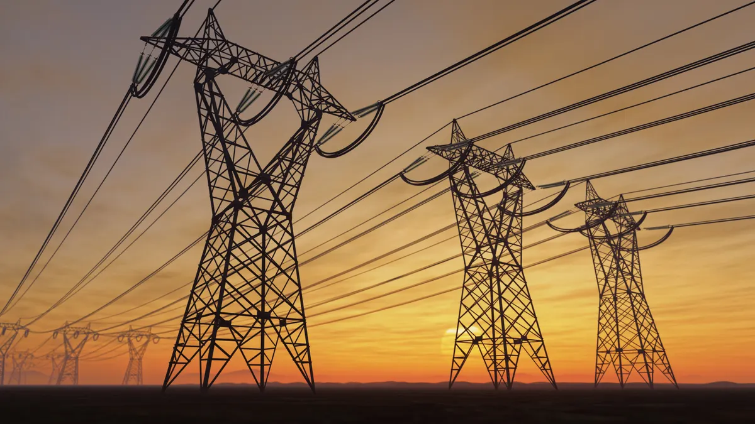
Industry Overview

Slide 3
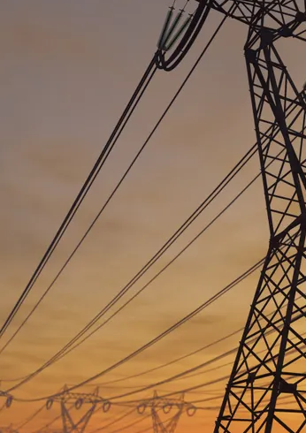
Four structural trends are driving the need to modernize and expand the grid
Rapid growth in electricity demand: driven by AI and data centers and the electrification of transport and heating, demand is returning to growth in mature markets and could more than double globally by 2050.
Critical aging infrastructure: over 70% of U.S. transmission assets and over 50% of U.S. distribution assets are more than 20 years old, necessitating urgent replacement
Structural shift in the energy system: the grid is transitioning from centralized fossil fuel generation to a decentralized, multi directional network, as wind and solar rise from ≤20% of global generation in 2025 to ≥75% by 2050
Escalating climate and weather risk: increased frequency and severity of extreme weather events require immediate, large scale grid hardening
Investment must scale sharply, and the cost of falling behind is already high
Global grid investment is expected to exceed $500 billion in 2026, but needs to reach ~$600 billion a year by 2030 under Net Zero Emissions by 2050 scenario
Grid related outages already cost the U.S. an estimated $54 billion a year, the highest among major economies
Coordination across a complex stakeholder map determines how fast upgrades get built
Utilities, developers, regulators, and investors each hold a piece of the solution and must act in sync
Priorities differ by region: the U.S. focuses on reliability and permitting, Europe on offshore integration, China on scale and curtailment
Key Messages
Industry Overview
Interconnection and stronger institutions unlock savings that pay for the transition
Europe’s ENTSO-E lets countries trade power across borders, saving €8 to €23 billion a year between 2030 and 2050 while cutting curtailment
Political and financial support can accelerate or stall progress; permitting and cost allocation rules need to keep pace with technology
Credit: Ilayda Tezcan, Ariela Farchi, and Gernot Wagner. Share with attribution: Wagner et al. “Powering Grids,” Columbia Business School Climate Knowledge Initiative (29 October 2026).

Slide 4


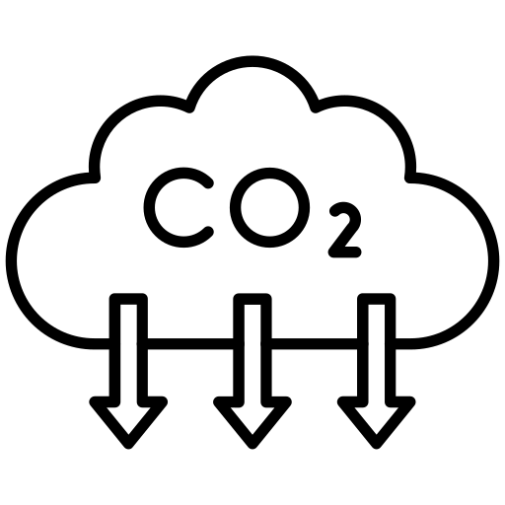
Modern energy grids are meant to provide power in a way that maximizes security while minimizing emissions and costs
Industry Overview
Solutions: Optimize
Solutions: Modernize
Solutions: Expand
Deployment
1
Maximizing grid security
  Supply of energy must meet demand wherever required on the grid and maintain reliability
  Energy powers the economy; lost hours are directly related to lower productivity and standard of life, while constrained grids prevent industrial expansion
  Grids must be secure and sovereign, with cybersecurity and supply chain challenges posing an increasing threat to connected assets
3
Minimizing cost of power
  Affordable electricity is a human right, while achieving it and connecting any form of new generation requires expensive change that needs to be paid for somehow
  Grids must seek creative ways to achieve returns while ensuring that costs are fairly allocated and without raising backlash from customer costs
2
Minimizing carbon emissions
  Intermittent and inverter-based technologies are being prioritized because they are the readiest source available and fastest to connect
  These technologies present unique challenges to the grid and its operations
Credit: Hasan Alawadhi, Stephanie Chen, Sevgi Helin Tilkicioglu, Isabel Hoyos, Dominica Wambold, Ariela Farchi, Pia Doris Morrow, and Gernot Wagner. Share with attribution: Wagner et al. “Powering Grids,” Columbia Business School Climate Knowledge Initiative (29 October 2026).

Slide 5
Global grids face the critical need to adapt due to demand growth, a changing energy landscape, aging assets and extreme weather
Industry Overview
Solutions: Optimize
Solutions: Modernize
Solutions: Expand
Deployment
Rapid growth in electricity demand
Structural shift in the electricity system
Energy Transition
Aging Infrastructure
Extreme weather
Increasing Demand
Driven by intensive load growth from AI/Data centers and the rapid electrification of transport and heating
Transitioning from centralized fossil-fuel generation to a decentralized, multi-directional energy network with more distributed abundant energy resources
Drivers of
Grid Modernization
and Expansion
Critical aging infrastructure
Escalating climate & weather events
Over 40% of global grid assets (up to 70% in the U.S.) are reaching the end of their 50-year design life, necessitating urgent replacement
Increased frequency and severity of extreme weather events require immediate and large-scale grid hardening
Sources: World Energy Investment (IEA, 2026); Global Landscape of Energy Transition Finance (IRENA, 2025).
Credit: Christy Wong, Ariela Farchi, and Gernot Wagner. Share with attribution: Wagner et al. “Powering Grids,” Columbia Business School Climate Knowledge Initiative (29 October 2026).

Slide 6

Global electricity demand projected to accelerate across nearly all major regions, no longer solely led by China
Industry Overview
Solutions: Optimize
Solutions: Modernize
Solutions: Expand
Deployment
Increasing demand
Electrification, data centers, and other new loads are driving the “age of electricity,” reversing decades of stagnant demand in mature markets
Observations
China has been the clear demand-growth outlier since 2010, with electricity demand up ~150% by 2025 versus ~50% globally
Sharp trajectory shift happens in mature markets: U.S. and European demand was broadly stagnant through 2025 but is projected to return to sustained growth
Recent growth from electrification, renewables, and data centers is a major challenge for decades-old grid systems, requiring massive investment
Other estimates forecast electricity growth to exceed that of the IEA’s Stated Policies Scenario, more than doubling by 2050
% Change in electricity final demand vs. 2010 baseline, 2010-2025 actuals, 2026-2050 forecasted¹
World
Asia excl. China
China
United States
Europe
Rest of World
“Age of electricity”
Before 2025, China was the sole driver of global electricity demand growth.
¹2010-2025 data from Energy Institute 2026 Statistical Review of World Energy; 2026-2050 modeled based on IEA Stated Policies scenario, from IEA World Energy Outlook 2025
Sources: Statistical Review of World Energy (Energy Institute, 2026); World Energy Outlook 2025 (IEA, 2025); Electricity 2026 (IEA, 2026); New Energy Outlook (BNEF, 2026); Power generation from renewables set to jump 84% in next five years (BNEF, 2026).
Credit: Pia Doris Morrow, Ariela Farchi, Dominica Wambold, and Gernot Wagner. Share with attribution: Wagner et al. “Powering Grids,” Columbia Business School Climate Knowledge Initiative (29 October 2026).

Slide 7


Electrification and data centers are among primary drivers accelerating electricity demand across the US, EU, and China
Industry Overview
Solutions: Optimize
Solutions: Modernize
Solutions: Expand
Deployment
Increasing demand
By 2030, data centers projected to account for ~50% of U.S. demand growth, building and transport electrification lead in the EU, and industrial electrification in China
Observations
Building and transportation electrification, industry, and data centers are leading to compounding electricity demand growth in the 2020s
While data center electricity demand represents a small portion of all growth, its average annual growth rate is expected to double again in the years ahead under base scenarios and is the leading electricity demand growth driver in the U.S.
Electricity demand characteristics from each of these drivers pose distinct challenges to grids; each can drive significant increases in peak as well as average demand, with different levels of predictability and control
Electricity demand total growth by sector and end-use in the US, EU, and China, 2015-2030, TWh
Industry
Cooling
Heat pumps
Data centers
Rest of building
Transport
Other
United States
European Union
China
2015-2020
2020-2025
2025-2030
2015-2020
2020-2025
2025-2030
2015-2020
2020-2025
2025-2030

Slide 8

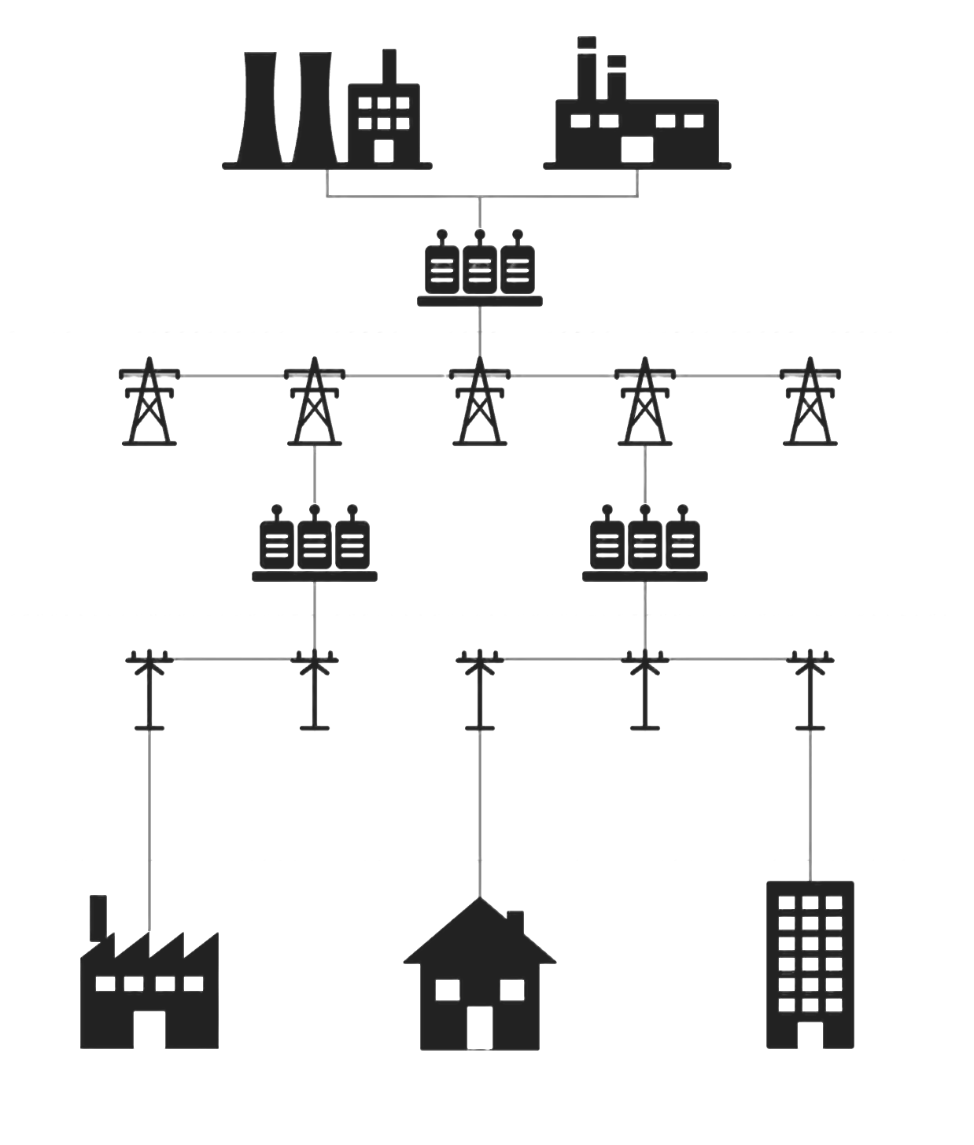
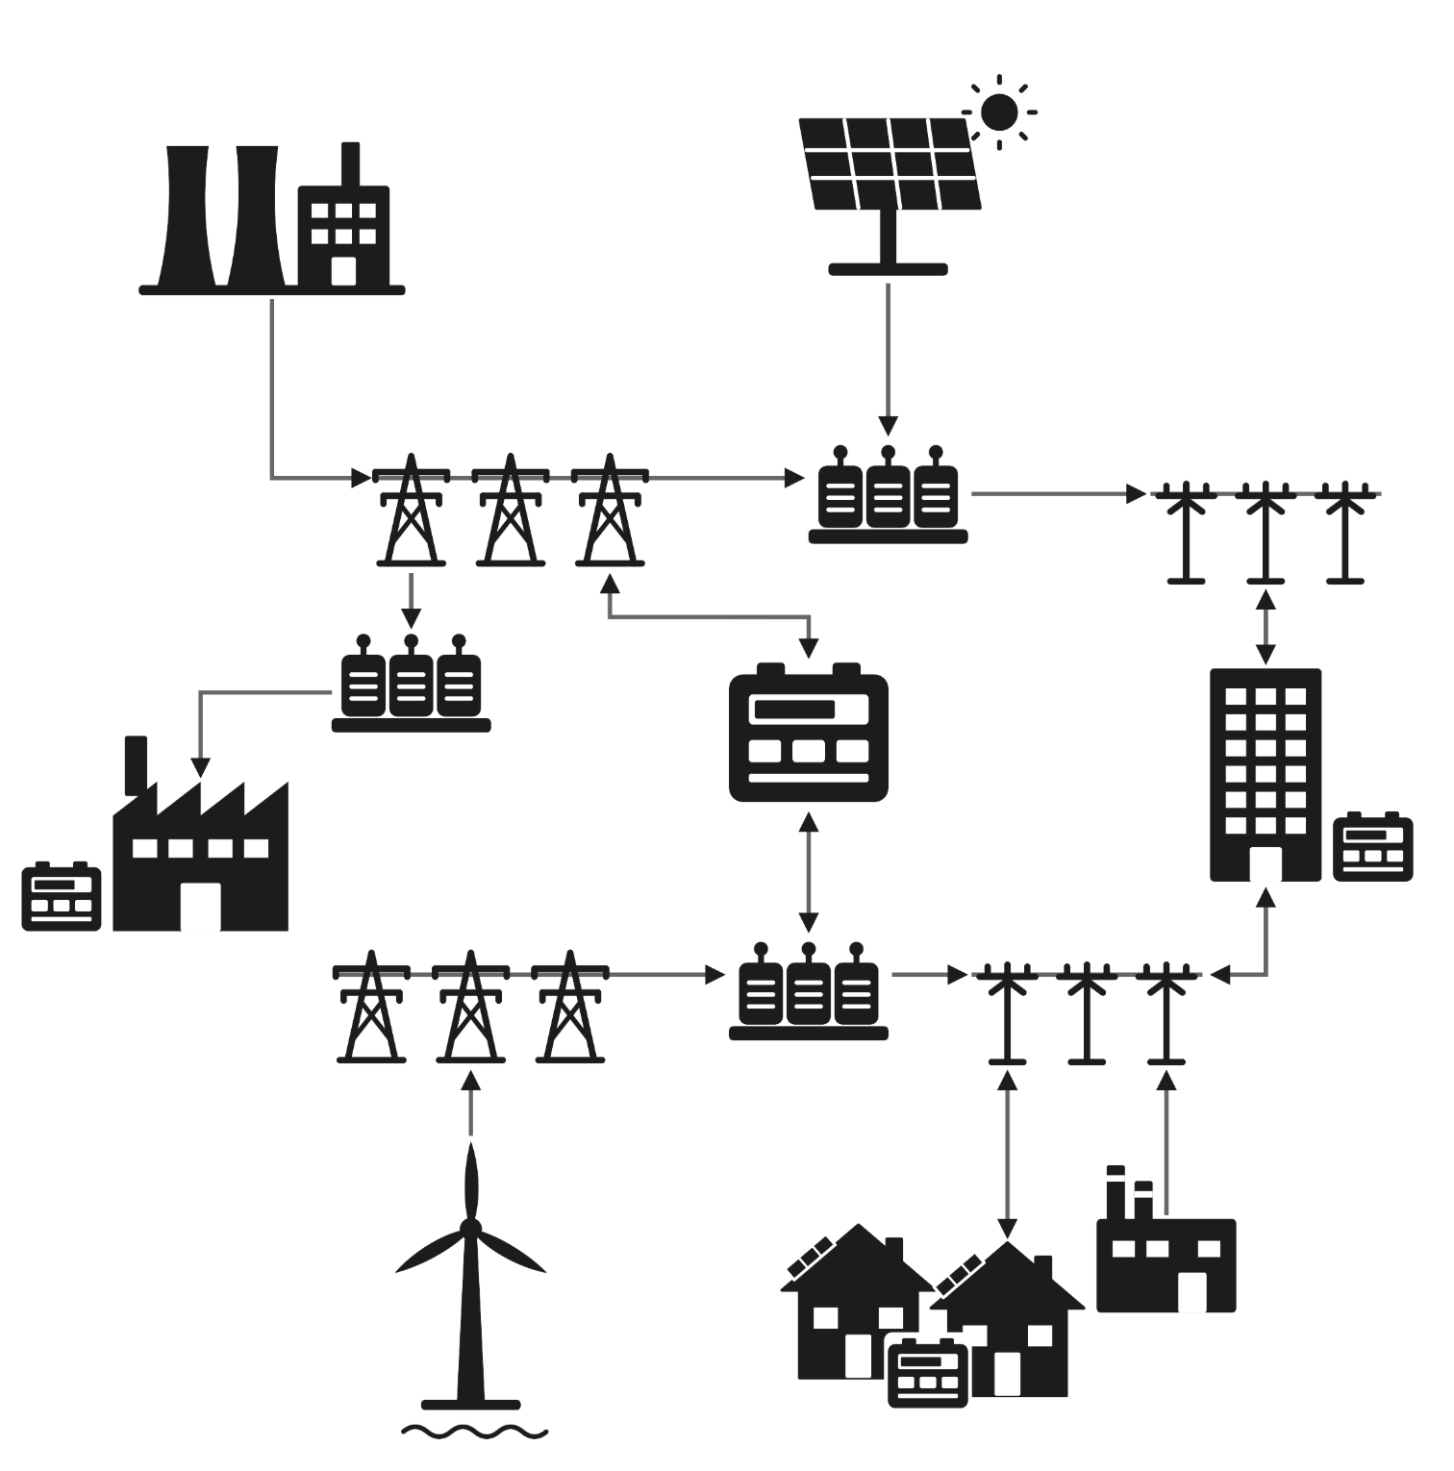
The power grid is transforming from a one-way centralized system to a two-way distributed network
Industry Overview
Solutions: Optimize
Solutions: Modernize
Solutions: Expand
Deployment
Energy transition
Traditional grids followed a one-way linear flow from generation to end use
Modern grids are increasingly networked due to distributed generation, which will reach 40% of global supply by 2040
Linear flow of energy
Large-scale
generation units
​Control​
Centralized utility dispatch
Resilience
Single point of failure, cascade risk
Scalability
Large capital-intensive T&D builds
Cost structure
High upfront infrastructure investment
Carbon profile
Fossil-fuel dominant at scale
Flow of energy
Power flow
Multi-directional, prosumers¹ generate, consume & trade
Control
DERMS/ VPPs aggregate distributed resources
Resilience
Single point of failure, cascade risk
Scalability
Modular; incremental prosumer-driven
Cost structure
Lower marginal cost; prosumer & DER-financed
Carbon profile
High renewable (VRE) penetration enabled
Utility scale renewable
Large-scale
generation unit
Substation
Step-up transformer
Transmission grid
Transmission
Distribution
Substation Step-down transformer
Utility scale storage
Commercial user with storage
Industrial user
with storage
Distribution grid
Transmission
Distribution
Local power plant
Industrial
user
Residential
user
Commercial
user
Off-shore renewable
Domestic user with solar and storage
¹Producers/Consumers
Sources: VPP Liftoff Report (DOE); Unlocking the potential of distributed energy resources (OECD, 2022); Integrating distributed energy resources in power distribution systems: A comprehensive review of impacts, challenges, and opportunities from a distribution system operator’s perspective (Lee, 2026).
Credit: Christy Wong, Ariela Farchi, Brenda Rain, and Gernot Wagner. Share with attribution: Wagner et al. “Powering Grids,” Columbia Business School Climate Knowledge Initiative (29 October 2026).

Slide 9
Wind and solar are set to supply over 50% of global electricity by 2050, up from ~15% in 2025
Industry Overview
Solutions: Optimize
Solutions: Modernize
Solutions: Expand
Deployment
Energy transition
Clean energy sources approach ~80% of generation by 2050, led by wind and solar
Intermittent and inverter based clean-power is expected to be the dominant energy source of the future
World Electricity Generation by Source (TWh)¹
World Installed Capacity by Source (GW_e)¹
Nuclear
Hydro
Wind
Solar
Bioenergy
Geothermal
Coal
Gas
Other fossil
68%%
80.1%
2025
2030
2035
2040
2045
2050
2025
2030
2035
2040
2045
2050
Observations
Low-emissions electricity, including renewables and nuclear, rises from ~40% of generation in 2025 to ~80% by 2050
Wind and solar drive most of the growth, increasing from ~16% to ~68% of generation and from ~37% to ~80% of installed capacity
This shift increases reliance on variable, inverter-based resources, raising the need for grid flexibility, transmission expansion, storage, and system balancing
Sources: Working paper, Innovation uncertainty shapes divergent pathways toward decarbonization (Moers et al., 2026).
Credit: Ilayda Tezcan, Ariela Farchi, and and Gernot Wagner. Share with attribution: Wagner et al. “Powering Grids,” Columbia Business School Climate Knowledge Initiative (29 October 2026).

Slide 10

Grid infrastructure is reaching or has passed its life expectancy in advanced economies, requiring urgent upgrades to be operational
Industry Overview
Solutions: Optimize
Solutions: Modernize
Solutions: Expand
Deployment
Aging infrastructure
+40% of global transmission infrastructure is over 20 years old; the U.S. accounts for the highest ratio, at 70%
EU and the U.S. lead in aging distribution: +50% are beyond useful life and need immediate modernization
Transmission infrastructure aging by region, 2024
Distribution infrastructure aging by region, 2024
< 10 years
10-20 years
>20 years
< 10 years
10-20 years
>20 years
23%
27%
29%
28%
24%
31%
28%
33%
43%
54%
44%
22%
54%
59%
20%
23%
70%
26%
18%
30%
24%
30%
23%
23%
23%
26%
21%
55%
53%
48%
50%
45%
54%
34%
42%
19%
33%
37%
23%
11%
20%
20%
World
Middle East
Southeast Asia
India
China
European Union
United States
World
Middle East
Southeast Asia
India
China
European Union
United States

Slide 11

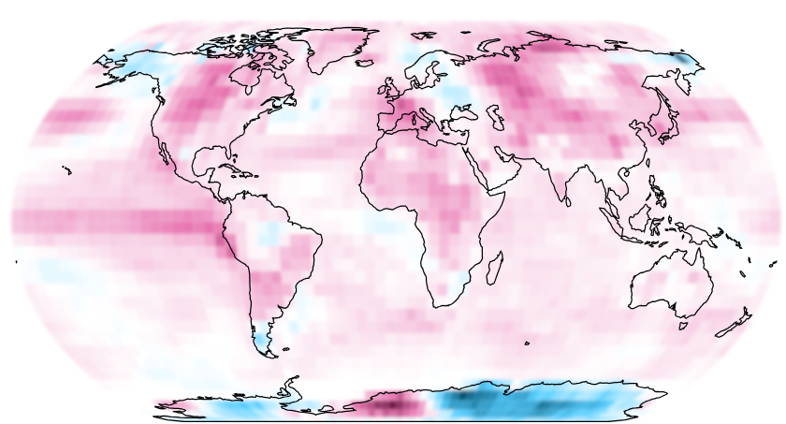
Changing global temperatures and extreme weather events significantly disrupt grid operations
Industry Overview
Solutions: Optimize
Solutions: Modernize
Solutions: Expand
Deployment
Extreme weather
Temperatures are shifting from historical baselines, existing infrastructure isn’t built to support this change
US Case Study: Extreme weather events directly damages critical grid infrastructure
Gridded average temperature anomaly vs. 1991-2020 base period,
July 2026 °C
Storm damage and recovery time on US transmission lines,
miles affected x days to restoration
Hurricane
Winter storm
Days to restoration
Cyclone
Tornadoes
125
70
Hurricane Milton
65
60
55
50
45
Hurricane Sally
Hurricane Zeta
40
Hurricane Helene
35
Wabash Valley Tornadoes
20
Hurricane Laura
Hurricane Ian
Dual-Ended Grid Stress: This rising thermal baseline creates compounding operational challenges, driving unprecedented electricity demand for cooling while simultaneously reducing the transmission capacity and efficiency of existing infrastructure
Regions experiencing warmer than average temperatures, such as the western EU, central Asia, and northern North America, see significant infrastructure distress from increased energy demand
15
Hurricane Idalia
Winter Storm Elliott
10
Winter
storm Uri
Hurricane Beryl
5
Extratropical Cyclone
0
Miles of
transmission
affected¹
0
500
1,000
1,500
2,000
2,500
3,000
3,500
9,500
¹Miles of transmission affected represents the approximate length of lines damaged, shut down, inspected, repaired, or otherwise impacted.
Sources: Temperature departure from global average (NCEI/NOAA, July 2026); A quieter hurricane season could still pummel US power grid (Claims Journal, 2026). Credit: Christy Wong Ka Ying, Brenda Rain, Ariela Farchi, and Gernot Wagner. Share with attribution: Wagner et al. “Powering Grids,” Columbia Business School Climate Knowledge Initiative (29 October 2026).

Slide 12
Grids continue to face long-standing challenges globally, while capital flows, new technology, and policy provide opportunities
Industry Overview
Solutions: Optimize
Solutions: Modernize
Solutions: Expand
Deployment
Grid reliability, interconnection queues, transmission congestion, grid infra deployment are key grid challenges…
…yet increasing investor interest, demand-driven capital flows, and ready-to-deploy technologies provide a critical opportunity
Grid reliability & frequency instability
Retiring spinning generators, renewables entering the load, surging peak demand create reliability problems (outages due to NYC Heatwave 2026)
Grid-scale battery storage, grid-forming inverters, demand flexibility
Interconnection queue backlogs
Cumulative active capacity in queues was 2.06 TWh at the end of 2025 in the US according to Lawrence Berkeley National Laboratory
AI-automated queue planning software, changing infrastructure such as solid-state transformers, changing interconnection policy
Investment mismatch
Global increase in grid financing still lags behind power generation investments
Investment opportunities such as grid enhancing technologies, transmission build-out
Expansion permitting & cost allocation bottlenecks
Intra-state HVDC lines face regulatory hurdles and cost allocation challenges
leading to long wait times (e.g. +10 years for Grain Belt Express approvals)
Advanced reconductoring, composite wires, blended finance
Key takeaway
As emerging trends compound long-standing bottlenecks with no easy-fix, solving this complex grid challenge requires a multi-pronged approach leveraging novel technologies, innovative capital structures, and modern regulatory frameworks.
Source: Grain Belt Express, (Orennia, 2025); Empowering growth: The opportunity in Latin America’s energy infrastructure (JP Morgan, 2025); US Interconnection Queues (LBNL, 2026), Intense heat knocks out power for thousands across New York City as resident search for relief (abc7, 2026)
Credit: Gunay Kiran, Ariela Farchi, Pia Doris Morrow, and Gernot Wagner. Share with attribution: Wagner et al. “Powering Grids,” Columbia Business School Climate Knowledge Initiative (29 October 2026).

Slide 13
Grid reliability failures impose large economic costs, with US showing the highest outage losses among selected markets
Industry Overview
Solutions: Optimize
Solutions: Modernize
Solutions: Expand
Deployment
Grid reliability
Equipment and technical failures represent ~50% of grid-related outage costs in the US, totaling ~$4.8B in 2021, a direct reflection of grid congestion
Observations
Economic impact from grid-related outages has tripled in the United States and highest among the selected countries, estimated at USD 54 billion annually
Outage-related losses in the U.S. account for roughly 0.23% of GDP, exceeding China, Australia, Germany, and Türkiye
Natural events and technical/equipment failures represent the largest contributors to outage costs across most markets
Lengthy transmission development timelines, often exceeding a decade for major high-voltage projects, have constrained grid expansion and increased system congestion
Outage losses impede economic and industrial development
Estimated economic impact of grid-related outages by cause as a share of GDP in selected countries, 2021
0.23 % of GDP
Technical/Equipment
15%
Human
Nature
0.17 % of GDP
0.18 % of GDP
3%
20%
0.16 % of GDP
21%
39%
6%
37%
39%
0.09% of GDP
12%
6%
76%
46%
82%
43%
55%
Germany
Türkiye
United States
China
Austalia
$36 Billion
$1.3 Billion
$54 Billion
$31 Billion
$2.4 Billion

Slide 14
Grid build out and interconnection delays are leading obstacles preventing existing capacity from coming online
Industry Overview
Solutions: Optimize
Solutions: Modernize
Solutions: Expand
Deployment
Interconnection backlogs
Annual breakdown of US interconnection queues by energy source (GW)
Observations
Connecting capacity to the grid is a central obstacle globally, particularly in the US and EU:
  Long feasibility studies were designed when only a few new coal or gas plants were connecting to grid
  Grids at maximum capacity force developers to pay for new transmission lines or wait for expansion
  To reduce delays, FERC now requires batch studies and adopts a ‘first ready, first served’ model
Queue volume declined in 2024 & 2025 due to withdrawals, not completions
  700GW+ in 2024 and 750GW in 2025 as first-ready, first-served cluster study models, capital requirements, and revenue models reduced speculation
  Declines were concentrated in renewables and storage; queues have since begun increasing again
Solar
Wind
Other renewables1
Batteries, other storage
Coal
Gas
Nuclear
1,000
900
Interconnection delays risk pushing renewables and batteries behind-the-meter, effectively losing them as grid-connected assets
908
800
730
700
600
596
603
557
500
400
348
300
258
277
295
201
202
234
200
136
110
115
126
95
127
100
78
0
2007
2008
2009
2010
2011
2012
2013
2014
2015
2016
2017
2018
2019
2020
2021
2022
2023
2024
2025

Slide 15
While financing flows into grids have been increasing globally, they still lag behind investments into power generation
Industry Overview
Solutions: Optimize
Solutions: Modernize
Solutions: Expand
Deployment
Investment mismatch
Traditional grid investment flows have been growing globally, but further financing is required to match the investment into and expansion of power generation
Observations
Grid financing has lagged behind load (demand) and generation investment growth
Substantial grid financing opportunities expand beyond those tracked as ‘Power’ investments, including digital, end use, and generation associated investments
Generation investment has been nearly double than grid investment for the last decade
Grid-connected (front-of-meter) storage is primed for sustained global investment, tied closely to the deployment of variable renewables
Investors can play a major role in financing EMDE grids, especially as international development financing dries up
Grids and utility scale storage investment by region, US$B, 2015-2025¹
Cumulative power investments by source, $B, 2015-2025
North America
Africa
Electricity Networks
Other Clean Power
Asia Pacific
Middle East
Storage
Coal & Waste
Europe
Eurasia
Renewables
Oil & Nat Gas
Central & South America
Nuclear
Fossil Fuels w/ CCUS
5,500
Grid investment continues to lag power generation, creating a significant financing gap and a growing opportunity for private capital to support grid modernization, expansion, and storage deployment.
5,500
314
322
309
295
294
295
314
321
353
404
447
0
0
2
2015
2016
2017
2018
2019
2020
2021
2022
2023
2024
2025

Slide 16
Permitting design is a trade-off between legitimacy and speed; coordinated planning with structured consent strikes best balance
Industry Overview
Solutions: Optimize
Solutions: Modernize
Solutions: Expand
Deployment
Permitting bottlenecks
 | Ad hoc planning with full local veto | Coordinated planning with structured consent | Centralized planning with national overrides
Siting & Planning | Local siting control Case-by-case approvals Reactive planning No national override | Regional/national corridor planning with structured consultation Override as backstop. | National planning, with eminent domain authority in infrastructure Deemed strategic
Cost Allocation | Generator pays for grid expansion Costs flow via wholesale prices | Regionalized cost sharing in future retail bills Partial public funding possible | National cost recovery through many means Treated as strategic infrastructure
Efficiency & Queues | Development done in solos with potential for bottlenecks and long queues/restudies | Targeted transmission corridors Potentially shorter queues and predictable timelines | Infrastructure can precede generation Maximizing deliverability
Congestion & Curtailment | High grid congestion can lead to reactive upgrades | Lower congestion as anticipatory build reduces curtailment | Structurally the lowest congestion (if planned well)
Political Trade-Off | High local legitimacy but with risk of delay | Balanced legitimacy & speed | High speed & certainty; risk of democratic pushback
Democratic yet slow
Preferred policy pathway
Undemocratic yet efficient
Sources: Transmission Interconnection Roadmap (DOE, 2025); Transmission planning and cost allocation (FERC, 2025); Customer-oriented approaches to generator interconnection (EBA, 2025).
Credit: Hasan Alawadhi, Stephanie Chen, Helin Tilkicioglu, Isabel Hoyos, Hyae Ryung Kim, and Gernot Wagner. Share with attribution: Wagner et al. “Powering Grids,” Columbia Business School Climate Knowledge Initiative (29 October 2026).

Slide 17
Global grid investment is expected to rise to +$500B in 2026 and increase through 2030, driven by infrastructure, materials, and labor
Industry Overview
Solutions: Optimize
Solutions: Modernize
Solutions: Expand
Deployment
Grid investment
Investment grew ~85% over 5 years, targeted to reach $600B by 2030 in NZE¹
2040-2050, 80% of investment needs to be used to modernize and 20% to expand
Observations
Grid investment needs to be spread across physical grid infrastructure, and grid enhancing technologies
Investing in robust supply chains and a prepared work force, alongside infrastructure and technology, will be critical to achieving global targets
  Increasing costs of equipment divest grid investments away from potential new infrastructure
Venture capital investments into grids has increased significantly in 10 years
  Investment in grid hardware rose 4x from ~$200M in 2015 to ~$800M in 2025
  Investment into optimization (reinforcements) rose from ~$50M to ~$400M
  Largest rise was in VPPs and DERMS, from ~$50M to ~$650M
Investment in power grid infrastructure, 2016-2026e USD Billions
Breakdown of global annual investment required,
2040-2050
ROW
Central and South America
Europe
China
Africa
APAC ex. China
North America
45%
550
+11% p.a.
450
395
$800-900B
320
355
310
310
300
295
295
310
35%
19%
2016
2018
2020
2022
2024
2026e
2030
New
connections
Asset replacement
Grid Reinforcement
2040-2050

Slide 18
Grid investments enable economic savings; cross-border trade can drive cost efficiency, renewables growth, and reduced curtailment
Industry Overview
Solutions: Optimize
Solutions: Modernize
Solutions: Expand
Deployment
Grid investment
ENTSO-E members trading power through capital markets can realize savings of €1.5-1.8 per €1 invested
Observations
Through the ENTSO-E, member states can exchange power through efficient capital markets, instead of relying on resources within their own borders
This leads to some countries being net exporters (France, Sweden, etc) or net importers (i.e. Italy, UK, etc.) depending on where power is more efficient to generate from
ENTSO-E expansion is essential to the energy transition as it:
Enables direct cost savings through lower fuel costs, lower firming costs, lower compliance costs, avoided generation for security, price convergence
Reduces RE curtailment requirements, which also enables dispatch of cheaper power
Net Exchange Volumes by member (2024, TWh)
Further transmission and storage investments lead to savings
By 2030
Investing
5 Billion €/yr
8 Billion €/yr cost reduction
30 TWh/yr avoided curtailment
19 MtCO₂e/yr avoided
Other
Exp.
By 2040
Other
Imp.
14 Billion €/yr cost reduction
343 TWh/yr avoided curtailment
27 Mton/yr avoided CO₂
Investing
6 Billion €/yr
By 2050
Investing
13 Billion €/yr
23 Billion €/yr cost reduction
122 TWh/yr avoided curtailment
15 Mton/yr avoided CO₂
Total Energy Exchange (2024): 480 TWh
17% of total energy consumed in the EU
Sources: ENTSOE Factsheet (ENTSOE, 2025); ENTSOE TYNDP (ENTSOE, 2025).
Credit: Hasan Alawadhi, Stephanie Chen, Helin Tilkicioglu, Isabel Hoyos, Hyae Ryung Kim, and Gernot Wagner. Share with attribution: Wagner et al. “Powering Grids,” Columbia Business School Climate Knowledge Initiative (29 October 2026).

Slide 19

Technology Solutions

Slide 20

Solutions fall into three pillars, each with a distinct speed to deploy and opportunity type
Expand: new transmission and interconnection, 5-15+ years, $200B+ annually estimated 2030-2035
Modernize: hardware upgrades to the grid including batteries, 1-4+ years, $200-400B/year estimated 2030-2035
Optimize: digital optimization and demand mgmt., 1 to 2+ years, systems savings potential of $150B+ by 2035
Expanding grid is slowest lever, and permitting & cost allocation are binding constraints
EMDEs need ~60M km of new lines, while +45M km of T&D lines must be replaced by 2050 globally
HVDC moves large volumes of power over long distances with lower losses, and can connect distant generation to load centers, but its high converter station costs only pay off over long corridors
China has built 45 ultra high voltage lines in about 15 years under central planning, while 36 U.S. HVDC projects, roughly 187 GW, remain stalled for lack of a cost allocation rule
Modernizing the grid draws significant capital flows, with battery applications expanding
Grid forming inverter adoption must accelerate to keep grids stable as batteries and intermittent RE scale
Battery storage is projected to draw $26B in U.S. spend in 2026 and over $100B globally, with a $330B U.S. long duration storage projection by 2050; decreasing costs are expanding the grid value of SATA and BESS
FACTS can unlock capacity in months at a 30 to 1 benefit to cost ratio, AMI is a $22B+ market growing at over 12% a year, and digital twins can increase grid upgrade capital efficiency by 20-30%
Key Messages
Technology Solutions
Optimizing via digital and load orchestration tools delivers the most value per dollar spent
Load shifting turns flexible household and business loads into grid assets and could save the U.S. power system over $15B a year by 2030; in bidirectional charging, V2B cuts building costs and provides backup, while V2G depends on market design
DERMS coordination could grow U.S. VPP capacity to 80 to 160 GW by 2030, saving ~$10B a year, and cut projected transformer overloads from 81% to 28% by 2050
The global VPP market is set to triple to $15B to $30B by the early 2030s, delivering peak capacity at 40% to 60% less cost than adding new gas peakers

Slide 21
Optimizing, modernizing, and expanding will upgrade insufficient and aging infrastructure into a resilient, intelligent grid ecosystem
Industry Overview
Solutions: Optimize
Solutions: Modernize
Solutions: Expand
Deployment
 | Optimize grid assets​ | Modernize and harden the core | Expand grid networks
Definition | Maximize the value of the grid through digital intelligence and demand management | Upgrade and modernize the core with capital efficient physical and technical augmentation | Structurally extend the grid's network to integrate available and emerging generation
Physical and Capital Profile¹ | Digital intelligence & demand-side solutions Asset-light | Hardware solutions at existing grid nodes Capital efficient | Net new and upgraded grid transmission Capital intensive
Highlighted Solutions | Load Shifting Technologies Distributed Energy Resource Management Systems (DERMS) Virtual Power Plants (VPPs) Bi-directional charging | Grid-Forming Inverters (GFM) Grid-Scale Battery Storage Flexible AC Transmission Systems (FACTS) Advanced Metering Infrastructure (AMI) Digital Twins | New transmission and distribution HVDC
Time to Deploy | 1-2+ years | 1-4+ years | 5-15+ years
Investment Opportunity² | Estimated $50-$150B+/yr from 2030-2035¹ Systems savings potential of $150B+ by 2035 | Estimated $200B-$400B+/yr from 2030-2035 | Estimated $200B+/yr from 2030-2035
Key Policy Levers | Performance based regulation reform DER aggregation reform, NWA incentives | Smart grid grants and incentive programs Cap and floor and depreciation schemes | Regional/interregional transmission planning Permitting, siting, and queue reform
¹The capital profile indicated is relative and intended to reflect the grid capital investment. ²Investment opportunity is global and based on projected investments for highlighted solutions as defined in each solution area, supplemented by World Energy Investment 2025-2026 reports aligned to STEPS 2030 and BNEF NZE and ETS scenarios. Grid expansion is driven significantly by net-new wires (transmission & distribution); modernize & harden the core includes IEA’s Power segment of battery storage; the optimize range includes grid orchestration software and a subset of end-use related charging infrastructure, with savings potential reflecting estimated grid value from demand flexibility. Sources: Building the future transmission grid (IEA, 2025); World Energy Investment (IEA, 2026); World Energy Investment (IEA, 2025); Electricity 2026 (IEA, 2026); Energy storage enters the 100 gigawatt era (BNEF, 2026); Electric Vehicle Outlook (BNEF, 2026); The Value of Demand Flexibility (IEA, 2025); Building grids faster (Energy Transitions Commission, 2024); Electricity Grids and Secure Electricity Transitions (IEA, 2023).
Credit: Dominica Wambold, Ariela Farchi, and Gernot Wagner. Share with attribution: Wagner et al. “Powering Grids,” Columbia Business School Climate Knowledge Initiative (29 October 2026).

Slide 22
Optimizing existing assets unlocks the lowest-cost grid capacity, while expansion offers unlimited investment opportunity
Industry Overview
Solutions: Optimize
Solutions: Modernize
Solutions: Expand
Deployment
Illustrative
Ceiling
Observations
AI could turn turn large loads into flexible grid assets, unlocking existing capacity while catalyzing investment in grid optimization and modernization
  ~100 GW of latent capacity: Flexible data center demand could unlock substantial capacity from infrastructure that already exists
  Faster interconnection: By reducing or shifting demand during constrained hours, large loads could connect without waiting for equivalent amounts of new grid build-out
  Investment catalyst: Data center investment flows can help deploy grid optimization and modernization technologies, including for storage, DERMS, and grid-forming inverters
  Untapped capacity: AI-enabled demand flexibility is estimated to be able to raise system efficiency up to 30% more broadly
Globally, storage and flexibility offer a major potential source of bridge power to meet growing demand while deferring as much as $1.8T in global grid investment through 2050
Expand
5-15+ yrs, capital intensive
HVDC, new transmission
Floor
AI is both driving grid demand and mitigating grid constraints
AI-enabled data center flexibility could unlock ~100 GW of dormant capacity while accelerating grid optimization and modernization
Price per unit capacity ($/MW, illustrative)
Uncapped upside
Modernize
1-4+ yrs, capital efficient
GFM, storage, FACTS, AMI, digital twins
Optimize
1-2+ yrs, load shifting,
DERMS, VPPs, V2G
Capacity (GW, illustrative)
20% of capacity

Slide 23
Scaling grid solutions requires overcoming distinct stakeholder bottlenecks across optimization, modernization, and expansion
Industry Overview
Solutions: Optimize
Solutions: Modernize
Solutions: Expand
Deployment
Key bottlenecks range from market access in Optimize to utility incentives in Modernize and permitting and cost allocation in Expand
Observations
Grid constraints are increasingly institutional, not technological:
  Optimizing requires access to existing flexibility,
  Modernizing requires mechanisms to monetize grid value,
  Expanding requires agreement on approvals, cost allocation, and project delivery
Barriers become more complex as solutions scale: Distributed-energy scaling is being held back by fragmented regulation and utility incentives, while transmission policy is explicitly focused on planning and cost allocation
 | Optimize grid assets | Modernize and harden the core | Expand grid networks
 | Load shifting, DERMs, VPPs, V2G | GFM, storage, FACTS, AMI, digital twins | HVDC, new transmission
Regulators & policymakers¹ | Enable DER aggregation and compensation; load flexibility could deliver >$15B annual system savings | Set standards and create markets for reliability services; Ireland increased allowable non-synchronous penetration from ~50% to 75%, targeting 95% | Resolve permitting and co-allocation to unlock >100 GW HVDC project pipeline
Utilities, planners & operators | Procure and orchestrate flexibility; ~200 GW of cost-effective US load flexibility could reduce peak constraints | Deploy upgrades where they defer new build; FACTS can increase transmission capacity by ~30-50% | Plan and operate new corridors capable of adding multi-GW capacity per project
Technology providers & developers | Scale orchestration platforms; coordinated DERs could form an ~80-160 GW VPP fleet | Supply grid hard- and software; >80% of US storage capacity is front-of-meter | Develop HVDC systems offering ~30-50% lower losses over long distances vs. comparable AC
Customers & beneficiaries | Monetize existing flexible assets; North America already has between 30-60 GW of VPP capacity on the grid | Participate through batteries, smart meters and flexible assets; AMI enables demand response and operational savings | Benefit from greater transfer capacity while ultimately funding regulated investment through tariffs
Investors & financiers | Fund asset-light platforms; coordinated DER/VPP deployment could generate ~$10B/year in grid savings | Finance storage and regulated/ contracted grid assets across a rapidly scaling market | Provide long-duration infrastructure capital once permitting and cost allocation are resolved
Critical stakeholder | Utilities and market operators | Utilities and regulators | Regulators and planners
Key bottleneck | Market access & orchestration | Utility incentives & standards | Permitting, cost allocation & delivery capacity
Keys to unlock capacity
Make flexibility accessible, dispatchable & monetizable
Reward capacity unlocked, reliability delivered and costs avoided
Accelerate approvals and align who benefits with who pays
¹Including permitting authorities.
Sources: VPP Liftoff Report (DOE); State Utility Incentives for Non-Wire Alternatives (Wharton,2020); Electricity Grids and Secure Energy Transitions (IEA, 2023). Credit: Pia Doris Morrow, Ariela Farchi, Dominica Wambold, and Gernot Wagner. Share with attribution: Wagner et al. “Powering Grids,” Columbia Business School Climate Knowledge Initiative (29 October 2026).

Slide 24
Load Shifting Technologies move non-essential electricity use from high-demand periods to times when the grid is less stressed
Industry Overview
Solutions: Optimize
Solutions: Modernize
Solutions: Expand
Deployment
Load Shifting
Device signaling
Flexible loads
Load shift
Compensation
1
2
3
4
How does load shifting work?
Why is it critical for the energy transition?
Moves consumption away from peak hours, reducing stress on lines, transformers, and generators
It helps match demand to renewable production times, rather than forcing renewables to follow a fixed demand profile
By shaving peaks and filling valleys, load shifting reduces the need for carbon-intensive peaker plants
Wider use of smart thermostats, heat pumps, water heaters, industrial load control, and EV smart charging linked to time-varying prices and automation
Advantages
Smart devices (data centers, thermostats, EV chargers, industrial controls) receive signals from the utility about when electricity is cheap, expensive, or scarce
Reduces peak load and grid stress: Demand smoothing
Enhances renewable energy utilization: Better alignment
1
When it is expensive, algorithms or customer-set preferences determine which load can be delayed without affecting comfort or operations
2
Disadvantages
During high-demand periods, the device reduces consumption and during low-demand hours, it increases consumption.
Customer behavior and participation: Engagement needed
Communication reliability: Stable signals
Limited visibility: Data gaps without AMI or sensors
3
Smart meters or built-in sensors track the load shifts so the system can fine-tune behavior, and the customer can benefit from lower bills, incentives, or grid-support payments
4
Source: Order No. 2222 Explainer: DERs in Electricity Markets (FERC, 2020); California's Biggest Battery Test Ever (PG&E, 2025); How Many Smart Meters Are Installed in the US? (EIA, 2023)
Credit: Sevgi Helin Tilkicioglu, Hasan Alawadhi, Pia Doris Morrow, Vincent Sandow-Straesser, and Gernot Wagner. Share with attribution: Wagner et al. “Powering Grids,” Columbia Business School Climate Knowledge Initiative (29 October 2026).

Slide 25
Load flexibility is a deployable solution that allows data centers to operate as grid-responsive assets
Industry Overview
Solutions: Optimize
Solutions: Modernize
Solutions: Expand
Deployment
Case Study
Emerald AI demonstrated data centers can shift up to 40% of non-critical load in <40 seconds
AI-automated demand response lowers data center consumption in response to peak demand
Observations
Converting data centers from static to flexible consumers improves speed-to-power and affordability by making best use of existing infrastructure
Expedited access to constrained grids in exchange for flexibility guarantees can effectively incentivize load-shifting adoption
EPRI’s DCFlex initiative and Mosaic framework provide resources for utilities seeking to integrate data centers as flexible loads
Emerald AI’s workload orchestration solution has enabled operational-scale grid flexibility in the U.K. and in several U.S. states
  In a collaboration between Santa Clara, Emerald AI, and Silicon Valley Power, SVP is pioneering a program where data centers that are willing to be flexible are more likely to be granted additional capacity
Flexible load capacity (load shedding potential) by grid service duration and response speed¹, % power drop
Demonstration of Peak Load relief (TV pickup effect example²)
Data center power targets (kW)
Grid demand (GW)
Data center power consumption (kW)
Frequency stabilization / rapid dispatch
<40 seconds
35-40%
Peak relief / shaving
Real-time (inverse-tracking)
~35%
AI cluster power draw (kW, illustrative)
Grid demand (GW, illustrative)
Sustained load reduction
2-10 hours (sustained)
Automated workload orchestration curtailed data center power draw by ~25%, providing an alternative source for peak relief
Carbon intensity matching
5-minute matching granularity
Time (minutes)
¹Emerald AI, EPRI, National Grid, and Nebius ‘AI Factory’ modeling with automated clustered response to grid disturbances across multiple use cases and scenarios; ² UK phenomenon – during football matches, use of domestic appliances, such as tea kettles, picks up significantly during half-time and at the end of the match, causing demand peaks. Sources: Power-Flexible AI Factories (Emerald AI, 2026); Flex Mosaic (EPRI, 2026); Global Effort to Prepare Future-Ready Grids (EPRI, 2025); AI data centers as grid-interactive assets (Nature Energy, 2025); Fast, Flexible Solutions for Data Centers (Rocky Mountain Institute, 2025); Blowing Off Steam (NVIDIA, 2026); AI drives demand, and will soon manage it (Silicon Valley Voice, 2026). Credit: Dominica Wambold, Ariela Farchi, Gunay Kiran, and Gernot Wagner. Share with attribution: Wagner et al. “Powering Grids,” Columbia Business School Climate Knowledge Initiative (29 October 2026).

Slide 26
A U.K. program demonstrated system and customer benefits from demand response, particularly driven by blackout avoidance
Industry Overview
Solutions: Optimize
Solutions: Modernize
Solutions: Expand
Deployment
Case Study
Octopus Energy’s Saving Sessions demand flexibility program provided customer benefits of ~ £5M, lifted energy retailer margins by ~£1M, and provided cost-effective insurance against blackout risk
Observations
Demand side response, enabled by technologies like VPPs and battery + renewables, can increase investor returns and reduce system and customer costs by providing an alternative to curtailment or generation overbuild
Avoiding costly Distribution upgrades via demand response could help offset escalating costs
VPPs could provide peak capacity relief at up to 40-60% lower cost than new generation, with deployment in as little as 6 months
Financing sources for demand response and VPP implementation include policy-enabled ancillary service market revenues (enabled in the U.S. by FERC 2222), public subsidy (e.g., via U.S. DOE), and VC/Growth Equity
Modeled system value (welfare analysis) of Octopus Energy’s demand flexibility program (GBP ‘000, 2022-2023 pilot results)¹
Benefit
Totals
The largest system value occurs from avoiding the cost of the National ESO imposing involuntary blackouts (e.g., load shedding). The U.K. sets the VoLL at £6,000/MWh
Avoided rebalancing costs are assumed not applicable in a VoLL scenario, but reflect the relative program value without VoLL benefits
-2165
Customer Benefit
Energy Retailer Benefit
CO2 Abatement Value
Avoided Outage Value (VoLL)
Total Benefit (incl. VoLL)
Program Cost
Avoided Balancing Costs
Net Operator Cost

Slide 27
Bidirectional charging enables vehicle-to-building and vehicle-to-grid interactions, turning EVs into flexible energy storage
Industry Overview
Solutions: Optimize
Solutions: Modernize
Solutions: Expand
Deployment
Bidirectional charging
1
Vehicle
2
Bidirectional charger
3
Buildings and energy grids
How does Bidirectional Charging for grid systems work?
Why is it critical for the energy transition?
EV batteries represent a rapidly growing flexible storage resource
Bidirectional charging can help balance peaks, improve resilience, and support renewable integration
It allows parked vehicles to provide value beyond transportation
It can defer grid and building infrastructure upgrades by using existing battery capacity
Advantages
1
An EV first participates through V1G, where charging is intelligently timed or managed while electricity still flows one way from the grid to the vehicle
Unlocks additional value from EV batteries while vehicles are parked
Can support resilience, peak management, and renewable integration
Creates value for EV owners through lower bills/increased home resilience (V2B), or by generating revenue streams (V2G)
2
With a bidirectional charger, the EV can charge and discharge, enabling electricity stored in the car’s battery to be used when needed
3
That stored electricity can be directed to budlings (V2B) or the grid (V2G) to reduce peak demand, support resilience, or optimize site electricity use
Disadvantages
4
EVs are connect to the grid through a bi-directional inverter and communication interface, allowing an aggregator or utility to coordinate discharge across multiple vehicles simultaneously
These aggregated EVs export to the grid and respond to real-time utility or market signals, such as frequency regulation or demand responses, to provide system-wide flexibility and grid services
Requires bidirectional-capable hardware, controls, and coordination
Depends on standards, interconnection, and compensation mechanisms
Participation and value vary by site readiness, driver behavior, and market design
Source: Vehicle-to-Grid Integration Assessment Report, (US DOE, 2025); Global EV Outlook 2026, (IEA, 2026); EV Batteries Could Satisfy Short-Term Grid Storage Demand, (Nature, 2023)
Credit: Sevgi Helin Tilkicioglu, Hasan Alawadhi, Isabel Hoyos, Vincent Sandow-Straesser, and Gernot Wagner. Share with attribution: Wagner et al. “Powering Grids,” Columbia Business School Climate Knowledge Initiative (29 October 2026).

Slide 28
V2B can cut building costs and provide backup; V2G can earn revenue but depends on approval and policy
Industry Overview
Solutions: Optimize
Solutions: Modernize
Solutions: Expand
Deployment
Bidirectional charging
V1G works today; V2B is emerging as backup power; V2G is limited to early offers and pilots
Vehicle supply is the first constraint, as few EV models can send power back
Observations
Smart charging (V1G) delivers €19-42B a year in modeled European system savings; V2G adds up to €2.5B¹
Bill savings do not equal grid relief; static time-of-use tariffs can lead many EVs to charge or discharge at once, worsening grid impacts
V2G offers for private EV owners only appeared in 2025 and V2G regulation remains fragmented
In IEA's illustrative home case, ~$500 a year in benefit pays back a bidirectional charger in ~2 years (AC) to 10 years (DC)
Where no EV is parked on site, a stationary battery competes with V2B, as storage pack prices fell 45% to $70/kWh in 2025
 | V1G Smart charging | V2B / V2H Home or building | V2G Grid export
Power flow | One way; charging timed to match generation or ease congestion | Vehicle discharges to the home or building where it is parked | Vehicle exports power to the grid
Value captured | Lower charging cost and avoided peak load | Bill savings and backup power | Energy arbitrage, ancillary services and distribution-level services
Grid approval (typical U.S. practice)³ | No interconnection approval; the system only charges | Usually none if it discharges only in outages, like a backup generator; approval if it discharges while grid-connected, like a stationary battery | Interconnection approval, as it discharges while the grid operates
Extra hardware | Smart charger or vehicle that adjusts charging on a signal; no bidirectional hardware | Bidirectional charger, <$1.5k AC to $5k+ DC; backup also needs a device that isolates the building from the grid | Bidirectional charger certified to local grid codes and able to communicate with the EV
V2G-capable EV models in production, by region, 2020 to 2026²
Japan
Europe
United States
China
Korea
Number of
EV models
Only 22 models (<1.5% of all EV models) are V2G-capable in 2026; 13 are European, and IEA first records U.S. models in 2026²
22
13
4
3
3
3
4
2020
2021
2022
2023
2024
2025
2026

Slide 29
U.S. pilots demonstrate bidirectional operation, but economics and deployment remain site-specific
Industry Overview
Solutions: Optimize
Solutions: Modernize
Solutions: Expand
Deployment
Bidirectional charging
PG&E's backup phases need no grid approval, while its grid-connected phases do; only Boulder reports realized bill savings
Observations
PG&E's pilot summary identifies high bidirectional equipment costs, especially DC, and limited compatible EVs and chargers as barriers
OEM and charger-provider agreements took longer than anticipated in PG&E's pilots
Delaware's fleet vehicles had to be retrofitted with a bidirectional converter
Interconnection processes at most utilities were designed for solar, not yet adapted for batteries
Net metering is not yet required for V2G in most states; without it, earlier Delaware-area calculations show regulation revenue can halve
PG&E's microgrid pilot faced control-system deployment issues and funding delays
Five U.S. bidirectional charging cases, by type, scale and grid approval
 | North Boulder Rec Center | PG&E Residential pilot | PG&E Commercial pilot | PG&E Microgrid pilot | Delmarva Power fleet pilot
Type | V2B | V2H; V2G planned¹ | V2B and V2G | V2M (vehicle-to-microgrid) | V2G
Location | Boulder, CO | Contra Costa and Yolo counties, CA | Oakland, CA | Humboldt County, CA | Newark, DE (PJM market)
Period | Dec 2020 to Nov 2021 | As of Jun 2025 | As of Jun 2025 | As of Jun 2025 | Final report, Mar 2026
Scale | 1 city fleet Nissan LEAF on a two-way charger | 3 customers | 1 customer (Zum bus fleet), 74 chargers | 3 airport staff customers, 4 chargers | 4 Ford Mach-E fleet vehicles
Program scope | Cutting the building's demand charges | Home backup, then bill savings | Building backup, then bill savings and V2G | Community resiliency during outages | PJM frequency regulation on a recorded signal, and time-of-use arbitrage
Grid approval | Not stated in the report | None for backup (Phase I); Rule 21 agreement once grid-connected (Phase II) | None for backup (Phase I); Rule 21 agreement once grid-connected (Phase II) | Rule 21 agreement required for all participants | Interconnection required; simplified review only under 10 kW
Result | $2,963.50 in demand charge savings² | Not yet reported⁴ | Not yet reported⁴ | Not yet reported⁴ | Modeled $1,102 to $3,359 a year for a hypothetical 10 kW car³; PJM made no payment; no measurable battery degradation

Slide 30
V2G could play a significant role in fulfilling grid storage demand, unlocking up to ~60 TWh in combination with second-use
Industry Overview
Solutions: Optimize
Solutions: Modernize
Solutions: Expand
Deployment
Bidirectional charging
Total actual available capacity under various conditions in STEP-NCX scenario in 2050
Observations
Leveraging V2G and re-use are two domestic sources for battery storage deployment
V2G participation in grids could play a role in providing the real-world capacity for short-term grid storage, with EV batteries together with second-use utilization rates reducing other battery and generation needs
When both V2G participation rates and second-use rates are at 50%, the projected real-world capacity reaches between 25 and 48 TWh by 2050 (STEP-NCX scenario)
Meeting grid storage demands by 2050
(3.4 to 19.2 TWh) can be done with different combinations of V2G and second-use. Without any second-use batteries in stationary storage, grids would require V2G participation rates of an achievable 12% to 43%
Assuming half of second-use batteries (retired EV batteries repurposed for stationary grid storage after falling below automotive performance thresholds) are used for grid storage, the required participation rate of V2G drops to below 10%
 | 6 TWh |  |  |  |  |  |  |  |  | 62 TWh
100%
90%
80%
70%
60%
50%
40%
30%
20%
10%
 | 10% | 20% | 30% | 40% | 50% | 60% | 70% | 80% | 90% | 100%
2050 grid storage demand
Second-use utilization rate
Vehicle-to-grid participation
Source: Electric vehicle batteries alone could satisfy short-term grid storage demand by as early as 2030 (Nature, 2023).
Credit: David Foye, Petr Jenicek, Birru Lucha, Hyae Ryung Kim, Dominica Wambold, and Gernot Wagner. Share with attribution: Wagner et al. “Powering Grids,” Columbia Business School Climate Knowledge Initiative (29 October 2026).

Slide 31
Distributed Energy Resource Management Systems orchestrate millions of small assets into a single, dispatchable grid resource
Industry Overview
Solutions: Optimize
Solutions: Modernize
Solutions: Expand
Deployment
DERMS
Distributed energy resources
Metering & telemetry
Dispatch & control
1
2
3
Forecasting
4
Optimization
5
6
Verify & settle
How does DERMS for grid systems work?
Why is it critical for the energy transition?
Unlocks flexibility hidden in millions of behind-the-meter assets, turning passive load into a controllable, grid-supporting resource
Lets the distribution grid absorb far more rooftop solar and EVs without costly wire upgrades, by actively managing local flows
By aggregating DERs into virtual power plants, it provides capacity and ancillary services otherwise met by fossil peakers
Shifts the grid from centralized, supply-following dispatch to a distributed, demand-flexible system
Advantages
Distributed energy resources (DERs), e.g., rooftop solar, batteries, EVs and thermostats, are connected and registered to the platform
Defers grid capex: Avoids new wires
Fast to deploy: Software-led
Unlocks DER value: Idle assets earn
Improves reliability: Local flexibility
Integrates renewables: Absorbs solar/wind swings
1
2
Each asset continuously reports its output, state of charge and availability
3
The platform forecasts load, solar and wind output, prices and grid constraints
It optimizes a dispatch that respects grid limits and market signals
Disadvantages
4
Integration complexity: Many vendors & systems
Needs enrollment & rules: Opt-in, standards, FERC 2222
Cybersecurity: Millions of endpoints to secure
5
Setpoints go back to the assets: charge, discharge, curtail or shift load
6
Delivered response is verified and participants are paid, then the loop repeats
Source: VPP Liftoff Report (DOE); Order No. 2222 Explainer: DERs in Electricity Markets (FERC, 2020); GridOS DERMS: Distributed Energy Resource Management System (GE Vernova, 2025).
Credit: Sevgi Helin Tilkicioglu, Hasan Alawadhi, Pia Doris Morrow, Vincent Sandow-Straesser, and Gernot Wagner. Share with attribution: Wagner et al. “Powering Grids,” Columbia Business School Climate Knowledge Initiative (29 October 2026).

Slide 32
DERMS provide an increasingly distributed grid with improved visibility, dispatch efficiency, interoperability and market integration
Industry Overview
Solutions: Optimize
Solutions: Modernize
Solutions: Expand
Deployment
DERMS
Renewable power capacity growth by technology¹
TW, 2013-2030
Observations
Without centralized coordination, 81% of US distribution transformers could be overloaded by 2050, dropping to just 28% with DERMS-based coordination and reducing peak load by 17%
DERMS unlocks DERs as dispatchable non-wires alternatives, deferring costly infrastructure upgrades, tripling US VPP capacity to 80–160 GW by 2030 could save $10B annually in grid costs
Enables TSO-DSO coordination, bridging two operators who historically lack real-time data exchange across the T/D interface
5.0
Visibility
Grid operators can see availability and charge level of resources behind the meter, enabling forecasts on generation
4.5
PV-utility
PV-distributed
4.0
Wind
Hydropower
3.5
Other
Dispatch and constraint management
Aggregates and dispatches DERs, optimizing peak shaving and economics while adhering to security constraints. Plus, settles C&I flexibility payments¹
3.0
2.5
  Does not include Behind the Meter batteries which are expected to be ~2 TW total by 2030
2.0
33%
1.5
Interoperability and market integration
DERMS bridge the system gap integrating different DERs to the tech stack with dispatch optimization and wholesale / flexibility markets
1.0
30%
0.5
16%
0.0
2013-2018
2019-2024
2025-2030
¹DERMS are used to size metered loads of Commercial and Industrial (C&I) customers to figure out how much a C&I customer needs to be paid when their process load is curtailed and use the information credit the customer.
Sources: Renewable electricity capacity growth by technology segment (IEA, 2025); Coordinating distributed energy resources for reliability can significantly reduce future distribution grid upgrades and peak load (Navidi et al., Joule, 2023); VPP Liftoff Report (DOE); Use Cases and Digital Twins Solutions (ENTSO-E & DSO Entity, 2026); Batteries and Secure Energy Transitions (IEA, 2024). Credit: Hasan Alawadhi, Isabel Hoyos, Dominica Wambold, Ariela Farchi, and Gernot Wagner. Share with attribution: Wagner et al. “Powering Grids,” Columbia Business School Climate Knowledge Initiative (29 October 2026).

Slide 33


Flexibility markets, supported by DERMS, provide incentives for aggregated DERs and VPPs to respond to grid needs at scale
Industry Overview
Solutions: Optimize
Solutions: Modernize
Solutions: Expand
Deployment
DERMS
The EU and US have policies in place to encourage the participation of distributed resources in energy markets
GE’s GridOS demonstrates how DERMS can collaborate with market platforms to improve flexibility operations
U.S.
 | Market Platform | DERMS
Focus | Marketplace operations Commercial transactions | Asset powerflow analysis Grid physics
Who does it interact with? | Portal for service providers to register DERs and submit bids | Internal dashboard for grid or DER operators to manage flexibility
How does it facilitate flex markets? | Clears bids based on economic criteria (best price) | Screens bids against physical grid network models (capacity limits, voltage constraintsm etc)
FERC 2222
Allows DERs to participate in regional capacity, energy, and ancillary services markets
A coordinatior aggregates DERs in order to meet size and performance requirements, and participate alongside traditional resources
EU
RED III
Targets to increase renewable energy use across the EU
Encourages engagement of DERs in electricity and flexibility markets through aggregators
EU Network Code-on-Demand Response
Ensures that demand response resources can participate in wholesale electricity markets
Standardise how demand response is measured
Considers this key factor to energy security and the energy transition
Sources: GridOS DERMS and flexibility markets (GE Vernova, 2025); FERC order no. 2222: Fact sheet (FERC, 2020); Guidance on article 20a (EU, 2025); New code on demand response (EU ACER, 2025). Credit: Ariela Farchi, and Gernot Wagner. Share with attribution: Wagner et al. “Powering Grids,” Columbia Business School Climate Knowledge Initiative (29 October 2026).

Slide 34
Virtual power plants aggregate thousands of distributed assets into a single, dispatchable, market-facing power plant
Industry Overview
Solutions: Optimize
Solutions: Modernize
Solutions: Expand
Deployment
VPP
Distributed energy resources
Monitor & forecast
Optimize & dispatch
Bid into markets
Grid & wholesale markets
1
Aggregate
2
3
4
5
Deliver & settle
How do VPPs work?
Why are they critical for the energy transition?
Turn millions of DERs into firm, dispatchable capacity, with no new power plant built
Deliver peak capacity at roughly half the cost of a new gas peaker or grid-scale battery, easing affordability
Distributed batteries charging on midday solar and discharging at peak absorb renewable variability and displace fossil peakers
Among the fastest, cheapest ways to meet near-term load growth (e.g., data centers and electrification) while transmission lags
Advantages
1
Aggregate thousands of distributed energy resources (DERs), e.g., rooftop solar, home and commercial batteries, EVs and smart thermostats, into one cloud-managed portfolio
Fast & low-cost: Deploys in months
Cheaper than peakers: ~Half the cost
Pays participants: Owners earn for it
Scales with DERs: Solar, batteries, EVs
Boosts resilience: Peaks & emergencies
2
Monitor every asset in real time and forecast generation, load and market prices
3
Optimize and dispatch the resources. Software decides when each asset charges, discharges or curtails to meet grid and market needs
Disadvantages
4
Bid the combined capacity into wholesale energy, capacity and ancillary markets, or into utility programs
Market access: Patchy rules, FERC 2222 to 2028
Interoperability: Opt-in & multi-vendor control
Undervalued: Operators cap & under-credit VPPs
5
Deliver the committed service and share the revenue back with participating owners
Source: Pathways to Commercial Liftoff: Virtual Power Plants (US DOE, 2025); 2025 North America VPP Market (Wood Mackenzie, 2025)
Credit: Vincent Sandow-Straesser, Ariela Farchi, and Gernot Wagner. Share with attribution: Wagner et al. “Powering Grids,” Columbia Business School Climate Knowledge Initiative (29 October 2026).

Slide 35
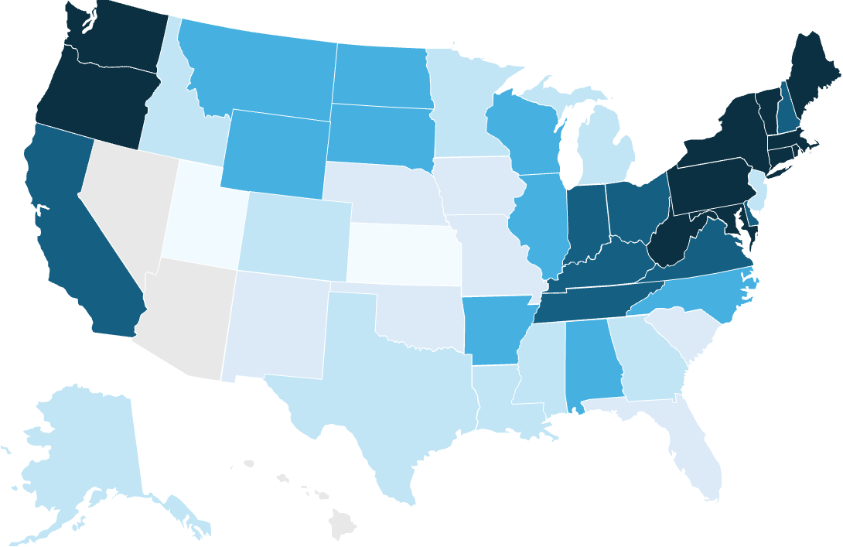
Google and Voltus expand their virtual power plant agreement tenfold to unlock 1 GW of flexible grid capacity
Industry Overview
Solutions: Optimize
Solutions: Modernize
Solutions: Expand
Deployment
Case Study
Demand flexibility agreements are expanding across U.S. data centers
Google and Voltus expand their PJM virtual power plant agreement to 1 GW
Observations
VPPs offer a scalable, less infrastructure-intensive approach to meeting growing electricity demand
Distributed flexibility can deliver benefits to households and businesses
  Participating customers receive financial incentives through bill savings and direct payments
  Broader deployment of VPPs could reduce the need for infrastructure built primarily to meet peak demand
BYOC demonstrates how hyperscalers can finance additional grid capacity
  This presents a capital-efficient solution to improve grid utilization
  Hyperscalers like Google bring in critical financing; data center investments can expedite the flexibility technology learning curve
Google locations with flexible data center agreements
Flexibility arrangement
Potential flexibility arrangement
Average electricity bill change
100 MW
Initial three-year agreement
1 GW
Expanded VPP agreement
0% 10% 20% 30% 40% 50%
June
July
Aug
Sep
October
2026
Deal Dynamics
Google funds a VPP operated by Voltus, aggregating flexible resources from households and businesses across PJM
Voltus coordinates batteries, smart thermostats, and other flexible assets to reduce electricity demand during periods of grid stress
The original agreement targeted up to 100 MW of accredited distributed capacity annually over three years, with the same capacity re-enrolled or requalified each year
The October 2026 expansion targets a 1 GW VPP, scaling the BYOC model to help meet growing data center demand while compensating participating customers
Source: We are working with Voltus to build a 1 GW VPP (Google, 2026); Large Load Customer Projects and Tariffs (EEI, 2026); A new framework for DER value in the speed to power era (The Brattle Group, 2026); How we’re making data centers more flexible to benefit power grids (Google, 2025); Google and Voltus to deliver grid capacity and local economic benefits through bring your own capacity agreement (Voltus, 2026); PJM Capacity Auction Procures 138,318 MW of Generation Resources as Work Continues To Address Growing Electricity Demand (PJM, 2026). Credit: Ariela Farchi, Pia Doris Morrow, Dominica Wambold, Christy Wong, and Gernot Wagner. Share with attribution: Wagner et al. “Powering Grids,” Columbia Business School Climate Knowledge Initiative (29 October 2026).

Slide 36
Advanced Metering enables two-way digital communication between utilities and customers, enabling smarter grid operations
Industry Overview
Solutions: Optimize
Solutions: Modernize
Solutions: Expand
Deployment
AMI
1-15 mins
Smart meter
Communication tower
Utility software
Meter Data Management System (MDMS)
Utility
1
2
3
4
5
How does Advanced Metering Infrastructure (AMI) 2.0 work?
Why is it critical for the energy transition?
Provides near- real-time visibility of electricity use
Enables dynamic tariffs, demand response, smart EV charging, and integration of rooftop solar and batteries at scale
Better data and price signals help shift and reduce consumption, lowering peak demand and allowing more renewables to operate without curtailment
Smarter AMI 2.0 platforms combine metering, grid monitoring, and customer apps into one digital layer for the grid
Advantages
Each meter communicates usage data between utilities and customers, creating a two-way digital link – instead of a one-way, reading-only method
Better visibility: Real-time data
Foundation for a smart grid: Digital layer
Supports flexible demand: Dynamic control
Faster outage detection: Instant alerts
Multi-purpose: Smart meters at customer premises, networks & MDM with utilities
1
The utility’s software receives the measurements, checks for errors, and organizes the data to ensure accurate billing and reliable operational information
2
The Meter Data Management System (MDMS) stores detailed consumption and generation data, applies validation rules, and prepares the data for billing, forecasting, outage detection, load analysis, and customer dashboards
Disadvantages
3
Upfront cost: Major investment, utility-paid
Integration complexity: System alignment
Customer acceptance: Trust and adoption
Data utilization: Despite high AMI adoption, deriving DER value of the analytics layer lags
The AMI data feeds many utility functions: outage detection, demand response, dynamic pricing programs, remote connect/disconnect, and dashboards that show customers their real-time electricity use
4
Sources: Demand Response and Advanced Metering (FERC, 2025); Electricity Grids and Secruity Energy Transitions (IEA, 2024); What is advanced metering infrastructure (AMI) (IBM, 2026).
Credit: Sevgi Helin Tilkicioglu, Hasan Alawadhi, Isabel Hoyos, Dominica Wambold, Ariela Farchi, and Gernot Wagner. Share with attribution: Wagner et al. “Powering Grids,” Columbia Business School Climate Knowledge Initiative (29 October 2026).

Slide 37
Closing the AMI implementation gap requires interoperability mandates, targeted grants, and demand response market pricing
Industry Overview
Solutions: Optimize
Solutions: Modernize
Solutions: Expand
Deployment
AMI
Effective policy drives value capture, assisted by performance incentives and interoperability
AMI adoption is largely achieved via the rate base and grant funding
Observations
The US pathway illustrates the ‘slow and steady’ route to AMI deployment in mature markets
  Funded through the utility rate-base PUC process, with costs and system savings passed through via OpEx reductions
  Evolution from AMI 1.0 to AMI 2.0 is in progress as meters age
Concessional capital delivered via grants, development finance, and incentives can accelerate utility and customer adoption especially in undercapitalized areas
Mandates may help drive high value data utilization and complete adoption throughout grid systems, maximizing the value of demand management programs
AMI is a foundational technology for many demand response capabilities
US AMI deployment percentage by application, 2015-2024
Enabling Policies
System Design | Set and govern time-of-use (TOU) rates, critical peak pricing, and real-time dynamic pricing to incentivize customer behavior Optimize pricing and measure impacts to ensure data translates into system savings
Regulation | Establish a national framework for AMI data sharing, interoperability, and cybersecurity Mandate functional interoperability, secure and non-discriminatory data governance, pay-for-performance, dynamic rating, and adoption
Public Finance | Authorize concessional capital (incentives, grants, DFIs) to drive adoption, focusing on under-capitalized utility systems or regions Require default time-varying rates to access grants and other public revenue sources
Residential
Commercial
Industrial
85
84
The US AMI deployment ramp to ~80% across residential, commercial, and industrial reflects the efficacy but slow pace of financing via rate base
81
80
80
77
75
75
73
73
69
69
70
68
65
66
65
61
62
63
60
57
58
58
US federal grant programs offer concessional capital primarily for underserved utility areas, a model for EMDEs
55
52
54
54
50
51
50
47
43
45
44
45
40
40
40
38
0

Slide 38
Digital Twins can create a real-time virtual model of grid assets and operations, providing a key tool for grid orchestration
Industry Overview
Solutions: Optimize
Solutions: Modernize
Solutions: Expand
Deployment
Digital twins
1
3
3
4
5
Field sensors
SCADA / AMI Systems
Grid Assets
Meter Data Management System (MDMS)
Utility World Models
How do Digital Twins for grid systems work?
Why is it critical for the energy transition?
Can reduce costs of and accelerate and maximize the safe integration of renewable energy
Key enabler for integrating and managing bi-directional resources and demand management
Scenario planning and advanced modeling capabilities help planners and operators de-risk large system changes required for the energy transition
Advantages
Sensors collect real-time field data from grid equipment (e.g., voltage, current, temperature, faults, equipment condition)
Asset value realization – de-risks GETS
Utilization control – system-wide visibility
Decision-making – net-new simulation, scenario, and testing capabilities
Energy source integration – facilitates generation, storage, DER, and EV sources
1
SCADA / AMI systems transmit and organize operational data from control rooms and customer meters, giving visibility into grid flows, outages, and demand patterns
2
Asset-level data adds the static physical context: where equipment is located, what it is, how old it is, its capacity, condition, and maintenance history
3
Disadvantages
Upfront cost - major investment, utility-paid
Data quality and management – quality and upkeep dependent
Complexity – across assets and subsystems
Security – cybersecurity and data security risk
System models combine real-time electricity and asset data into a virtual grid model that can simulate power flows, test scenarios, forecast risks, support planning and operations, and provide real-time monitoring & visualization
4
Sources: Demand Response and Advanced Metering (FERC, 2025); Electricity Grids and Secruity Energy Transitions (IEA, 2024), What is advanced metering infrastructure (AMI) (IBM, 2026).
Credit: Helin Tilkicioglu, Hasan Alawadhi, Isabel Hoyos, Hyae Ryung Kim, Dominica Wambold, Ariela Farchi, and Gernot Wagner. Share with attribution: Wagner et al. “Powering Grids,” Columbia Business School Climate Knowledge Initiative (29 October 2026).

Slide 39
Effective policy for digital twins targets system-level design to deliver savings and reliability as part of a smart grid strategy
Industry Overview
Solutions: Optimize
Solutions: Modernize
Solutions: Expand
Deployment
Digital twins
Indian utilities enhanced grid operations by implementing substation digital twins
Korea’s state-run utility used digital twins in a smart grid to reduce its power costs¹
Regulators can unlock grid asset value with interoperable, secure digital twins
Percent savings per use case on each transformer
Near-term actions
Percent of annual electricity purchasing cost reduction
Define and mandate interoperability standards for grid digital twins to drive system-wide optimization and maintain a competitive vendor environment
Establish regulatory cost-recovery frameworks to incentivize utility adoption (rate base inclusion)
EMDE: Leverage IEA 3DEN to fund and scale pilots
55%
Curtailment Cost Reduction
45%
Voltage Stability Cost Reduction
78%
Revenue Capture Savings
22%
Asset Utilization
Savings
Forward-looking opportunities
As digital twins mature, require their inclusion and documentation with interconnection
Establish and enforce secure open-data exchange governance models for orchestration technology
Prioritize data security, interoperability, and public benefits for aspects supported by public finances
India: Digital Twins for enhanced distribution grid operation and management, implemented by Panitek Power under UNEP/IEA 3DEN Phase I, reduced utility technical and commercial losses
Smart meters and sensors on 23 feeders across 4 substations enabled corrective action to improve asset utilization ($16K) and reduce energy losses ($36K/yr) per unit
Korea: An AI-based power grid mgmt. system deployed by KEPCO enables safe integration of low-cost renewable sources and GETS through digital twin orchestration, increasing profitability
Expected to reduce electricity procurement costs by $73.4M+ annually, improve efficiency and stability, and enable increased EV and renewables adoption
System-level benefits
5-10% estimated cost reduction from Operations & Maintenance (O&M), in addition to outage reduction
20-30% improved capital efficiency & operational performance of infrastructure upgrades with digital twins

Slide 40
Grid-forming inverters paired with intermittent energy sources and battery enable the stability support critical for grid reliability
Industry Overview
Solutions: Optimize
Solutions: Modernize
Solutions: Expand
Deployment
GFM
Power generation
& battery storage
Grid forming inverter
(GFM)
Utility scale grid
1
2
3
How do Grid-Forming Inverters (GFM) work?
Why is it critical for the energy transition?
To integrate non-firm, synchronous power sources, the grid needs an alternative source of stability
Allow high penetration of renewable, non-synchronous energy sources in a grid
Installing GFMs in place of GFLs as the default selection can strengthen the overall grid
GFMs are required for renewable resources and batteries to be compensated for inertia services
Advantages
GFMs connect to inverter-based resources (IBRs) like solar panels, wind systems, or batteries to transform electricity from DC to AC for grid integration in non-synchronous systems
Enables renewables and battery grid integration >60%
Provides the hardware basis for inertia services
Are cost-competitive and mature enough to deploy
Procurable via existing OEM supply chain
1
GFMs adopted in place of Grid Following Inverters (GFLs) improve grid operations. While GFLs only match grid voltage and frequency, GFMs enable active control of the AC output through advanced power electronics
2
Disadvantages
GFMs enable grid stability in by offsetting the loss of inertia from synchronous, turbine-based sources
Advantages over GFLs:
A voltage source independent of the grid
Frequency support during a disturbance
Monetizable synthetic inertia
Bi-directional control
Black start capabilities
Incremental cost (firmware, PCB, sensors, testing)
Integration resistance, considered “emerging tech”
Without policy, OEMs lack demand signal to ramp at scale and reduce premiums
Increased lead times as supply chain is developed
3
Sources: Getting the Grid to Net-Zero (IEEE Spectrum, 2024); Introduction to Grid Forming Inverters (NREL, 2024); Optimization of power management in PV-based smart grids using grid-support and grid-forming inverters (PLoS, 2026).
Credit: Dominica Wambold, Sevgi Helin Cikicioglu, Stephanie Chen, Pia Doris Morrow, and Gernot Wagner. Share with attribution: Wagner et al. “Powering Grids,” Columbia Business School Climate Knowledge Initiative (29 October 2026).

Slide 41
Mass adoption of grid-forming inverters is required to connect the pipeline of available energy resources to the grid
Industry Overview
Solutions: Optimize
Solutions: Modernize
Solutions: Expand
Deployment
GFM
Requiring GFMs for energy storage in the active queue is critical to safely deploy this capacity into the grid
Organic GFM deployment pathways do not meet NREL’s safe minimum share of 25% for systems with 60%+ IBRs
U.S. projected build through 2032 vs. active queue capacity, GW
U.S. IBR Capacity (GW) vs. GFM Inverter Share (%) Projections, 2015-2035
Projected Storage Build
Active queue capacity
Cumulative IBR Fleet (GW)
GFM Fleet Share of Inverters (% of total)
5.1x
4.2x
10.5x
100%
  Annual IBR capacity additions to the grid exceed 90% of all net-new grid energy resources
  Even anticipating NERC enforcement of reliability standards, current GFM adoption is not sufficient to ensure stability
  Nationwide, GFMs would remain well below the 25% threshold through 2033
  25% is NREL’s estimated minimum GFM inverter share to support high IBR systems. Localized concentration can drive risk even at higher levels
4.6x
80%
60%
6x
6.8x
40%
2.4x
20%
CAISO
ERCOT
ISO-NE
MISO
NYISO
PJM
SPP
0%
2015
2026
2035
The historic trajectory reflects true organic growth, with no regional or national mandates or enforced standards in place prior to 2026, while the projected trajectory anticipates an uplift from the 2026 ERCOT and 2027 Southwest Power Pool mandates for new inverter-based resources as well as the initiation of enforcement under FERC directives and NERC requirements for PRC-029-1 compliance. Projections proceeded 2026 U.S. supply chain restrictions on Chinese-made grid-firming inverters. Sources: US storage sector outlook (Wood MacKenzie, 2024); Queued Up (Lawrence Berkeley National Laboratory, 2026); Examining Supply-Side Options to Achieve 100% Clean Electricity by 2035 (NREL, 2022); Electric Power Monthly Tables (U.S. EIA, 2026); FERC Order 901 Directives Mapping (NERC, 2026). Credit: Dominica Wambold, David Foye, Petr Jenicek, Birru Lucha, Hasan Alawadhi, Ariela Farchi, and Gernot Wagner. Share with attribution: Wagner et al. “Powering Grids,” Columbia Business School Climate Knowledge Initiative (29 October 2026).

Slide 42
Policy is the most effective lever to enable GFM deployment, while market design and unified standards can unlock private financing
Industry Overview
Solutions: Optimize
Solutions: Modernize
Solutions: Expand
Deployment
GFM
U.K.’s stability pathfinder program incentivized adoption through market creation and reform
Australia’s system strength mandate focused on weak areas following a major blackout
Observations
Recommendations vary between system types, given the difference in generation ownership and general policy architectures and incentives
In the U.S., ERCOT is leading out of necessity – NOGRR282 combined with a $1,500 incentive (implemented this year) are among measures intended to address the major risks that high battery and solar deployment have placed on the system
In ISO/RTO areas, enforcement of FERC recommendations would help address the growing system risk, in line with Level 3 alert
Globally, systems have tended to adopt GFM following a crisis, rather than proactively, incurring financial and reputational losses while setting back IBR adoption
Estimated Projected GFM capacity, MW
Estimated Projected GFM capacity, MW
+115% p.a.
+121% p.a.
2020
2022
2024
2026
2020
2022
2024
2026
Market Design & Unified Standards, Subsidy-free policy lever
Advance and adopt unified GFM standards Expand Ancillary Services market frameworks to include compensation for inertia and voltage support Why: Enables debt financing without subsidy by providing predictable cashflows Viability: Best addressed at national level, critical at the local level where instantaneous IBR generation can exceed 60%
Regulatory Mandate, Interventionist option, where feasible
Convert recommendations for GFMs to binding interconnection requirements for batteries and solar and wind generated electricity Adopt system-level integration requirements Why: Sends demand signal to OEMs to scale, reduces cost Viability: Likely only in high IBR penetration markets and best applied with burn-in time for supply chain readiness

Slide 43
Flexible AC transmission systems are critical, stabilizing power flow and voltage in real time for safe and reliable grid operations
Industry Overview
Solutions: Optimize
Solutions: Modernize
Solutions: Expand
Deployment
FACTS
Transmission Line
FACTS systems
Controlling
Stabilizing Transmission
1
2
3
4
How do FACTS for grid systems work?
Why is it critical for the energy transition?
Allow operators to actively control power flow and voltage in real time, allowing existing AC transmission lines to operate more effectively
Provide fast, dynamic control that helps integrate renewables without waiting for new transmission lines
Reduce the need for grid expansions by increasing the usable capacity of existing infrastructure
Play a critical role in congested corridors and renewable-heavy regions
Advantages
1
When demand changes, renewable output fluctuates, or a line approaches its limit, causing voltage drops, overload risk, or unstable power flow
Increases line capacity: Better utilization
Reduces congestion: Optimized flow
Avoids need for new lines: Faster deployment
2
FACTS control systems measure voltage, current, and phase angle, and detect deviations from normal operating limits
This helps controllers determine whether power must be injected or absorbed, or redirected
Disadvantages
3
High-speed electronic valves switch on or off, changing electrical conditions on the line by adjusting voltage support or line impedance
High capital cost: Device costs
Complex control systems: Advanced software
Specialized maintenance: Skilled workforce
4
The correction prevents overloads, stabilizes voltage, and allows more power to flow safely through the network
Sources: How Advanced Transmission Technologies Can Revamp the US Power Grid (WRI, 2025); VPP Liftoff Report (DOE).
Credit: Sevgi Helin Tilkicioglu, Hasan Alawadhi, Pia Doris Morrow, Vincent Sandow-Straesser, Ariela Farchi, and Gernot Wagner. Share with attribution: Wagner et al. “Powering Grids,” Columbia Business School Climate Knowledge Initiative (29 October 2026).

Slide 44
FACTS devices reduce transmission bottlenecks and reliability risk by controlling power flow and voltage
Industry Overview
Solutions: Optimize
Solutions: Modernize
Solutions: Expand
Deployment
FACTS
Category
System
Operational / investment value
Deployment maturity
VSC-based¹
Thyristor-based²
Low
High
Flexible AC Transmission Systems (FACTS)³
Series
SSSC – Static Synchronous Series Compensator
Helps operators relieve overloaded lines by shifting power flows across the network. Useful where congestion is recurring and new transmission is slow, expensive, or difficult to permit
Control line impedance or inject series voltage to manage line loading
TCSC – Thyristor-Controlled Series Capacitor
TSSC – Thyristor-Switched Series Capacitor
TCSR – Thyristor-Controlled Series Reactor
Shunt
STATCOM – Static Synchronous Compensator
Helps operators maintain voltage stability during heavy load, renewable output swings, or grid disturbances. Useful where voltage limits are blocking new load or renewable interconnection
Inject or absorb reactive power to regulate local voltage
SVC – Static VAR Compensator
Combined series-shunt
UPFC – Unified Power Flow Controller
Provides high-control capability on critical corridors by managing both line flow and voltage from one installation. Useful where a single constrained corridor has high reliability or congestion value
Coordinate series and shunt control to manage power flow and voltage
Combined series-series
IPFC – Interline Power Flow Controller
Helps operators balance loading across multiple transmission lines in the same corridor. Useful where one path overloads while nearby lines remain underused
Coordinate power flow across multiple transmission lines
¹Uses voltage-source converters. It is fast and flexible. ²Prove technology, mainly used to control voltage (reactive power), less flexible. ³Selected not exhaustive
Source: SVC PLUS (STATCOM) (Siemens Energy, 2025); Static Var Compensator (SVC) (Hitachi, 2025); Thyristor controlled series compensation (Hitachi, 2025); FACTS (ABB, 1999); Fixed series compensation (Hitachi, 2025); Unified power flow controller (Astrophysics Data System, 2001); Phase shifting transformer (PST) (Entsoe, 2025); Flexible AC Transmission System (EEP, 2015).
Credit: Sevgi Helin Tilkicioglu, Stephanie Chen, Hasan Alawadhi, and Gernot Wagner. Share with attribution: Wagner et al. “Powering Grids,” Columbia Business School Climate Knowledge Initiative (29 October 2026).

Slide 45

Leveraging FACTS can lower capital and reinforcement costs by increasing capacity without building new lines
Industry Overview
Solutions: Optimize
Solutions: Modernize
Solutions: Expand
Deployment
FACTS
PG&E leverages reduced grid strain to support firm loads amid 1.4 GW of planned data center demand
National Grid unlocked significant transfer capacity to relieve bottlenecks and enable clean energy generation
San Jose, California, USA
Challenge
England, United Kingdom
Challenge
Data centers are projected to add more more then 1.4GW of grid load
No near-term plan for transmission expansion
Maintain reliability meeting NERC criteria
North-south boundary congestion limited power flows to high-demand areas
An evolving power flow network is leading to inefficient use of infrastructure
Solution
Solution
The Network Innovation Alliance (NIA) co-funded a project to:
  Ease network constraints
  Boost clean power flow into the grid
Resolve key bottlenecks by routing power to circuits where there is available capacity
Identify best locations for GETs
Redirect power flow to underutilized lines and increase available capacity
  Faster than reconductoring or energy storage
Outcomes
Boosted capacity by +100MW
Immediate transfer relief
Created headroom for 510MW of firm load
Solution is scalable for future grid enhancements
Outcomes
~$430M new infrastructure and constraint savings over a 7-year period
~$445M consumer cost savings
2GW additional boundary capacity
Sources: PG&E San Jose project (Smart Wires); PG&E and Smart Wires enhance reliability (Smart Wires); National Grid to reduce grid bottlenecks (Smart Wires); NGET boundary project (Smart Wires).
Credit: Ariela Farchi, and Gernot Wagner. Share with attribution: Wagner et al. “Powering Grids,” Columbia Business School Climate Knowledge Initiative (29 October 2026).

Slide 46
Grid-scale batteries offer storage solutions for intermittency, transmission and distribution nodes, and reserve capacity
Industry Overview
Solutions: Optimize
Solutions: Modernize
Solutions: Expand
Deployment
Battery Storage
1
Batteries + Intermittent Generation
2
Batteries + Transmission (SATA¹)
3
Batteries + Distribution
How do grid-scale batteries work?
Why is it critical for the energy transition?
Pairing battery with renewable sources increases their ease of integration and value to grids and generators
Solar + storage is the fastest energy technology to deploy, enabling it to capture investment and meet rising electricity demand
Increasingly attractive for capacity and reserve functionality as cost and ease of digital integration improve due to location flexibility and fast-response capabilities
LDES as an alternative to new natural gas peaking capacity can avoid stranded asset buildouts with better scalability and flexibility
Advantages
At Generation - co-located with intermittent generation charge during peak production and discharge during evening ramp, reducing the need for curtailment while producing a more predictable grid energy source
Reduces curtailment: Higher system value
Baseload matching: Combined with VREs
Smoothing the curve: Via energy shifting
Multi-purpose: Offer peak shaving, load smoothing, and grid stability services (with GFMs)
Reduced CapEx: With nodal reinforcement
1
Storage as a Transmission Asset (SATA) - using grid-scale storage at weak or congested nodes to reinforce and strengthen the existing transmission network
2
Nodal reinforcement at Distribution - supports localized grid resilience and manages extreme load swings from clustered private assets or industrial manufacturing at the substation level without overloading transformers
Disadvantages
3
Revenue uncertainty: Highly dependent on electricity market compensation mechanisms
Duration constraints: For cost competitive technologies (though improving)
LDES cost profile: Dependent on subsidy
Battery Energy Storage Systems (BESS) and Long-Duration Energy Storage (LDES) are among the most scalable type of grid-scale storage.
¹Storage as a transmission asset
Sources: How battery storage could unlock the grid and make power more affordable (World Economic Forum, 2026); Energy Storage Enters the 100 Gigawatt Era (BNEF, 2026), Why batteries are the electric grid’s most powerful asset (SEIA, 2025), Grid Scale Storage (IEA, 2024).
Credit: Dominica Wambold, Ariela Farchi, and Gernot Wagner. Share with attribution: Wagner et al. “Powering Grids,” Columbia Business School Climate Knowledge Initiative (29 October 2026).

Slide 47
Locational Marginal Pricing (LMP) is a great efficiency mechanism and incentive for battery storage, as demonstrated by CAISO
Industry Overview
Solutions: Optimize
Solutions: Modernize
Solutions: Expand
Deployment
Battery Storage
LMPs are based on the need at a node, showing when/where demand is high
CAISO’s LMP allows batteries to charge when prices are low (or negative) and discharge when prices are high, playing a key role in enabling profitable storage deployment
Hourly LMP at DLAP_PGAE node in CAISO, $/MWh, Feb 9 – Feb 16 2026
Net storage (MW) v. LMP in CAISO ($/MWh), Illustrative
LPM as a market enabler:
Creates a business model for battery storage
  Volatility and negative prices during solar peaks make co-located batteries profitable through energy arbitrage
Drives generators to internalize real system costs
  Congestion and loss costs are embedded in each node's price rather than socialized
Prioritizes renewables and maximizes their returns
  Renewables are dispatched first because they have 0 marginal fuel costs
  When fossils (high marginal fuel costs) set the clearing price, renewables earn the full price despite having no fuel costs
Insufficient as a long-term investment signal
  LMPs trend toward zero, eroding the revenue that attracts clean investment
  Sustained investment requires complementary policy tools: IRPs, PPAs, and capacity markets
1
Real-time
Day-ahead
Day-ahead pricing
Net charge
Real-time pricing
Net discharge
  A ~4x spike in the real-time market demonstrates that operators are willing to pay high prices to energy generators at a moment of high need at a given node
140
2
120
100
80
60
3
40
2/8/2026
2/15/2026
Net charge/discharge (MW)
20
Price ($/MWh)
Clearing price at one location (node) is determined by:
Cost of the next marginal system-wide generation unit at any given moment
Congestion relief at a node i.e. if injecting power at one node relieves congestion, the price is higher
Transmission loss reduction i.e. if injecting power at a node reduces overall loss, the price is higher
0
4

Slide 48
ERCOT and CAISO have driven highest U.S. battery deployment; CAISO’s contracts helped achieve grid stability with renewables
Industry Overview
Solutions: Optimize
Solutions: Modernize
Solutions: Expand
Deployment
Battery Storage
Private investment and arbitrage returns drove high battery deployment in ERCOT
CAISO leads battery deployment, surpassing 15GW of rated power in 2025
Observations
Battery deployment continues to accelerate as battery cell costs reduce and duration is extended
The global battery storage market is expected to exceed $100B in 2026, led by grid-connected batteries (~80%)²
Batteries can help balance the grid, complement renewables, and lower customer electricity costs
Regulatory uncertainty, permitting, interconnection delays, and saturation are investor challenges
Merchant project finance and ancillary markets are key financing mechanisms
Tolling & hybrid agreements are emerging, and some developers are shifting towards behind-the-meter, contract-backed deals
Contracts (capacity, resource adequacy) offer lower risk profiles
ERCOT Battery Fleet, 2020-2026¹
CAISO Battery Fleet, 2020-2026¹
Energy Capacity (GWh)
Existing Rated Power (GW)
Energy Capacity (GWh)
Existing Rated Power (GW)
New Rated Power (GW)
New Rated Power (GW)
ERCOT’s pure merchant risk model with energy arbitrage and ancillary services revenue, paired with permissive permitting, accelerated battery deployment and reduced ratepayer bills. RTC+B should help incentivize longer duration arbitrage, helping increase total energy capacity in the system
Mandates drove utility capacity contracts, unlocking institutional capital to fund a high energy capacity fleet. Though market spreads compressed, CAISO still leads the U.S. in deployment
1
1
0
0
2020
2021
2022
2023
2024
2025
2020
2021
2022
2023
2024
2025
¹Modo Energy reporting cross-referenced with CAISO and ERCOT data, respectively
Sources: ERCOT Annual Buildout Report (Modo Energy, 2026); CAISO battery fleet crosses 15 GW after record 4.7GW year (Modo Energy, 2026); Batteries have reshaped ERCOT’s Ancillary Services Procurement (Waldoch, 2026); Understanding Battery Energy Storage Systems (Texas Solar + Storage Association, 2026); Battery storage is scaling up and taking on a larger system role (IEA, 2026); World Energy Investment (IEA, 2026); Special report on battery storage (CAISO, 2025), Gridstatus.io (Grid Status, 2026).
Credit: Dominica Wambold, Ariela Farchi, and Gernot Wagner. Share with attribution: Wagner et al. “Powering Grids,” Columbia Business School Climate Knowledge Initiative (29 October 2026).

Slide 49

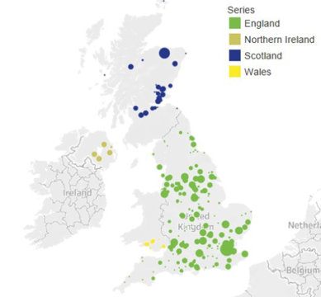
Capacity and flexibility market reform, long-term contracting, and R&D support are durable policy levers for grid-scale storage
Industry Overview
Solutions: Optimize
Solutions: Modernize
Solutions: Expand
Deployment
Battery Storage
UK’s National Grid awarded GBP323M in 10-yr stability service contracts to BESS
Australia demonstrated that battery + GFM + renewables reduces costs
Battery needs speed and standards to connect, and revenue certainty to finance
U.K. 2026 battery footprint
Average high of South Australia FCAS regulation price
2016-2017 (pre-HPR) vs. 2018-2019, A$/MWh¹
Near-term actions
Establish, implement guidance on battery reliability and standards, incl. duration-based accreditation
Prioritize co-located storage-plus-renewables for interconnection requests and construction starts
Expand SATA designation pathways and capacity market eligibility for storage (e.g., FERC 841)
South Australia Regulation FCAS Price (A$/MWh)
Forward-looking opportunities
Establish BESS/PPA tolling framework with long-term contracts (aligned with lifecycles) to enable senior debt financing at lower cost of capital
Reform ISO/RTO capacity markets to create a storage-specific ‘always available’ capacity product that compensates battery firm dispatch
Pre-HPR
Post HPR
United Kingdom: National Grid ESO awarded GBP323M in 10-yr stability service contracts to utility-scale BESS projects, substituting BESS inertia & reactive power
Demonstrated the effectiveness of using long-term contracted ancillary revenue to drive private sector BESS project financing; GBP14B target system savings
Australia: Hornsdale Power Reserve (Neoen/Tesla ’17) demonstrated that renewables plus battery storage can substitute for grid-scale synchronous generation services (100MW/129MWh)
Reduced South Australia’s average Regulation FCAS price by ~90% vs. the pre-HRP baseline, bringing SA in line with other regions
Demonstrated revenue and technical viability
System-level benefits
129% revenue growth for BESS from multi-stream stacking vs. single revenue stream
<100ms BESS response time v. 6+ seconds for peakers, improving grid flexibility
¹Hornsdale was a primary catalyst in driving the Regulation FCAS prices down in SA but not all savings should be attributed to Hornsdale. 3rd party analysis by Aurecon (2022)
Sources: Grid Scale Storage (IEA, 2024); Interconnection Final Rule (FERC, 2024); Queued Up (Lawrence Berkeley National Laboratory, 2025); National Grid ESO, Stability Pathfinder Phase 2 (National Grid, 2024); Grid-scale battery energy storage systems (IEA, 2026); Stacking up the storage (Renewable UK, 2025); Hornsdale Power Reserve Expansion Project (ARENA, 2023).
Credit: Dominica Wambold, Ariela Farchi and Gernot Wagner. Share with attribution: Wagner et al. “Powering Grids,” Columbia Business School Climate Knowledge Initiative (29 October 2026).

Slide 50
Developing economies lead transmission expansion; replacement is a global need across both developing and advanced economies
Industry Overview
Solutions: Optimize
Solutions: Modernize
Solutions: Expand
Deployment
Transmission
EMDEs¹ require ~60M km of new lines by 2050, driven by ~90% rising electricity demand and ~10% renewables
Globally, 45M+ km of transmission and distribution lines must be replaced by 2050, led by the US and China
Expansion of grid lines by driver in selected region/country in the CPS¹,
2024-2050
Grid line replacement by selected region/country and replacement share of grid additions in the CPS¹, 2024-2050
Emerging and Developing Economies (EMDEs)
Advanced Economies (AEs)
~90% of the replacements are for distribution lines
Million km
Million km
Advanced economy new transmission tracks generation
2024
2030
2035
2040
2045
2050
2024
2030
2035
2040
2045
2050
2024
2030
2035
2040
2050
China
Southeast Asia
Other EMDE
United States
Other AE
United States
Other AE
India
Middle East
India
Middle East
European Union
European Union
China
Southeast Asia
Other EMDE

Slide 51
Grid capex investment is accelerating globally and shifting toward EMDEs; in the US, infrastructure investment remains public-led
Industry Overview
Solutions: Optimize
Solutions: Modernize
Solutions: Expand
Deployment
Emerging markets
AEs drive grid investment today; EMDEs increase in volume and share by 2030s
US power infra. investments are mostly public; private share increased since 2010
Observations
Near-term grid investment is concentrated in US, EU, and China
As grid investment shifts toward EMDEs, financing becomes harder:
  Utilities often face limited tariff recovery
  Higher cost of capital
  Bankable regulation and stronger utility balance sheets become critical
US private investment
  Increased from $17.6B to $37.6B between the 2009-2016 and 2017-2024 periods, raising private share from 17% to 24%
Federal support is targeted rather than fully sufficient:
  GRIP¹ directs ~$10B for interconnection, modernization, resiliency
  SPARK² adds ~$1.9B for reconductoring and advanced transmission technologies
Average annual grid investment by economic grouping in the CPS to 2035 (US$B, 2024, MER)
Private and public investments in US power infrastructure in US$B
EMDE Distribution
Advanced Economies Distribution
Private investment
Public Investment
EMDE Transmission
Advanced Economies Transmission
US investor-owned utilities spent ~$93B on T&D in 2024, with distribution representing ~65% of total grid investment
2020
2021
2022
2023
2024
2025-2030
2031-2035
2036-2050
2010
2015
2020
2021
2022
2023
2024
¹Grid Resilience and Innovation Partnership. ²Speed to Power through Accelerated Reconductoring and other Key Advanced Transmission Technology Upgrades.
Sources: World Energy Investment (IEA, 2026), Industry Data (EEI, 2025), Funding the growth in the US power sector (Deloitte, 2025), Electricity Grids and Secure Energy Transitions (IEA, 2023).
Credit: Ilayda Tezcan, Ariela Farchi, Dominica Wambold, and Gernot Wagner. Share with attribution: Wagner et al. “Powering Grids,” Columbia Business School Climate Knowledge Initiative (29 October 2026).

Slide 52
Even under moderate load and clean electricity growth in the US, transmission investment is required, with capacity rising by 20-25%
Industry Overview
Solutions: Optimize
Solutions: Modernize
Solutions: Expand
Deployment
Transmission
Energy growth has a major impact on capacity needs across both regional and interregional transmission
Observations
Both regional and interregional transmission capacity requirements increase by 2035, even under moderate load and clean energy growth assumptions
Interregional transfer capacity needs rise much faster than within-region transmission, highlighting the increasing importance of moving power across regions rather than only strengthening local grids
Scenarios with high clean energy growth show substantially higher transmission needs
As clean electricity growth is the main driver of capacity demand, growth in nuclear and geothermal is critical
Load growth
Clean energy growth
Growth in within-region transmission and interregional transfer capacity needs across the U.S. 2035 compared to 2020, % median anticipated rate
Moderate
Moderate
Moderate
High
High
High
412
Regional transmission
Interregional transmission

Slide 53
High Voltage Direct Current enables multi-GW power transfer over thousands of kilometers efficiently
Industry Overview
Solutions: Optimize
Solutions: Modernize
Solutions: Expand
Deployment
HVDC
Power generation
AC Transmission Line
AC to DC converter
HVDC Transmission Line
DC to AC converter
AC Transmission Line
Distribution and end use
1
2
3
How do HVDC Transmission Lines work?
Why they are critical for the energy transition?
HVDC can move large loads of power over long distances with lower losses and precise control
Makes it practical to connect remote renewables (offshore wind, desert solar, large hydro) to distant demand centers
By reducing losses and unlocking large-scale renewables, HVDC cuts the need for fossil generation and extra backup capacity
Advantages
A converter station transforms AC into direct current (DC), which flows in one steady direction, making long-distance transmission more efficient
Efficient for long distance: Lower losses
Ability to connect asynchronous (different frequencies)¹ systems: Grid bridging
Suitability for underwater applications: Subsea capable
Ability to handle longer periods of overload operations: Stable transfer
1
In HVDC lines the DC power moves through a line with lower losses, better controllability, and greater efficiency than an equivalent AC line
2
Disadvantages
A second converter station changes the DC back into AC so it can be used by the local grid
High upfront cost: Major investment
Greater complexity in components: Advanced equipment
3
¹AC grids must stay synchronized with same frequency and timing. When two grids run at different frequencies (e.g., 50 vs 60 Hz) or aren’t in sync, a direct AC connection would be unstable and HVDC interconnection via DC conversion would be needed
Source: Assessing HVDC Transmission for Impacts of Non‐Dispatchable Generation (EIA, 2018).
Credit: Sevgi Helin Tilkicioglu, Hasan Alawadhi, Pia Doris Morrow, Vincent Sandow-Straesser and Gernot Wagner. Share with attribution: Wagner et al. “Powering Grids,” Columbia Business School Climate Knowledge Initiative (29 October 2026).

Slide 54
HVDC benefits are realized with longer corridors, improving efficiency, lowering costs per delivered MWh
Industry Overview
Solutions: Optimize
Solutions: Modernize
Solutions: Expand
Deployment
HVDC
Topic | HVAC (AC transmission) | HVDC (DC transmission)
How does it work? | Electricity changes direction 50/60 times per second | Electricity flows one way continuously going in one direction
How easy is it to connect to today’s grid? | Very easy - plugs in directly to existing AC Needs voltage control and reactive support (FACTS tools) along the route | Needs converters at each end, but then it can connect into asynchronous systems Converters are expensive, but HVDC lines can be simpler for long transfer
How controllable is the power flow? | Less controllable | Set and adjusted directly by the converters
When does it make more sense? | Usually best for short to medium distances | Often best for very long distances, especially when moving bulk power across regions
What’s the cost profile? | Lower upfront terminal cost, but may need more grid reinforcements/reactive equipment as distance grows | High upfront cost at the ends (converter stations) but can be cheaper per delivered MWh for long routes Cost components (2017): 16% transmission line, 83% infrastructure, 1% services/other
AC and DC lines cost comparison by distance
Investment cost
Total AC costs
Total DC costs
DC terminal costs
AC terminal costs
Distance
Critical distance
Submarine lines: 60km
Overhead lines: 200km
Source: Review, Special Report 60 years of HVDC (ABB, 2014); Assessing HVDC Transmission for Impacts of Non‐Dispatchable Generation (EIA, 2018).
Credit: Sevgi Helin Tilkicioglu, Hasan Alawadhi, Pia Doris Morrow, and Gernot Wagner. Share with attribution: Wagner et al. “Powering Grids,” Columbia Business School Climate Knowledge Initiative (29 October 2026).

Slide 55



Policy is critical for HVDC, with supportive environments enabling a low cost of capital and streamlined deployment across regions
Industry Overview
Solutions: Optimize
Solutions: Modernize
Solutions: Expand
Deployment
HVDC
U.S. Grain Belt plans halted by loan and permitting challenges
China’s record-setting HVDC line transmits mostly coal power
Australia’s link, with joint local gov. ownership, promotes renewables
Description
A 542-mile (600 kV) HVDC line, linking the SPP, MISO, and AECI grid regions to wind generation in Missouri
Cost
Phase 1 total cost ~$4.4B. Conditional DOE loan guarantee of up to $4.9B to anchor private financing (Nov. 2024) $1.7B in construction contracts (May 2025)
Political involvement
DOE terminated the $4.9B loan guarantee (July 2025) Citing a speculative revenue model and non-binding utility contracts Construction delayed now seeking fully private financing to proceed
Description
The Changji-Guquan (Zhundong-Wannan) UHVDC line transmits coal, wind, and solar power 3,324 km. At 12 GW capacity, it is the world's highest-voltage, longest-distance HVDC line
Cost
Total investment ~$7.2B (50B yuan) State-funded under NDRC approval
Political involvement
Commissioned in 2018; in 2024 transmitted ~55% coal-fired electricity, despite renewable energy mandate Provincial governments at both sending and receiving ends insist on guaranteed coal operating hours as a financial condition, crowding out renewables
Description
Marinus Link in Australia is a 750 MW HVDC 345 km undersea and underground interconnector, enabling bi-directional flows of Tasmania's hydro/wind and mainland solar
Cost
Stage 1: ~$5B AUD (2026-2030) Stage 2: subject to future funding CEFC committed $3.8B in concessional finance (Sep 2025) under the Rewiring the Nation program
Political involvement
Joint government ownership: Commonwealth (49%), Victoria (33.3%), Tasmania (17.7%)
Sources: State high court rejects challenge to wind generated transmission (Capitol News, 2026); Department of Energy Terminates Taxpayer-Funded Financial Assistance for Grain Belt Express); DOE cancels $4.9B conditional loan for Grain Belt Express (Utility Dive, 2025); Grain Belt Express is the Latest FAST-41 Covered Project (Permitting dashboard, 2024); Changji-Guquan UHVDC five-year commissioning (China Daily, 2024); Trends and Contradictions in China's Renewable Energy Policy (CGEP, 2025); China struggles to capitalize on record renewables build-out (Japan Times, 2025); Done right, China's UHV grid can help phase out coal (Dialogue Earth, 2026); CEFC to invest in visionary Marinus link project (CEFC, 2025).
Credit: Christy Wong, Ariela Farchi, Dominica Wambold, and Gernot Wagner. Share with attribution: Wagner et al. “Powering Grids,” Columbia Business School Climate Knowledge Initiative (29 October 2026).

Slide 56
The ~$7T of projected data center capital flows by 2030 can be instrumental in developing and deploying grid technologies
Industry Overview
Solutions: Optimize
Solutions: Modernize
Solutions: Expand
Deployment
Data center investments
Data center capital flows reached ~$500B in 2025
Data center investments into key grid technologies can accelerate grid deployment and renewable integration
Energy transition financing and data center
Optimize
AI data center workload management and flexibility present new models for large load flexibility and demand response optimization
Optimized technologies provide a key opportunity for joint financing arrangements, bridging Corporate and traditional VC, PE, and utilities
Google and Voltus demonstrate successful BYOC commitments to enable customer Virtual Power Plant integration
Non-firm connection agreements
Modernize
Major utility investment priorities to upgrade existing grid infrastructure represent cost-effective opportunities for data center integration
Data center investments can accelerate deployment of grid-scale battery and power electronics,(e.g., grid-forming inverters and FACTS)
Achieving system-wide orchestration through advanced metering infrastructure ‘2.0’ and implementation of digital twin solutions advances both grid modernization and the feasibility of grid-connected data centers
Expand
The urgency of data center power demand and value derived from grid connectivity creates a strong incentive to integrate available IVR supply
Hyperscaler risk capital provides a critical alternative to federal subsidy for the development and integration of clean firm power sources
Case studies in Australia, the U.K., and the U.S. demonstrate successful collaboration models for data centers and grid expansion
China
Other Asia Pacific
North America
Europe
Central and South America
India
Middle East
Eurasia
Africa

Slide 57

Deployment

Slide 58

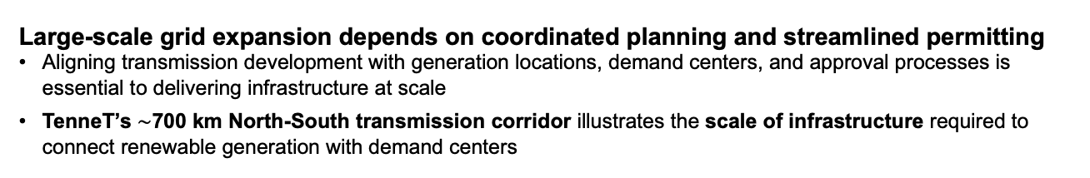
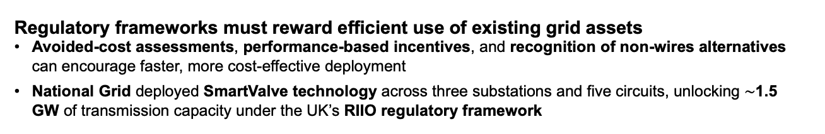
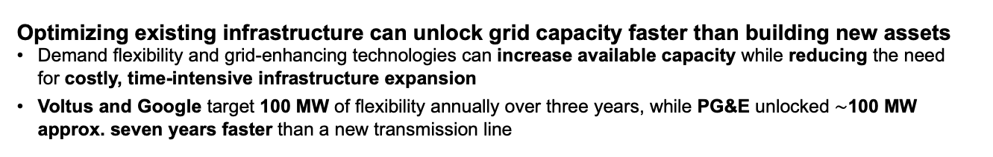
Optimizing existing infrastructure can unlock grid capacity faster than building new assets
Demand flexibility and grid-enhancing technologies can increase available capacity while reducing the need for costly, time-intensive infrastructure expansion
Voltus and Google target 100 MW of flexibility annually over three years, while PG&E unlocked $\sim$100 MW approx. seven years faster than a new transmission line
Regulatory frameworks must reward efficient use of existing grid assets
Avoided-cost assessments, performance-based incentives, and recognition of non-wires alternatives can encourage faster, more cost-effective deployment
National Grid deployed SmartValve technology across three substations and five circuits, unlocking $\sim$1.5 GW of transmission capacity under the UK’s RIIO regulatory framework
Electricity markets need to compensate flexibility and grid-stability services
Payments for demand response, frequency regulation, reserves, and other ancillary services can support reliability and higher renewable penetration
EirGrid’s DS3 program supported an increase in allowable system non-synchronous penetration from 50% in 2014 to 75% in 2024.
Large-scale grid expansion depends on coordinated planning and streamlined permitting
Aligning transmission development with generation locations, demand centers, and approval processes is essential to delivering infrastructure at scale
TenneT’s $\sim$700 km North-South transmission corridor illustrates the scale of infrastructure required to connect renewable generation with demand centers
Key Messages
Deployment
Bankable revenue models and access to long-term capital are critical deployment enablers
Long-term contracts, diversified financing structures, and clear cost-recovery mechanisms can mobilize investment in capital-intensive grid projects
CHPE secured $6B financing package, including $5.2B in debt and $800M in equity, supported by a 25-year NYSERDA contract

Slide 59





Global grid deployment demonstrate how capacity can be unlocked, modernized, and expanded across different time horizons
Industry Overview
Solutions: Optimize
Solutions: Modernize
Solutions: Expand
Deployment
Global grid deployment
Time horizon
Case study | Capacity impact | Timing / status | Technology | Deployment enabler | Lessons learned
Voltus – Google PJM, U.S. | 1 GW VPP capacity committed | Expansion announced in October 2026 | VPP and distributed demand flexibility | Bring-your-own-capacity agreement | Unlock & scale capacity without new wires
PG&E California, U.S. | +100 MW | Operational 2025; ~7 years ahead of new-line alternative | FACTS / SmartValve | CAISO avoided-cost evaluation; FERC framework | Retrofit faster than new transmission
National Grid UK | ~1.5 GW | Deployed | FACTS / SmartValve | Ofgem RIIO incentives | Rewarding efficiency can scale grid upgrades
EirGrid DS3 Ireland | Higher allowable nonsynchronous generation for grid stability | 2014-2024: Phased market modernization | Ancilary services / grid stability | New market products and comparison | Markets must reward system services
TenneT Germany | ~700 km North-South transmission | Long-term build-out; investment horizons 2030/2035 | Underground transmission and offshore HVDC, financing of €117B planned through 2035 | Permitting reform and large-scale capital | Planning, approvals and finance must align
CHPE Quebec – NYC | 1,250 MW | Long-lead HVDC project | Buried HVDC with $6B financing package | Long-term contracted revenues and project finance | Revenue certainty enables major infrastructure
Short-term
Optimize &
unleash capacity
Planned / Committed
Mid-term
Modernize tech, policy & market
Operational
Operational
Operational
Long-term
Expand generation & transmission
Under construction
Under construction
Disclaimer: The following examples are selected case study examples and non-exhaustive. Grid transition priorities and deployment pathways vary by region; no one-size-fits-all approach applies. TenneT's €117B is a company-wide capital plan, not the cost of the individual North-South transmission corridor. Figures should not be compared as equivalent project costs.
Sources: Google and Voltus to Deliver Grid Capacity and Local Economic Benefits Through Bring Your Own Capacity Agreement (Voltus, 2026); PG&E and Smart Wires Enhance Grid Reliability, Capacity for Data Centers in San Jose (PG&E Corporation, May 2025); World's First Large-Scale Use of Power Flow Technology on Transmission Network Will Unlock 1.5 GW (National Grid, May 2021); DS3 Programme: Delivering a Secure, Sustainable Electricity System(EirGrid, n.d.); TenneT Investor Relations (TenneT, 2026); Champlain Hudson Power Express Announces Financial Close (Champlain Hudson Power Express, 2022).
Credit: Pia Doris Morrow, and Gernot Wagner. Share with attribution: Wagner et al. “Powering Grids,” Columbia Business School Climate Knowledge Initiative (29 October 2026).
> Deep dives on the following pages

Slide 60
Google and Voltus demonstrate how large customers can scale grid flexibility through distributed resources
Industry Overview
Solutions: Optimize
Solutions: Modernize
Solutions: Expand
Deployment
Short-term
Voltus – Google (PJM, U.S.)
Policy insights
Implemented policies and mechanisms
PJM capacity-market framework and existing demand-response participation arrangements
FERC Order 2222 establishes framework for aggregated DER participation in wholesale markets
Evolving policy opportunities
Continued implementation of DER aggregation rules, clearer participation requirements and evolving large-load/ bring-your-own-capacity arrangements
Planned / Committed
Key facts
1 GW
Expanded VPP capacity commitment
Rapid growth in data-center electricity demand creates need for additional capacity that can be delivered faster than conventional grid expansion
Google to provide funding
Voltus to recruit, coordinate, and compensate participating customers
PJM to provide relevant capacity-market context
Problem
Stakeholders
10x
Expansion from initial 100 MW agreement
VPP aggregating batteries, smart thermostats, and flexible residential and commercial loads
Bring-your-own-capacity agreement creates commercial incentive to aggregate existing flexible resources
Technology
Deployment enabler
Oct 2026
Expansion announced
Google funds Voltus to aggregate distributed flexibility, expanding the original 100 MW agreement to a 1 GW VPP commitment in October 2026
Large electricity customers can help finance dispatchable grid capacity without waiting for new transmission construction
Deployment model
Lesson learned

Slide 61
PG&E showcases how grid-enhancing technologies can unlock capacity years ahead of new transmission
Industry Overview
Solutions: Optimize
Solutions: Modernize
Solutions: Expand
Deployment
Mid-term
PG&E (California, U.S.)
Policy insights
Implemented policies and mechanisms
CAISO Transmission Planning Process and avoided-cost assessment
FERC Order 881 on transmission line ratings
FERC Order 1920 on long-term transmission planning
Evolving policy opportunities
Stronger requirements to evaluate grid-enhancing technologies against new transmission and improved cost-recovery incentives for non-wires alternatives
Operational
Key facts
+100 MW
Capacity unlocked
Transmission constraints in the San Jose area limit the grid’s ability to accommodate increasing electricity demand
PG&E as utility/ deployer
Smart Wires as technology provider
CAISO as transmission planner
CPUC and FERC as regulators
Problem
Stakeholders
Up to 34%
reduction in thermal overloads
Smart Wires SmartValve, a flexible AC transmission system (FACTS) that controls power flows on existing infrastructure
CAISO’s avoided-cost evaluation creates a framework for comparing grid-enhancing technologies with conventional network upgrades
Technology
Deployment enabler
~7 years
Earlier than new-line alternative
SmartValve installation at Los Esteros provides approx. 100 MW of additional capacity and reduces overloads by up to 34%
Existing infrastructure should be evaluated for cost-effective upgrades before committing to slower, more capital-intensive expansion
Deployment model
Lesson learned

Slide 62
FERC Order 1920 improves grid reliability, lowers costs, and adapts the grid to changes in energy transition & climate via planning
Industry Overview
Solutions: Optimize
Solutions: Modernize
Solutions: Expand
Deployment
Mid-term
Landmark rule issued, requires transmission providers to: plan for 20 yrs & update every 5 yrs, evaluate projects on 7 metrics, and be transparent on cost allocation…
…unlocking five key grid modernization and optimization outcomes
1
Avoided reliability upgrades and aging infrastructure replacement
3
5
Ensures proactive & long-term regional transmission planning over a 20 year horizon
Solves cost allocation bottleneck by requiring regions to establish clear, upfront formulas to split costs based on who benefits from the seven metrics
Mandates consideration of Grid-Enhancing Technologies (GETs) like dynamic line rating, incentivizing system optimization
Enhances transparency in local transmission planning via stakeholder engagement before inputs are incorporated into regional planning
Addresses long-term transmission needs by requiring the assessment of “right-sized replacements” for aging facilities
Encourages interregional transmission lines
Cost savings via new transmission facilities allowing dispatch of lower-cost generators
Reduced costs due to reduced congestion during outages
7
Capacity cost benefits from reduced peak energy losses and peaker plants
FERC 1920
Benefit
Metrics
1
2
3
4
5
6
7
2
4
6
Reduced loss of load probability or reduced planning reserve margin cost
Reduced transmission energy losses
Reduced costs during extreme weather & unexpected events
Sources: Explainer on the Transmission Planning and Cost Allocation Final Rule (FERC, 2025).
Credit: Gunay Kiran, Ariela Farchi Cohen, Pia Doris Morrow, Gernot Wagner. Share with attribution: Wagner et al. “Powering Grids,” Columbia Business School Climate Knowledge Initiative (29 October 2026).

Slide 63
Performance-based regulation can incentivize transmission capacity upgrades as shown by National Grid
Industry Overview
Solutions: Optimize
Solutions: Modernize
Solutions: Expand
Deployment
Mid-term
National Grid (UK)
Policy insights
Implemented policies and mechanisms
Ofgem’s RIIO price-control framework, Totex Incentive Mechanism, Network Innovation Allowance, and Network Options Assessment
Evolving policy opportunities
Further refinement of performance-based incentives and cost-sharing arrangements that reward avoided network expenditure
Operational
Key facts
~1.5 GW
Capacity unlocked
Uneven transmission loading limits the transfer of electricity across existing network circuits
National Grid Electricity Transmission, Smart Wires, Ofgem, and the electricity system operator responsible for network option appraisal
Problem
Stakeholders
3
Substations
SmartValve modular power-flow control devices that redirect electricity across the network to relieve constrained circuits
Ofgem’s RIIO framework and Network Options Assessment support consideration of efficient alternatives to conventional reinforcement
Technology
Deployment enabler
5
Circuits
Large-scale installation across three substations and five circuits, unlocking approx. 1.5 GW
Utilities are more likely to deploy capacity-enhancing technologies when regulatory incentives reward efficiency and whole-system value
Deployment model
Lesson learned

Slide 64

Regulation should incentivize and set standards for non-wire alternatives (NWA), energy efficiency & grid forming inverters (GFM)
Industry Overview
Solutions: Optimize
Solutions: Modernize
Solutions: Expand
Deployment
Mid-term
Cost-of-Service Regulation for NWAs & GFMs saved billions in UK
Utilities can bank a portion of savings from an estimate
Key regulatory changes needed for grid transition & set up for RIIO-2
 | UK’s RIIO-1¹
Case study | Ofgem (the UK's energy regulator), transitioned to RIIO-1 (Revenue = Incentives + Innovation + Outputs), which allows utilities to recover TotEx savings This framework rewards network companies for improving reliability, implementing innovative technologies, and finding cost effective non-wire alternatives (NWAs) Took over from a traditional cost-of-service regulation, which incentivizes utilities to build heavy infrastructure to generate returns
Results | Network operators recovered £96 Billion between 2010-2018 This yielded a 38% net savings on UK consumer energy bills compared to what customers would have paid with the traditional infrastructure expansion²
Illustration of upside for utility under RIIO-2
1
Incentives boosting non-wire alternatives to investment i.e. RIIO, New York’s Reforming Energy Vision (REV) or Demand Management Incentive Scheme (DMIS) of Australia, etc.
2
Regulations incentivizing energy efficiency
3
Mandating or incentivizing modern grid-balancing hardware, specifically naming Grid Forming Inverters (GFM)
RIIO-ED2 operates on a 5-year vs. 8-year period to reduce the risk of estimate divergence
More conservative allowances and estimation mechanisms were set to better align capital returns and outputs, requiring innovation for upside
There are now explicit incentives for demand flexibility
RIIO-2
Year 1
Year 2
Year 3
Year 4
Year 5
OFGEM total expenditure estimate ex-ante
Customer upside (in lower bills)
Utility’s upside (in higher allowable returns)²
Utility’s actual total expenditure
Key technologies utilized
GFM (Grid Forming Inverters)
NWAs relying on DERMS, VPPs and load shifting
¹ RIIO: Revenue = Incentives + Innovations + Output which is a performance-based regulatory framework for electricity and gas networks in Great Britain ^{2.} OFGEM adds a capitalization ratio multiplier to total expenditure or upside, meaning that a share of the total expenditure or upside in one year is added to the RAB and is recovered over a period, while the other share is recovered in that same year. ^{3.} Residential bills calculated assuming £1k energy bill of 28 million houses.
Source: Open letter on the RIIO-2 framework (OFGEM, 2017), OFGEM (2024), PICLO (2023).
Credit: Hasan Alawadhi, Pia Doris Morrow, Isabel Hoyos, Gunay Kiran, Dominica Wambold, Ariela Farchi Cohen, and Gernot Wagner. Share with attribution: Wagner et al. “Powering Grids,” Columbia Business School Climate Knowledge Initiative (29 October 2026).

Slide 65


Permitting reform can accelerate grid interconnection by prioritizing project readiness and reducing queue bottlenecks
Industry Overview
Solutions: Optimize
Solutions: Modernize
Solutions: Expand
Deployment
Mid-term
Stricter requirements, “connect & manage,” and “first ready, first served” systems have proved to reduce interconnection queues
Observations
Interconnection speed is critical to getting the required generation on the grid as soon as possible
ERCOT has faster interconnection due to its “connect and manage” approach
CAISO needs ‘Resource Adequacy’ studies making interconnection slower
FERC mandated a transition from "first-come, first-served" to a "first-ready, first-served” approach, while ENTSO-E and Natonal Grid are also making similar changes
Aggressive structural gating, predefined zoning & stricter upfront grid-readiness (removing first-come, first-served approach) limit developers from casually entering the queue
1.5¹
Connect & Manage approach
Dynamically manages grid bottlenecks in real-time by curtailment or market redispatch
Requires intensive studies
First ready, first served system, prioritizing projects aligned with state-level plans
Strict First-Come, First-Served approach
Unviable projects that applied years ago blocked ready & funded projects
Interconnection queue size
Policy shift toward a hybrid “First Ready and Needed, First Served” approach
1. Interconnection queue size assumed here only includes renewables, so actual ratio will be higher
Sources: Energy Markets & Policy (2025); ERCOT (2025); CAISO (2025), ENTSOE Map (2025); ENTSOE (2025); Beyond (2025); GTLAW (2025); DUKES (2025).
Credit: Gunay Kiran, Hasan Alawadhi, Stephanie Chen, Helin Tilkicioglu, Isabel Hoyos, Hyae Ryung Kim, and Gernot Wagner. Share with attribution: Wagner et al. “Powering Grids,” Columbia Business School Climate Knowledge Initiative (29 October 2026).

Slide 66
Ancillary-service markets enable greater renewable integration as demonstrated by Ireland’s DS3 program
Industry Overview
Solutions: Optimize
Solutions: Modernize
Solutions: Expand
Deployment
Mid-term
EirGrid DS3 (Ireland)
Policy insights
Implemented policies and mechanisms
DS3 System Services arrangements and market compensation for ancillary services such as fast frequency response, reserves and reactive power
Evolving policy opportunities
Expanded participation for DER aggregators and evolving technical standards, and compensation for grid-forming capabilities
Operational
Key facts
50%
Initial SNSP limit
2014
Higher shares of inverter-based renewable generation require new ways to maintain frequency, voltage and system stability
EirGrid and system-service providers, including generation, storage, and other eligible flexibility resources
Problem
Stakeholders
65%
Intermediate milestone
2018
Fast frequency response, reserve, reactive power, and other grid-stability capabilities, supported by batteries, inverters, and control systems
Explicit ancillary-services products create revenue for capabilities needed to operate a more renewable electricity system
Technology
Deployment enabler
75%
SNSP capability
2024
Secure Sustainable Electricity System (DS3) program develops and compensates services needed for a high-renewables power system
Energy-only compensation is insufficient where reliability depends on fast response, reserve, and voltage-support services
Deployment model
Lesson learned

Slide 67
Reformed capital recovery and allocation markets promote broad participation and deployment of distributed resources
Industry Overview
Solutions: Optimize
Solutions: Modernize
Solutions: Expand
Deployment
Mid-term
Incentivizing ancillary services and facilitating DER integration are the backbone of a grid with high renewable penetration
Observations
Assets should be rewarded for ancillary services to the grid, not just the Megawatts, this includes reactive power, which will be a required asset in inverter-based generation future
Ireland’s DS3 program provides a successful example of a market-based framework, with 12 service products to compensate providers for supporting grid stability
Additionally, a market for DERs to aggregate and sell directly to the grid is needed as a way of improving economics
 | Ireland EIR Grid
Overview | With EirGrid and SONI’s DS3 program, Ireland managed a high penetration of non-synchronous renewable energy on its grid To maintain stability, the power market evolved from compensation on energy output to rewarding performance and grid-stabilizing capabilities (ancillary services, e.g. reactive power, fast frequency response)
Success levers | 12 distinct system service products to monetize vital grid capabilities (e.g., reactive power, ramping products, etc.) Established market rules allowing DERs Leveraged key modern grid technologies
Results | Increased Renewable Limits (SNSP) 2014 (Start of DS3): 50% 2018 (Record milestone): 65% 2024 (2024 capability): 75%
Ireland’s SNSP¹ limits due to ancillary service market
2014
2018
2024
Start of Ds3
Record number
Key technologies utilized
Grid-forming inverters
DERMS
VPPs
Grid-scale batteries

Slide 68
TenneT illustrates how coordinated transmission planning and diversified financing connect generation surpluses to demand
Industry Overview
Solutions: Optimize
Solutions: Modernize
Solutions: Expand
Deployment
Long-term
TenneT (Germany)
Policy insights
Implemented policies and mechanisms
Germany’s Federal Requirements Plan Act (BBPIG), Energy Industry Act (EnWG) and 2022 Easter Package Provisions prioritizing energy infrastructure
Evolving policy opportunities
Continued permitting simplification, coordinated offshore/ onshore planning and financing arrangements for major transmission investment
Under construction
Key facts
~700 km
North-South transmission corridor
Northern Germany has renewable generation surpluses while the South faces a supply deficit
TenneT, German authorities, financial institutions, and public/ private capital providers
Problem
Stakeholders
€67B
Company investment plan through 2030
Long-distance underground transmission, HVDC connections and offshore grid infrastructure
Coordinated transmission planning, German permitting legislations, and diversified long-term financing
Technology
Deployment enabler
€117B
Company investment plan through 2035
Approx. 700 km of North-South transmission, alongside offshore connection projects including LanWin1, LanWin2, LanWin5, and BalWin4
Transmission expansion requires alignment between generation geography, permitting, investment plans and access to capital
Deployment model
Lesson learned

Slide 69
Large transmission projects like TenneT leverage innovative financing methods while maintaining traditional debt-to-equity ratios
Industry Overview
Solutions: Optimize
Solutions: Modernize
Solutions: Expand
Deployment
Long-term
TenneT combined sovereign equity co-investors, green bonds & subordinated hybrid debt for this project
Long-term power delivery agreements provide CHPE with revenue certainty needed to secure bank debt
The capital plan involves €67 billion in investments through 2030 and €117 billion through 2035
Used HoldCo/OpCo Hybrid Capital Structure, allowing borrowing while protecting credit ratings
Specifically structured to issue debt under the official European Green Bond Standard Regulation; a €3.5 billion European Green Bond was issued as senior unsecured debt
A unique pre-committed €11.8 bn (surpassing planned €8.5 bn) equity cushion which combined a government development bank (KfW) with giant international private institutional pension and sovereign wealth funds (APG, NBIM, GIC)
CHPE was designed by TDI and sponsored by Blackstone
It is fully private and financed through a private investment package of $6 billion
$800 million sponsor equity
Non-recourse debt package raised from a large syndicate of commercial banks led by Société Générale supported by a group of coordinating lead arrangers: MUFG, Mizuho, CIBC
$5.2 billion project-level debt
Long-term NYSERDA Tier 4 REC contract (25 years) provides cash flow visibility needed to back $5.2B in debt
$8.5bn
(13%)
$800mn
(13%)
$13bn
(19%)
$35bn
(52%)
$3bn
(4%)
$8bn
(12%)
$5.2bn
(87%)
Equity
Debt
Equity
Shareholder loan
Cash flow generation
Senior debt
Hybrids
Key financing methods utilized
Subordinated hybrid capital, European Green Bonds, long-term power delivery agreements, blended capital

Slide 70
The Champlain Hudson Power Express (CHPE) demonstrates how contracted revenues can finance major cross-border transmission
Industry Overview
Solutions: Optimize
Solutions: Modernize
Solutions: Expand
Deployment
Long-term
CHPE (Quebec – NYC)
Policy insights
Implemented policies and mechanisms
New York’s Tier 4 renewable energy credit procurement framework, implemented through NYSERA’s long-term contract
Project permitting and approvals
Evolving policy opportunities
Broader use of long-term clean-energy procurement, transmission contracting and permitting approaches for future cross-border projects
Under construction
Key facts
1,250 MW
Transmission capacity
New York City needs additional access to low-carbon electricity supply, while major transmission construction faces permitting and financing challenges
Hydro-Québec, Transmission Developers Inc., NYSERDA, Blackstone, commercial bank syndicate, and regulators and permitting authorities
Problem
Stakeholders
339 miles
Buried HVDC corridor
339-mile buried HVDC transmission link connecting Quebec hydropower with New York City, including conversion to AC at the receiving end
Long-term NYSERDA Tier 4 renewable energy credit contract, lender participation, buried routing, and trenchless construction techniques
Technology
Deployment enabler
$6B
Project financing package
Privately sponsored, project-financed transmission development
Predictable contracted revenue can attract large-scale private debt and equity to transmission projects
Deployment model
Lesson learned

Slide 71
Investors have a major opportunity to participate in funding the future of the U.S. grid; approaches vary primarily by system type
Industry Overview
Solutions: Optimize
Solutions: Modernize
Solutions: Expand
Deployment
Key opportunity
 | Vertically Integrated | Restructured (ISO/RTO) | ERCOT
Geographic alignment | South, Northwest, Intermountain West | PJM, MISO, CAISO, ISO-NE, NYISO, SPP | Texas (‘energy-only’ market)
Planning mechanisms | Integrated Resource Plans (IRPs) Utility RFPs | Regional transmission plans FERC-1920 and cost allocation tariffs | ERCOT-specific planning (e.g., CREZ) Market price signals
Primary funding vehicles | Utility debt and equity (public markets) incl. for Non-Wire Alternatives (NWAs) and GETs | Utility debt and equity, merchant project finance, NWA contracts | Utility debt and equity, merchant project finance, wholesale market revenue
ROI mechanisms | State policy Regulated rate base inclusion | Regional cost allocation Aggregated DER markets | Texas PUC Transmission Cost of Service Merchant (market) driven (energy and ancillary revenue)
Key oversight bodies | Public Utility Commissions (PUCs) FERC (inter-state) | ISOs/RTOs and FERC State Public Utility Commissions | Public Utility Commission of Texas FERC (reliability-only)
 | NERC: Authority for reliability standards; relevant with demand (load) increases to unlock investor opportunities including inter-system coordination, technologies benefitting from national standards, and where federal support can be tapped (e.g., ITCs, GRIP)
Emerging financing models expand access from private capital to grid-connected assets
VPPAs: Hedge revenue risk, enable PF
CTTs: Absorb first-of-a-kind risk
BYOC: 3rd party customer-sited capacity
Build-Transfer: Offset cost & timeline risk
PBR & ADER: Incentivize asset efficiency
Asset-backed securitization: Grid & off-grid
Sources: World Energy Investment (IEA, 2026); GETS (Bipartisan Policy Institute, 2026); Energy Transition Investment Trends (BNEF, 2026); Grid resilience (J.P. Morgan, 2026); Queued Up (LBNL, 2026); Large Loads Letter (U.S. DOE, 2025); VPP Liftoff Report (DOE); Policy recommendations to unlock the value of LDES (C2ES, 2024).
Credit: Dominica Wambold, Ariela Farchi, and Gernot Wagner. Share with attribution: Wagner et al. “Powering Grids,” Columbia Business School Climate Knowledge Initiative (29 October 2026).

Slide 72
U.S. grid expansion is a coordination challenge across rules, capital, assets and siting
Industry Overview
Solutions: Optimize
Solutions: Modernize
Solutions: Expand
Deployment
Key barriers
Delay hotspot stages
Who is included | Roles & Responsibilities |  | Planning & Need | Financing & Cost Allocation | Interconnection application | Siting& Permitting | Procurement & Construction
FERC | Federal rule setter: Sets interstate transmission, wholesale market, interconnection, cost-allocation rules
DOE / GDO / national labs | Federal deployment enabler: Identifies national infrastructure needs, funds and de-risks projects, and informs planning
NERC + Regional Entities | Reliability authority: Sets enforceable reliability, planning, operations and cybersecurity standards
RTOs, ISOs, ERCOT | Regional planners / operators: Operate grid and markets, manage congestion & coordinate regional interconnection
State PUCs / PSCs, | State regulatory gatekeepers: Approve utility investment, rates, cost recovery and siting where applicable
State Energy Offices | State policy coordinators: Align with state energy policy, resilience & energy targets and federal funding opportunities
Transmission owners, IOUs, public power, co-ops | Asset owners / builders: Build, own, maintain and modernize transmission and distribution assets
Federal land agencies, state/ local gov., Tribal gov. | Permitting and public acceptance actors: Determine whether projects can be sited, permitted & built on acceptable timelines
Generators, DCs, industrials | Interconnection customers / demand drivers: Create generation and load needs, submit interconnection requests
OEMs / EPCs / workforce / investors | Delivery and capital ecosystem: Provide equipment, EPC services, qualified labor, grid technologies and capital
Build & Deploy
Finance
Regulate
Demand
Primary Decision Gate
Secondary Influence
>4 yr
median IR-to-COD¹
~4 yr
federal permitting
>2.5 yr²
equipment lead times + constrained EPC capacity
¹Interconnection Request to Commercial Operation Date. ^{2.} Q2 2025 at ~2.5 years (128 weeks) for power transformers and ~2.8 years (144 weeks) for Generator Step-Up (GSUs).
Sources: FERC Orders 1920 and 2023; CITAP (DOE, 2024); Long-Term Reliability Assessment (NERC 2024); 2025 Edition Characteristics of Power Plants Seeking Transmission Interconnection As of the End of 2024 (Berkeley Lab, 2025); Wood Mackenzie Q2 2025 Survey Results.
Credit: Ilayda Tezcan, Ariela Farchi, Pia Doris Morrow, and Gernot Wagner. Share with attribution: Wagner et al. “Powering Grids,” Columbia Business School Climate Knowledge Initiative (29 October 2026).

Slide 73









CKI Grids Team
Fellows
Hasan Alawadhi
MBA, Columbia Business School
Climate Knowledge Initiative Fellow
Sevgi Helin Tilkicioglu
MBA, Columbia Business School
Climate Knowledge Initiative Fellow
Dominica Wambold
MBA, Columbia Business School
Climate Knowledge Initiative Fellow
Ilayda Tezcan
MBA, Columbia Business School
Climate Knowledge Initiative Fellow
Gunay Kiran
MS in Sustainability Management
Climate Knowledge Initiative Fellow
Stephanie Chen
MBA, Columbia Business School
Climate Knowledge Initiative Fellow
Christy Wong
MPA, Columbia SIPA
Climate Knowledge Initiative Fellow
Ryon Roque
BS in Civil Engineering
Climate Knowledge Initiative Fellow
Vincent Sandow-Straesser
MS in Climate Finance
Climate Knowledge Initiative Fellow

Slide 74

CKI Team Staff, Faculty, and Alumna
Isabel Hoyos
MS in Sustainability Management
Former Senior Staff Associate

