Slide 1

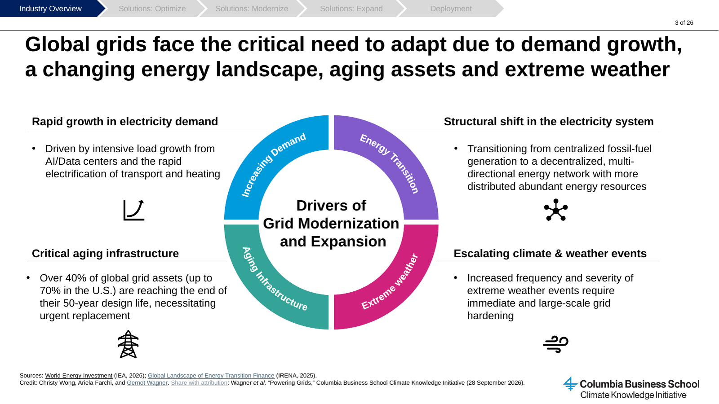
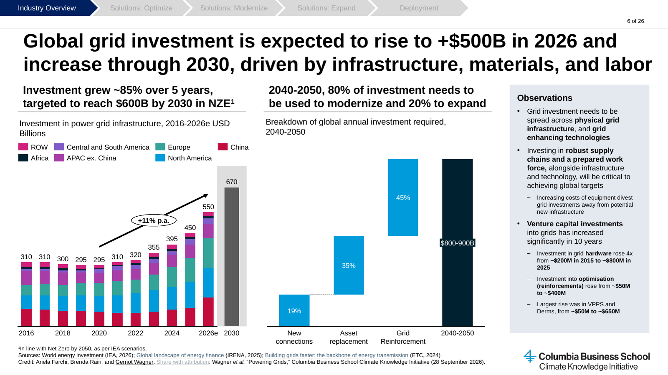
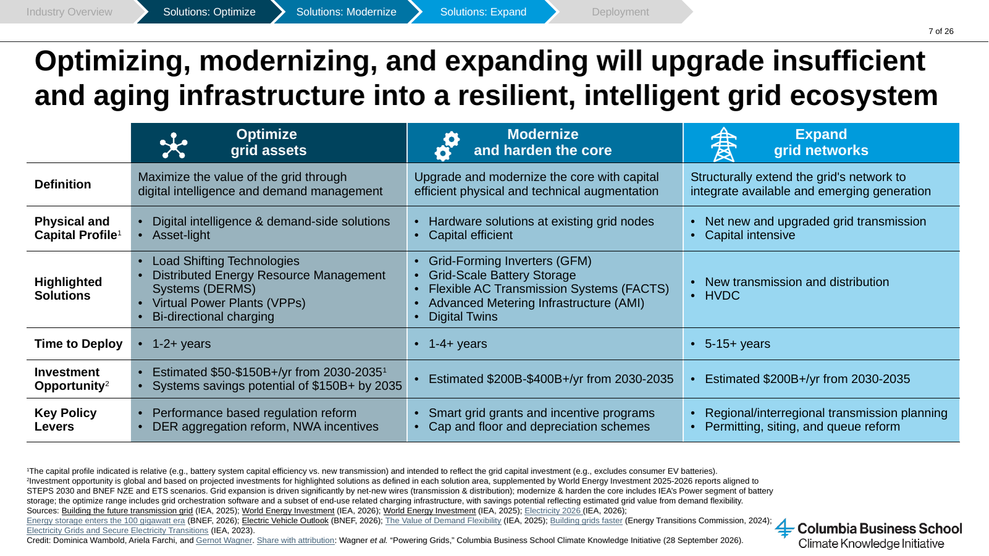
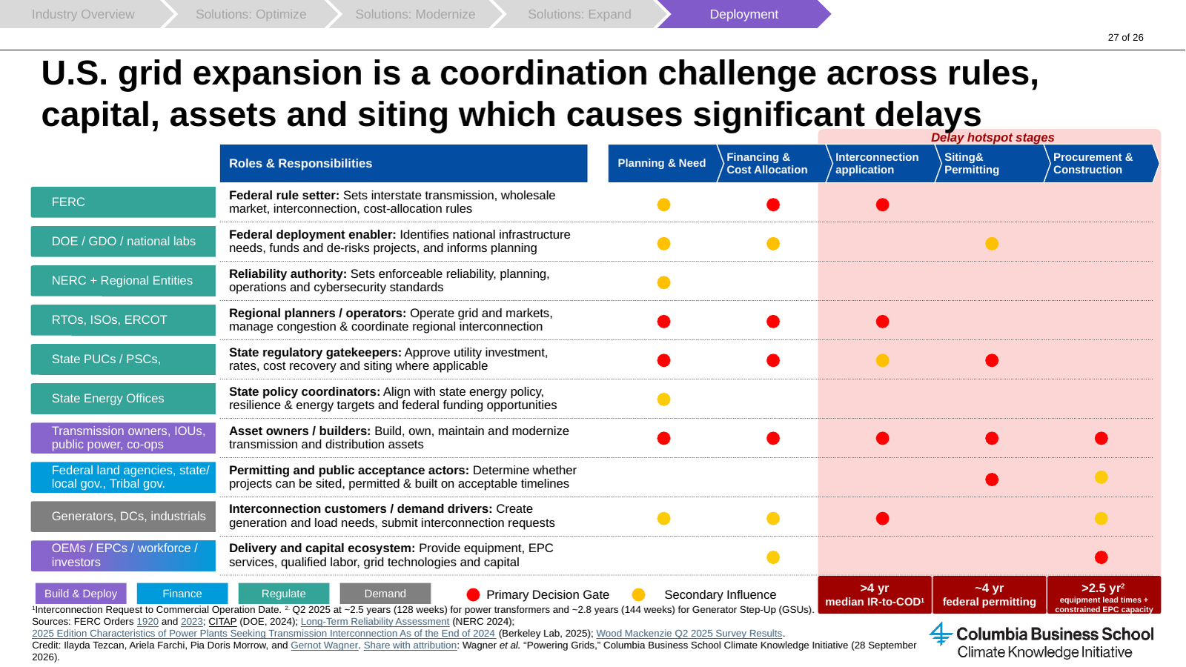
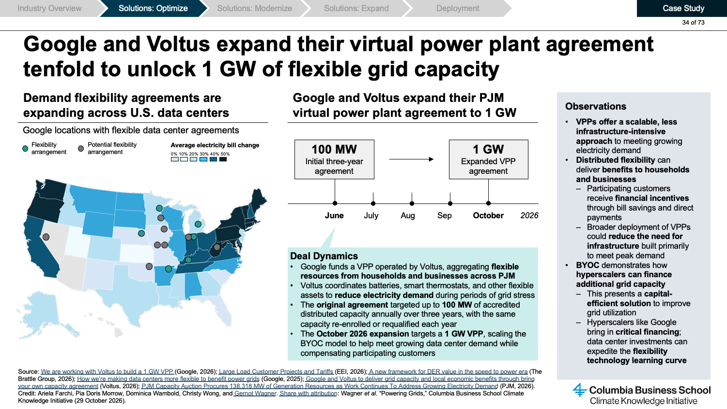

Slide Deck
Deep Dive
Key Insights
Powering Grids
Executive Summary
See Slides 1-6 of deck
Global electricity demand growth is accelerating across nearly all major regions, with data centers projected to account for ~50% of U.S. demand growth by 2030
Over 40% of global grid assets (up to 70% in the U.S.) are reaching the end of their 50-year design life, necessitating urgent replacement
Annual global grid investment is expected to exceed $500B in 2026 and reach $600B a year by 2030 in a net zero pathway
Optimizing (1-2+ yrs) unlocks the lowest-cost grid capacity, modernizing takes 1-4+ yrs, and expanding (5-15+ yrs) is the most capital intensive
AI-enabled data center flexibility could unlock ~100 GW of dormant capacity from grid infrastructure that already exists
Why invest in power grids?
Investment Opportunities
Slides 4-6
Slides 7-26
Grid investment needs reach $800-900B a year in 2040-2050, 80% of it to modernize
Optimization is an estimated $50-150B+/yr opportunity from 2030-2035
Modernization and expansion each draw an estimated $200B+/yr from 2030-2035
Virtual power plants deliver peak capacity at roughly half the cost of a new gas peaker
Storage and flexibility could defer up to $1.8T in global grid investment through 2050
New T&D and HVDC
Capital intensive – Investor type: Infrastructure, Utilities
Extends the network to new generation; HVDC moves multi-GW power over thousands of kilometers with lower losses. Expansion draws an estimated $200B+/yr from 2030-2035.
Grid-Scale Battery Storage
Capital efficient – Project Finance, Utilities
Batteries firm renewables and reinforce congested nodes; the global market is set to exceed $100B in 2026.
GFM, FACTS, AMI & Digital Twins
Capital efficient – Utilities, Growth, Private Equity
Hardware and digital upgrades at existing nodes; FACTS can increase transmission capacity by ~30-50%.
DERMS & Virtual Power Plants
Asset-light – Growth, VC
Tripling U.S. VPP capacity to 80-160 GW by 2030 could save $10B a year; North America already has 30-60 GW of VPPs.
Load Shifting & V2B/V2G
Asset-light – VC, Corporate
Data centers can shift up to 40% of non-critical load in under 40 seconds; EVs can act as flexible storage.
5-15+ yrs
Expand & Modernize
1-4+ yrs
1-4+ yrs
Grid Capacity Cost Curve by Lever (Illustrative)
Ceiling
Expand
5-15+ yrs, capital intensive
Floor
Uncapped upside
1-2+ yrs
Price per unit capacity ($/MW, illustrative)
Modernize
1-4+ yrs, capital efficient
Optimize
1-2+ yrs
Optimize
1-2+ yrs
Capacity (GW, illustrative)
Key Risks
Investment Trends
Slide 32
Slide 17
Interconnection delays, with a >4 yr median from request to commercial operation
Federal permitting (~4 yr) and cost allocation disputes slow new transmission
Lead times exceed 2.5 yr for power transformers, with constrained EPC capacity
Rising grid costs risk customer backlash if they are not fairly allocated
Optimize and modernize draw VC, PE and corporate capital, i.e., VC into VPPs and DERMS rose from ~$50M to ~$650M in 10 years
Expansion relies on infrastructure finance recovered through the rate base, i.e., CHPE ($6B, 87% project debt), TenneT green bonds
Hyperscalers are financing grid capacity, i.e., Google (Voltus, 1 GW VPP capacity committed across PJM)
About CKI
The Climate Knowledge Initiative (CKI) conducts rigorous techno-economic analyses and turns them into actionable, business-relevant insights. Through research, communication, and stakeholder engagement, CKI bridges the knowledge gap between academia and business leaders. View the full report on power grids.
Credit: Ilayda Tezcan, Ariela Farchi, Pia Doris Morrow, and Gernot Wagner. Share with attribution: Wagner et al. "Powering Grids," Columbia Business School Climate Knowledge Initiative (29 October 2026).

