Slide 1
Powering Data
23 January 2026
Hyae Ryung Kim, Ariela Farchi Behar, Isabel Hoyos, Una Oljaca, Shubhangi Prasad, Yosafat Partogi Simbolon, Clara Zibell, and Gernot Wagner

Slide 2

Rising demand: Data centers are on track to triple global electricity use by 2035, with AI the dominant driver. By 2030, they could consume nearly 1,000 TWh per year, ~3% of world demand.
Despite surging demand, emissions can plateau if data centers are increasingly powered by renewables. By 2030, over 50% of data center power is projected to be renewable, but fossil fuels (especially gas and coal in China and the United States) remain a near-term power source. Decarbonizing the energy supply is critical to curbing data center emissions.
Regional trends: The U.S. and China alone will account for 80% of growth, making them the epicenter of both opportunity and grid stress. Europe will grow slower but faces permitting and public pushback. India is rapidly emerging as the next hub.
The U.S. grid faces long interconnection queues, increasing household bills, and local moratoriums. This is pushing data center developers to shift to “power first” siting strategies and behind-the-meter solutions such as onsite renewables, small modular reactors (SMRs) for nuclear, and geothermal.
China’s state-led model, Eastern Data, Western Computing, enables speed and grid decompression by moving data center clusters inland and away from major cities, offering a potential template for the West.
Data center operators: Amazon, Microsoft, Google, Meta, and other companies that operate hyperscale data centers control >50% of capacity and are the biggest buyers of renewables in the U.S. Their procurement decisions effectively shape clean energy investment pipelines.
Efficiency gains in hardware (GPUs, custom chips), cooling (liquid vs. air), and AI model architectures (e.g., DeepSeek) can help data center operators cut energy use by 10-40x, but it is unlikely to fully offset growth in demand.
Emerging solutions: AI-driven grid optimization (e.g., virtual power plants, predictive load shifting), innovative energy deals, and geothermal baseload integration could be game changers in efforts to balance reliability, cost, and sustainability.
Executive Summary
Meeting AI Energy Demand
Credit: Shubhangi Prasad, Hyae Ryung Kim, and Gernot Wagner. Share with attribution: Kim et al., "Powering Data" (23 January 2026).

Slide 3
AI growth driving increased energy demand; U.S. and China ~70% of electricity used by data centers globally and growing
Projected global electricity consumption for
data centers¹, TWh
Electricity consumption of data centers by region, IEA base case: 2020-2030
Observations
Energy demand from data centers is projected to grow in line with adoption of AI.
U.S and China will lead data center power demand by 2030.
  U.S. to increase by 240 TWh (+130%)
  China by 175 TWh (+170%)
  Europe by 45 TWh (+70%)
Electricity demand in advanced economies is projected to rise for the first time in over a decade.
Data centers are expected to make up 30-40% of new energy demand between 2024 and 2030.
  Emissions from data centers are projected to plateau and then decrease as the energy supply becomes decarbonized.
IEA Liftoff
Accenture – Base
ROW
EU
U.S.
IEA Base
S&P
Asia Pacific
China
IEA Headwinds
Gartner
2020
2024
2030
¹ Projections vary due to uncertain efficiency gains, inconsistent reporting, and different modeling approaches (bottom up, aggregated totals, hybrid, extrapolation).
Sources: IEA, Global data centre electricity consumption by sensitivity case, 2020-2035 (I2025); S&P, Global data center power demand by 2030 (2025); Gartner, Electricity demand for data centers to double by 2030 (2025); Accenture, Powering sustainable AI (2025).
Credit: Yosafat Partogi, Hyae Ryung Kim, and Gernot Wagner. Share with attribution: Kim et al., "Powering Data" (23 January 2026).

Slide 4
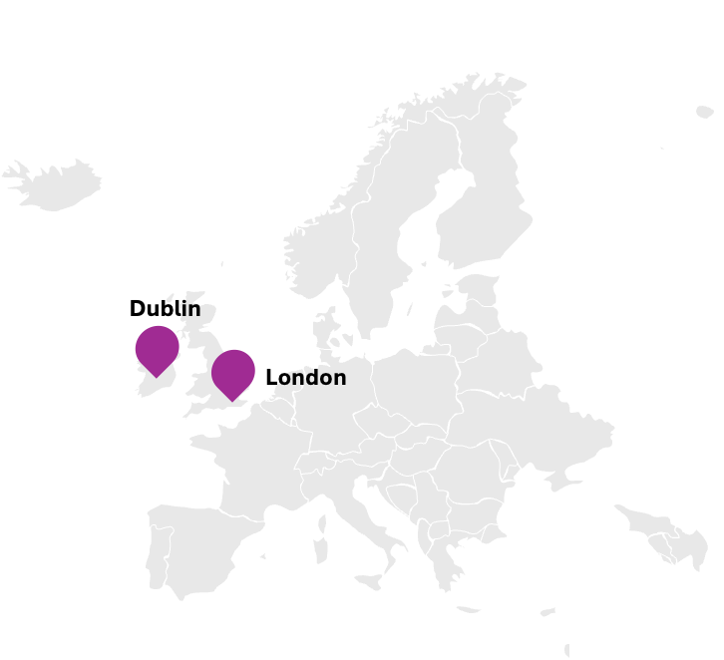
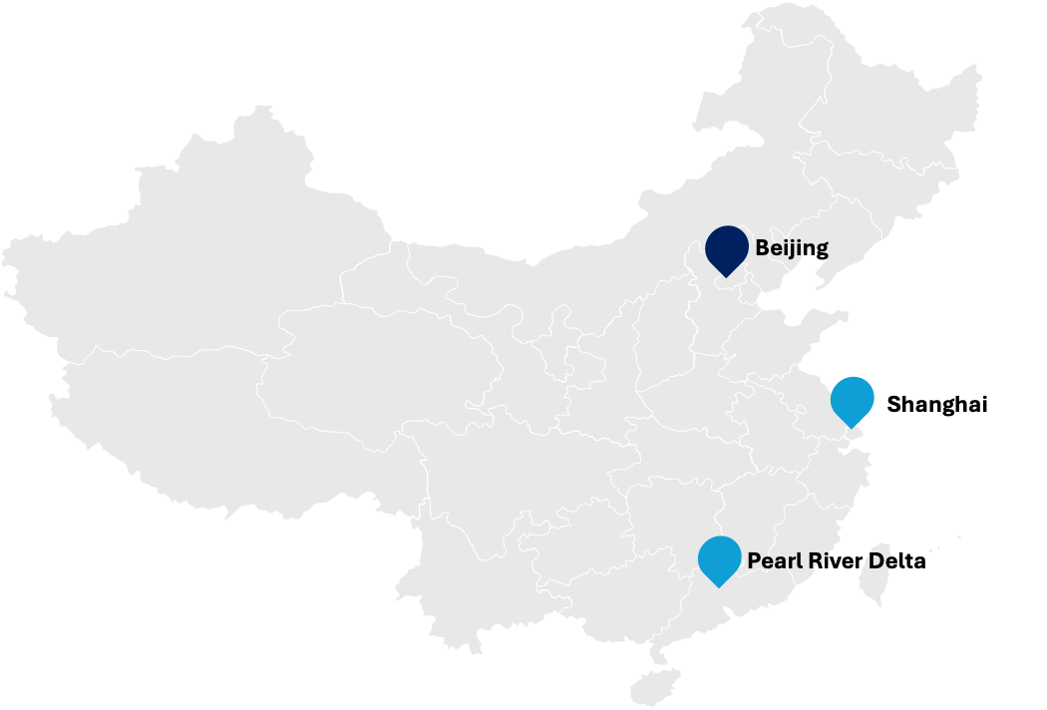
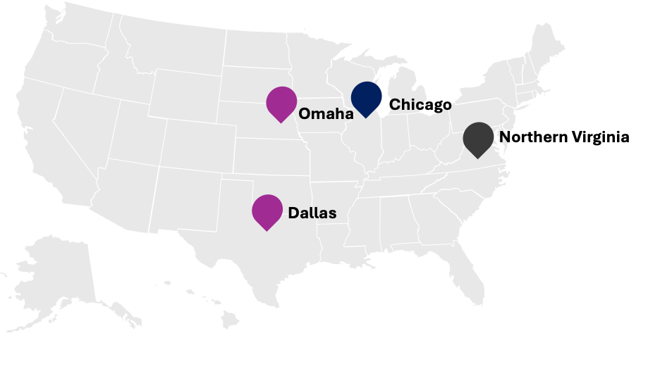



Data centers are concentrated in infrastructure-rich regions, driving gigawatt-scale clusters and local grid congestion risks
The U.S., EU, UK, and China host nine of the 10 largest data center clusters in the world by capacity, GW
Capacity range
> 6 GW
2.1–3 GW
1.8–2.1 GW
1.5–1.8 GW
Leads in global data center capacity and demand but faces mounting grid stress in key clusters
State-led data center clusters located in renewables-rich grid and moving inland to relieve grid stress
Prioritizes sustainability and regulation, but fragmented grids and public resistance slow data center growth
Data center share in total electricity demand, %
Observations
Over 15% of global data center capacity under development remains concentrated in the top 10 markets highlighted in the map above, underscoring the need for strategic planning to address growing pressure on local grids.
In 2024, the U.S., China, and Europe together accounted for ~85% of global data center electricity consumption, with 180 TWh, 100 TWh, and 70 TWh, respectively. While the absolute share of national demand may seem modest — just over 4% in the U.S., ~2% in Europe, and ~1.1% in China — the scale is significant given these economies’ vast power systems and competing demands from industries like manufacturing and transport and residential use.
5%
4%
U.S.
3%
China¹
2%
EU
Asia Pacific (excl. China)
1%
ROW
Global average
0
Note: Singapore ranks among the top clusters but is excluded due to the map’s regional scope. ¹Lack of substantial data makes it challenging to accurately estimate China’s data center electricity consumption. Source: IEA, Energy and AI (2025).
Credit: Shubhangi Prasad, Isabel Hoyos, Hyae Ryung Kim, and Gernot Wagner. Share with attribution: Kim et al., "Powering Data" (23 January 2026).
2005
2010
2015
2020
2025

Slide 5
Clean energy is expected to grow in share of data center energy mix across geographies, despite different deployment drivers
United States
China
European Union¹
Observations
U.S. deployment is market-driven, fragmented by state permitting and dependent on corporate PPAs, raising risk of grid bottlenecks in major data center clusters.
China’s state-led model offers speed and scale with centralized permitting, bundled land-power packages, and national mandates (e.g., Eastern Data, Western Computing), enabling rapid build-out.
The EU has strong decarbonization goals and regulatory levers (CSRD, Green Deal Digital), but slow permitting and public resistance (e.g., Dublin moratorium) threaten deployment timelines.
Permitting bottlenecks in the U.S. and EU contrast sharply with China’s fast-tracked national build-out, giving China a decisive edge in infrastructure readiness.
A power mix shift across regions converges toward more renewables and nuclear by 2035 — but China’s top-down mandates may make the transition faster, even if its coal reliance remains a near-term emissions challenge.
Other
Wind
Solar PV
Nuclear
Natural gas
Coal
2020
2025
2030
2035
2020
2025
2030
2035
2020
2025
2030
2035
Deployment | Market-driven, cluster-based model | State-led, decentralized model | Market-driven, urban-centered model
Power demand growth projection | +130% (~425 TWh by 2030) | +170% (~277 TWh by 2030) | +~70% (~45 TWh increase by 2030)
Policy drivers | CHIPS Act, AI and clean energy orders Tax breaks, utility deals, DOE grants Corporate power purchase agreements (PPAs) | AI 2030 and Eastern Data, Western Computing High and New Technology Enterprise (HNTE) 15% tax break, bundled permits, and fast approvals Co-located with renewables | Green Deal Digital, Digital Decade Carbon markets, RRF, and CSRD-driven incentives France: Offers tax breaks for green, efficient data centers Germany: RRF funds support digital and energy upgrades
Permitting | Fragmented (1-3 years) | Centralized and fast-tracked | Often slow (5-7 years), local resistance
Grid flexibility required | Flexibility urgent industry piloting batteries, workload shifts, and gas backup | Minimal flexibility needed; strong central planning enables coordination but is underutilized | Regulation-led flexibility; automation and cooling shifts help, but grid limits slow progress
¹ Projections based on IEA scenarios. EU data calculated by discounting US and China from global data.
Sources: IEA, Energy and AI (2025); Sinosities, Mapping China’s Inland Data Centers (2025); Engineering, The “Eastern Data and Western Computing” Initiative in China Contributes to Its Net-Zero Target (2024); Bruegel, Annual Report (2024); Cushman & Wakefield, Americas Data Center Update (2025).
Credit: Shubhangi Prasad, Ariela Farchi, Isabel Hoyos, Hyae Ryung Kim, and Gernot Wagner. Share with attribution: Kim et al., "Powering Data" (23 January 2026).

Slide 6




China’s strategy to move its data center clusters inland is enabling grid decompression and offering a model for the West to adopt
China
Case study: Xinjiang and Qinghai, China
National Integrated Computing
Network node-type hubs
Massive build-out: 39 data center projects have been approved in Xinjiang and neighbouring Qinghai, with plans to use over 115,000 Nvidia chips.
Strategic location: Utilizes remote, low-cost land with clean energy, especially in Qinghai.
Deployment model: Nyocor, a partly state-owned green energy company, is building a large data center with 625 servers and 2,000 Nvidia H100 chips.
China’s state-led AI infrastructure model shows how shifting data centers away from major cities can ease grid stress, offering a strategic alternative to the West’s market-driven approach.
National Strategy
Eastern Data, Western Computing aims to establish a network of 10 data center clusters in Eastern China and eight computing hubs in Western China.
Computing power corridors connect remote infrastructure to urban AI users.
Clean Energy Integration
Data centers are sited alongside renewable power bases (Western China has abundant local clean energy for computing hubs to leverage).
Grid decompression: The country is relocating compute away from power-constrained urban hubs.
Xinjiang
Qinghai
Clean-energy-rich hubs
Urban hubs
Utility-Style Compute Access
.
State-planned data center hubs serve as the central hubs for China's unified cloud computing and artificial intelligence infrastructure.
Companies can remotely access computing power, enabling startups across China to train AI models without owning their own data centers.
Public-Private Governance
Energy SOEs like State Grid and Nyocor co-invest in data centers, ensuring integration of power infrastructure with AI compute.
Private tech giants (e.g., Alibaba, Tencent, Huawei) are major operators in these hubs but work under central policy guidance and long-term MOUs with local governments.
Sources: Bloomberg, China’s Got Big Plans for AI — In the Desert (2025); Strider Technologies and SCSP, China’s AI Infrastructure Surge Report (2025).
Credit: Shubhangi Prasad, Isabel Hoyos, Hyae Ryung Kim, and Gernot Wagner. Share with attribution: Kim et al., "Powering Data" (23 January 2026).

Slide 7

AI workloads fuel demand for high-capacity, energy-intensive data centers; low vacancy rates show demand outpaces supply
United States
Breakdown of AI workloads and hardware¹ in modern data centers, % (2024)
Global hyperscale data center growth (count) and U.S. vacancy rates, % (2018-2030)
Observations
All three types of data centers perform AI workloads, but hyperscale data centers are AI-dominant, which explains higher power and capacity requirements.
Overall hyperscale capacity growth will be driven by larger data centers, rather than facility additions. Median data center size is expected to grow over the next 10 years (up to 375 MW of total capacity).
  Hyperscale data centers >100 MW consume as much power as 350,000 to 400,000 electric vehicles do.
Global vacancy rates fell to a record low of 6.6% in Q1 2025. In contrast, average vacancy rates in U.S. primary markets fell to a record low of 1.9% in Q4 2024.
  Despite a 43% year-over-year capacity increase in the top four U.S. data center markets (Northern Virginia, Chicago, Atlanta, Phoenix) in Q1 2025, data center availability remains extremely limited.
GPU chips
CPU chips
Dominant
Partial
None
Total²
Hyperscale
Vacancy rate
Number of data centers
Enterprise
Colocation
Hyperscale
5%
15%
74%
9%
Smaller data centers used by businesses or institutions
Data centers that lease space for companies to house their own equipment
Data centers operated by major tech companies to support their own tech services
3%
2%
Training¹
Training
Training
1,916
(66%)
Inference²
Inference
Inference
1,136
(44%)
500
(20%)
GPU chips are ideal for AI-heavy workloads thanks to their high memory bandwidth and parallel-processing capabilities. The scale of compute required for training makes hyperscale data centers highly energy-intensive, despite GPUs being more energy efficient than CPUs for AI.
2018
2024
2030
¹ Central processing unit (CPU) chips are ideal for general-purpose, flexible, and sequential workloads. Graphics processing units (GPU) are optimized for high-speed processing and ideal for compute-intensive workloads like AI training and inference. ² Total data center projections are highly uncertain, as these include both AI and non-AI data centers.
Sources: IEA, Energy and AI (2025); Synergy Research Group, Hyperscale Operators and Colocation Continue to Drive Huge Changes in Data Center Capacity Trends (2024), McKinsey, How data centers and the energy sector can sate AI’s hunger for power (2024); IEA, What the data centre and AI boom could mean for the energy sector (2024); BloomEnergy, Onsite Generation Expected to Fully Power 27% of Data Center Facilities by 2030 (2025), CBRE, Global Data Center Trends 2025 (2025).
Credit: Clara Zibell, Isabel Hoyos, Hyae Ryung Kim, and Gernot Wagner. Share with attribution: Kim et al., "Powering Data" (23 January 2026).

Slide 8
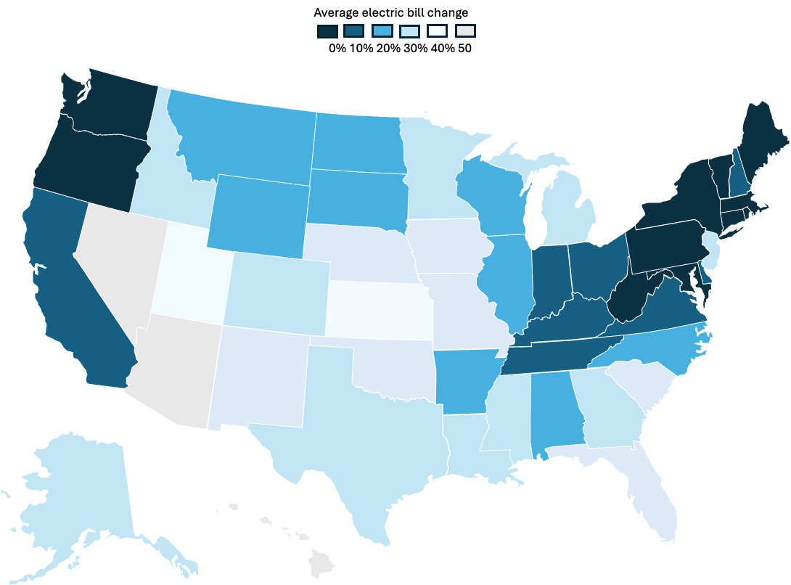
Data center growth is adding to U.S. grid strain and pushing up household electricity bills
United States
Household electricity bills are rising near the largest data center clusters
Case study: Dominion Energy, Virginia
Northern Virginia is the world’s largest data center hub with a data center capacity of over 5.9 GW, led by Amazon Web Services (AWS).​ Dominion Energy, Virginia’s main utility, is grappling with soaring power demand from data centers. By 2030, an extra 11 GW of capacity is anticipated, which would be more than 40% of Virginia's current peak demand. A $35 billion AWS expansion by 2040 is resulting in a massive load increase.​ Dominion must increase its current capacity by nearly 5x by 2038 → 13.3 GW. +$8.51 per month by 2026: Dominion has proposed its first residential rate hike since 1992, citing data center demand, to manage grid stress.
Average electricity bill change
0% 10% 20% 30% 40% 50%
Observations
U.S. power demand is rising sharply, with data centers and cloud computing emerging as key drivers of the surge.
Data centers used 4.4% of U.S. power in 2023, which could hit 6.7 to 12% by 2030.
By 2028, U.S. data center growth could add 150-400 TWh of electricity use, doubling or tripling their 2023 share.
The grid needs 18-47 GW more capacity by 2030 to keep up with this increasing demand.
The PJM grid (13 U.S. states) expects electricity bills to rise 20%+ this summer (2025), largely due to surging demand from AI and cloud data centers.
Virginia’s electricity demand could jump 183% by 2040 if unchecked data center growth continues — forcing utilities to build costly infrastructure that pushes up household bills.
Grid upgrades and delays in new power projects mean costs get passed to all customers, not just data centers — prompting states like New Jersey, Georgia, and Oregon to propose separate rate classes to protect residents.
Largest data center clusters in the U.S.
251-500 MW
501-1,000 MW
1,001-2,000 MW
> 2,000 MW
Sources: McKinsey, How data centers and the energy sector can sate AI’s hunger for power (2024); The White House Council of Economic Advisers, The Economic Benefits of Unleashing American Energy (2025); Reuters, America’s Largest Power Grid Is Struggling to Meet Demand from AI (2025); CBS News, The AI Revolution Is Likely to Drive Up Your Electricity Bill (2025); Power, How Much Power Will Data Centers Consume? (2024); The Washington Post, Amazon launches $35 billion data center expansion in Virginia (2023); Cushman & Wakefield, Americas Data Center Update (2025).
Credit: Shubhangi Prasad, Isabel Hoyos, Hyae Ryung Kim, and Gernot Wagner. Share with attribution: Kim et al., "Powering Data" (23 January 2026).

Slide 9
Rising data center demand and saturated primary markets drive ‘power first’ strategy to cut costs and speed deployment
United States
Trade-offs in data center siting across primary, secondary, and tertiary markets¹
Power-first development prioritizes a secure power supply over site selection, incentivizing geographic expansion
Primary
Primary markets remain attractive given established infrastructure and proximity to end users, but limited land and power access leads to interconnection delays.
Hyperscale data centers are increasingly being sited in secondary markets due to faster permitting and stronger power availability.
Tertiary markets offer abundant land and power but face higher operational risk.
Environmental factors like water availability and environmental justice impacts are often overlooked in data center siting, despite growing scrutiny.
The power-first model prioritizes securing energy capacity before site selection, permitting, or construction begins, as energy availability becomes the key constraint on scaling AI infrastructure. This can mean siting data centers in secondary or tertiary markets with less congestion as primary markets become saturated.
Secondary
Tertiary
Advantages
Key priorities
Eases grid burden
Reduces transmission distance
Improves reliability and resilience
Resolve regulatory uncertainty
Build new network infrastructure
Develop labor force
Example: Google + TPG Rise Climate + Intersect Power (2024)
The partnership between Intersect Power, Google, and TPG Rise Climate will deliver renewable power and storage to new data centers.
Intersect Power plans to catalyze $20 billion in clean energy and storage infrastructure by 2030.
Google will act as an anchor tenant in colocated industrial parks, pairing data centers with clean power.
Phase 1 is expected online in 2026; full completion is targeted for 2027.
¹ Primary markets are established hubs with dense infrastructure; secondary markets are emerging cities with growing demand and lower costs; tertiary markets are smaller or rural areas just beginning to attract data center investment.
Sources: CKI Analysis; Intersect Power, Intersect Power Forms Strategic Partnership with Google and TPG Rise Climate (2024); Latitude Media, Google’s new data center model signals a massive market shift (2024).
Credit: Una Oljaca, Isabel Hoyos, Hyae Ryung Kim, and Gernot Wagner. Share with attribution: Kim et al., "Powering Data" (23 January 2026).

Slide 10
Data center operators account for a growing share of renewable PPAs, mostly annual, with increasing hourly matching
United States
Corporate renewable PPAs by project stage, GW
 | Annual matching PPAs | Hourly matching PPAs
Description | Enough capacity procured to meet 100% of annual power demand, independent of hourly demand. | Some or all electricity consumption matched hourly by low-emissions sources located in the same region.
Advantages | Help meet renewable energy goals while retaining flexibility in electricity sources and lower costs. | Higher guarantee of covering demand, decreasing emissions, and mitigating volatility risk of power costs.
Disadvantages | Independent of real-time energy use, limiting value for grid reliability. | Higher costs, more operationally complex, and regionally limited due to baseload needs.
Primary power sources | Data center PPAs in the U.S. by electricity source | Google and Microsoft developing hybrid portfolios that harness baseload technologies such as geothermal and nuclear to ensure continuous renewable power supply. Google achieved an average of 66% carbon-free energy in 2024.
Average cost of power¹ (US$/MWh)
Data center operators
Other companies
120
30%
Solar PV
60
37.5%
Wind
62.5%
40%
70%
36
58%
Industrial retail price
60%
80
Annual matching
42%
Hourly matching
Operational
Under development
Announced
% hourly demand met by renewables
Gas
Solar PV
Wind
Hybrid
80%
90%
99%+
¹ Excluding grid fixed costs.
Sources: IEA, Energy and AI (2025); McKinsey, How hyperscalers are fueling the race for 24/7 clean power (2024); Google, Environmental report (2025).
Credit: Una Oljaca, Hyae Ryung Kim, and Gernot Wagner. Share with attribution: Kim et al., "Powering Data" (23 January 2026).

Slide 11



With U.S. interconnection queues growing >3x, operators are expanding to onsite generation to meet growing power demand
United States
With interconnection delays and long construction timelines increasing costs, wait times, and risks for project developers…
…data center operators are moving beyond the utility grid to secure a stable
power supply
U.S. interconnection queue by energy source, GW
Long wait times
Grid-connected behind-the-meter generation
In 2025, APR Energy announced the deployment of four mobile gas turbines providing >100 MW of BTM power to an unnamed U.S. hyperscale data center operator.
1,438
Five-year average wait time from request to commercial operation
Primarily serves local load, with limited or no export.
Reduces grid dependence
Improves resilience
Often avoids interconnection queue
Adds CapEx and OpEx; still reliant on grid for full operation
Solar
Geothermal, hydro, mixed renewables, other
Wind
Other renewables
70% increase in time required to secure a connection since 2014
Batteries & other storage
Coal
Gas
Nuclear
908
Low success rates
Grid-connected with microgrid capabilities
Snohomish PUD’s microgrid in Arlington, WA, integrates solar, BESS, and EV charging with intelligent controls to support a data center and enable seamless islanding during outages.
730
10% success rate for projects expected to come online by 2028
Able to disconnect from the grid and operate independently.
High resilience
Operational during outages
Optimizes use of onsite renewables
Requires advanced controls and storage → complex, expensive
596
20-80% Interconnection agreement suspension rates across the U.S.¹
348
Fully off-grid generation
ECL announced a 1 GW off-grid, modular, hydrogen-powered colocation data center in Texas with Phase 1 completed in summer 2025.
NYISO, SPP, PJM, and
ISO-NE have higher suspension rates (46-79%); ERCOT, CAISO, and MISO have lower rates (~20%)
Off-grid sources operate entirely independent from the grid.
No exposure to interconnection delays or grid failures
Enables remote or modular deployment (e.g., military purposes)
High upfront costs, risk of supply shortfalls
2020
2021
2022
2023
2024e¹
¹ Interconnection agreement suspension rates refer to the frequency at which approved projects pause or delay their grid connection timelines.
Sources: Berkeley Lab, Grid connection barriers to renewable energy deployment in the United States (2024); Berkeley Lab, Generation, Storage, and Hybrid Capacity in Interconnection Queues (2025); Enverus, 2025 Interconnection Queue Outlook (2025); Utility Dive, Fortress backs behind-the-meter gas turbines (2025); Business Wire, ECL Announces World’s First 1 Gigawatt Off-Grid, Hydrogen-Powered AI Factory Data Center (2024); Tencent, How a Microgrid Is Solving a Key Energy Challenge (2025), OffgridAi, How off-grid solar microgrids can power the AI race (2024).
Credit: Una Oljaca, Hyae Ryung Kim, and Gernot Wagner. Share with attribution: Kim et al., "Powering Data" (23 January 2026).

Slide 12
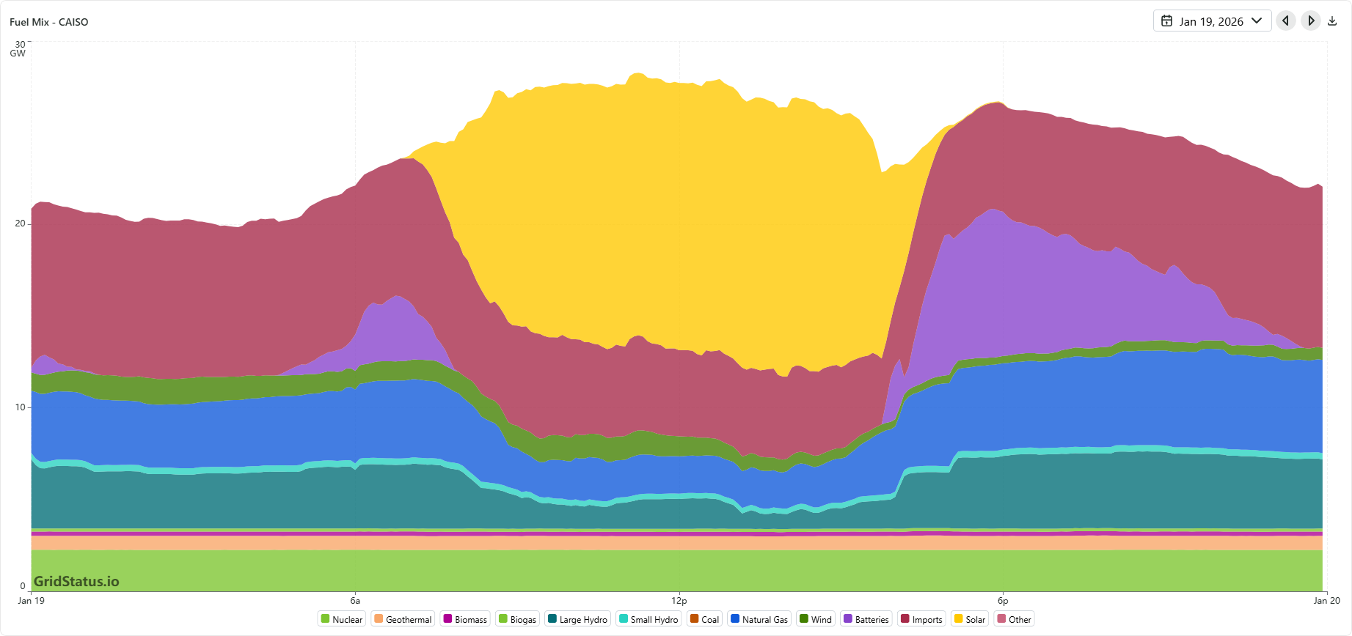



Nuclear and geothermal can deliver clean and firm electricity for data centers, strengthening grid reliability for 24/7 operations
Nuclear and geothermal can reduce reliance on fossil-fuel peaker plants as a growing share of data center electricity demand is met by renewables…
… and satisfy data centers’ energy needs
Firm power
Fuel mix for CAISO, 19 January 2026
Gridstatus.io
Power sources that provide continuous, uninterrupted energy regardless of season or weather conditions.
e.g. CAISO snapshot:
Baseload: nuclear, geothermal, biogas, and biomass.
Other: hydro and natural gas
Nuclear
High-capacity factor
~70-90% with geothermal nearer to 70 and nuclear to 90, ensures stable and continuous electricity supply
Geothermal
Biomass
Biogas
Large hydro
Small hydro
Coal
Natural Gas
Peaker plants
Wind
Carbon free energy
~0g CO₂e/kWh of energy produced enables hyperscalers to work towards hourly clean energy targets
Power facilities that meet grid needs during periods of highest electricity demand (peak load), helping maintain grid reliability. They operate flexibly and can be turned on quickly to respond to surges in demand.
Batteries
Imports
Solar
Hourly net load (year average) in California
Other
28,000
Peak-load
26,000
Clean energy transition
24,000
As aging Peaker plants retire, there is a need to bring new firm power sources online to continue ensuring grid stability.
Nuclear and geothermal emerge as sources of clean, firm energy that can compliment intermittent renewable sources by providing continuous clean power – helping create a reliable grid.
22,000
Mid-load
Longer service lifetime
Lifespan of 30-50+ yrs for geothermal and 60-80 yrs for nuclear
20,000
2012
Increased Ramp
Megawatts
2013
18,000
16,000
2014
Potential over Generation
2015
14,000
2016
2018
2017
12,000
2019
2020
10,000
Baseload
Sources: IEA, Energy and AI (2025); McKinsey, 2025 Global Energy Perspective, (2025); Utility Drive, Clean firm generation in the energy transition (2024); Gridstatus.io, Fuel mix – CAISO (2026);
Credit: Ariela Farchi, Isabel Hoyos, and Gernot Wagner. Share with attribution: Kim et al., "Powering Data" (23 January 2026).
0
12am
3am
6am
9am
12am
3pm
6pm
9pm

Slide 13




Big tech hyperscalers account for >50% of new U.S. clean energy deals, leveraging agreements to meet growing AI demand
Deep Dive: Hyperscalers
Notable energy investments announced by leading data center operators in the U.S., 2020-2025¹
Observations
By 2030, data centers are expected to source upwards of 1000² TWh annually.
  Amazon, Microsoft, and Google account for 59% of all hyperscale data center capacity.
Amazon, Microsoft, Meta, and Google all have renewable energy targets, with some going as far as having 24/7 carbon-free energy goals. Procuring energy from renewable sources is critical to achieving established goals while meeting increasing energy demand from AI training and inference data centers.
  Tech companies have seen an increase in energy demand and scope 2 emissions as a result of increasing data center capacity.
  Renewable PPAs and offtake agreements allow companies to curb scope 2 emissions while meeting increasing energy requirements.
For energy developers, an agreement with a hyperscale operator indicates project security and creates attractive conditions for future investors.
835 MW, Nuclear: Enabled the restart of Constellation Energy's nuclear facility in Pennsylvania, which had been retired in 2019
500 MW, Solar: In line with its data center community pledge, signed an agreement with Pivot Energy to develop over 100 community-scale solar projects to the ease data center energy burden
250 MW, Solar: Built a new solar project with National Grid Renewables as part of a $3.3 billion investment in AI infrastructure in Wisconsin
1.1 GW, Nuclear: Partnered with Constellation Energy to power an existing high-performing nuclear facility in Illinois, allowing the plant to relicense and continue its operations for
20 years
790 MW, Solar and Wind: Signed four energy agreements to procure solar and wind power, delivered through the local grid in Ohio, Arizona, and Texas
150 MW Geothermal: Partnered with XGS to deploy a next-generation geothermal project in New Mexico, leveraging XGS’s proprietary technology
Microsoft
Meta
2.5 GW, Nuclear: Invested more than $1 billion in nuclear energy in the U.S. across developing SMRs and existing plants with X-Energy, Dominion, and Talen Energy
650 MW, Wind: Invested in the first utility-scale wind farm in Mississippi in collaboration with AES and agreed to fund future upgrades, positioning it to enable 1.3 GW of renewable energy in the area
200 MW, Solar: Repurposed an old coal mine brownfield into the largest expected solar farm in Maryland with
CPV Backbone
3 GW, Hydro: Signed largest hydroelectricity agreement to date with Brookfield
890 MW, Solar: Invested in the largest solar project in MISO with Swift Current and network updates in PJM with Energix
500 MW, Nuclear: Partnered with Kairos power to lower costs and scale access to power in communities with SMRs
120 MW, Geothermal: Collaborated with Fervo Energy to secure reliable carbon-free energy, enhancing and scaling its geothermal technologies in Nevada
Amazon
Google
¹ Investments have been announced; this does not imply that the projects are in operation with the MW online yet. ² Based on IEA projections – number varies based on projection source.
Sources: Google, Environmental Report (2025); Microsoft, Environmental Sustainability Report (2025); Meta, Sustainability report (2024); Amazon, Carbon-Free Energy (2024); IEA, 5 ways Big Tech could have big impacts on clean energy transitions (2021); Tech Drives Power Contracts, World Economic Forum (2025); Utility Dive, Big tech is upending the energy landscape (2024); CKI Analysis.
Credit: Ariela Farchi, Hyae Ryung Kim, and Gernot Wagner. Share with attribution: Kim et al., "Powering Data" (23 January 2026).

Slide 14




As U.S. energy demand outpaces grid capacity, hyperscalers are investing in solutions to boost efficiency
Deep Dive: Efficiency Solutions
Hyperscalers face energy consumption issues
Google’s data center electricity consumption surged by 27% in 2024, reaching 30.8M MWh, or a 7x increase over the past decade.
Meta’s planned data center in Louisiana is projected to consume 2.3x the electricity consumed by the entire city of New Orleans.
AWS rapid credit program is unable to secure guaranteed power for new data centers in Northern Virginia due to local grid strain, causing a bottleneck and delayed expansion plan.
Efficiency solutions
High
Medium
Low
AI-driven optimization
Advanced cooling systems
Energy-efficient hardware
Investment level: Efficiency gain:
Investment level: Efficiency gain:
Investment level: Efficiency gain:
Intelligent cooling control – Google leverages DeepMind to create autonomous, cloud-based control systems for cooling its data centers, to reach a 40% reduction in energy used for cooling.
Predictive maintenance – AWS can forecast component failures and automate the process of moving workloads to healthy hardware without customer impact using telemetry data in real time.
AI-powered load shifting – Microsoft uses ML models trained on historical workload patterns (specifically CPU usage) to forecast future demand within Azure.
Hyperscalers are shifting from traditional air cooling to more efficient liquid cooling.
Amazon is deploying custom cold-plate liquid cooling systems to better manage the heat generated by powerful AI chips.
Recent Microsoft research shows that switching cooling can reduce:
  15 to 20% of energy demand
  30 to 50% of water consumption
Lower power processor – CPUs and GPUs are being engineered for superior performance per watt. Nvidia and Intel are developing specialized chips for specific workloads.
Efficient memory (RAM) – Industry is shifting toward lower voltage memory modules, which will lead to substantial energy savings at the massive scale of hyperscale data centers.
Replacing hard disk drives with solid-state drives will consume less power.
Source: Financial Times, How more efficient data centres could unlock the AI boom (2025).
Credit: Yosafat Partogi, Hyae Ryung Kim, and Gernot Wagner. Share with attribution: Kim et al., "Powering Data" (23 January 2026).

Slide 15
Google’s data centers showed a decrease in emissions of ~12% in 2024, despite a ~28% increase in energy demand
Case Study: Google
With data centers nearly doubling energy consumption since 2019, Google has focused on clean energy procurement and efficiency to control emissions
Efficiency
Google deployed highly efficient computer chips, TPUs, which has led to a 6x improvement in computing power per unit of electricity compared to that in 2020.
In collaboration with local utilities, Google has implemented a demand response initiative, aiming to make its machine learning capabilities more flexible and shifting power demand from its data centers during certain times of the day or year.
Clean energy procurement
Google signed its first PPA in 2010 and has been pioneering power purchasing models, with more than 2.5 GW of clean energy online to serve its operations.
To procure clean energy faster, Google reimagined its PPA process, cutting negotiation and execution time by 80%.
Colocation deals with TPG Rise and Intersect Power bring a new way to power AI development.
In 2024, clean energy purchases resulted in an estimated 8.2 MtCO₂e avoided.
Data center electricity consumption, million MWh
Data center energy emissions, MtCO₂e
+27.6%
40
3.5
-11.7%
35
3.0
3.0
30
29
2.7
2.5
25
2.0
20
1.5
15
14
10
1.0
5
0.5
0
2019
2020
2021
2022
2023
2024
0.0
2019
2020
2021
2022
2023
2024
Sources: Google, Environmental Report (2025); Google, A Smarter Way to Buy Clean Energy (2023); Google, How We’re Making Data Centers More Flexible (2025); Google, A New Approach to Data Center and Clean Energy Growth (2024).
Credit: Ariela Farchi, Isabel Hoyos, Hyae Ryung Kim, and Gernot Wagner. Share with attribution: Kim et al., "Powering Data" (23 January 2026).

Slide 16

Case Study: DeepSeek and Efficiency
DeepSeek disrupts AI industry with key architecture and model developments; efficiency improvements target training phase
Key architecture and model innovations in DeepSeek V3
Observations
Improvements in speed, cost, and performance reduce overall energy usage through efficiency.
Speed, cost, and performance improvements made during the training phase are reflected in the inference phase upon model deployment.
While model and architecture design improves energy efficiency, choice of hardware, cooling, and the energy source in data centers also affects total energy consumption (in both training and inference phases).
Targeted Improvements:
Speed
Cost
Performance
  All four innovations are concerned with the AI training¹ phase, but only Mixture of Experts also relates to the AI inference² phase.
Multi-head Latent Attention
Mixture of Experts
³
Reduces key-value (KV⁴) cache by rearranging the traditional matrix into a smaller latent structure.
Reduces required memory (13-5%) and compute operations per token, increases inference speed
Only relevant parameters are activated per input (<6% of parameters per token).
Results in 2-4x lower FLOPS, lowers memory use, speeds training, reduces number of chips needed by 87% (DeepSeek uses 2,048 vs. industry average of 16,000+)
~91% fewer computing hours needed and 10-40x lower total energy consumption than other AI models
Multi-token Prediction
Mixed Precision Framework
Tokens are predicted in parallel rather than sequentially.
Requires fewer training tokens, enhances model performance
Reserves higher precision (FP32) for key operations and uses a low-precision format (FP8) for compute-density operations.
Reduces training time, reduces GPU memory usage, enables faster computation
¹ AI training is the initial model development phase where it learns to recognize patterns through large datasets and intensive computation. ² AI inference is the deployment phase in which a model makes real-time predictions or decisions. Lower compute power is needed, but user proximity (low latency) is required. ³ MOE minimizes performance degradation. ⁴ KV cache is the stored token information that models use to respond to queries (greater cache = greater memory use).
Sources: DeepSeek, DeepSeek V3 Technical Report (2024); Bain & Company, DeepSeek: A Game Changer in AI Efficiency? (2025); Ji et al., Towards Economical Inference: Enabling DeepSeek's Multi-Head Latent Attention in Any Transformer-based LLMs (2025).
Credit: Clara Zibell, Isabel Hoyos, Hyae Ryung Kim, and Gernot Wagner. Share with attribution: Kim et al., "Powering Data" (23 January 2026).

Slide 17


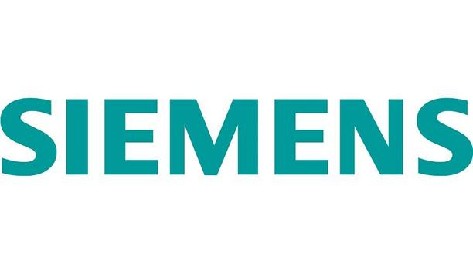





AI solutions for the energy grid are moving into the mainstream, with a growing number of startups gaining significant traction
Deep Dive: AI-Powered Grid Solutions
Non-Exhaustive
Category | Subcategory | Specific AI-powered technology | Description | Market adoption (niche, growing, mainstream) | Relative investment needs (low, med., high) | Comparative quadrant¹ | Example
Renewable Energy Generation & Storage | Renewables Optimization & Management | AI-powered solar and wind forecasting | AI models process hyperlocal weather data, satellite imagery, and historical plant performance to generate highly accurate forecasts of energy production. | Mainstream | Low to med. | Scalable solutions
Renewable Energy Generation & Storage | BESS Optimization & Trading | AI-based battery dispatch algorithm | The AI analyzes real-time electricity market prices, grid demand forecasts, and the battery's state of charge to execute the most profitable charge/discharge strategy. | Growing to Mainstream | Variable/ Scalable 2 | Scalable solutions
Grid Operations, Transmission & Distribution | Grid Enhancement & Infrastructure Build-out | AI-assissted grid planning and digital twins | AI creates digital models of the grid to simulate the impact of new assets (like EV charging hubs) before they are built. | Growing | High | Strategic bets | Gridscale X
Grid Operations, Transmission & Distribution | Advanced Weather Intelligence | Hyperlocal threat forecasting | AI provides granular weather forecasts specifically for utility service territories, predicting the risk of ice storms on lines, high winds, or wildfire conditions. | Mainstream | Low to med. | Scalable aolutions
Grid Operations, Transmission & Distribution | Fault Detection & Response | AI-powered fault analysis (including FLISR) | AI analyzes data from smart meters and line sensors to instantly pinpoint the location and type of a fault and can automate grid switching to restore power. | Growing to mainstream | High | Foundational platforms | EcoStrucxure Grid
Energy Efficiency | Commercial & Industrial Energy Management | AI-optimized building energy management systems (BEMS) | The AI learns a building's unique thermal properties and occupancy patterns to intelligently control HVAC and lighting, minimizing energy use. | Mainstream | Medium | Scalable solutions
Energy Consumption & Management | Demand Response & Load Flexibility | AI-aggregated demand response (VPPs) | AI platforms aggregate thousands of consumer devices into a virtual power plant. When the grid is stressed, the AI sends signals to these devices to slightly reduce their load in a coordinated way. | Growing to Mainstream | Variable / Scalable 2 | Scalable Solutions
Energy Consumption & Management | Energy Trading & Forecasting | AI for price & load forecasting | ML models analyze vast historical datasets, weather patterns, and economic indicators to predict wholesale electricity prices and regional demand. | Mainstream | High | Foundational Platforms
¹ Strategic Bet = High Investment, Low/Growing Adoption; Foundational Platform = High Investment, Mainstream Adoption; Scalable Solutions = Low/Medium Investment, Mainstream Adoption.
² Investment depends on project scale. | Sources: CBInsights, The grid tech market map (2024); EnergyEvolution, Challenges in Implementing Smart Grid Tech (2024).
Credit: Yosafat Partogi, Hyae Ryung Kim, and Gernot Wagner. Share with attribution: Kim et al., "Powering Data" (23 January 2026).

Slide 18
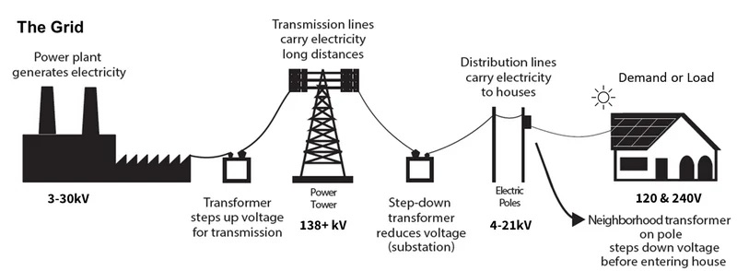
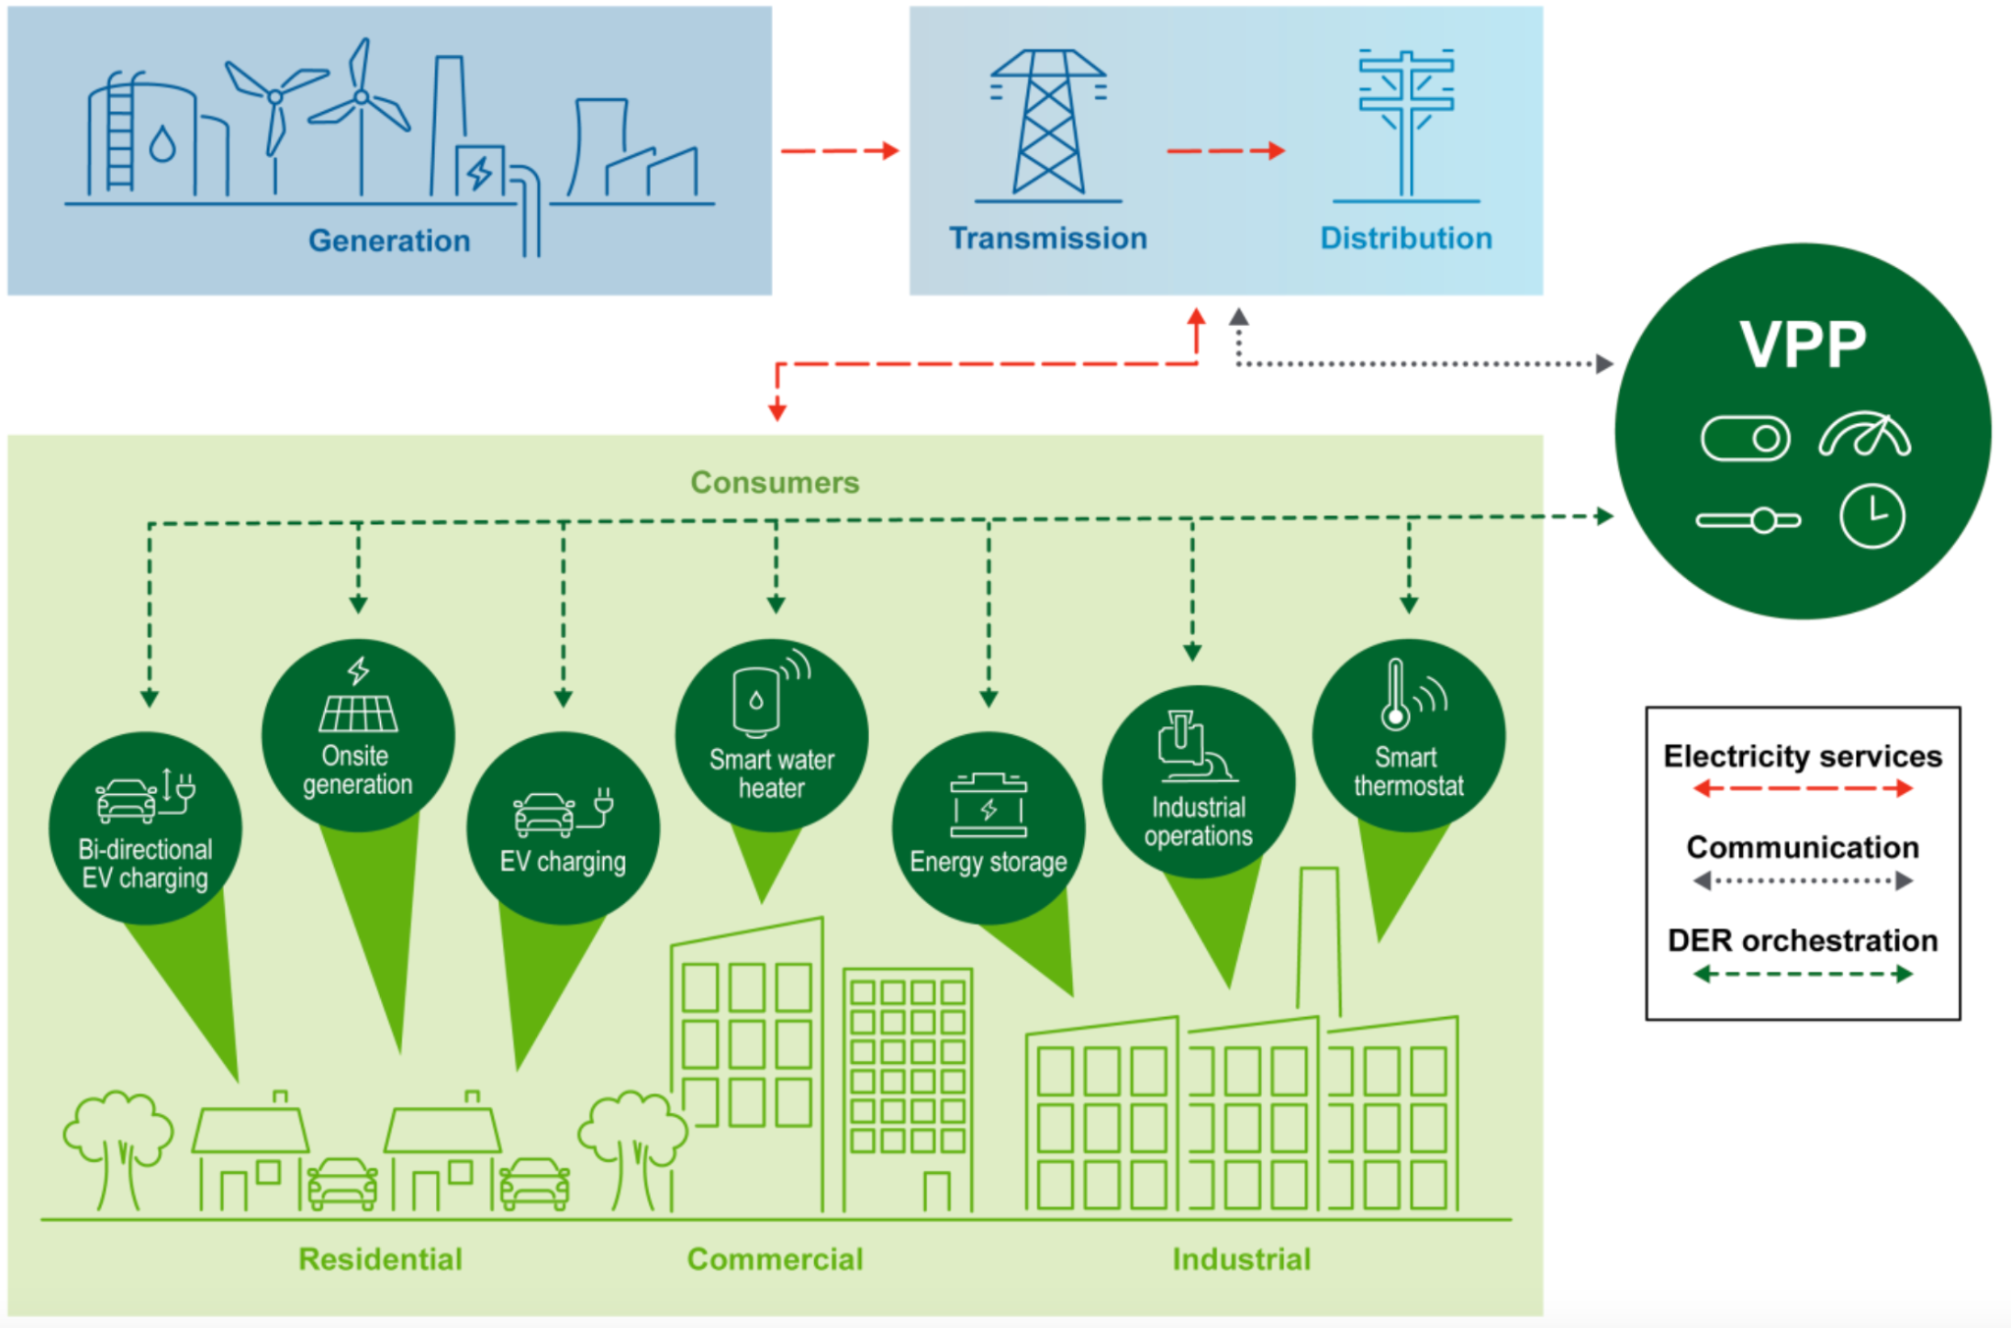
VPPs can adjust energy supply in real time, prioritize renewable sources, and cut reliance on carbon-intensive power generation
Deep Dive: AI-Powered Grid Optimization
With electrical grids facing several challenges…
…AI solutions like virtual power plants are a potential answer
  Electricity is created at power plants by converting mechanical energy into electrical energy.
  Electricity is transported over long distances at high voltages to minimize loss.
  Electricity is distributed to homes and businesses through local wiring.
Aging infrastructure leads to more power outages.
Climate change puts more stress on the grid due to extreme weather.
Energy demand growth leads to a traditional grid’s inability to handle new loads and integrate renewables.
Distributed energy resources (DERs) are becoming more prevalent given increasing affordability, reliability concerns with traditional grids, and the push for cleaner energy (i.e., solar panels, EVs, battery storage).
VPP tech aggregates, controls, and optimizes DERs from consumers.
  AI-powered solutions can analyze real-time data to optimize energy distribution, predict energy production, and anticipate energy consumption patterns for proactive management of energy resources.
This in turn increases grid resilience and reliability, as excess or surplus energy created from DERs can be redistributed back to the grid.
The solution increases electrification and relieves load stress at the grid at low cost.
Sources: Data and graphics from DOE, Pathways to Commercial Liftoff: Virtual Power Plants (2025).
Credit: Yosafat Partogi, Hyae Ryung Kim, and Gernot Wagner. Share with attribution: Kim et al., "Powering Data" (23 January 2026).

Slide 19








AI Data Center Team
Hyae Ryung (Helen) Kim
PhD in Sustainable Development
Senior Research Fellow, Climate Knowledge Initiative
Shubhangi Prasad
Master of Public Administration
Fellow, Climate Knowledge Initiative
Ariela Farchi Behar
Master of Sustainability Management
Staff Associate, Climate Knowledge Initiative
Yosafat Partogi Simbolon
Master of Business Administration
Fellow, Climate Knowledge Initiative
Isabel Hoyos
Master of Sustainability Management
Senior Staff Associate, Climate Knowledge Initiative
Clara Zibell
BA in Sustainable Development
Fellow, Climate Knowledge Initiative
Una Oljaca
BA in Sustainable Development
Fellow, Climate Knowledge Initiative
Gernot Wagner
Senior Lecturer, Columbia Business School
Faculty Director, Climate Knowledge Initiative
gwagner@columbia.edu

Slide 20
Appendix

Slide 21
Glossary
AI BTM CPU DC KV FLOPS PPA PV MOE MHLA MPF MW LLM EGS EU SOE GPU SMR | Artificial intelligence Behind the meter Central processing unit Data center Key-value Floating point operations per second Power purchase agreement Photovoltaic Mixture of Experts Multi-head Latent Attention Mixed Precision Framework Megawatt Large language model Enhanced geothermal systems European Union State-owned enterprise Graphics processing unit Small modular reactors (nuclear)
TPU PUE | Tensor processing unit Power usage effectiveness

Slide 22
AI boom expected to reverse decades-long downward trend in U.S. electricity growth
Annual growth in U.S. electricity use (1950-2024) and projected growth by 2035 and 2050, %
Observations
Total U.S. electricity use was ~4,100 TWh in 2024, and is expected to increase to ~4,900 and ~5,600 by 2035 and 2050, respectively, under the IEA Stated Policies scenario.
Total U.S. population has grown steadily since 1950, from around 150 to 350 million people.
Electricity demand from data centers in the U.S. is projected to increase by 240 TWh (+130%) by 2030.
Current Policies (IEA)
Stated Policies (IEA)
  Efficiency gains in appliances, lighting, and manufacturing offset population growth.
  The iPhone (2007) introduced a new wave of digital transformation characterized by smartphones, social media, and big data.
  Widespread adoption of AI since 2023 will drive increased electricity use.
2035
2050
Sources: EIA, Total Energy (2025); IEA, World Energy Outlook (2025); Statista, Resident population of the United States from 1950 to 2025 (2025).
Credit: Isabel Hoyos and Gernot Wagner. Share with attribution: Kim et al., "Powering Data" (23 January 2026).
1950
1960
1970
1980
1990
2000
2010
2020

Slide 23
Off-grid SMRs are a mid- to long-term solution for increased energy demand from hyperscale and colocation data centers
Deep Dive: Nuclear SMRs
Projected global data center energy demand¹, TWh
Urban proximity and spatial concentration²
Observations
Long timelines for transmission connection, gas turbines (more than seven years), and power supply stress the need for off-grid solutions.
Off-grid solar is a strong option for training-only data centers, when uptime requirements are slightly relaxed.
The small size and modularity of SMRs allow these to be sited closer to data centers. This is ideal for inference AI workloads, which have low-latency and high-redundancy requirements.
The data center construction timeline is up to seven years in the United States. SMR technology is expected to be deployed after 2030.
IEA liftoff
IEA headwinds
Spatial concentration²
3.0
Data center type
IEA base
Bloomberg ETS – U.S. demand
Hyperscale
Energy source
High uncertainty
Colocation
SMRs can power spatially concentrated data center clusters.
Edge
SMRs
Large nuclear plants
Distributed
0.0
Off-grid solar
Distance from urban areas (km)
Data center types
 | Training AI | Inference AI
Hyperscale | Primary | Common
Colocation | Limited | Common
Edge | Not suitable | Primary
Distributed | Not suitable | Primary
¹ IEA Scenarios are based on projected AI uptake, energy sector bottlenecks, and efficiency improvements. ² Spatial concentration = electrical output/land area used.
Sources: IEA, Energy and AI (2025); IEA, Electricity (2025); Baranko et al., Fast, scalable, clean, and cheap enough (2024); Ember, Global Electricity Review (2025); BNEF, How AI Influences US Data Center Power Demand (2025); Gartner, Power Shortages Will Restrict 40% of AI Data Centers by 2027 (2024); Last Energy, On-Site Nuclear Power (2023).
Credit: Clara Zibell, Khande-Jaé Fisher, Isabel Hoyos, and Gernot Wagner. Share with attribution: Houwink et al., "Reenergizing Nuclear" (23 September 2025).

Slide 24

BTM geothermal is a potential low-carbon baseload energy source, can play key role in meeting growing U.S. power demand
Deep Dive: BTM Geothermal
Geothermal satisfies key baseload energy needs, which is critical as demand grows
Behind-the-meter EGS potential for hyperscale data centers in 15 largest U.S. markets¹, GW
Observations
EGS potential is based on subsurface conditions and geothermal costs.
55-64% of projected hyperscale demand growth could be met with geothermal, representing 15-17 GW of new capacity.
While much of the potential is in the West, only Atlanta and New York City show promise for BTM EGS.
This scenario estimates a national weighted average LCOE for new geothermal capacity of $78-$85/MWh.
If developers site data centers near high geothermal potential areas, EGS could meet all projected load growth by 2035 with a 31-45% lower LCOE.
Direct cooling via GHPs could further reduce data center electric loads using little water consumption.
Streamlined permitting, better data and supply chains, and federal incentives are needed to make this shift possible.
High-capacity factor
~70-90% (can exceed 90% for next-generation geothermal power), higher than all power sources except nuclear
Denver, CO
100% projected demand growth met by BTM geothermal
Hermiston, OR
15% projected demand growth met
Los Angeles, CA
46% projected demand growth met
San Francisco, CA
System inertia
Rotating turbines spin continuously due to high inertia, building resistance to frequency changes and helping maintain grid stability
Monroe, LA
Austin, TX
San Antonio, TX
Nevada leads in streamlining geothermal permitting through oversight by the Nevada Division of Minerals and Nevada Bureau of Mines and Geology, supported by the Bureau of Land Management on federal lands.
Chicago, IL
Extended service lifetime
Lifespan of 30-50+ years compared to 30-35 years for solar PV, 30 for wind turbines,10-40 for coal plants, and 20-40 for other fossil fuel plants
Reno, NV
VA/Washington, DC
Salt Lake City, UT
San Jose, CA
Sustainable operation
Lowest land use (7.5 km2/TWh/year) among renewables; low lifecycle GHG emissions – 37 gCO₂e/ kWh vs. 400-1,000 gCO₂e/kWh for non-renewables
Las Vegas, NV
Dallas-Ft. Worth, TX
Phoenix, AZ
¹ Assumes ongoing clustering of data centers, willingness to pay a 20% green premium above the regional electricity rate, and use of dry-cooled EGS and optional solar and BESS.
Sources: Rhodium Group, The Potential for Geothermal Energy to Meet Growing Data Center Electricity Demand (2025); SLB, Beyond levelized cost (2025).
Credit: Una Oljaca, Hyae Ryung Kim, and Gernot Wagner. Share with attribution: Kim et al., "Powering Data" (23 January 2026).

