Slide 1

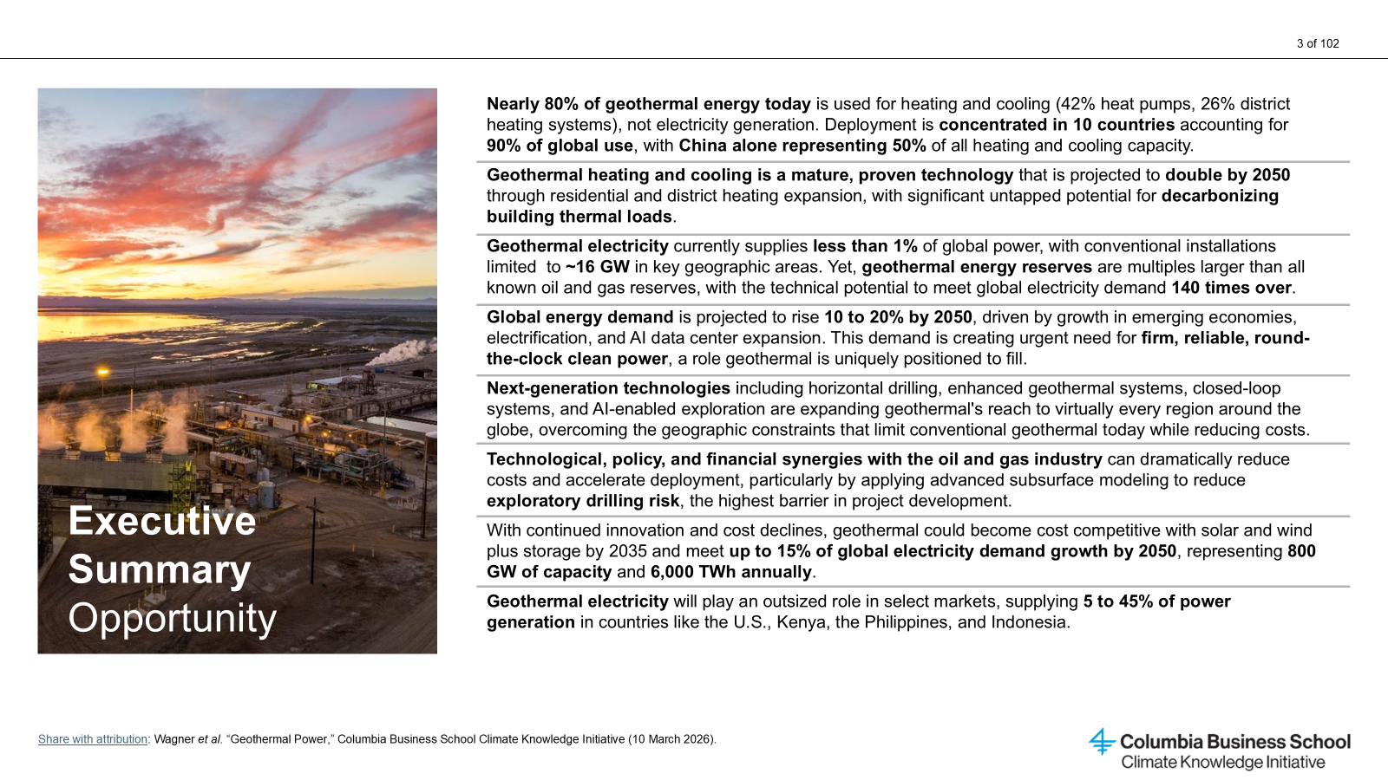
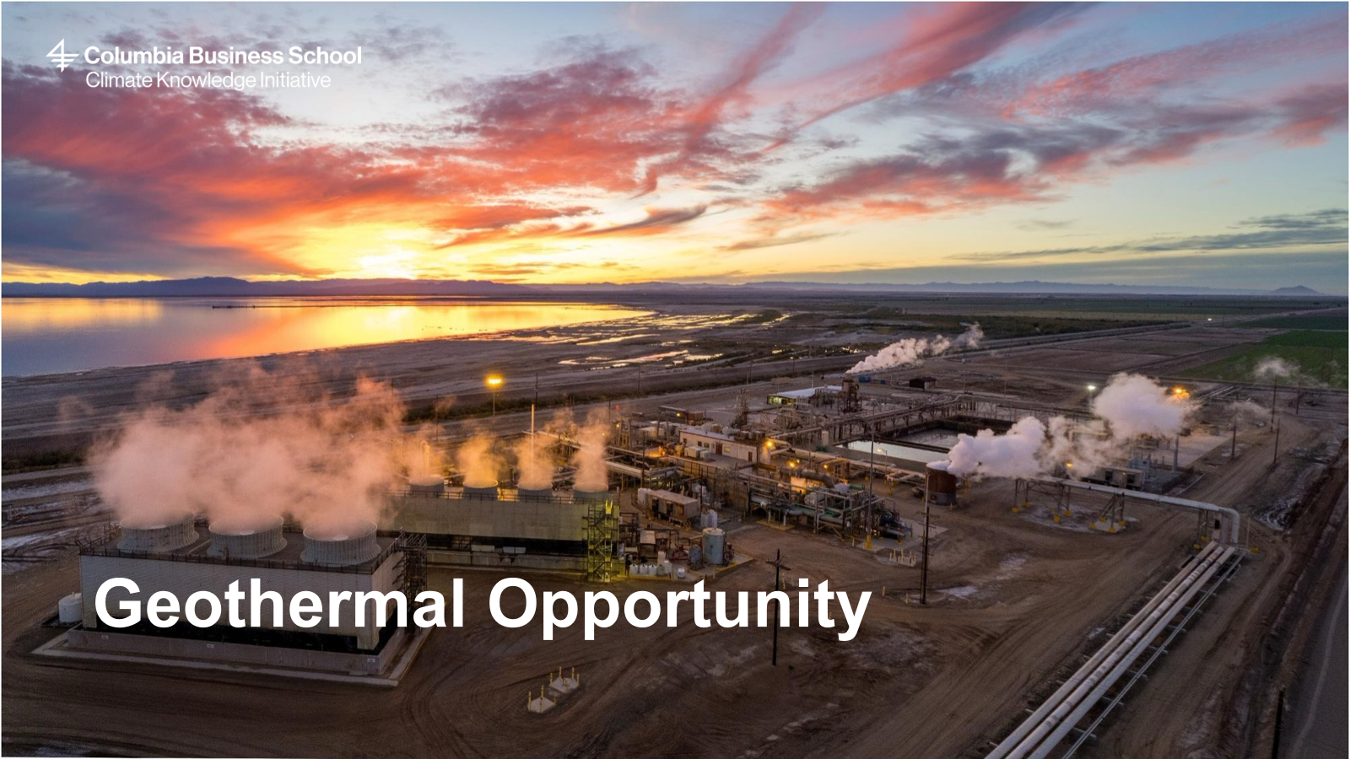
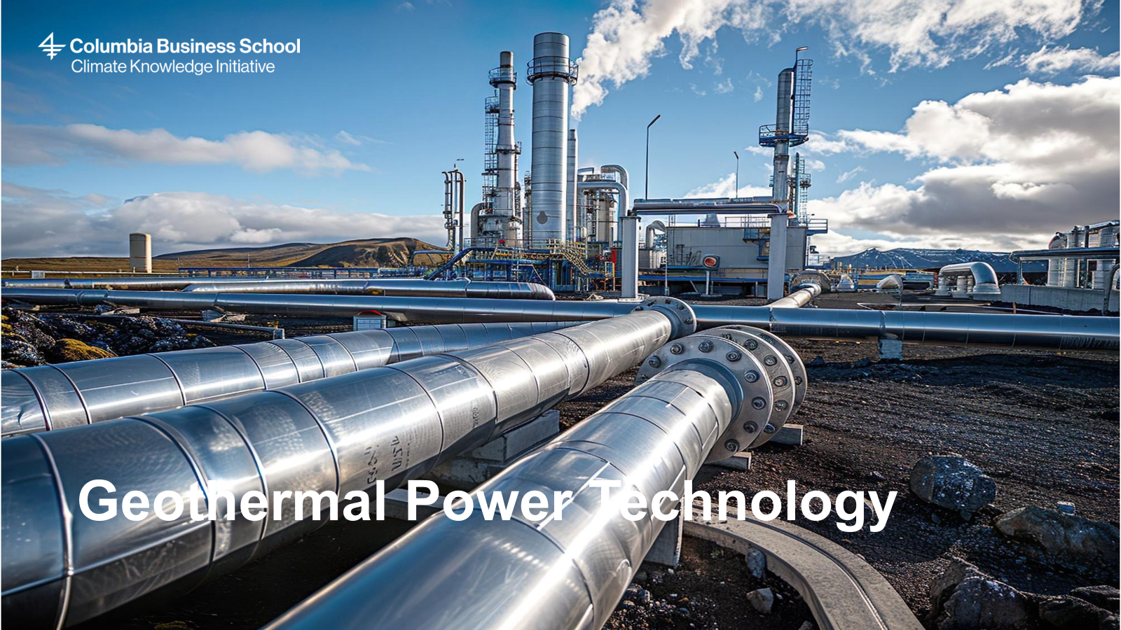
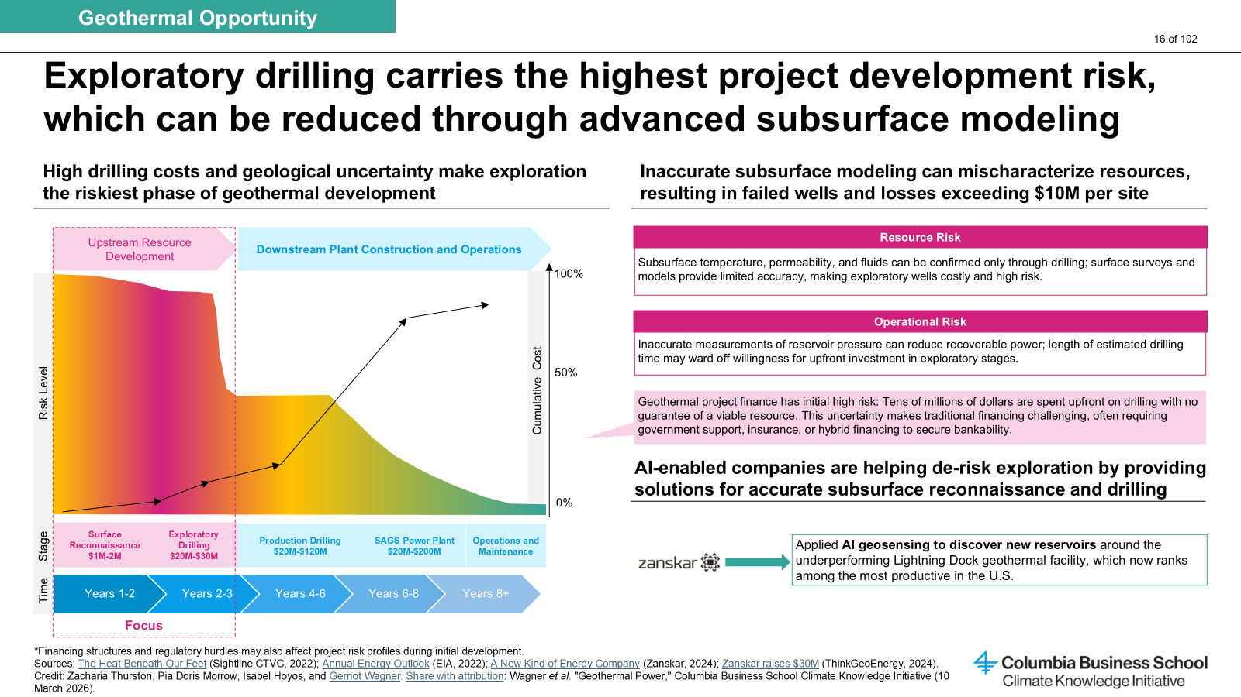
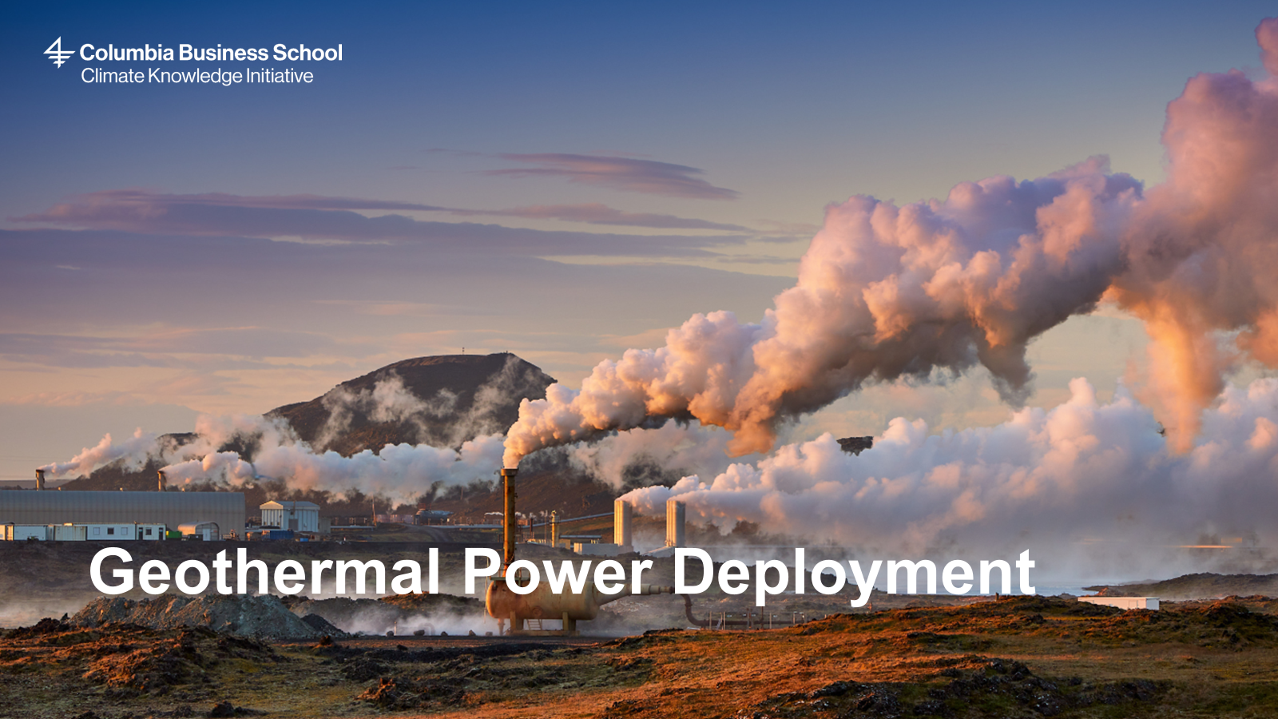

Slide Deck
Key Insights
Geothermal Power
Executive Summary
See Slide 3 of deck
Geothermal provides firm, dispatchable, zero-carbon power, one of only two scalable 24/7 technologies alongside nuclear with broad bipartisan support
Geothermal reserves are estimated to be 500x larger than all proven oil & gas reserves; just 1% of resources could meet global electricity demand 140 times over
Currently only ~16 GW are installed across 32 countries, supplying <1% of global electricity; next-gen technologies are removing constraints for scale-up
With continued investment into next-gen technologies, geothermal could become cost-competitive with solar + storage by 2035 and supply ~15% of global electricity demand by 2050
Hyperscalers are signing large PPAs and making equity investments to secure geothermal power for data centers
Why invest in geothermal power?
Investment Opportunities
Slide 4
Slide 19
Geothermal provides firm, clean power, complementing renewables and strengthening grid reliability
Geothermal enhances energy security by reducing reliance on imported fuels and supply chains
Geothermal assets offer 30-50 yr stable cash-flows that appeal to long-term institutional investors
Leveraging oil & gas technology and workforce can reduce costs and de-risk next-generation development
Geothermal brines can contain critical minerals, creating additional strategic opportunities
Conventional Hydrothermal
Low Risk – Investor type: Project Finance
Taps hot water reservoirs near tectonic zones. Proven technology globally deployed and derisked, with unexploited reserves remaining.
Enhanced Geothermal Systems (EGS)
Medium Risk – Growth, Private Equity
Hydraulic stimulation creates fractures in hot rock to circulate fluid. EGS are the most promising next-gen geothermal technology.
Closed Loop Systems (AGS)
Medium-High Risk – Venture Capital, PE
Sealed subsurface pipes circulate fluid without requiring fracturing or brine; geographically flexible and targeting $0.08/kWh by 2035.
AI-Enabled Exploration
High Risk – VC
ML models can process seismic, satellite, and well-log data faster and more accurate than current models to pinpoint drilling targets.
Advanced Drilling
High Risk – VC
Vaporizes rock via high-power millimeter waves, plasma, or lasers to reach 10–20 km depths without mechanical wear.
TRL 8-9
Power-generating assets
TRL 7-8
TRL 7-8
IEA Cumulative Investment Estimate of Geothermal ($Bn)
Electricty Only
TRL 6-9
Combined Heat and Power
Industrial Heat
Complementary Tech
TRL 4-5
2025
2030
2035
2040
2045
2050
Risks and Mitigation Strategies
Adoption & Investment Trends
Slide 16
Slide 78
Exploration risk (25% drilling success rate) can be mitigated by AI-enabled subsurface modeling and government risk-sharing programs
High drilling costs (~54% of next-gen LCOE) can fall with O&G technology transfer (i.e., MMW, plasma, laser)
Grid interconnection permit timelines in the U.S. can be reduced with on-site (behind-the-meter) deployment
~16 GW installed globally; concentrated in 10 countries (US, Indonesia, Philippines, Türkiye, New Zealand, Mexico, Kenya, Iceland, Italy, Japan)
Main growth driver are Hyperscaler PPAs, i.e., Microsoft ($1B Kenya), Google (Nevada 115 MW, Fervo), Meta (150 MW XGS in NM + Sage), Amazon (Japan)
Fervo IPO in 2026 as a major market-validation event
About CKI
The Climate Knowledge Initiative (CKI) conducts rigorous techno-economic analyses and turns them into actionable, business-relevant insights. Through research, communication, and stakeholder engagement, CKI bridges the knowledge gap between academia and business leaders. View the full report on geothermal power.
Credit: Paul Greitemann, Ariela Farchi, Pia Doris Morrow, and Gernot Wagner. Share with attribution: Wagner et al. "Geothermal Power," Columbia Business School Climate Knowledge Initiative (10 March 2026).

