Slide 1
How Alumni Can Get Involved with Healthcare @CBS

Slide 2
Dear Alumni and Friends,
The Healthcare and Pharmaceutical Management Program (HPM) values the wealth of experience our alumni bring to the healthcare community at a Business School (CBS).
Your participation and commitment are essential to our mission to grow the healthcare community at CBS, and allows us to connect with alumni across the globe.
Alumni can get involved with HPM in multiple ways such as through student mentorship, career advising, knowledge sharing, and financial support of specific HPM priorities. This guide outlines how you can contribute in meaningful and important ways.
In good health,
Carri Chan
Faculty Director
cwchan@gsb.columbia.edu

Slide 3
How Can You Support HPM?
Stay Connected
Knowledge
Share
Mentor Program
Careers
Events
Financial

Slide 4
Stay Connected
Newsletter
LinkedIn
Social Media
Sign up for our monthly newsletter to keep up-to-date on news, events, alumni, student life and more.
Follow our Page
Join our Group
Get connected to all of Columbia Business School
social channels.

Slide 5
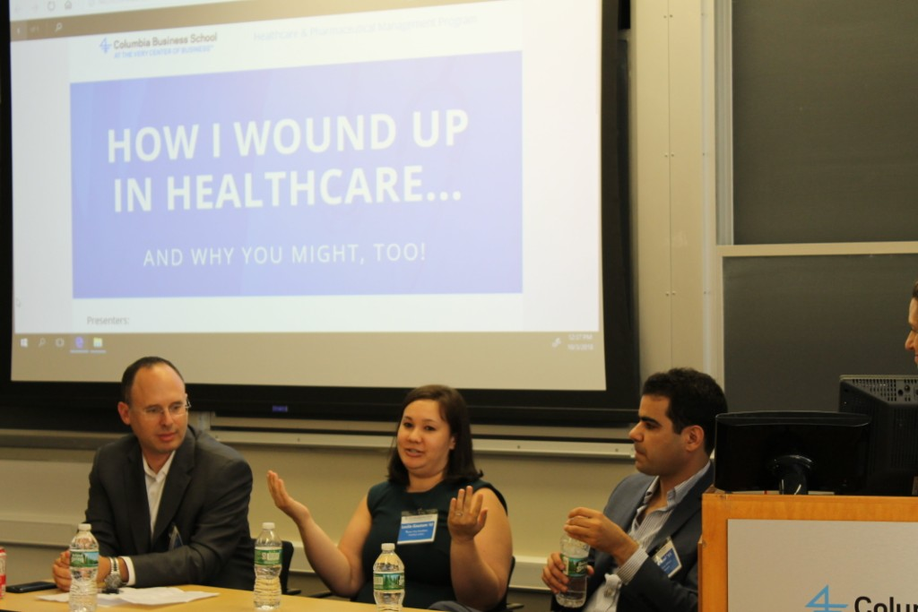
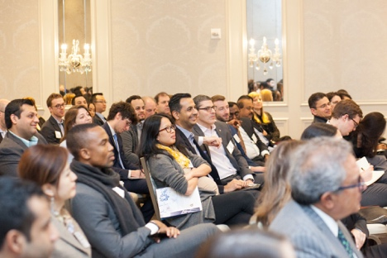
Share Your Knowledge
Speak on-campus
Annual Conference
Class Lectures
We welcome the opportunity to hear from CBS alumni who are willing to share their experiences, knowledge and expertise. If you’re interested in speaking, please complete this short form and email Bianca Bellino at bb2715@gsb.Columbia.edu right after to let her know you filled out the form.
Always a highlight of the year, the annual CBS Healthcare Conference attracts 500+ students, alumni, faculty, industry executives, entrepreneurs and professionals. We would welcome the chance to discuss speaking and conference support with you. Please contact HPM Faculty Director Carri Chan for more information.
Faculty throughout the CBS community blend theory with practice by inviting guest speakers to classes to address relevant topics through a real world lens. The complete list of HPM courses can be found here. If you would like to be a guest speaker, then you must contact the course instructor directly.
Please note that speaker engagements in our classes are often solidified a year in advance and are at the sole discretion of the faculty instructing the course.

Slide 6
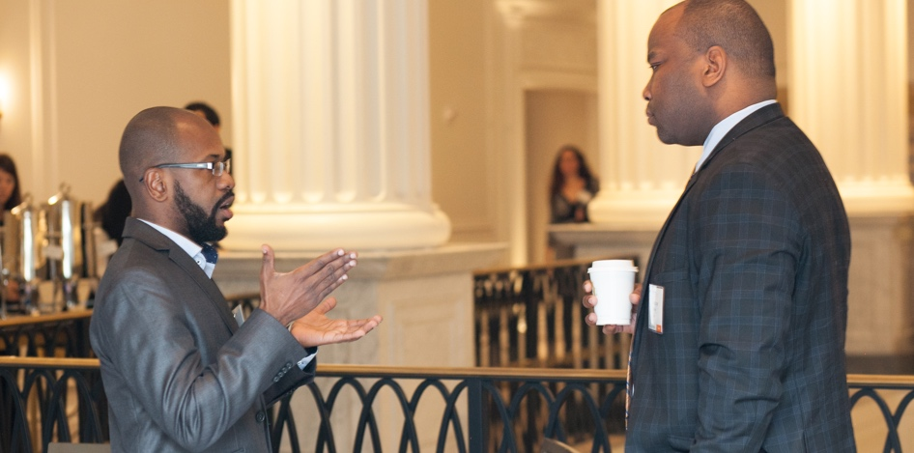
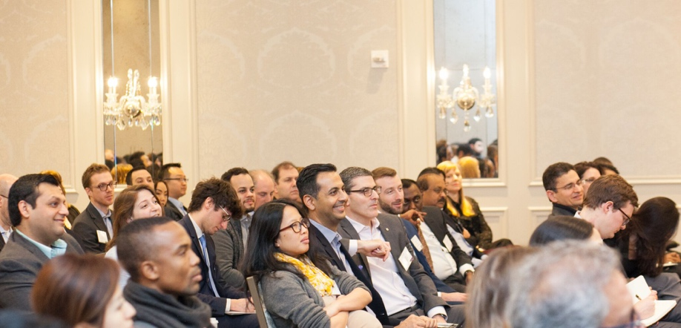
Mentor Program
Program Requirements
The program is designed to encourage regular communication and interaction during the mentorship period so that both mentor and mentee derive value
A minimum full academic year commitment
Completion of an online orientation
Regular meetings between Mentors and Mentees, ideally in person OR via Skype/FaceTime/etc. –totaling about 5 hours over the academic year (e.g. bi-monthly 1 hour meetings per semester)
Completion of program surveys & other assessment materials
HPM launched a formal mentor program in 2018 to help students develop meaningful relationships with industry professionals who can offer career guidance, real-world insights, and job search advice. We hope to help broaden awareness of the many career opportunities that exist within healthcare and to create a positive support system for CBS students that enables academic and professional success.
Become a Mentor
Alumni interested in getting involved should e-mail Bianca Bellino at bb2715@gsb.Columbia.edu

Slide 7
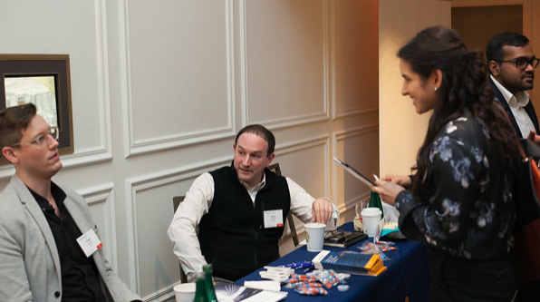
Recruit a Student
Post internships & full time jobs
Students are interested in opportunities to enhance their real world experience in healthcare through internships, summer jobs and full-time positions.
We created a packet which includes a few resources to help you tailor your job description for COIN, the school wide job portal. We will also distribute the job posting to students directly via Healthcare Industry Association (HCIA) newsletter.
Once you have posted it on COIN, make sure to send a copy to HPM Director Carri Chan.

Slide 8
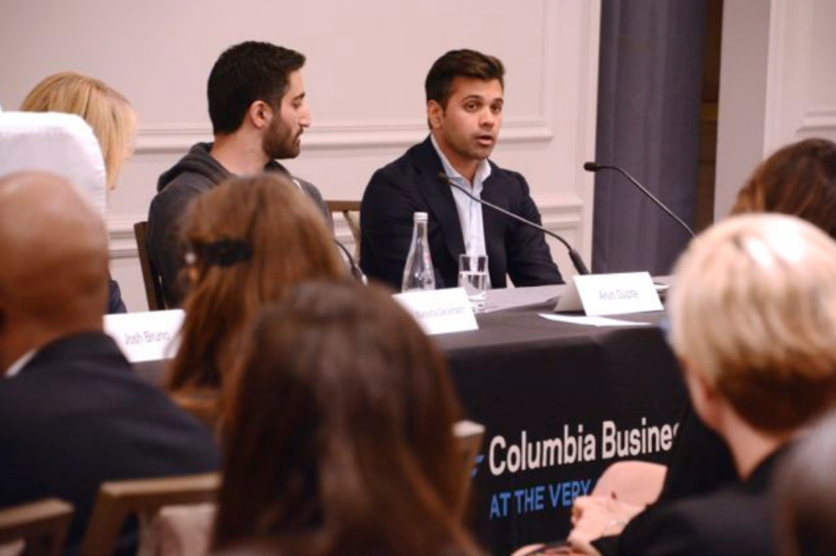
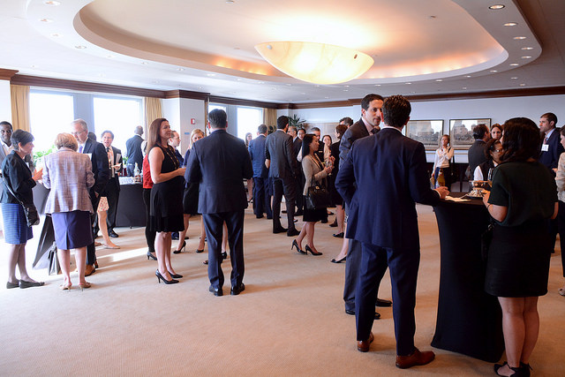
Host an Event
Engage with alumni & students
We appreciate having the opportunity to host events with members of the CBS healthcare community. Our events occur around the globe and range in size and scale. They can involve anything from small regional happy hours to larger sponsored events with guest speakers or lecturers.
Event hosts typically provide space, food/beverage, AV support and at least one staff person to help during registration and logistics.
If you have office space or a venue that you would like to make available to the HPM Program to host events, please email HPM Director Carri Chan with specifics around location, room size, availability (time of day) and topic areas you’d like to explore.

Slide 9
Fund our Future
HPM needs your financial support to grow
Your generous contribution will help further HPM's mission to educate tomorrow's leaders to improve healthcare by forging innovative business models that impact how people are cared for globally. We thank you in advance for your support!
GIVE ONLINE
How to make your donation:
1
On the main screen, please select "Other" as the designation option
2
On the next page, be sure to include "Gift for the Healthcare and Pharmaceutical Management Program" in the Comments/Special Instruction field

Slide 10
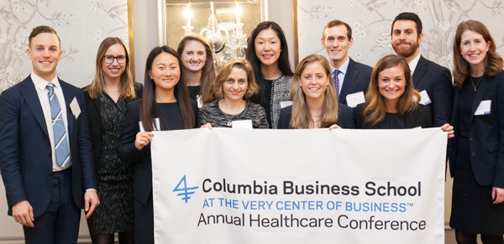
Thank you!

