Slide 1
Sectoral Dislocations and Long Run Crises
Joseph E. Stiglitz
Delhi
November 2011

Slide 2
This recession and the Great Depression
This is the longest period since the Great Depression during which unemployment has been as high as it has been
Natural to think about comparisons between the two

Slide 3
“Standard view”
We had a financial crisis—a bubble
We need to fix banking system
We needed a short term stimulus to plug hole until banking system repaired
Once repaired we can go on as usual

Slide 4
Alternative view
Before the crisis the US (and to a large extent the global) economy was “sick,” supported by a real estate bubble, which led to a consumption bubble
Bottom 80% of Americans were consuming roughly 110% of their income
Not sustainable

Slide 5
While bubble “hid” underlying problems, it left in its aftermath additional problems
Excess capacity in real estate
Excess leverage
Major mistake of administration was to think that fixing the banking system would “suffice”
But they didn’t succeed in restoring lending
But even deleveraging won’t suffice to restore economy
Won’t (and shouldn’t) return to world with consumption 110% of income

Slide 6
Evidence against prevailing view
Financial sector has been largely repaired—and yet the economy has not recovered
Large enterprises have no shortage of funds
Investment (outside of real estate) has almost returned to normal—couldn’t expect any better given weak demand
Real estate won’t return to normal any time soon

Slide 7
Deep downturns and structural transformation
Great Depression was a period of structural transformation—move from agricultural to industry
Great Recession is another period of structural transformation (from manufacturing to service sector, induced by productivity increases and changes in comparative advantage brought on by globalization)
Rational-expectations models provide little insights in these situations
Periods of high uncertainty, information imperfections

Slide 8
Structural transformations may be associated with extended periods of underutilization of resources
With elasticity of demand less than unity, sector with high productivity has declining income
There may be high capital costs (including individual-specific non-collateralizable investments) associated with transition—but with declining incomes, it may be impossible to finance transition privately
Capital market imperfections related to information asymmetries
Declining incomes in “trapped” high-productivity sector has adverse effect on other sectors

Slide 9
Contrast with results where there is perfect mobility
Productivity improvements can lead everyone to be better off
Though normally there are distributive consequences
Gainers could compensate losers

Slide 10
Distorted economy (e.g. associated with bubble) can give rise to analogous problems
Labor “trapped” in bloated construction sector and financial sectors
This crisis has elements of both
Movement out of manufacturing has been going on for a long time
But problems compounded by cyclical problems

Slide 11
Basic model
Two sectors (industry, agriculture)
(1) βα = βD^{AA} (p, pα) + E D^{MA} (p , w* )
(2) H(E) = βD^{AM} (p, pα) + E D^{MM} (p , w* ) +I
β is the labor force in agriculture, (1 - β) is the labor force in industry,
α is productivity in agriculture,
D^{ij} is demand from those in sector i for goods from sector j
w* is the (fixed) efficiency wage in the urban sector,
I is the level of investment (assumed to be industrial goods),
p is the price of agricultural goods in terms of manufactured goods, which is chosen as the numeraire, and
E is the level of employment (E ≤ 1 - β);
and where we have normalized the labor force at unity.

Slide 12
Basic result
Normally (under stability condition, other plausible conditions) with immobile labor
An increase in agricultural productivity unambiguously yields a reduction in the relative price of agriculture and in employment in manufacturing.
The result of mobility-constrained agricultural sector productivity growth is an extended economy-wide slump

Slide 13
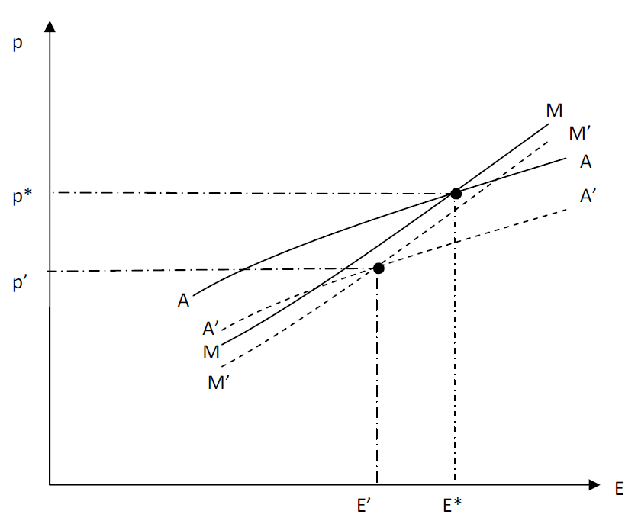
Figure: effects of an increase in agricultural productivity.

Slide 14
Great Depression
From 1929 to 1932, US agriculture income fell more than 50%
While there had been considerable mobility out of agriculture in the 1920s (from 30% to 25% of population), in the 1930s almost no outmigration
Labor was trapped
Could not afford to move
High unemployment meant returns to moving low

Slide 15
Government expenditures
Under the stability condition, an increase in government expenditure increases urban employment and raises agricultural prices and incomes
Even though problem is structural, Keynesian policies work
Even more effective if spending is directed at underlying structural problem

Slide 16
Structural transformation
Economy will be moving away from manufacturing towards service
But housing and financial services are already overbloated
Health and education, etc. will need to be expanded
And these depend heavily on public funding
Constraints on public funding will make the transition all the more difficult

Slide 17
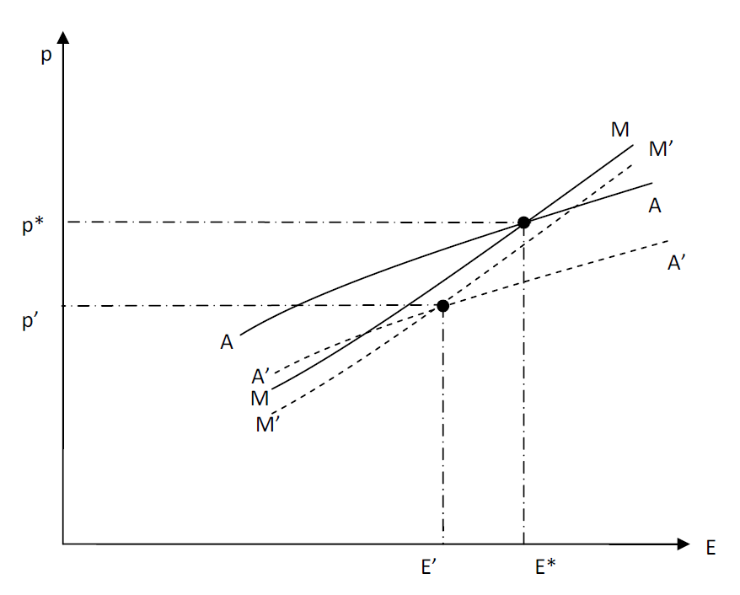
Figure: Impact of Keynesian stimulus: an increase of G increases both employment and rural prices

Slide 18
Emerging from the Great Depression
New Deal was not big enough to offset negative effects of declining farm income
And much of federal spending offset by cutbacks at state and local level
Analogous to current situation, where government employment is now lower by 700,00 than it was before crisis
Local government alone has lost 550,000 since the peak of employment in September 2008

Slide 19
War
WWII was a massive Keynesian stimulus
Moved people from rural to urban sector
Provided them with training
Especially in conjunction with GI bill
It was thus an “industrial policy” as well as a Keynesian policy
Forced savings during War provided stimulus to buy goods after War
In contrast to the legacy of debt now

Slide 20
Wages
In model, under normal condition, lowering urban wages lowers agricultural prices and urban employment
High (rigid) wages are not the problem
Lowering wages would lower aggregate demand—worsen the problem
In this crisis, the US—country with most flexible labor market—has had poor job performance, worse than many others

Slide 21
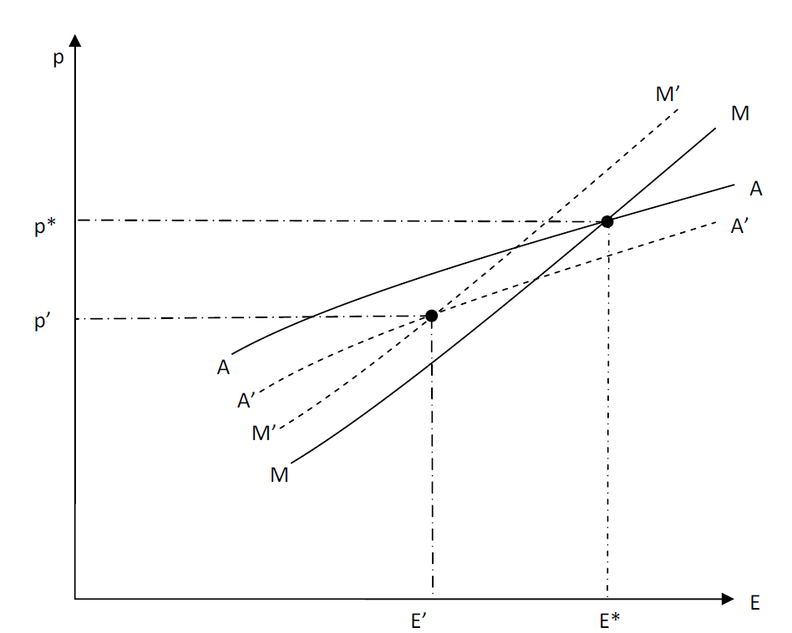
Figure: the effects of downward wage adjustments.

Slide 22
An aside on irrelevance of standard macro-models
Since such structural transformations seldom occur, rational expectation models are not of much help
Since the central issue is structural, aggregate model with single sector not of much help
Since among major effects are those arising from redistribution, a representative agent model is not of much help
Since central issue entails frictions in mobility, assuming perfect markets is not of much help
Problems exacerbated by efficiency wage effects

Slide 23
An aside on current interpretations of the Great Depression
Banking crisis was a result of the economic downturn, not a cause
But financial crisis can help perpetuate downturn
Standard interpretation has it that if only the Fed had expanded money supply, Great Depression would have been avoided; monetary contraction caused the Depression
But we’ve had a massive expansion of money base—yet economy is still very weak

Slide 24
Global perspective
Increase in productivity in manufacturing will limit total number of jobs in sector
But changing comparative advantage will mean that US, Europe will get a smaller fraction of these jobs
Even greater sectoral adjustment

Slide 25
Other factors weakened global aggregate demand before crisis
Growing inequality—partially related to sectoral transformation
Oil price boom—transferred resources to oil rich countries
Build up of reserves in emerging countries—partially a result of mismanagement of 1997 crisis
Two of these factors have become worse since the crisis → unstable response

Slide 26
Towards a New Macroeconomics
Should be clear that standard models were ill-equipped to address key issues discussed above
Assumptions ruled out or ignored many key issues
Many of risks represent redistributions
How these redistributions affect aggregate behavior is central
New Macroeconomics needs to incorporate an analysis of Risk, Information, Institutions, Stability, set in a context of
Inequality
Globalization
Structural Transformation

Slide 27
With greater sensitivity to assumptions (including mathematical assumptions) that effectively assume what was to be proved (e.g. with respect to benefits of risk diversification, effects of redistributions)

Slide 28
Concluding remarks
Models and policy frameworks (including many used by central banks) contributed to their failures before and after the crisis
And also provide less guidance on how to achieve growth with stability (access to finance)
Fortunately, new models provide alternative frameworks
Many of central ingredients already available
Credit availability/banking behavior
Credit interlinkages
Sectoral analysis
Distributional analysis

Slide 29
More broadly, sensitive to (i) agency problems; (ii) externalities; and (iii) broader set of market failures
Models based on rational behavior and rational expectations (even with information asymmetries) cannot fully explain what is observed
But there can be systematic patterns in irrationality, that can be studied and incorporated into our models

Slide 30
Concluding remarks
Less likely that a single model, a simple (but wrong) paradigm will dominate as it did in the past
Trade-offs in modeling
Greater realism in modeling banking/shadow banking, key distributional issues (life cycle), key financial market constraints may necessitate simplifying in other, less important directions
Complexities arising from intertemporal maximization over an infinite horizon of far less importance than those associated with an accurate depiction of other aspects of the economy (sectoral transformation; financial markets)

Slide 31
New policy frameworks
New policy frameworks need to be developed based on this new macroeconomic modeling
Focus not just on price stability but also in financial stability

Slide 32
References
Domenico Delli Gatti; Mauro Gallegati; Bruce C. Greenwald; Alberto Russo; Joseph E. Stiglitz, “Sectoral Imbalances and Long Run Crises,” presented to IEA meeting, Beijing, July, 2011.
“Rethinking Macroeconomics: What Failed and How to Repair It,” Journal of the European Economic Association, 9(4), pp. 591-645.

