Slide 1
The Economic Crisis: Towards a New World Order? Towards Sustainable Growth?
Hong Kong
Joseph E. Stiglitz
April 29, 2009

Slide 2
We are not out of the Woods…
The world has pulled back from the brink where it was in September 2008
But the world is not yet on the course of a robust recovery
In fact, prospects are that growth will slow down towards the end of the year/early next year
We have not fully taken on board the lessons of the crisis
Prospects of regulatory reform are better than ever
But creating a new global balance will not come easily

Slide 3
The Unfolding Crisis
The crisis has continued much as expected in the U.S.
As predicted, strong growth in 3rd and 4th quarters
Continued lag in job recovery
Job growth in first quarter still slow (162,000)
Much of it temporary (48,000 census workers)
Much of it stimulus spending
Average job growth for first quarter (54,000 per month) not keeping pace with new entrants to labor force—but far better than losses of 753,000 per month last year
Labor market remains grim
Average duration of unemployment at record level
Little dent in 15 million job seekers
1/6 Americans who want a full time job still can’t get one
Expectation of unemployment remaining in excess of 9% for next year
Will be middle of decade or later before unemployment returns to normal

Slide 4
Europe’s Prospects Worse
High unemployment
Large budgetary deficits
Speculative attacks
Attack on Greece, potentially other European countries
No real foundations—European countries can meet debt obligations (so long as interest rates remain reasonable)
Europe responded but too slowly and inadequately
No institutional response
Problem recognized at the founding of the euro—but nothing was done
Need solidarity funds, not just for new entrants but also for stability
America is a single currency area but has a fiscal framework
Europe does not
Potential problems down the road
Consequence: budgetary cutbacks
Likely to weaken economies

Slide 5
OECD Fiscal Balance
Source: OECD, Economic Outlook No. 86, 19 November 2009

Slide 6
Towards a double dip in US: sources of anxiety(1)—beyond weak labor market
Premature cutback in fiscal stimulus
Fiscal stringency in states/local government
Exit from unusual monetary measures
Fed has been buying all mortgages
Continuing residential foreclosures
Administration admits previous programs haven’t worked
Haven’t dealt with ¼ mortgages underwater
Likely to keep consumer spending depressed, contribute to bank weaknesses

Slide 7
Towards a double dip: sources of anxiety (2)
5. Unfolding problem in commercial real estate
6. Record level of bank closings
Tip of iceberg: shows weaknesses in banking system
7. Small- and medium-sized enterprises can’t get access to credit
Banks constrained both by supervisors and balance sheet
Borrowers constrained by lack of collateral (decrease in real estate values)
8. Weakening euro and Europe makes export prospects bleaker

Slide 8
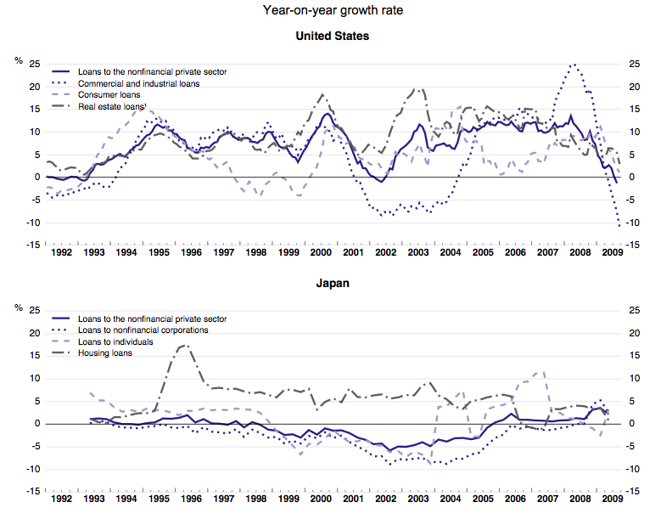
Bank Lending Collapse (1)

Slide 9
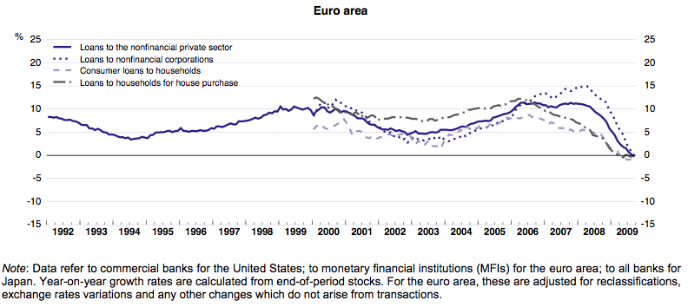
Bank Lending Collapse (2)
Source: OECD, Economic Outlook No. 86, 19 November 2009

Slide 10
New Elements in U.S.
Growing concern about deficits
Obama talking about freezing discretionary spending (other than military)
Motivated by worries about debt/GDP ratio reaching 90% or more by end of decade
Should encourage focus on high-return investment spending which would lower long-term debt
Likely to lead to curtailing government spending before robust recovery
Health care reform’s economic impact remains uncertain
Doing nothing cast a pallor of uncertainty
But job impact remains debated

Slide 11
Fundamental Problem
What had sustained world before crisis was real estate bubble
Led to consumption levels that were not sustainable
Even if banking system were working perfectly, there would be a problem
But financial system is not working well in many countries

Slide 12
Hope of a Short-Lived Downturn
Once banking system was repaired private sector would recover
Only temporary help would be required
But downturn was deeper than they expected

Slide 13
Global Perspective
Mismanagement of 1997/98 East Asia crisis led to reserve accumulation—savings
Weakening global aggregate demand
Problem worse now: those countries that had large reserves did better
Growing inequality within most countries also weakening global aggregate demand
Nothing is being done about these global problems

Slide 14
Two High Points
1. Recovery in most of Asia has been strong (and stronger than expected)
China: 8.7% annual GDP growth in 2009
India: 5.6% annual GDP growth in 2009
But Japan’s growth dropped 4 percentage points to -5.3%
World growth fell nearly four percentage points from 2008 to 2009; India and China slowed by less than two percentage points

Slide 15
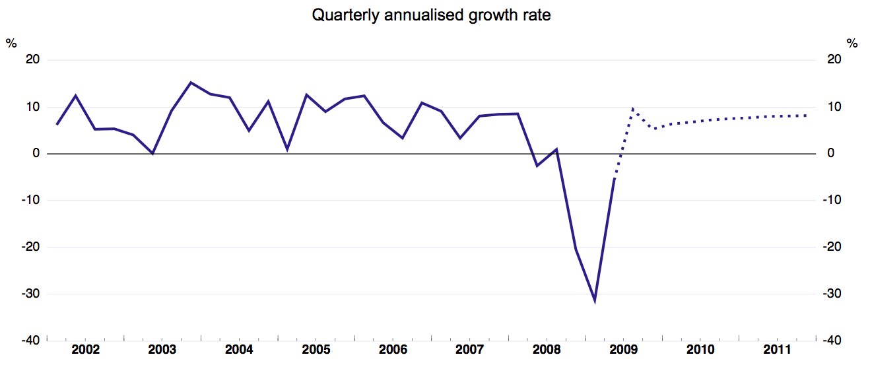
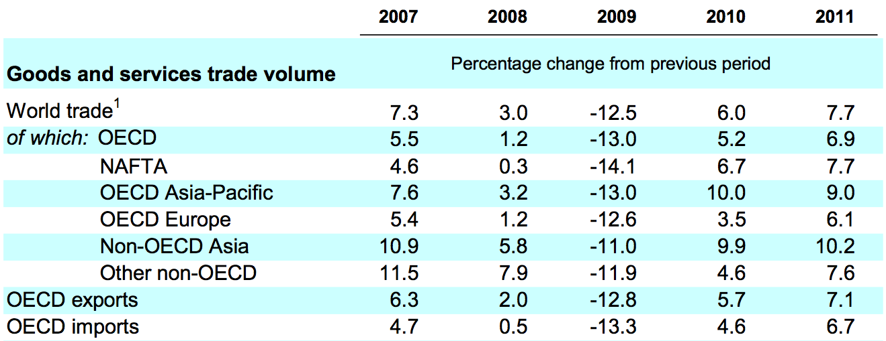
2. International trade is recovering
Source: OECD, Economic Outlook No. 86, 19 November 2009

Slide 16
IMF Forecasts
Global growth expected to resume in 2010, across all economies
Latest projections (January 2010) are more positive than October 2009 assessments

Slide 17
IMF projections: Output Growth, Year-on-Year
Source: IMF WEO Update, 26 January 2010

Slide 18
2010 Growth Projections, Revised
Source: IMF WEO Update, 26 January 2010

Slide 19
IMF Projections: Output Growth, Q4 over Q4
Source: IMF WEO Update, 26 January 2010

Slide 20
Causes of Crisis and Regulatory Reform
Plenty of blame to go around
Financial sector at center
Failed to perform central roles
Managing risk
Allocating capital (providing credit to where it had highest returns)
Running an efficient payment mechanism
All at low cost

Slide 21
Peeling Back Onion
But why did financial sector fail?
Inadequate/distorted incentives
Organizational (too big to fail)
Individual
Throughout the sector—rating agencies
Need to explain distorted incentives
Corporate governance
Failure of investors to understand risk

Slide 22
But Regulators Failed Too
Regulation had worked
Made wrong inference from success
Stripped it away
Appointed regulators who didn’t believe in regulation
Need to explain why

Slide 23
Explaining Failure of Regulation
Politics—special interests
Campaign contributions
Lobbyists
Revolving door
Economic theory
Some argued that markets were self-correcting, efficient
Adam Smith’s Invisible Hand

Slide 24
Irony: at very time that deregulation movement was gaining strength, good economic theory was explaining why markets often didn’t work
Adam Smith’s invisible hand often seems invisible because it’s not there
We should have known that from Great Depression
Greenspan “Put” led to superbubble—economy kept going only because of repeated interventions

Slide 25
Prospects of Regulatory Reform Rapidly Improving
As more misdeeds of the financial sector come to light
Lehman Brothers’ deceptive accounting
Goldman Sachs’ helping Greece engage in deceptive accounting through derivatives
Selling short products that they created
Fraud charge against Goldman
Speculative attacks in Europe

Slide 26
Pillars of Regulatory Reform
Transparency
Incentives
Structure
Behavior
Products
In many ways, things today are worse than they were before the crisis

Slide 27
Transparency
Mistake to move away from mark to market accounting—best available information
Problem is with how the information is used by regulators

Slide 28
Incentives
One thing economists agree on: incentives matter
Need to restrict incentives that lead to short-sighted behavior and excessive risk taking
Need to provide incentives for banks to lend
Need to change structure—too big to fail provides bad incentives

Slide 29
Structure
Need to do something about too big to fail, too big to be resolved, too intertwined to fail institutions
Banks have incentives to become too big to fail, too intertwined to fail
These banks have competitive advantage from implicit subsidy—big distortion
Break up banks—little evidence of economies of scale or scope
Tax in order to level playing field
Regulation, restrict excessively risky behavior
Higher capital adequacy standards
NO derivatives
Huge cost of AIG bailout
Volcker Rule—reduced scope for conflicts of interest added benefit

Slide 30
Behavior and Products
Restrict leverage—countercyclical macro-economic prudential regulation
Restrict usury, predatory lending
“Suitability” and “fiduciary” standards
Restrict naked derivatives

Slide 31
What will Probably Get Done
Consumer protection (Financial Product Safety Commission)
Some form of systemic regulation
Higher leverage requirements
Some derivatives reform (reversing 2000 law)
“encouraging” move to clearing houses/exchange traded
Higher margin requirement
Increased resolution authority and a fund for resolution

Slide 32
What May Get Done
Not allowing government insured/subsidized institutions to issue derivatives
Forcing derivatives to be traded through clearing houses/exchanges
Some further restrictions on the too big to fail banks (proprietary trading?)
Some taxes on financial institutions
Some reform in incentive pay and in corporate governance (“say in pay”)

Slide 33
What Probably Will Not Happen
Making sure that banks don’t get too big to fail
Restricting size and activities
Or imposing taxes and requirements to take away their competitive advantage from implicit government subsidy
A financial transactions tax or other “strong” financial sector levy
Reforms in the governance of the Federal Reserve System (lack of democratic accountability)
Strong reform of incentives
Strong reform in accounting

Slide 34
Questions on Horizon: Towards a New Global Order
Can China’s (or India’s) growth be basis of global recovery?
Unlikely: too small a share of global economy
Can China’s (or India’s) growth be sustained without an American/European recovery?
Possible: these countries have vast untapped domestic demand
But China has not yet succeeded in reforming its growth model
Key issue in discussions on 12th five year plan
Failed to increase savings rate in 11th five year plan

Slide 35
Questions on Horizon
How worried do we have to be about inflation?
In short run, deflation is more immediate issue
China’s huge demands for resources (like steel) may lead to some cost-push inflation
Inflationary expectations (e.g. worry about long-term demand for funds from huge deficits) may drive up long-term interest rates, dampen economy
Fed’s ability to manage process questionable
With potential new Obama appointees, Fed is likely to be somewhat more focused on employment

Slide 36
OECD Inflation Forecast
Source: OECD, Economic Outlook No. 86, 19 November 2009

Slide 37
Questions on Horizon
How worried do we need to be about global imbalances?
Did not cause last crisis
But could cause next
Remain large
G-20 proposals not likely to be effective
Should not be encouraging China to consume more—world cannot survive if everyone consumes at America’s profligate level
What is needed is more investment
Retrofitting for global warming, helping address global poverty
Key challenge: recycling savings
Financial Sector failed

Slide 38
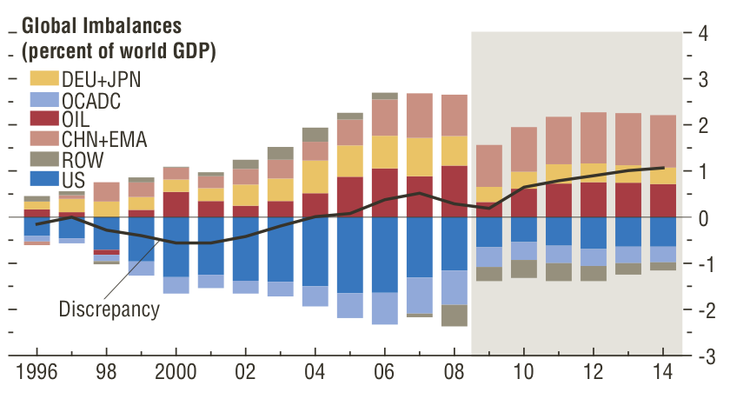
Global Imbalances
Source: IMF, WEO, October 2009, Figure 1.13
Notes: DEU + JPN: Germany and Japan; OCADC: Bulgaria, Croatia, Czech Republic, Estonia, Greece, Hungary, Ireland, Latvia, Lithuania, Poland, Portugal, Romania, Slovak Republic, Slovenia, Spain, Turkey, United Kingdom; CHN+EMA: China, Hong Kong SAR, Indonesia, Korea, Malaysia, Philippines, Singapore, Taiwan Province of China, and Thailand; OIL: Oil exporters; ROW: Rest of the world.

Slide 39
Questions on Horizon
5. How worried do we need to be about trade tensions?
Marked tensions between China and US over exchange rate
Not real economic issue: adjusting exchange rate will not have significant effect on US multilateral trade deficit
Tensions not a surprise
Given limitations of fiscal and monetary policy, protectionism last resort
Tensions likely to rise if high unemployment persists
Continuing worry

Slide 40
A New Global Order?
Crisis showed the interdependency of the world
And the inadequacy of the global institutions to meet these challenges
Both the short-run challenges and the long
Macro-coordination
Regulatory coordination

Slide 41
Towards a New Global Reserve System?
The dollar-based reserve system is already fraying
Confidence in the dollar as a good store of value eroding
Part of instability of global financial system
UN Commission recommendation for creation of a new global reserve system receiving widespread support
More equitable, more stable, stronger global aggregate demand
Keynes argued for it: an old idea whose time has come?

Slide 42
Towards a New Global Reserve System?
Risk is that the world will gravitate towards a two, three, or four currency system
Could be more unstable than the current one

Slide 43
Global Regulatory Coordination
Comprehensive regulation desirable to avoid regulatory arbitrage
But global coordination often an excuse for doing nothing
Each country has responsibility for protecting its citizens and its economy
Regulate first, harmonize later

Slide 44
Long-Run Problems
While the crisis has persisted, long run problems have continued (aging of population, global warming)
But the resources available to deal with them have diminished
Successful Copenhagen Climate Change Conference could have helped us address global economic problem—new investment for retrofitting the global economy to deal with global warming
Instead, new uncertainties about the way forward may have an adverse effect
Meanwhile, risks of global warming continue

Slide 45
G-20 Not an Adequate Institutional Response
Lacks representativeness, legitimacy
172 countries not represented
Should be strengthening existing global institutions
UN Commission recommendation—Global Economic Coordinating Council

Slide 46
The Crisis and the New Global Economic Order
The global economic order was changing before the crisis—shifting in the relative strength of emerging markets, the source of global economic growth
The crisis has exposed flaws in the old order, in the global system, in the “model” underlying American capitalism, and has given new confidence to the “new players”
This will accelerate change

Slide 47
Overview
We have pulled back from the brink
But the world faces enormous uncertainties
Most likely prospect remains a Europe and U.S. mired in a slow and unsteady recovery
Asia will do better
A new global economic order will emerge
But the creation of this order may not be a smooth or orderly process

