Slide 1
The Economic Crisis: Towards a New World Order? Towards Sustainable Growth?
Mumbai
Joseph E. Stiglitz
May 26, 2010

Slide 2
We are not out of the woods…
The world has pulled back from the brink where it was in September 2008
But the world is not yet on the course of a robust recovery
In fact, prospects are that growth will slow down towards the end of the year/early next year
We have not fully taken on board the lessons of the crisis
Prospects of regulatory reform are better than ever
But creating a new global balance will not come easily

Slide 3
The Unfolding Crisis
The crisis has continued much as expected in the U.S.
As predicted, strong growth in 3rd and 4th quarters, slowing in first quarter of this year
Continued lag in job recovery
Job growth in first quarter still slow (162,000)
Much of it temporary (48,000 census workers)
Much of it stimulus spending
Average job growth for first quarter (54,000 per month) not keeping pace with new entrants to labor force—but far better than losses of 753,000 per month last year
Labor market remains grim
Average duration of unemployment at record level
Little dent in 15 million job seekers; April unemployment rate increased to 9.9%
1/6 Americans who want a full time job still can’t get one
Specific socio-economic and regional unemployment rates higher (teenage unemployment more than 25%)
Expectation of unemployment remaining in excess of 9% for next year
Will be middle of decade or later before unemployment returns to normal

Slide 4
Europe’s Prospects Worse
High unemployment
Large budgetary deficits
Speculative attacks
Attack on Greece, potentially other European countries
No real foundations—European countries can meet debt obligations (so long as interest rates remain reasonable)
Europe responded but too slowly and inadequately
Problem recognized at the founding of the euro—but nothing was done
Need solidarity funds, not just for new entrants but also for stability
America is a single currency area but has a fiscal framework
Europe does not
Potential problems down the road

Slide 5
Not just a matter of profligacy
Spain had a budget surplus before the crisis
Spain had only a 60% debt-to-GDP ratio
Spain had better bank regulation (at least in some dimensions) than the US and most other countries
Yet today, Spain stands at the precipice
Huge deficit (exceeds 10% of GDP)
20% unemployment
More than 40% youth unemployment

Slide 6
Combined European and IMF support
Ensuring that Greece and (at least some) other European countries can roll over their debt and finance their deficits
The question is: Will it work?
Market response: Risk of default has gone down considerably, but is still significant
Question: Why hasn’t the trillion-dollar rescue done a better job at restoring confidence?

Slide 7
Structure of rescue may be self-defeating
Heavy demands on austerity, structural reforms
Akin to old-style IMF programs
Many suggest that they must do this to avoid charges of a double standard
But these programs have often been ineffective
Austerity (especially when pursued by many countries in Europe simultaneously) may be self-defeating

Slide 8
The effect of cutting back spending and/or raising taxes could be massively contractionary
The improvement in the deficit will be minimal
The small improvement will exacerbate pessimism

Slide 9
“Structural” reforms partially misplaced
Impact effect of wage cuts will be to further reduce aggregate demand
Across-the-board wage and price cuts are not a feasible substitute for devaluation
Political resistance in some countries likely to be high
European democracies may be less likely to accept “dictated terms” (Iceland)
Already high unemployment in some countries (Spain)

Slide 10
Further reasons for skepticism of the “Program”
Europe will benefit from the weak euro
Europe is winning the contest of which currency is the “ugliest”
New form of competitive devaluation
Given overall global weakness, weak euro will not suffice to restore prosperity or even a modicum of normalcy

Slide 11
But there appear to be no other tools to restore prosperity
Monetary policy has limited effect
Trade policy is not an option

Slide 12
With EU average debt level at 73% of GDP, is fiscal policy an option?
Yes, if money is spent on high-return investments, e.g. in education, technology, and infrastructure
Generating stronger growth in the short run and longer run
Generating higher tax revenues
Even with limited returns (5-6%), long-term debt/GDP ratio will be reduced
Should not focus on short-run deficit (deficit fetishism)
But on a country’s balance sheet—liabilities and assets
One should take a long-term perspective

Slide 13
Are there enough funds to bail out PIGS plus Italy?
Not certain…
Bailouts are effectively (temporary) transfer of funds from the stronger countries
If bailouts restore confidence, they are not really bailouts, just temporary provision of liquidity
Lenders will be repaid
But even the stronger countries must effectively borrow to finance bailout
Another example of a transfer of liabilities
Raising questions of the viability of the entire project, if the downturn lasts long and, as a result, deficit reductions are less successful
What matters is not just efforts, but outcomes
If markets share these qualms, interest rates may remain high
Reinforcing pessimistic perspective

Slide 14
Thinking the unthinkable?
A default?
Part of modern capitalism
Financial markets often misjudge creditworthiness
Important to give countries/companies/individuals a fresh start
Nineteenth-century models (Dickens debt prisons, military force to impose debt repayment) are things of the past
IMF often viewed as a modern version of military might by developing countries
But European democracies are less likely to accept such stringent terms
Default less likely immediately
Many countries still have a large primary deficit
Default would choke off ability to borrow to finance deficit
Thus they would face austerity in any case
But once primary deficit is reduced, incentives change, especially if (a) there are large external payments and (b) severe and unpopular conditionalities are imposed
Defaults are disruptive
But Argentina showed that there is life after default — averaged 8.5% growth for six years (2003–2008)

Slide 15
Risk of contagion
Investors reassess likelihood of other countries defaulting
Recognizing this, the rest of Europe has and will be forced to come to assistance
But will Germany provide more assistance if a trillion dollars doesn’t work?

Slide 16
Thinking the unthinkable? The dissolution of the euro?
The circumstances of different European countries are markedly different, both with respect to fiscal and trade deficits and with respect to debt
Limited “solidarity” to share burden of adjustment
Without exchange rate and interest rate mechanisms, there is a need for large fiscal assistance
What is required may be more than those who are capable of providing it are willing to give

Slide 17
Budget deficits forecast
Source: IMF, World Economic Outlook, April 2010

Slide 18
EU government debts
General government consolidated gross debt as a percentage of GDP, 2009 (eurostat)

Slide 19
Inconsistent macro-frameworks
Focus has been on countries with too high deficits as the “problem”
Concerns are legitimate
Especially as one focuses on long-term problems (aging of population)
These long-term problems have continued to fester, but the crisis has diminished the ability of countries to deal with them
Markets have recognized this

Slide 20
Surpluses are the problem
But equally, countries with too high trade surpluses are a problem
Surpluses mean that they are producing more than they are consuming
Contributing to an insufficiency of aggregate demand
Imposing macro-economic costs on others
Keynes recognized this
Wanted to impose tax on surplus countries
Part of original Bretton Woods initiative
US refused

Slide 21
Current account balances
Source: IMF, World Economic Outlook, April 2010

Slide 22
Three alternatives
Europe finishes the euro agenda:
Germany recognizes the problem, Europe establishes an effective fiscal and macro coordination framework, and it works
The euro comes to an end
Weak countries do a cost-benefit analysis and decide that the costs exceed the benefits
Market fundamentalist philosophy that underlies much of the EU project is viewed as wrong
Can legitimately blame lack of sufficient solidarity to make project successful
Strong countries decide it is not worth subsidizing weak countries
Probably myopic view
Germany would find it hard to maintain surpluses
Critical part of its economic model

Slide 23
3. Muddling through/brinkmanship
Strong countries provide just enough assistance and critical level of conditionalities (enforcement of conditionalities) to keep euro together
But because the money is provided reluctantly, late, and in minimal amounts with maximum conditionalities, overall costs may be higher than if an effective program were designed initially
Especially because judgments will differ—some market participants will think amount insufficient
Resulting in higher interest costs

Slide 24
OECD Fiscal Balance
Source: OECD, Economic Outlook No. 86, 19 November 2009

Slide 25
Towards a double dip in US: sources of anxiety(1)—beyond weak labor market
Premature cutback in fiscal stimulus
Fiscal stringency in states/local government
Exit from unusual monetary measures
Fed has been buying all mortgages
Continuing residential foreclosures
Administration admits previous programs haven’t worked
Haven’t dealt with ¼ mortgages underwater
Likely to keep consumer spending depressed, contribute to bank weaknesses

Slide 26
Towards a double dip: sources of anxiety (2)
5. Unfolding problem in commercial real estate
6. Record level of bank closings
Tip of iceberg: shows weaknesses in banking system
7. Small- and medium-sized enterprises can’t get access to credit
Banks constrained both by supervisors and balance sheet
Borrowers constrained by lack of collateral (decrease in real estate values)
8. Weakening euro and Europe makes export prospects bleaker

Slide 27
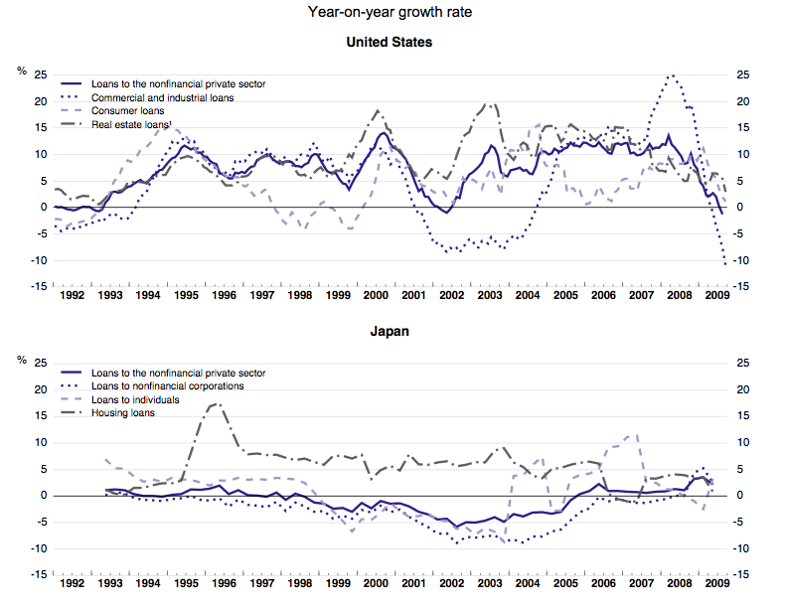
Bank Lending Collapse (1)

Slide 28
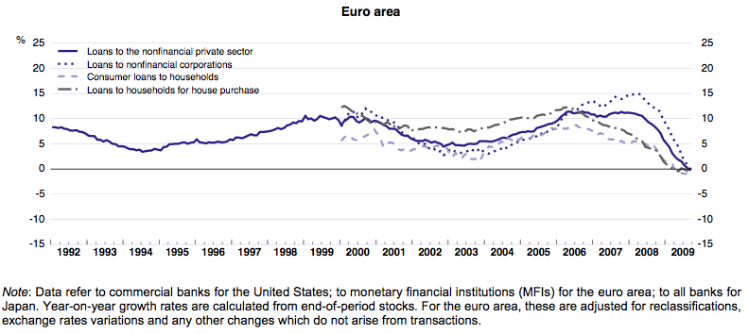
Bank Lending Collapse (2)
Source: OECD, Economic Outlook No. 86, 19 November 2009

Slide 29
New Elements in U.S.
Growing concern about deficits
Obama talking about freezing discretionary spending (other than military)
Motivated by worries about debt/GDP ratio reaching 90% or more by end of decade
Should encourage focus on high-return investment spending which would lower long-term debt
Likely to lead to curtailing government spending before robust recovery
Health care reform’s economic impact remains uncertain
Doing nothing cast a pallor of uncertainty
But job impact remains debated

Slide 30
Fundamental Problem
What had sustained world before crisis was real estate bubble
Led to consumption levels that were not sustainable
Even if banking system were working perfectly, there would be a problem
But financial system is not working well in many countries

Slide 31
Hope of a Short-Lived Downturn
Once banking system was repaired private sector would recover
Only temporary help would be required
But downturn was deeper than they expected

Slide 32
Global Perspective
Mismanagement of 1997/98 East Asia crisis led to reserve accumulation—savings
Weakening global aggregate demand
Problem worse now: those countries that had large reserves did better
Growing inequality within most countries also weakening global aggregate demand
Nothing is being done about these global problems

Slide 33
Two High Points
1. Recovery in most of Asia has been strong (and stronger than expected)
China: 8.7% annual GDP growth in 2009
India: 5.6% annual GDP growth in 2009
But Japan’s growth dropped 4 percentage points to -5.3%
World growth fell nearly four percentage points from 2008 to 2009; India and China slowed by less than two percentage points

Slide 34
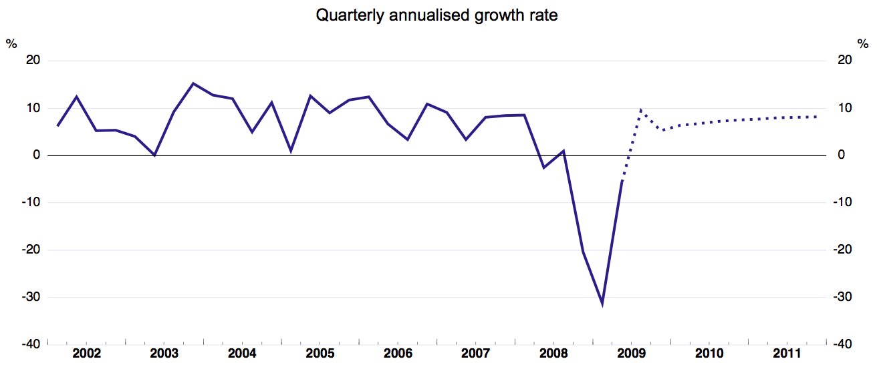
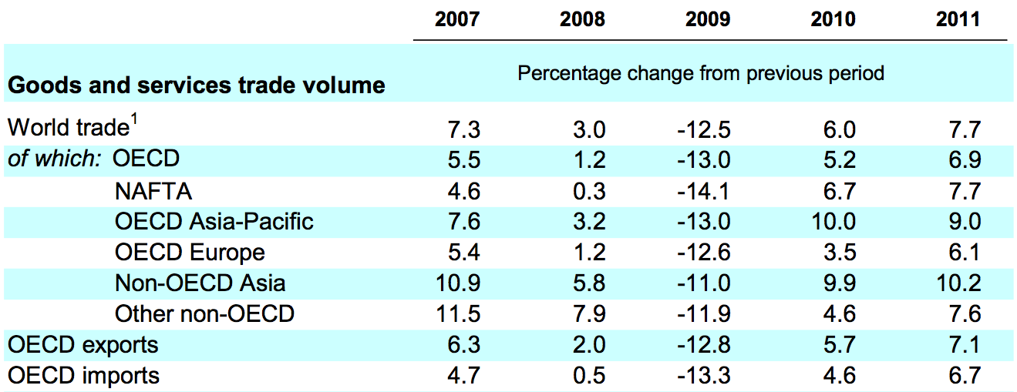
2. International trade is recovering
Source: OECD, Economic Outlook No. 86, 19 November 2009

Slide 35
IMF Forecasts
Global growth expected to resume in 2010, across all economies
Latest projections (January 2010) are more positive than October 2009 assessments

Slide 36
IMF projections: Output Growth, Year-on-Year
Source: IMF WEO Update, 26 January 2010

Slide 37
2010 Growth Projections, Revised
Source: IMF WEO Update, 26 January 2010

Slide 38
IMF Projections: Output Growth, Q4 over Q4
Source: IMF WEO Update, 26 January 2010

Slide 39
Causes of Crisis and Regulatory Reform
Plenty of blame to go around
Financial sector at center
Failed to perform central roles
Managing risk
Allocating capital (providing credit to where it had highest returns)
Running an efficient payment mechanism
All at low cost

Slide 40
Peeling Back Onion
But why did financial sector fail?
Inadequate/distorted incentives
Organizational (too big to fail)
Individual
Throughout the sector—rating agencies
Need to explain distorted incentives
Corporate governance
Failure of investors to understand risk

Slide 41
But Regulators Failed Too
Regulation had worked
Made wrong inference from success
Stripped it away
Appointed regulators who didn’t believe in regulation
Need to explain why

Slide 42
Explaining Failure of Regulation
Politics—special interests
Campaign contributions
Lobbyists
Revolving door
Economic theory
Some argued that markets were self-correcting, efficient
Adam Smith’s Invisible Hand

Slide 43
Irony: at very time that deregulation movement was gaining strength, good economic theory was explaining why markets often didn’t work
Adam Smith’s invisible hand often seems invisible because it’s not there
We should have known that from Great Depression
Greenspan “Put” led to superbubble—economy kept going only because of repeated interventions

Slide 44
Prospects of Regulatory Reform Rapidly Improving
As more misdeeds of the financial sector come to light
Lehman Brothers’ deceptive accounting
Goldman Sachs’ helping Greece engage in deceptive accounting through derivatives
Selling short products that they created
Fraud charge against Goldman
Speculative attacks in Europe

Slide 45
Pillars of Regulatory Reform
Transparency
Incentives
Structure
Behavior
Products
In many ways, things today are worse than they were before the crisis

Slide 46
Transparency
Mistake to move away from mark to market accounting—best available information
Problem is with how the information is used by regulators

Slide 47
Incentives
One thing economists agree on: incentives matter
Need to restrict incentives that lead to short-sighted behavior and excessive risk taking
Need to provide incentives for banks to lend
Need to change structure—too big to fail provides bad incentives

Slide 48
Structure
Need to do something about too-big-to-fail, too-big-to-be-resolved, too-intertwined-to-fail institutions
Banks have incentives to become too big to fail, too intertwined to fail
These banks have competitive advantage from implicit subsidy—big distortion
Break up banks—little evidence of economies of scale or scope
Tax in order to level playing field
Regulation, restrict excessively risky behavior
Higher capital adequacy standards
NO derivatives
Huge cost of AIG bailout
Volcker Rule—reduced scope for conflicts of interest added benefit

Slide 49
Behavior and Products
Restrict leverage—countercyclical macro-economic prudential regulation
Restrict usury, predatory lending
“Suitability” and “fiduciary” standards
Restrict naked derivatives

Slide 50
What will probably be done
Consumer protection (Financial Product Safety Commission)
Some form of systemic regulation
Higher leverage requirements
Some derivatives reform (reversing 2000 law)
“encouraging” move to clearing houses/exchange traded
Higher margin requirement
Increased resolution authority and a fund for resolution

Slide 51
What may be done
Not allowing government-insured/subsidized institutions to issue derivatives
Forcing derivatives to be traded through clearing houses/exchanges
Some further restrictions on the too big to fail banks (proprietary trading?)
Some taxes on financial institutions
Some reform in incentive pay and in corporate governance (“say in pay”)

Slide 52
What probably will not happen
Making sure that banks don’t get too big to fail
Restricting size and activities
Or imposing taxes and requirements to take away their competitive advantage from implicit government subsidy
A financial transactions tax or other “strong” financial sector levy
Reforms in the governance of the Federal Reserve System (lack of democratic accountability)
Strong reform of incentives
Strong reform in accounting

Slide 53
Questions on Horizon: Towards a New Global Order
Can China’s (or India’s) growth be basis of global recovery?
Unlikely: too small a share of global economy
Can China’s (or India’s) growth be sustained without an American/European recovery?
Possible: these countries have vast untapped domestic demand
But China has not yet succeeded in reforming its growth model
Key issue in discussions on 12th five-year plan
Failed to increase savings rate in 11th five-year plan

Slide 54
Questions on Horizon
How worried do we have to be about inflation?
In short run, deflation is more immediate issue
China’s huge demands for resources (like steel) may lead to some cost-push inflation
Inflationary expectations (e.g. worry about long-term demand for funds from huge deficits) may drive up long-term interest rates, dampen economy
Fed’s ability to manage process questionable
With potential new Obama appointees, Fed is likely to be somewhat more focused on employment

Slide 55
OECD Inflation Forecast
Source: OECD, Economic Outlook No. 86, 19 November 2009

Slide 56
Questions on Horizon
How worried do we need to be about global imbalances?
Did not cause last crisis
But could cause next
Remain large
G-20 proposals not likely to be effective
Should not be encouraging China to consume much more—world cannot survive if everyone consumes at America’s profligate level; besides, increases in consumption likely to be in services (education, health), with limited impact on imports
What is needed is more investment
Retrofitting for global warming, helping address global poverty
Key challenge: recycling savings
Financial Sector failed

Slide 57
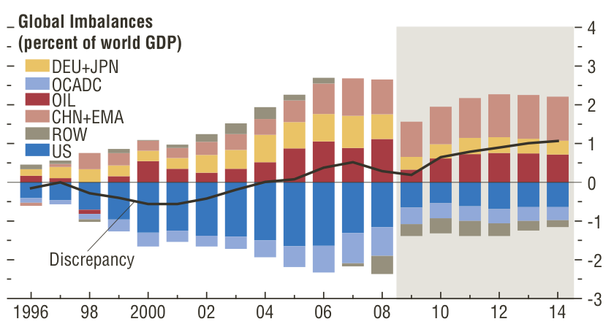
Global Imbalances
Source: IMF, WEO, October 2009, Figure 1.13
Notes: DEU + JPN: Germany and Japan; OCADC: Bulgaria, Croatia, Czech Republic, Estonia, Greece, Hungary, Ireland, Latvia, Lithuania, Poland, Portugal, Romania, Slovak Republic, Slovenia, Spain, Turkey, United Kingdom; CHN+EMA: China, Hong Kong SAR, Indonesia, Korea, Malaysia, Philippines, Singapore, Taiwan Province of China, and Thailand; OIL: Oil exporters; ROW: Rest of the world.

Slide 58
Questions on Horizon
5. How worried do we need to be about trade tensions?
Marked tensions between China and US over exchange rate
Not real economic issue: adjusting exchange rate will not have significant effect on US multilateral trade deficit
Tensions not a surprise
Given limitations of fiscal and monetary policy, protectionism last resort
Tensions likely to rise if high unemployment persists
Continuing worry

Slide 59
A New Global Order?
Crisis showed the interdependency of the world
And the inadequacy of the global institutions to meet these challenges
Both the short-run challenges and the long
Macro-coordination
Regulatory coordination

Slide 60
Towards a New Global Reserve System?
The dollar-based reserve system is already fraying
Confidence in the dollar as a good store of value eroding
Part of instability of global financial system
UN Commission recommendation for creation of a new global reserve system receiving widespread support
More equitable, more stable, stronger global aggregate demand
Keynes argued for it: an old idea whose time has come?

Slide 61
Towards a New Global Reserve System?
Risk is that the world will gravitate towards a two, three, or four currency system
Could be more unstable than the current one

Slide 62
Global Regulatory Coordination
Comprehensive regulation desirable to avoid regulatory arbitrage
But global coordination often an excuse for doing nothing
Each country has responsibility for protecting its citizens and its economy
Regulate first, harmonize later

Slide 63
Long-run Problems
While the crisis has persisted, long-run problems have continued (aging of population, global warming)
But the resources available to deal with them have diminished
Successful Copenhagen Climate Change Conference could have helped us address global economic problem—new investment for retrofitting the global economy to deal with global warming
Instead, new uncertainties about the way forward may have an adverse effect
Meanwhile, risks of global warming continue

Slide 64
G-20 Not an Adequate Institutional Response
Lacks representativeness, legitimacy
172 countries not represented
Should be strengthening existing global institutions
UN Commission recommendation—Global Economic Coordinating Council

Slide 65
The Crisis and the New Global Economic Order
The global economic order was changing before the crisis—shifting in the relative strength of emerging markets, the source of global economic growth
The crisis has exposed flaws in the old order, in the global system, in the “model” underlying American capitalism, and has given new confidence to the “new players”
This will accelerate change

Slide 66
Overview
We have pulled back from the brink
But the world faces enormous uncertainties
Most likely prospect remains a Europe and U.S. mired in a slow and unsteady recovery
With high volatility
Asia will do better
A new global economic order will emerge
But the creation of this order may not be a smooth or orderly process

