Slide 1

Interactive Decision Tree: Moderating Canvas Quizzes
Updated April 1, 2025

Slide 2



Instructions
This interactive decision tree helps CBS faculty and staff grant a student extra time or attempts on a Canvas quiz.
In general, students should be able to complete a quiz within the designated time frame. However, on rare occasions a professor may allow a student additional time due to extenuating circumstances. The steps to do this vary by situation. To make the process easier, we've created this interactive tool to guide you through it quickly.
This does not apply to students with ODS-approved accommodations (e.g., extended time) or makeup exams/reschedules. The program office (OSA/EMBA) handles accommodations and makeup exams. Refer to the MBA Exam Policy or EMBA Exam Policy and contact the program office with questions.
If you want to add extra time for all students in the class, edit the quiz settings (time limit, due time, and available until time). The extra time will apply for all in-progress attempts or attempts not yet started. It won’t apply to completed attempts.
How to use this decision tree:
Do not edit this slide deck. If you do, the built-in links may not work correctly.
Open this deck in Slide Show mode.
Go to the next slide after this one.
Answer the question by clicking on the “YES” or “NO” buttons.
Another question will appear. Continue answering each question (Yes or No) until you arrive at the answer, which describes the correct action steps to take for your situation.
At any time, you may click the “RESET” button to start over at the beginning.
Or simply close the deck and reopen it in Slide Show mode.
Email samberg@gsb.columbia.edu with questions or concerns about this tool. Find a text-only version here.

Slide 3
Starting slide
Are you granting the
student an extra attempt, to start over from scratch?

Slide 4
Slide 4
Are you granting the
student an extra attempt, to start over from scratch?
Should the student
access the extra attempt
immediately?

Slide 5
Slide 5
Are you granting the
student an extra attempt, to start over from scratch?
Should the student
access the extra attempt
immediately?
If the quiz has a set time limit, are you giving the student additional time beyond that limit?

Slide 6
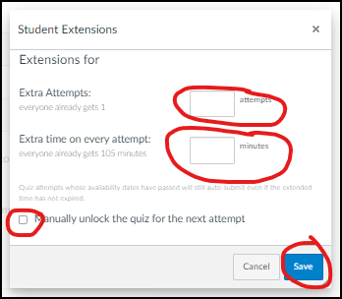
Slide 6
Are you granting the
student an extra attempt, to start over from scratch?
Should the student
access the extra attempt
immediately?
If the quiz has a set time limit, are you giving the student additional time beyond that limit?
ACTION STEPS:
“Click “Moderate This Quiz”.
Click “Student Extensions” (pencil icon).
Add the number of extra attempts.
Add extra time on every attempt (doesn’t apply to attempts already in progress).
Check the box “Manually unlock the quiz for the next attempt”.
Click “Save”.
The student has immediate access to the quiz. Canvas will flag the submission as late.

Slide 7
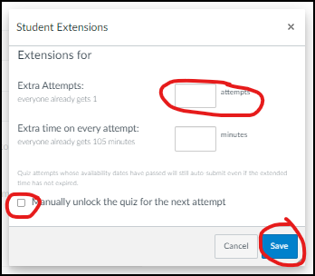
Slide 7
Are you granting the
student an extra attempt, to start over from scratch?
Should the student
access the extra attempt
immediately?
If the quiz has a set time limit, are you giving the student additional time beyond that limit?
ACTION STEPS:
“Click “Moderate This Quiz”.
Click “Student Extensions” (pencil icon).
Add the number of extra attempts.
Check the box “Manually unlock the quiz for the next attempt”.
Click “Save”.
The student has immediate access to the quiz. Canvas will flag the submission as late.

Slide 8
Slide 8
Are you granting the
student an extra attempt, to start over from scratch?
Should the student
access the extra attempt
immediately?
If the quiz has a set time limit, are you giving the student additional time beyond that limit?

Slide 9
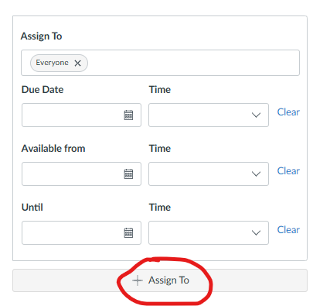
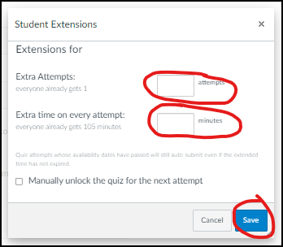
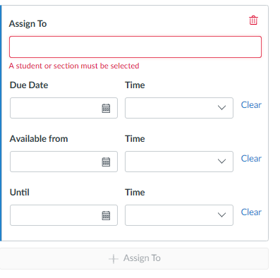
Slide 9
Are you granting the
student an extra attempt, to start over from scratch?
Should the student
access the extra attempt
immediately?
If the quiz has a set time limit, are you giving the student additional time beyond that limit?
ACTION STEPS:
“Assign To” the individual student with specific Due Date, Available From, and Until times.
Click “Moderate This Quiz”.
Click “Student Extensions” (pencil icon).
Add an extra attempt.
Add extra time on every attempt (doesn’t apply to attempts already in progress).
This means the student starts over from scratch with the full time limit plus the extra time.

Slide 10
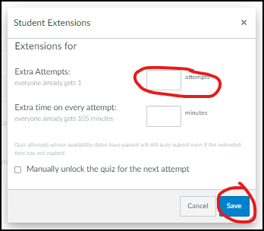
Slide 10
Are you granting the
student an extra attempt, to start over from scratch?
Should the student
access the extra attempt
immediately?
If the quiz has a set time limit, are you giving the student additional time beyond that limit?
ACTION STEPS:
“Assign To” the individual student with specific Due Date, Available From, and Until times.
Click “Moderate This Quiz”.
Click “Student Extensions” (pencil icon).
Add the number of extra attempts.
Click “Save”.

Slide 11
Slide 11
Are you granting the
student an extra attempt, to start over from scratch?
If the quiz has a set time limit, are you giving the student additional time beyond that limit?

Slide 12
Slide 12
Are you granting the
student an extra attempt, to start over from scratch?
If the quiz has a set time limit, are you giving the student additional time beyond that limit?
Did the student already
start the quiz?

Slide 13
Slide 13
Are you granting the
student an extra attempt, to start over from scratch?
If the quiz has a set time limit, are you giving the student additional time beyond that limit?
Is the attempt currently in progress (the student didn’t submit yet, there’s still time on the clock and it’s before the
“Until” time)?
Did the student already
start the quiz?

Slide 14
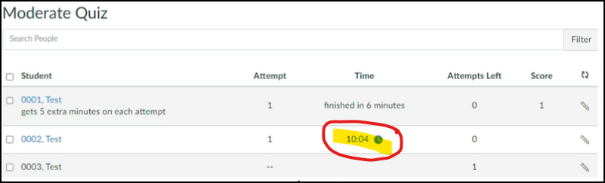
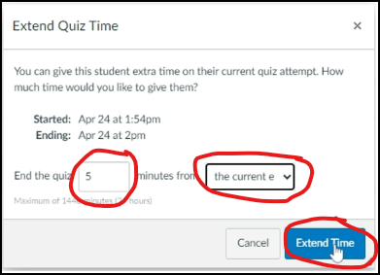
Slide 14
Are you granting the
student an extra attempt, to start over from scratch?
If the quiz has a set time limit, are you giving the student additional time beyond that limit?
Is the attempt currently in progress (the student didn’t submit yet, there’s still time on the clock and it’s before the
“Until” time)?
Did the student already
start the quiz?
ACTION STEPS:
Click “Moderate This Quiz”.
Click the blue clock icon in the column labeled “Time”.
In the “Extend Quiz Time” window, End the quiz [##] minutes from the current end time (or from now).
Click “Extend Time” to save your changes.

Slide 15
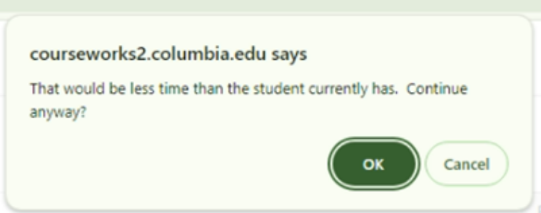
Slide 15
Are you granting the
student an extra attempt, to start over from scratch?
If the quiz has a set time limit, are you giving the student additional time beyond that limit?
Did the student already
start the quiz?
Is the attempt currently in progress (the student didn’t submit yet, there’s still time on the clock and it’s before the
“Until” time)?
ALTERNATE ACTION STEPS:
If you want the student to answer only the questions unanswered in the first attempt, without the full time limit, instruct them to answer only those questions and let them know how much time they have. Later you can manually grade both submissions (1st and 2nd).
Click “Moderate This Quiz”.
Click “Student Extensions” (pencil icon).
Add an extra attempt.
“Assign To” the student with a specific “Until” time so the quiz closes automatically at that time. Or manually end the quiz early for the student by doing the following:
  Click “Moderate This Quiz”.
  Click the blue clock icon in the column labeled “Time”.
  In the “Extend Quiz Time” window, End the quiz [##] minutes from now.
  Click “Extend Time” to save your changes.
  Click “OK” if this message appears: “That would be less time than the student currently has. Continue anyway?”
ACTION STEPS (RECOMMENDED):
Since the student started the quiz and it’s now closed:
“Assign To” the individual student with specific Due Date, Available From, and Until times.
Click “Moderate This Quiz”.
Click “Student Extensions” (pencil icon).
Add an extra attempt.
Add extra time on every attempt (applies only to the second attempt).
This means the student starts over from scratch with the full time limit plus the extra time.

Slide 16
Slide 16
Are you granting the
student an extra attempt, to start over from scratch?
If the quiz has a set time limit, are you giving the student additional time beyond that limit?
Did the student already
start the quiz?
Is the student taking the quiz outside of the scheduled “Available From” and “Until” times?

Slide 17
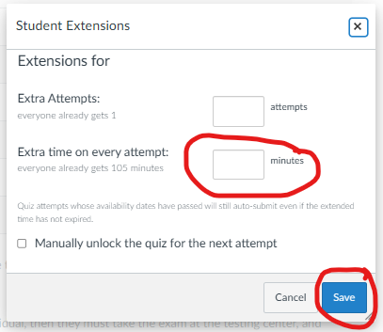
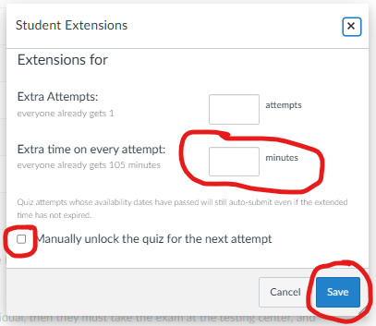
Slide 17
Are you granting the
student an extra attempt, to start over from scratch?
If the quiz has a set time limit, are you giving the student additional time beyond that limit?
Is the student taking the quiz outside of the scheduled “Available From” and “Until” times?
Did the student already
start the quiz?
ACTION STEPS (RECOMMENDED):
“Assign To” the individual student with specific Due Date, Available From, and Until times.
Click “Moderate This Quiz”.
Click “Student Extensions” (pencil icon).
Add extra time on every attempt.
Click “Save”.
ALTERNATE ACTION STEPS:
Click “Moderate This Quiz”.
Click “Student Extensions” (pencil icon).
Add extra time on every attempt.
Check “Manually unlock the quiz for the next attempt”.
Click “Save”.
The student now has immediate access to the quiz. Canvas will flag their submission as late.

Slide 18
Slide 18
Are you granting the
student an extra attempt, to start over from scratch?
If the quiz has a set time limit, are you giving the student additional time beyond that limit?
Did the student already
start the quiz?
Is the student taking the quiz outside of the scheduled “Available From” and “Until” times?
ACTION STEPS:
Click “Moderate This Quiz”.
Click “Student Extensions” (pencil icon).
Add extra time on every attempt.
Click “Save”.

Slide 19
Slide 19
Are you granting the
student an extra attempt, to start over from scratch?
If the quiz has a set time limit, are you giving the student additional time beyond that limit?
Is the student taking the quiz outside of the scheduled “Available From” and “Until” times?

Slide 20
Slide 20
Are you granting the
student an extra attempt, to start over from scratch?
If the quiz has a set time limit, are you giving the student additional time beyond that limit?
Is the student taking the quiz outside of the scheduled “Available From” and “Until” times?
ACTION STEPS:
Edit the Quiz. “Assign To” the individual student with specific Due Date, Available From, and Until times.

Slide 21
Slide 21
Are you granting the
student an extra attempt, to start over from scratch?
If the quiz has a set time limit, are you giving the student additional time beyond that limit?
Is the student taking the quiz outside of the scheduled “Available From” and “Until” times?
ACTION STEPS:
Return to the start of this decision tree and make sure you answered all questions correctly. If you don’t find the info you need, contact samberg@gsb.columbia.edu for assistance.

