Slide 1
Value Investing Program
Student Information Session
February 3, 2026

Slide 2
Agenda
Tuesday, February 3, 2026
  Introduction to the Heilbrunn Center
    Our Team
    Our Courses
  The Value Investing Program
    Overview of the Program
    Application Process
    Debunking Myths

Slide 3







Heilbrunn Center: Our Team
  D
Tano Santos
Robert Heilbrunn Professor of Finance and Asset Management
Meredith Trivedi
Executive Director
Julia Kimyagarov
Director
Delilah DiCioccio
Associate Director
Get in Touch
Geffen 673
valueinvesting@gsb.columbia.edu
www.grahamanddodd.com

Slide 4
Center Update:
Spring 2027
Course Name | Professor
Advanced Investment Research | Kian Ghazi
Applied Security Analysis | Ben Isaac ’14/ Zachary Fuss/ Evan Zehnal ’17
Applied Value Investing | Eric Almeraz ’02/ David Horn ’02
Applied Value Investing (EMBA) | Ehsan Ehsani ’22
Art of Forecasting (B Term) | Ellen Carr
Compounders | Anouk Dey/ Jeff Mueller ’13/ Bryan Power
Distressed Value Investing | Michael Gatto ’93
Distressed Value Investing | Dan Krueger ’02
Economics of Strategic Behavior | Paola Valenti
Economics of Strategic Behavior | Laura Doval
From Feast to Famine (And Back Again) (Blockweek) | Ellen Carr
Hybrid Fund Investing: Crossing Over from Public to Private Markets and Back Again | Chuck Murphy ’09
International Value Investing | David Samra ’03
Practice of Wealth Management for High-Net-Worth Clients | Maria Brisbane/ Alex Zachary
Seminar in Wealth Management | Kristin Gilbertson/ Andrew Gundlach ’01
Security Analysis | Michael Mauboussin
Shareholder Activism as a Value Strategy | Jeff Gramm ’03/ Terry Kontos ’05
The Business of Asset Management | Guy Miller ’10
The Case for Boring: Investing in Investment Grade (B Term) | Ellen Carr
Value Investing in Credit Markets | Denis Tolkachev ’15/ Anjali Verghis ’15
Value Investing in Private Credit | David Glazek/ Mac Trivedi ’14
Value Investing (A Term) | Tano Santos
Value Investing with Legends (B Term) | Tano Santos
Courses Supported by the Heilbrunn Center
2026–2027
Fall 2026
Course Name | Professor
Activist Value Investing for Small Cap Companies | Eric Rosenfeld/ Ehsan Ehsani ’22
Advanced Investment Research | Kian Ghazi
Applied Credit Investing | Bill Casperson/ Sheldon Stone ’78
Applied Value Investing | Jonathon Luft ’08/ Jonathan Cohen ’14
Applied Value Investing | T. Charlie Quinn ’06
Applied Value Investing | Kevin Oro-Hahn ’10
Applied Value Investing | Scott Hendrickson ’07/ Matt Fixler
Applied Value Investing | Eric Gandhi ’13
Credit Superhighway | Ellen Carr/ Michael Gatto
Economics of Strategic Behavior | Jacopo Perego
Managing Large Pools of Assets for Families and Institutions | Adam Shapiro’ 02/ Brian Waterhouse’15
Mental Models | Pei Huang’ 15/ George Schultz/ Brian Waterhouse ’15
Modern Value (VI Program Block Week) | Tano Santos
Security Analysis | Chris Begg
Seminar in Value Investing (EMBA Fri./Sat.) | Paul Johnson
Seminar in Value Investing (EMBA Sat. only) | Paul Johnson
Shorting Selling | David Horn ’02/ Jamie Lester ’02
The Analyst’s Edge | Adam Birnbaum ’08/ Shayan Mozaffar ’11
Summer 2027
Course Name | Professor
Seminar in Value Investing (EMBA) | Paul Johnson

Slide 5
The Value Investing Program Curriculum
Economics of Strategic Behavior
Required
Optional
Modern Value
The Credit Superhighway
Applied Value Investing
Applied Credit Investing (oa)
Distressed Value Investing
From Feast to Famine and Back Again
Investing in Investment Grade
Value Investing in Private Credit
Value Investing in Credit Markets
Activist Investing for Small Cap Companies
Advancement Investment Research (oa)
Compounders (oa)
Hybrid Fund Investing
International Value
Managing Large Asset Pools (oa)
Mental Models (oa)
Seminar in Wealth Management: Investing for Family Offices, Endowments and Foundations
Shareholder Activism
Short Selling
The Analyst’s Edge (oa)
Value Investing with Legends

Slide 6
The Value Investing Program Community
Outside of the Classroom
Career Support
  Value Investing Program Resume Book
  Industry Mentors
  Pitch Review
Events
  Orientation and Welcome Reception
  Young Alumni Panel for Value Investing Students
  HR Talk with Capital Group
  7th Annual Applied Value Stock Pitch Challenge
  Value Investing Program Alumni Day
Alumni Network
  AVI Alumni Directory

Slide 7
Value Investing Program: Requirements and Logistics
To be considered a Value Investing Program Graduate, you must complete all 7 courses.
A maximum of 40 full-time MBA students are admitted to the Program.
All 7 courses have Corporate Finance and Capital Markets as pre-requisites.
All courses depend on availability and are subject to change without notice.
The Modern Value Block Week will take place August 31 – September 4, 2026. Please ensure you are back in New York for this week as it is a mandatory requirement of the Program and zoom is not available.

Slide 8
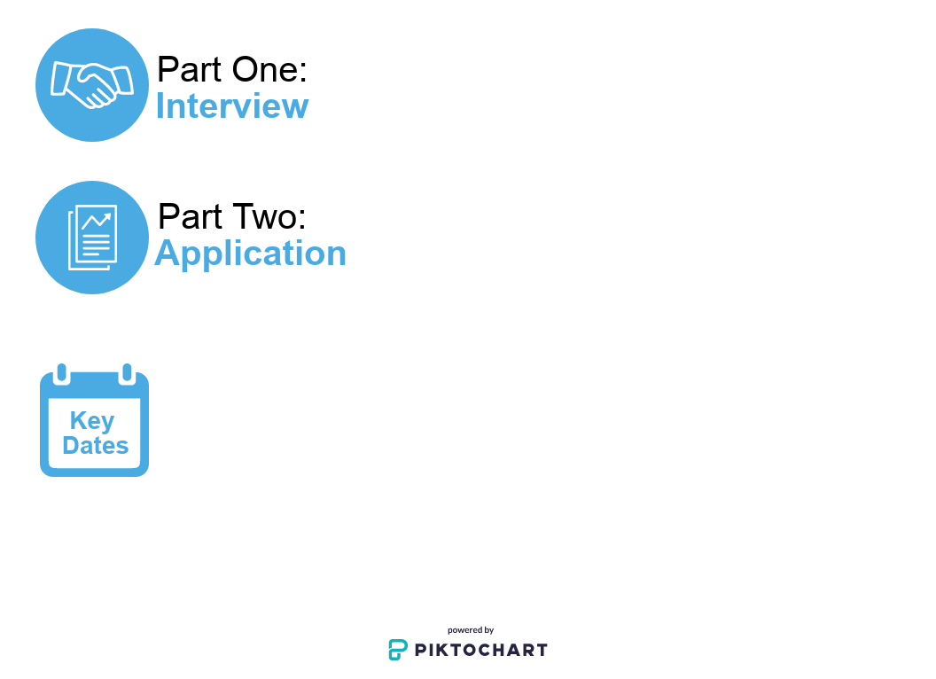
Value Investing Program: How to Apply
Part One: Application
Wednesday, February 4, 2026, by 5:00 p.m.- Applications Sent to Students who attended the Information Session
Monday, February 23, 2026, at 12:00 p.m. (noon) - Applications Due
Monday, February 23, 2026, those who submitted an application will receive a Google Doc link to sign up for an interview
Interviews will take place Thursday, February 26, 2026, through Friday, March 13, 2026
Important Things to Note:
Applications should be sent to valueinvesting@gsb.columbia.edu as a single PDF file named LastName_FirstName.pdf.
You will receive confirmation that we have received your submission. Late submissions will NOT be accepted.

Slide 9
Value Investing Program: How to Apply
Part One: Application
Monday, March, 2, 2020 at 9:00 a.m. - Interview sign-ups begin
Friday, March 13, 2020 at 5:00 p.m. - Interview sign-ups end
Monday, March 23 – Wednesday, March 25 & Monday, March 30, 2020 – Wednesday, April 8, 2020 - Interviews
*Sign-up sheet is located across from Uris Room 2M6 (in the 2M Centers’ Suite).
**Timeslots will be filled on a first come, first served basis.
Applications must include:
  Application Information Form - sent to you on Wednesday, February 4, 2026
  Cover Letter (1 page)
  Resume (1 page)
  Investment Write-Up
    You will choose from one of two ideas communicated in the application form
    What value you assign to the company and why
    What makes this idea attractive or unattractive
    The competitive situation of the company (industry or peers)
    Limit the text and financial analysis (charts, tables, etc.) to 2 pages (single-sided)
In the application, it helps to demonstrate interest in the subject matter, your aptitude for investing, and commitment to the work.

Slide 10

Value Investing Program: How to Apply
Part Two: Interview
You must sign up for a 15-minute interview with the Heilbrunn Center after submitting your application
Interviews will take place Thursday, February 26 – Friday, March 13
The interview sign-up sheet via google doc will be emailed to everyone who submitted an application
Interview signs-ups begin at on Monday, February 23, 2026
Interview signs-ups end at 12:00 p.m. (noon) on Friday, February 27, 2026
Sign-ups are on a first come, first serve basis

Slide 11
Value Investing Program: Application Review Process
Part Three: Application Review and Notification
Your application will be reviewed by the Applied Value Investing professors.
At the professor’s discretion, phone interviews may also be scheduled.
The review/selection process is conducted with best efforts to match instructor/student preferences after the program students have been selected.
By applying to the Value Investing Program applicants agree to accept the decision rendered on their application.
Students will be notified on Friday, May 29, 2026 by 5:00 p.m. via email. All decisions are final.
We are unable to provide specific feedback on any applications. By submitting an application, you acknowledge that you understand this policy.

Slide 12
Value Investing Program: Debunking Application Myths
This process is not one size fits all.
There is no set formula.
Highlight your interest and commitment to the subject.

Slide 13
Q&A with Current Students
Karn Dalal ’26, Oro-Hahn section of AVI
Tiago Souza ’26, Hendrickson/Fixler section of AVI
Isabella Gao ’26, T. Charlie Quinn section of AVI
Dimitry Karavaikin ’26, Cohen/Luft section of AVI

