Slide 1
Using AI For Academic Research
Session 1 – Integrating AI Tools In Academic Research
Notes:
https://gsb-columbia-edu.zoom.us/j/95273189901
https://docs.google.com/document/d/1lHgyIG9JY0hWhl8yiFxKvkscBZOBCtm8h1TQzMEQqNY/edit
https://docs.google.com/spreadsheets/d/1Erf2X_Z6BSceavo7Bged6R2eFu7cDtTIY7OIrswRceY/edit#gid=0

Slide 2
Three Ways to Work with Claude

Slide 3
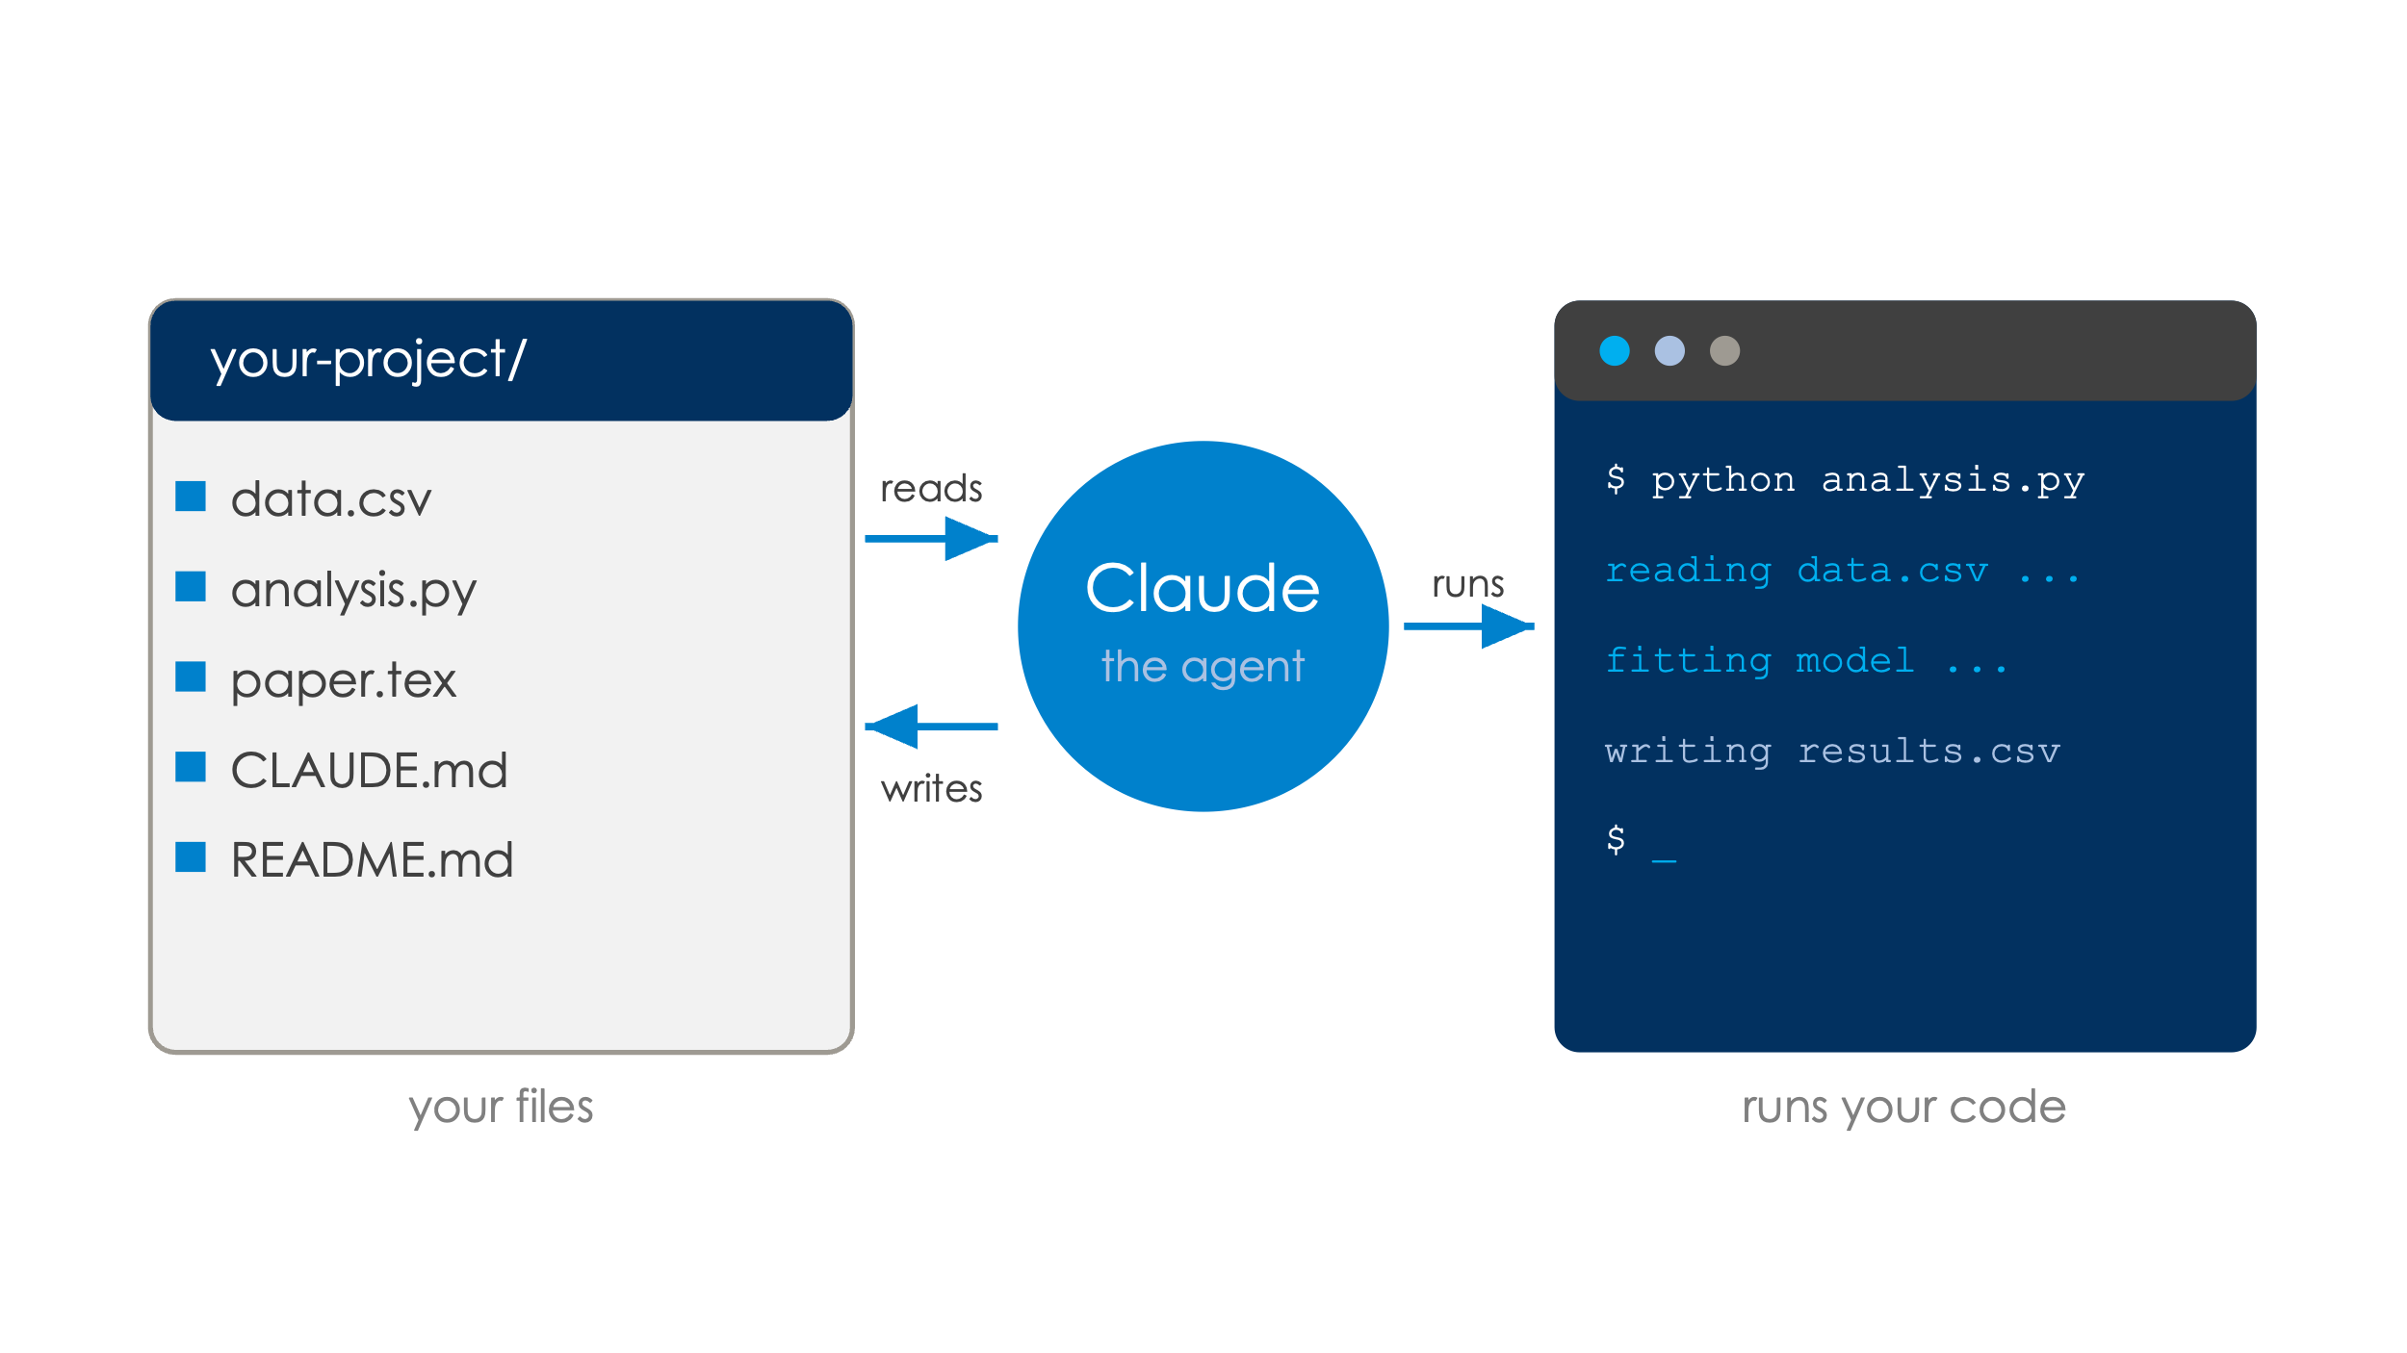
At a Glance
Today’s goal: Demystify AI Agents
Illustrate how to use a coding agent to your work
  Read your files, create and run code, edit documents
  Work on data analytics, research…
  Handle long-running tasks while you supervise
  …
Think of it as an RA?
  Yes: give it context, it does the legwork, you review
  No: instant, tireless… and it will confidently make things up

Slide 4
Three Ways to Work with Claude
Chat: all-purpose usage, mostly non-agentic
Cowork: Claude agent for productivity
  Emails, calendars,…
Claude Code: Claude agent for coding
  Many many ways to use Claude Code: differ on customization, functionalities…
  GUI (Claude Desktop)
  VS Code extension:
    Chatbot that lives next to your code and data
  Terminal / CLI:
    Similar to the extension, but can be heavily customized
  Cmux…

Slide 5
Same Model, Different Reach
The same request, typed into a browser tab and into Claude Code. The chatbot must hand the work back to you; the agent does it where your files live.
Claude in a browser tab
Claude Code in your folder
CHATBOT
AGENT
claude.ai
ai_workshop · claude
Plot China vs Japan holdings since 2015
> Plot China vs Japan holdings since 2015
● Read data/raw/shl2024_appendix.csv
● Bash(python code/plot_holdings.py)
✓ Saved results/china_japan.png
I can't see files on your computer. Upload the CSV here, or run this on your machine:
import pandas as pd
df = pd.read_csv("shl2024_appendix.csv") # you run this
Upload a file or reply…
> ▌
WHERE IT RUNS
In a sandbox on Anthropic's servers, it never sees your disk.
WHERE IT RUNS
On your machine, in the folder you open, gated by permission prompts.
YOUR FILES
Only what you upload by hand, attachment by attachment.
YOUR FILES
Reads them where they live, .dta, .csv, whole folders, and runs your Stata, R, Python.
THE LOOP
Writes code and hands it back. You download it, run it, debug it.
THE LOOP
Runs its own code, reads the error, fixes it, runs again, receipts at every step.
TESTED?
Never on your real data, it can't reach it. You are the runtime.
TESTED?
Its numbers come from code it ran on the real files, and the scripts stay behind, rerunnable.
Underneath, the same model
the difference is reach: your files · your tools · the ability to test what it writes

Slide 6
Three Ways to Work with Claude
Chat: all-purpose usage, mostly non-agentic
Cowork: Claude agent for productivity
  Emails, calendars,…
Claude Code: Claude agent for coding
  Many many ways to use Claude Code: differ on customization, functionalities…
  GUI (Claude Desktop)
  VS Code extension:
    Chatbot that lives next to your code and data
  Terminal / CLI:
    Similar to the extension, but can be heavily customized
  Cmux…

Slide 7
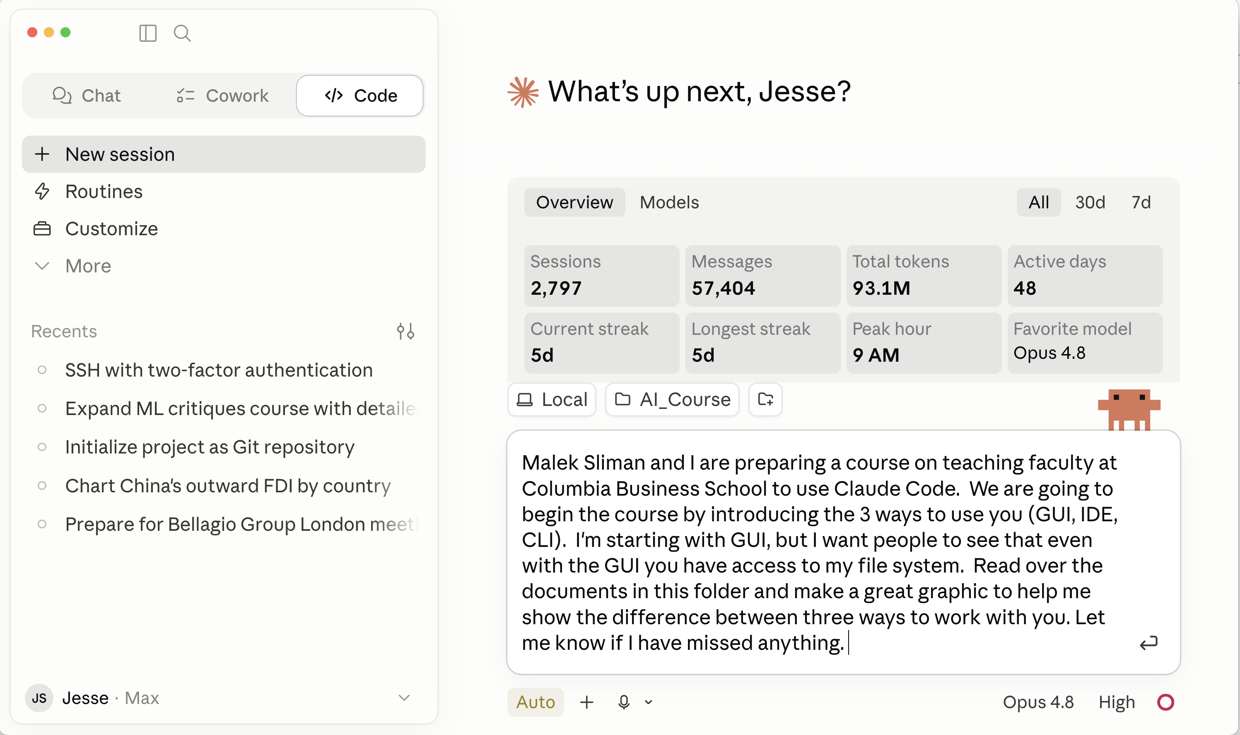
GUI

Slide 8
Three Ways to Work with Claude
Chat: all-purpose usage, mostly non-agentic
Cowork: Claude agent for productivity
  Emails, calendars,…
Claude Code: Claude agent for coding
  Many many ways to use Claude Code: differ on customization, functionalities…
  GUI (Claude Desktop)
  VS Code/IDE extension:
    Chatbot that lives next to your code and data
  Terminal / CLI:
    Similar to the extension, but can be heavily customized
  Cmux…

Slide 9
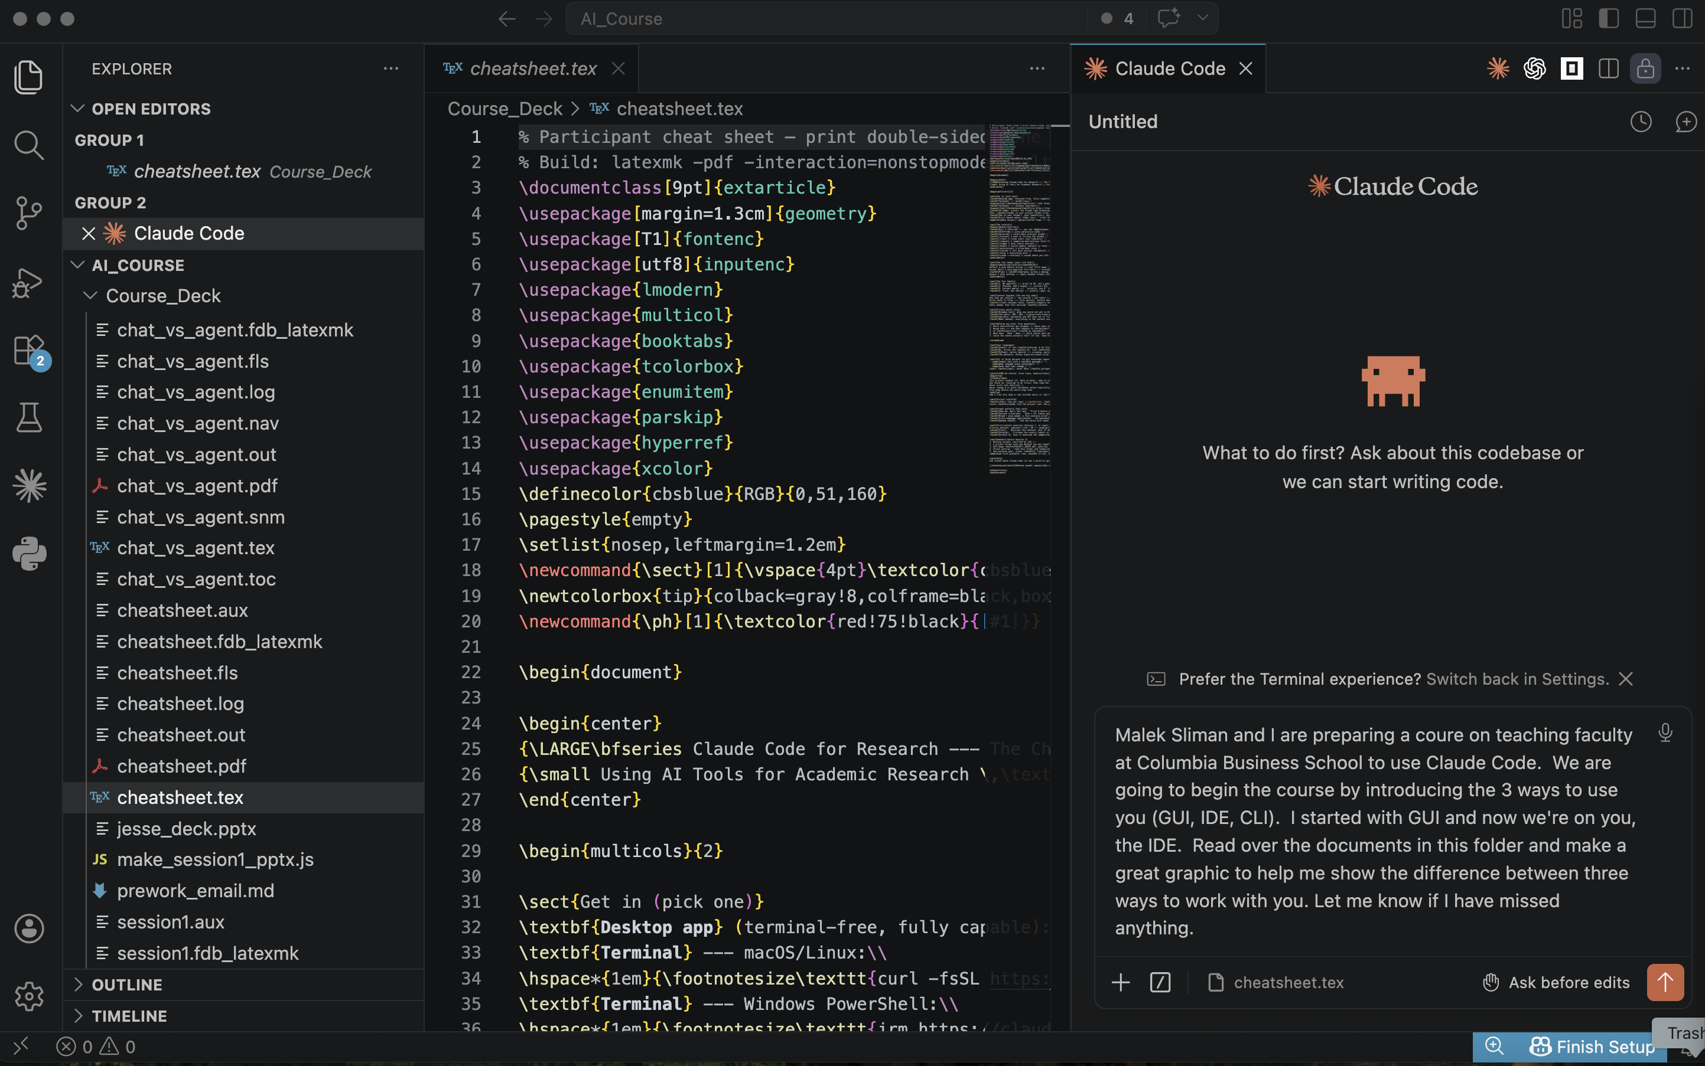
IDE - VSCode

Slide 10
Three Ways to Work with Claude
Chat: all-purpose usage, mostly non-agentic
Cowork: Claude agent for productivity
  Emails, calendars,…
Claude Code: Claude agent for coding
  Many many ways to use Claude Code: differ on customization, functionalities…
  GUI (Claude Desktop)
  VS Code/IDE extension
    Chatbot that lives next to your code and data
  Terminal/CLI/Cmux…
    Similar to the extension, but can be heavily customized

Slide 11
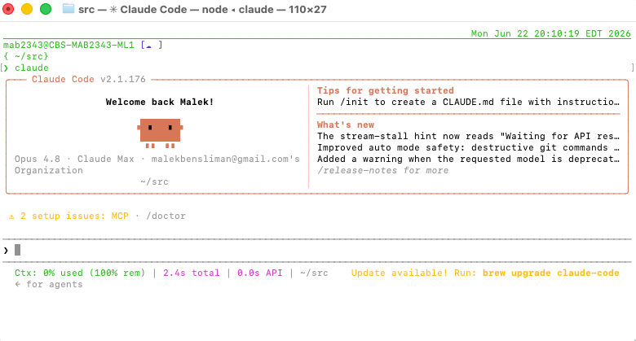
Built-in Terminal

Slide 12
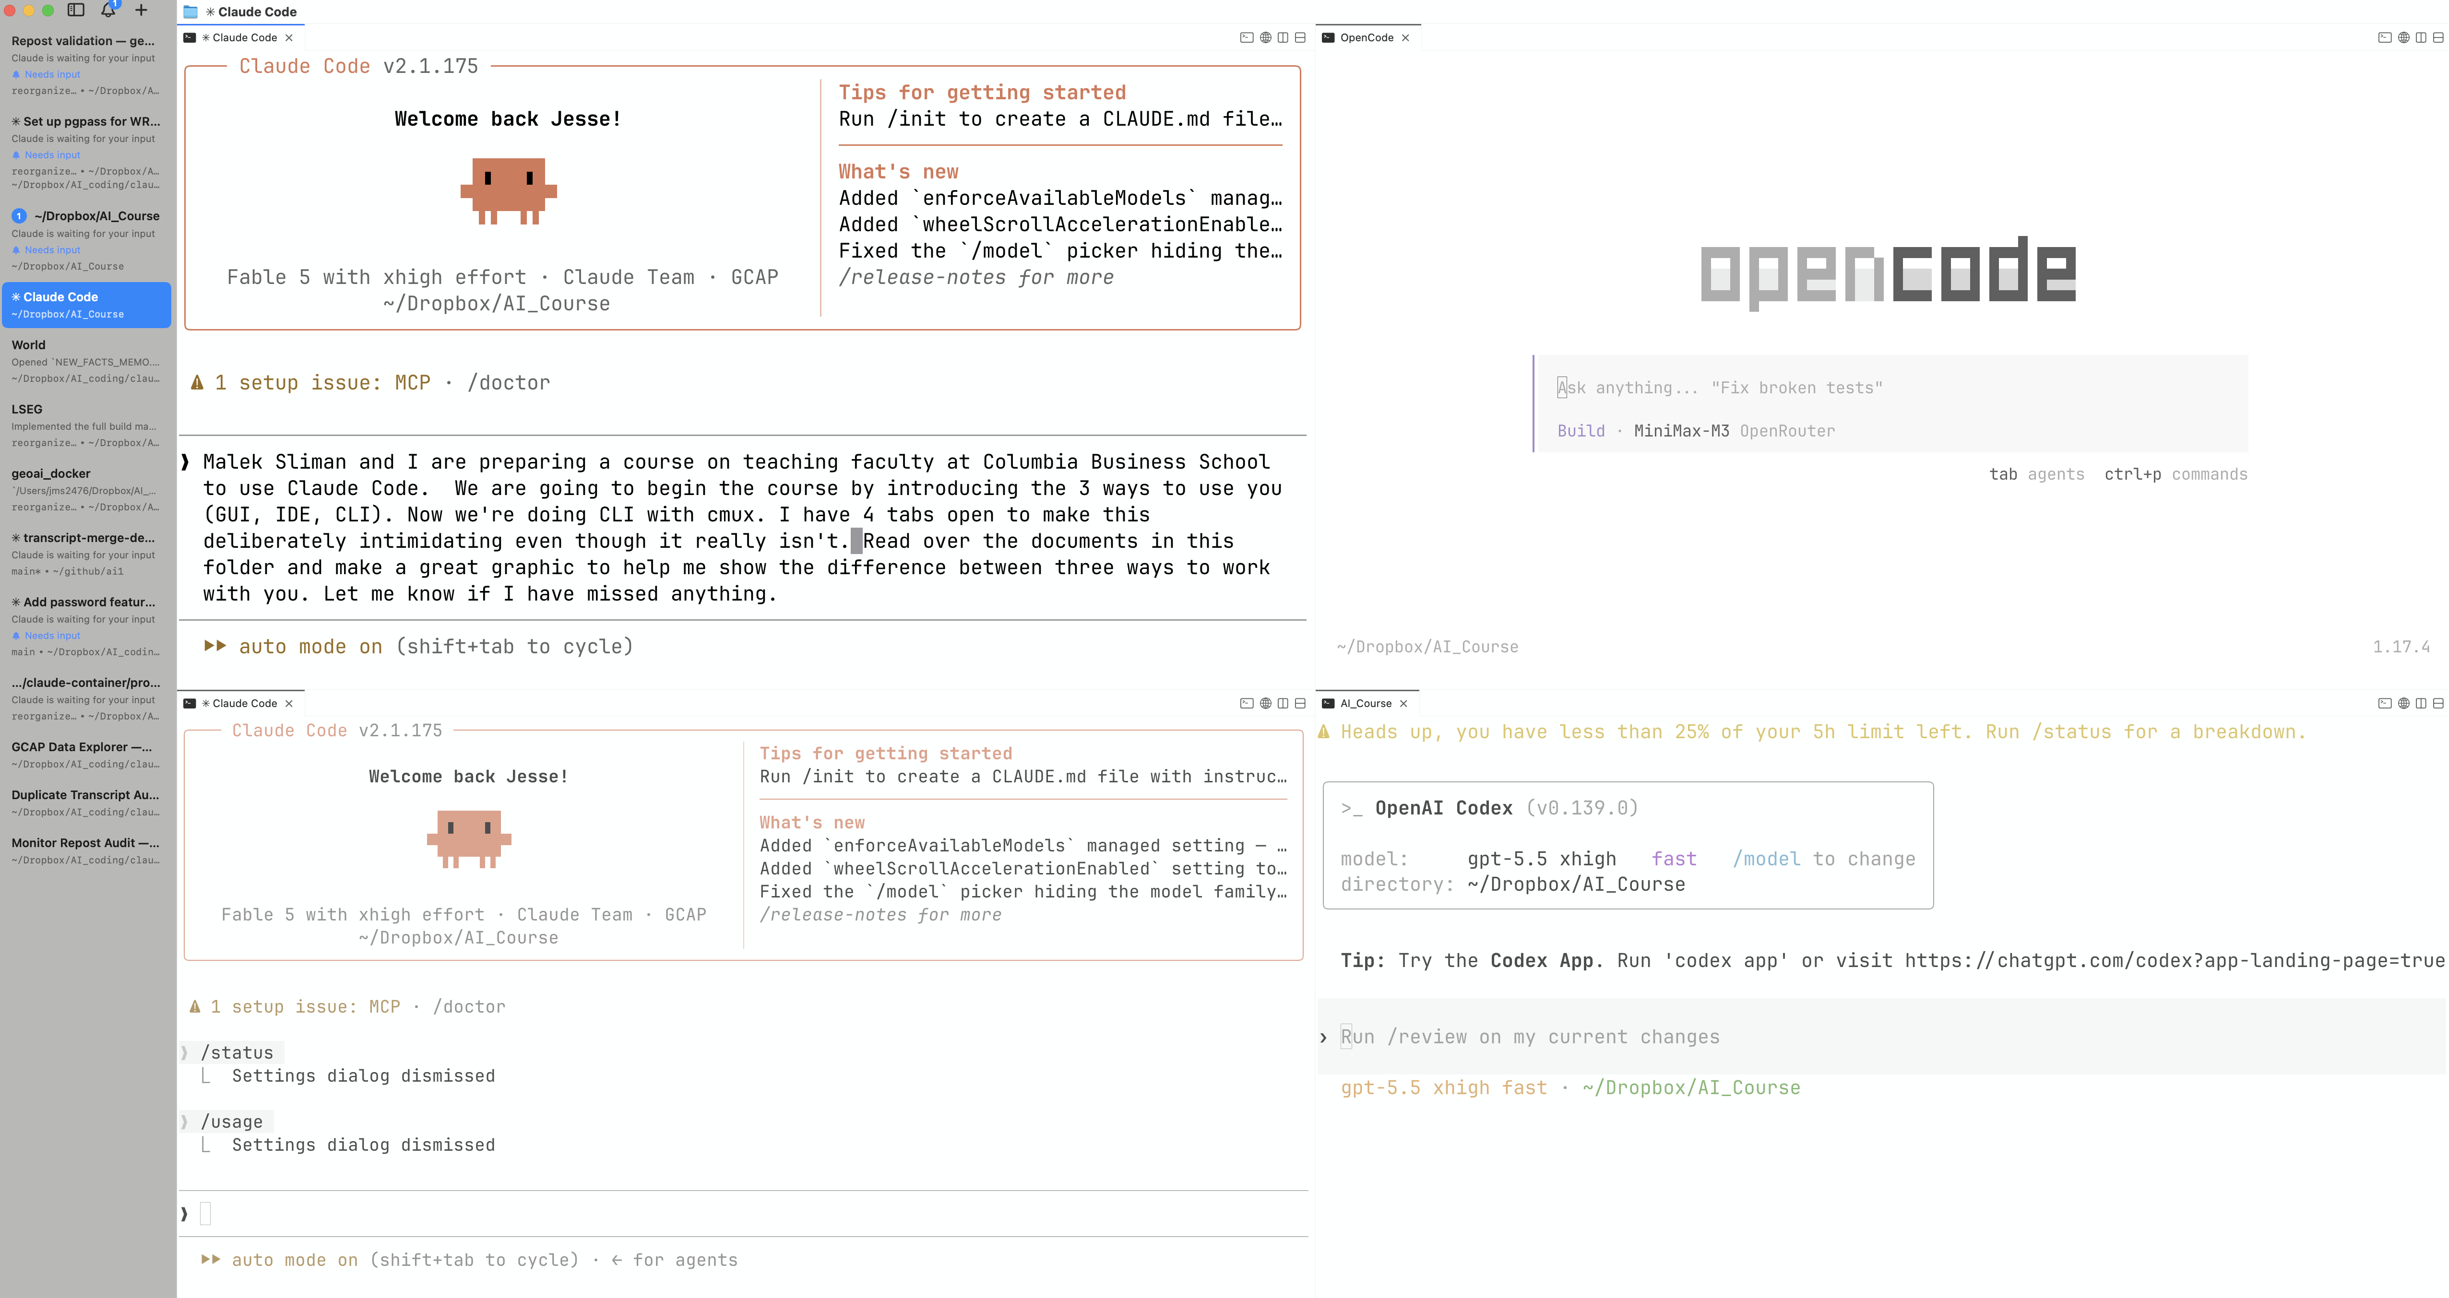
Cmux

Slide 13
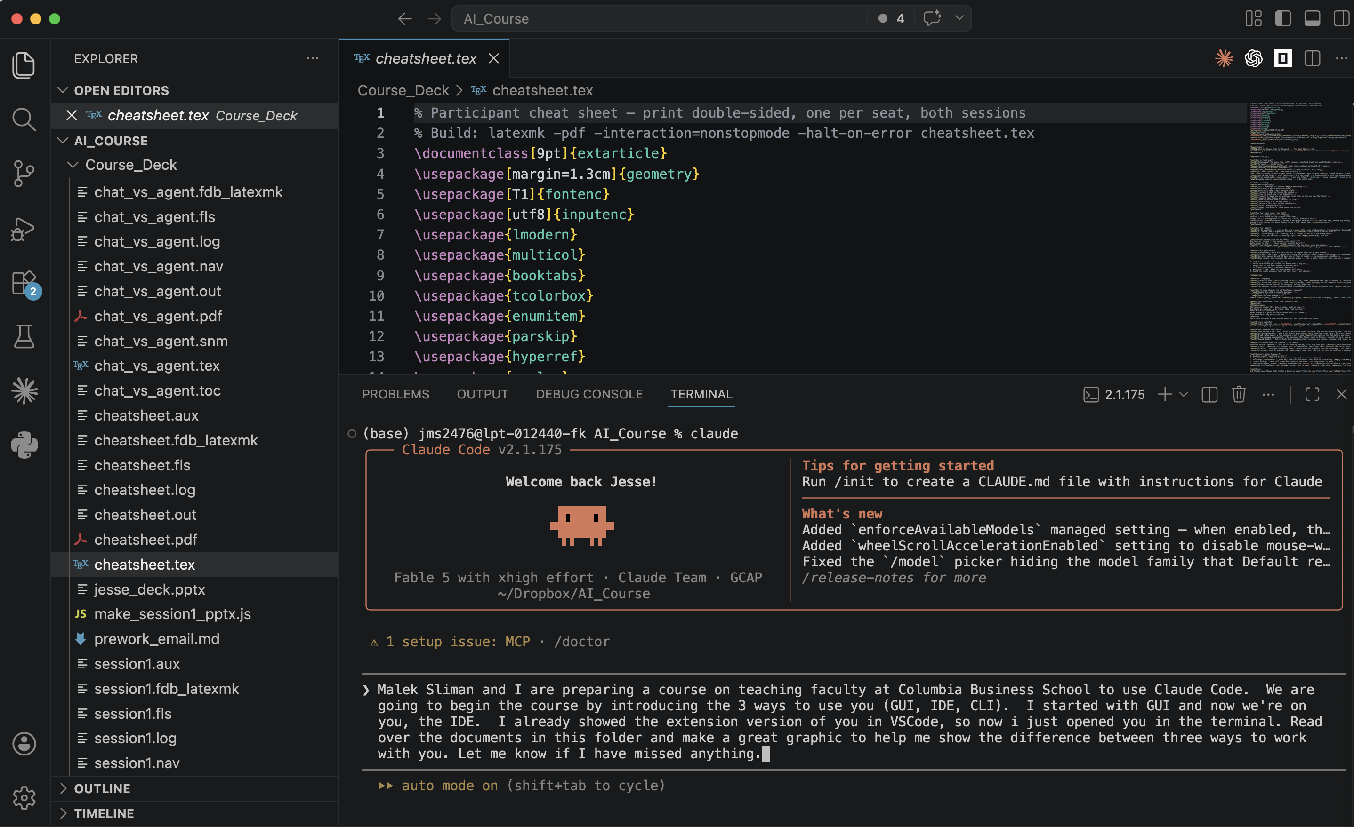
Terminal in the IDE

Slide 14



To Sum Up
1
Desktop app
2
VS Code
3
Terminal
BUT
GUI · start here
IDE · if you edit code
CLI · where power users land
Claude in a web browser
Looks like the chat you already know, but it runs on your Mac, in your folder.
Lives inside your editor, diffs and files side-by-side as it works.
Where it ends up, not where you must start. You still just type English.
"…outbound DNS failed."
The browser chat runs in a sandbox: it never touches your disk, your data, or your Stata.
You › what's in this folder?
• reading data/raw/ … 30
12 def clean(df):
13 return df.dropna()
$ claude
› clean the raw data
✗ No access to your machine
same English in ↓ ↓ ↓ same agent underneath ←
ONE ENGINE
The same Claude Code agent, the loop
brief → act → read result → repeat
Key Element!
Plan mode, CLAUDE.md, skills, git, permissions, identical on all three. The surface is a skin.
The GUI is not the browser chat. The Desktop app is the full agent: same file access as the terminal.
Choosing a surface is cosmetic!
The folder you launched in
.dta / .csv / .parquet
Stata · R · Python
the shell & git
YOUR MACHINE
✓ Full file access on every surface
Same "trust this folder?" permission dial on all three: file access is gated identically. The GUI is not riskier; it is the same agent.
+ a fallback: Claude Code on the web / mobile runs in the cloud (its files, not yours), for the locked-down laptop.

Slide 15
Why Use a Coding Agent?
Give access to your file system so it can
  Read/Write/Modify on its own
Integrate with databases / programs
  Example: integrate with Chrome for data scraping
Operate at scale
  Agents give access to sub-agents, parallelization…
Offload long-running/annoying tasks
  Example: tedious/repetitive data cleaning
…

Slide 16
Today’s Focus
Today
  GUI + VS Code + Terminal
    Reminder: all exchangeable! They all do the same thing!
    Pick the one that works for you!
  Demo end-to-end project
  Goal: Get you started on using Claude Code in one of your projects
Difficulty: this is a linux experience, rather than Windows/MacOS
  Need to invest time to setup/customize for your own workflow
  As ecosystem evolves fast, we are all both a bit ahead and a bit behind everyone else at the same time!
Disclaimer: We will show what works for us but it might not be optimal for you
  We will try to show different setups (with similar results) so you pick what’s right for you
Notes:
Go fast past Chat / Cowork, then spend real time in VS Code + the terminal. “Linux, not macOS”: a little setup, then enormous leverage.

Slide 17
The Terminal, The Editor, and Your First Session

Slide 18
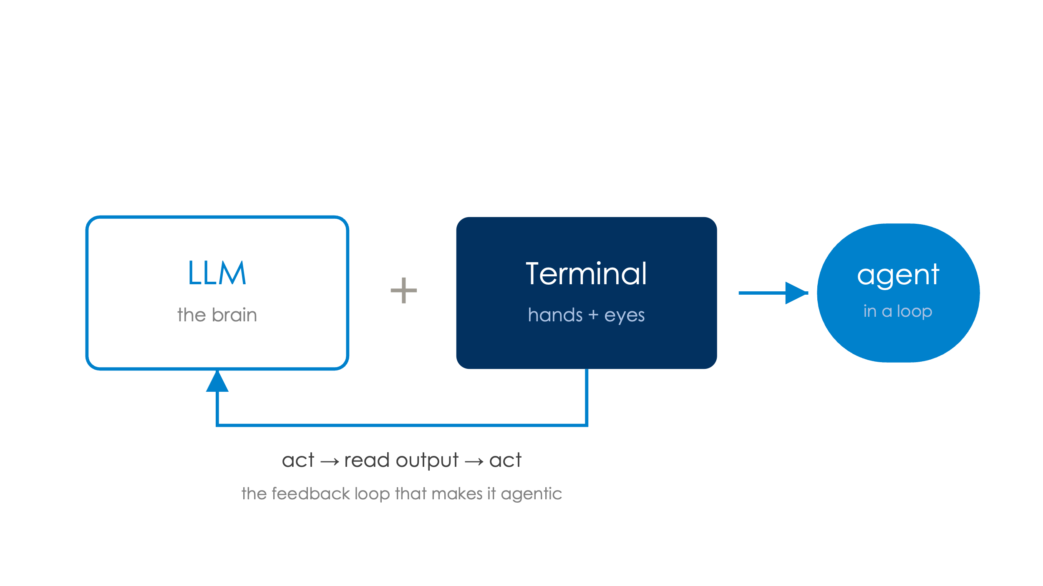
The Terminal: Your Computer’s Full Control Interface
An interface that lets you perform any operation on your computer.
  To open a file you can double-click it or go to terminal type open filename
  From the terminal you can edit files, run programs (R / Stata / Python), install software, download data, hit the network…
Quick aside: a coding agent = an LLM + a terminal.
  Take an LLM: you can prompt it to generate terminal commands
  Make sure the commands are actually run in a terminal
  → The result: an LLM that can interact with your computer
  Rinse and repeat: the LLM uses the terminal to create a file, read it, add or modify text, read it again
  That feedback loop is what lets an LLM become agentic
Notes:
Live demo: run a few commands. ls, a one-line R / Python snippet, curl a file.

Slide 19
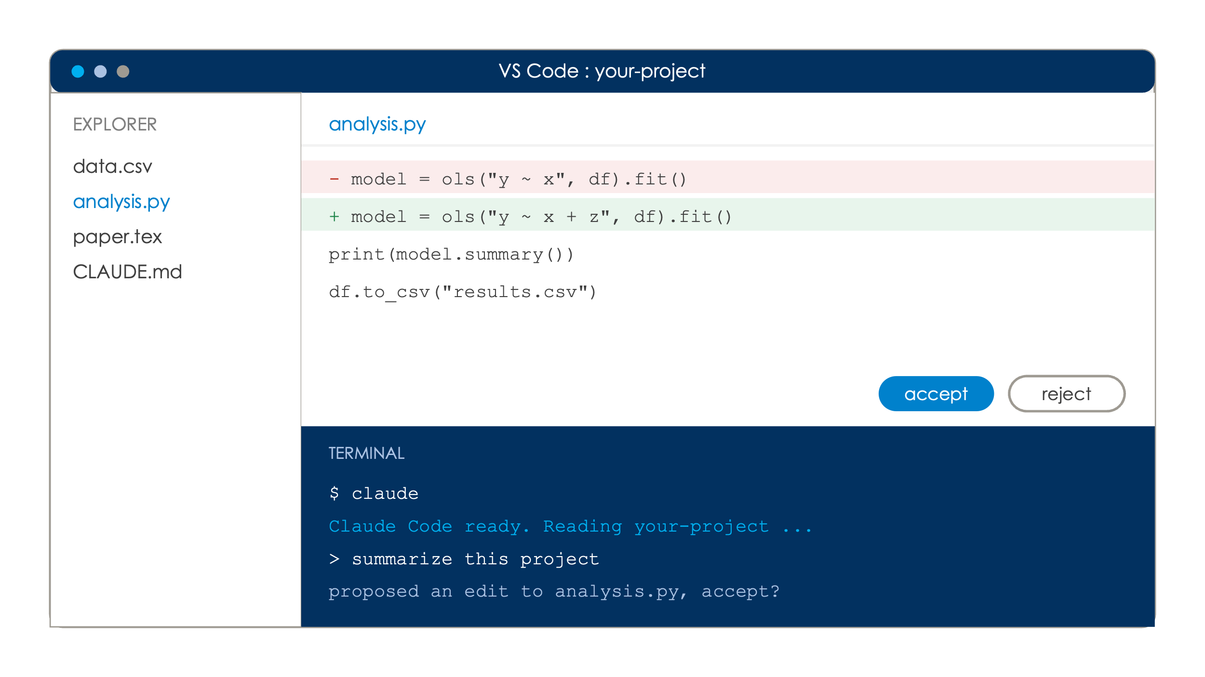
VS Code is A Cockpit
VS Code is an IDE
  A powerful one-stop shop to see the files, edit code, access the terminal
Open a folder to see your files and exactly what Claude will be able to access
Built-in terminal at the bottom
  Run claude there
  Edits appear as diffs you accept or reject.
Do you absolutely need VS Code?
  No: Some people work only with a terminal, cmux…
Notes:
The recommended starting point. The win is visibility: you watch the agent, file by file.

Slide 20
Getting Started
The tools
  Terminal: pre-built
  VS Code: https://code.visualstudio.com/
  Claude Code: https://code.claude.com/docs/en/quickstart
    Requires subscription
    Can also use codex
We will demo: GUI + Terminal (in VS Code)
  Feel free to use your own project OR demo project
GUI: Download Desktop App: https://claude.com/download
Terminal
  Open terminal
    MacOS/Linux: curl -fsSL https://claude.ai/install.sh | bash
    Windows: Open a powershell: irm https://claude.ai/install.ps1 | iex
  Enter claude to start (always)
  Authenticate with /login (one-off)

Slide 21
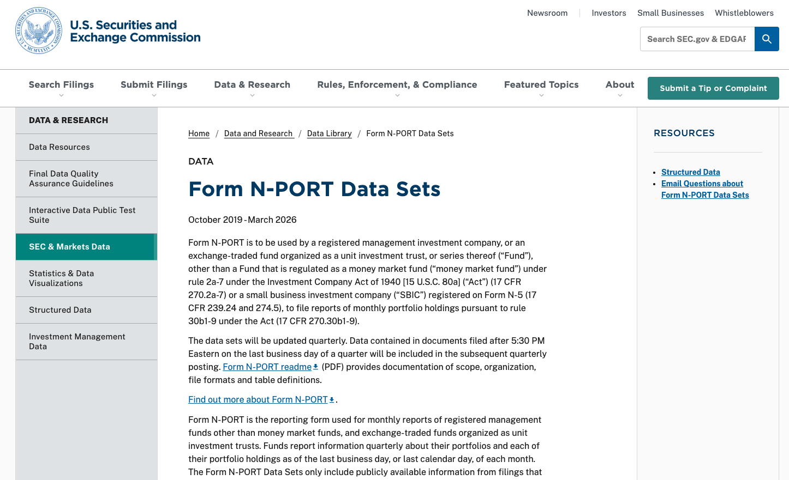
The Data

Slide 22
Not Shown today: Building the Dataset in ~ hour
You're in an empty folder. From the SEC's bulk Form N-PORT data sets at https://www.sec.gov/data-research/sec-markets-data/form-n-port-data-sets, build a clean panel of US mutual-fund holdings for the last seven December year-ends.
Download it yourself, work out the schema, build one documented Parquet file (Python + DuckDB).
Before any analysis, validate it so I can trust the numbers:
• resolve duplicate / amended filings — keep the latest, drop superseded
• reconcile total assets to the Fed’s Financial Accounts
• report identifier coverage by year
• log the data quirks
Leave numbered, rerunnable scripts and a verification memo.

Slide 23
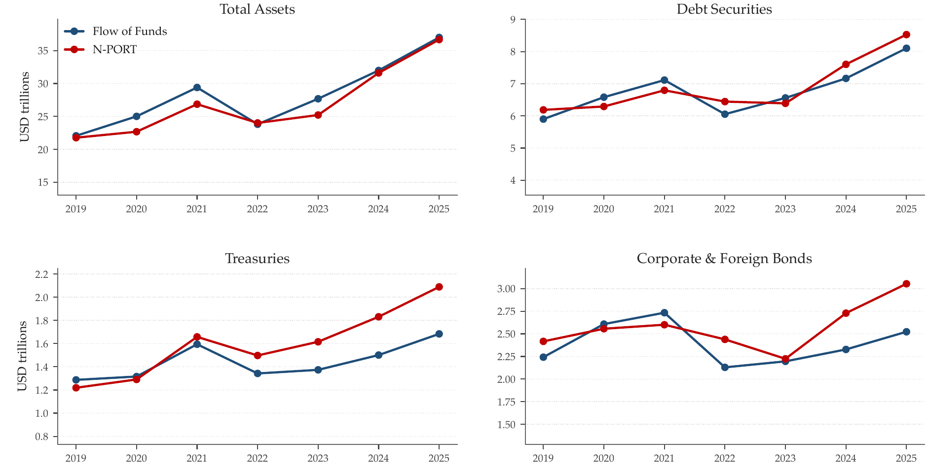
Aggregated up, N-PORT reproduces the Fed's Financial Accounts
The Fed benchmark needs the full quarterly census — every fund in each filing (~12,400), not just the Dec-31 panel (~6,400).
In full, N-PORT's totals reproduce the Fed's mutual-fund + ETF accounts: total assets, debt, Treasuries, corporate & foreign bonds.
N-PORT's total is netted for fund-of-funds to match the Fed's consolidated sector; the debt panels need no adjustment.
Where they part is interpretable — N-PORT runs above on Treasuries by the ETF holdings the Fed's mutual-fund series omits.

Slide 24
A Second Prompt: Building the Foreign-Bond Dataset
Defined at the security level — every foreign bond, not a fund-level sample.
From the validated N-PORT panel (2019–2025), build the foreign-bond dataset —
one row per fund-holding, defined at the SECURITY level (not a fund sample):
• straight bonds only (asset_cat = 'DBT')
• keep a holding only if the issuer's country is a REAL non-US country:
a 2-letter ISO code that is NOT the US, NOT a US territory (PR, GU, …),
and NOT a country-less code (XX, N/A)
• this excludes Puerto Rico (US) and supranationals (World Bank, EIB, ADB)
Write to all_foreign_bonds.parquet; report rows, countries, value — and stop.
859,796 holdings · 151 foreign countries · $3.0T · 36 MB · queryable in under a second.

Slide 25

Let’s do Some Research…
Huge literature in international finance in the early 2000s on the challenges of countries borrowing in their own currency
  “Original Sin” from Eichengreen and Hausmann
It’s been 20 years and now we can construct administrative data micro data in an hour with a prompt
Easy to work with parquet files
All data here: https://tinyurl.com/nportforeign
  Or as csv: https://tinyurl.com/nportcsv

Slide 26
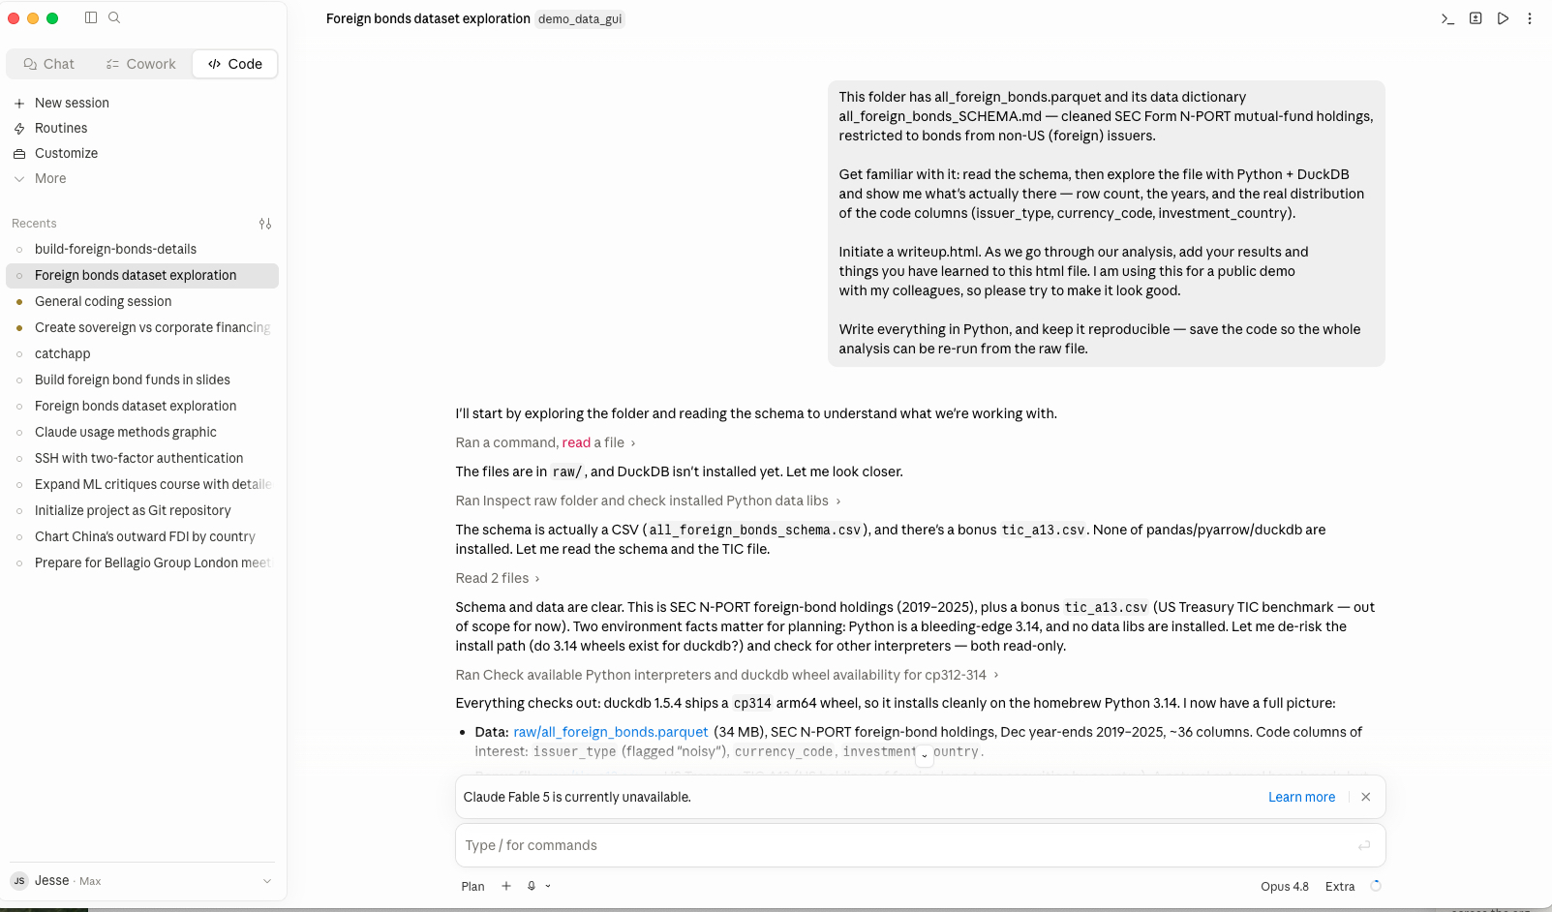
Approach 1: GUI
Select “+ New session”
In folder, select the relevant folder
Ask Claude to analyze the data…

Slide 27
Approach 2: Terminal – New Project vs Existing Project
New Project
Existing Project
Open the folder in VS Code
Use the bottom terminal: enter claude
/init writes a CLAUDE.md
  Describe your goal in Plan mode
  let it scaffold the structure and first code
Open the folder in VS Code
Use the bottom terminal, and enter claude
Ask “summarize this project,”
  OR run /review to get a code review of it
  OR run /claude-automation-recommender
  OR run /init
Read-only by default: nothing changes without your say-so

Slide 28
Some Created Files
CLAUDE.md
  A file in your repo the agent reads every time: conventions, data locations, gotchas…
  /init drafts one: you can refine
AGENTS.md
  Alternative to CLAUDE.md for other agents
  You can write in CLAUDE.md to read AGENTS.md
.claude
  Self-generated folder (but can be edited) containing configurations
  Settings, custom commands, skills, hooks…
IMPORTANT: These files will be created with the GUI, the terminal, the extension…
Notes:
The “give your RA a memory” point, paid off. Show a tiny example.

Slide 29
Driving Claude Code

Slide 30

Permission Modes
Plan: think first, no edits
Accept edits
  Will show every changes for your review
Auto
  Runs tools itself
  Only surfaces key decisions for approval
Skip permissions
  Malek: Never use it!
  Jesse: it’s okay to use!
Tips:
  Can switch by using Cmd+Shift+Tab
  Always start in Plan and review
    When you fill confident: graduate to Auto as you trust it
  In Auto: Read every summary
Notes:
The steering wheel. Match mode to risk. YOLO only in throwaway / sandboxed contexts.

Slide 31
Choosing a Model
Haiku: fastest and cheapest
  Quick edits, file reads, simple questions
Sonnet: the balanced default
  Handles most coding day to day: best value
Opus: maximum capability
  Multi-file refactors, architecture, hard debugging: slower and pricier
Switch anytime with /model
Rule of thumb:
  What they say:
    Start on Sonnet → Escalate to Opus when stuck OR Drop to Haiku for trivial work
  What we do: Opus all-day except Haiku for very obvious task
    More complex models can overengineer
Notes:
The steering wheel. Match mode to risk. YOLO only in throwaway / sandboxed contexts.
Delegate to codex in session 2 + how to use api key

Slide 32

Prompting the Agent Well
Be specific: state the goal, the constraints, and what "done" looks like
  “Add a filter that drops empty rows" > ”clean my data"
Give context, not just commands
  Point it to the files, an example to follow, or the data location
Plan then Approve:
  Ask it to outline the approach
  Approve before it edits
Agents go wrong ALL THE TIME!
  Iterate: Observe and if it drifts, correct course or redo the step instead of piling on
Notes:
The steering wheel. Match mode to risk. YOLO only in throwaway / sandboxed contexts.

Slide 33
Starting to Customize!
Claude Code can be heavily personalized but will often ask for “scope”
  Key question: Should the customization be at the user level or only at the project level?
Claude Code has 4 scopes of settings
  Managed (not applicable): settings set by IT: highest priority
  User:
    Personal preferences you want in every project
    Live in ~/.claude/ (or %USERPROFILE%\.claude in windows)
  Project:
    Settings specific to a project and shared with others
    Live in the folder: .claude/
  Local:
    Settings specific to a project but unique to you
    Live in the folder: .claude/settings.local.json
Managed > Local > Project > User

Slide 34
Starting to Customize! For Real!
Tune the basics: /config
  Run /config in any session (settings save to User ~/.claude/settings.json)
  Set theme, default model, editor mode (normal/vim), verbose on/off
  Turn includeCoAuthoredBy off to drop the Co-Authored-By: Claude commit trailer
  Set effortLevel to max for hardest reasoning
  Enable notifications (input-needed + agent-push) so you're pinged when Claude needs you or finishes
Customize statusline: /statusline
  Run /statusline and ask for: folder, model, context %, cost, duration
    Example: {…/proj} [Opus 4.8] [ctx:25%] [$0.42] [1h7m]
  You don’t like it? Ask it to polish: make durations easier to read, color-code remaining context window,…
Modify some hidden (annoying) behaviors:
  Ask Claude in session to set ENABLE_TOOL_SEARCH=false
    Load all tool schemas upfront: without it, many future add-ons will never load
  Some other optional behaviors available here https://code.claude.com/docs/en/env-vars
    After using it long enough ask Claude to suggest changes

Slide 35
Starting to Customize: plugins
Enable some plugins: /plugin
  Superpowers: process skills: brainstorm, systematic-debugging, plans
  claude-md-management: keep CLAUDE.md healthy
  security-guidance: warns on dangerous code patterns
  Context7: live library/framework docs lookup: pyright-lsp / typescript-lsp
Output style plugins
  Explanatory vs learning
Notes:
pr-review-toolkit — /review-pr + 6 specialist review agents
- chrome-devtools-mcp / frontend-design — for web work

Slide 36
Starting to Customize: Output Style
You › summarize Q3 sales from sales.csv
PROACTIVE/DEFAULT
Just does it, shows its work
EXPLANATORY
Answers, then teaches
LEARNING
Hands you the keyboard
● Read sales.csv (1,204 rows)
● Grouped by quarter, summed
✓ Q3 = $4.2M (+12% QoQ)
Top region: APAC ($1.6M)
✓ Q3 = $4.2M (+12% QoQ)
▸ INSIGHT
I dropped 18 refunded rows,
so this is net, not gross.
✓ Loaded data. Scaffolded:
net = df[df.status
!= '____']
# TODO(human): which
# status is a refund?
What you see: You see each tool it runs, then the answer. It assumes the obvious instead of stopping to ask.
What you see: Same result, plus short ‘Insight’ notes that explain the choices it made.
What you see: It pauses and leaves a TODO(human) for you to fill in, then continues. Learn by doing.
Notes:
OUTPUT STYLE: Proactive (acts now) · Explanatory (adds teaching Insights) · Learning (adds TODO(human) for you).
Set the tone with /output-style.

Slide 37
So… What Makes it Agentic?
AI Agent
  A program that autonomously performs tasks on behalf of a user or another system by designing its workflow and using available tools
What does an agent need:
  Interface: programmatic access at scale → API
  Action layer: how the agent acts on the world → tool use (e.g., MCP)
  Competence layer: what the agent is good at → Skills + prompting
In other words: all AI Agents start with the same LLM!
  MCP gives the agent reach + Skills give it expertise
  Difference is what it sees and how much it can do its own
Key: how to manage context efficiently

Slide 38
Skill and MCP = Instructions added to a Prompt
SKILL - SKILL.md: A markdown file of know-how
PROMPT: What the model actually reads
---
name: dcf-valuation
description: Build a DCF properly
---
## Steps
1. Project free cash flows
2. Discount at WACC, sum PVs
1. Skill instructions
how to do the task
loads in prompt
2. MCP tools
what it can call
MCP: A tool the model
3. Your prompt
“Value Tesla from its 10-K”
tool: get_filings(ticker, form)
desc: fetch SEC EDGAR filings
returns: the filing text
Model reads it top to bottom then answers
A skill or MCP prepends instructions and tools to your prompt: you type your prompt and it runs with all of it already in context

Slide 39
Claude Code at Columbia

Slide 40
Costs + Plan
What Columbia/CBS provides: Education agreement
  Available to faculty / PhD students / Ras
  Only includes chat + Cowork – Code available through API
Benefit?
  No-training guarantees and admin controls
  Sstronger privacy for research data than a personal plan
Claude Code: API/token pricing is very expensive
  Subscription is more manageable but… personal plan!

Slide 41
Understanding Privacy
What stays local
  Your files: nothing is uploaded straight up
  Conversation history (~/.claude/)
  Anything in folders it never enters
What goes to Claude
  Everything in the context window
    Your prompts, the files it reads, and every command's output (e.g., stata log)… but same as pasting it all into chat
  Nothing is sent when idle
By default
  Only reads inside the folder you launch it BUT can potentially roam outside → deterministic deny rules: use /permissions
  Training:
    API and enterprise traffic is not used for training
    Consumer plans have a settings toggle… which changes regularly!
Notes:
Esc — interrupt mid-flight. The most important key in the room: you can always stop it.
Shift+Tab — cycle permission modes
Up-arrow — edit/re-run a previous prompt

Slide 42
Your Assignments
Redo: take one finished project.
  Can you replicate?
  Are there new analyses Claude recommended?
  Could you have achieved it faster or better with the agent?
Take notes on what worked for you
  We will share learned best practices
Bring data: come to Session 2 with your own data to analyze

Slide 43
Next Time
Terminal customization, dictation setup
Hooks (mechanical guardrails)
Skills, MCPs, subagents, plugins
Claude on the CBS Grid, overnight jobs
The API as a measurement instrument
Git beyond the undo button

Slide 44
Best Practices

Slide 45
The Context Window
quality degrades
before it fills
free space
Everything in a session lives in one long, finite document that is re-sent every turn:
  Your instructions and its replies,
  every file it reads,
  every log and output it sees
Large but finite:
  about a million tokens on top tiers, less on cheap ones
  It degrades before it dies: long before the window fills, it quietly loses the thread
Everything fancy (Session 2): skills, subagents, plan files… are just context-window management
its thinking + replies
logs and command output
(the 40k-token Stata log lives here)
files it read
(the README, the do-file)
your brief
system prompt + CLAUDE.md

Slide 46
Managing Your Context
One task per session. “One session = one table of the paper.” Start fresh often; /clear is free.
Write state to files — files persist, context does not. Notes, decisions, schemas, READMEs. A fresh session reads them and resumes without re-briefing.
/clear between tasks; /compact only to continue. Compaction keeps decisions, loses detail — never mid-way through delicate debugging. (Near the limit it auto-compacts on its own: same move, uninvited — now you know what happened.)
Why the demo project's README is obsessively detailed
It is Claude's long-term memory: a fresh session reads it and knows the schema, the suppression flags, the Hong Kong/Taiwan revision — no re-explaining. Note the honest sequence: the cold open started from an empty folder because on day one you have no documentation. You end day one by buying it — one sentence (“create a readme about the sources”) — and every later session starts smarter. Documentation finally has a self-interested author.
Using AI Tools for Academic Research — Session 1
Columbia Business School · 12 / 51

Slide 47
Working with an Agent is Managing Context
The agent only knows what’s in its context window
Key: Everything in a session lives in one long, finite document that is re-sent every turn:
  Your instructions and its replies, every file it reads, every log and output it sees
When the agent goes off track: really a context problem!
  The window is finite: as it fills, early details fade and quality drops
Context is also filled with “add-ons”
  Supercharge the LLM to use a specific skillset or even access different tools
Everything fancy (Session 2): skills, subagents, plan files… are just context-window management

Slide 48
Key Commands
/context: visualize how the context is used
/clear: Wipe and start fresh when you switch tasks
/compact: Summarize the conversation so far into a shorter form
  Frees space while keeping the gist → long session doesn’t degrade or hit the limit
Compact trick
  /compact [message]: Will compact the context with the message in mind
  Before compacting, ask Claude:
    Compact message given the current task → it will keep the relevant information
    Post-compact message to give Claude → it will pick up the pieces and continue the task

Slide 49
Starting to Customize: Install an MCP server, write a skill…
Install an MCP Server
Create a skill
Easiest: just ask Claude
  “Connect to the GitHub MCP server”
Run it in the terminal
  claude mcp add github
Edit .mcp.json in your repo
  { "mcpServers": { "github": { … } } }
You can check your current MCPs:
  claude mcp list
Create the file in ~/.claude/skills/<name>/SKILL.md
Use it:
  Claude auto-loads it using the description
  Or type /skills to check.
SKILL.md
1
2
3
4
5
6
7
8
---
name: dcf-valuation
description: Build a DCF the standard way; use when valuing a company.
---
## Steps
1. Project free cash flows
2. Discount at WACC, sum PVs
Notes:
OUTPUT STYLE: Proactive (acts now) · Explanatory (adds teaching Insights) · Learning (adds TODO(human) for you).
Set the tone with /output-style.

Slide 50
The Jargon Decoded
Focus on Claude Code
Term | Think of it as… | What it actually does
CLAUDE.md | A sticky note on your project | Set of information that Claude reads every session in a specific project. You and Claude write and update it.
Memory | A sticky note on you | What Claude remembers about you across all projects. Updates automatically as you work.
Skill | A saved playbook | A markdown (text) file with a workflow/instructions Claude can run. You can call it yourself or it auto-loads when relevant.
MCP | A plug for outside tools | Connects Claude to external services: your database, Slack, a browser…
Subagent | An intern | A separate Claude session that does a side task and returns just the summary. Keeps your main chat clean.
Agent teams | A crew | Multiple Claudes working in parallel on the same problem, talking to each other.
Hook | An auto-trigger | “When X happens, run Y.” Automatic and deterministic operations (e.g., send a notification whenever Claude is done working)
Plugin | A package | Bundles skills, hooks, MCPs into one installable component you can share or reuse across projects.

Slide 51
When to Use Each
Don't pre-build a setup. Below is not an exhaustive list: you can and should be creative!
When this happens… | Add | Example
Claude gets a convention wrong twice | CLAUDE.md | “Always explain your work in three bullet points…”
You re-explain your preferences in every new chat | Memory | “I prefer concise answers.”
You keep typing the same prompt to start a task | Skill | Create an /explain skill that you can call yourself that pulls your commits and formats an update
You paste the same playbook for the third time | Skill | You describe the /explain skill so Claude auto-loads it
You keep copying data Claude can't see | MCP | Connect your database to Claude so it can query it directly
A side task floods your chat with noise | Subagent | Research task that reads 50 files, returns 3 bullets
You want something to happen automatically | Hook | Notify me when you are done
A second repo needs the same setup | Plugin | Package your skills + hooks, install elsewhere

Slide 52
To Summarize: Using an AI Agent
Most of you have already used an agent (sometimes without knowing it)
  Key concept: LLM that can access specialized context and tools to take actions
  Example: Modify a powerpoint, add a calendar event…
Problem: Each tool/skill takes up space on a limited context window
Solution: Move away from a model view to a system view
  No longer: “let’s just build the biggest, most general model”
  Instead: Context Management:
    Take an existing LLM and build an “infrastructure” that allows it to query and use the right tool/skill at the right time
  Software engineering is evolving toward system engineering
Infrastructure is still in development and can be overwhelming

Slide 53
CLAUDE.md
Loaded at the start of every session; global (~/.claude/) plus per-project; more specific wins.
What belongs: 5–10 behavioral lines — where things live, how to run things, what never to touch. Each line earned by a real incident.
From my actual global CLAUDE.md
— Never change N or point estimates unless explicitly asked. When fixing tables, do NOT re-estimate.
— Enter plan mode for any non-trivial task.
— Dropbox: verify files are not 0-byte placeholders before editing.
What does not: essays, wishes, auto-generated boilerplate.
Evidence
Gloaguen et al. (2026, ETH Zurich): LLM-generated context files increased agent steps and cost across every model tested, with little accuracy gain. More instructions ≠ better RA.
Using AI Tools for Academic Research — Session 1
Columbia Business School · 29 / 51

Slide 54
Session 2: AI for academic research

Slide 55
Version control with git

Slide 56
Why git
An agent edits many files fast. Git is your undo and your record.
  Without it, a bad run can quietly clobber work.
Minimal workflow
  git init, git add, git commit, git branch, git diff.
  Commit before you let the agent loose; commit again when it is good.
When Claude makes a mistake
  git diff to see what changed; git restore or revert to undo.
  A clean commit means you can always get back.

Slide 57
Git worktrees
Run several agent tasks in parallel on separate branches without collisions.

Slide 58
Recap and common failures

Slide 59
Since Session 1
What did you try? What broke?
Quick round the room: one win, one wall.

Slide 60
The usual failure modes
Lost context (a long session drifted), over-trusting unverified output, no git safety net, vague prompts.
Each has a fix we will cover today.

Slide 61
Context management

Slide 62
Why long sessions degrade
The context window is finite; as it fills, early details fade and quality drops.
“It got dumber” usually means “the window is full.”
/compact: summarize and keep going. /clear: hard reset between tasks.
One task per session; do not let it sprawl.

Slide 63
The memory hierarchy
User (~/.claude/CLAUDE.md): applies to every project.
Project / repo (./CLAUDE.md): conventions for this repo, shared with collaborators.
Local (.claude/settings.local.json): your machine only, not committed.
Put durable facts in CLAUDE.md so you never re-explain.

Slide 64
Extending Claude Code (skills, MCP, plugins, hooks)

Slide 65
Ways to extend it
Skills
  Reusable, packaged know-how and commands.
  Example: a Stata skill to run Stata from the command line.
MCP
  A standard way to plug in tools/data: databases, APIs, services (Qualtrics, WRDS, …).
  Install once; the agent gains a new power.
Plugins
  Plugins bundle skills / MCP / commands; install from a marketplace.
  We’re building a CBS marketplace — add it once, install what you need.
Subagents
  Subagents: parallel helpers for big tasks.
  Output styles (Explanatory / Learning) tune voice — handy for academic writing.
Hooks
  Run your own shell commands automatically on events — format after every edit, run tests on save, ping you when a long task finishes.
  Configured in settings; the agent triggers them, you don’t.
custom slash commands — bolt new capabilities onto the LLM + terminal core.
Notes:
Frame as “more tools and hands” on the same agent from Session 1.

Slide 66
Remote work

Slide 67
Claude where you aren’t
claude --teleport (or /teleport), /remote-control (drive it from your phone), claude --remote.

Slide 68
Multiplexing (optional power)
tmux / zellij: many panes; long jobs that survive disconnects.
cmux: a tabbed setup with a browser, nice once you multitask.
Notes:
Moved here from Session 1. Optional and advanced; flag it for the keen, do not scare beginners.

Slide 69
The Research Grid
SSH into Columbia’s compute; run long jobs.
tmux / zellij so sessions survive disconnects.
Notes:
For heavy data/compute. Pair with worktrees + tmux.

Slide 70
The Research Grid
SSH into Columbia’s compute; run long jobs.
tmux / zellij so sessions survive disconnects.

Slide 71
Collaborative demo

Slide 72
Blank folder to result, live
Empty folder to a finding, using Columbia data.
Plan: query WRDS for a country’s CDS series, find dates of relevant news, visualize the risk spike.

Slide 73
Demo 2, Qualtrics MCP
Pull survey data through the Qualtrics MCP; analyze in place.

Slide 74
Your project

Slide 75
Recap and common failures

Slide 76
Since Session 1
What did you try? What broke?
Quick round the room: one win, one wall.

Slide 77
The usual failure modes
Lost context (a long session drifted), over-trusting unverified output, no git safety net, vague prompts.
Each has a fix we will cover today.

Slide 78
Context management

Slide 79
Why long sessions degrade
The context window is finite; as it fills, early details fade and quality drops.
“It got dumber” usually means “the window is full.”
/compact: summarize and keep going. /clear: hard reset between tasks.
One task per session; do not let it sprawl.

Slide 80
The memory hierarchy
User (~/.claude/CLAUDE.md): applies to every project.
Project / repo (./CLAUDE.md): conventions for this repo, shared with collaborators.
Local (.claude/settings.local.json): your machine only, not committed.
Put durable facts in CLAUDE.md so you never re-explain.

Slide 81
Extending Claude Code (skills, MCP, plugins, hooks)

Slide 82
Ways to extend it
Skills
  Reusable, packaged know-how and commands.
  Example: a Stata skill to run Stata from the command line.
MCP
  A standard way to plug in tools/data: databases, APIs, services (Qualtrics, WRDS, …).
  Install once; the agent gains a new power.
Plugins
  Plugins bundle skills / MCP / commands; install from a marketplace.
  We’re building a CBS marketplace — add it once, install what you need.
Subagents
  Subagents: parallel helpers for big tasks.
  Output styles (Explanatory / Learning) tune voice — handy for academic writing.
Hooks
  Run your own shell commands automatically on events — format after every edit, run tests on save, ping you when a long task finishes.
  Configured in settings; the agent triggers them, you don’t.
custom slash commands — bolt new capabilities onto the LLM + terminal core.
Notes:
Frame as “more tools and hands” on the same agent from Session 1.

Slide 83
Remote work

Slide 84
Claude where you aren’t
claude --teleport (or /teleport), /remote-control (drive it from your phone), claude --remote.

Slide 85
Multiplexing (optional power)
tmux / zellij: many panes; long jobs that survive disconnects.
cmux: a tabbed setup with a browser, nice once you multitask.
Notes:
Moved here from Session 1. Optional and advanced; flag it for the keen, do not scare beginners.

Slide 86
The Research Grid
SSH into Columbia’s compute; run long jobs.
tmux / zellij so sessions survive disconnects.
Notes:
For heavy data/compute. Pair with worktrees + tmux.

Slide 87
The Research Grid
SSH into Columbia’s compute; run long jobs.
tmux / zellij so sessions survive disconnects.

Slide 88
Blank folder to result, live
Empty folder to a finding, using Columbia data.
Plan: query WRDS for a country’s CDS series, find dates of relevant news, visualize the risk spike.

Slide 89
Demo 2, Qualtrics MCP
Pull survey data through the Qualtrics MCP; analyze in place.

Slide 90
Turn your idea into a plan
In Plan mode, write the prompt; let it draft a plan. Do not execute yet.

Slide 91
Iterate the plan (get a second opinion)
Read and edit the plan by hand; ask another model (for example GPT) to critique it.

Slide 92
Execute and supervise
Run in Auto (or skip-permissions in a safe sandbox); watch, verify, commit.

Slide 93
LLMs for unstructured data

Slide 94
Scrape to structure
Example: scrape EDGAR filings, build a parquet / SQLite with DuckDB.
The agent writes the scraper and the queries; you do not need to know SQL.

Slide 95
Where the compute and credits come from
Running inside Claude / Codex, versus OpenRouter credits, versus your own OpenAI / Anthropic API key.
Trade-offs: convenience, cost, control.

Slide 96
(Time permitting) Writing like you
Generate a style file from your past writing; draft new text in your voice.

Slide 97
Working safely
Sandboxing / containers for risky runs; mind secrets and keys; use permission modes; git as undo.
Sensitive / IRB data: keep it local; know what leaves your machine.

Slide 98
TODO: this is complex: move to session 2 Multiplexing (optional power)
tmux / zellij: many panes; long jobs that survive disconnects.
cmux: tabbed setup with a browser — nice once you multitask.
Notes:
Optional/advanced. Flag it for the keen; don’t scare beginners.

